Slide 1
Pearson VUE in the House!
Amber Thompson
Program Manager
Natalie Cummins
Client Channel Operations Manager

Slide 2
What’s New
Natalie!
Client Channel Operations Manager
Support Line
Notes:
Content Slide color accent left

Slide 3
CCT Cloud Computing Technology
No more updates – we’ll take care of them for you
Just need internet
Let your SRM know if you are interested

Slide 4
Price Increase
Majority of jurisdictions had a price increase that went live on July 1st
What does this mean?
Increase of $6
Vouchers
Auto Discounts
Notes:
Content Slide color accent right

Slide 5
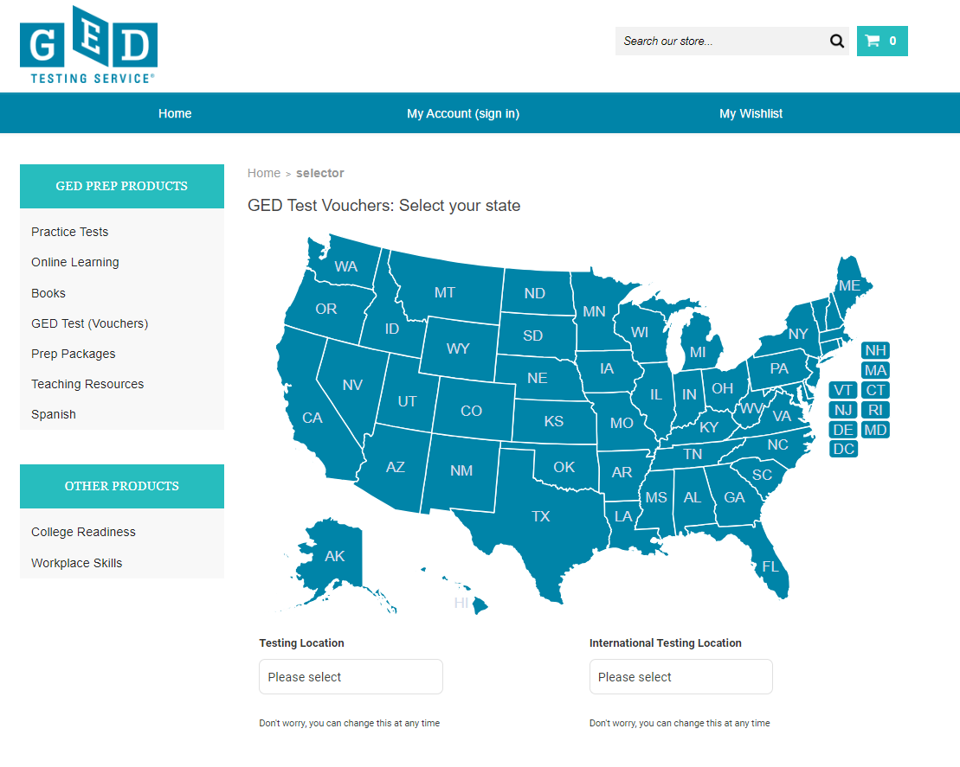
Speaking of Vouchers…
Marketplace went live Jan 1 2023!
https://shop.gedmarketplace.com/
Click to add content 2
Notes:
Content Slide color accent left- 2 column

Slide 6
Any Questions?

Slide 7
End of Presentation
Notes:
Closing Slide

