Slide 1
GED Analytics
Scott Salesses - Director, Strategic Accounts & Testing Operations
Brent Gerken - Manager, GED Technical Operations
Azeem Begum - Sr. Systems Product Support Analyst
July 18, 2023

Slide 2
GED Analytics Updates & Reminders
Mapping new jurisdictions! (NY, IN, NH)
3 of 4 Report: added last exam taken
When a date range is applied it will filter both the last Passed and last Failed test taken
Added 1 of 4 and 2 of 4 Reports to compliment 3 of 4
(External>Jurisdiction>Additional Reports)
Added 'County' column to Candidate level drill down report
GED Manager Utilization Report (External>Jurisdiction>Additional Reports)
Added Key metrics reporting to Additional Reports folder
Funnel Chart – Test Taker Journey Breakdown
Clarified definitions on hover fields in our reports

Slide 3
GED Analytics Updates Internal
Internal Reporting
GED Works
Marketing distribution
Products
International access restrictions
Tableau server version upgrade
Miscellaneous analytical

Slide 4
GED Manager to GED Analytics
How to gain access:
With permission, once logged into GED Manager you automatically get access to GED Analytics

Slide 5
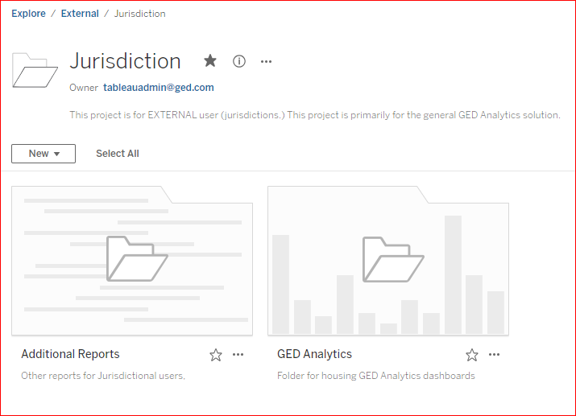
Jurisdiction landing page
- Additional Reports - GED Analytics

Slide 6
GED Analytics Roles: Explorer vs Viewer
Explorer Level Access
Aggregate jurisdictional data
Candidate Drilldown or Test Drilldown
Passer data (1 of 4, 2 of 4 and 3 of 4)
Viewer Level Access
Aggregate jurisdictional metric counts
No Candidate or Test Drilldown
No Passer data

Slide 7
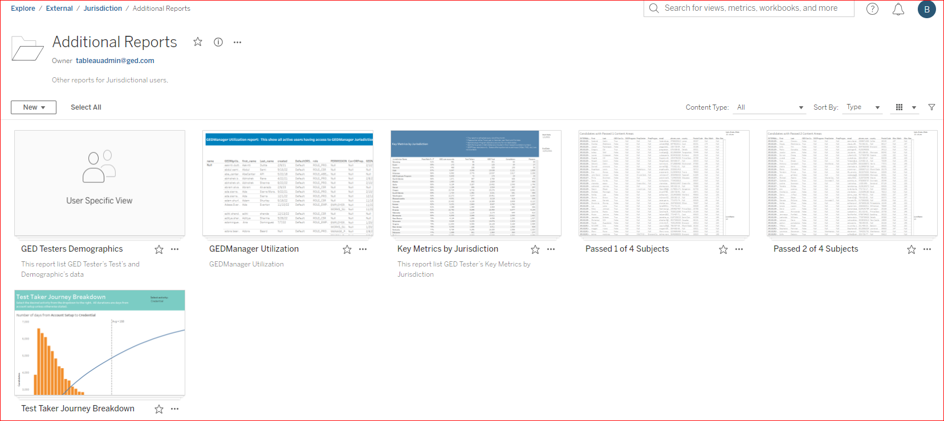
Additional Reports
GED Manager Utilization
Key Metrics by Jurisdiction
Passed 1 of 4 Subjects
Passed 2 of 4 Subjects
Test Taker Journey Breakdown

Slide 8
GEDManager Utilization report

Slide 9
2of 4 Passer report
Useful data for outreach
GED ID
FName/LName
PrepCenter
Can Contact (Opt in)
Email address
Phone number
Subject
Test score
Date last passed

Slide 10
GED Analytics
Test Summary
Test Taker Summary
Performance Summary
Demographic Summary
Appointment Summary
Passed 3 of 4 (Explorer Only)
Candidate Drilldown (Explorer Only)
Test Drilldown (Explorer Only)

Slide 11
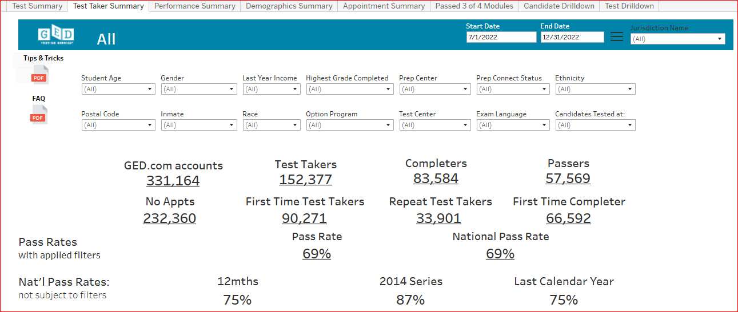
GED Manager: Test Taker Summary

Slide 12
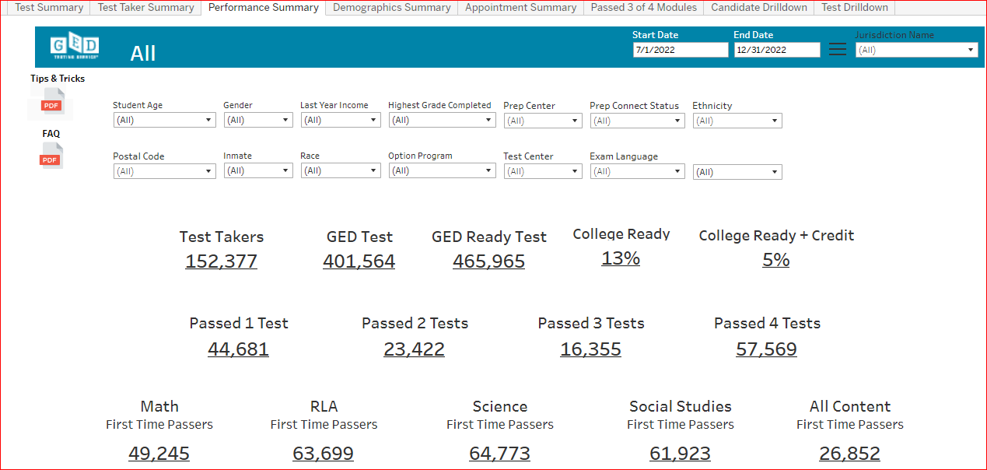
GED Manager: Performance Summary

Slide 13
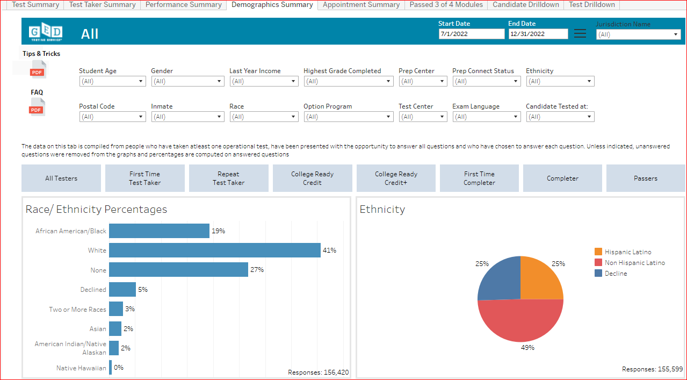
GED Manager: Demographic Summary

Slide 14
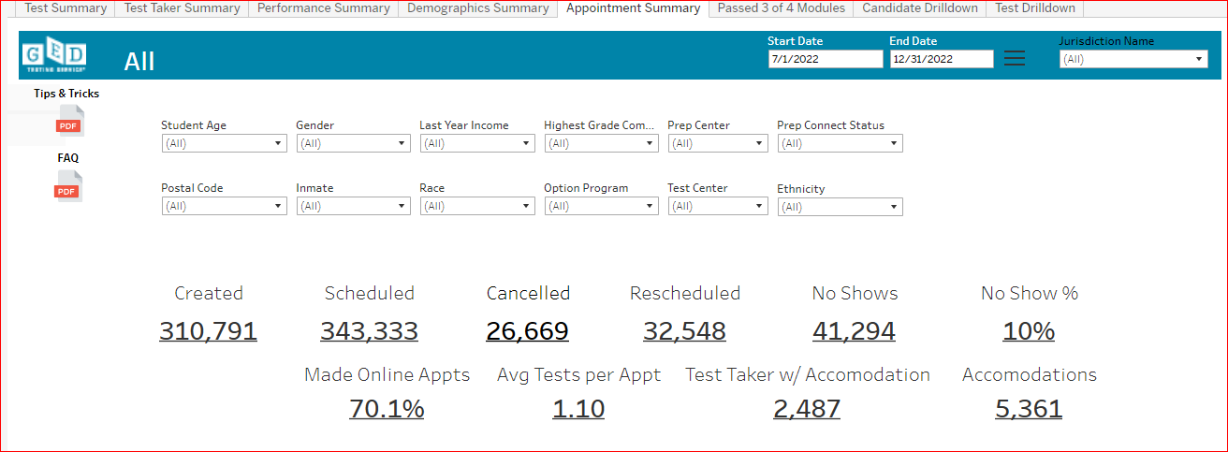
GED Manager: Appointment Summary

Slide 15
Thank You!
Feedback or questions related to GED Analytics please email
operations@ged.com

Slide 16
Session Survey
Your feedback is important. Please scan the QR code below to rate this session.

