Slide 1
How to help your students leverage the Career Currency of their Credly GED credential
Pat Leonard, Strategic Alliances and Partnerships
Pearson Workforce Skills
July 2023
pleonard@credly.com

Slide 2
Do you know what the ‘World of Work’ is looking for in new hires …. And why?

Slide 3
5 global workforce shifts driving demand for badges
the automation of work
the skills gap
demographic shift
from roles to skills
agile careers
New technologies change in-demand skills.
The half-life of technical skills is shortening.
Robot-proof human skills will persist and differentiate.
1bn jobs will be transformed by technology in the next decade.
Sources: OECD, McKinsey Global Institute, Deloitte, PwC Global Workforce Survey, Alphabet/Google FutureSkills
© 2012-2023 Credly, Inc | Proprietary | 3
Notes:
Tectonic shifts are taking place in the world of work. For many years we have heard about skills gaps and the disconnect between employers and higher education / further education and training organizations. Now automation is impacting work at scale, accelerating change, driving skills shifts and requiring agile organizations to adopt skills-based strategies to remain competitive and to grow productivity.
New technologies change in-demand skills.
The half-life of technical skills is shortening.
Robot-proof human skills will persist and differentiate.
1bn jobs will be transformed by technology in the next decade
68m jobs are "algo-threatened" in the top 500 companies.

Slide 4
5 global workforce shifts driving demand for badges
the automation of work
the skills gap
demographic shift
from roles to skills
agile careers
85m jobs may be unfilled by 2030 due to skills shortages, at a cost of $8.5tn
70% of execs see talent shortages as the most important driver for skills-based capabilities.
Sources: OECD, McKinsey Global Institute, Deloitte, PwC Global Workforce Survey, Alphabet/Google FutureSkills
© 2012-2023 Credly, Inc | Proprietary | 4
Notes:
Tectonic shifts are taking place in the world of work. For many years we have heard about skills gaps and the disconnect between employers and higher education / further education and training organizations. Now automation is impacting work at scale, accelerating change, driving skills shifts and requiring agile organizations to adopt skills-based strategies to remain competitive and to grow productivity.
New technologies change in-demand skills.
The half-life of technical skills is shortening.
Robot-proof human skills will persist and differentiate.
1bn jobs will be transformed by technology in the next decade
68m jobs are "algo-threatened" in the top 500 companies.

Slide 5
5 global workforce shifts driving demand for badges
the automation of work
the skills gap
demographic shift
from roles to skills
agile careers
Age and multicultural workforce profile changes
Millennial expectation for recognition and ongoing development
Skills-based hiring addressing bias and diversity
Sources: OECD, McKinsey Global Institute, Deloitte, PwC Global Workforce Survey, Alphabet/Google FutureSkills
© 2012-2023 Credly, Inc | Proprietary | 5
Notes:
Tectonic shifts are taking place in the world of work. For many years we have heard about skills gaps and the disconnect between employers and higher education / further education and training organizations. Now automation is impacting work at scale, accelerating change, driving skills shifts and requiring agile organizations to adopt skills-based strategies to remain competitive and to grow productivity.
New technologies change in-demand skills.
The half-life of technical skills is shortening.
Robot-proof human skills will persist and differentiate.
1bn jobs will be transformed by technology in the next decade
68m jobs are "algo-threatened" in the top 500 companies.

Slide 6
5 global workforce shifts driving demand for badges
the automation of work
the skills gap
demographic shift
from roles to skills
agile careers
Jobs can't keep up
Skill-sets for jobs changed 25% in 5 years.
Estimated to change 50% in the next 5 years.
Sources: OECD, McKinsey Global Institute, Deloitte, PwC Global Workforce Survey, Alphabet/Google FutureSkills
© 2012-2023 Credly, Inc | Proprietary | 6
Notes:
Tectonic shifts are taking place in the world of work. For many years we have heard about skills gaps and the disconnect between employers and higher education / further education and training organizations. Now automation is impacting work at scale, accelerating change, driving skills shifts and requiring agile organizations to adopt skills-based strategies to remain competitive and to grow productivity.
New technologies change in-demand skills.
The half-life of technical skills is shortening.
Robot-proof human skills will persist and differentiate.
1bn jobs will be transformed by technology in the next decade
68m jobs are "algo-threatened" in the top 500 companies.

Slide 7
5 global workforce shifts driving demand for badges
the automation of work
the skills gap
demographic shift
from roles to skills
agile careers
Fluid careers are the new normal + the gig-economy & the "projectification" of work.
A generational increase in career switching : median tenure for 25-34 year-olds is 3.2 years.
1 in 5 workers expect to change jobs this year.
Sources: OECD, McKinsey Global Institute, Deloitte, PwC Global Workforce Survey, Alphabet/Google FutureSkills
© 2012-2023 Credly, Inc | Proprietary | 7
Notes:
Tectonic shifts are taking place in the world of work. For many years we have heard about skills gaps and the disconnect between employers and higher education / further education and training organizations. Now automation is impacting work at scale, accelerating change, driving skills shifts and requiring agile organizations to adopt skills-based strategies to remain competitive and to grow productivity.
New technologies change in-demand skills.
The half-life of technical skills is shortening.
Robot-proof human skills will persist and differentiate.
1bn jobs will be transformed by technology in the next decade
68m jobs are "algo-threatened" in the top 500 companies.

Slide 8
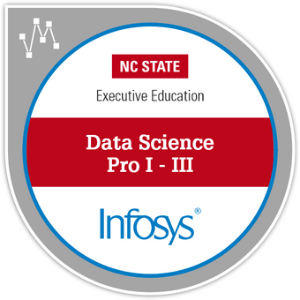
Spectrum of Digital Credential Recognition
EXPERIENCE
Not Measured
Unstructured Learning
Events/Conferences
Participation
Membership
Volunteering
Projects
Hackathons
LEARNING
Not Measured
Structured Learning
Self-Led Learning
Soft Skills
Professionalism
Competencies
Product Knowledge
VALIDATION
Measured
Validated Learning
Learning + Assessment
Portfolio/ Evidence
SME Review/ Peer Review
CERTIFICATION
Measured
Validated Achievement
Credentials Industry Certification
Diplomas and Degrees
Certificate Programs
License
Notes:
Digital credentials can be used to represent a wide range of learning-related outcomes, from experiences to non-credit, credit, and even entire certifications or diplomas. The advantage of the industry-standard Open Badge credential format is that the data is highly structured and the achievements are interoperable and learner-controlled.

Slide 9
Madison College
The Power of Digital Credentials
130+ types of digital badges
77% of badge holders believe that badges improve job opportunities
25% growth in digital badges issued every semester

Slide 10
Colorado Community College System
The Power of Digital Credentials
500,000 social media impressions
Created learning and career pathways
Increase in job placement
Notes:
Full case study: https://resources.credly.com/resources/case-study-autodesk

Slide 11
Case Study: From employee engagement to enterprise-wide skills platform
Quick Stats:
48% increased employee engagement, 36% increased customer satisfaction, and 34% increased productivity
IBM makes our skills data discoverable to HR and managers in real-time; informs people analytics and strategic workforce planning.
125%
694%
87%
Course enrollments in IBM-credential online courses increased
Course completions of IBM-credential online courses increased
Credential earners feel more engaged with IBM and are motivated to learn more

Slide 12
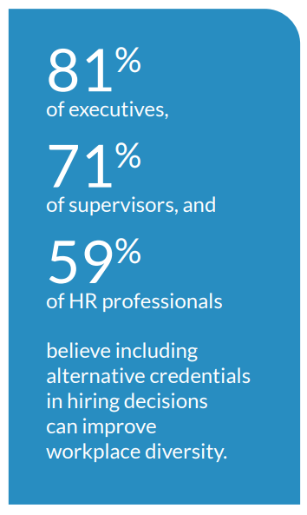
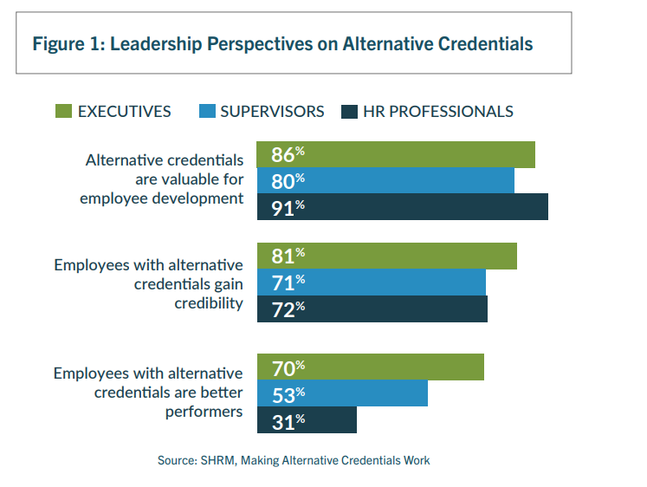
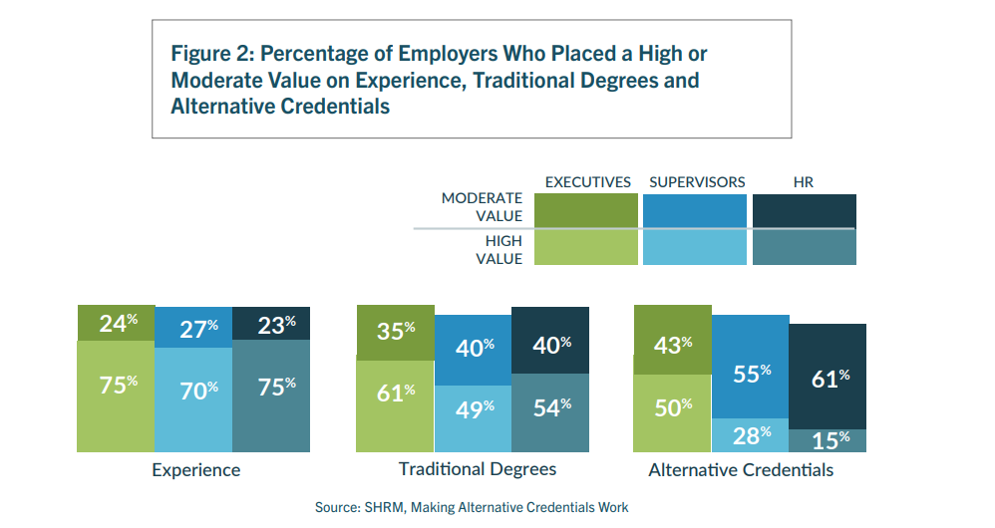
Employer Views on Alternative Credentials
… the tide is turning to skills-based signals
The Effect of Employer Understanding and Engagement on Non-Degree Credentials, UPCEA/Collegis, Feb 2023

Slide 13
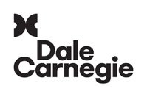
Credly believes in a network full of opportunity serving both earners and issuers
Associations
Corporations
Training & Education

Slide 14
How do you help your graduates translate learner outcomes into skills … and then into opportunities With Digital GED Credentials?

Slide 15
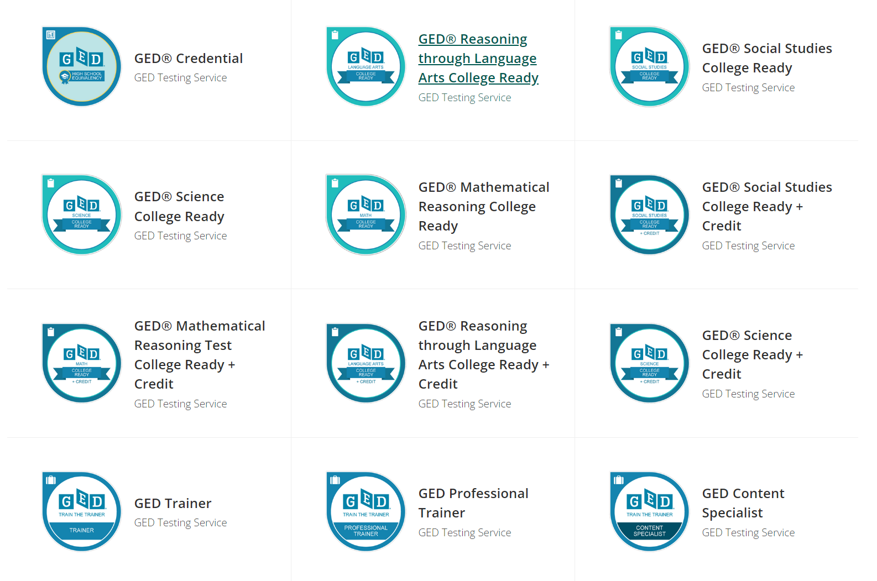
GED Digital Credentials

Slide 16
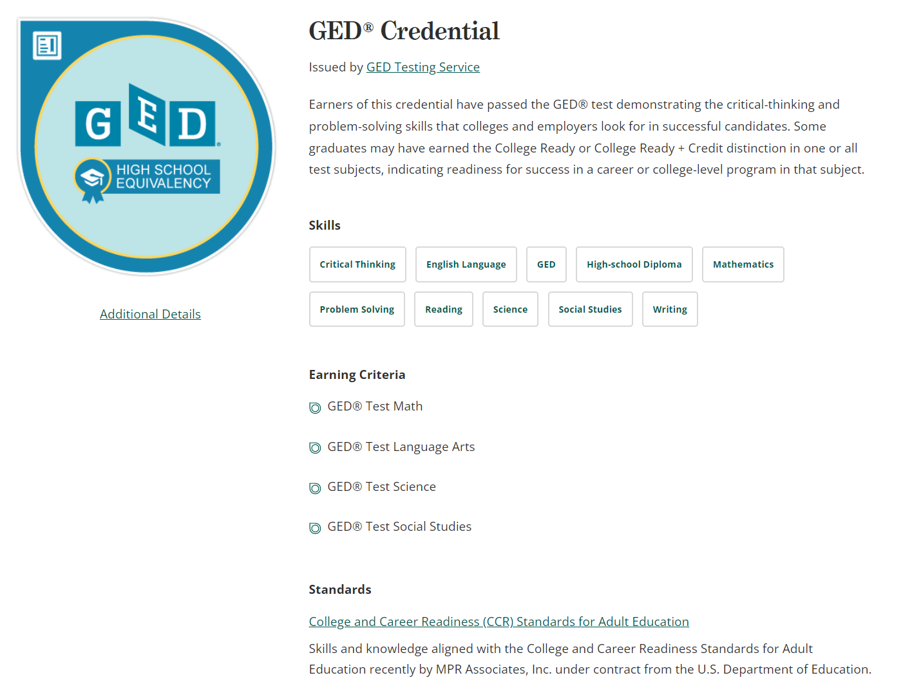
A Currency for Human Capital
✓
Trusted Sources
✓
Skill Transparency
✓
Connection to Jobs
✓
Verified Accomplishments

Slide 17
Credly Connects Earners to Opportunities
Individual
Earns a Credential
Credential Issued
on Credly
Earner Curates
Credly Profile
Opportunities Presented to Earner via Credly, Based on Earned Skills
Certification
Assessment
Course
Learning Experience
Other Achievements
Current Employer
Future Employer
Learning and Assessments

Slide 18
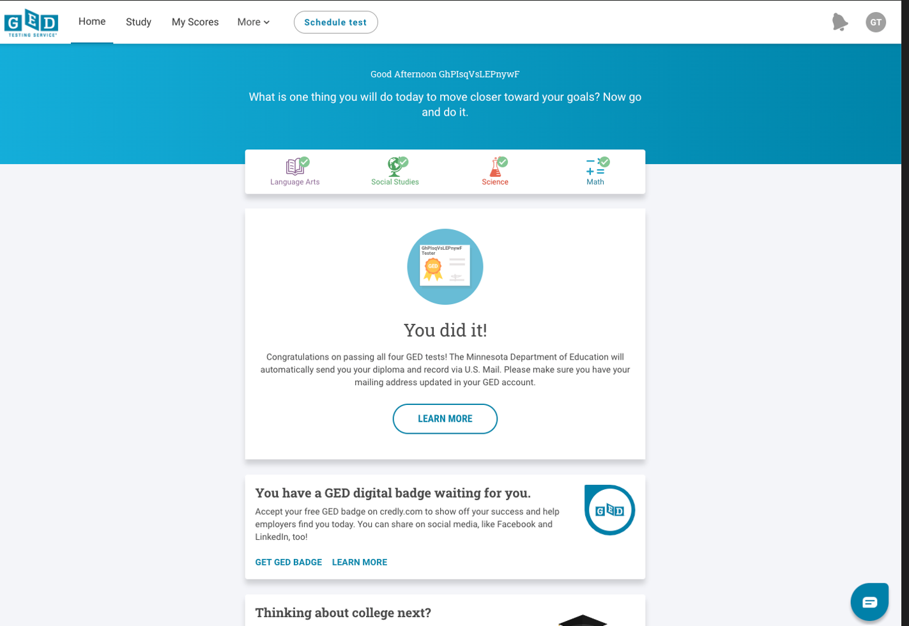
The GED® candidate experience: Badges earned by Passers are notified on GED.com

Slide 19
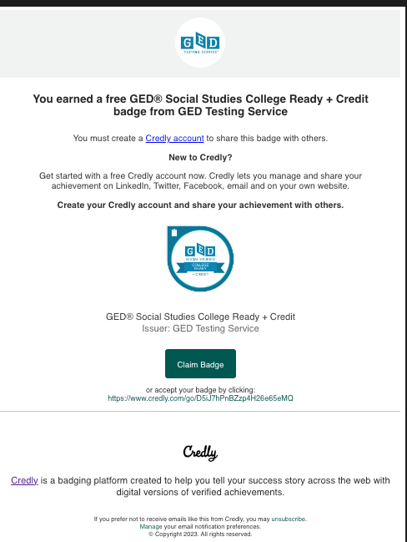
… and notified via direct email to claim their badge:

Slide 20
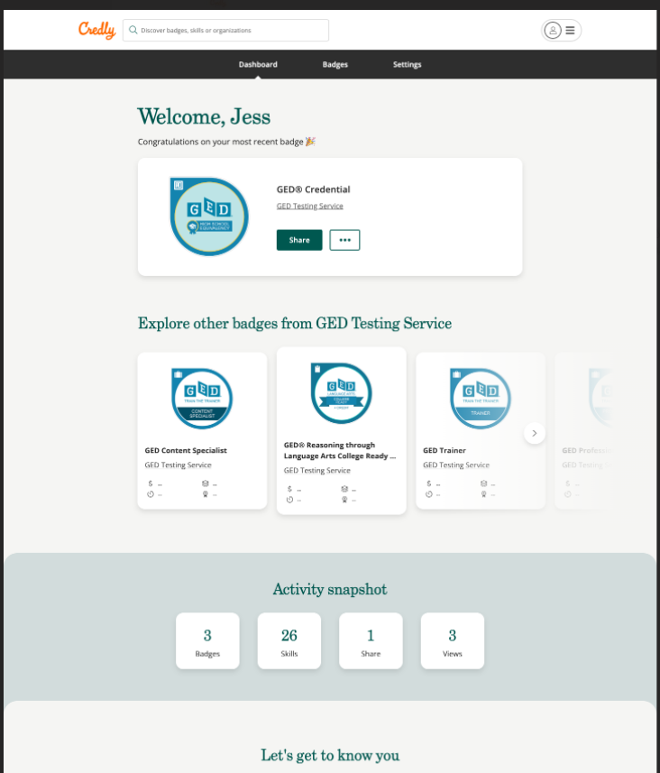
Credly Account

Slide 21
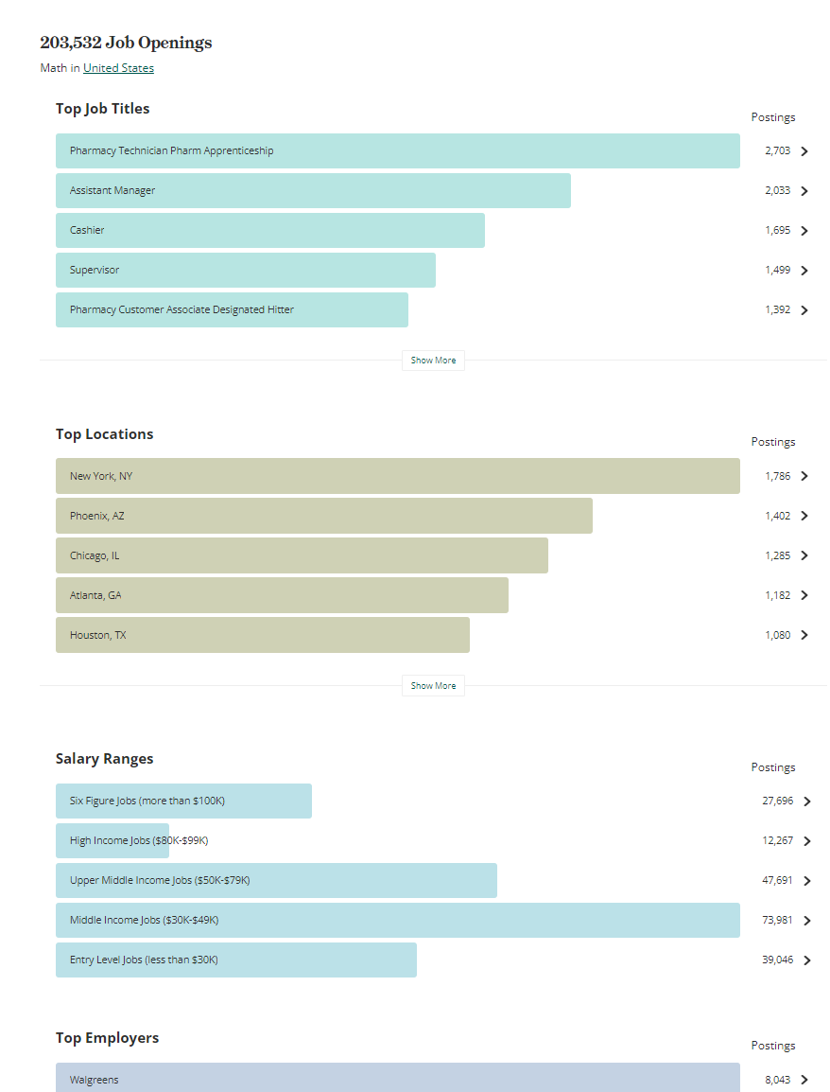
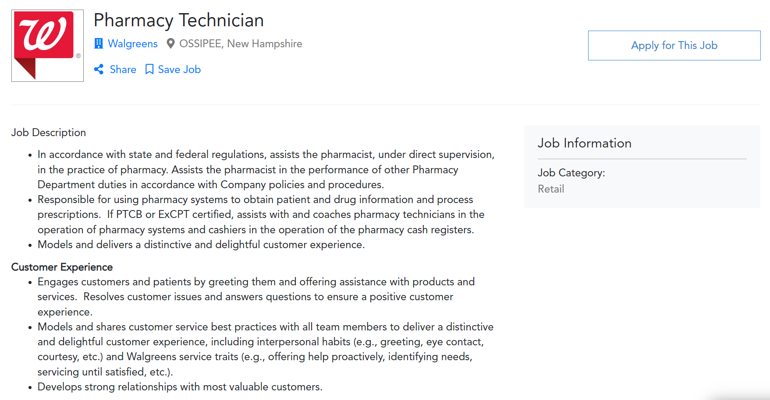
Students connect directly to opportunities:
Employment

Slide 22
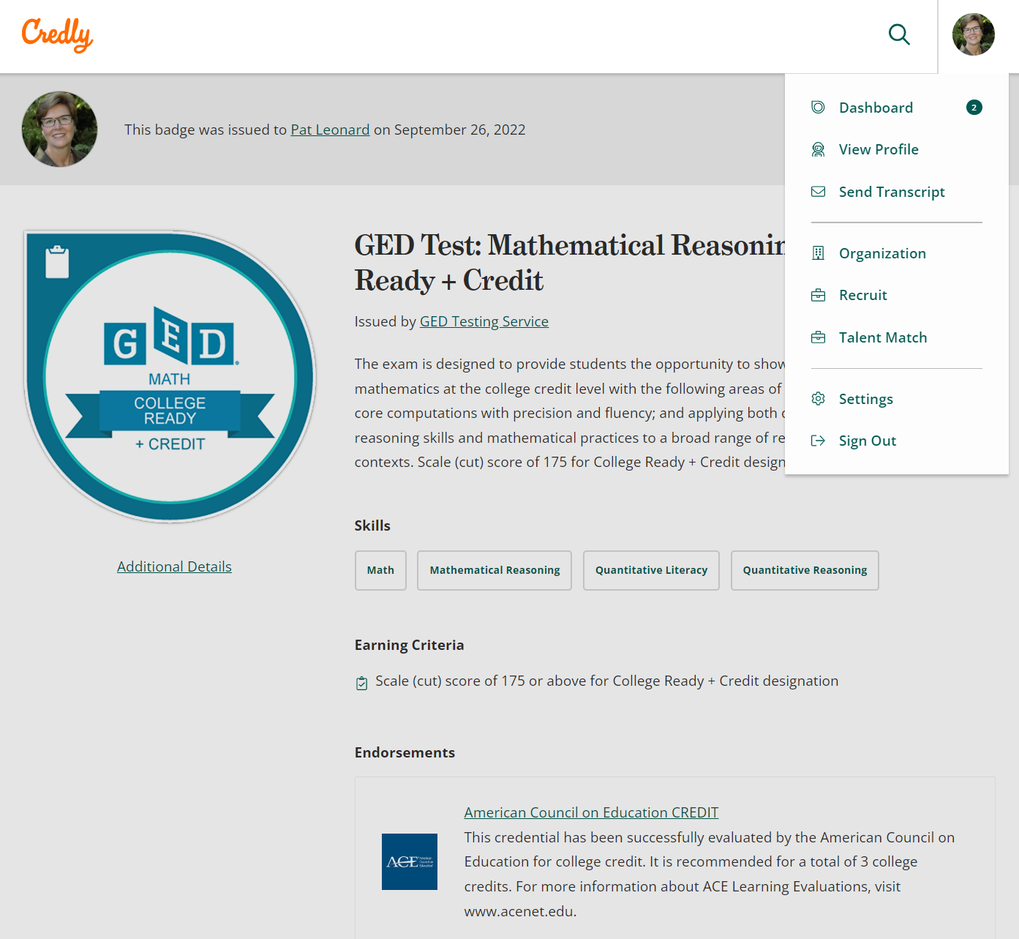
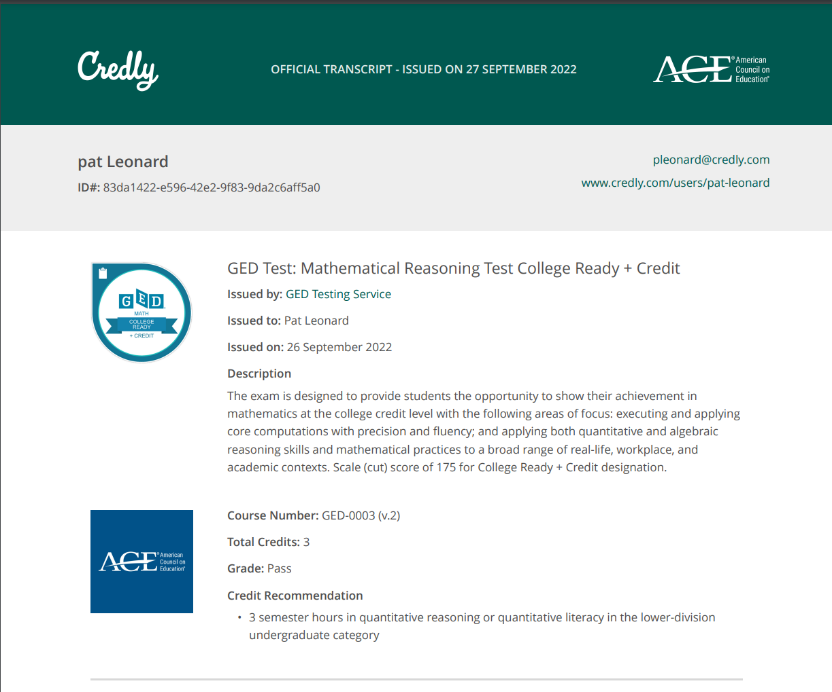
Education
Students connect directly to opportunities:

Slide 23
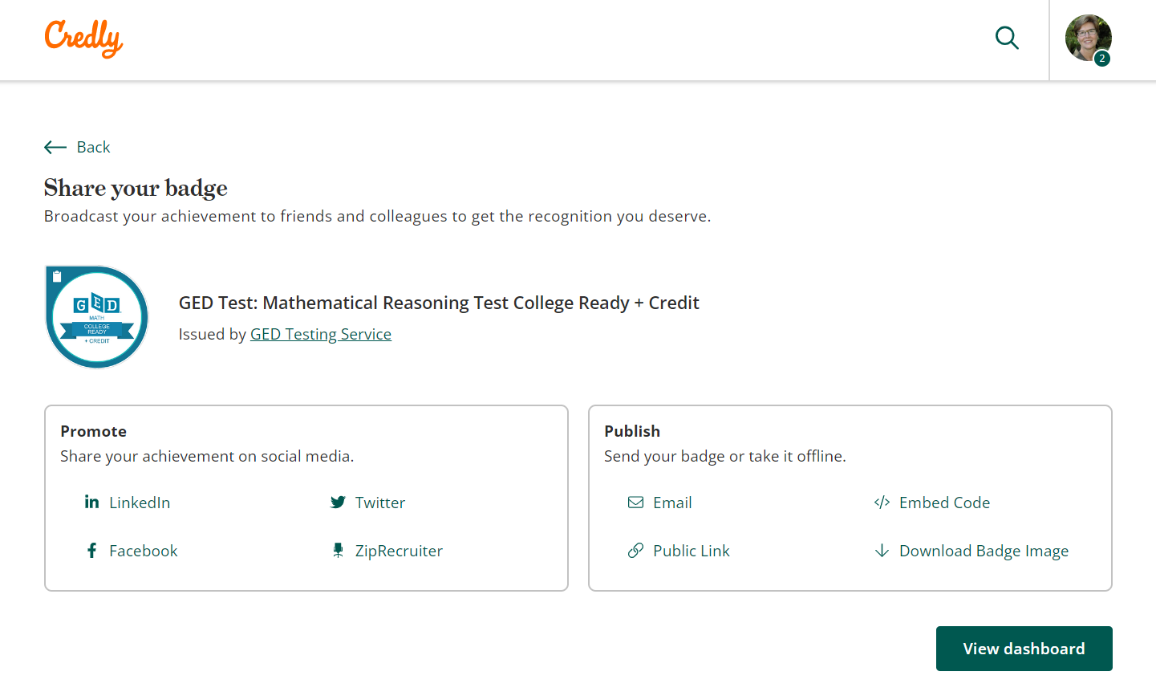
Students connect directly to opportunities:
Self-advocate Social Sharing

Slide 24
Credly Acclaim digital credential platform benefits
Add market value to programs
Translate learning outcomes to skills
Engage & recognize industry and employer partners
Increase demand for programs & certificates
Increase enrollment and revenue
Drive program completions
Increase persistence to next courses
Connect earners with opportunities
Highlight skills-in-demand
Reinforce market relevance
Link to Labor Market Insights and jobs
Build brand identity
Reduce credential misrepresentation
Increase SEO brand impressions with every share/view/click
Notes:
Create a culture of recognition and learning with our digital credential issuing capabilities, and leverage our unique workforce insights to optimize L&D initiatives, engage employees, and surface internal opportunities for talent.

Slide 25
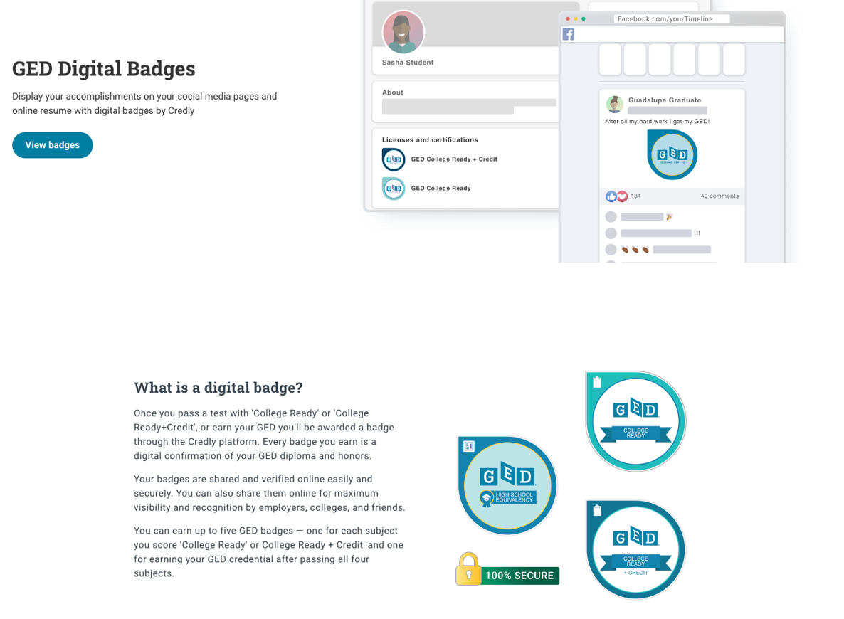
New 'Learn More' page on GED.com

Slide 26
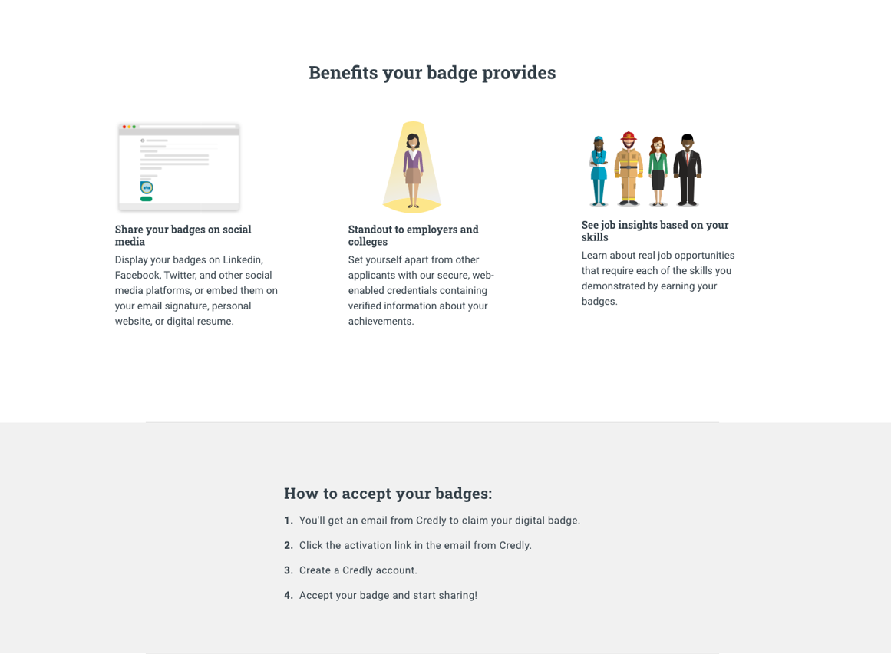
'Learn More' page on GED.com

Slide 27
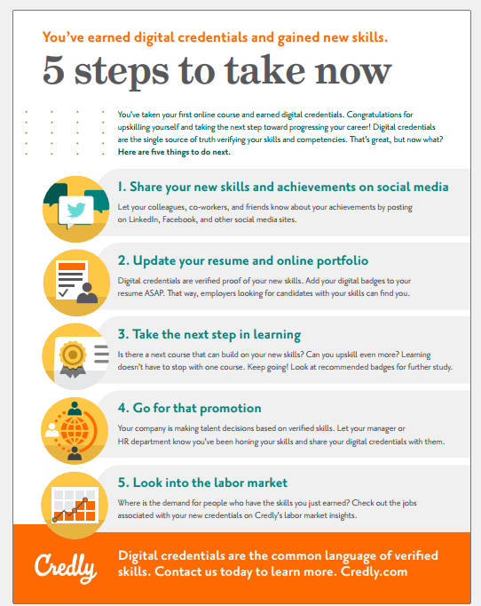
One-page overview for your students

Slide 28
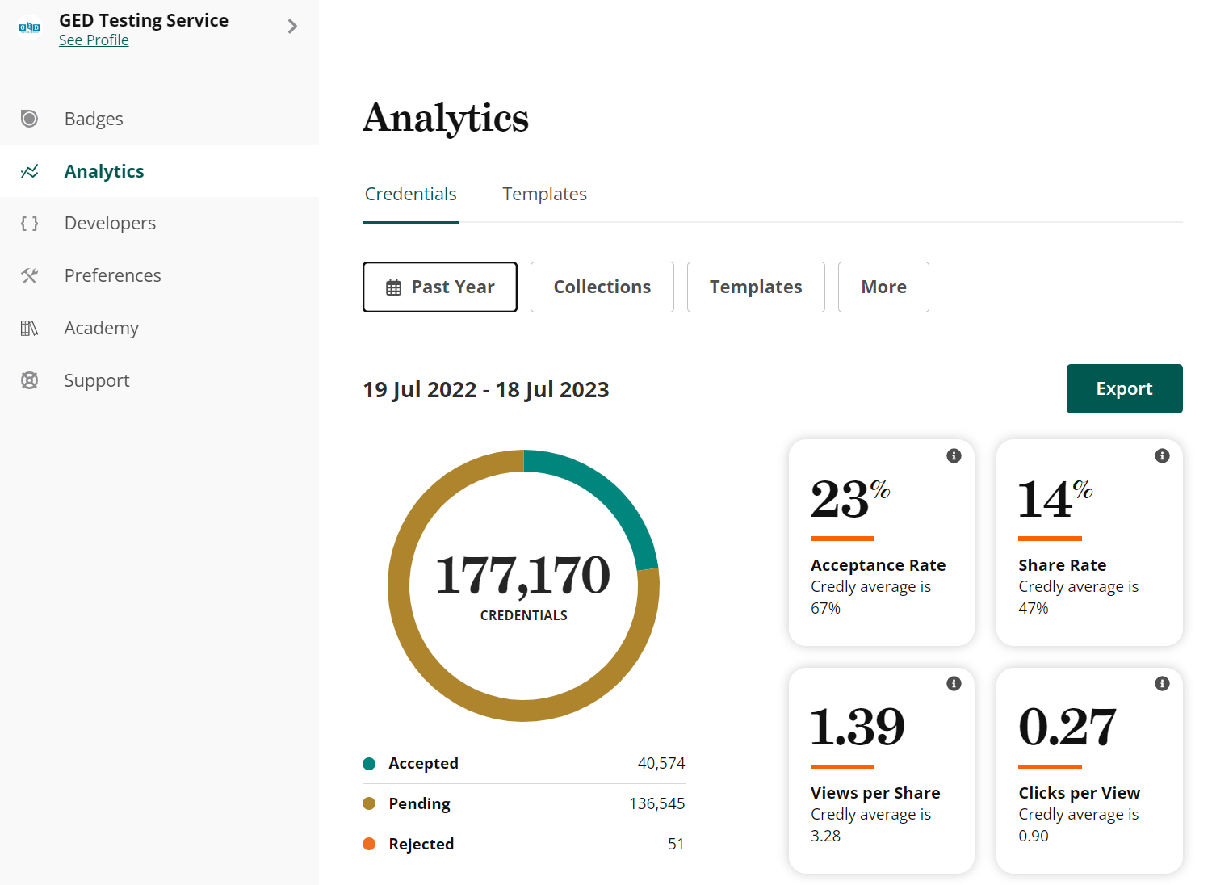
GED® Testing Service badge stats

Slide 29
41

