Slide 1
What an Effective Extended Response Requires from Students
Susan Pittman
GED® and GED Testing Service® are registered trademarks of the American Council on Education (“ACE”). They may not be used or reproduced without the express written permission of ACE or GED Testing Service LLC. The GED® and GED Testing Service® brands are administered by GED Testing Service LLC under license from ACE.

Slide 2
Access Materials
https://bit.ly/GEDRLA2025
In this two-part session, we will focus on what students need to learn and be able to demonstrate to write an effective extended response, including:
Close Reading
Writing Basics – grammar, mechanics and usage
Developing and supporting an argumentative essay

Slide 3
Beginning with the End in Mind!
What does an effective extended response really look like?

Slide 4
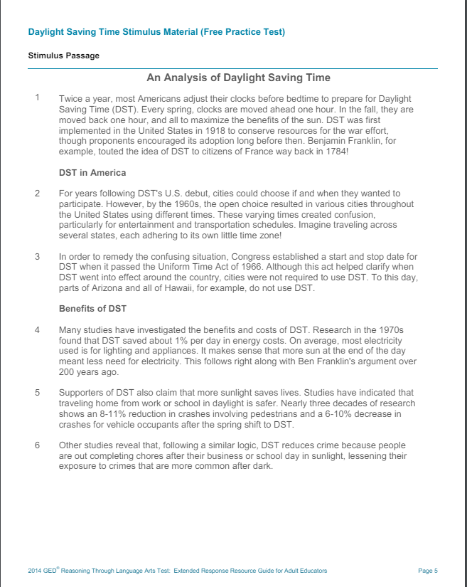
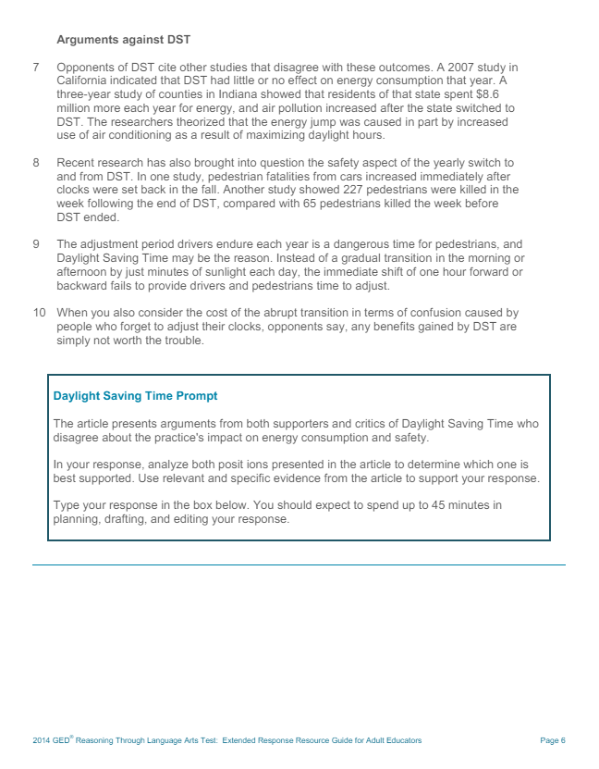
Notes:
Most of the writing prompt passages consist of two passages arguing opposite points of view. (A few present the opposing points of view within one text.)
Have participants read the passage. Have them identify the arguments made for each position, pro and con. Have them highlight the evidence that supports each argument.
As a group, review the prompt. Highlight key words. Notice how the key words in the prompt follow the instructions that are given to students.

Slide 5
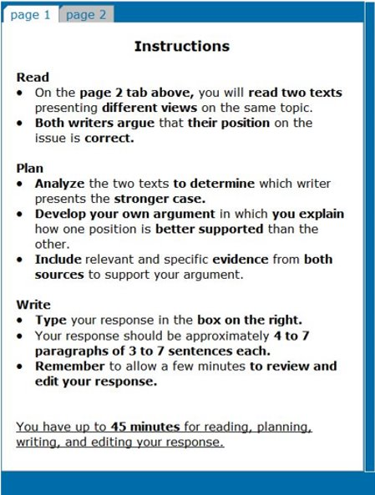
GED® Extended Response
Students read two short passages and respond to a prompt.
Prompt directs students to write an essay evaluating which passage makes a stronger argument and is better supported.
Prompt is essentially always the same, with slight wording differences as needed.
There is no “right” or “wrong” answer to the question of which writer presents the stronger case; students are scored on HOW they answer that question and address the prompt.
Notes:
Review the key points.
Walk participants through the instructions. Emphasize the key words in the Plan and Write sections.
Make special note of the last bullet that address a key concern among students.

Slide 6
Writing Prompt
Prompt provides outline for success across all 3 traits
  Analyze the two texts…(Trait 1)
  Include evidence…(Trait 1)
  Include relevant and specific evidence…(Traits 1 & 2)
  Develop your own argument…(Trait 2)
  Your response should be approximately…(Trait 2)
  Remember to review and edit your response…(Traits 1,2,3)
Notes:
This slide provides the clearest explanation for the purpose behind the extended response. It is all about applying/demonstrating the ability to use skills that are assessed in the rest of the GED RLA test.

Slide 7
Extended Response Scoring Traits
Trait 1 – Creation of Arguments and Use of Evidence
Analyze the two texts
Generate a text-based argument
Establish a purpose related to the prompt
Include evidence from both texts
Trait 2 – Development of Ideas and Organizational Structure
Develop ideas
Make clear connections between ideas
Use transitional devices
Have an organizational structure
Keep formal style throughout
Choose words wisely
Trait 3 – Clarity and Command of Standard English Conventions
Use correct sentence structure to ensure clarity
Apply conventions of standard English
Avoid errors in mechanics and conventions to avoid interfering with comprehension
Response is not expected to be perfect.
Notes:
Review key points of each Trait. You may want to download and print a copy of the RLA ER Rubric and accompanying annotations to ensure that you are comfortable with the content.

Slide 8
Student Challenges with Argumentative Writing
General Issues
There is no argument, rather there are summaries of the texts
There is an argument, but it isn’t supported by evidence
The response includes an analysis of one of the text, not both
There are limited, if any, supporting details
The writer has difficulty staying on topic and providing facts and support
The writing lacks structure
Opinion versus Argument
Argument is backed by logic/support/facts and leads to a conclusion.
Opinion is more personal and anecdotal.
Lack of Original Text
Inability to paraphrase
Too many quotes
Copy words directly from the text
Notes:
Students summarize the texts instead of evaluating the arguments made in the texts.
Students merely copy words from the texts (nonscorable = 0 points).
Students only analyze or discuss one of the texts rather than both.

Slide 9
Student Challenges with Argumentative Writing
General Issues
Correlation between performance on the RLA assessment as a whole and performance on ER
Students who score 0s and 1s on the ER are more likely struggling with skills across the RLA assessment
How the skills align across all portion of the RLA
Reading items correlate to Traits 1 and 2
Language (Editing) items correlate to Trait 3
Common Reasons for Low Scores
Students do not write a full response
Students lack a structure and appropriate tone
Students’ English conventions are poor. Their writing lacks proper grammar, capitalization, punctuation, and vocabulary (word choice, slang, etc.)
Students have issues with sentence structure
Notes:
Review key points on the slide.
Data shows a strong correlation between test taker performance on the RLA assessment as a whole and performance on the ER.
Students who are getting 0s and 1s on the ER are likely struggling with all skills across the RLA assessment.
It helps to understand how the skills align across all portions of the RLA.
Reading items correlate to Traits 1 and 2.
Language (Editing) items correlate to Trait 3.
ER items require strong written performance of all 3 traits.
Some common reasons for low scores on ER responses:
Students do not write a full response.
They do not analyze, and/or
they do not elaborate, and/or
they do not reference the evidence in the text.
Students lack a structure and appropriate tone.
Their writing has no clear introduction, body, or conclusion.
No transitions are made between ideas.
They are not writing for an audience.
Students’ English conventions are poor. Their writing lacks:
proper grammar (subject/verb agreement, etc.) and/or
proper capitalization, and/or
proper punctuation, and/or
complete sentences (run-ons or fused sentences used instead), and/or
improper vocabulary (incorrect word choice, slang, etc.).

Slide 10
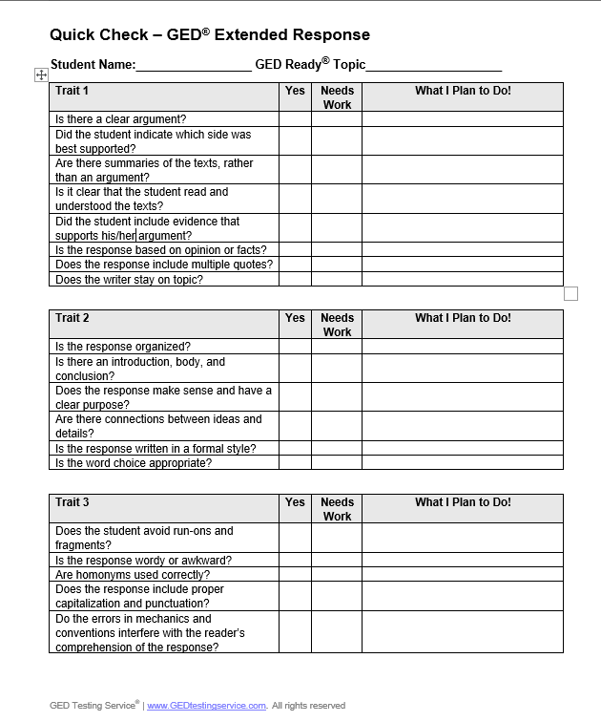
Quick Check in the Classroom
Notes:
The GED Testing Service provided teachers with a number of tools for analyzing and evaluating student writing samples. However, the number of teachers who use these tools is limited. The main reason for lack of use is that the scoring tool is time consuming to use. The electronic scoring tool is great, but many teachers lack the time and understanding of exactly how to use it.
This Quick Check form is available to teachers to use as an analysis, evaluation, and planning document. Beyond determining if the response is “yes” or “needs work” the teacher can write a brief plan for each item that needs work. It is highly recommended that teachers do not assign more than one or two areas for students to work on. Adding more simply overloads the students.
Quick Check is not an official GED scoring tool.
On the next slides, you will find five writing samples. Read through them and identify the “needs works” areas for each sample.

Slide 11
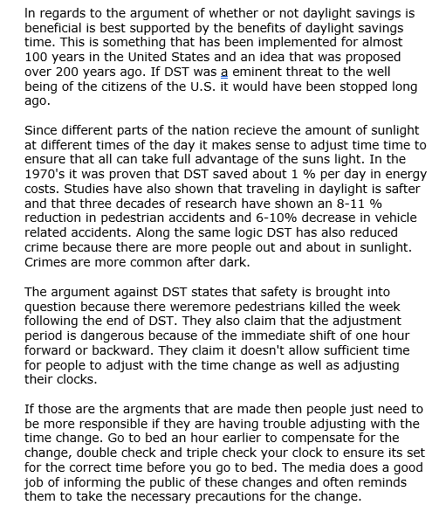

Slide 12
How did the student get to this point?
Read the prompt and followed directions.
1
Read the arguments for DST and identified supporting evidence.
2
Read the arguments against DST and identified supporting evidence.
3

Slide 13
Issue-based stance
Trait 1
1
Evidence from the text to back the stance.
Opposing arguments

Slide 14
Limited development
Simplistic organization
Summary of the advantages
Trait 2
0
Summary of the disadvantages
Challenge to the opponent’s arguments

Slide 15
Demonstrates
correct sentence structure (except Sentence 1)
Word confusion
(eminent and imminent),
Use of apostrophes
Trait 3
2

Slide 16
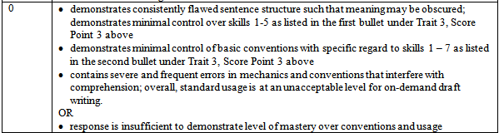
One problem all students can avoid!
Now the safety issue comes up again, in the yearly switch to and from DST. One study shows pedestrian fatalities from cars increased immediately after clocks were set back in the fall. Arguments continue with another study that shows 227 pedestrians were killed in the week following the end of DST compared with 65 pedestrians killed the week before DST ended. lt is also stated that the adjustment period drivers endure each year is a dangerous time for pedestrians, and DST may be the reason. Instead of a gradual transition in the morning or afternoon by just minutes of sunlight each day, the immediate shift of one hour forward or backward fails to provide drives and pedestrians time to adjust. These opponents believe the consideration of cost and confusion are simply not worth all of the trouble. With everything there are pros and cons no matter what, so in the end we can only hope the good outweighs the bad.
Note: Text in red was copied directly from the source text.
Notes:
This is an example of problem that occurs far too often. In this case, the student copied directly from the source text. All of the original source text is in red. This is something that teachers can help students avoid doing.
Notice that there are some lead-ins such as,
One study shows….
It is also stated…
Remember: A phrase is a group of words acting as a unit that does not include a subject and a predicate. A clause is a group of words acting as a unit that does have both a subject and a predicate. A phrase can never stand by itself as a complete sentence while a clause might be able to.
Too many students believe that by adding a phrase or a clause to a sentence is “paraphrasing”.
Not true. Paraphrasing or rephrasing means to state something written or spoken in different words, especially in a shorter and simpler form to make the meaning clearer.
A paraphrase should show that you have taken in the author's idea, understood it, and can explain it in your own words. Therefore, your rewrite should look totally different from the original.

Slide 17

Improving Students’ Reading Skills
My students know the basics. So, where should I begin?

Slide 18

Close Reading
Textual Analysis
A process of reading with intent and depth, going beyond a superficial understanding to uncover layers of meaning and significance.

Slide 19
Close Reading
Careful and Repeated Readings
Requires multiple readings of the text
Annotation
Annotating of text (highlighting, underlining, making notes
Active engagement with the text
Focus on Language and Structure
Examination of author's word choices (diction), sentence structure, imagery, figurative language, to understand how they shape the text's meaning
Analysis of Content and Craft
Analysis of what the text says and how it says it
Interpretation
Seeks to understand the text's deeper meanings and significance

Slide 20
Close Reading
Close reading requires a student to slow down, pay attention to details, and actively construct meaning from a text.

Slide 21
Reading Strategies
Close Readers | Not-So-Close Readers
Reread | Read the text once
Focus on the text | Let their thinking wander
Ask questions | Take the text at face value
Pay attention to language | Ignore syntax clues
Uncover deeper meaning | Understand only at surface level

Slide 22
Focus on the Skill Gaps
Students need to consider the whole text context and closely analyze the details.
Students need to read and comprehend the text. Go back to the text to find the order of events.
Students need to compare two passages that share ideas or themes and focus on the similarities and differences in perspective, tone, style, structure, purpose, or impact.
Students need to compare two argumentative passages on the same topic that present opposing claims…and analyze how each text emphasizes different evidence or advances a difference interpretation of facts.

Slide 23
Understanding What is Explicitly Stated
When leasing an apartment, there are several important things to keep in mind. First, make sure to read and understand the lease agreement thoroughly. This document covers all the terms of your tenancy, such as the rent amount, lease duration, security deposit, and maintenance responsibilities. It also includes policies on pets and guests. Be sure to check for clauses about early termination, renewal options, and late payment penalties to avoid any surprises.
Second, take a close look at the apartment and its neighborhood. Before signing the lease, inspect the apartment for any damages or issues that need fixing. Check for amenities like parking, laundry facilities, and security features. Also, research the neighborhood to make sure it is safe and convenient for your needs, such as being close to work, schools, and other essential services. The quality of the neighborhood can greatly affect your overall living experience.
Finally, consider your financial situation. Besides the monthly rent, you will have other expenses like utilities, renter's insurance, and maintenance fees. Make sure your budget can handle these costs comfortably. It’s also a good idea to have some savings for emergencies or unexpected expenses. By planning your finances carefully, you can manage your lease responsibly and avoid financial stress.

Slide 24
Understanding What is Explicitly Stated
When leasing an apartment, there are several important things to keep in mind. First, make sure to read and understand the lease agreement thoroughly. This document covers all the terms of your tenancy, such as the rent amount, lease duration, security deposit, and maintenance responsibilities. It also includes policies on pets and guests. Be sure to check for clauses about early termination, renewal options, and late payment penalties to avoid any surprises.
Second, take a close look at the apartment and its neighborhood. Before signing the lease, inspect the apartment for any damages or issues that need fixing. Check for amenities like parking, laundry facilities, and security features. Also, research the neighborhood to make sure it is safe and convenient for your needs, such as being close to work, schools, and other essential services. The quality of the neighborhood can greatly affect your overall living experience.
Finally, consider your financial situation. Besides the monthly rent, you will have other expenses like utilities, renter's insurance, and maintenance fees. Make sure your budget can handle these costs comfortably. It’s also a good idea to have some savings for emergencies or unexpected expenses. By planning your finances carefully, you can manage your lease responsibly and avoid financial stress.

Slide 25
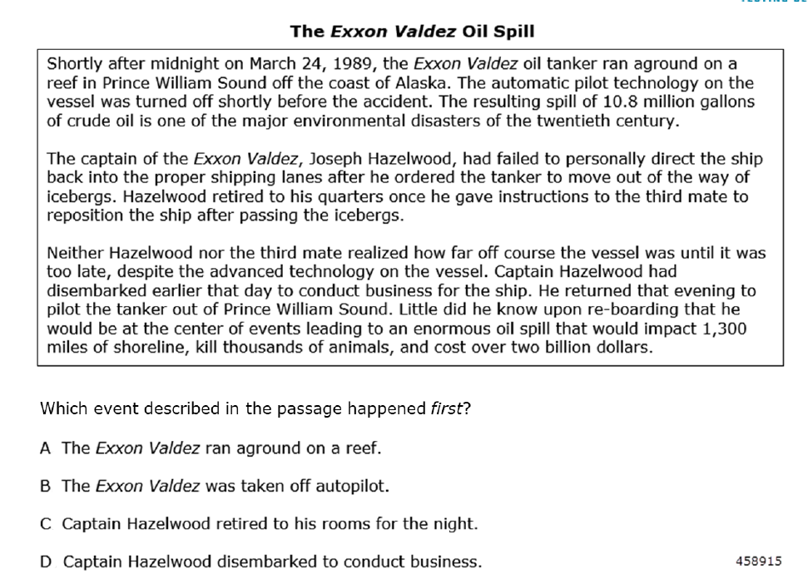
Use Sample Test Questions
Notes:
Relate to Real-World Examples:
Current Events: Discuss current events or news stories related to the topic being taught.
Everyday Life: Draw parallels between concepts and situations students encounter daily.
Local Context: Use examples from the local community or region to make learning more relevant.
Simulations and Role-Playing: Simulate real-world scenarios to allow students to practice skills in a safe environment.
2. Incorporate Student Interests:
Student-Chosen Topics:
Allow students to choose topics or projects that align with their interests.
Personal Connections:
Encourage students to share their experiences and perspectives related to the material.
Diverse Perspectives:
Introduce different viewpoints and cultural contexts to broaden understanding.

Slide 26
Identify Sequence of Events
8
7
9
4
5
6
1
2
3
Notes:
Relate to Real-World Examples:
Current Events: Discuss current events or news stories related to the topic being taught.
Everyday Life: Draw parallels between concepts and situations students encounter daily.
Local Context: Use examples from the local community or region to make learning more relevant.
Simulations and Role-Playing: Simulate real-world scenarios to allow students to practice skills in a safe environment.
2. Incorporate Student Interests:
Student-Chosen Topics:
Allow students to choose topics or projects that align with their interests.
Personal Connections:
Encourage students to share their experiences and perspectives related to the material.
Diverse Perspectives:
Introduce different viewpoints and cultural contexts to broaden understanding.

Slide 27
R.9.3 Skills Gap Explained
R.9.3 | Students will compare two argumentative passages on the same topic that present opposing claims […] and analyze how each text emphasizes different evidence or advances a different interpretations of facts.
What does this indicator measure?
  Critical thinking
  Analyzing how authors use evidence to serve their agenda
  Analyzing how two authors could use the same fact differently
  The Gap
  Students need to look closely at how each author is using the information differently to serve their overall purpose. Multilayered skills: critical thinking.
Special considerations
  Only measured with paired informative texts

Slide 28
R.9.3 Example
R.9.3 | Students will compare two argumentative passages on the same topic that present opposing claims […] and analyze how each text emphasizes different evidence or advances a different interpretations of facts.
Text 1: A historian references a fact that 100,000 people attended a march for a particular cause. The historian emphasizes that the 100,000 people is a large number.
Text 2: A different historian also writes about the march but emphasizes that the 100,000 people is fewer than attended the march in previous years.
How do the historians use the number of people attending the march differently?
**One uses it to suggest significant support for the cause, whereas the other uses it to imply that support for the cause is decreasing over time.

Slide 29
Practice Concise Writing
Create your own sentences or paragraphs
Find interesting topics
Do a group think and edit
Because massive flu outbreaks completely strained our hospitals, we had to essentially reconsider the role of telehealth in our medical system.

Slide 30
Drill Down to What’s Important!
Watch for redundancies
Watch for those abbreviations
Turn clauses to phrases and phrases to single words
Drop the intensifiers
Eliminate “important sounding” phrases
The meeting will start at 12 noon.
I need to get some cash from the ATM machine.
Smith College, which was founded in 1871, is a premier women’s college.
The proposed salary increase is very inadequate.
As a matter of fact, there are more parks in the city than we expected.
Southern Illinois University https://write.siu.edu/

Slide 31
Drill Down to What’s Important!
At this point in time, we can’t ascertain the reason as to why the screen door was left open.
Essential Resource for the Classroom
https://write.siu.edu/_common/documents/handouts/writing-concise-sentences-exercise-included.pdf
At what point in time will a downturn in the stock market have a really serious effect on the social life of people as a whole?
One time when I went to the park, my friend, whose name is Jake, went with me and we had fun due to the fact that it was a nice day out.

Slide 32

Brain Break!

Slide 33

Fun Focus
Google Reviews and Evidence Based Writing

Slide 34




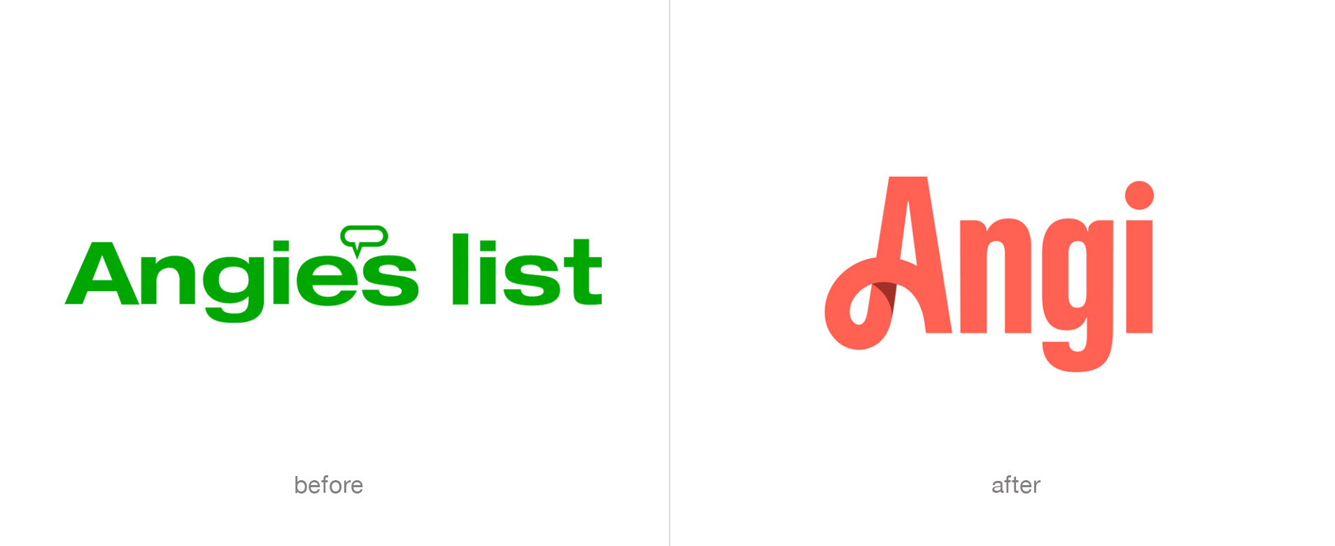
To Review or Not Review

Slide 35
Google Reviews – EB Writing in Context
Online reviews of parks, restaurants, bars, shops/stores
  Five-Star Rating System
    Yelp
    TripAdvisor
    Open Table
  Users make claims in their reviews
  Users develop claims with support/evidence
COABE 2020 Presentation: Timothy Berrigan, Brooklyn Public Library, tberrigan@bklynlibrary.org
Notes:
Online reviews of parks, restaurants, bars, shops/stores
Five-Star Rating System
Yelp Adjacent
Users make claims in their reviews
Users develop claims with support/evidence

Slide 36
Tom Berrigan’s Argument for Using Google Reviews
Online resource/activity
Reviews of recognizable/neighborhood places spark debate
Non-academic language;
  unedited (errors)
Wide variety of authorship
Prior knowledge isn’t an obstacle
Accessible and Approachable (not “formal” argumentative prompt)
Google Reviews are essentially Intro. paragraphs
It can be fun!
COABE 2020 Presentation: Timothy Berrigan, Brooklyn Public Library, tberrigan@bklynlibrary.org
Notes:
Online resource/activity
Reviews of recognizable/neighborhood places spark debate
Non-academic language;
unedited (errors)
Wide variety of authorship
Prior knowledge isn’t an obstacle
Accessible and Approachable (not “formal” argumentative prompt)
Google Reviews are essentially Intro. paragraphs
Fun?

Slide 37
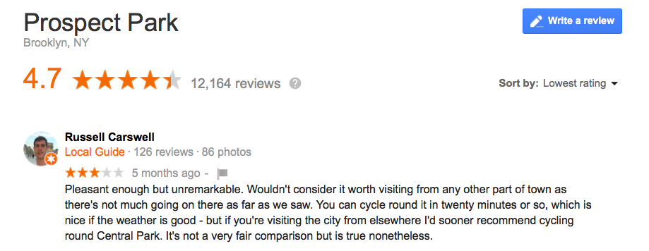
Sample Review - What Do You Notice? What Do You Wonder?
COABE 2020 Presentation: Timothy Berrigan, Brooklyn Public Library, tberrigan@bklynlibrary.org
Notes:
Online resource/activity
Reviews of recognizable/neighborhood places spark debate
Non-academic language;
unedited (errors)
Wide variety of authorship
Prior knowledge isn’t an obstacle
Accessible and Approachable (not “formal” argumentative prompt)
Google Reviews are essentially Intro. paragraphs
Fun?

Slide 38
What Do You Notice? What Do You Wonder?
We noticed
He’s a local guide
What makes Central Park better?
Grammar/voice
Went to park before reviewing
Seems to believe audience is from out of town
Emphasizes cycling
Demonstration of opinion
Not a lot of details
We wondered
  Why is Prospect unremarkable?
    What would he like to see at a park?
  Where does the reviewer live in the city?
    Do we think he lives in the city?
  What is his reasoning for going to the park?
  There is an opinion here; is there an argument?
  What does Central Park have more of?
COABE 2020 Presentation: Timothy Berrigan, Brooklyn Public Library, tberrigan@bklynlibrary.org
Notes:
Online resource/activity
Reviews of recognizable/neighborhood places spark debate
Non-academic language;
unedited (errors)
Wide variety of authorship
Prior knowledge isn’t an obstacle
Accessible and Approachable (not “formal” argumentative prompt)
Google Reviews are essentially Intro. paragraphs
Fun?

Slide 39

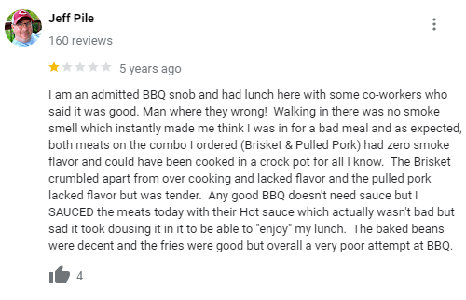
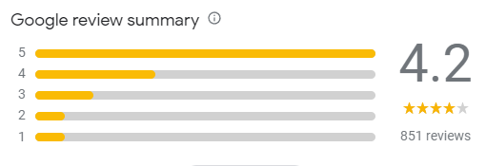
What Do You Notice? What Do You Wonder?
Notes:
Online resource/activity
Reviews of recognizable/neighborhood places spark debate
Non-academic language;
unedited (errors)
Wide variety of authorship
Prior knowledge isn’t an obstacle
Accessible and Approachable (not “formal” argumentative prompt)
Google Reviews are essentially Intro. paragraphs
Fun?

Slide 40
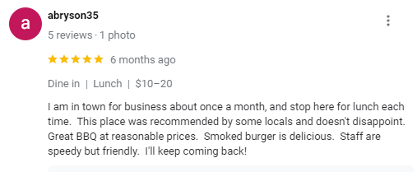
What Do You Notice? What Do You Wonder?
Notes:
Online resource/activity
Reviews of recognizable/neighborhood places spark debate
Non-academic language;
unedited (errors)
Wide variety of authorship
Prior knowledge isn’t an obstacle
Accessible and Approachable (not “formal” argumentative prompt)
Google Reviews are essentially Intro. paragraphs
Fun?

Slide 41

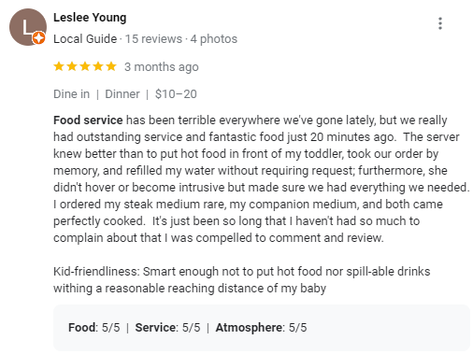
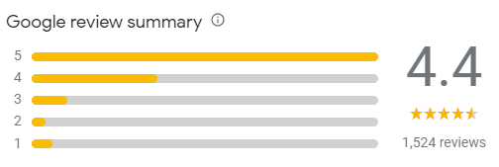
What Do You Notice? What Do You Wonder?
Notes:
Online resource/activity
Reviews of recognizable/neighborhood places spark debate
Non-academic language;
unedited (errors)
Wide variety of authorship
Prior knowledge isn’t an obstacle
Accessible and Approachable (not “formal” argumentative prompt)
Google Reviews are essentially Intro. paragraphs
Fun?

Slide 42
Response Prompts for Critical Reading
Which review did you agree with personally? Provide three reasons.
  What about the review did you agree with?
  What did you find most compelling or convincing?
Which review did you disagree with personally? Provide three reasons.
Which review was most convincing?
What was your favorite piece of evidence?

Slide 43
Your Turn
Use Google to locate a hotel, restaurant, special event space (park, lake), or even a service.
Skim through the reviews
Pick one high rating and one low rating that you could use with your students
Set up a chart like the following and include your responses
I noticed… | I wonder…
______________________ provided the most convincing review because _____________________ ________________________________________________________________________________
Notes:
Online resource/activity
Reviews of recognizable/neighborhood places spark debate
Non-academic language;
unedited (errors)
Wide variety of authorship
Prior knowledge isn’t an obstacle
Accessible and Approachable (not “formal” argumentative prompt)
Google Reviews are essentially Intro. paragraphs
Fun?

Slide 44
“If the purpose of language is to ensure that one is understood, then grammar is the superstructure.”

Slide 45
What would you do?
When I think about my dream job I get very excited because it is something that I have thought about for a long time and have really wanted to do ever since I was a little girl growing up in Charlotte. I used to love watching my mama cook she was the best cook and could make some great comfort food. I first learned how to cook when I was four and I made some vegetable soup with fresh veggies from our garden. Because of my Moms influence I want to become a chef and make outstanding food. I want to go to culinary school and learn as much as I can and then become a sous chef and eventually I want to own my own restaurant and earn the big bucks.
My dream job is a supermarket meat department manager. I like food. I really like beef. Beef rules. I like being around food. I like working with people. I like helping people. That is why I want to be a meat department manager.
My dream job would be in outside sales. I would love this job because of the travel the chance to earn commissions and the way I can set my own hours. I love to travel because I get to meet different people see different places and have new challenges. When I think about doing this job I get very excited. My uncle who is very close to me worked in outside sales for over forty years.

Slide 46
What would you do?
IMHO my dream job iz 2 b a CEO. U tink OMG. This is TMI TYVM. I DC. It wud b gr8 2 b a CEO. FYI CEO are 7K. This is AFAIK. I M not J/K. DIS iz rly my POV. B4N. I wiL CU 2moro.
For help in translating, use transl8it.com
I feel like my dream job is literally the best job in the world. This job has got me like you can’t believe. I wanna be an auto mechanic. Oil literally runs in my veins man. There is nothing more awesome for me than getting my hands dirty inside an engine. Since I’m to legit to quit, I’m gonna work until I reach my goal. If you don’t like it, my bad.

Slide 47
Grammar Hit List
Run on sentences, fused sentences, or sentence fragments
Frequently confused words, homonyms, and contractions (it’s versus its)
Subject-verb agreement
Basics of pronoun usage
Placement of modifiers and word order

Slide 48
A Student Response (to DST prompt)
ln my way its good because in DST is good for lot of people. The studies have indicated that traveling home from work or school in daylight is safer. Nearly three decades of research shows an 8-11% reduction in crashes invilingpedestrains and a 6-10% decrease in crashes for vehicle occupants after the spring shift to DST.ln sunlight we can finishes our chores. In everything new things takes time to adjust. After some days went we feel this is the right thing. In studies only shows that too. Only one week after changing the clocks and before go back the clocks only accidens happen after that its not for only one week we think what about the rest of the weeks. If we see in everything its right or wrong. In my way DST is for lot of people.In way who dont like sun its natural way of light.

Slide 49
Scoring Annotations
This brief response demonstrates consistently flawed sentence structure (“In my way its good because in DST is good for a lot of people .”) and includes several fragments (“In studies only shows that too.”) and run-on sentences.
Sentences are largely incorrect, awkward, or illogical and demonstrate a lack of fluency.
Minimal control of standard English conventions is evident, particularly with regard to frequently confused words, punctuation, subject-verb agreement, and modifier placement.
These severe and frequent errors interfere with comprehension (“If we see in everything its right or wrong.”).
Therefore, Response 19 earns a score of 0 for Trait 3.

Slide 50

If students can write an effective claim, they can write an effective extended response.
The Claim

Slide 51
What is a claim?
A claim is the main argument of an essay. It is the most important part of an academic paper.
A claim defines the paper’s goals, direction, and scope. It is supported by evidence.
A claim must be argumentative.
A good claim makes a focused argument (Because of the growing obesity epidemic, elementary schools should ban junk food from their cafeterias.) rather than a general one (Junk food is bad.). •
Academic claims are complex, nuanced, specific, and detailed.
Notes:
What is a claim? • A claim is the main argument of an essay. It is the most important part of an academic paper. • A claim defines the paper’s goals, direction, and scope. It is supported by evidence. • A claim must be argumentative. • A good claim makes a focused argument (Because of the growing obesity epidemic, elementary schools should ban junk food from their cafeterias.) rather than a general one (Junk food is bad.). • Academic claims are complex, nuanced, specific, and detailed.

Slide 52
Think About It!
Your supervisor asked you to review Zoom and BlueJeans video conferencing systems. She wants your recommendations on which system to purchase. She provided you with the following link to review: https://www.uctoday.com/collaboration/video-conferencing/bluejeans-vs-zoom-which-video-conferencing-should-you-choose/
You reviewed the info and even tried out both systems. Now, you must write up your recommendations.
Claim First Draft: I recommend that the company purchase Zoom Enterprise.
Claim Second Draft: After a careful review of Zoom and BlueJeans, I recommend the purchase of Zoom Enterprise because it is better.
Claim Third Draft: After a review of Zoom and BlueJeans, Zoom is the better choice for our company because it offers more features, opportunities for expansion, and a higher level of support.

Slide 53
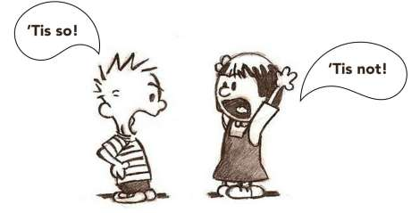
Learning to Write Effective Claims…
Helps students sharpen their close reading skills
Helps them learn to focus on the evidence provided
Requires that they make a decision and stick with it
Requires that they use evidence to support the decision
Requires that they use higher cognitive skills

Slide 54
Different Types of Evidence
Type of Evidence | Definition
Factual | Truthful statements that cannot be denied. Statements that the average person may know or which can be proven.
Statistics or Data | Numerical facts; can be presented in raw numbers, percentages, or fractions.
Examples or Anecdotes | Real-life situations, events, or experiences that illustrate a position; anecdotal stories that help explain an author’s claim.
Expert Testimony | The observations or conclusion of someone who is considered highly knowledgeable because he/she is an expert in a particular field of study or occupation; someone who has firsthand knowledge and experience.
Logical Reasoning | An explanation which draws conclusions that the reader can understand; a discussion which helps the reader understand or make sense out of facts or examples offered.
Emotional Appeal | Use of sympathy, fear, loyalty, etc. to persuade; manipulates the reader’s emotions – ethos, pathos, logos.
Notes:
Key Points
Discuss that evidence is more than just facts and stats.
Share the different types of evidence and definitions on the chart. Discuss why this makes a difference in analyzing text and developing a claim as students read the source texts to find evidence.
Review the different types of evidence and definitions on the chart.

Slide 55
Think Real-Life Examples
Type of Evidence | Sample Statement
Factual | Individuals who have a high school credential earn more than those without a high school credential.
Statistics | There are 39 million adults who do not have a high school diploma.
Anecdotes | I did not complete high school, but at age 39 I received my GED diploma which allowed me to finally enter college.
Expert testimony | According to a study by the American Council of Education, adults who earn a GED® credential can earn the same level of weekly wages as high school graduates, increasing their earning potential by about $115 per week.
Logical reasoning | Having a high school credential provides students with the first step toward achieving their educational or career goals.
Emotional appeal | We owe adults nothing less than the opportunity to receive their high school credential; their futures depend on it.

Slide 56
Opinion versus Argument/Arguable Claim
Krispy Kreme doughnuts are delicious.
I like dance music.
The current mayor is not competent.
Krispy Kreme doughnuts taste better than other donuts because of their texture, sweet glaze, and golden appearance.
Dance music comes in many forms and is popular because of the clear, fast beats that get people up and moving.
The current mayor is clearly incompetent because he has mishandled money, spent time on frivolous causes, and never listens to the people he is supposed to serve.

Slide 57
What’s the Starting Point?
Conclusion
5
The claim
Is the roadmap with signs and markings
Guides the writer and reader through the argument
Provides the position taken
Provides the reason “why”
Evidence & Counterclaim
4
3
Evidence
Evidence
2
1
Claim
Notes:
Key Points (This slide has multiple animations.)
Well-written essays and papers have main ideas that are evident from the very beginning. The message should not be unclear or cloaked in too many words. Students need to state what you will be talking about, proving, dismissing, etc. This should be clear right away. The reader does not need to excavate two paragraphs to know what you will be discussing; it’s all right there in the introduction.
In the same sense, what the rest of essay or paper will look like is evident. The writer’s next few sentences in the introductory paragraph guide the reader. Each paragraph should then bring up a new point to support the thesis statement.
“So What” Question - The so what question distinguishes the outstanding papers from the competent ones. The so what question, as its name implies, simply looks at the interpretive claim you’re making and asks, “So what?”
Be prepared to answer “So what?” about your thesis statement.
Be prepared to explain why the point you are making is worthy of a paper. Why should the reader read it?

Slide 58
Opinion vs Arguable Claims
Opinions
Are not supported by evidence
Are supported by more opinion
Only state support, no necessarily the reason behind the support
Arguable Claims
Are supported by evidence
Can be substantiated with research, expert testimony, and academic reasoning
Address the “so what” question

Slide 59
Opinion vs Arguable Claims
Opinion Example
Ice cream is delicious
Arguable Claim Example
Ben and Jerry’s ice cream is more delicious that other ice creams because it is creamy, flavored naturally, and made in small batches.

Slide 60

The Value of a Claim
A claim is the main argument of an essay.
It is probably the single most important part of the response.
The complexity, effectiveness, and quality of the entire response hinges on the claim.
Notes:
Key Points
What earns points? Remember, it’s not which side the test-taker likes best, but rather which side the test-taker believes is better supported and why. Maybe one side was better supported because it included more current and factual research. Maybe one side of an argument provided stronger statistical data. Whatever the reason, a single statement of stance is insufficient. To earn points, the test-taker also needs to provide more that just quotations. Evidence that is cited must be analyzed so that it supports the overall message. This requires that the test-taker “connects” the evidence back to the claim.

Slide 61
Is it really a claim?
In reading this article about DST, I must say that I am FOR DST because not only do we get more sunlight, but it is also provides many safey for not only me, but as for the other people in my society.
In regards to the argument of whether or not daylight savings is beneficial is best supported by the benefits of daylight savings time.
Between the two positions in this article, the one against Daylight Saving Time is better supported.
In the articles that present the arguments from both critics and supporters of Daylight Saving Time and how they impact energy consumption and safety, I believe that the position of those who support DST is better supported.
Notes:
Discuss each of them. Ask participants to revise.

Slide 62
What Can You Do to Help this Student?
Between the two positions in this article, the one against Daylight Saving Time is better supported.
Start with the existing claim.
Identify what needs to change to make this a better claim.
Read through the student’s response and identify evidence used.
Identify what these pieces of evidence have in common.
2007 study in California
3-year study in Indiana
Spent more on energy
Increase use in AC
Study on safety
Gains are offset
Notes:
Key Points (This slide includes multiple animations.)
Review the information and reveal the claim and the evidence the student used.

Slide 63

The Value of the Word Because
People do things because they provide a benefit or have value.
People choose to live somewhere because of its proximity to schools or work.
People drive a certain car because of its fuel economy, reliability, etc.
If because is a power word, shouldn’t students be using it to make their claims stronger?

Slide 64
Build the New Claim
Which argument was better supported?
Why was it better supported?
Claim
…the one against DST is better supported.
It is supported by research and logical reasoning.
The position against DST is better supported because it includes research and logical reasoning.
Notes:
Key Points (This slide includes an animation.)
The claim of an extended response needs two parts: a position and a reason for taking that position. By looking at the original claim and the evidence the student used, when can pull them together to write a more effective claim.

Slide 65
Develop the Introduction
Create an opening sentence
Connect to the claim
Include your claim

Slide 66
Rework the Introduction
The article presents two opposing views on DST. Both positions are well organized and supported with several examples. However, the position against DST is better supported because it includes more research and logical reasoning based on safety and crime.
Current Intro
Between the two positions in this article, the one against Daylight Saving Time is better supported. Although both positions are well organized and supported with several examples. the evidence supporting the view against DST is more specific and thorough.
Notes:
The position against DST is better supported because it includes research and logical reasoning.

Slide 67
Build the New Claim
Which argument was better supported?
Why was it better supported?
Claim
The position of those who support DST is better supported
It is supported by research, facts, and logical reasoning.
The position in favor of DST is better supported because it is backed by research, facts, and logical reasoning.
Notes:
Key Points (This slide includes an animation.)
The claim of an extended response needs two parts: a position and a reason for taking that position. By looking at the original claim and the evidence the student used, when can pull them together to write a more effective claim.

Slide 68
How would you rework the intro?
Current Intro
In the articles that present the arguments from both critics and supporters of Daylight Saving Time and how they impact energy consumption and safety, I believe that the position of those who support DST is better supported.
Notes:
The position against DST is better supported because it includes research and logical reasoning.

Slide 69

Have a Process and Use It!
Notes:
Key Points
69

Slide 70
Expectations for Constructed Response
When you write . . .
determine which position presented in the passage(s) is better supported by evidence from the passage(s)
explain why the position you chose is the better-supported one
remember, the better-supported position is not necessarily the position you agree with
defend your assertions with multiple pieces of evidence from the passage(s)
build your main points thoroughly
Notes:
Key Points
Test-takers should be familiar with the expectations of the constructed response prior to taking the test. This information should be an integral part of classroom instruction.
[Review the bulleted items on the slide.]

Slide 71
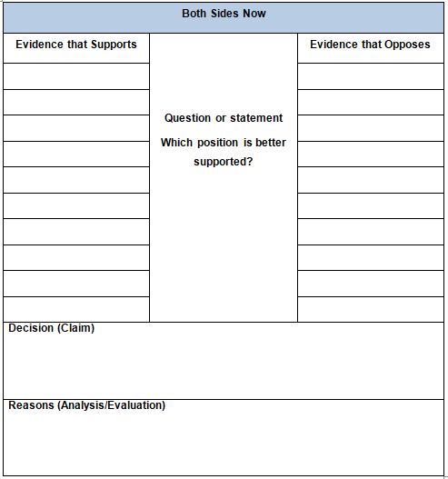
Both Sides Now
Students should
List the evidence that supports
List the evidence that opposes
Evaluate the evidence
Select the position that is better supported
Provide reasons why (analysis/evaluation)
Notes:
Key Points
One graphic organizer that works well for getting students to analyze and evaluate evidence within a text is Both Sides Now. First students need to read the text. Then they determine the question being asked and write it in the middle. Most of the time, the question being asked is which position is better supported. Before a claim can be written, the evidence must be analyzed and evaluated. On one side, students should write in evidence that supports a position. On the other side, evidence should be written in that opposes the position. It’s important that students include different types of evidence, such as facts, statistics, anecdotal, logical reasoning, etc.
After the evidence has been documented, it’s time to look at all of the evidence and determine which side is better supported. That information goes into the “Decision” section of the organizer. But it’s not enough just to determine which side is better supported, students also need to be taught to analyze and evaluate why one side was better supported. This information goes into the “Reasons” section of the graphic organizer.
Use of this type of organizer provides students with a way to create an effective claim and to identify evidence to use both to support the claim and to provide a counter-claim and rebuttal.

Slide 72
Build the Claim
Which argument was better supported?
Why was it better supported?
Claim
Notes:
Key Points (This slide includes an animation.)
The claim of an extended response needs two parts: a position and a reason for taking that position. By looking at the original claim and the evidence the student used, when can pull them together to write a more effective claim.

Slide 73
Now I’m ready . . .
Claim | States what is being argued and what points are being made. An effective claim is debatable, narrow enough to deal with in a writing, and has valid evidence to support it.
Evidence | Supports the claim; not personal opinions, but, information from reliable sources (texts).
Bridge | The logical connection between the evidence and the claim - explains how the pieces of evidence are connected to the claim.
Counterclaim | A claim that negates or disagrees with the claim.
Rebuttal | Evidence that negates or disagrees with the counterclaim.
Conclusion | Closes the essay and once more attempts to convince the reader that the claim is the best position on the issue.
Notes:
Key Points
Bring the process together by sharing with participants that through thinking routines, they have now analyzed the prompt, closely read the source texts, identified evidence, and determined what side is best supported. What is left? To put the different parts of an effective response. Discuss the parts of effective argumentative writing.
Sample modeling script - Ok, now that I have identified evidence and determined which side is best supported, it’s time to put together the different parts of an effective constructed response. I know that I will need to better craft my claim – what is being argued and what points are being made. Because I have analyzed the evidence prior to writing my claim, I am better able to develop the claim based on the evidence from the source texts, rather than what I may think. Then I will need to identify the evidence that I want to use, as well as determine how each piece of evidence connects to the claim. I know that for every position, there is an opposite position, so I will want to have a counterclaim and a rebuttal to the claim. Finally, I will want to write a conclusion that convinces the reader that the claim is the very best position on the issue.
Note: All resources/templates for the following section are located on pages 29-48 of the workbook. Be sure to emphasize that by having students complete the pre-work of analyzing the evidence before writing a claim, they are less likely to make the “better supported” decision from a strictly personal viewpoint.

Slide 74
Keep it Simple!
Beginning
The introduction states the main idea or position. It begins with a topic sentence/thesis statement. The beginning restates the question and sets the stage to answer the prompt.
Middle
Answer the question first.
Write a closing that summarizes the position taken or restates the thesis statement in a different way.
Ending
Provide important information the author stated and meant. This is where you go to the text(s) and provide examples/evidence and important details to support the answer.
Sample phrases to introduce each text reference include: … stated; in the text …; for example . . .
Include background information as required through the prompt.
Notes:
Key Points
Structure is important to the writing task. Instead of a five-paragraph structure, the more effective structure to teach is that all writing has a beginning, middle, and ending. Whether the writing is comprised of a paragraph, a multi-paragraph essay, or even a book, effective writing has a beginning, middle, and ending. Ideas should drive structure, rather than structure driving ideas.

Slide 75
A Few Insights to Improve Student Performance
What Earns Points
Notes:
Key Points
Let’s look at what earns points, so we have a better idea on what we need to do in the classroom.
75

Slide 76
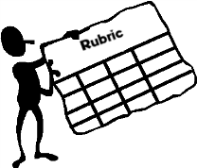
What Earns Points
Going beyond merely stating which side is better supported
  A single statement of a stance is considered insufficient
  Needs to include the “why”
Doing more than just using quotations
  Evidence cited must support the overall message and must be analyzed in some way
Notes:
Key Points
What earns points? Remember, it’s not which side the test-taker likes best, but rather which side the test-taker believes is better supported and why. Maybe one side was better supported because it included more current and factual research. Maybe one side of an argument provided stronger statistical data. Whatever the reason, a single statement of stance is insufficient. To earn points, the test-taker also needs to provide more that just quotations. Evidence that is cited must be analyzed so that it supports the overall message. This requires that the test-taker “connects” the evidence back to the claim.

Slide 77
What Earns Points
Analyzing the issue or the quality of the argument through which both sides are presented
  Evidence cited must support overall message and must be analyzed in some way
Demonstrating that the test-taker has engaged with the text and has created a text-based argument
Notes:
Key Points
Let’s look at other ways that test-takers earn points.
It’s not just about listing evidence. It’s about analyzing the issue or the quality of the arguments through which both sides are presented. Evidence that test-takers cite must support the message and must connect in some way to the claim. Test-takers must be able to engage with the text and then create a text-based, not a personal, argument. Remember, there is no one “right answer”. Rather, the test-taker needs to analyze and evaluate the evidence in order to determine which side is better supported by the evidence.

Slide 78
Interact with Text – Analyze
Purpose/Context | What is the text about? What type of text is it? What overall purpose does the text serve?
Author | Who is the author of the text? What qualifies him/her to write on this subject?
Audience | Where does the text appear? What does the author expect the reader to do or think based on the argument/information presented?
Proof/Evidence | What type of evidence is provided? Is more than one type of evidence provided? Is evidence provided for both sides of an argument?
Organization/ Structure/Style | What is the organization of the text? What is the tone? What type of sentence structure/complexity, figurative language, rhetorical questions are used?
Notes:
Key Points
The skill of analyzing text does not just happen. In teaching students to analyze, it is important that you model for students how you interact with the text. You will want to model interacting with text in order to analyze what is being said, as well as interacting with the text to identify the different types of evidence. Students often have difficulty in analyzing instead of summarizing text. Show students how you ask questions as you read or interact with text.
Remind students that part of the prompt stated that they needed to analyze the arguments. In order to analyze instead of summarize, the reader needs to ask himself/herself questions throughout the reading. Questions about the purpose/context, author, audience, proof/evidence, and organization/structure/style of the text are important to answer in order to effectively evaluate the information prior to writing.

Slide 79
Analyze, (Evaluate), and Engage
This . . .
Instead of . . .
In the argument for daylight savings time, it seems that the pro daylight savings time position has won. The first article brings up several improvements in the daily lives of Americans which daylight savings time brings about. The article then uses studies and large scale research to support its position. In the second article, only smaller scale studies are used, and the writer uses arguments with no factual basis to support anti-daylight savings positions.
The changing to daylight saving time twice a year is quite confusing to a lot of people, especially at the time right before and after the change. A person can become upset when they forget to change their clock each time. More accidents can also happen in rushing, when you forget to change all of your clocks.
Notes:
Key Points
Let’s look at how this may look in actual writing.
Review the two sample texts.

Slide 80
What to Avoid
Responses should not
Be composed of a summary of the passage or authors’ positions
Include personal information (e.g. opinion)
Be written in first person (let’s discuss why)
Notes:
Key Points
There are some things that test-takers should avoid. First, this type of writing is not a summarization. Just summarizing an author’s opinion does not answer the prompt which asks for the test-taker to analyze and evaluate both sides and determine which one is better supported. Personal information should also be avoided. This task is not a personal opinion piece, so phrases such as the following should be avoided: I think. I feel. I know.
Although an occasional use of “I” may not result in a scorable “0”, students should be taught to use the more formal third person style.
Discuss the different uses of the different styles.

Slide 81
Examples
Summarization
Personal Information
If those are the arguments that are made, then people just need to be more responsible if they are having trouble adjusting with the time change.
Back when it was thought of it made sense – but times have changed and now its time to not have it.
Notes:
Key Points
Let’s look at a couple of examples of summarization and personal information. Look familiar? We often work with both of these types of writing in the classroom. However, this is not the type of writing being assessed by the constructed response on the RLA test.

Slide 82
Simple Techniques to Improve Scores
Expose students to a structured approach to the writing task and help them understand that they need to:
Write a complete response (300-500 words), not just a short paragraph
Provide commentary on the evidence cited (explain the “why”)
Develop two or three ideas fully, rather than mention a lot of things without detail
Leave five minutes at the end for proofreading
Notes:
Key Points
[Review the bulleted items on the slide.]
Discuss that these are ideas on how to improve scores. Also, note that the length is not about counting words, but rather it indicates that the writing sample needs to be long enough to adequately address the prompt. A short paragraph is not enough.

Slide 83
What to Avoid
Responses should not
Be composed of a summary of the passage or authors’ positions
Include personal information (e.g. opinion)
Be written in first person (let’s discuss why)
Notes:
Key Points
There are some things that test-takers should avoid. First, this type of writing is not a summarization. Just summarizing an author’s opinion does not answer the prompt which asks for the test-taker to analyze and evaluate both sides and determine which one is better supported. Personal information should also be avoided. This task is not a personal opinion piece, so phrases such as the following should be avoided: I think. I feel. I know.
Although an occasional use of “I” may not result in a scorable “0”, students should be taught to use the more formal third person style.
Discuss the different uses of the different styles.

Slide 84
You can always edit a bad page. You can’t edit a blank page.
— Jodi Picoult

Slide 85
Bringing It All Together!
Start with the students’ own work
Use the Quick Check to assess the response
Start with the claim and a quick fix (something easy for the student to change, such as removing irrelevant information)
Spend ample time working with the claim and the evidence that supports it
Review the sentences and make revisions
Check the organizational structure
Address any grammatical errors
Celebrate Success!
Notes:
Key Points
Discuss the information on the slide.

Slide 86
Resources
Notes:
Key Points
There are many more resources from GEDTS. Let’s spend a few minutes to look at some of the resources available.
86

Slide 87
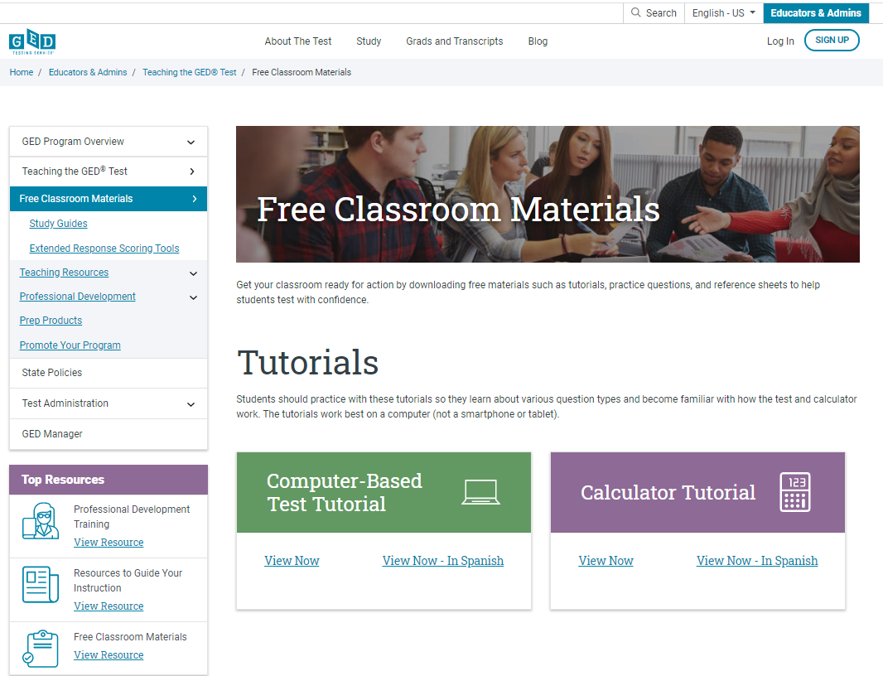

Slide 88


Slide 89
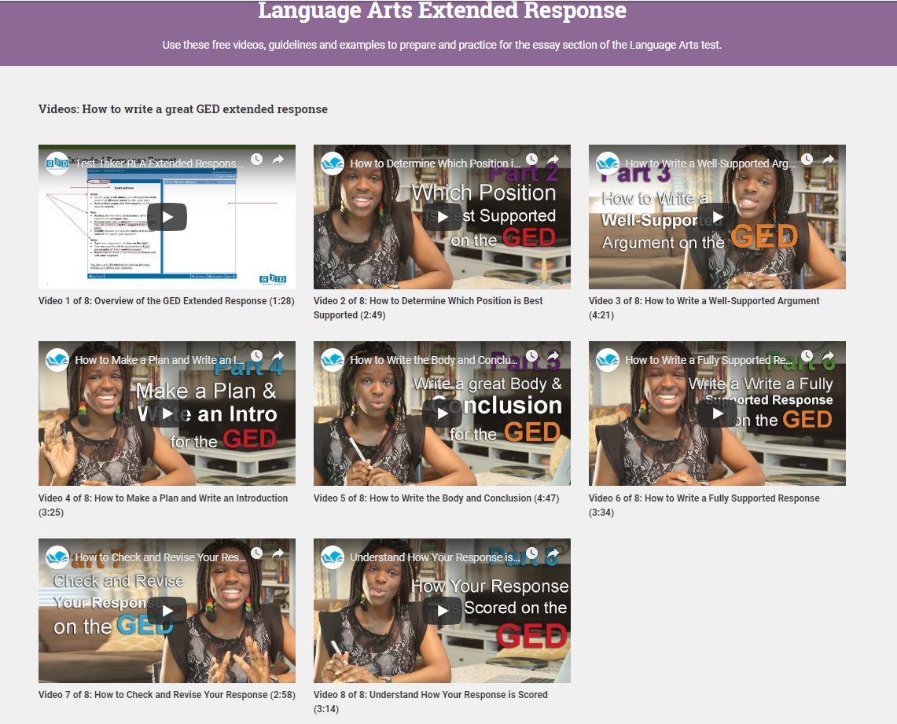
Access Extended Response Video Series
https://ged.com/about_test/test_subjects/language_arts/extended_response/
Notes:
Key Points
Don’t forget that there are also numerous resources on the GED Testing Service website. Webinars in May and June 2016 provide a step-by-step resource on how to teach constructed responses. Videos can be accessed from YouTube or the GED Testing Service website. There are also all of the guides for extended responses and tutorials. Just go to: https://ged.com/educators_admins/program/

Slide 90
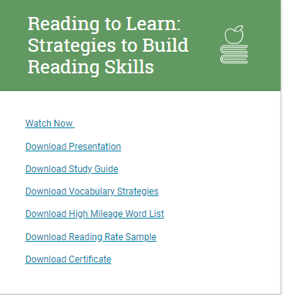
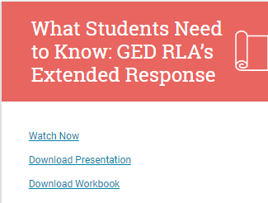
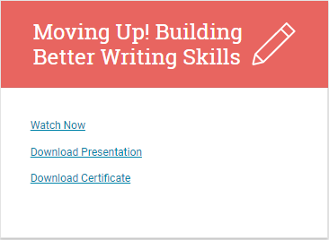
Tuesdays for Teachers’ Webinars

Slide 91

Q & A

Slide 92

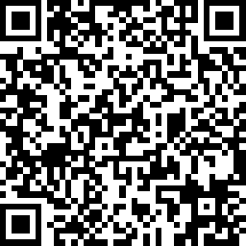
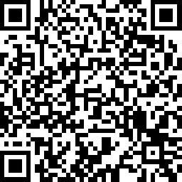
Session Survey
Your feedback is important. Please scan the QR code below to rate this session.
Part 1
Part 2

