Slide 1
Welcome to GED®
Mellissa Hultstrand & Elizabeth Lanphear
GED® and GED Testing Service® are registered trademarks of the American Council on Education (“ACE”). They may not be used or reproduced without the express written permission of ACE or GED Testing Service LLC. The GED® and GED Testing Service® brands are administered by GED Testing Service LLC under license from ACE.

Slide 2
An Overview of the GED® Test
Getting Started

Slide 3
The GED® Test
Available in English and Spanish
A wide array of accommodations are available:
Including extended time, additional breaks, reader/recorder, private room, screen reader (JAWS) and many more
Visit GEDTS Accommodations Information Page
Notes:
Available in English and Spanish
A wide array of accommodations available
Including zoom-text, alternate color palettes, Braille, screen reader, extended time, paper testing for special circumstances

Slide 4
GED® Test
Test | Time | Notes
Reasoning through Language Arts | 150 minutes | Three Parts and Part 3 includes 45 minutes for the extended response (timed separately)
Mathematical Reasoning | 115 minutes | Part 1 – calculator not allowed; Part 2 – calculator allowed
Social Studies | 70 minutes
Science | 90 minutes
Notes:
The chart provides an overview of the time for each of the tests, as well as pertinent notes.

Slide 5
Variety of Item Types
Multiple-choice
Fill-in-the-blank
Drag-and-drop
Hot-spot
Drop-down
Extended-response (Language Arts)
Notes:
The new GED test includes a wider variety of item types than were on the 2002 Series test. Multiple choice items continue to appear on the test as one of the key item types. Multiple choice items are a reliable method of measuring skills and knowledge at a range of cognitive levels in a standardized manner. But remember that the additional item types allow us to measure a wider range of skills and cognitive levels.
Constructed response items come in two versions – one, we call short answer, and that type can usually be answered in a few sentences (e.g. Science), and the extended response, which requires a longer response – multiple paragraphs (e.g. Reasoning Through Language Arts)

Slide 6

Overview of RLA Test
Content - Integrated reading and writing
Close reading
Clear writing
Editing and understanding the use of standard written English in context
Source texts – 75% nonfiction; 25% fiction
Passage length – 400-900 words
Range of text complexity, including texts at the college- and career-ready level
Technology-enhanced items and extended response
Notes:
Key Points
This slide provides a short overview of the content and context of the RLA Test. Review the information on the slide. For additional information, access the Assessment Guide for Educators Reasoning through Language Arts section.

Slide 7
Extended Response on RLA
A constructed response item includes:
One or more source texts
Texts offer two positions on a given topic
A prompt that provides instruction on what the student is expected to do

Slide 8
Purpose of Extended Response
To provide students with an opportunity to demonstrate
Knowledge of writing conventions in English
Understanding of what they’ve read
How well they use evidence to build arguments
Their ability to clearly communicate their thinking in their own words

Slide 9
Don’t Forget the Little Stuff
Expose students to a structured approach to the writing task and help them understand that they need to:
Write a complete response, not just a short paragraph (300-500 words)
Provide commentary on the evidence cited (explain the “why”)
Fully develop two or three ideas, rather than mention a lot of things without detail
Leave five minutes at the end for proofreading—that is one of the things evaluated
Notes:
Key Points
[Review the bullets on the slides.]
Discuss that these are ideas on how to improve scores. Also, note that the length is not about counting words, but rather is indicates that the writing sample needs to be long enough to adequately address the prompt. A short paragraph is not enough.

Slide 10
Some Things to Keep in Mind
Heavy emphasis on reasoning (argumentation, evidence, close analysis of textual details)
The RLA Test includes literary and informative texts:
1/3 Literary (fiction, memoirs, excerpts)
2/3 Informative (articles, blog posts, newspaper op-ed columns, any kind of real world persuasive text)
Each test has a set of items. Two main item types
Multiple Choice
Drag and Drop
All RLA Reading items are text-based
Notes:
Key Points
[Review the bullets on the slides.]
Discuss that these are ideas on how to improve scores. Also, note that the length is not about counting words, but rather is indicates that the writing sample needs to be long enough to adequately address the prompt. A short paragraph is not enough.

Slide 11
Why Should Time be Spent on the Essay
The ability to write is one of the critical differentiators of long-term success.
Writing skills help develop thinking skills that impact performance on the entire test.
Any score point earned counts towards the overall score
Notes:
Key Points
[Review the bullets on the slides.]
Discuss that these are ideas on how to improve scores. Also, note that the length is not about counting words, but rather is indicates that the writing sample needs to be long enough to adequately address the prompt. A short paragraph is not enough.

Slide 12

Overview of Mathematical Reasoning Test
Content
45% - Quantitative Problem Solving
Number operations
Geometric thinking
55% - Algebraic Problem Solving
Texas Instruments - TI 30XS Multiview™ (calculator allowed on most items)
Integration of mathematical practices
Formula page, symbols, and calculator page provided
Notes:
Key Points
This slide provides a short overview of the content and context of the Mathematical Reasoning Test. Review the information on the slide. For additional information, access the Assessment Guide for Educators Mathematical Reasoning section.

Slide 13

Overview of Social Studies Test
Content
50% - Civics and Government
20% - United States History
15% - Economics
15% - Geography and the World
Themes
Development of Modern Liberties and Democracy
Dynamic Responses in Societal Systems
Social Studies Practices – analyzing, thinking, reasoning
Technology-enhanced question items
Notes:
Key Points
This slide provides a short overview of the content and context of the Social Studies Test. Review the information on the slide. For additional information, access the Assessment Guide for Educators Social Studies section.

Slide 14

Overview of Science Test
Content
Life Science – 40%
Physical Science – 40%
Earth and Space Science – 20% Themes
Themes
Human Health and Living Systems
Energy and Related Systems
Science Practices – reasoning and thinking scientifically
Question types - Technology-enhanced items
Notes:
Key Points
This slide provides a short overview of the content and context of the Science Test. Review the information on the slide. For additional information, access the Assessment Guide for Educators Science section.

Slide 15
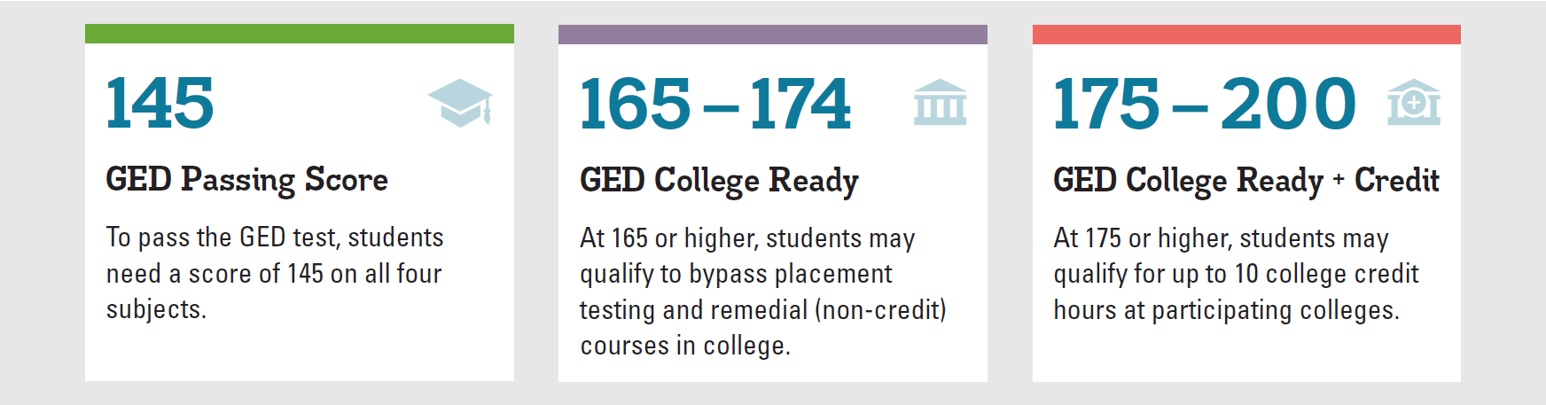
GED Score Levels Explained
GED College Ready scores improve the chances for college success.
Learn more at GED.com/collegeready
Notes:
A 145 or better in each subject will lead to a credential. However, I’ve highlighted the upper score “benchmarks” to acknowledge the opportunity for testers to either enter credit bearing course work, bypassing additional placement tests where approved (165+), OR to earn college credit, similar to AP exams for scores at or above 175, where approved.

Slide 16

Many colleges have already adopted the ACE® Credit Recommendations
Approximately 250 colleges across the U.S. have implemented one, or both, of the recommendations (CR and/or CR+credit)
Colorado Community College System (both recommendations)
Connecticut Public College System
Georgia Technical College System
Illinois Community College System
Kansas Board of Regents (2 & 4-year colleges)
Kentucky Community and Technical College System
Ohio Community College System
Virginia Community College System
Texas Higher Education Coordinating Board
Additional Colleges in AL, AZ, KS, MA, MO, NJ, OR, RI, WA

Slide 17


Slide 18
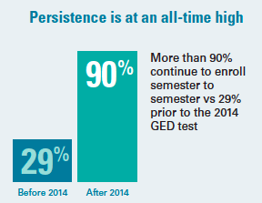
Persistence!
Congrats, all your hard work is paying off!
This number currently surpasses overall community college persistence rates

Slide 19
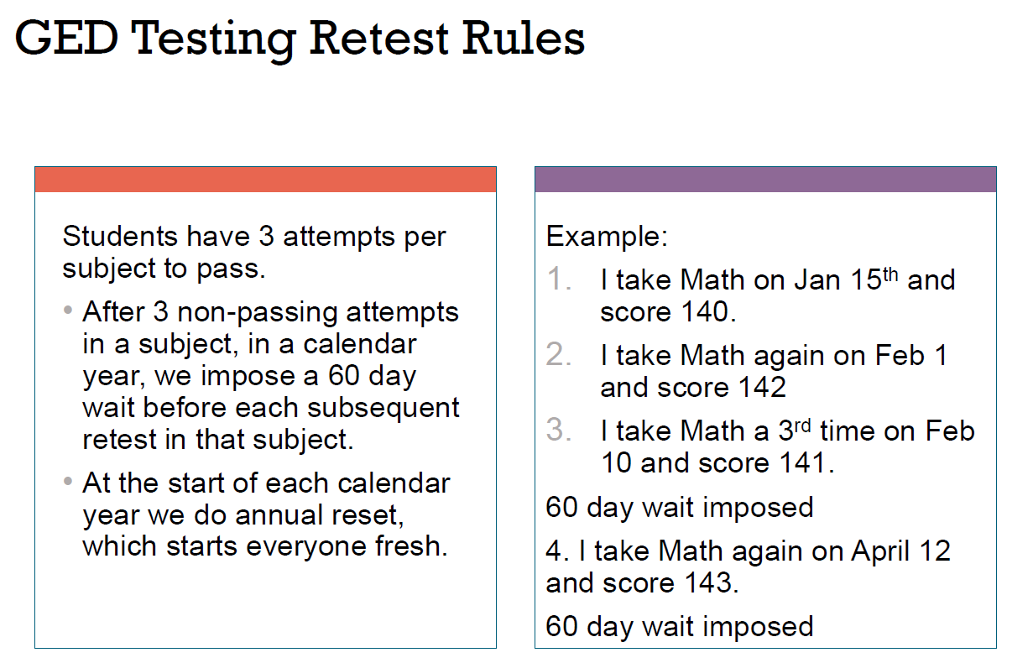

Slide 20
GED Ready® & Score Reports
What are they and how can they help our Testers and Teachers?

Slide 21
GED Ready® - Assessing Readiness
Three Score Level Indicators on GED Ready®
GED Score Report:
GED Ready®
GED Exam
Not Likely to Pass | Too Close to Call | Likely to Pass
100-133 | 134-144 | 145-200

Slide 22
GED Ready®
Realistic practice opportunity | Computer based and same platform as GED® test
Standardized and normed | Same norming and standardization study as official test
Predictive | Tells students if they are likely to pass
Half-length | 4.25 hours in length
Notes:
Key Points
The GED Ready® practice test has the same look and feel as the official GED® test, and gives students firsthand experience answering computer-based test questions written and developed by the test’s creators. The score report tells students if they are likely to pass or if it’s too close to call and they should keep studying. The test is half-length and takes approximately 4.25 hours. And just like the official test, GED Ready ® can be taken separately by content areas (RLA, Mathematical Reasoning, Social Studies, and Science).

Slide 23
A “Peek” at Score Reports
GED Manager™ provides access to student score reports for both GED Ready® and GED® operational (“live”) subtests
There are several ways to access student scores to determine outcomes and to review score reports to help students improve their scores. A “peek” at the student score report follows…

Slide 24
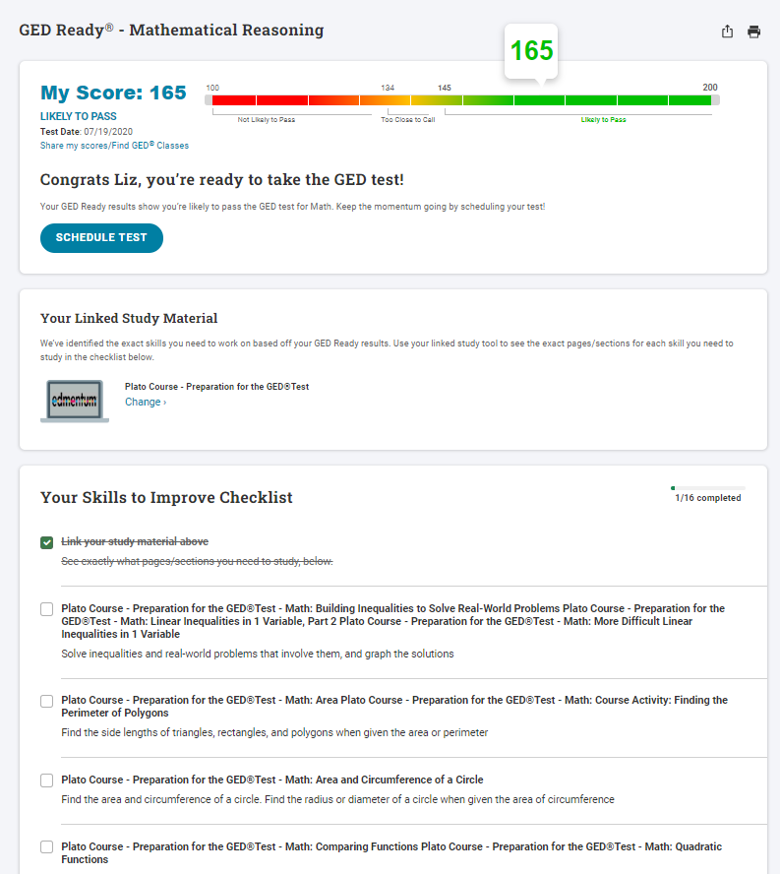
Individualized Study Guides
Creating a customized study guide allows students to know exactly what to study. They feel like they are not “wasting time”. This accelerates the process and helps them stay engaged.
You’ll see references to scoring a GED Ready Red, Yellow, Green. It’s referring to this scale here

Slide 25
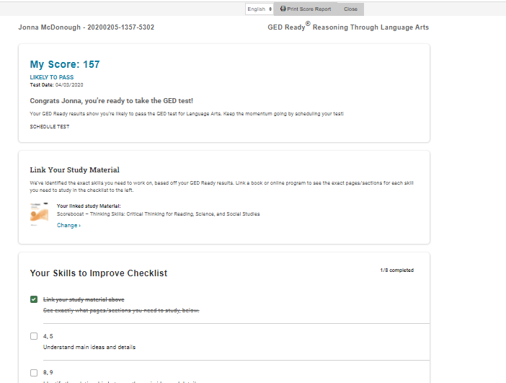
Student Score
Select Student Curriculum
Review Checklist of lessons in Student Curriculum for further study/remediation

Slide 26

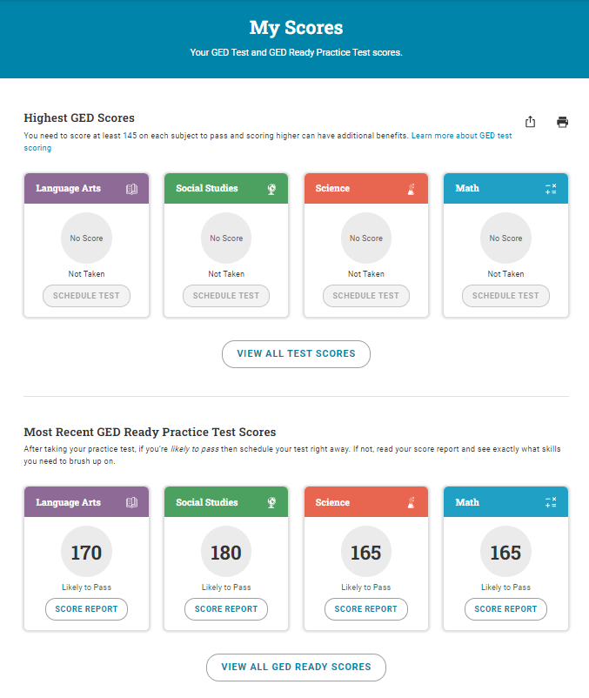
Score Reports
Click on
Score Report

Slide 27
Student Accounts
What do the Students see when they log into their GED account?

Slide 28

Creating a Test Taker account
Go to www.GED.com
Click on “Sign Up” to create a test taker account
Click on “Log In” to log into a test taker account
We would like you to create a “fictitious” student account and take at least one GED Ready test. You should have received instructions and Voucher codes

Slide 29

The account set up process points them to Adult Education

Slide 30
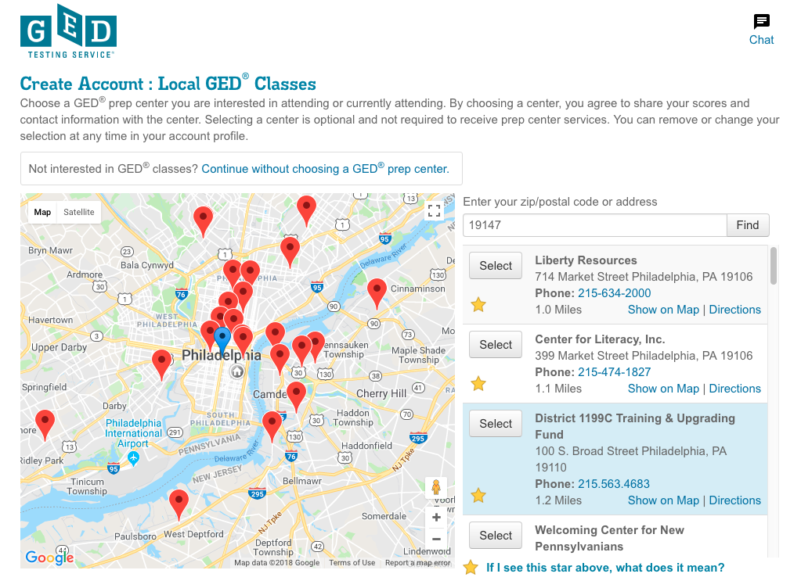
If yes, Student is routed to GED® Test Prep Center Selection page

Slide 31
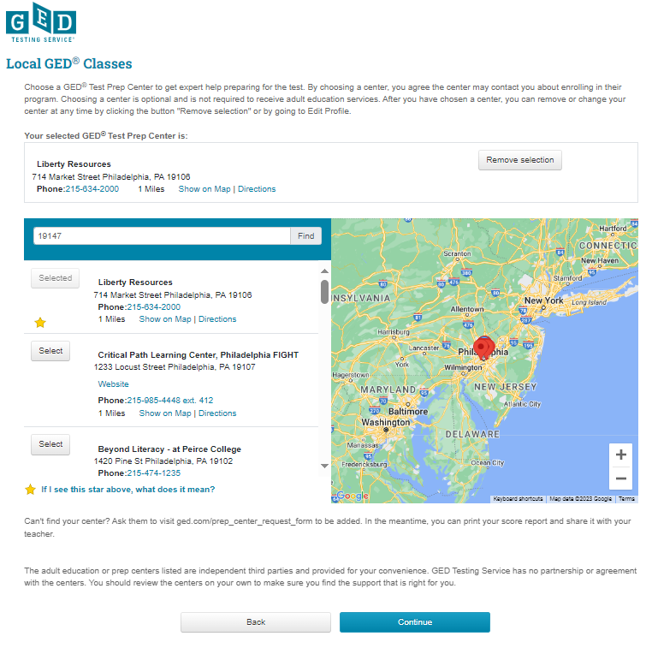

Slide 32
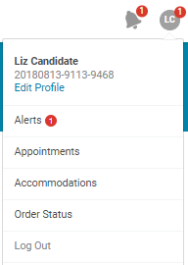
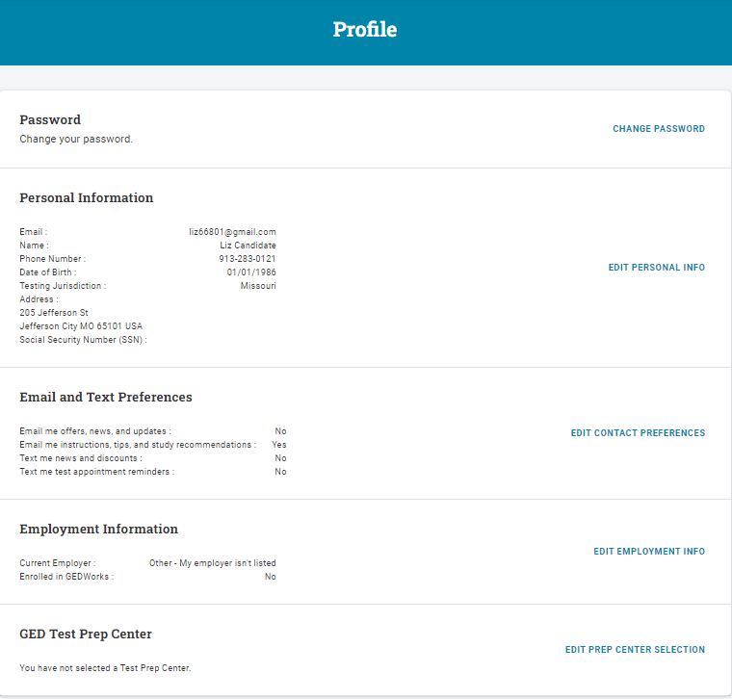
If Test Taker didn’t add you at account creation, have them edit their profile in their account

Slide 33

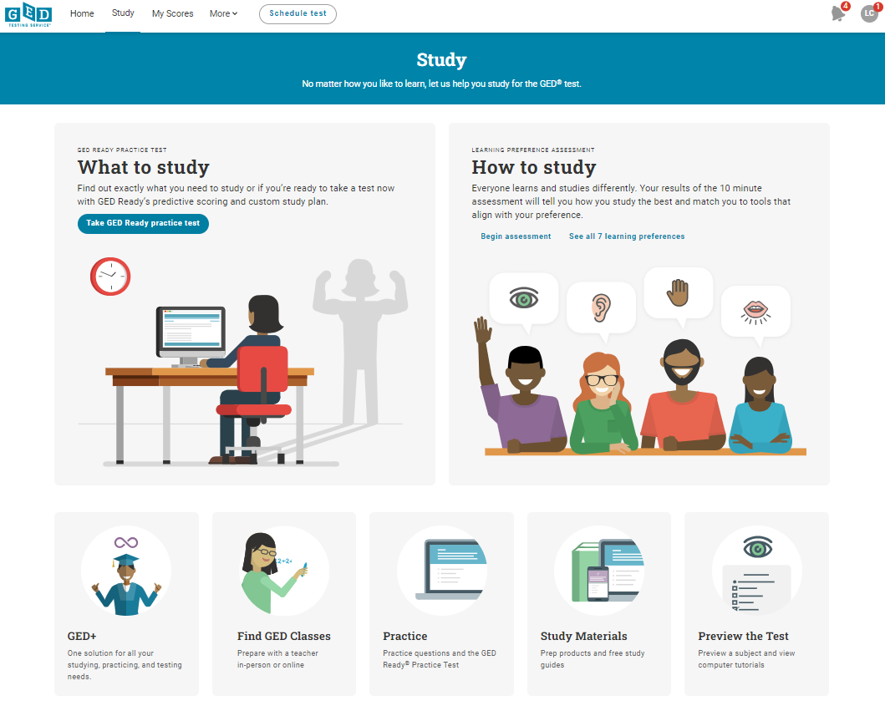
Student accounts have lots of resources

Slide 34
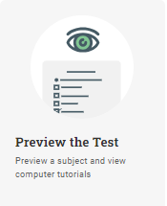
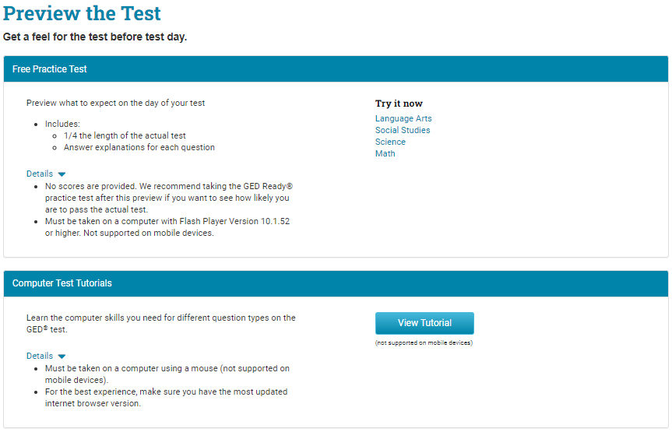
Preview the test

Slide 35
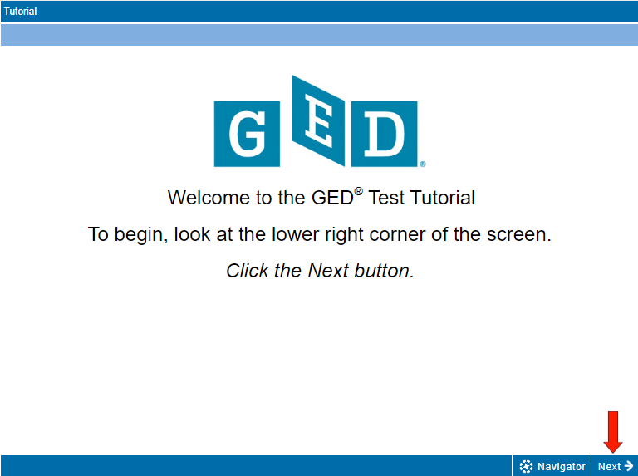
Test Demonstrator
https://ged.com/practice-test/en/computer-demonstrator

Slide 36
How to Schedule a Test

Slide 37
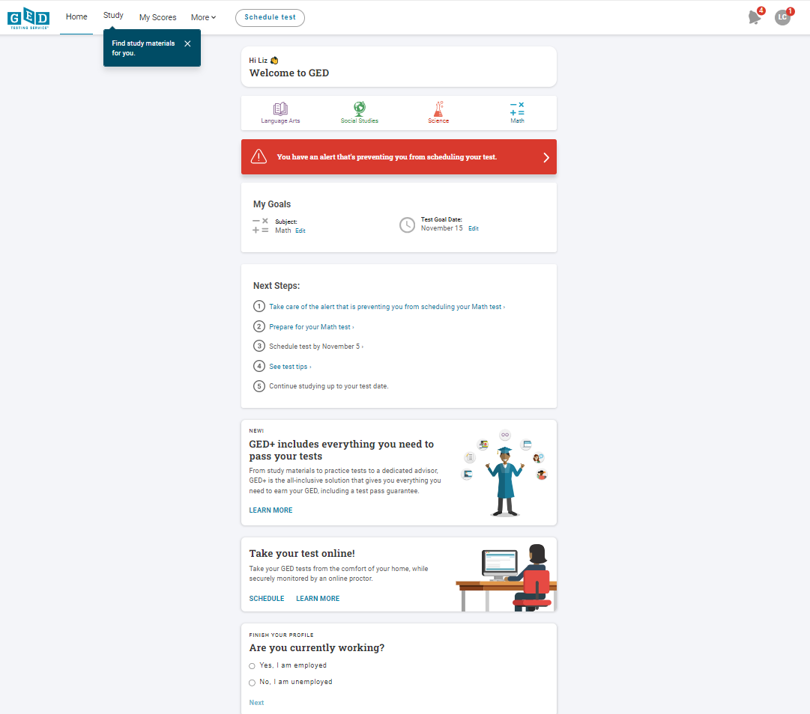
Alerts Must Be Taken Care of Before Scheduling
Manage any alerts, Age, pay Jurisdiction fee…

Slide 38
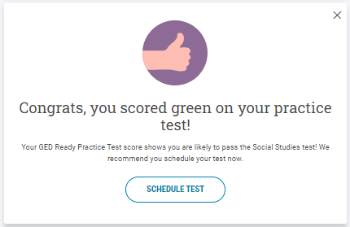
Schedule a test from the test taker’s Home Page
Home menu
OR
Banners on the home page

Slide 39
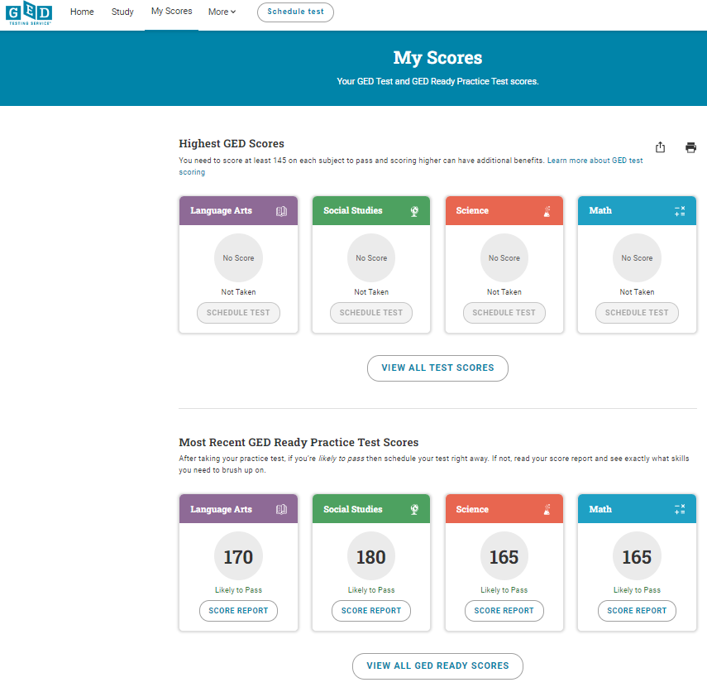
Schedule a test – from the My Scores page

Slide 40
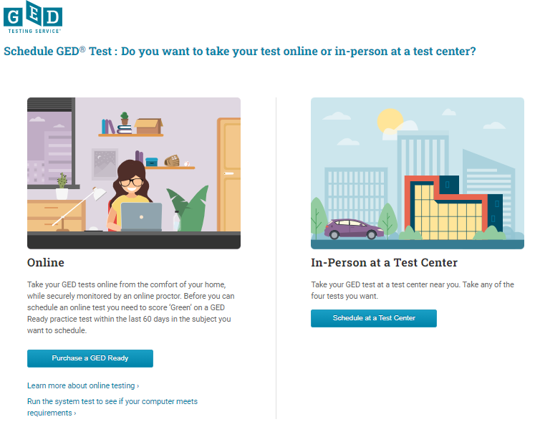
Next step:
To schedule the online proctored test, you must have a GED Ready in the green zone (145 or higher), within 60 days

Slide 41
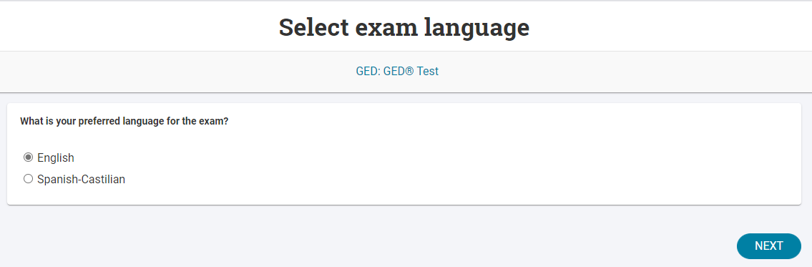
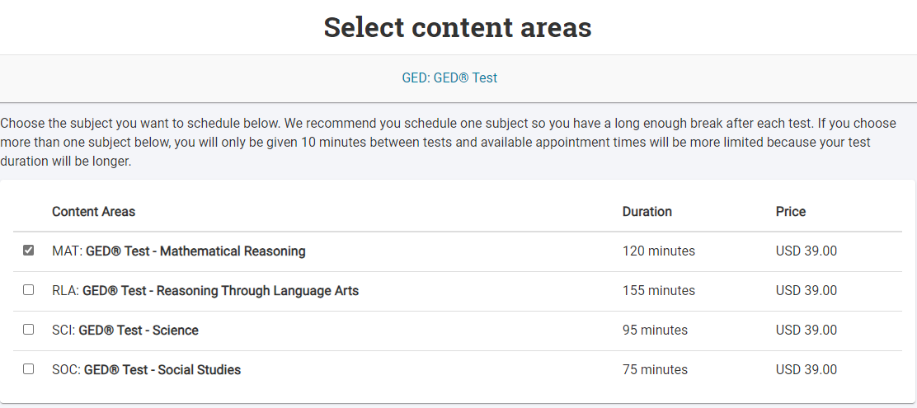

Next Step:
33.00
33.00
33.00
33.00
Agree to GED Testing Service policies

Slide 42
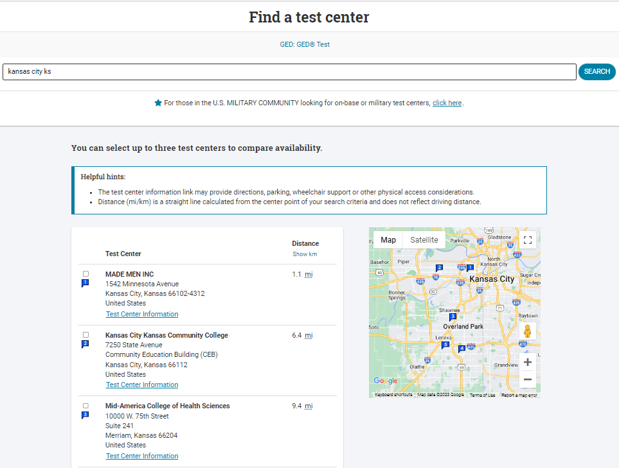

Slide 43
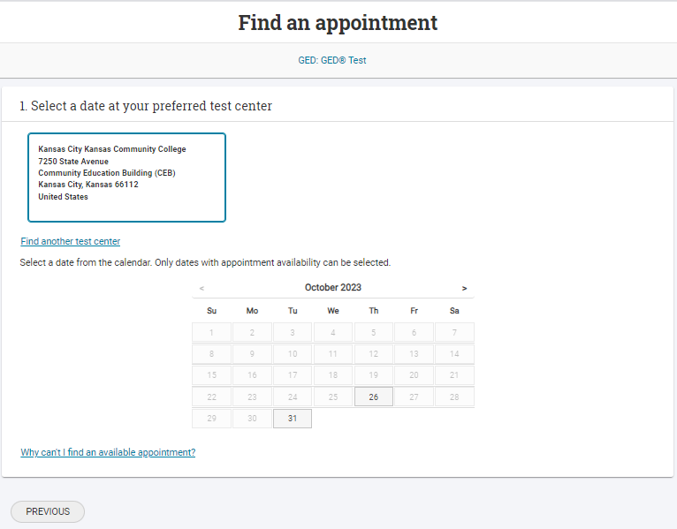

Slide 44
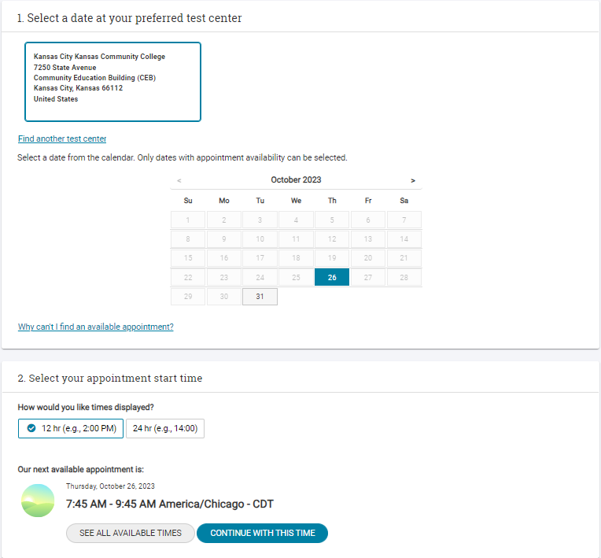

Slide 45
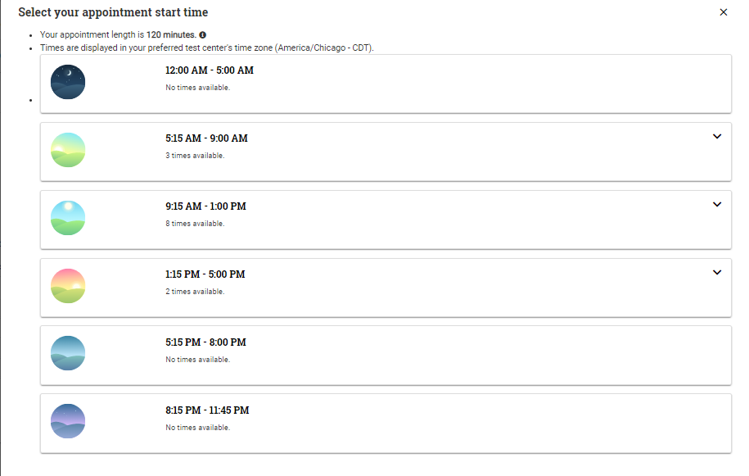
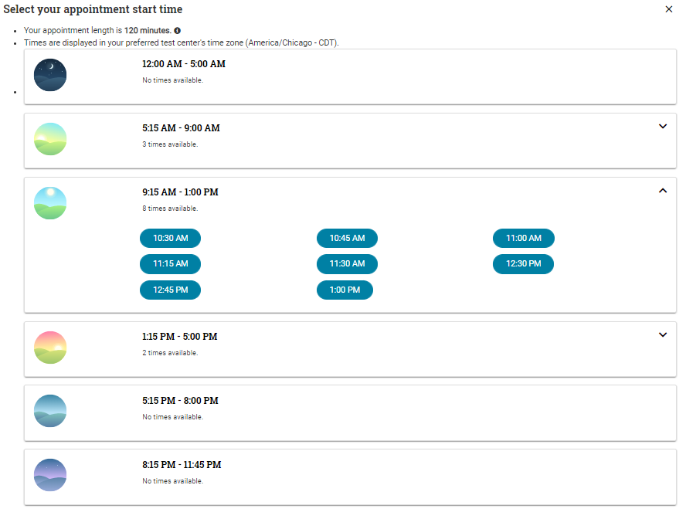
Select a time

Slide 46
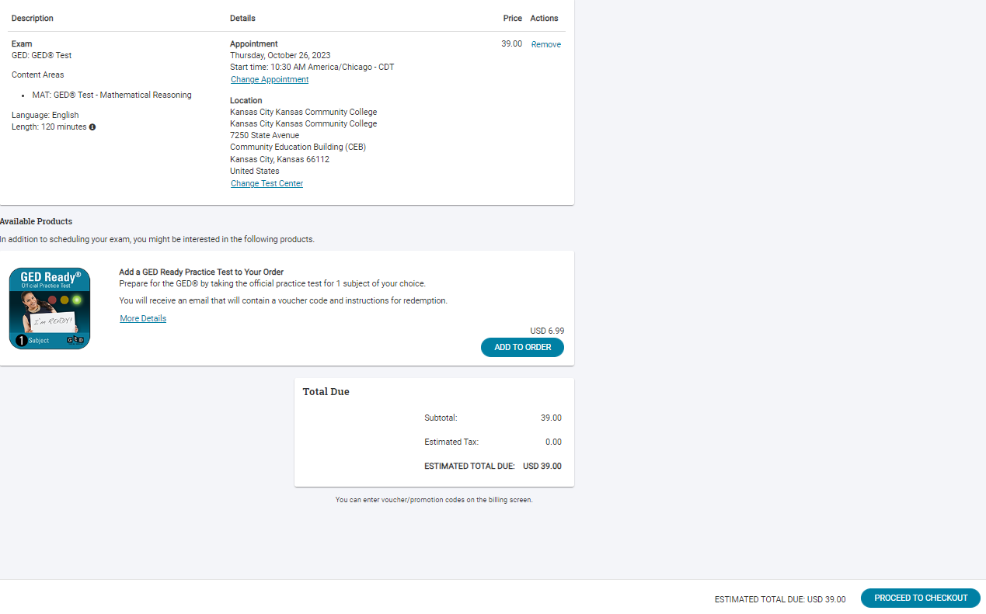
Schedule a test
Ignore pricing –
I had to use KS to get screenshots

Slide 47
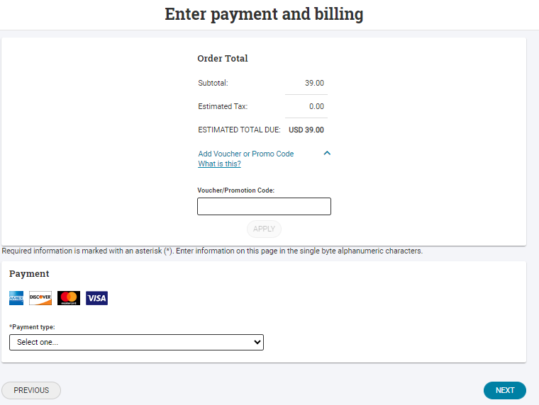
Schedule a test
Ignore pricing –
I had to use KS to get screenshots

Slide 48
For Your Students Testing Online (OP):
Testing at home, with our Online Proctored (OP) testing platform:
Different rules regarding calculators, scratch pads, and retakes
Students should prepare for OP testing when they know this is their preferred testing experience.
For more details:
https://ged.com/take-the-ged-test-online/

Slide 49
Some Additional Resources for Students

Slide 50



GED & Me™, is now in the Apple App Store for download!
Our official app

Slide 51

GED.com update – “Additional Resources” https://www.ged.com/additional-resources/

Slide 52

GED.com update – “Additional Resources” https://www.ged.com/additional-resources/

Slide 53
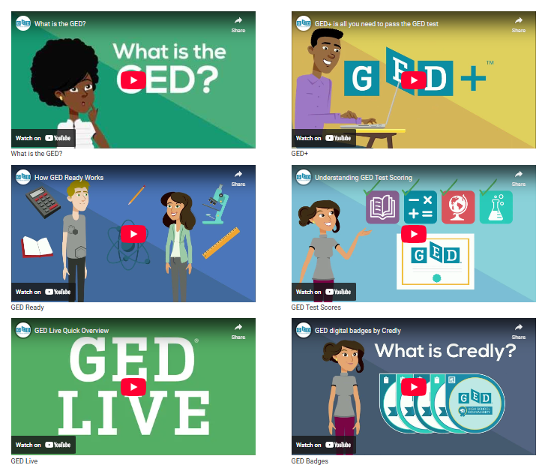
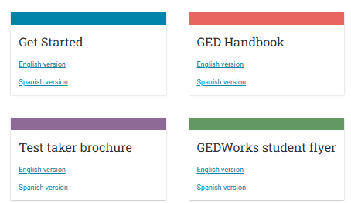
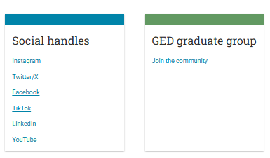
GED.com update – “Additional Resources” https://www.ged.com/additional-resources/

Slide 54

GED Blog: https://www.ged.com/blog/

Slide 55

GED Student Roundup: Updates, promos and more!

Slide 56

GED Student Roundup: Updates, promos and more!

Slide 57
Important Resources for the Educators
Located within the Educator Portal and they are FREE!!!

Slide 58


Go to GED.com

Slide 59

Updated Educator Portal

Slide 60
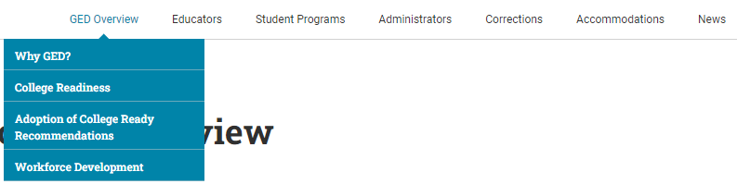
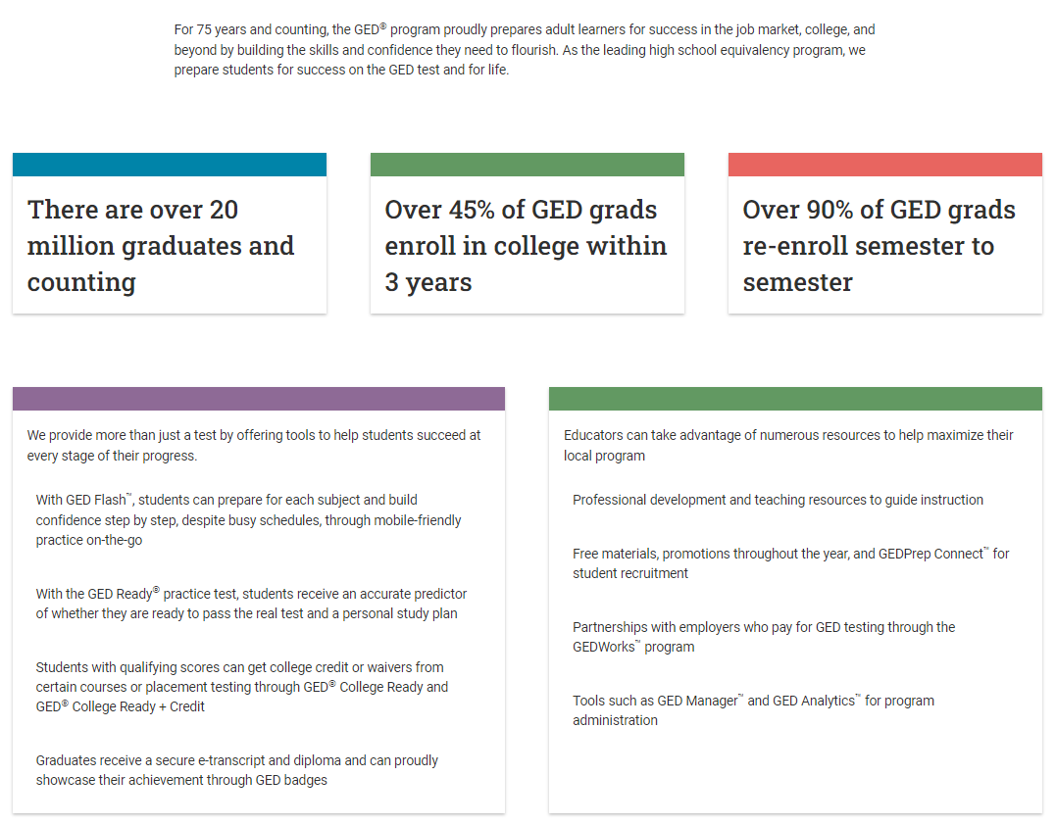
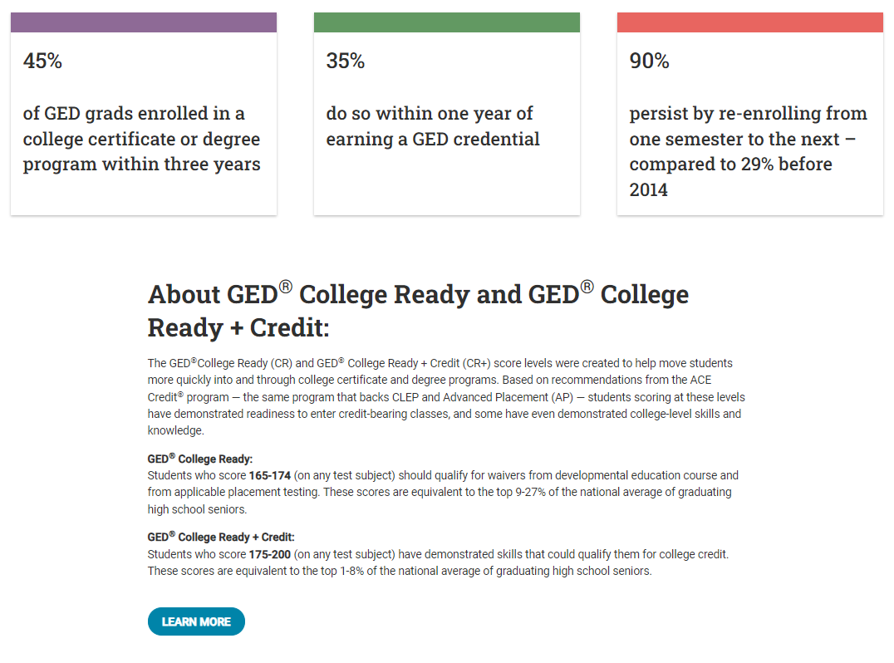
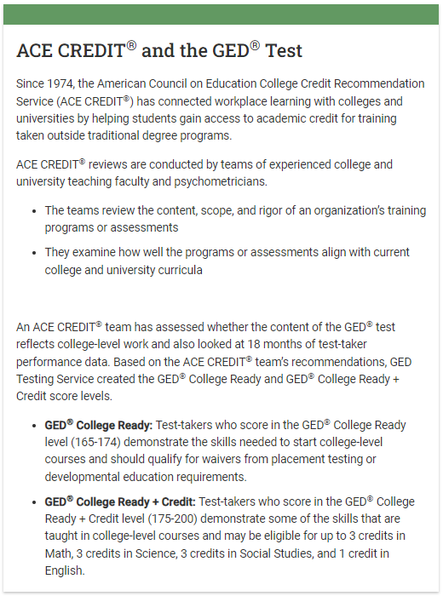
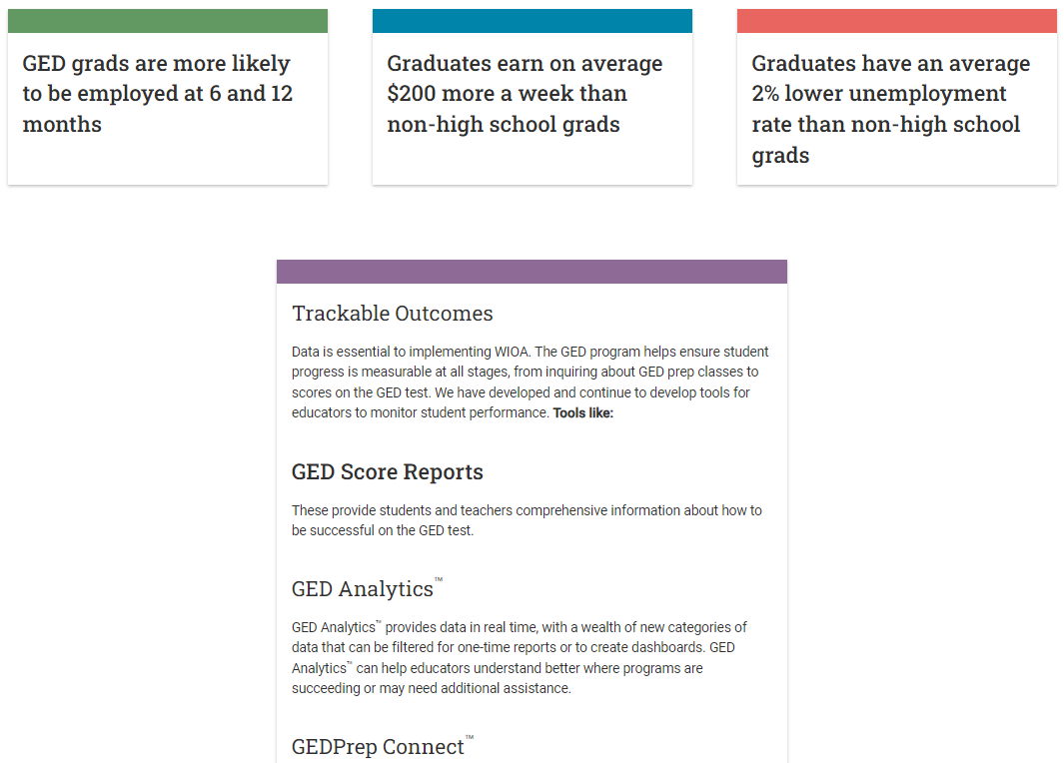
GED Overview

Slide 61

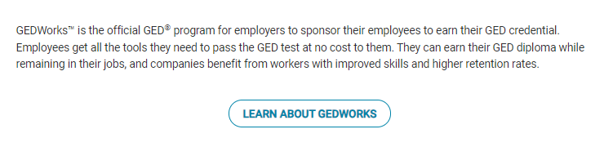


Student Programs

Slide 62
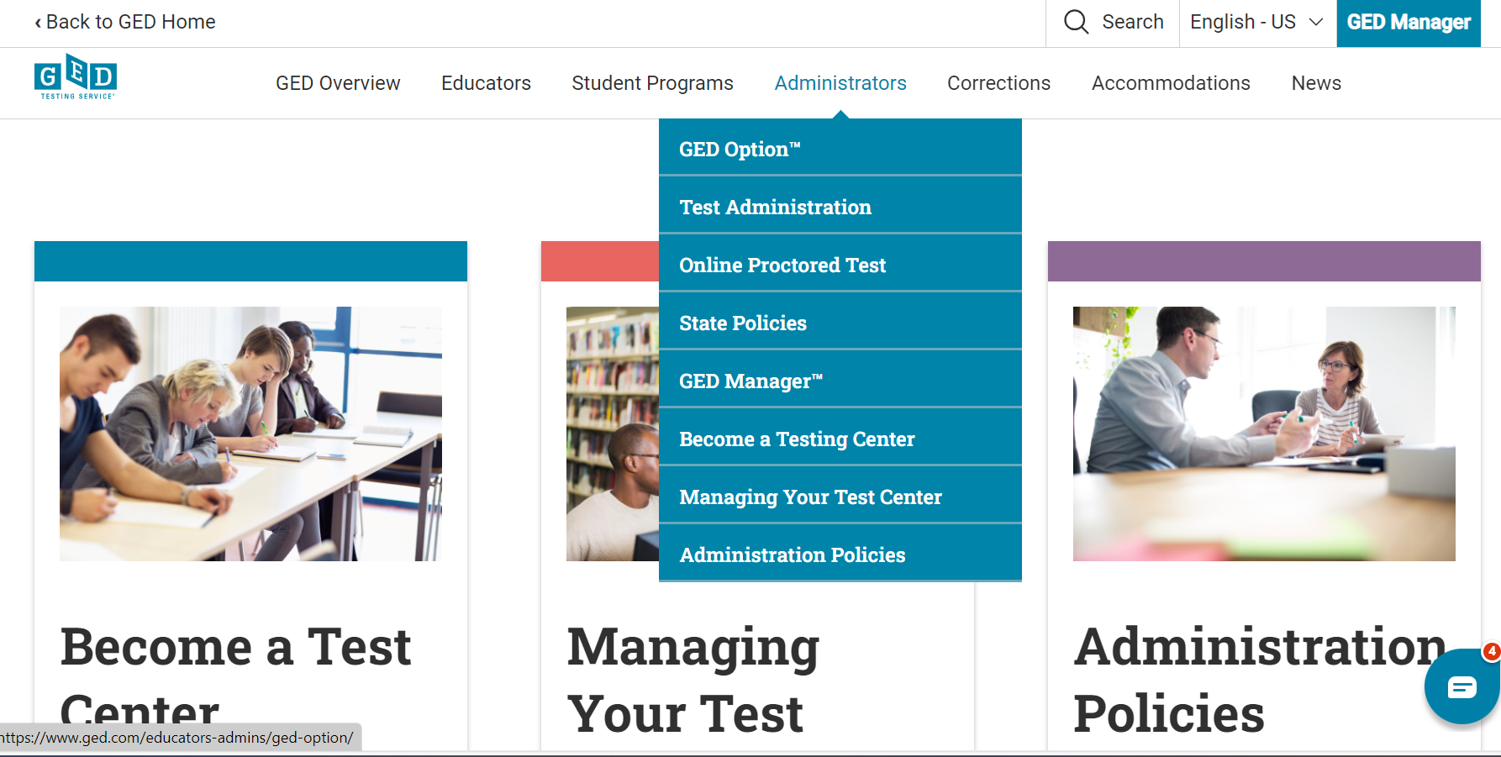
Updated Administrators section

Slide 63
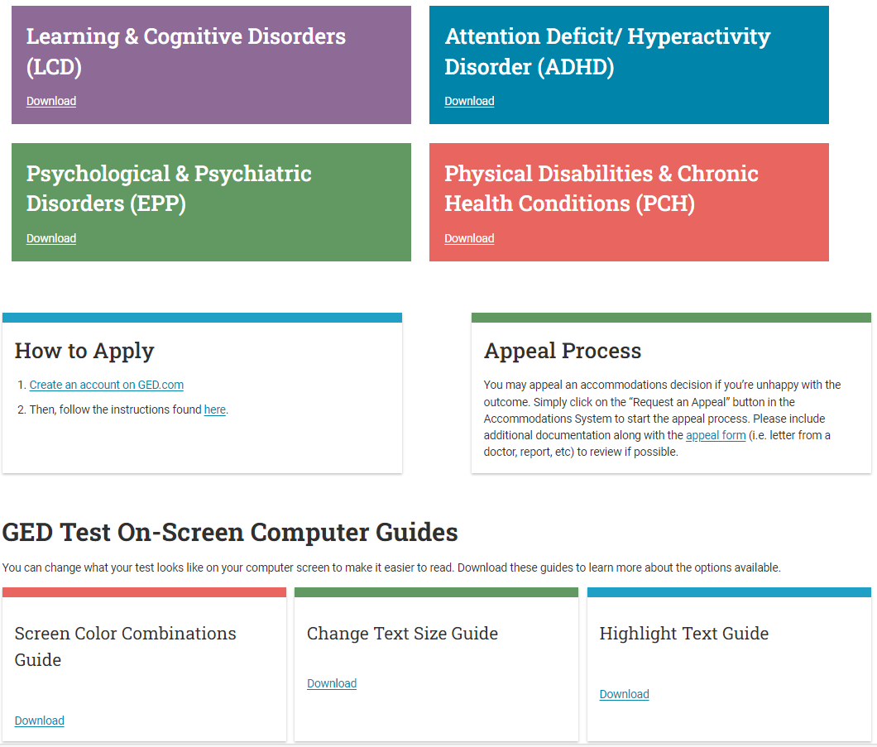
Accommodations

Slide 64

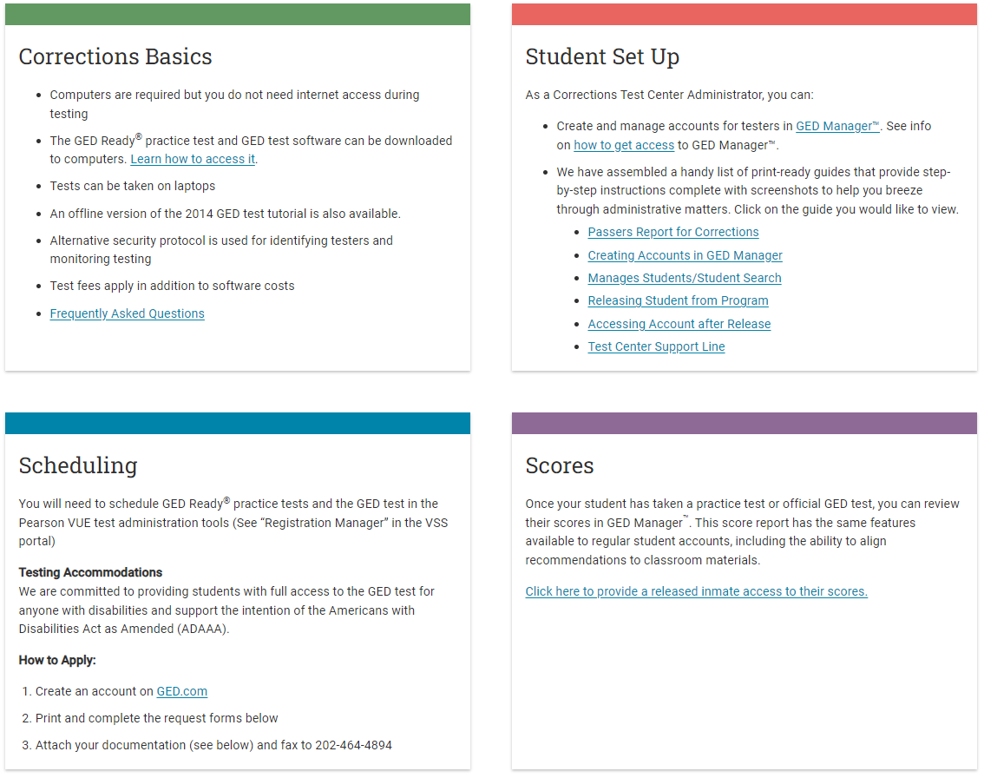
Corrections

Slide 65



Slide 66

Educators

Slide 67

Practice Test and Study Guides

Slide 68
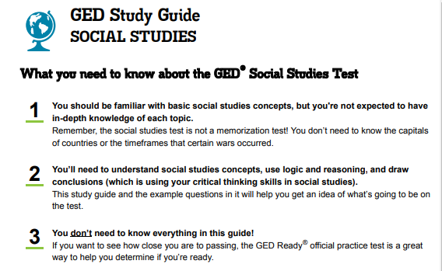
Educators – Study Guides https://www.ged.com/educators-admins/teaching/classroom_materials/study_guides/

Slide 69
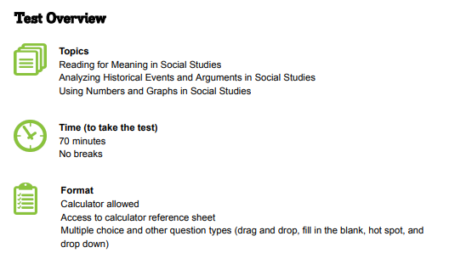
Educators – Study Guides https://www.ged.com/educators-admins/teaching/classroom_materials/study_guides/

Slide 70
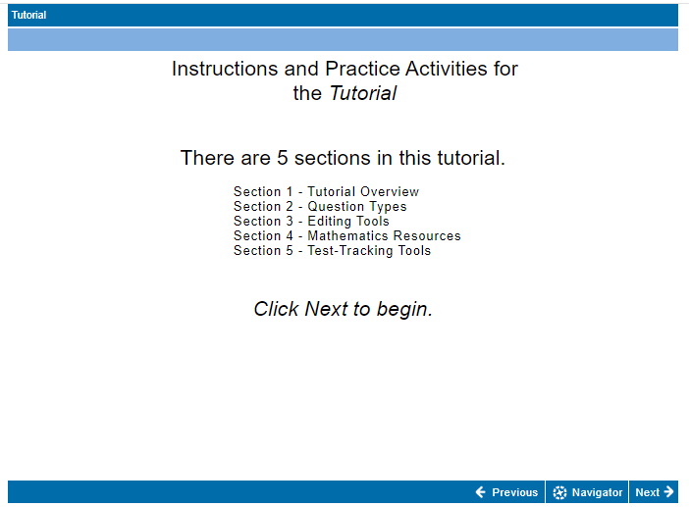
Educators – Calculator Tutorial https://www.ged.com/practice-test/en/computer-demonstrator/

Slide 71
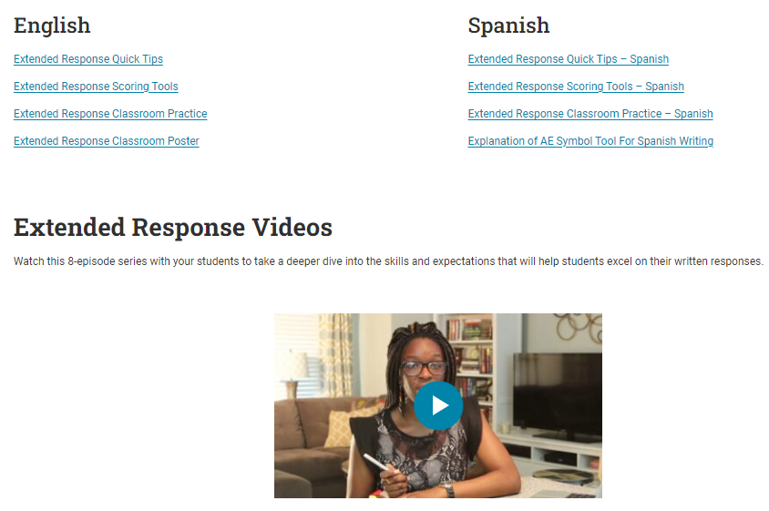
Educators – Extended Response Tools and Practice https://www.ged.com/educators-admins/teaching/classroom_materials/

Slide 72
Where to find the videos
Available on GED.com in each student’s account under the “Study” tab
Available for educators here: https://ged.com/about_test/test_subjects/language_arts/extended_response/
Available at: www.newreaderspress.com/writing-for-the-ged-test
Or contact New Readers Press for DVDs that can be sent to your facility:
tlipke@proliteracy.org
Videos are FREE

Slide 73
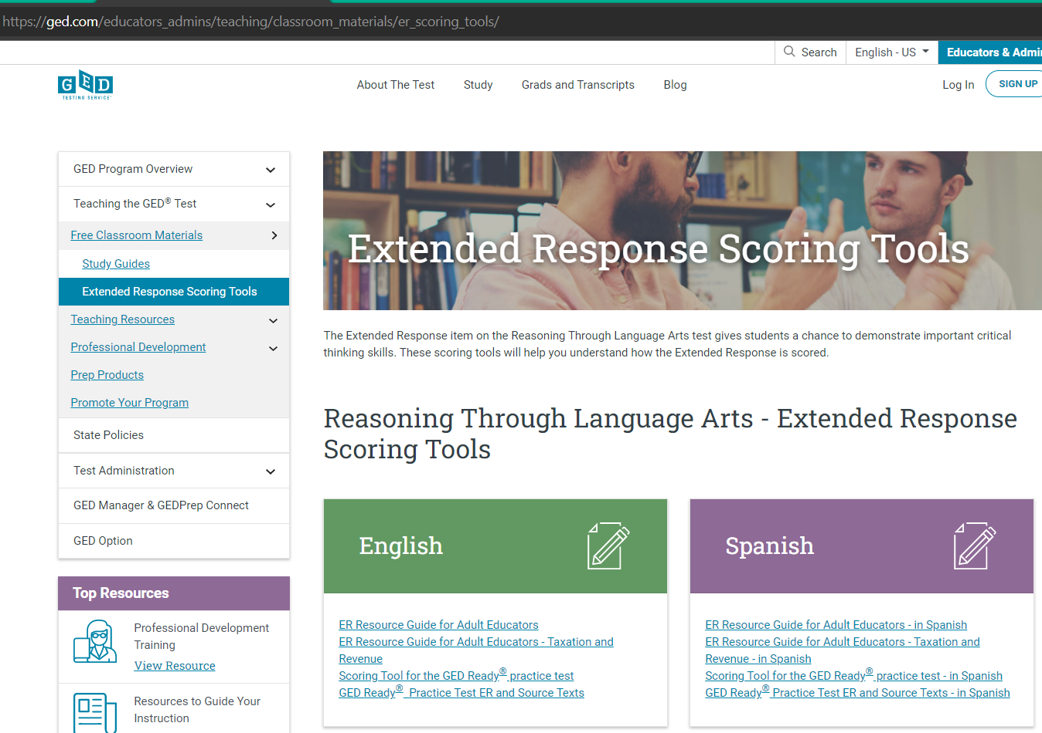
Scoring the Extended Response

Slide 74
GED Ready® RLA Extended Response Scoring tool
Educators score the Extended Response (ER) on the GED Ready Reasoning Through Language Arts (RLA) exam – it is intended to be an instructional tool to provide feedback to improve test taker outcomes
Scoring tool is available in English and Spanish
The tool guides Educators to assess student performance across all three traits
More information on the ER traits assessed found in Chapter 3 of the Assessment Guide for Educators

Slide 75
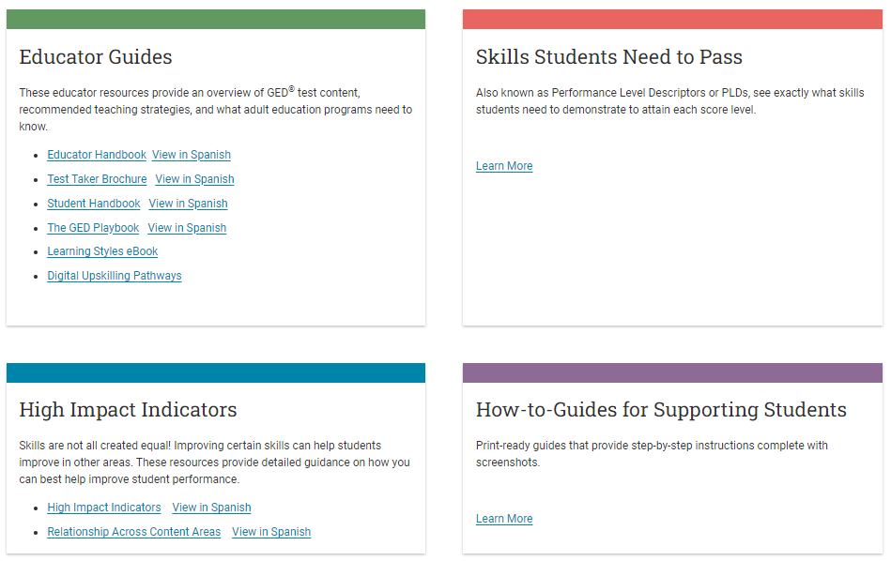
Educators – Teaching Resources https://www.ged.com/educators-admins/teaching/teaching_resources/

Slide 76
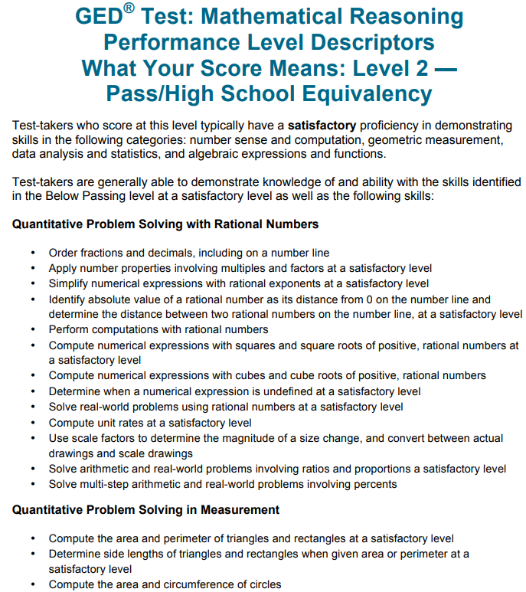
Performance Level Descriptors

Slide 77
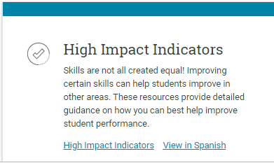
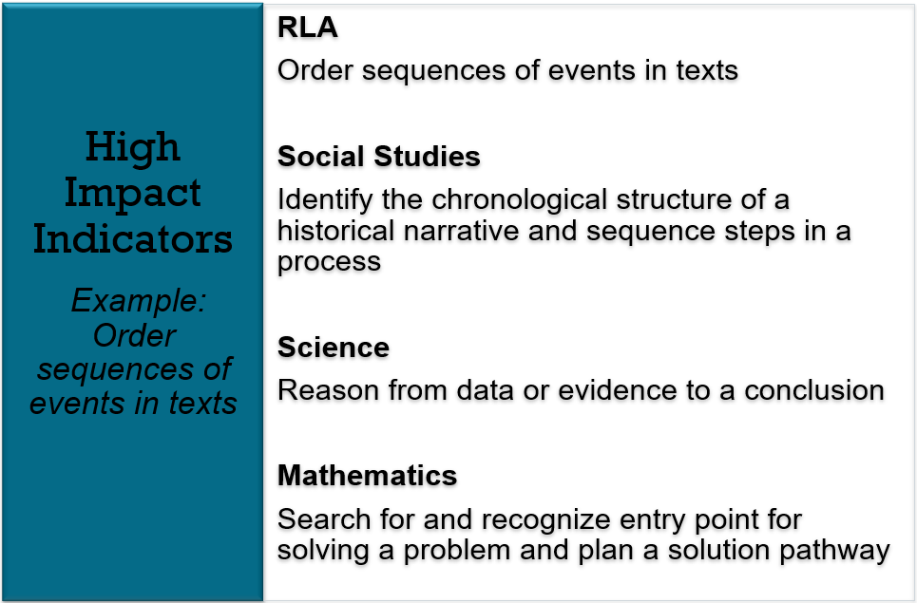
High Impact Indicators
Not all skills are created equal!
Improving certain skills can help students improve in other areas. These resources provide detailed guidance on how you can best help improve student performance.

Slide 78

Assessment Guide for Educators
The Complete Assessment Guide is 230 pages
It’s also broken down into each subject (40-60+ pages each)

Slide 79
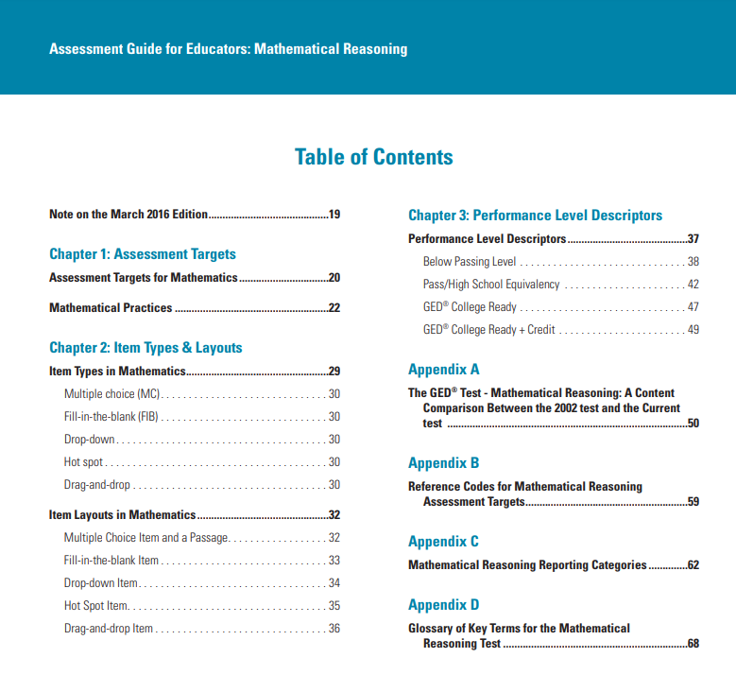
Assessment Guides for each subject

Slide 80

Educator Handbook
Educator Handbook

Slide 81


Additional Resources
GED Playbook
Student Handbook
Notes:
Key points:
The GED Playbook (launched at the 2022 GED Conference):
The GED Playbook is for those who oversee and manage the GED adult education program, as well as instructors. It is a good starting point to assist in navigating and understanding the GED program.
GED Student Handbook (launched at the 2023 GED Conference):
The Student Handbook serves potential adult education program students, self-paced learners, and advocates of students navigating their GED journey. Within this document you will find many helpful resources and tips.

Slide 82


Slide 83
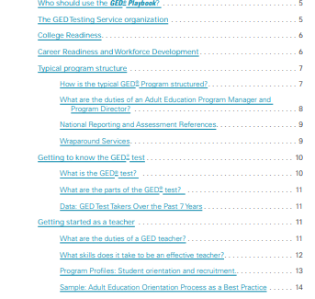

Educators – Educator Guides https://www.ged.com/educators-admins/teaching/teaching_resources/

Slide 84


Slide 85


Slide 86


Slide 87


Educator – Adult Education Program Toolkit https://www.ged.com/educators-admins/teaching/promote_your_program/

Slide 88

Educator – GED Manager™ & GEDPrep Connect™ https://www.ged.com/educators-admins/test_admin/ged_manager/

Slide 89

Educators – Professional Development https://www.ged.com/educators-admins/teaching/professional_development/
Notes:
Please note that this screenshot was taken before this recording and resources were added to the page.

Slide 90

Educators – Professional Development
Recorded presentation
Slideshow document
Resources – including strategies & classroom activities
More . . .
Notes:
Key Points
Review information on the slide regarding the resource (where it is located and what is included). Make sure to discuss that archived webinars provide:
A recorded presentation of the live webinar
A copy of the slides provided to participants
Resources – a guide that you can download and print that includes instructional strategies and classroom activities. Some of the guides also provide you with sample lesson plans and a list of great websites to visit for more ideas and information.
Dependent on the webinar, additional materials may also be linked to the webinar.
Tuesdays for Teachers Archived Webinars are located at: https://ged.com/wp-content/uploads/relationships_between_HII_and_other_indicators.pdf

Slide 91


Educators – Professional Development

Slide 92

Educators – Professional Development

Slide 93

Tuesdays for Teachers on YouTube
On YouTube, search for “GED Testing Service Tuesdays for Teachers”

Slide 94


Slide 95


In Session Educator Newsletter

Slide 96

In Session Educator Newsletter Stay up-to-date by subscribing
At the bottom of each of the pages is an opportunity to sign up for the
In Session Educator Newsletter – please take the opportunity to sign up and stay informed on the latest news, resources, pricing specials, etc.
Notes:
It only requires your email address

Slide 97
Test Taking Tools

Slide 98

Test Tutorial (in student’s account: study/preview test)
Use the Test Tutorial to explore tools prior to the test
https://ged.com/practice-test/en/computer-demonstrator

Slide 99



Slide 100

Changing the screen color and font

Slide 101

Using the highlight tool

Slide 102


Using the Flag for Review

Slide 103
Your State Relationship Team
Mellissa Hulstrand
IL,MI,MN,TN,VT,WI
PR,VI,MI Prisons
Mellissa.Hultstrand@ged.com
Brian Smith
GA,IN,PA
Brian.Smith@ged.com
Scott Salesses
MA,NY
FBOP
Scott.Salesses@ged.com
Lisa Pool-Osorio AK,CA,ID,NV,OR,UT,WA, Guam
Lisa.Pool-Osorio@ged.com
Adora Beard
AL,DC,DE,MD,VA,PR
Military
Adora.Beard@ged.com
Liz Lanphear AZ,CO,HI,KS,MO,NE,NM,ND,SD
Elizabeth.Lanphear@ged.com
Diane Vaccari
CT,FL,KY,NJ,OH,RI,SC,WV
Bermuda
Diane.Vaccari@ged.com
Jonna Forsyth
CA,MS,MT,NC,NH,OK,TX,WY
Jonna.Mcdonough@ged.com
Debi Faucette
AR,CA,LA
Debi.Faucette@ged.com

Slide 104
Thank You!
Mellissa.Hultstrand@GED.com
Elizabeth.Lanphear@GED.com
Walt.Jimenez@Pearson.com

Slide 105


Session Survey
Your feedback is important. Please scan the QR code below to rate this session.

