Slide 1
Using Data to Better Understand Learner Trends
Kris Meehan – Operations Analyst
Diane Vaccari – State Relationship Manager
August - 2025
GED® and GED Testing Service® are registered trademarks of the American Council on Education (“ACE”). They may not be used or reproduced without the express written permission of ACE or GED Testing Service LLC. The GED® and GED Testing Service® brands are administered by GED Testing Service LLC under license from ACE.

Slide 2

Objective
This session will cover a data-driven analysis of GED® student journeys that provides impactful insights to the diversity of the learners we serve.
Understanding these trends, differences, and needs can help to better target where support is most needed.

Slide 3
Why is Data so Important in Education?
Tool to drive learner success
Spot patterns and trends
Create tailored experiences
Increased efficiency of the GED® program

Slide 4
Agenda
National Trends
Mobile App
Product Efficacy
Learner Trends

Slide 5
National Trends
General metrics across the GED® Program

Slide 6
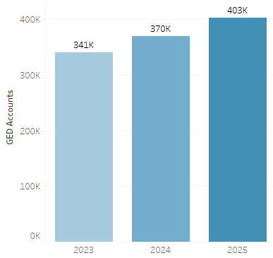
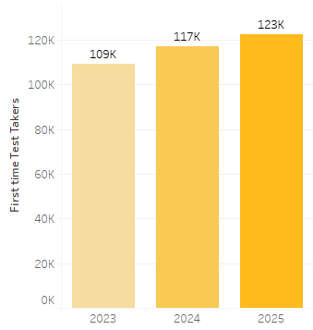
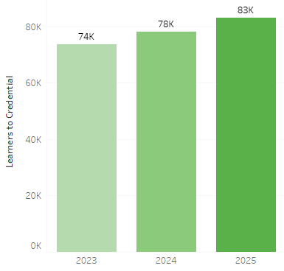
Through June, there have been more new accounts, more first-time test takers, and more credentialers than years past
New Accounts Created
First Time Test Takers
Learners to Credential
+9%
+5%
+6%

Slide 7
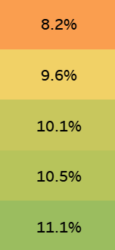
Older Learners Account for a Larger Portion of Credentialers Than Years Past
Portion of Credentialers 40+ Years of Age
2021
2022
35% relative growth from 2021 to 2025
2023
2024
2025

Slide 8
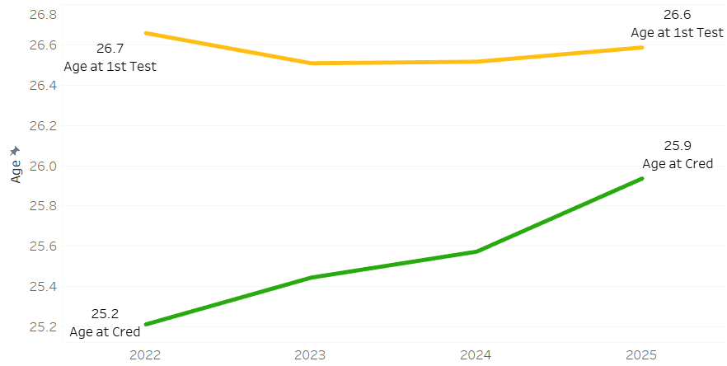
Narrowing the Age Gap from 1st Test to Credential
Average Age at 1st Test & Credential (by year)
Average age
YELLOW = Avg age of learners at time of 1st Test
GREEN = Avg age of learners at time of credential

Slide 9


Accommodations: Learners and Tests
Since January 2023
Nearly 14,000 learners approved for testing accommodations
Over 60,000 appointments scheduled with accommodations

Slide 10
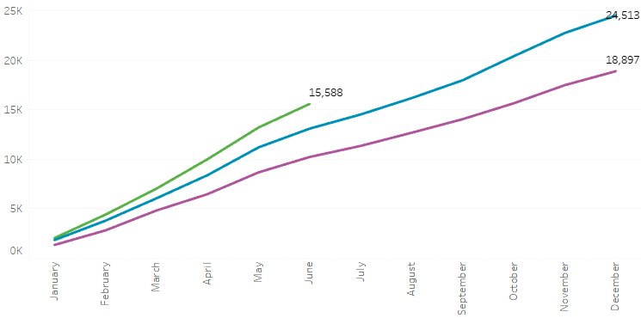


Volume of Appointments Scheduled with Accommodations by Year and Month
Running Sum of Appointments by Month and Year
Count of Appointments
Month

Slide 11
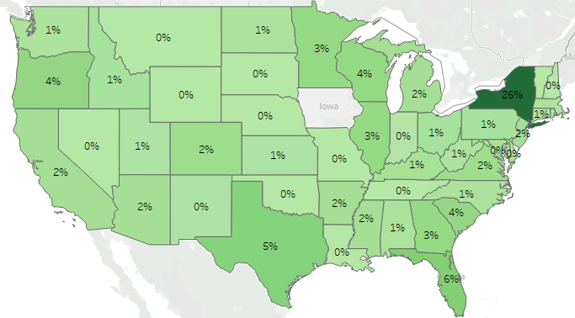
Distribution of Appointments Scheduled with Accommodations by State

Slide 12
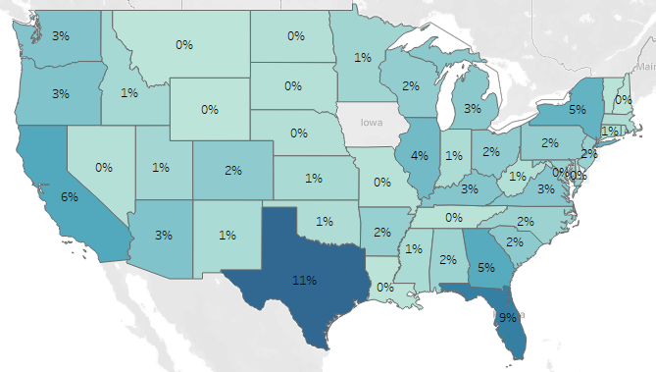
Distribution of Accommodation Appointments vs All Appointments
Appointments with Accommodations
All Appointments

Slide 13
GED & Me™ Mobile App
Usage & engagement metrics

Slide 14
What is the GED & Me™ Mobile App?
Personalized study guidance
Practice questions
Progress tracking & goal setting
Reminders to keep learners on track
Flexible, mobile-friendly study tool

Slide 15




Mobile Learner Acquisition
Official App Release – June 26th, 2024
200K
App store downloads
147K
Finished account setup (74%)
68K
Engaged with in-app questions (46%)
4.8 out of 5 (1000+ ratings)
Up through July 2025

Slide 16
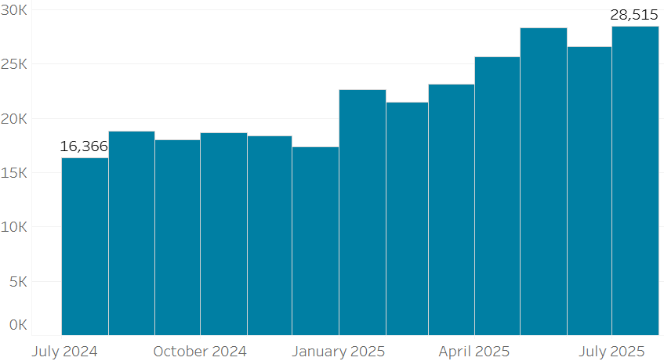
Count of Distinct Users per Month
Count of unique users

Slide 17

Who is Using the App?
30%
of mobile learners are brand new
(got App same day as creating GED account)
45%
of mobile learners are long-standing
(got app 6+ months after creating GED account)

Slide 18




Who is Using the App?
87% are studying independently
56% are caregivers for at least one person
46% are working full-time
45% say their motivation is to support their family

Slide 19
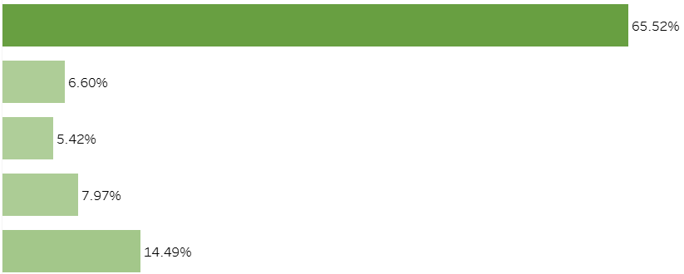
Where are Mobile Learners at in Their GED Journey?
Mobile user distribution by current subject
1st Subject
2nd Subject
3rd Subject
4th Subject
Credentialed
% of learners at each stage

Slide 20
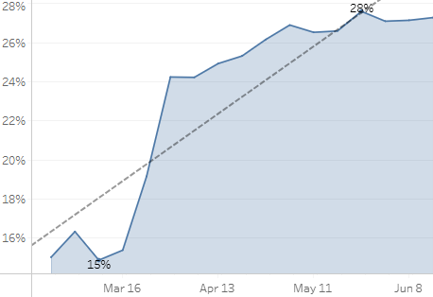
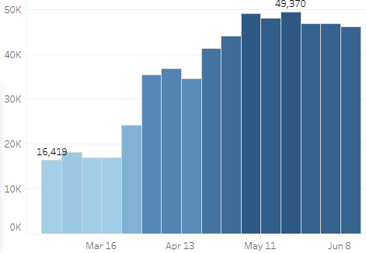
Mobile User Engagement with Questions
Portion of daily users to engage with in-app questions
Question count by week
% Answer Question
Total Question Count
Date
Date

Slide 21
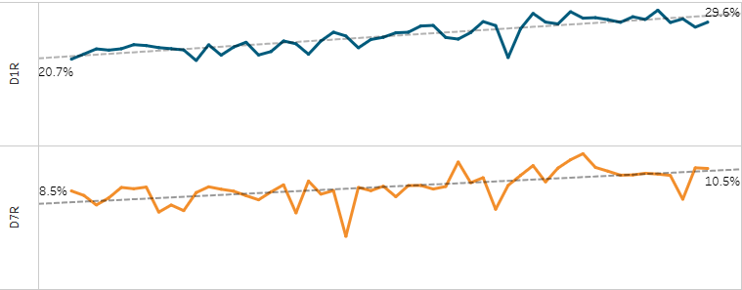
Mobile User Retention
Typical day 1 retention rates for educations apps: 13-14%
Typical day 7 retention rates for educational apps: 8-10%
App Lifetime
Retention Metrics July 2024 July 2025
Day 1 Retention 21% 30%
Day 7 Retention 8.5% 10.5%

Slide 22
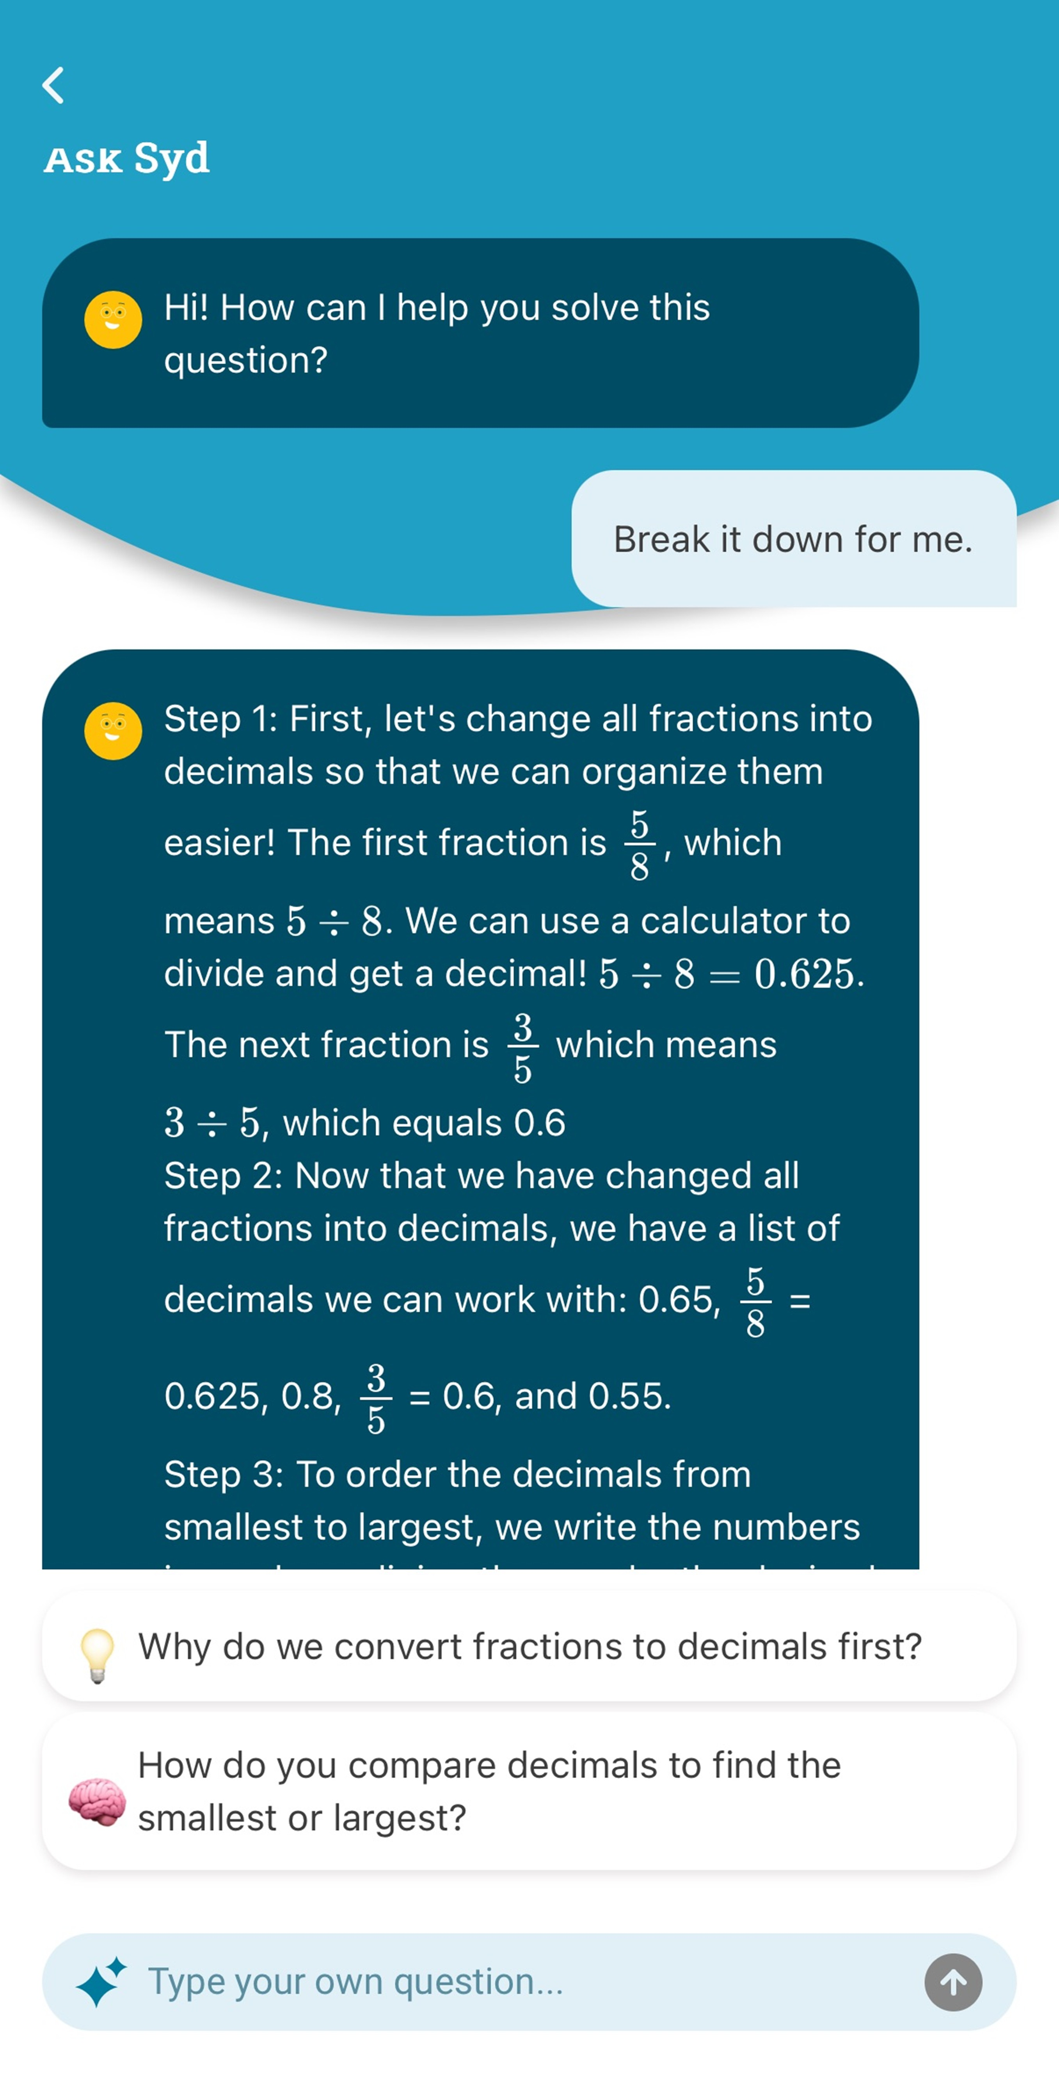
What’s next for the App?
AI Assistance with practice questions
  Real-time assistance with questions
  Trained on relevant learning content
Continued optimization of app flow
  A/B testing
  Streamlined interface (core-loop)

Slide 23
Product Efficacy
Success metrics

Slide 24
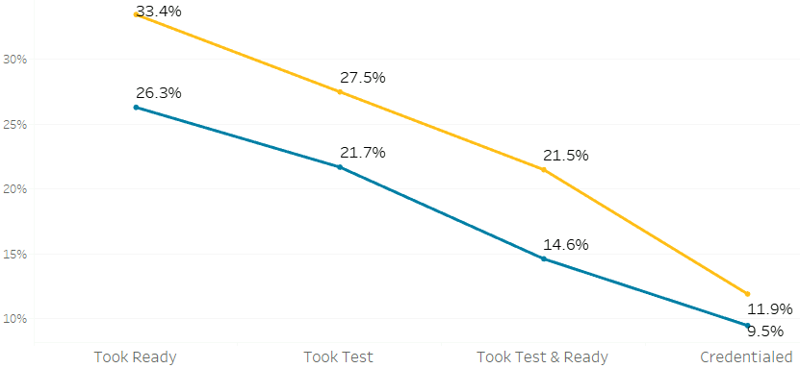

How do Activity Levels of Mobile Users compare to non-Mobile Users?
  Portion of Users to Reach Different Milestones
  Mobile users
  Non-mobile users
  % of learners reaching milestones

Slide 25
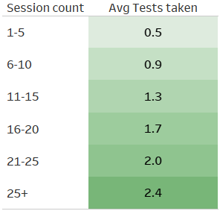
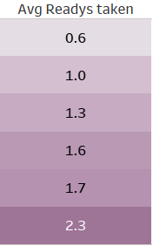
Increased App Activity Correlates With Increased Testing Activity
When grouping mobile users based
on how many app session they’ve
had, those with more sessions average
a higher number of GED Tests and
GED Readys taken

Slide 26

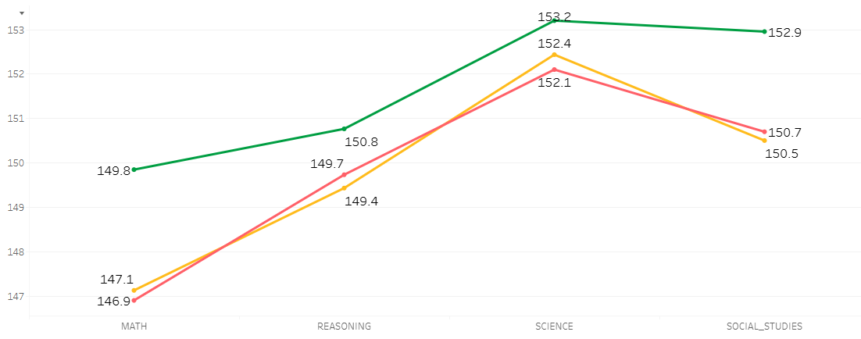
Increased Engagement with Mobile App Questions Results in Higher Test Scores
Avg GED Test scores based on Questions Completed in-app
Avg Score
Subject

Slide 27
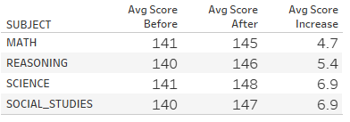
Effectiveness of Products (GED+™)
Two-tailed test
Look at all users who purchase GED+
Compare their average score in that subject before and after ordering the product
Look for any significant score change (+ or -)
Timeframe: last 2 years

Slide 28
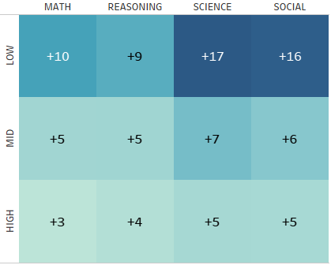
Effectiveness of Products (GED+™)
Average score increase by subject and score group
Segmenting users by average
score prior to purchasing GED+
Low – under 135
Mid – 135-140
High – more than 140
Product shows increased effectiveness among low scoring learners
Timeframe: last 2 years

Slide 29
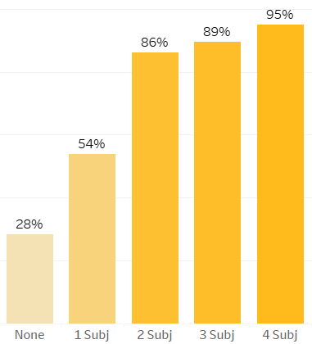
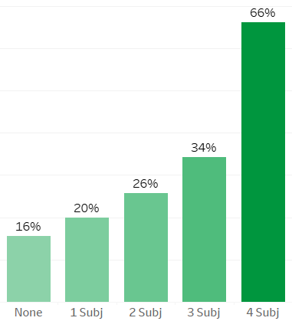
Effectiveness of Products (GED+™)
Portion of users to test and credential based on GED+ subjects purchased
Portion of users to take 1st Test
Portion of users to Credential
% take 1st Test
Credential rate
Subject Count
Subject Count

Slide 30
Learner Trends
Predictive metrics & learner behavior

Slide 31
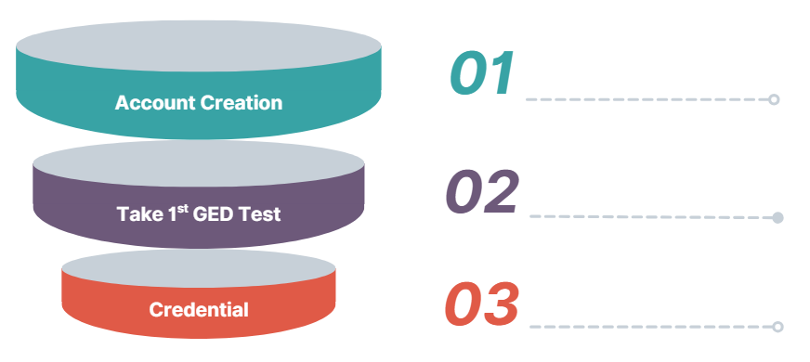
Understanding Learner Behavior
100%
Question:
29%
What drives learners to take their 1st GED Test?
16%
Timeframe: last 2 years

Slide 32


Taking a Ready has the most influence on taking 1st Test
Has taken a Ready?
no
yes
13% likelihood to take 1st GED Test
60% likelihood to take 1st GED Test
Questions:
What features drive learners to take a GED Ready?
Why are some Ready takers not taking a GED Test?

Slide 33
Predictive Analysis – How does it work?
Uses past learner data to find patterns
Identifies learners that are more or less likely to convert based on those patterns
Helps us to make informed decision about where to focus support and outreach
Not a perfect process, but a tool to spot trends and risk factors early in a learner’s journey

Slide 34
Impact of Features in Predicting Taking a GED Ready®
High impact
Age
Product
Purchases
Motivation
Other demographic data
Low impact

Slide 35
Decision Tree of Likelihood to Take a GED Ready®
Purchased Products > 0
false
true
Age < 19
Age < 19
false
true
false
true
Likelihood to take Ready = 25%
Likelihood to take Ready = 45%
Likelihood to take Ready = 62%
Likelihood to take Ready = 72%

Slide 36
Learner Distribution Decision Tree
Purchased Products > 0
false
true
Age < 19
Age < 19
false
true
false
true
70% of learners
25% of learners
3.5% of learners
1.5% of learners

Slide 37
Suggestions to Improve Engagement with GED Ready®'s
Problem – a large portion of our user base has not engaged with Readys
Recommendation 1 – increase outreach to these learns encouraging them to take their 1st Ready (promotions, proof of efficacy)
Recommendation 2 – promote products like GED+, highlighting the increased success seen of learners who purchase these products

Slide 38
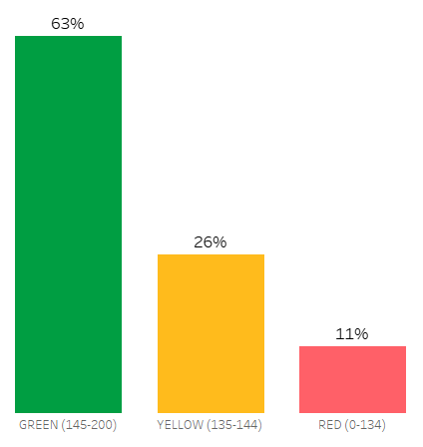
Activity Trends After GED Ready®
When learners take a GED Ready, they get one of three colors associated with their Ready based on their score…
RED – scored below 135
YELLOW – score between 135-144
GREEN – score above or equal to 145
Distribution of Readys by Score Group

Slide 39
Learner Activity After Taking a GED Ready®
What is a learner’s next activity after taking a Ready based on their score group?
  1. Taking a GED Test in that subject
  2. Taking another Ready in that subject
  3. Neither (no further activity in that subject)
Question: Why are some Ready takers not taking a GED Test?

Slide 40
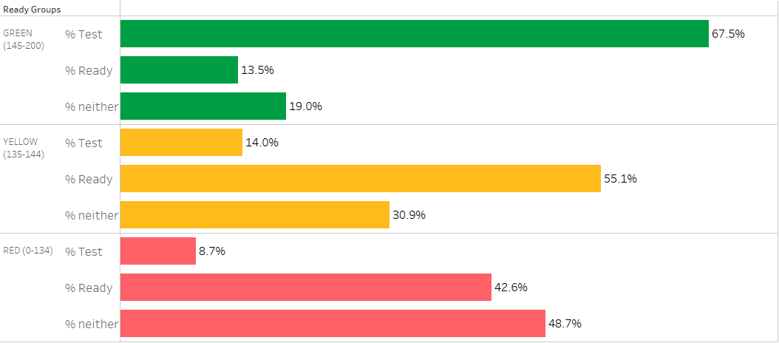
GED Ready® Activity Trends
Next activity based on Ready score group

Slide 41
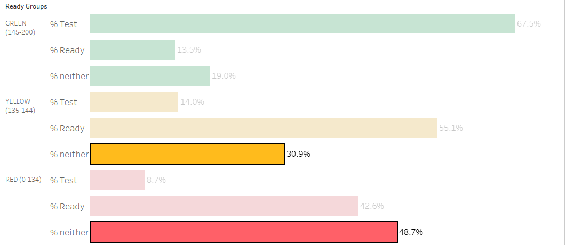
GED Ready® Activity Trends
Next activity based on Ready score group

Slide 42
Simplified view of activity levels based on GED Ready® score
Ready score >= 145
false
true
Ready score >= 135
80% stay active
false
true
50% stay active
70% stay active

Slide 43
GED+™ Learners show higher persistence
Ready score >= 145
false
true
Ready score >= 135
90% stay active
false
true
75% stay active
85% stay active

Slide 44
GED Ready® Activity Trends
Problem – there is a significant drop-off of learners scoring in the red (and yellow) on GED Readys
Recommendation 1 – increase outreach to learners with low Ready scores (product promotions, additional resources)
Recommendation 2 – reach out to learners with GREEN Ready scores that have not scheduled a GED Test
Recommendation 3 – rework assigned colors for Ready scores

Slide 45
Take aways
The GED® Program is continuing to grow (more new accounts, test takers, and credentialers)
Encouraging learners to engage with the GED & Me™ app can increase overall success
Taking a GED Ready is most predictive of embarking on testing journey
Providing additional resources and product suggestions (GED+™) to learners with no testing activity or low Ready scores could boost success and reduce drop-off

Slide 46

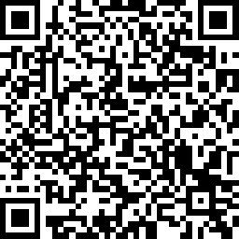
Session Survey
Your feedback is important. Please scan the QR code below to rate this session.
Kris Meehan
Operations Analyst
kris.meehan@pearson.com

Slide 47
