Slide 1
Taking on the Challenge of Providing Instruction in Science
Krista Mosher
August 5 & 6, 2025
GED® and GED Testing Service® are registered trademarks of the American Council on Education (“ACE”). They may not be used or reproduced without the express written permission of ACE or GED Testing Service LLC. The GED® and GED Testing Service® brands are administered by GED Testing Service LLC under license from ACE.

Slide 2

Why Science Instruction?
Science (and Social Studies) don’t get the same amount of attention as math and writing in adult education classrooms.
Why?
Why should we spend precious instructional time on science?
Do you feel there are ways to integrate science into other content areas?
Notes:
Today we’re going to discuss some strategies of teaching science and making the instruction more cross-content to increase your teaching time impact.

Slide 3
Today’s Objectives
Discover ways to incorporate science instruction in the adult education classroom
Identify and apply the GED® Science High Impact Indicators
Understand the circle of inquiry and how to integrate it with the 5 E’s
Discuss and Apply the Scientific Method
Notes:
So today, we’re going to hit these objectives:

Slide 4
High Impact Indicators – What they are…
They represent particular foundational skills that are the basis for the development of other skills covered in the GED® Assessment Targets and have broad usefulness that can be applied in multiple contexts.
GED® testing data suggests that educators may not be currently focusing on these skills in their GED® test preparation.
They are a good fit for classroom instruction because they are not complicated but are important for students to know and use.
Notes:
I will be highlighting the Science HII throughout the presentation as we discuss different skills and strategies to bring to the classroom. All subjects have high impact indicators and can be found on GED.com. One thing I really like about the HIIs are that they tell you what you should be seeing in your student’s work if they are mastering the concepts. I will show you these and other resources at the end of the session.

Slide 5
HII SP.7: Apply formulas from scientific theories.
Students’ work shows they have…
solved for a variable within a scientific equation
balanced an equation.
identified what changes will result if a variable within a scientific equation increases or decreases.
identified relationships between variables in a scientific formula.
interpreted symbolic representations of information and scientific data.
Notes:
Our first HII is applying formulas. Reading these bullets, what other content area comes to mind? Yes, math! Specifically, algebra.

Slide 6

Science Formulas are Algebra!
The necessary formulas for a question will be given to the student.
Information needed to solve the formulas on the science test will be given either in the problem or other piece of data.
https://www.presentermedia.com/powerpoint-clipart/open-head-emc2-pid-8913

Slide 7
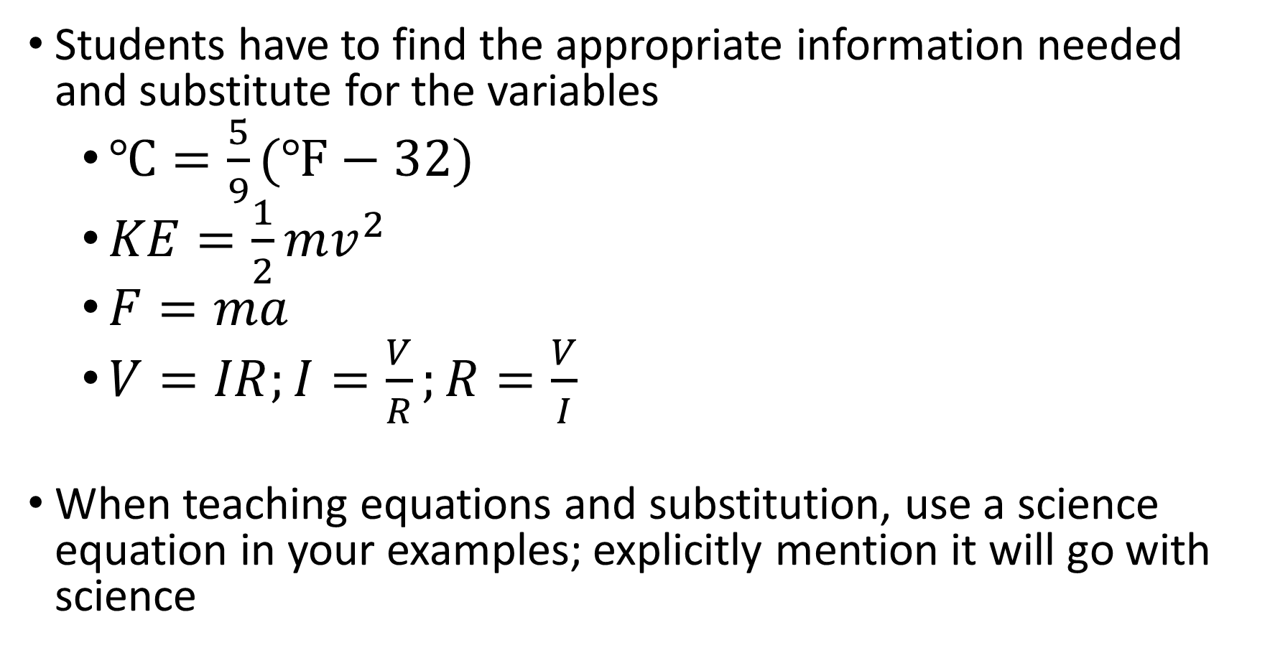
Students have to find the appropriate information needed and substitute for the variables
  $℃=\frac{5}{9}(℉−32)$
  $KE=\frac{1}{2}mv^{2}$
  $F=ma$
  $V=IR;I=\frac{V}{R};R=\frac{V}{I}$
When teaching equations and substitution, use a science equation in your examples; explicitly mention it will go with science
Notes:
Examples are:
Fahrenheit to Celsius
Kinetic Energy
Force
Voltage = current * resistance
Does anyone have another example of a formula they have seen or used?

Slide 8
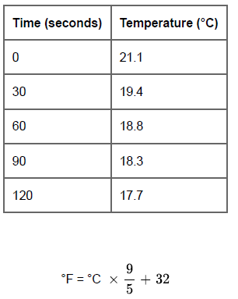
Test Example
A temperature change occurs when ammonium chloride is dissolved in a water solution. The table shows the temperature change over a period of 120 seconds.
What is the appropriate temperature of the solution in degrees Fahrenheit at 60
seconds?
You may use the calculator.
Notes:
Example of a test question. What elements of math and science do you see?

Slide 9
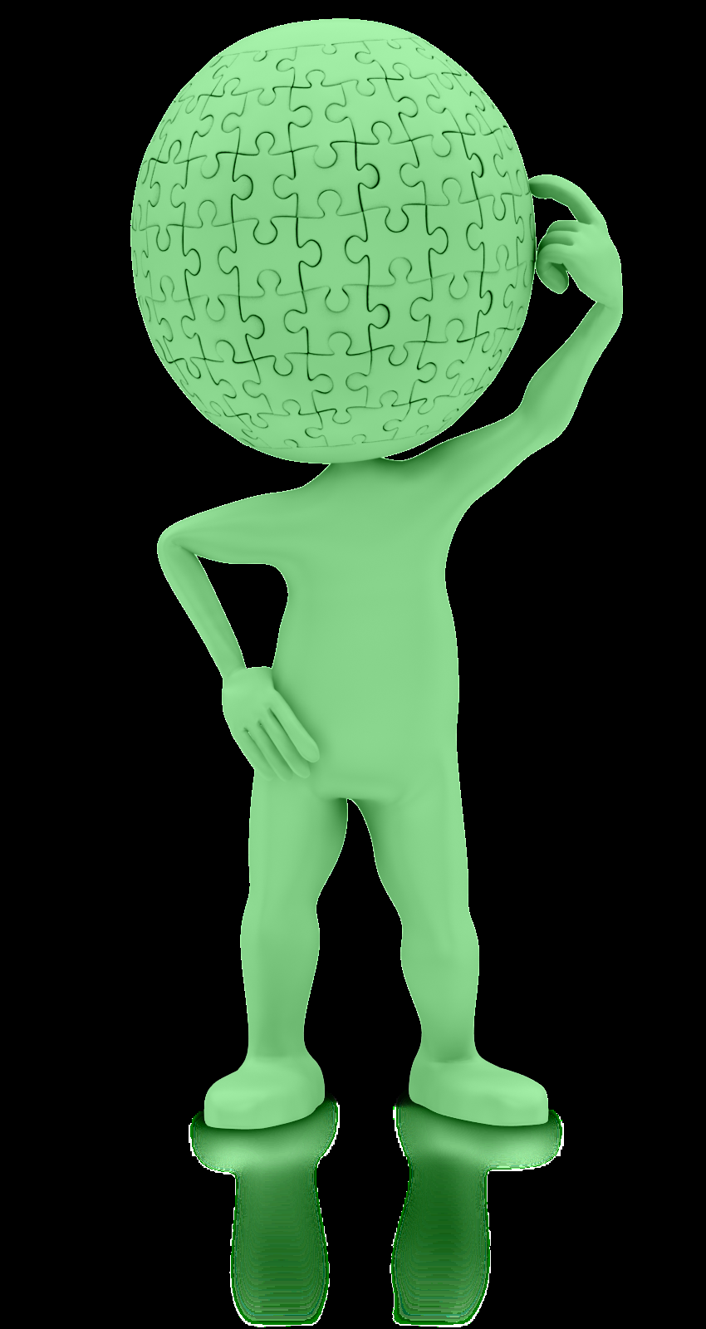
Let’s talk Inquiry and the 5 E’s
https://www.presentermedia.com/powerpoint-clipart/puzzle-head-pc-pid-2565

Slide 10
“Inquiry is something that students do, not something that is done to them.”
Inquiry and the National Science Education Standards
Notes:
Key Points
Thoughts about quote?

Slide 11
Circle of Inquiry
Draw out and work with students’ pre-existing understandings to make student “thinking” visible and central to the learning.
Students gain competence in their area of study by organizing factual knowledge around conceptual frameworks to facilitate knowledge retrieval and application.
An inquiry may seek to help students learn about existing knowledge, or it may challenge them to produce new knowledge.
Students engage with research by discussing, debating, and presenting their findings to communicate their understanding and results.
Reflection activities help students take control of their learning by facilitating thinking about their learning (i.e. metacognition).
Ask
Investigate
Reflect
Create
Discuss
Notes:
Key Points
So what is an inquiry method of teaching science? It’s simply that lessons are set up to allow students to investigate, create, discuss, reflect, and ask about what they are learning. Remember, it’s not about memorizing content, but rather on understanding and applying information

Slide 12
Five Features of Science Inquiry
The learner:
  Engages in scientifically oriented Questions
  Gives priority to Evidence in responding to questions
  Formulates Explanations from Evidence
  Connects Explanations to Scientific Knowledge
  Communicates and justifies Explanations
Notes:
Key Points
Think about the lessons that you teach in your science classroom. Does the learner have the opportunity to use an inquiry based method of learning?
Discuss the features of science inquiry.

Slide 13
Teaching Through Inquiry – 5Es
Engage
Explore
Explain
Extend
Evaluate
5 Es
Notes:
13
Key Points
So, how do you get started teaching through inquiry? Many science instructors develop lessons using the 5Es. Before we look at a sample thematic lesson, what exactly is the 5Es model? It is simply a way of teaching science that provides a structure for students to engage, explore, explain, elaborate, and evaluate scientific knowledge.
Engage - students and stimulate their scientific curiosity
Explore - the meaning of the concept through hands-on activities and questions
Explain - how a concept applies to real-world situations and is supported by evidence
Elaborate/Extend - on meaning or application in different contexts
Evaluate - student understanding by providing time for review and reflection
Share with participants that additional information on how to use the 5Es when lesson planning is provided in their workbook.

Slide 14

Human Health and Living Systems
https://www.presentermedia.com/powerpoint-clipart/woman-shield-virus-pid-23344
Notes:
Key Points
Let’s spend a few moments looking at how to develop a lesson plan based on the 5Es model. Let’s look at the area of Human Health and Living Systems.

Slide 15
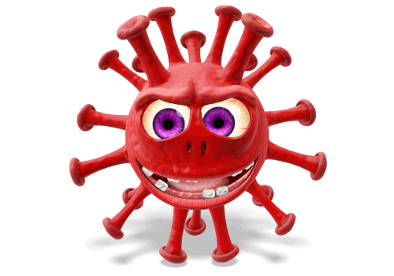
Setting the Stage
Have you ever taken an antibiotic?
How and when should antibiotics be used?
Who was Alexander Fleming?
What are bacteria?
What have you heard about super-bugs?
https://www.presentermedia.com/powerpoint-animation/crazy-virus-looking-around-pid-25400
Notes:
Key Points
Let’s set the stage for this lesson by asking students a few questions. You may wish to record their answers and refer back to them throughout the lesson.

Slide 16
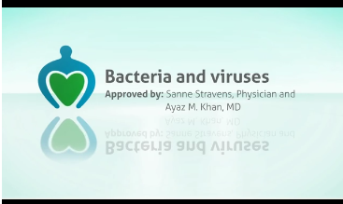
Explore – What’s the difference?
http://ed.ted.com/on/q41jt6vp#finally
Notes:
Key Points
Students may know that they have taken antibiotics for an infectious disease, but what type of an infectious disease. Was it a bacterial or viral infectious disease. Have students explore the similarities and differences between bacteria and viruses. You may wish to use a short video.

Slide 17
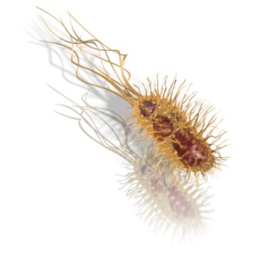

Explore - Bacteria/Virus – What’s the Difference?
What are bacteria?
What are viruses? Is there a difference?
What can we do to fight bacteria?
How come sometimes medicine we take for infections don’t work?
What is a superbug?
https://www.presentermedia.com/powerpoint-clipart/virus-spore-pid-10023
https://www.presentermedia.com/powerpoint-clipart/common-bacteria-pid-10016
Notes:
Key Points
You may also wish to present students with guiding questions to answer, such as those on the slide. You want them to ask and answer questions about the topic.

Slide 18
Explore – Use a Venn Diagram
Bacteria
Virus
Both
Notes:
Key Points
Because it’s important that students understand the differences and similarities between bacterial and viral infectious diseases and why (or why not) antibiotics are used, you may wish to provide students with a blank Venn Diagram. Have them use their exploring skills by researching the similarities and differences and share their findings with the class. Ask additional questions, such as: Do you know some illnesses that are caused by bacteria? How about by viruses? How are the diseases different because of their cause?

Slide 19
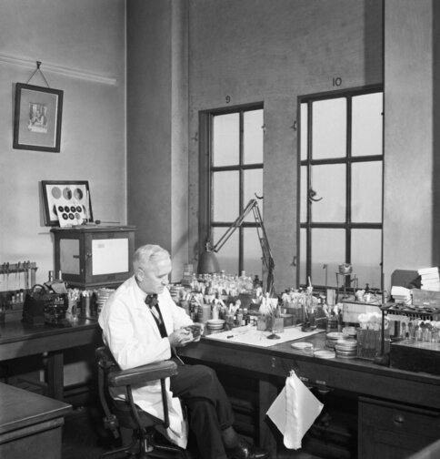
Explain - Who was Alexander Fleming?
Penicillin – Wonder drug or not?
A Short Bio
http://www.nobelprize.org/nobel_prizes/medicine/laureates/1945/fleming-bio.html
http://www.bbc.co.uk/history/historic_figures/fleming_alexander.shtml
MLA style: Sir Alexander Fleming – Photo gallery. NobelPrize.org. Nobel Prize Outreach 2025. Wed. 23 Jul 2025. <https://www.nobelprize.org/prizes/medicine/1945/fleming/photo-gallery/>
Notes:
Key Points
As you begin your discussion on how antibiotics apply to real-world situations and are supported by evidence, you can start with a short biography on Alexander Fleming. When Alexander Fleming discovered penicillin in 1927, antibiotics were seen as a wonder drug. But as early as 1947 – just four years after the use of penicillin became common – we began to see bacteria developing a resistance to antibiotics.
Knowledge about early antibiotics, such as penicillin, is important to students’ understanding of superbugs and how these bacteria are not responding to typical antibiotics.
These short biographies provide a reading connection for the science classroom.

Slide 20
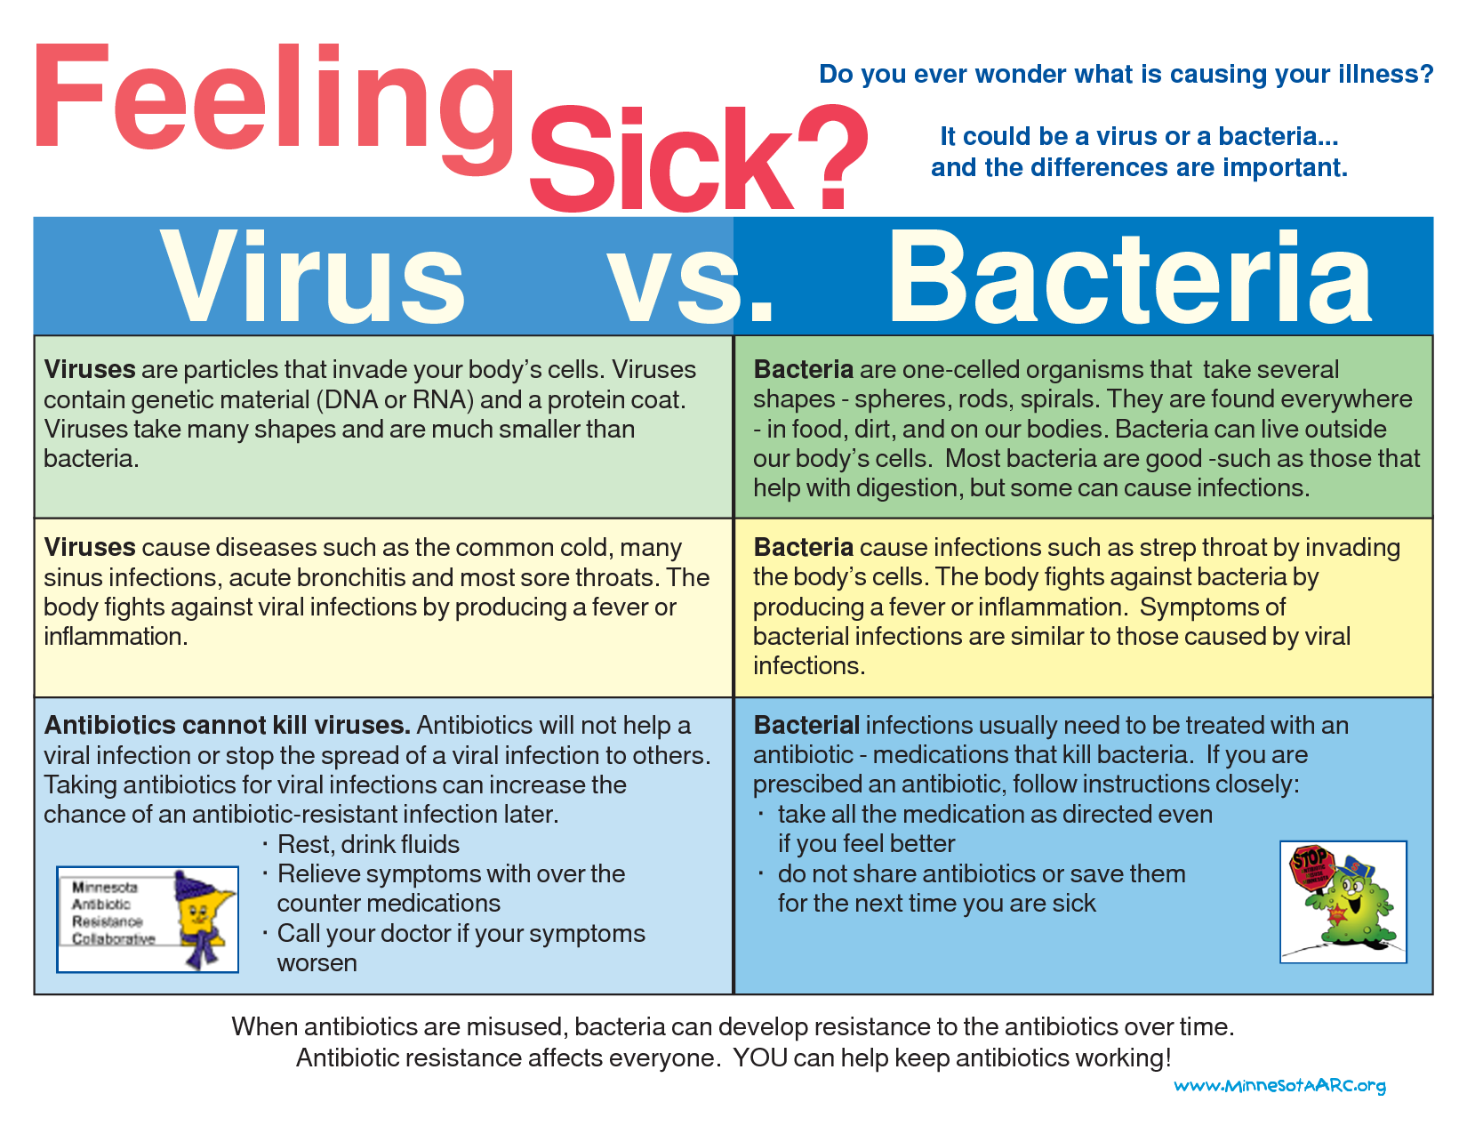
Is It Viral or Bacterial?
Notes:
Key Points
As you explain the basic concepts of antibiotic resistant infections you will want to reinforce that antibiotics only work against infections caused by bacteria, fungi and certain parasites. They don't work against any infections caused by viruses. Viruses cause colds, the flu and most coughs and sore throats.
A simple chart, such as this one from the Minnesota Antibiotic Resistance Collaborative, is a great resource for summarization of the basic ideas and concepts.

Slide 21
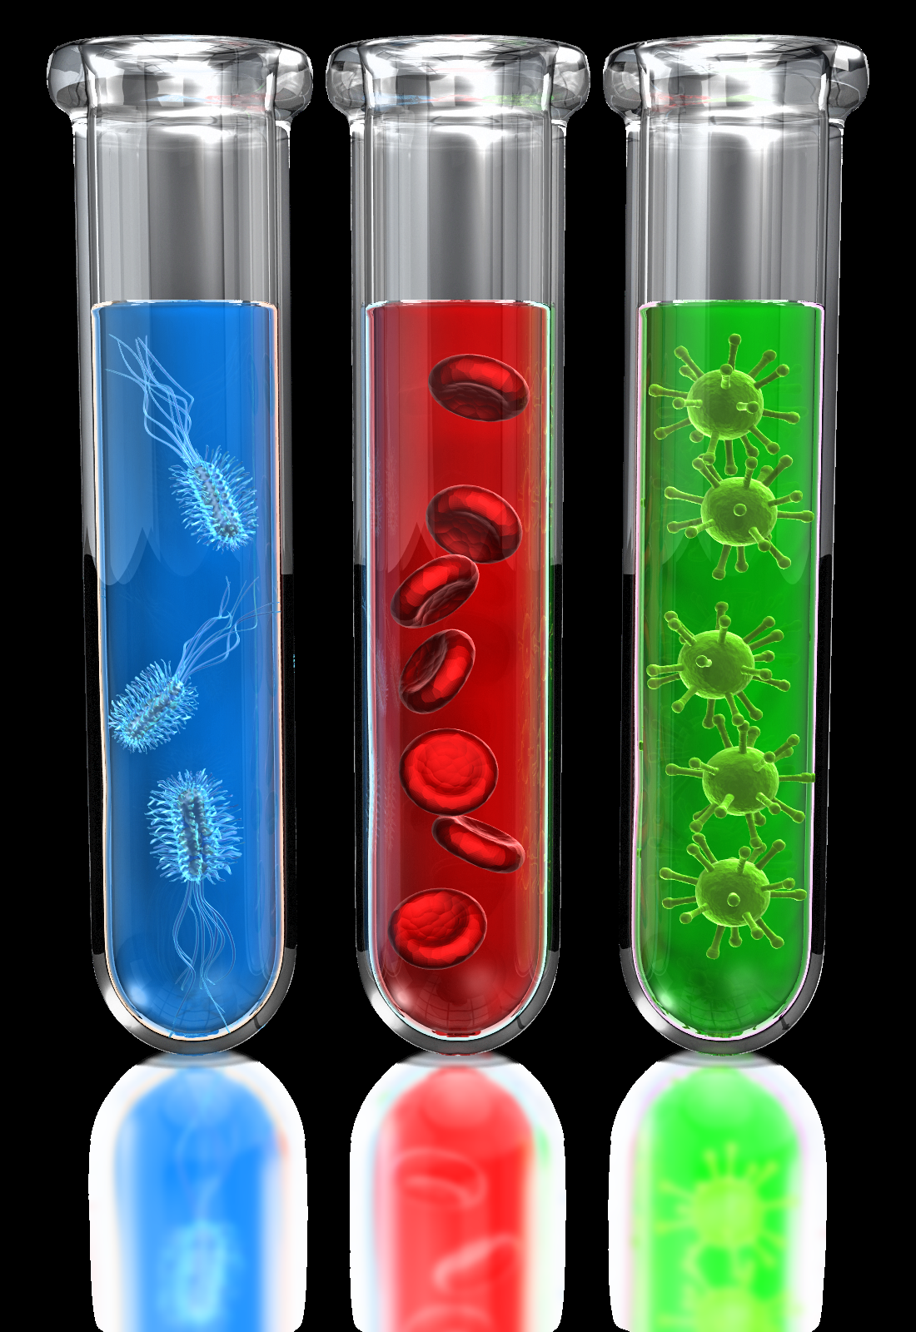
Integrate Reading and Writing
Superbugs, what they are and why they may be the new pandemic
https://www.iberdrola.com/innovation/superbugs
The War on Superbugs
https://www.sciencenewsforstudents.org/article/war-superbugs
https://www.presentermedia.com/powerpoint-clipart/test-tube-science-pid-12682
Notes:
Key Points

Slide 22


Extend – Earth Science
http://www.pbs.org/wgbh/rxforsurvival/index.html
http://www.pbs.org/wgbh/rxforsurvival/series/teachers/index.html
Notes:
Key Points
When extending or elaborating a thematic lesson, you may wish to show students how the topic crosses the different areas of science. An example is the RX for Survival website that shows how infectious diseases are a global challenge. This site provides great lesson plans, as well as resources.

Slide 23

Extend – Earth Science
Windows to the Universe - Changing Planet: Infectious Diseases
http://www.windows2universe.org/earth/changing_planet/infectious_disease.html
Disease | How is it spread? | Where is it found? | What are the symptoms? | How is it prevented?
Notes:
Key Points
Because there are many different ways that infectious diseases travel throughout the world, have students extend their knowledge by identifying a bacterial of viral infection and documenting their answers in the chart. The video “Changing Planet” provides an overview of how different types of infectious diseases are spread throughout the world.

Slide 24

Integrate Graphics
Notes:
Key Points
Of course, don’t forget to integrate graphics and games. Graphics and text work together to clarify a concept, such as this graph depicting the how rapid diagnostics would reduce unnecessary prescriptions.

Slide 25
Evaluate with Questions
What are the differences between viruses and bacteria?
Are all bacteria harmful? Explain.
How does the overuse of antibiotics lead to resistant strains of bacteria?
When you get a cold, should you take an antibiotic to help you get better? Why?
What can you do in your life to reduce antibiotic resistance?
Notes:
Key Points
There are many ways to evaluate what students have learned throughout the lesson. You may wish to include both text-dependent types of questions, as well as questions that require students to determine what they personally can do to reduce antibiotic resistance in their lives.

Slide 26
Evaluate with Research
Research five solutions to antibiotic resistance. These can be ways to avoid developing and spreading resistance or possible alternatives to antibiotics. Cite your sources for each piece of information you find. Make sure to use reputable sources based on scientific facts.
Example: Overuse of antibiotics increases the chance of bacteria developing antibiotic resistance.
Source: http://emerald.tufts.edu/med/apua/about_issue/about _antibioticres.shtml
Notes:
Key Points
You may also wish to have students complete a short research project in order to evaluate their learning. Notice that this activity does not require that your students write a long essay, but rather that they answer the question and provide reputable sources.
Review the activity listed on the slide.

Slide 27

The Scientific Method
https://www.presentermedia.com/powerpoint-clipart/science-analysis-pid-30865
Notes:
So using the 5 E’s and a variety of resources we can see how cross-content instruction could be done using science as the focus. In your workbook there is a thematic plan using energy as a topic as another example of using the 5 E’s. Let’s move into the Scientific Method next, which even though it seems specific to science is really problem-solving. We will see more High Impact Indicators throughout this discussion.

Slide 28
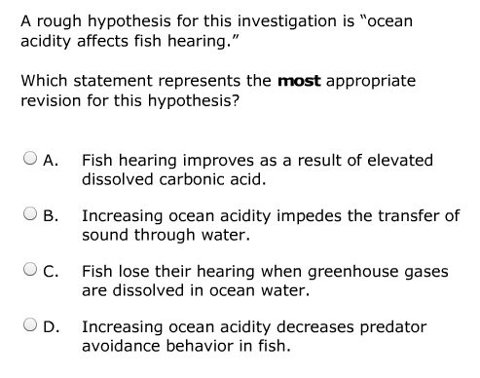
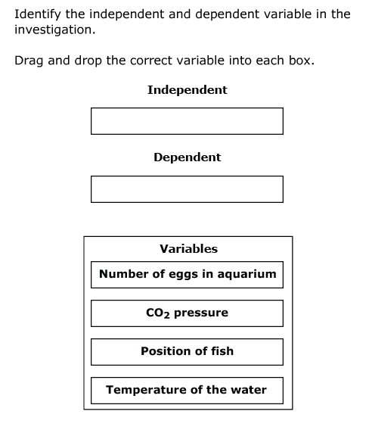
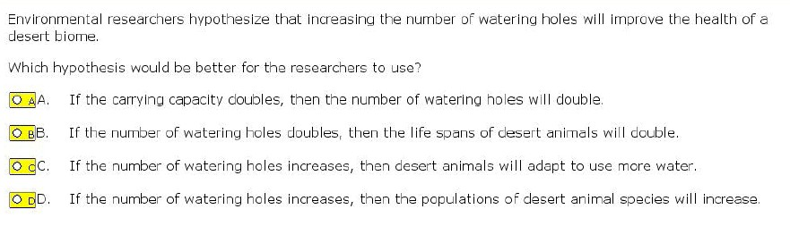
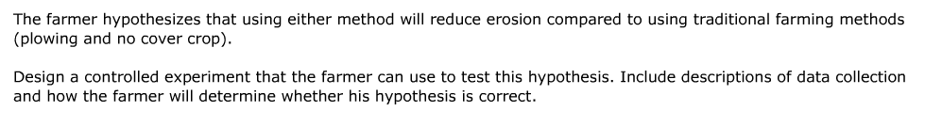
GED® Sample Science Questions – Look Familiar?
Notes:
Key Points
Reiterate that the Science Test assesses skills tied to scientific inquiry in many different ways. That is why it is important that students not only understand each of the steps in the scientific method, but can also apply them to different situations.
The questions on the slides are from the Item Sampler.

Slide 29
Can your students . . .
  Evaluate whether data supports a hypothesis?
Identify variables in an experimental process?
Determine a method for collecting data?
Determine the correct process for an experiment?
Draw a conclusion based on scientific data?
  Design a scientific investigation based on a given hypothesis?
Create a hypothesis?
Notes:
Key Points
Begin the discussion on the scientific method by asking participants if their students can do the items listed. Reinforce that these skills are necessary for both technology-enhanced and short answer items on the GED® Science test.
Note: Questions transition in when clicked.

Slide 30
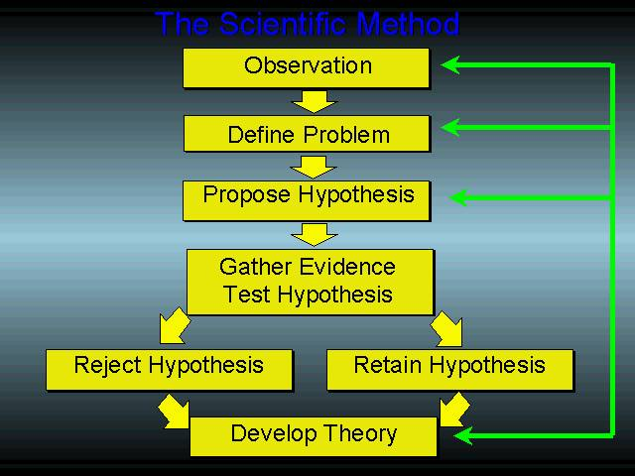
The Scientific Method
Teach experimental design through real-world application and reporting.
Notes:
Key Points
It is important that students understand the scientific method and experimental design, through real-world situations and reporting. This chart provides us with a graphic overview of each step, showing that experimental design is not always linear. But, what does each step really mean? Let’s take each step and identify the key components.
(picture in workbook)

Slide 31

Scientific Method in Action
Real-World Example:
It seems like it takes forever to get to work these days. Is there a better route that I can take?
Notes:
Key Points
But first, let’s see the scientific method in action in a real-world situation that has probably happened to many of us.
Note: This slide has the situation/observation first. Upon clicking, the chart is shown that provides the additional steps that mirror the scientific method – used in a real-world context. Share that it is important that students see how they use an informal version of the scientific method in their daily lives.

Slide 32
Scientific Method Process
Observation and Problem
It takes me too long to get to work. I need to find a better route. Looking at the map, I know that there are many different routes.
Hypothesis
If I use Route X, I will arrive at work more quickly.
Gather Evidence and Test the Hypothesis
I drive to work the same time each day at the same speed taking a variety of routes, including Route X.
Analyze Results
I look at the different route times. I find that Route X is faster than the original route that I took or any of the alternates.
Draw Conclusion
Route X is the best route. However, I may want to test my hypothesis when driving home as traffic patterns may change.

Slide 33

Observation/Define the Problem
Does exercise make your heart beat faster?
Why is the health of the desert biome deteriorating?
Observation is getting information through the senses.
All investigations start with a question.
Notes:
Key Points
In any experimental design, it is important that students understand that one first observes and does research (as necessary). Then, it is time to develop a question or problem that can be solved through experimentation. It all starts with a question. Questions should be about something that is observed and questions to be solved.

Slide 34
HII SP.2.b: Identify and refine hypotheses for scientific investigations.
What to look for in student work:
Students’ work shows they have…
identified a hypothesis for a given scientific investigation.
differentiated between an appropriate hypothesis and a poorly conceived hypothesis.
used a hypothesis to support or challenge a given conclusion.
identified a hypothesis for a given data set.
refined a hypothesis to more appropriately suit a scientific experiment.
Notes:
One of the Science High Impact Indicators deals specifically with hypotheses – highlighting the fact that it needs to be taught in the adult ed classroom,

Slide 35
Formulate a Hypothesis
Prediction/Educated Guess
Use If, then statements
  If ____ [I do this], then _____ [this will happen]
Focus on one variable only
Notes:
Key Points
The next step in the process is to formulate a hypothesis. What is a hypothesis? Students need to understand that a hypothesis is an educated guess or prediction about how things work. The hypothesis must also be testable; an experimental investigation can be done based on the hypothesis. The format of most hypothesis is an “If . . . , Then . . . “ statement. Such as: If soil temperatures rise, then plant growth will increase. This is a testable hypothesis.

Slide 36
HII SP.2.e: Identify and interpret independent and dependent variables in scientific investigations.
Students’ work shows they have…
identified the independent variable in a given investigation.
identified the dependent variable in a given investigation.
fully explained the relationship between the independent and dependent variables in a given experiment.
Notes:
The next HII is dependent and independent variables.

Slide 37
Variables in Experimental Design
Independent Variable | Dependent Variable | Control Variable
What is tested by the scientist What is changed (varied) by the scientist (What I change…) | What is observed What is measured The effect (response) caused by the independent variable (What do I measure?) | Things that could change but don’t Kept constant (the same) by scientists These allow for a fair test (What stays the same?)
Notes:
Key Points
As you are teaching the scientific method, don’t forget to ensure that students understand the vocabulary, such as independent and dependent variables. These two terms often are confusing for students. Share with participants that the independent variable manipulates the dependent variable (the dependent variable responds).
Have participants share ideas for how they teach students to correctly identify each of these terms.

Slide 38
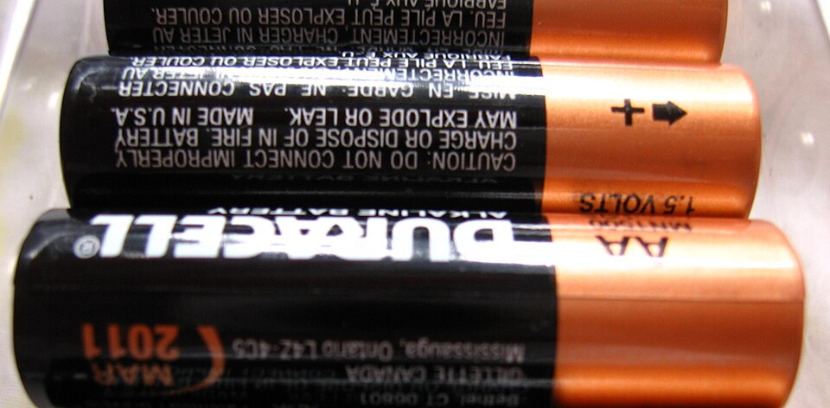
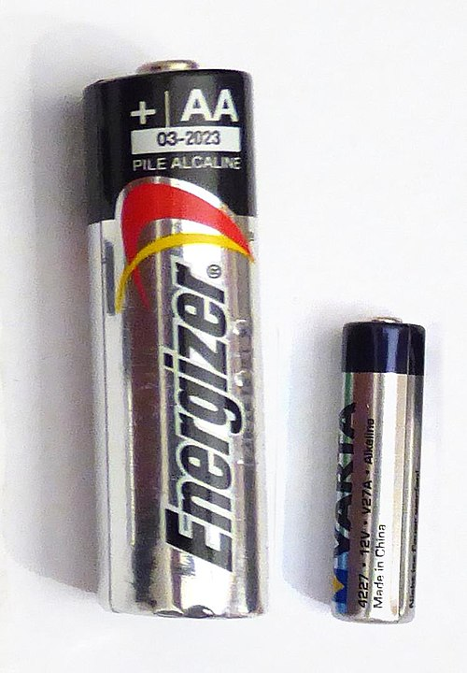
It’s Your Turn!
Which battery will last the longest: Energizer or Duracell?
Independent Variable:
Dependent Variable:
Constant Variable (Control):
Brand of battery
Life of battery
Size of battery, use of battery, temperature
https://commons.wikimedia.org/wiki/File:Batteries-a27-1.jpg#filelinks
https://commons.wikimedia.org/wiki/File:Duracell_AA_batteries-made_in_USA_(resized).JPG
Notes:
Key Points
What are the variables?

Slide 39

Gather Evidence and Experiment
Develop a procedure, list the needed materials and then, determine the control group.
Conduct the experiment.
Record the data in a data table.
https://www.presentermedia.com/powerpoint-animation/data-emote-appreciation-pid-24782
Notes:
Key Points
The next step that students need to understand completely is how to gather evidence and create the procedure for the experiment. This is an important step for students to understand. This step of the process should be “replicable” by others. Students should be able to develop a procedure, list the needed materials, and determine the control group. Then it’s time to conduct the experiment and record the data in a data table.

Slide 40
HII SP.4.a: Evaluate whether a conclusion or theory is supported or challenged by particular data or evidence.
Students’ work shows they have…
identified and explained why the evidence supports the proposed claim or solution.
identified and explained which piece of data supports or contradicts the given hypothesis. identified multiple reasons a piece of evidence supports a theory or hypothesis and compare those reasons to each other.
identified which scientific model would be weakened or strengthened by particular evidence.
fully explained why given evidence challenges a scientific theory.
Notes:
This HII deals with evaluation of a conclusion or theory is supported

Slide 41

Conclusion
Look back at the hypothesis.
Analyze the data to see if the hypothesis was accepted or rejected.
If hypothesis is rejected, give possible reasons for the difference between the hypothesis and the experimental results.
https://www.presentermedia.com/powerpoint-clipart/ah-ha-idea-pid-11015
Notes:
Key Points
Students need to have practice in providing conclusions when applying the scientific method. The conclusion is an important part of experimental design and is also a required element on one of the short answer question types and can also be assessed through technology-enhanced items. Make sure to provide students with different outcomes and have them analyze the data to see if a hypothesis was accepted or rejected.
Review the slide for other information.

Slide 42
HII SP.6.a: Express scientific information or findings visually.
Students’ work shows they have…
translated information presented verbally or numerically into a visual format
integrated information presented verbally and numerically into a visual format
identified relationships among graphs or diagrams
identified visual representations of scientific processes explained in a given text
completed diagrams to demonstrate understanding of relationships among variables, scientific concepts, or processes
Notes:
And finally, the last HII deals with presenting visually scientific information. This includes knowing how to read charts and graphs and create them based on data.
In your workbook, you will find a couple of scientific method graphic organizers and some ideas to discuss and apply to the scientific method.

Slide 43

Experiment Time!
We are going to discuss an experiment that puts all the HIIs we’ve discussed in perspective.
The experiment uses scientific method and shows cross-content strategies for math and social studies.
It can be easily implemented in your classroom.
https://www.presentermedia.com/powerpoint-animation/scientist-looking-observing-pid-13354
Notes:
We aren’t doing the experiment today, but I will walk through the steps and discuss how I did the experiment in my classroom.

Slide 44
The Scientific Method, Statistics, and M&M’s®
Let’s conduct a scientific experiment!
  Question: How does your sample compare to the population?
  Problem: Are the Mars sorters working properly?
  What might our hypothesis be?
  Go to your workbook and write out a hypothesis.
Notes:
Key Points
We will be evaluating two Mars factories’ plain M&M’s sorting machines – one in Hackettstown, NJ and the other in Cleveland, Tennessee. We have been given the official percentages from the company, and we will be determining how close our samples are to the official numbers.
Share with participants that for today’s experiment, they will be basing their hypothesis on the identified problem. Discuss the difference in statistics.

Slide 45
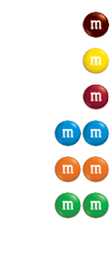
The Official Color Estimates for Plain M&M’s®
CLV
12.4%
13.5%
13.1%
20.7%
20.5%
19.8%
HKP
12.5%
12.5%
12.5%
25%
25%
12.5%
Notes:
Key Points
Here are the official numbers from each factory. These numbers are in your workbook
Complete the chart on the next page. Determine the frequency and the percentage of each candy color. Make sure to use the correct percentages from the Mars Company, dependent on where the candy was produced.
Let’s look at the data chart together

Slide 46
Data Chart
Candy Color | Package |  |  |  |  | Total | Average (Mean) | Percentage | Range | Median | Mode
 | 1 | 2 | 3 | 4 | 5
Blue
Brown
Green
Orange
Red
Yellow
Whole Bag
Notes:
In the classroom, I would use these instructions:
Create groups of 2, Hand out candy , and give instructions for the data chart. Each group will share their data with 4 other groups to get data for 5 packages. When you get your data, then work in your small group and fill out the rest of the chart.
You can also use online M&M simulators if you don’t want to use candy.
Look at this data chart – using math after collecting the data.

Slide 47
Analyze using Graphs
To compare your results to the ratio distribution from the Mars Company, create a graph to show the comparison. Select one of the following:
Create a histogram or bar graph to visually display the frequency of each color of M&M’s® in an average package as provided by the Mars Company.
Create a histogram or bar graph to visually display the frequency of each color of M&M’s® in the packages that you analyzed.
Create a pie chart that provides the ratio distribution as provided by the Mars Company.
Create a pie chart to compare the relative proportion of each individual color to the whole population.
Create a different type of graphic that shows comparison. Provide your reason for selecting this type of graphic to best display the data.
Notes:
Using graph paper or plain paper, choose a graph to visually display your findings. Graph instructions are in the workbook. You can use one of these or make one of your own.

Slide 48
Draw Conclusions
Using the data, form a paragraph that answers the problem you looked to solve in the M&M’s® lab, include how your actual results compared with your hypothesis. Was your hypothesis correct or not? How confident are you in your conclusion? Why? Why Not?
Looking at your data table and graphs, do you think you can predict what color(s) M&M you are most likely to pick from a package? If so, what color(s) is it?
Notes:
The last step is to draw conclusions – ask the questions, elicit discussion if time

Slide 49
Debrief Activity
Opinion of activity
Did we do science?
Did we do social studies?
Did we do math?
What other extension activities could we do with this activity?

Slide 50
Science Test Resources Workbook
Email me at kdmosher@tamu.edu for a copy
Full of resources
Experiment pages to use in your classroom
GED.com
  HII and Performance Level Descriptors
  Educator Resources
Notes:
Let’s take a minute and look at the workbook

Slide 51
Questions
Notes:
Did we meet the objectives for the session?
Discover ways to incorporate science instruction in the adult education classroom
Understand the circle of inquiry and how to integrate it with the 5 E’s
Identify and apply the GED Science High Impact Indicators
Discuss and Apply the Scientific Method

Slide 52

Thank you!!
Krista Mosher kdmosher@tamu.edu

Slide 53

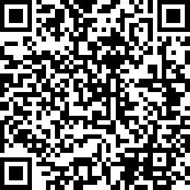
Session Survey
Your feedback is important. Please scan the QR code below to rate this session.

