Slide 1
Some “Ds” of Disabilities:
A facilitated conversation to discuss and propose solutions for the classroom
Jean Perrini
GED® and GED Testing Service® are registered trademarks of the American Council on Education (“ACE”). They may not be used or reproduced without the express written permission of ACE or GED Testing Service LLC. The GED® and GED Testing Service® brands are administered by GED Testing Service LLC under license from ACE.

Slide 2
Welcome
Jean Perrini
Kellie Blair Hardt
Debbie
Bergtholdt
Debi Faucette
Ann Evers

Slide 3
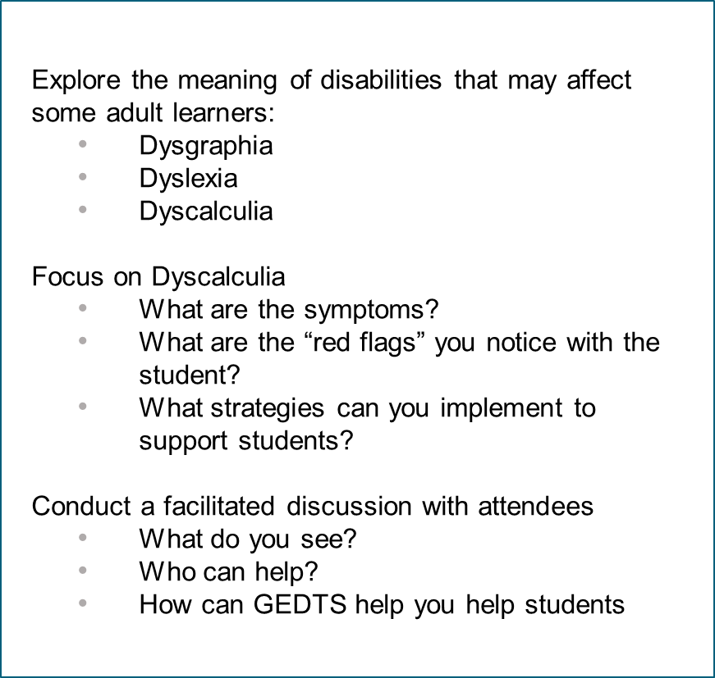
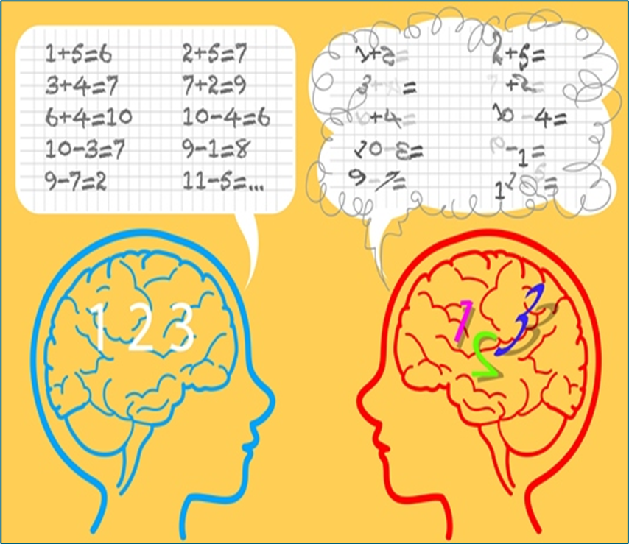
In this session, we will…

Slide 4
Dysgraphia
Definition (Reviewed by Psychology Today Staff; link: Dysgraphia | Psychology Today)
Dysgraphia is a learning disability that results in impaired handwriting, impaired spelling, or both in someone of normal or above-average intelligence. It is not a mental health disorder, but rather a brain-based learning disability marked by difficulty forming letters, spelling words correctly, staying within lines, writing legibly, or organizing and expressing one’s ideas on paper.
Symptoms
Dysgraphia can manifest as problems with fine motor skills, spatial perception, and/or language processing. Possible signs may include poorly formed individual letters; lack of or incorrect punctuation and capitalization; awkward or painful pencil grip and/or unusual positioning of wrist, arm, or body when writing; frequent hand cramps while writing; omitting words from sentences; skipping letters when writing words; poor sentence organization; sentences may be grammatically incorrect; incorrect word usage; difficulty writing and thinking at the same time

Slide 5
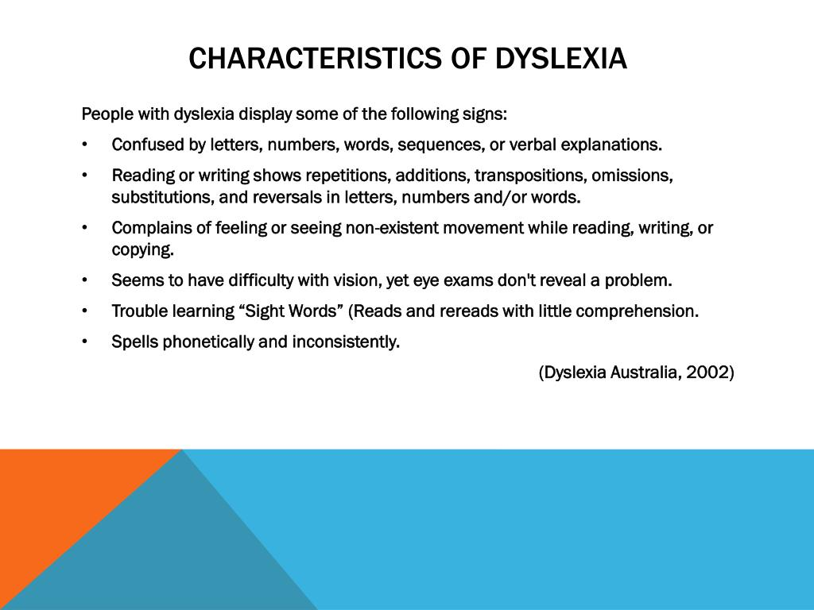
Dyslexia

Slide 6




Dyslexic Font Study
Some important considerations…
Many GED students have undiagnosed dyslexia
The GED® test is timed – thus reading efficiency is critical
Fonts in study...

Slide 7

Dyscalculia in Adult Education & GED Math
What is Dyscalculia?
Dyscalculia is a specific learning difference that affects a person’s ability to understand, learn, and perform math and number-based tasks.
It can manifest as difficulties with number sense, mathematical calculations, problem solving and more.
Often compared to Dyslexia but specifically impacts math skills rather than reading and writing; it is distinct and unrelated to intelligence or effort.
It’s recognized as a neurodevelopmental disorder in the DSM-5, under Specific Learning Disorders, with impairment in mathematics.
Prevalence estimates suggest around 3–6% of the population may have dyscalculia, but it is often underdiagnosed, especially in adults

Slide 8
Characteristics of Dyscalculia in Adult Learners
Adult learners with dyscalculia may experience…
Difficulties with Basic Number Sense
Trouble grasping the meaning of quantities (e.g., understanding what “5” means as a quantity)
Difficulty estimating amounts or comparing numbers
Challenges with Calculation and Numerical Memory
Persistent errors in basic operations (addition, subtraction, multiplication, division)
Difficulty remembering math facts (times tables, additions, subtraction facts)
Persistent errors in basic operations (addition, subtraction, multiplication, division)
Difficulty remembering math facts (times tables, additions, subtraction facts)
Spatial and Visual-Spatial Difficulties
Trouble aligning numbers in columns
Difficulty reading charts, graphs, or spatial layouts & reasoning/geometry/3D shapes

Slide 9
Characteristics of Dyscalculia in Adult Learners
Adult learners with dyscalculia may experience…
Issues with Time, Money, and Measurement
Difficulty telling time, reading clocks, estimating how long tasks will take
Challenges managing personal finances or making change
Struggling to measure or estimate sizes, distances, or weights
Math Anxiety
High levels of anxiety or fear when faced with math tasks
Avoidance behaviors that interfere with learning
Slow Processing Speed in Math
Taking longer than peers to complete math tasks (will restart several times despite knowing procedure)
Appearing “slow” in calculations despite strong reasoning skills in other area

Slide 10
Impact on GED Math Learning
Difficulty retaining math skills taught in previous lessons
short-term issues
Struggles with multi-step word problems common on the GED exam
over analyze presented information
Challenges understanding math vocabulary and symbols
symbols can appear backwards
Low confidence and increased test anxiety, especially in timed testing environments
May avoid math altogether, delaying their progress toward the GED

Slide 11
Dyscalculia Daily Living Characteristics
May perform similar tasks differently from day to day
May be able to learn information presented in one way, but not in another
May have difficulty following a schedule, being on time, or meeting deadlines
May get lost easily, either driving and/or in large buildings
May have trouble reading maps
May confuse similar letters or numbers, reverse them, or confuse their order
May have trouble dialing phone numbers and reading addresses
May confuse right and left, up and down
May be poorly coordinated

Slide 12

Strengths of Learners with Dyscalculia
May excel in other areas, such as:
Thrives with patterns and algorithms (after understanding concept)
Verbal reasoning
Creativity and problem-solving (compensation for lack of basic skills)
Storytelling and writing

Slide 13

Dyscalculia: The Key Takeaway
Dyscalculia is not about learners being “bad at math” or wanting to avoid it.
It’s a brain-based difference that requires targeted support.
Learners with Dyscalculia simply do not see numbers and number sense concepts in the same manner as traditional leaners.
With the right strategies, adult learners with dyscalculia can succeed and earn their GED
A special “Thank You”
to Kellie Blair Hardt who shared her journey and expertise with us as we consider how we can take the next steps to support our adult learners.

Slide 14
Practical Andragogy-Informed Teaching Strategies
Honor Learner Experience & Reframe Math Identity
Invite Learners to Talk Through Math
Allow Extra Processing Time & Reduce Cognitive Load
Use the TI-30XS Calculator with Intention
Integrate Assistive Technology & Visual Learning Apps
Notes:
Honor: Many adult learners carry math-related trauma from past school experiences. Help reframe their math identity through the use of affirming language and learner-centered practices.
§ Use statements like:
§ “You don’t need to be fast—you just need to understand it your way.”
§ Validate alternative methods: Learners with Dyscalculia may prefer using repeated addition instead of traditional multiplication. If it works, it’s valid.
§ Respond constructively to mistakes: Instead of “That’s incorrect,” try: “I see it differently or I disagree—can you explain your thinking?” This encourages reflection, peer discussion, debate and builds confidence.
Invite: Verbal reasoning often outpaces symbolic reasoning for learners with Dyscalculia.
o Ask learners to explain their thinking aloud to themselves before solving on paper.
o Encourage learners to record verbal reflections of their problem-solving steps to revisit later.
Allow: Provide pre-written notes, formula charts, or partially completed problem sets to ease cognitive demand.
o Introduce one new concept at a time to avoid overwhelm.
o Use spiral review: regularly revisit foundational skills alongside new content to reinforce retention.
Use: When used strategically, calculators can support mathematical reasoning and reduce working memory strain.
· Teach learners that tools are supports, not shortcuts.
· Model calculator use while narrating your thought process.
Integrate:Encourage use of apps like: Microsoft Math Solver, MathPapa, Photomath, ModMath (especially helpful for dysgraphia & dyscalculia).
· For instruction, try tools like Kami, a document annotation platform with features such as:
o Voice-to-text and text-to-voice

Slide 15
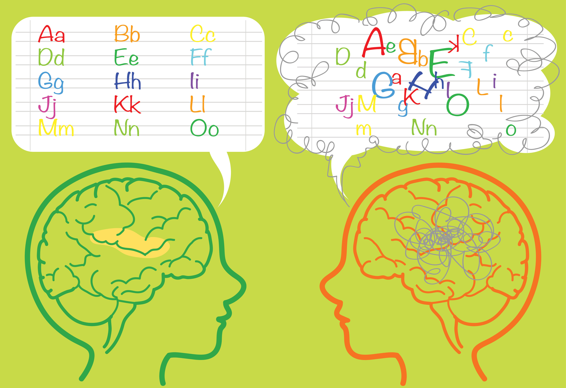
It’s Your Turn
What are you seeing in the classroom?
What strategies or resources would you like to share?
What support is needed for you and your students?

Slide 16



Thank you!
Kellie B. Hardt
Dyscalculia in Adult Education & GED Math
Hardt2Heart Adult Education Services, LLC
E-mail: hardt2heart75@gmail.com
or
ged2phd75@gmail.com
Jean Perrini
Lead Teacher
Workforce Development and Adult Education
Maryland Department of Labor
jean.perrini@maryland.gov
410-379-6283(O)
Debi Faucette
GED Testing Service
Concluding 35 years
in Adult Education
August 29, 2025

Slide 17

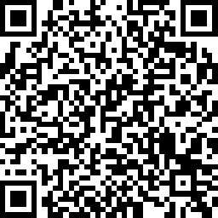
Session Survey
Your feedback is important. Please scan the QR code below to rate this session.

Slide 18
Additional Information

Slide 19
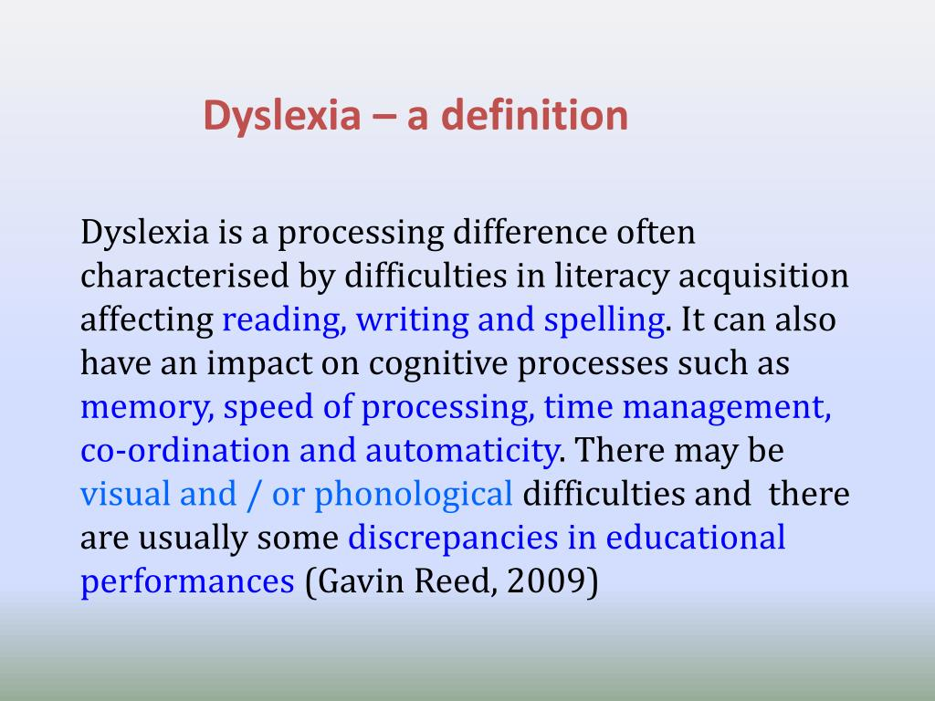
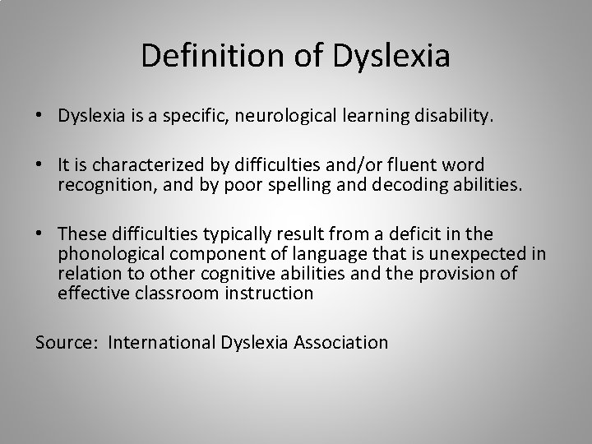
Dyslexia

Slide 20






Examples of Dyscalculia in Adult Learners
Making Change
Reading a Paycheck Stub
Graphs and Charts
Daily Living Math
Self-Avoidance and Perception
Word problems on the GED Math

Slide 21
Examples of Dyscalculia in Adult Learners
Making Change
Scenario: Jasmine, 32, retail
Can’t quickly figure out change for a customer if the register malfunctions.
Gets flustered and embarrassed, avoids shifts involving the cash register.
May hand over too much money or the wrong amount of change.
At home, struggles to track spending and balance a budget.
Very articulate and excellent with customers otherwise.
Reading a Paycheck Stub
Scenario: Luis, 44, pursuing GED
Has difficulty reading deductions on his paycheck.
Can’t figure out if overtime pay rates are correct.
Avoids discussing money because he’s afraid of “looking stupid.”
Does well in social studies and language arts GED classes, but dreads math.
Word Problem on the GED
Scenario: Monica, 27, GED student
Understands the words in a problem but can’t “see” how to set it up as an equation.
Loses track of steps while solving multi-step problems.
Mixes up operations (+ instead of ×).
Says: “I just shut down when I see a wall of numbers.”

Slide 22
Examples of Dyscalculia in Adult Learners
Daily Living Math
Scenario: Darius, 48, construction worker
Struggles measuring lengths precisely on the job.
Can’t quickly convert feet to inches or fractions to decimals.
Makes mistakes ordering materials because he miscalculates area or volume.
Highly skilled in building and problem-solving with his hands.
Time Management
Scenario: Tony, 52, in GED class
Arrives late to class because he misjudges how long his commute takes.
Has trouble estimating how much time to spend on math homework.
Struggles to keep pace on timed GED practice tests.
Feels embarrassed because he “should know this by now.
Graphs and Charts
Scenario: Anita, 39, studying for GED Math
Sees a bar graph and can’t match the heights to values.
Struggles reading pie charts or interpreting scales on graphs.
Says: “Numbers blur together and I can’t tell which is which.”
Excellent at writing essays and helping classmates with reading assignments

Slide 23
Examples of Dyscalculia in Adult Learners
Self-Perception & Avoidance
Scenario: Marisol, 34, returning to school for GED
Says she’s “bad at math” and avoids engaging during lessons.
Drops out of class once the math unit begins.
Reluctant to disclose difficulties, fearing she’ll be judged.
Previously labeled “lazy” or “not trying” in school, which hurt her confidence
Budgeting and Banking
Scenario: Andre, 29, full-time worker
Struggles to read bank statements or calculate interest rates.
Can’t keep track of due dates for bills because he can’t calculate days forward.
Overdrafts his account frequently.
Strong verbal communication and good work ethic, but calls himself “hopeless” at numbers.
Presented by
Kellie B. Hardt
Dyscalculia in Adult Education & GED Math
Hardt2Heart Adult Education Services, LLC
E-mail: hardt2heart75@gmail.com
or
ged2phd75@gmail.com

