Slide 1
How to Create IETs in Adult Ed!
Dr. Jeff Arnott, President of Lot 12 Education
Las Vegas, NV
GED® and GED Testing Service® are registered trademarks of the American Council on Education (“ACE”). They may not be used or reproduced without the express written permission of ACE or GED Testing Service LLC. The GED® and GED Testing Service® brands are administered by GED Testing Service LLC under license from ACE.

Slide 2
What is an Integrated Educational Training?
Integrated Education and Training (IET) combines education and job skills training to transition adult learners beyond basic education and through a career pathway that can offer them job training and eventual gainful employment (LINCS,2024).
It’s designed to help adults lacking basic, relevant occupational, and essential workplace skills attain the competencies and credentials needed for in-demand careers (LINCS, 2024).

Slide 3






Different IET Models
Bridge Models to Technical Training
Pre-Apprentiship Programs
Correctional Programs
ESL Intergration
Post-Secondary Dual Enrolled
Out of School Youth Models

Slide 4
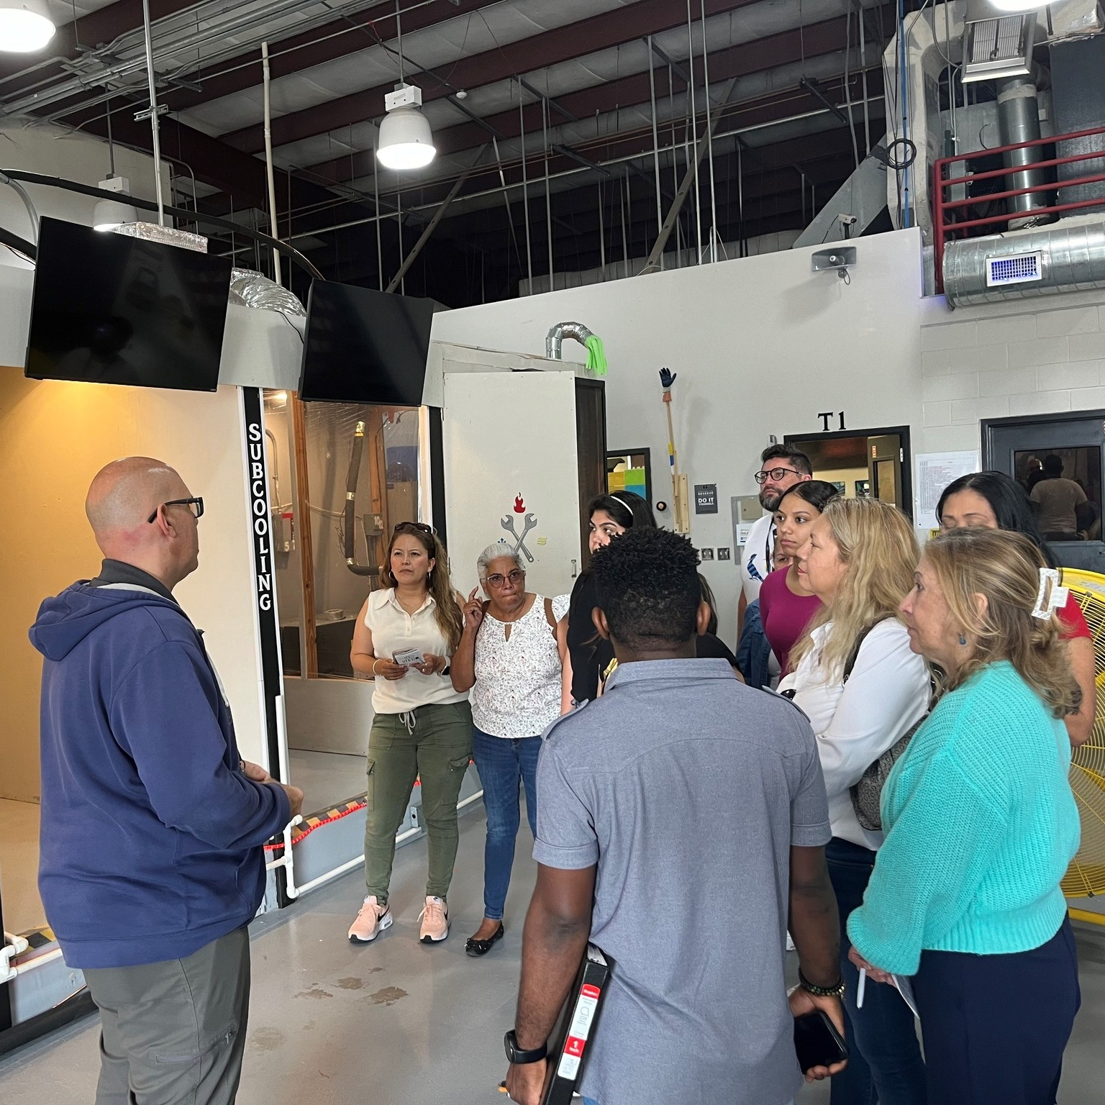
How Do You Measure A Successful Program?
What is a Successful Program?
Uses a Holistic Approach with High Expectations.
Improves Employment Outcomes for Students.
Hand On Contextual Approach.
Integration of Career Pathways.
Collaborative Work Based Options.
Flexible and Customizable.

Slide 5
How Long Does It Take?
FACTORS!
Depends on the situation! Many variables!
Industry / Institutional support.
Contracts / Equipment purchases.
Recruitment of staff and students.
Varies on the occupation or program.
Varying Department of Labor or Education processes.
You should take at least six months to plan.

Slide 6
Popular IET Programs
Programs in which I have had success:
Medical Assistant – Orlando Health
Carpentry – iBuild Central Florida
Deisel – School District of Osceola
Parapro – School District of Osceola
Manufacturing – Knights
Cybersecurity – Various
Culinary – Various
Other Possibilities:
HVAC
Welding
Project Manager
Graphic Design
Plumbing
Automotive Repair

Slide 7
Six Steps to Build a Great IET!
Wisely choose an IET program.
Identity staff & partners / Build Curriculum
Purchase equipment & materials.
Choose format, create schedule & develop articulations.
Market the program & recruit students.
Follow up and monitor.
CELEBRATE!

Slide 8
STEP ONE Wisely Choose an IET Program!
Assess what aligns best with your local program and economic conditions.
​
Gather market information from local chambers of commerce and the Department of Labor.
Identify available funding opportunities.
Find out which industry certifications are required in your area.
Conduct surveys with the students.
​ ​

Slide 9
STEP TWO
Identify Staff & Partners / Build Curriculum
Identify staff who are willing to plan & teach the classes. Create timelines.
Recruit employers to help design the related instruction, build curriculum & mentor students.
Find employers who will interview & hire your students.
Let the employers drive the conversations. Listen to them!
Have staff give you (if you are the supervisor) timelines and recommendations.
Set time (and wages) aside for those involved in the program to create IET standard and curriculum.

Slide 10
STEP THREE
​ ​
Purchase Equipment & Materials
Secure items for students with unique needs (e.g., ESL).
Identify supplemental materials & software.
Purchase any equipment that might be needed, especially large items with long lead times
Procure your bids and contracts.

Slide 11
STEP FOUR
​ ​
Create Format, Create Schedule, & Develop Articulations
Determine the number of hours the IET student will need to complete.
Will it be co-taught, hybrid, or online?
Determine the classroom calendar dates.
If needed, schedule staff trainings & professional developments.
Develop articulations with colleges, apprenticeship partners, technical schools, & other employment trainings providers.

Slide 12
STEP FIVE
​ ​
Marketing your program & student recruitment
Use a variety of techniques. Have a team responsible for community outreach.
Determine how many students plan to recruit. Determine the number of alternatives.
Develop a recruitment calendar & interview questions.
Interview as many candidates as possible.
Address any barriers to attendance.
Schedule all your mentor visits, job fairs, guest speakers, & other events before the course begins so you can give students advance notice.
Make sure all students get a (paper) copy of their paperwork & schedule.

Slide 13
STEP SIX
​ ​
Follow up and keep track!
​
Involve career navigators in the process and support students who may be facing difficulties. Offer extra academic assistance when necessary.
Regularly check in with teachers to see if they require any help.
Maintain some reserve funds for the program’s emergencies.
Have both students and teachers assess the IET upon completion. Conduct exit interviews to gather feedback for future improvements.
​

Slide 14

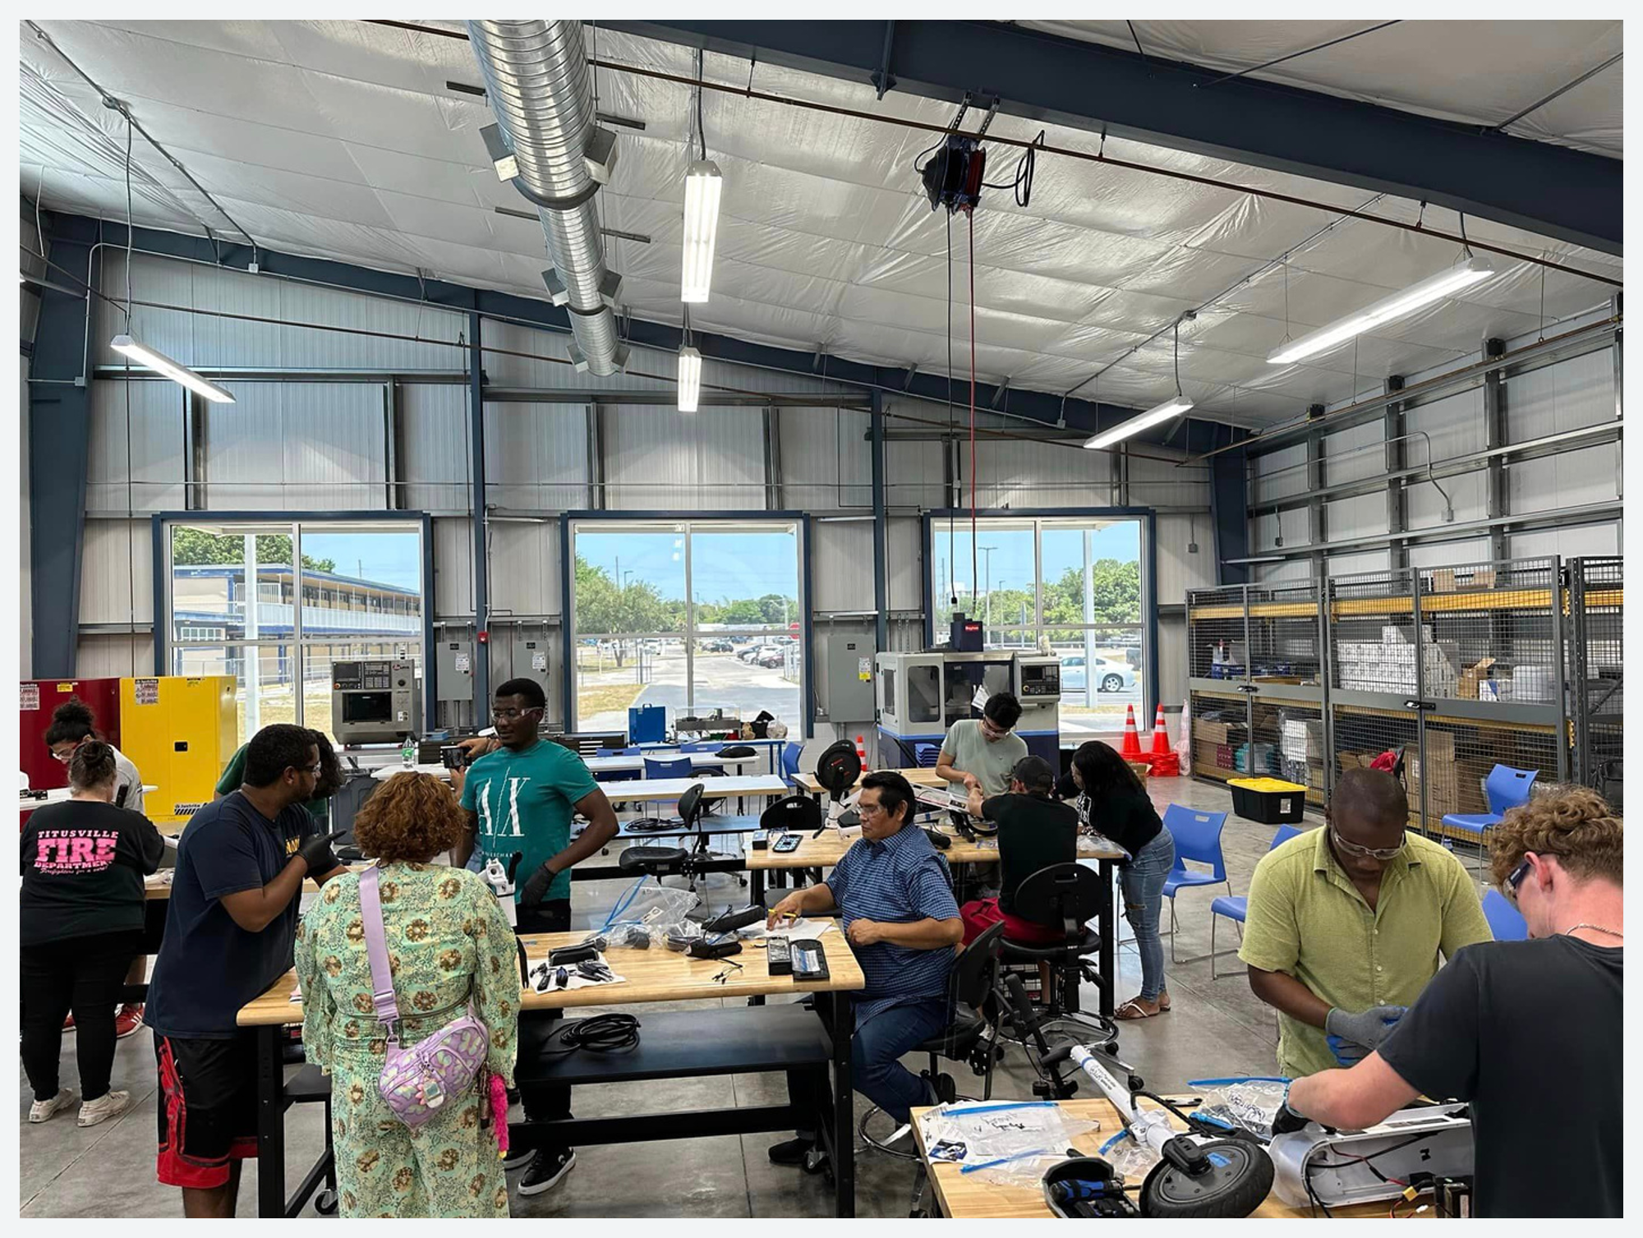
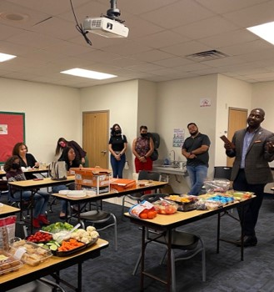
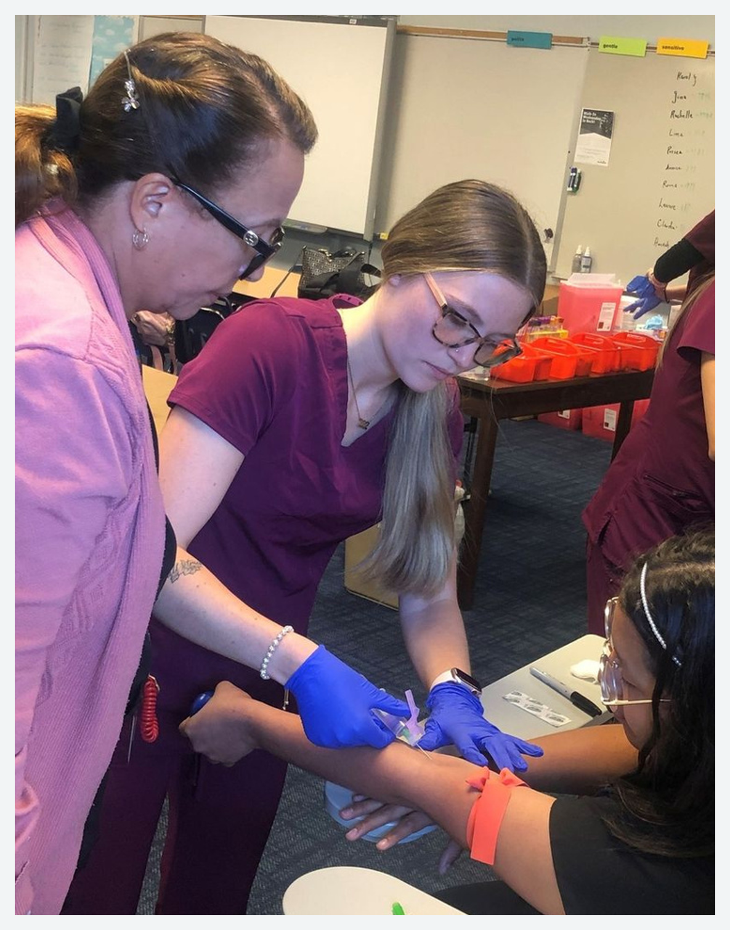

CELEBRATE & SHOWCASE!
​
​

Slide 15
Six Steps to Build a Great IET! REVIEW!
​ ​
Wisely choose an IET program.
Identity staff & partners. Develop curriculum.
Purchase equipment & materials.
Choose format, create schedule & develop articulations.
Market the program & recruit students.
Follow up and monitor.
CELEBRATE!
​

Slide 16
Thank You! Dr. Jeff Arnott 407-719-7123 jeff@Lot12Education.com X @JefferyArnott
Some additional subtitle text

Slide 17

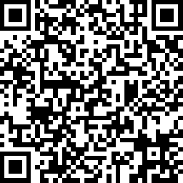
Part 1 Session Survey
Your feedback is important. Please scan the QR code below to rate this session.
QR CODE PLACEHOLDER

Slide 18
Part 2 Session Survey
Your feedback is important. Please scan the QR code below to rate this session.
QR CODE PLACEHOLDER

