Slide 1
Pearson VUE in the House!
Amber Thompson
Program Manager
GED® and GED Testing Service® are registered trademarks of the American Council on Education (“ACE”). They may not be used or reproduced without the express written permission of ACE or GED Testing Service LLC. The GED® and GED Testing Service® brands are administered by GED Testing Service LLC under license from ACE.

Slide 2
Agenda
1 | VUE vs GED: What is the difference?
2 | Best practices with students
3 | Vouchers
4 | OnVUE vs In Person
5 | Accommodations
6 | Security
7 | Connect

Slide 3
VUE vs GED: What is the difference?
Pearson VUE
Pearson VUE is the testing center that delivers the exam.
Provides secure testing environments, whether in physical test centers or through online proctoring services (OnVUE).
Handles the technical aspects of test delivery, including scheduling, check-in, monitoring, and scoring.
VSS, PCs, Call Center, Marketplace, Registration Manager, Admissions Manager, Connect, Channel Care
GED
GED Testing Service (GEDTS)is the organization that creates and owns the GED test, which is a high school equivalency credential
Provides the scores and works with vendors to provide the transcript and diploma
Partners with the jurisdictions and holds the contracts
SRMs, GED Manager™, GED Direct™

Slide 4
Best practices with students
ID policies
What if the ID doesn’t match?
DOB
Out of state
Breaks
Unscheduled breaks are not allowed
Exhibits
Create a case to request additional RLA and Math exhibits
Be up to date with your state specific policies
Review in connect

Slide 5
Vouchers: Marketplace vs GED Direct
GED Marketplace™
This is a platform where anyone can purchase GED Ready practice tests and GED test vouchers. Vouchers are used to pay for tests and are received via email.
If you need to purchase GED tests or practice tests for yourself or to distribute as vouchers, GED Marketplace™ is the appropriate platform.
Vouchers can be assigned to anyone. The student does not need to be part of your program or jurisdiction as long as the price is the same.
GED Direct™
This is a feature within GED Manager™ that allows educators with access to purchase and directly assign GED Ready® and GED® tests to their students. Instead of using vouchers, the tests are directly linked to student accounts, making tracking easier.
  This also eliminates the need to extend expiration dates
If you are an educator with GED Manager™ access and want to directly manage and assign tests to your students, GED Direct™ is the ideal choice.

Slide 6
Vouchers
Feature | GED Marketplace | GED Direct
User | Anyone | Educators with GED Manager access
Purchase Method | Voucher codes | Direct assignment to student accounts
Management | Purchase and distribute vouchers | Assign and track usage through GED Manager
Test Expiration | Vouchers have an expiration date. Can always be extended | Assigned tests do not expire

Slide 7
OnVUE vs In Person
Online Testing
Pros:
Offers flexibility and convenience for those who prefer to test from a familiar environment, according to OnVUE.
You can test from home or another suitable location with a reliable internet connection, a webcam, and a computer meeting specific requirements.
Cons:
Requires a reliable computer, internet connection, and a suitable testing environment.
Strict adherence to rules and potential for technical issues are also factors.
You need to ensure a quiet, distraction-free environment and meet specific technical requirements for your computer, internet, and webcam.
A live proctor monitors you through your webcam and screen sharing, ensuring test integrity.
In-Person Testing
Pros:
May be preferred by those who prefer a traditional testing environment and have access to a convenient testing center.
A proctor is physically present at the testing center to monitor the exam.
Cons:
Less flexible in terms of location and scheduling, and may require travel and adherence to specific rules.
The need to travel to the center, and they may have specific rules about personal belongings and other procedures.
You must go to a designated GED testing center.

Slide 8
OnVUE
Age guidelines
  Under 18 and needing a guardian
ID guidelines
  All IDs must be original (not a photocopy or digital ID), valid (unexpired), and government issued.
  IDs are valid (unexpired) if they do not contain an expiration date that has passed. If there is no
  expiration date on an ID, it is valid.
  All IDs must include the candidate's name and recent, recognizable photo. A visible signature is
  not required.
  All IDs must have a first and last name that matches the first and last name the candidate used to
  register (the name in the ProctorServ system)
  Restricted IDs
    Geneva Convention ID card
    Canadian health insurance card (issued by any province)
    U.S. House of Representatives ID
    U.S. military ID
    U.S. Senate ID
At home testing option
  Not intended to replace a site

Slide 9
Accommodations
To obtain accommodations for the GED test, individuals with documented disabilities need to apply through their MyGED account. The process involves creating an account on GED.com and selecting the option for accommodated testing.
Applicants must then submit documentation from qualified professionals, such as doctors or psychologists, that supports their need for accommodations, and also provide a rationale for their requested accommodations.
The Pearson VUE Development Team is working on an internal tool to help certain web scheduleable accommodations bypass the current accommodations scheduling process which requires candidates to call between 7am and 7pm CST.
Additionally, we have hired more accommodations agents to help with volume and assist in a more timely fashion

Slide 10
Security
Completed:​
​
OnVUE is now able to compare their current Headshot to the Headshot from their last session,regardless of whether the candidate tested at the Test Center or OnVUE.​
Geofencing and Inverse Geofencing for OnVUE Delivery. GEDTS is now blocking all countries except for USA via IP Address, post-VPN Disconnection​
Enhanced Router-Level VPN Blocking, in addition to our current application-level blocking​
​
Roadmap:​
Second generation OnVUE video sensors for No-Body, Multi-Body, Same-Face and Item Sensor, whichwill scan for cell phones, textbooks, pens, etc..​
A new AI risk-assessment score to calculate Candidate Risk​
Exciting Proof-of-Concept Experiments for both PalmID Biometric Authentication and Dual Camerafor OnVUE​

Slide 11
CCT
Cloud Computing Technology
No more updates – we’ll take care of them for you
Just need internet
Let your SRM know if you are interested

Slide 12
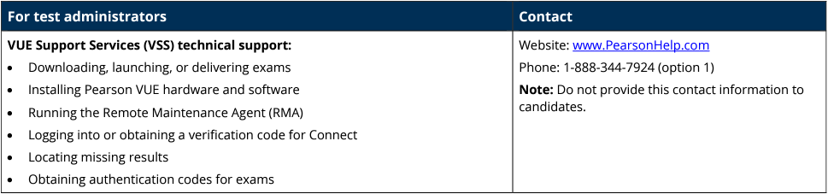
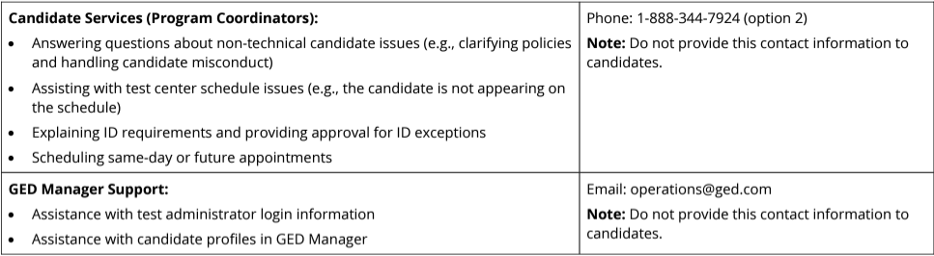
Support Line
Notes:
Content Slide color accent left

Slide 13
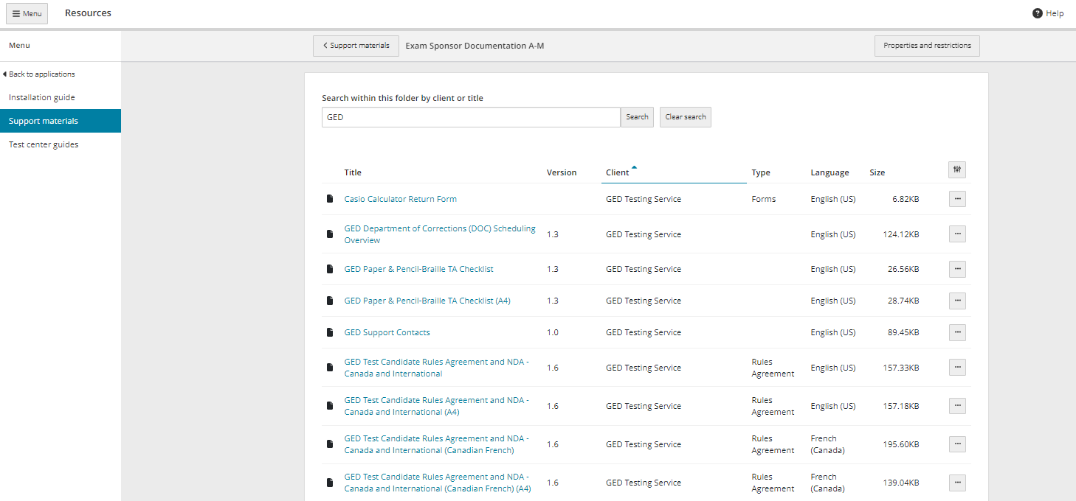
Assist

Slide 14
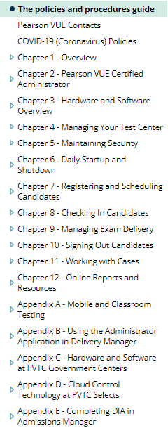
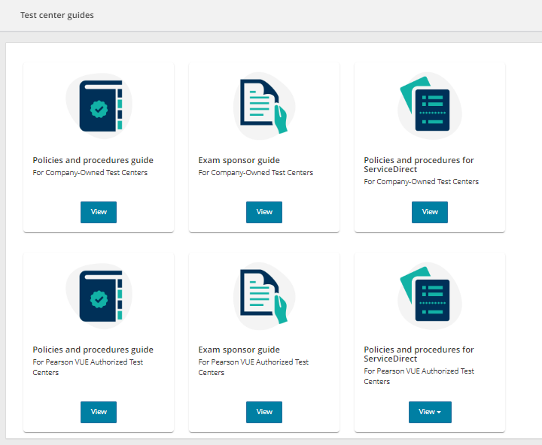
Assist Cont.
Test Center Guide:
Service Direct:
Case Creation
Site Closures
New updates coming! Look for information

Slide 15


Session Survey
Your feedback is important. Please scan the QR code below to rate this session.

