Slide 1

Rawan (Ro) Hanna
Sr. Manager, Workforce Development
GED® and GED Testing Service® are registered trademarks of the American Council on Education (“ACE”). They may not be used or reproduced without the express written permission of ACE or GED Testing Service LLC. The GED® and GED Testing Service® brands are administered by GED Testing Service LLC under license from ACE.

Slide 2





Economic Facts
39%
Of students who attend four-year institutions do not complete education
$1.6 Trillion
Of outstanding federal student loan balance
47.2 Million
Of Americans have outstanding student loans
(20% - undergrad & 24% postgrad)
$68K
Average salary in the U.S.*
*may differ based on occupation, education, state, etc.
38 Years Old
Is the average age of first-time home buyers
While housing market has improved (4.5M home deficit), not many can afford the cost
Sources: Inside Higher Ed: Nearly 40% of Students Started, Never Finished College (April 10, 2024); Education Data Initiative: Student Loan Debt Statistics (Updated March 16, 2025); SoFI Learn: Average US Salary by State (January 28, 2025); NBC News: Many first-time homebuyers are pushing 40 as millennials wait in vain for a better market (April 18, 2025); The Hill: America’s housing shortage by the numbers (April 17, 2025); Zillow: The U.S. is now short 4.5 million homes as the housing deficit grows (June 18, 2024)

Slide 3






The Skilled Labor Gap
91%
of Pros report difficulty finding skilled labor
72%
Of Pros are challenged to meet project schedule requirements
53%
Of Pros take fewer projects due to limited labor resources
40%
Of the construction workforce is set to retire in the next decade
3.9M
Trade jobs will open in the next decade
$75K
Average wage for construction workers in the U.S.*
*May differ based on occupation, state, etc.
Sources: Bureau of Labor Statistics Occupational Employment Projections, 2023-2033; BLS Monthly Job Openings Report, Oct 2024; USG + US Chamber of Commerce Construction Index Q4 2021; Spring 2024 HBI Construction Labor Market Report; Associated General Contractors of America 2024 Construction Outlook National Survey

Slide 4
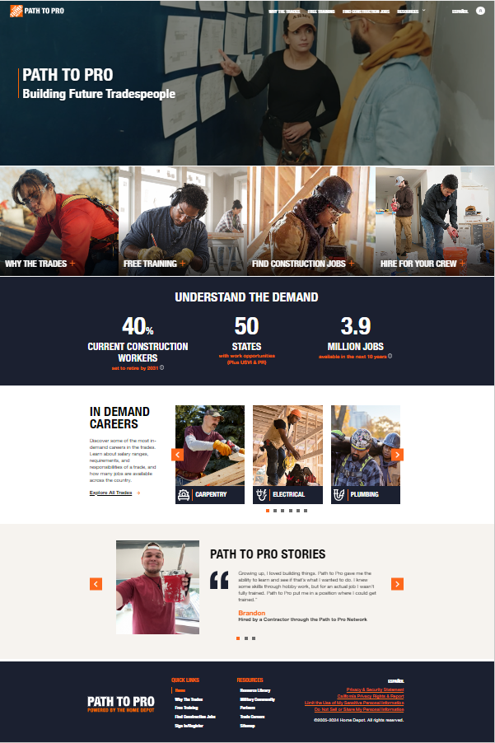
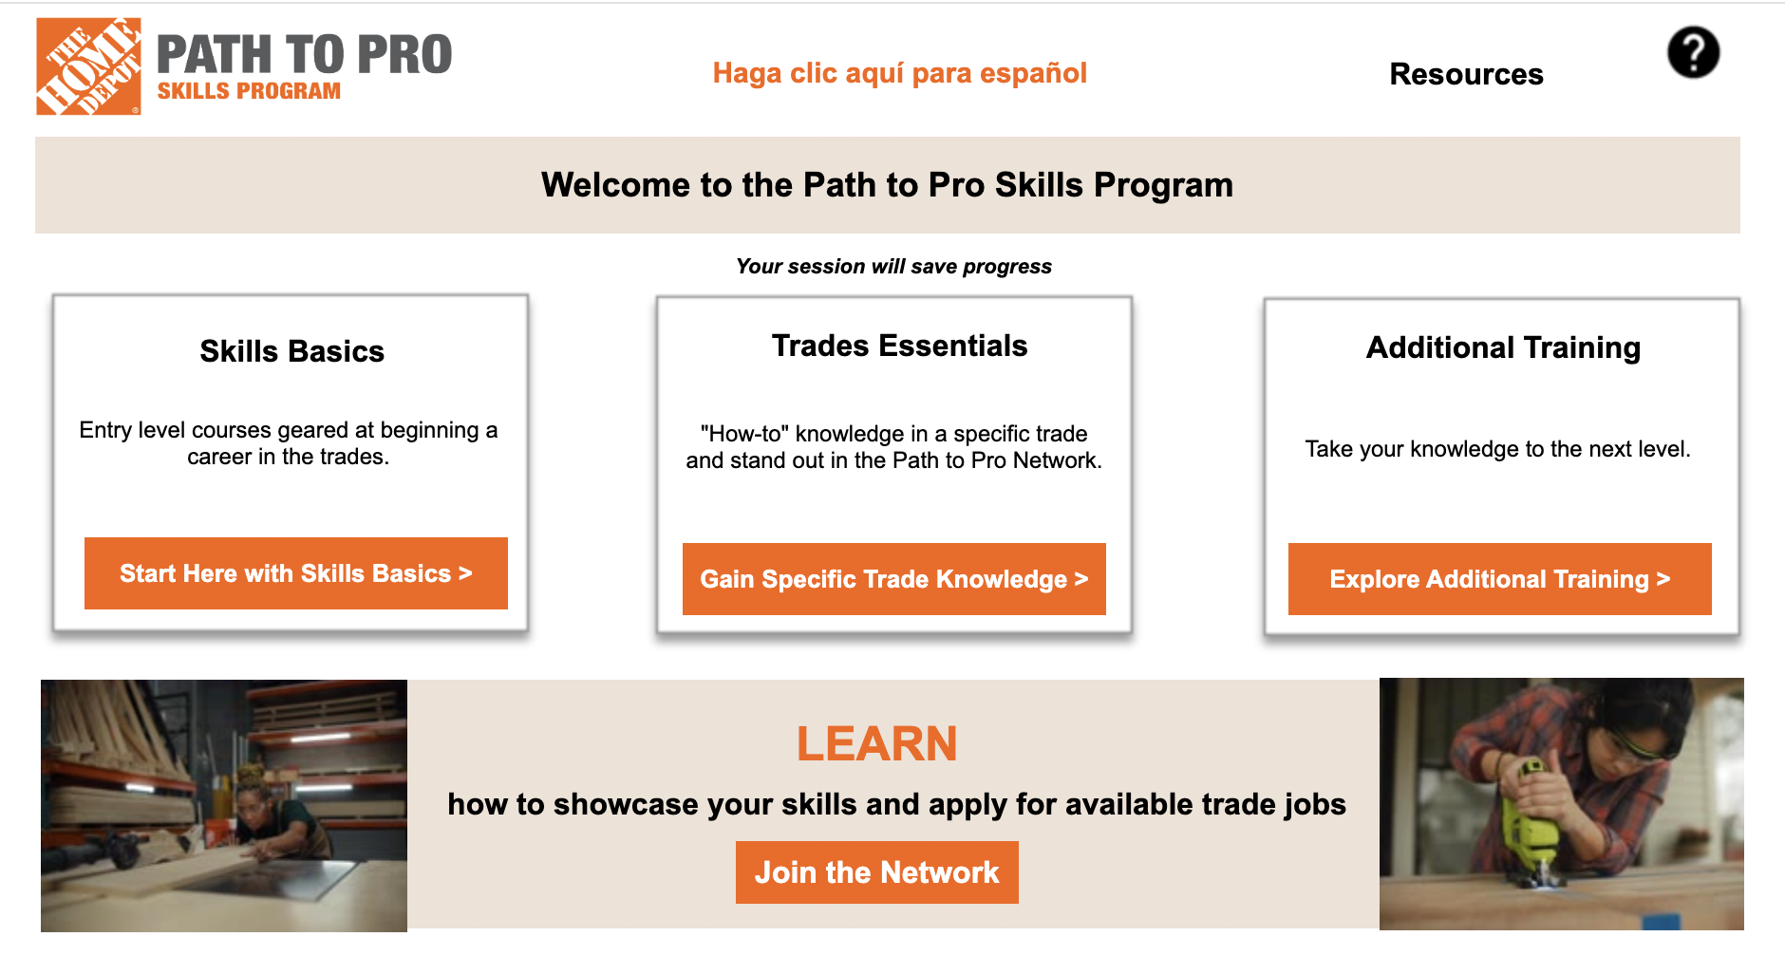
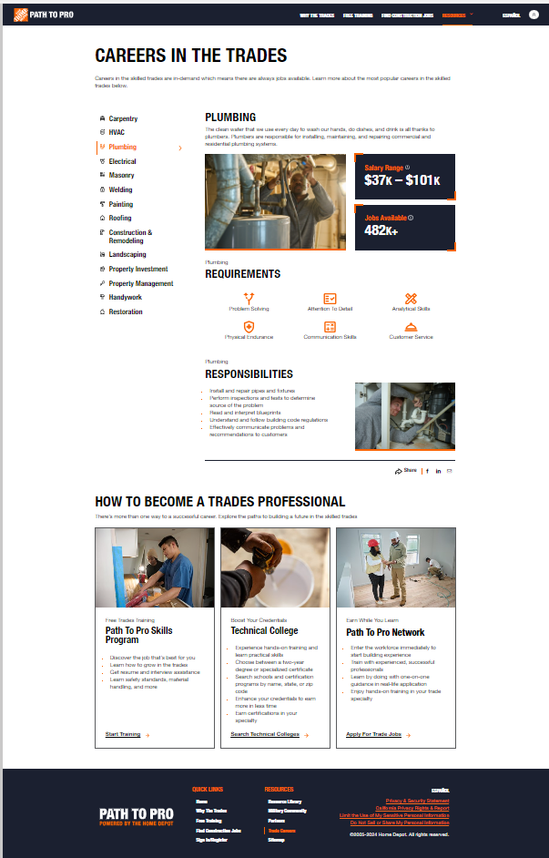

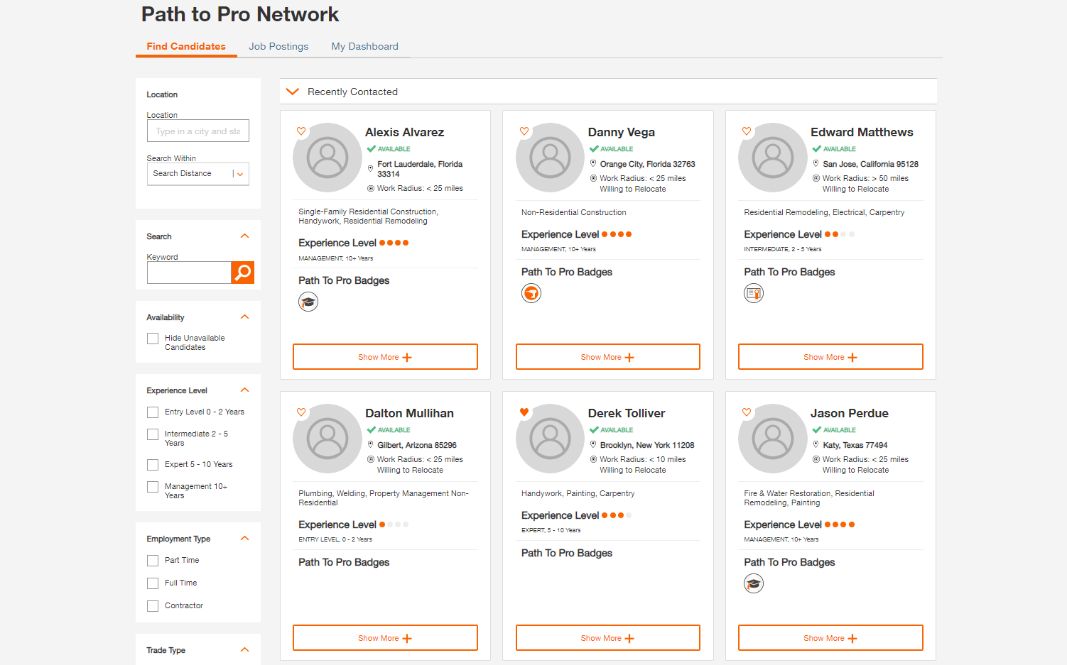
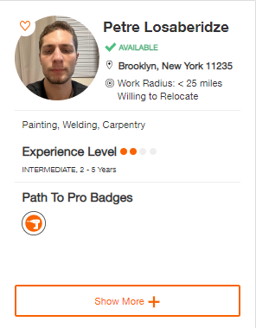
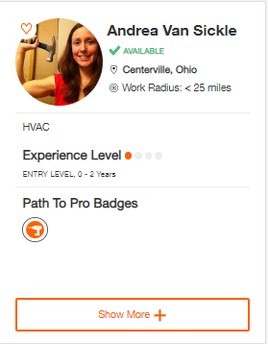
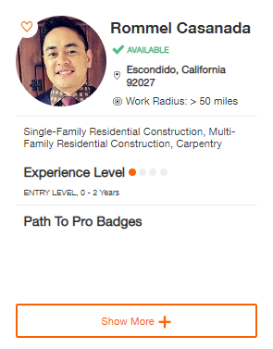
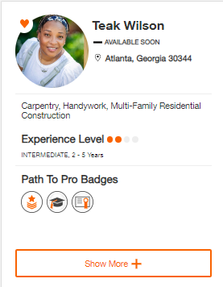
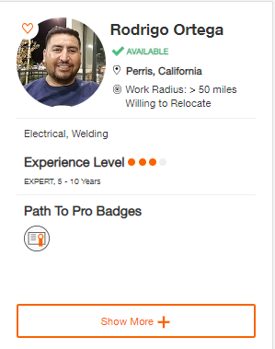
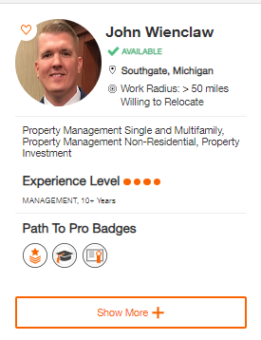

Solution for Trades Careers, Supporting our Pros
OUR mission
Reduce the barrier to entry for the next generation of trades professionals and provide Pros access to ready-to-hire candidates.
THD will engender higher loyalty, enable more jobs, and grow the home improvement industry.
Path to Pro Website
Path to Pro Skills Program
Path to Pro Network
One-stop-shop resource for prospects, parents, and influencers
Free, self-paced training for entry-level trades prospects
Proprietary labor marketplace and job board

Slide 5
PathtoPro.com
One-stop-shop resource with realistic information on the trades industry, providing next step career direction
PathtoPro.com launched in 2021
Provides trades information and why a career in the industry is a wealth creating opportunity
Details about the different trade types, training requirements, starting wage, and job opportunity
Site created to serve people interested in the trades, guidance counselors, and existing tradespeople seeking jobs
Fully translated in Spanish

Slide 6
Path to Pro Skills Program
Free, self-paced online training for entry-level trades prospects
FREE entry-level training for trades training thru self-paced, virtual content
  Provides trades fundamentals as well as soft skills and behavior setting
  Features quizzes and assignments that allow students to track progress
  Career mapping to help candidates plan their trajectory through goal setting

Slide 7
Path to Pro Network
Proprietary labor marketplace and job board for construction industry
JOBSEEKERS
  FREE real-time access to jobs in your trade, based on location and availability to work, and can apply in one-click
  Create a profile showcasing qualifications, including resume and work portfolio
  Ability to connect with hiring Pros
PROS
  Exclusive FREE access to community of trades jobseekers
  Pros can search talent based on location, job experience, and training
  Pros can create free job postings

Slide 8

How You Can Help
Help educate students about the opportunities in the skilled trades
Raise awareness of the skilled trades needs and as a great career path for students
Support guidance counselors and teachers to prioritize the skilled trades just as a 4-year college institution

Slide 9

TRADES TRAINING.
JOB CONNECTIONS.
Free with Path to Pro

Slide 10

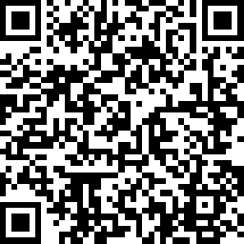
Session Survey
Your feedback is important. Please scan the QR code below to rate this session.

