Slide 1
Multidisciplinary Instruction: How To Maximize Your Teaching Time
Anita Kerr - Illinois Professional Development Network
GED® and GED Testing Service® are registered trademarks of the American Council on Education (“ACE”). They may not be used or reproduced without the express written permission of ACE or GED Testing Service LLC. The GED® and GED Testing Service® brands are administered by GED Testing Service LLC under license from ACE.
Notes:
All photos accessed via Microsoft 365 account – creative commons

Slide 2
bit.ly/multitaskingteachers
All resources mentioned in the presentation are available here.
Notes:
Link to all resources is here for your reference after the session -
You also have a handout with this link and a place to take notes

Slide 3

What's your role?
Notes:
Please tell us your role in adult education – classroom teacher, support staff, administrator, PD trainer, other? (Show of hands)
Though this session will speak most directly to teachers, hopefully all of you can take away information and resources that can be shared in your work teams.

Slide 4


You’re asking me to do WHAT???
ThePhoto by PhotoAuthor is licensed under CCYYSA.
The Photo by PhotoAuthor is licensed under CCYYSA.
Notes:
My friend and colleague Pat from LLCC here in Illinois gave me some good insight into what many teachers are feeling – often at the start of every semester. When I asked her, “What would be most helpful to teachers at this time?” she gave me this suggestion: help them not to feel so overwhelmed by all the demands on their class time – help them make the most of every classroom minute so their students can benefit the most.

Slide 5
We’re asking you to…
prepare students for HSE exams
incorporate college and career readiness concepts to meet WIOA regulations
teach to rigorous content standards
incorporate evidence-based practices
use (and teach students to use) technology
assess students to demonstrate level gains
Notes:
For those who are not teachers, your list may differ, but I bet it is still a complicated, multi-layered list!

Slide 6
Research says we are poor multitaskers…
“Doing more than one task at a time, especially more than one complex task, takes a toll on productivity.” www.apa.org
“Research conducted at Stanford University found that multitasking is less productive than doing a single thing at a time.”
“Here’s practical advice from a neuroscientist: Don’t try to multitask. It ruins productivity, causes mistakes, and impedes creative thought.” www.fortune.com
A recent Harvard Business Review post said multitasking leads to as much as a 40% drop in productivity, increased stress, and a 10% drop in IQ (Bergman, 2010).

Slide 7

Let's conduct an experiment...
Notes:
Let’s try a short experiment to simulate the problems of multitasking…
Show this YouTube video and have them do the activity – 5 minutes – 'Switchtasking is a thief' - You'll need a pen or paper and a blank sheet of paper (please feel free to use the back of your handout)
Don’t write anything on your paper until he says GO
https://www.youtube.com/watch?v=5eQyfirx2HA&t=3s

Slide 8
Multidiscipline, not multitask!
If multitasking is not a good option, then let’s become multidisciplinary planners instead. If we plan well and wisely at the outset, we will make life easier for ourselves, school more effective for students, and training more efficient for our participants.
Notes:
If multitasking is not a good option, then let’s become multidisciplinary planners instead. If we plan well and wisely at the outset, we will make life easier for ourselves, school more effective for students, and training more efficient for participants.

Slide 9
One approach to organizing content…
Language Arts
Reading strategies
Writing skills
Social Studies
Civics & government
Thousands of years of human history
Science
Biology, physics, chemistry, earth science, life science
Workplace and Career Readiness
Technology
Soft Skills
Content for Career Pathways
Interpret word problems
Numeracy, algebra, geometry
Teach a little Shakespeare
GED's essential questions
Scientific method
Show how to use that calculator
Hands-on experiments
Grammar
ELL Instruction
Civics concepts
Speaking & Listening
Vocabulary
Math
Notes:
* Silo approach: Teach content and skills in isolation (“this is a reading class, so we have to study reading skills”). Even if programs are set up this way, teachers can be creative in how they build lessons…we will see an example of this in a couple of slides
Again, if your role is not that of a teacher, you likely still have a tendency to silo your tasks in a similar way...

Slide 10
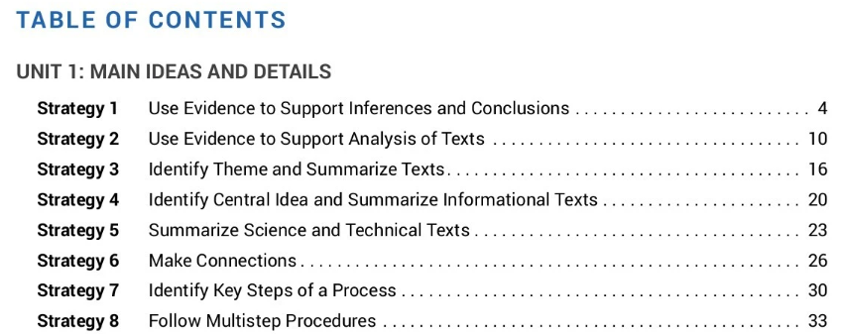
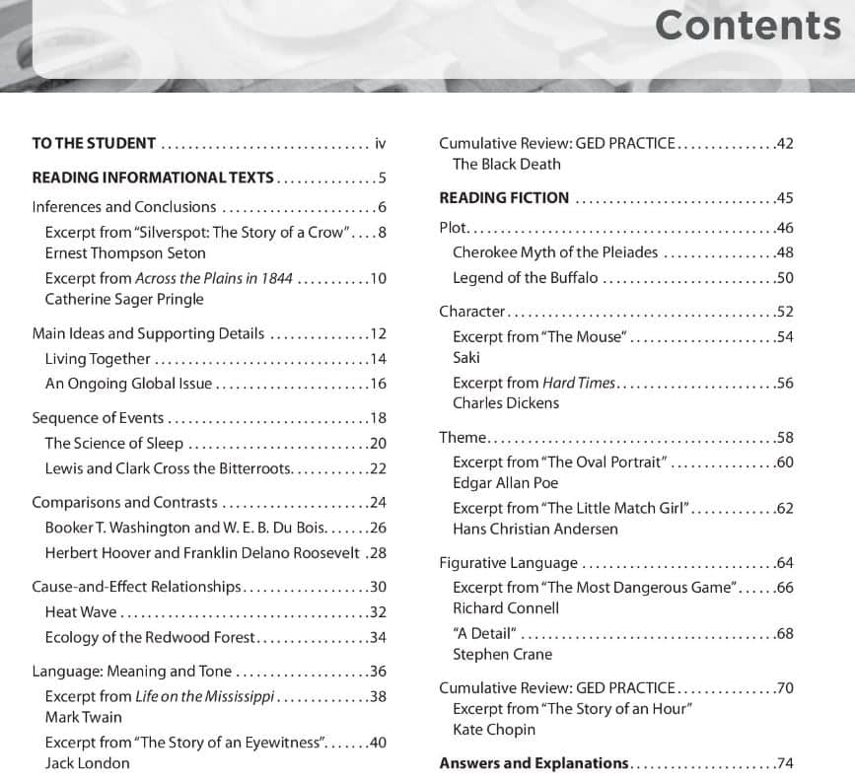
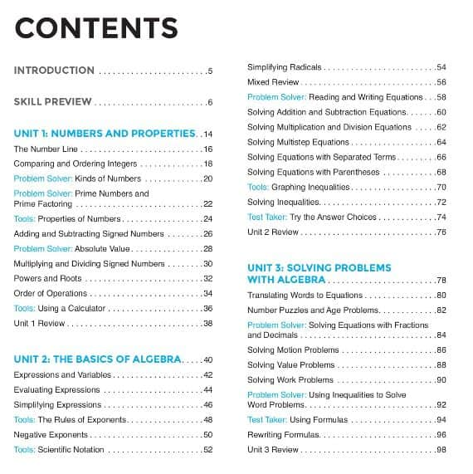
Adult Education textbooks often lend themselves to silo approach
Notes:
The typical adult ed textbook contributes to our tendency to stick to the silo approach – look at any table of contents. Teach this skill, then teach this skill, then teach this skill – a different text or problem set for each skill – these books are generally not thematically based. By reading one text to learn one skill, think how much time is spent reading multiple texts – we can find ways to overlap!
New Readers Press – Writing for the GED Test #2: Reading Comprehension
New Readers Press – Math Sense #2: Focus on Problem Solving

Slide 11
A better approach to maximize your time…
Theme/Concepts/Skills
Language Arts
English Language
Soft Skills
Science
Workplace Readiness
Social Studies
Career Awareness
Math
Technology
Notes:
Approach lesson plans with this visual in mind, as opposed to the silo approach on the previous slide. Ask yourself: What theme, concept, or skill do you want to teach, and what multiple content areas can you embed in the lesson to accomplish that goal? And remember, we aren’t going to switch back and forth between them like switchtasking – we will incorporate several skills into one activity so students see how these skills overlap and relate to one another!
What is the benefit of planning this way?

Slide 12
Benefits of a Multidisciplinary Approach
Connections – Show subjects as connected rather than separated to make meaningful connections.
Quality Time on Task – Use time more efficiently.
Communication – Active exploration of a theme promotes dialog, which develops speaking and listening skills.
Authenticity – Cross-curricular = realistic learning (not isolated and segmented). This is more like real-world problem solving!
Notes:
Put any other benefits to this approach in the chat –
Which of these benefits is most meaningful in your role?

Slide 13
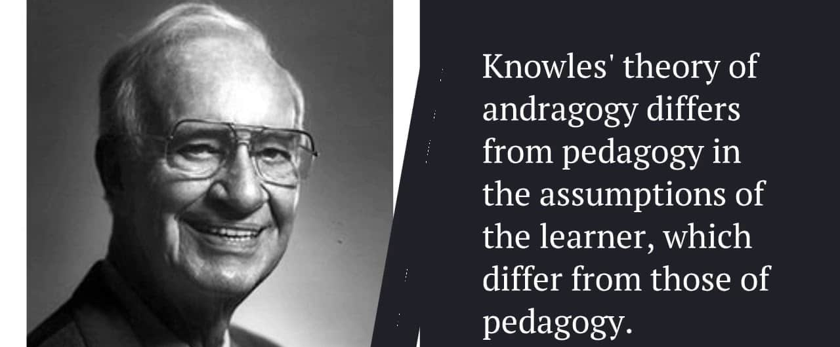
Does a lot of this sound familiar?
YES! It’s andragogy!
Notes:
This is Malcolm Knowles, the ‘father of adult learning theory’ – he helped us understand the key differences in the way adults approach learning, as opposed to how children approach learning… We can use this adult learning theory no matter how we are working with adults! But it especially helps us understand how to work with adult learners in the classroom.

Slide 14
What does Adult Learning Theory tell us?
Since adults are self-directed, they should have a say in the content and process of their learning.
Because adults have so much experience to draw from, their learning should connect to what they have already learned.
Since adults are looking for practical learning, content should be relevant to their academic, work, & personal goals.
Learning should center on solving problems instead of memorizing content.
Notes:
So what does adult learning theory tell us? Here’s a summary: Click for 4 bullets.
Highlight 1 or 2 of these and ask for a few examples that demonstrate how they've seen adult learning theory in action.
One example: using scenarios / real-life examples for discussion or as problems for them to solve, rather than just present facts for them to memorize. Putting the info in a context that makes sense to an adult helps them relate, learn, and apply. To teach an adult safety standards in the workplace, you could give them a handbook of rules to memorize. OR you could present a rule and then a scenario where they have to explain why that rule is in place and how it will protect them…this is contextualized learning for adults!

Slide 15

The College and Career Readiness Standards
The CCR Standards are a great foundation on which to build multidisciplinary lessons.
Do you have a copy?
Do you have it bookmarked on your computer?
Notes:
Standards found here: https://excellenceinadulted.org/resources/iccb-statewide-contextualized-curricula
Your state, like IL does, may also have its own adult education standards that are based on the CCRs. Be familiar and use them to help guide your planning.

Slide 16
A specific Language Arts content standard to teach:
CCR Anchor 8
Silo approach
Delineate and evaluate the argument and specific claims in a text, including the validity of the reasoning as well as the relevance and sufficiency of the evidence.
Select an article from a text or the internet.
Students read it, determine one claim the article makes, and provide some specific evidence that supports the claim.
Students write a brief written response and turn it in.
Notes:
Example: let’s say you want to teach the Language Arts college and career readiness standard Anchor 8 at Level B - Here’s how the silo approach might look, where you are achieving that one specific LA standard, but not much else...

Slide 17

But better yet: take a minute to brainstorm!
Notes:
Please think of at least 2 other content areas that could be brought into the lesson to complement the reading standard and record them on your notes page.
(Go to content standard slide before asking for responses)

Slide 18
What else can we logically add to the lesson?
Theme/Concepts/Skills
Language Arts
English Language
Soft Skills
Science
Workplace Readiness
Math
Technology
Social Studies
Career Awareness
Notes:
Remember, we are teaching how to delineate and evaluate the claims in a text, and we want to figure out logical ways to incorporate other content areas and skills. ….

Slide 19
A specific Language Arts content standard to teach:
CCR Anchor 8
Silo approach
Delineate and evaluate the argument and specific claims in a text, including the validity of the reasoning as well as the relevance and sufficiency of the evidence.
Select an article from a text or the internet.
Students read it, determine one claim the article makes, and provide some specific evidence that supports the claim.
Students write a summary paragraph and turn it in.
Notes:
Let them have a few minutes to brainstorm – take a few suggestions.

Slide 20
CCR Reading Anchor 8 – Delineate and evaluate the argument and specific claims in a text
Select a text on a scientific topic (article on the likely causes of climate change) Science, Career Awareness
Ask students to identify 3 claims made in the text (including data such as temperatures, ocean levels, etc.) Math
Put students in groups and ask them to create a brief PowerPoint illustrating the 3 claims. Require them to create a graph, chart, or other visual to support the data from the text. Technology
Ask students to present the PowerPoint to the class, requiring them to explain the claims, delineate supporting evidence, and field questions from the class. Soft Skills
Notes:
One example – throughout the lesson the original LA reading standard is being targeted, but 4 other content or skill areas are included as well.
What were some of the ideas you had?
Career Awareness: Use a workplace-related text or article
Math: select a text that includes claims with data and or financial information that can be calculated or analyzed
Technology: require students to type their extended response / ask students to research an opposing claim to the one made in their text
Soft Skills: have students work in groups, ask them to present their findings, allow them to debate each other’s claims using appropriate communication skills

Slide 21

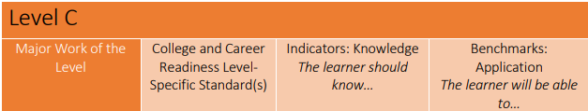
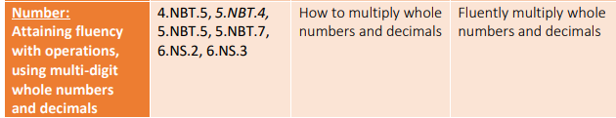
Can you identify 2 other content areas or skills to incorporate into a lesson on this math skill?
Notes:
Here’s a math standard from the Georgia math curriculum framework on developing fluency with multiplying whole numbers and decimals. That could be taught by just giving some model problems and then a page of practice problems. But what else could be done to make this a multidisciplinary lesson? Please turn to a partner and brainstorm 2 other content areas or skills you could incorporate into a lesson targeting this math standard.
You could present a lesson on purchases – the number of people in a group buying a concert ticket that costs a certain dollar amount, for ex. Technology standard – they could present data/findings from their math lesson on slides that they prepare. Speaking & Listening – they could present their finding to the class or to a partner.

Slide 22
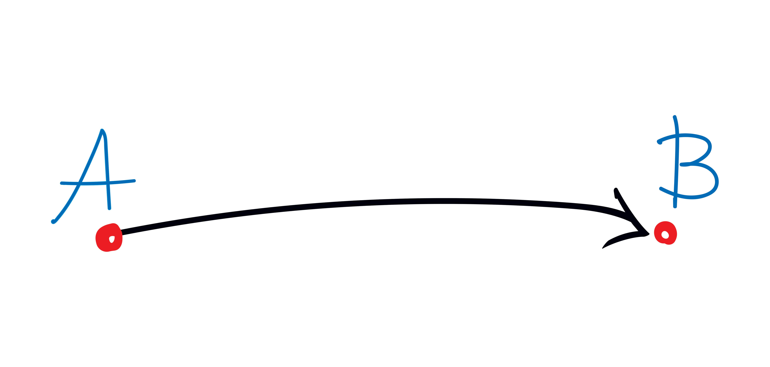
Making Connections
Are your students in a hurry to complete their GED®??
Help them make connections between their studies in all 4 subject areas.
Notes:
Many of our students are in a hurry to finish their GED test – and we can understand that! One way we can help them feel they are making progress through more than just 1 test a time is to help learners see the connections between a skill they are learning in one subject area that directly relates to another subject too! Think of one of your students recently who has been in a hurry – if you clearly explain how what they are studying in your science lesson today will benefit them when they are taking their Reasoning Through Language Arts test too, that may help them focus and motivate them to try harder. Anytime we have the chance to draw the direct line between what we are doing in class today to what they are going to need that skill for later – that’s a win!

Slide 23
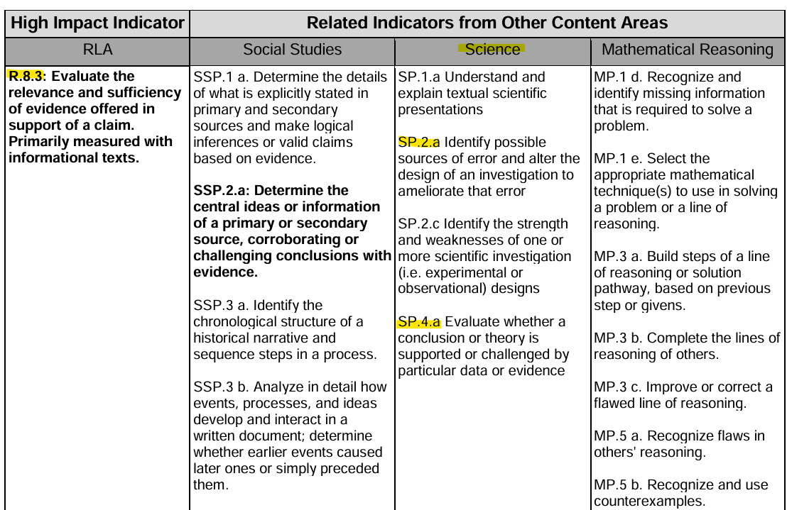
GED.com
Relationship Between High Impact Indictors & Other Indicators
Notes:
Here is one tool from GED Testing Service that really helps us draw that direct line for students:
On ged.com, under Educator/Administrator Resources, choose the Teaching Resources section to find the Relationships Between the High Impact Indicators and Other Indicators document – this is very helpful when you want help with your brainstorming and planning to create multidisciplinary lessons rather than teach isolated standards.
“Providing instruction in a single High Impact Indicator area can help students broaden and deepen their skills, enabling them to apply those skills in multiple ways and in a variety of contexts across all of the content areas covered by the GED® test.”

Slide 24

Notes:
So maybe you have listened to this point and are thinking, all this sounds fine….BUT – I just don’t have enough time in my classroom to do all this! I sympathize! How many of you have multilevel classrooms? How many of you teach more than 1 subject? Exactly – we are all trying to do so much!

Slide 25

Need more time??
Consider the
Flipped Classroom Model
Notes:
So consider this option – the flipped classroom model.
Adopting the model in its entirety may not be possible, but there are components that can be adapted and used in nearly all adult classrooms.

Slide 26
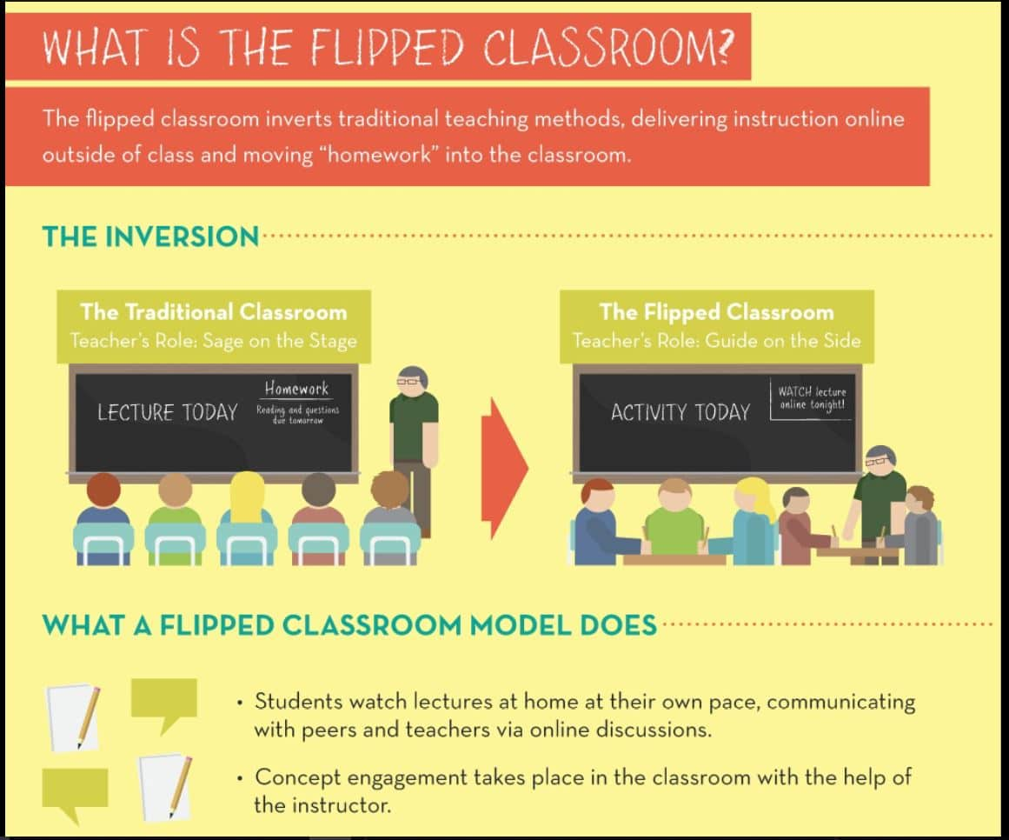
Notes:
Inverting traditional teaching methods, delivering direct instruction online outside of class and moving the ‘homework’ or application part into the classroom.

Slide 27
Benefits of Flipped Classroom Model
Allows students to navigate course material at their own pace
Encourages a self-directed approach to learning
Honors diverse learning styles
Encourages group work, peer collaboration, and discussions rather than passive listening
Enables exploration of the content in a contextualized setting
Notes:
Ideas cited from “The Benefits of Flipped Classrooms” by Paul Main, August 2024, Structural Learning.
https://www.structural-learning.com/post/the-benefits-of-flipped-classrooms -
Now the flipped classroom model assumes a couple of things:
One, all students have access to digital tools outside of class. Two, that students will do homework, even if it’s just watching a video, outside of class.
We know we can expect some pushback on these, so how should we approach these challenges?

Slide 28


Access
Notes:
Many have phones, and video is easily accessible on Youtube.
You can post short videos on your Facebook classroom account and let students access it there.
If no phone, remind them of computer access on campus and when.
If no opportunity exists, ask them to come to class a few minutes early and watch it in the classroom before class begins.
Consider modeling the online work together in class for first few weeks, then move it to independent work once they have the hang of it

Slide 29

Homework
Homework is sometimes necessary, so don’t be afraid to require it.
Change the expectation – your students will adjust.
Notes:
Homework is not a foreign concept to people; we have simply allowed it to become a foreign concept in adult ed.
Change the culture in your classroom – expect homework to be completed and explain why (maximizing class time, accelerating learning).
Remember: WIOA charges us to make students college and career ready – you can’t make them “college ready” without preparing them to do independent work.

Slide 30
Other Multidisciplinary Ideas

Slide 31
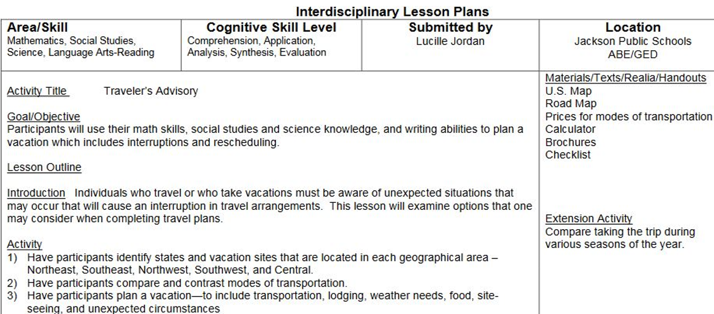
Use a multidisciplinary lesson plan template
Notes:
Note the sections of these lesson plan templates that lend themselves to multidisciplinary planning. Click to bring in 3 arrows.
This lesson is a great example of a multidisciplinary approach – planning a vacation that has interruptions and rescheduling – it includes costs for transportation and housing, maps for locations and travel plans, etc.
Links to sample templates are available on the Padlet provided to you at the end of this session.

Slide 32
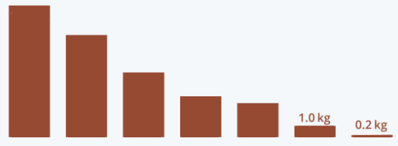

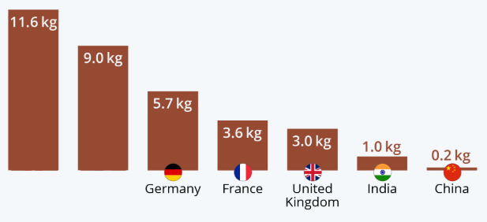
Ready-made multidisciplinary activities
Slow-Reveal Graphs
Notes:
Slow reveal graphs are a great resource to create multidisciplinary activities. You are given a slide deck where on the first slide you are given the most basic info – maybe just a few bars on a bar graph. Then each consecutive slide reveals a bit more information – on each slide you ask questions of students to prompt critical thinking, such as:
What new information did we just learn? How does it change your thinking about this graph?
What does “revenue per capita” mean?
What other information can we figure out from this data? Can we figure out how much money is spent on chocolate per year? …in just the US?

Slide 33
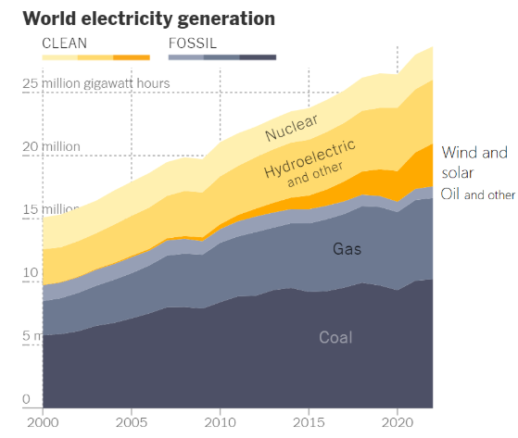
Ready-made multidisciplinary activities
New York Times
What’s Going On In This Graph?
What’s Going On In This Picture?
Notes:
Here’s another resource for multidisciplinary activities – NYT What’s Going On. Website provides some basic questions to ask, then you can add others -
What do you notice?
What do you wonder?
How does this relate to you and your community?
Create a catchy headline that captures the graph’s main idea.
Additional graphs, extension activities including math also available

Slide 34
Choose 1 focus area and integrate it everywhere
Integrating Digital Literacy |  | Integrating Other Content Areas
Reading: Use annotation tools to highlight and comment on text |  | Create a blog: Have students write blog posts to practice persuasive writing (LA)
History: Research primary sources online and create a digital timeline |  | Learn spreadsheet formulas: Track household expenses and create a budget (Math)
Writing: Use collaborative docs for peer editing and feedback |  | Make a presentation: Create a slideshow about local government functions (Civics)
Job Readiness: Create and share resumes using word processing software. |  | Create a podcast: Record conversations about community issues or current events (Civics, Speaking & Listening)
Notes:
Perhaps creating multidisciplinary lesson plans and activities feels overwhelming to you -
Maybe you want to concentrate on one specific skill or content area and make it a goal to integrate it into as much of your class as possible – let's look at the example of digital literacy – maybe your learners are really lacking in that area, so you want to make that a constant area of focus.
Look at all the ways you can integrate digital literacy! You can still accomplish all your core subject area content, but integrate, integrate, integrate! These ideas are courtesy of Joey Lehrman, Community Learning Partners.

Slide 35
BUT…
“I like that lesson I designed last year.”
“My students and/or I prefer using this specific textbook.”
“My program requires me to use the approved curriculum.”
“I already turned in my lesson plans for the semester.”
Don’t worry!
You can still use this multidisciplinary approach.
Notes:
Again, maybe you have been following along and really trying to see this approach work in your classroom situation, but you have some doubts or barriers…click 5xs
Multidisciplinary teaching is not an approach that requires you to start from scratch – simply reconsider how you are approaching the plans and materials already in use.

Slide 36

Ask questions that prompt critical thinking
If your monthly paycheck increases this year, are you better off than you were last year? Why or why not?
Can something be true and false at the same time? Why or why not?
How would life change if humans lived twice as long?
Notes:
Not all multidisciplinary activities must be highly designed, take a bunch of preparation, or involve websites or technology. Sometimes you just need to ask a really great question and prompt students to think critically about it!
This paycheck increase question is a great one – I borrowed this from my friend Joey Lehrman - it seems to have an obvious yes answer, but you could get into issues of quality of life (what tasks are you doing at work, what can more money get you), tax rates, additional expenses that come with children, cost of living, inflation that aren't accounted for in your raise, etc. This is a deep issue, but one that could involve math, career awareness, social/emotional needs, and more.
These types of questions could be used to get students talking, working in groups, to liven up a dull classroom, for a multitude of reasons. If you can't think up a good question, Google it! :)

Slide 37

Building Knowledge
Make a habit of looking at a question/prompt/activity and thinking:
How can I extend this?
What else can students research?
To what can we connect this?
Notes:
Small changes you can make as you prepare to teach or train with existing materials and plans. Once students have done the basics, where else can you build and extend knowledge?
Think of how our brain's neural pathways work – the more we make connections between ideas, the more pathways are created, and the better our brain works for us.
If you have existing teaching or training material that isn't multi-disciplinary, you can MAKE it so by asking some key questions.
Let's practice...

Slide 38
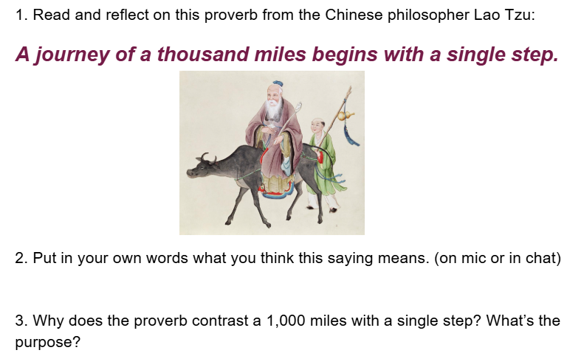
How can I extend this?
What else can students research?
To what can we connect this?
What other questions should I ask?
Notes:
Many of the texts available to us for adult ed instruction are built like this – a short reading, then a few questions, usually based on one skill. In this case, students are paraphrasing a proverb and analyzing a literary device (hyperbole).
I used this activity during a Zoom class the other night. What else could be done to extend this activity?? Take ideas in the chat…
Extend: Ask students to write their own proverb about persistence...or ask students to share their answers to #2 in a slide deck and present it to others
Research: Who is Lao Tzu and what was he famous for?
Connections: Goal setting - How might this proverb be applied to personal, education, or career goals?
Questions: Make it a math/science activity too. If a person’s stride equals 10 inches per step they take, how many steps would be in one mile for them? How many steps in 1,000 miles for them?

Slide 39

On the rough days…do one thing
“Many content-area teachers do not use writing to promote students’ learning (Kiuhara, Graham, and Hawken, 2009), but the findings from this report suggest that such techniques should be used more often.”
“When students read texts in science, social studies, and the language arts, their comprehension of this material is improved by writing about it. Likewise, writing about information presented in math, science, and other content classes enhances their learning of this material.”
Carnegie report available on LINCS

Slide 40
bit.ly/multitaskingteachers
Visit this link for multi-disciplinary instructional resources
Notes:
If time, visit http://www.bit.ly/multitaskingteachers and show them the padlet – encourage them to use and share with colleagues

Slide 41


Reflection Questions
Why might a multidisciplinary approach to teaching work well for students?
What concept or theme could I develop into a great multidisciplinary lesson plan for future use?

Slide 42

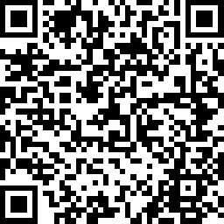
Session Survey
Your feedback is important. Please scan the QR code below to rate this session.

Slide 43
Thanks! Good luck as you "do it all!"
Anita Kerr
Illinois Professional Development Network
anikerr@siue.edu

