Slide 1
Moving Community Partnerships from Intention to Impact
Adora Beard
August 2025
GED® and GED Testing Service® are registered trademarks of the American Council on Education (“ACE”). They may not be used or reproduced without the express written permission of ACE or GED Testing Service LLC. The GED® and GED Testing Service® brands are administered by GED Testing Service LLC under license from ACE.

Slide 2
Welcome!
The greatness of a community is most accurately measured by the compassionate actions of its members.
-- Coretta Scott King

Slide 3

Learner Centered

Slide 4
Organizational Commitment
Learning Loop
Bring vibrancy to our own learning experiences
To enrich our own learning just as the experiences that we create for learners.
Strong Ties
Develop strong relationships with stakeholders to collectively acknowledge and empower each other.
Nurture a comprehensive network to ensure that the experiences we create make gains in problem solving and innovation.
Collective Action
Impact
Measure
Metrics
Evaluate, modify (if necessary), and mature.
Working together to amplify efforts
Shows up in the products that we make and in the services that we provide.
Build trust.

Slide 5

People & Culture
Bring vibrancy to our own learning experiences
Learning development programs to enrich our own learning just as the experiences that we create for learners.
Develop strong relationships with our stakeholders to collectively acknowledge and empower the underrepresented.
Nurture a comprehensive network to ensure that the experiences we create are truly inclusive.
It’s in our DNA
Shows up in the products that we make and in the services that we provide.

Slide 6
Principles for Positive Impact
To ensure strategy alignment
To inspire actions and/or influence
To break down barriers for learners
To foster innovation and problem solving
To consider feedback as moments of opportunity
To listen, engage, evaluate, and listen some more!
Operate from the place of generosity and/or vulnerability

Slide 7
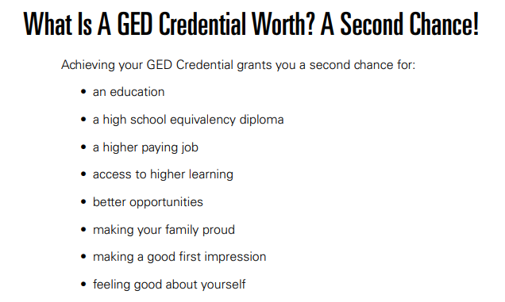
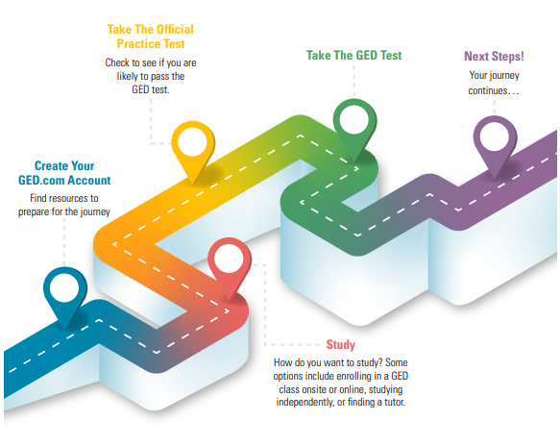

Slide 8
Belongingness
Worthiness
Competence
Mindset and Life Skills
Developing an environment and climate for students is critical. Co-creating administrative structures and practices fosters success for all learners.
Notes:
The mindset of a student is so important – They must know that they belong, that they are worthy, and that they are competent.
That must occur before anything that may set their aspirations on.

Slide 9



Pedagogy & Androgogy Defined
Merriam-Webster Dictionary Definitions:
PEDAGOGY: The art, science, or profession of teaching
Most common in K-12 education & higher education.
The term pedagogy boils down to the study of different teaching methods.
ANDRAGOGY: The art or science of teaching adults
The term boils down to the distinct ways adults best respond to learning
Most often called the Adult Learning Theory.

Slide 10

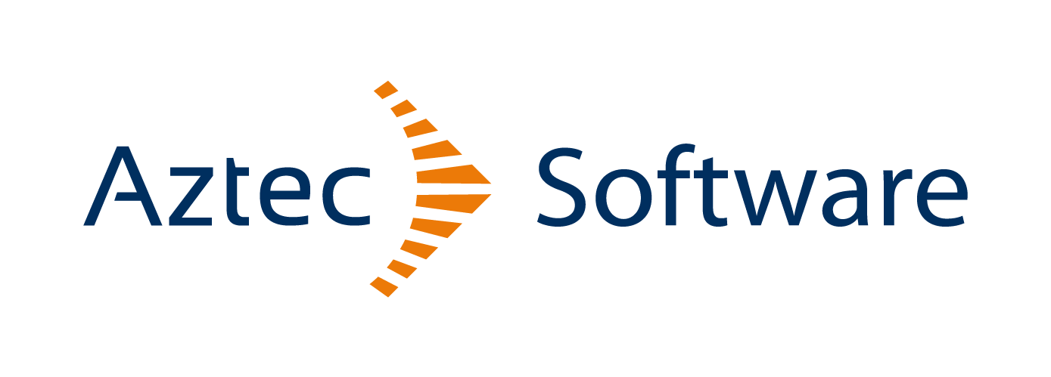

External Partnerships and Alliances

Slide 11
Community Partnerships
Shared Interest: Collaborative relationships between organizations and community groups or programs
What do we/can we offer?
Understand their needs, interests, and environment
Benefits: Shared resources, increased impact for students and GED products/services, stronger community ties and awareness
Metrics: Engagement levels, program test-taker and passer volume, learner, and program feedback.

Slide 12
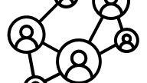

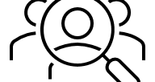
Community Engagement
Increase Stakeholder Involvement
Objective: Involve community leaders, members, and stakeholders in partnership activities.
Regular meeting cadence, workshops/events, progress evaluations, and reporting.
Collaborative Approach and
Clear Communication
Objective: Plan and make collaborative decisions.
Goal setting, action plans, statements of work, memorandums of understanding, feedback loop, established key metrics, and outcomes.
Advocacy, Awareness, and Visibility
Objective: Increase awareness of partnership initiatives and their impact on the community.
Marketing and Communications to highlight the importances and benefits of the partnership.

Slide 13
GED Community Partnership Program
The GED Community Partnership Program (GEDCPP) was created to connect more learners in preparation and support for the GED credential. This program aims to increase access to a high school equivalency diploma, while investing in grassroots community organizations that provide education, training, and other support services.
  In partnership with Aztec Software, the program launched in late 2021
  The program provides GEDTS, Aztec Software, and Essential Education study tools, technology, and test vouchers to support community organizations offering GED preparation.
  Participating organizations go through a vetting process that includes identifying the organization's needs, learners served, current outcomes, and other factors.

Slide 14
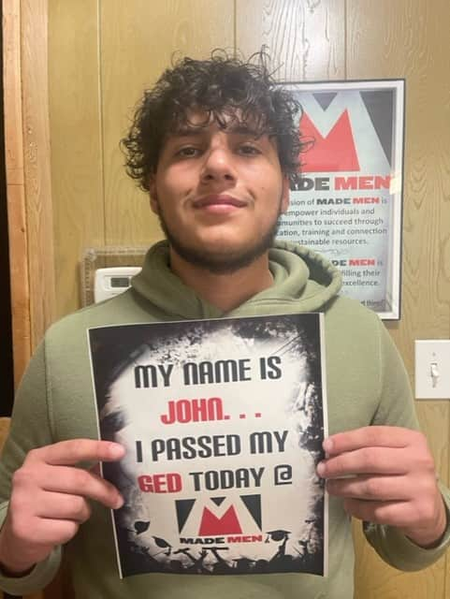
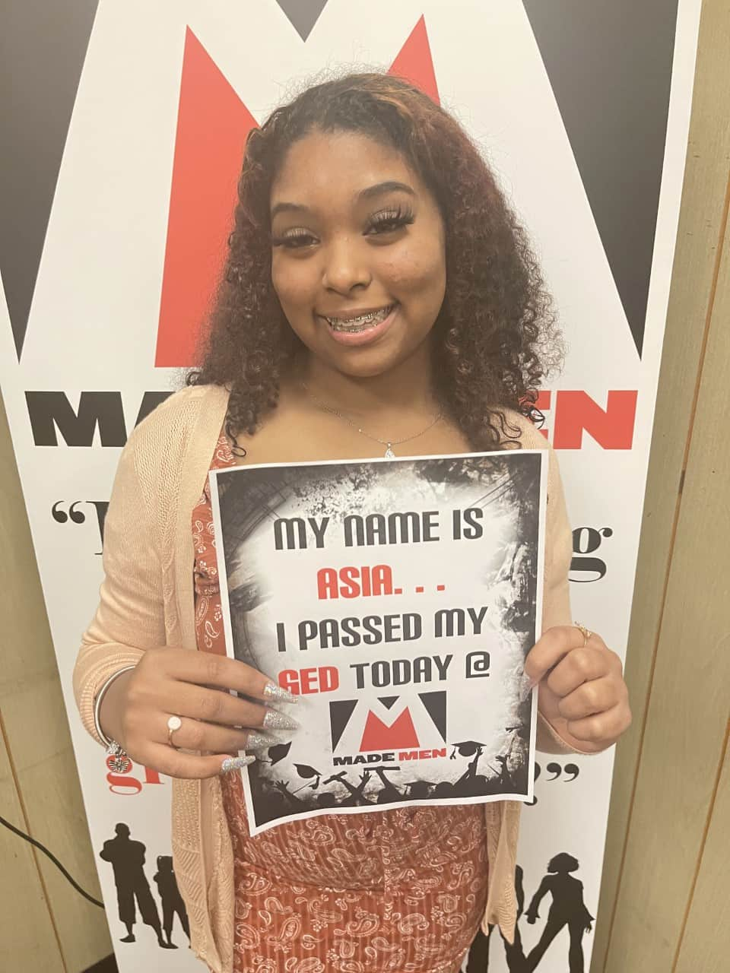
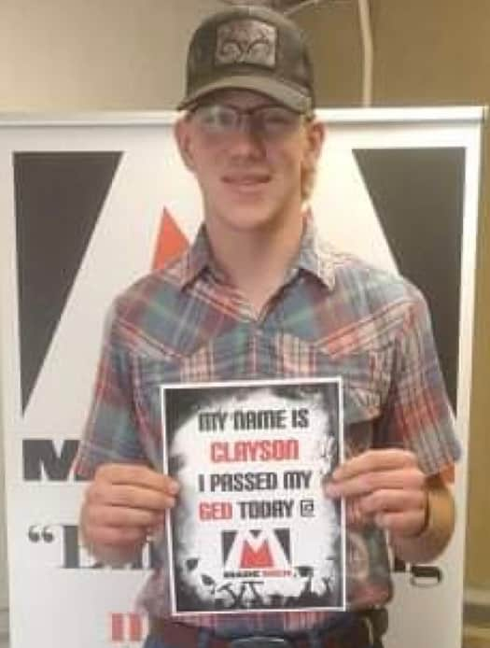
GED Community Partnership Program
First Graduates
John C.
Asia W.
Clayson W.

Slide 15
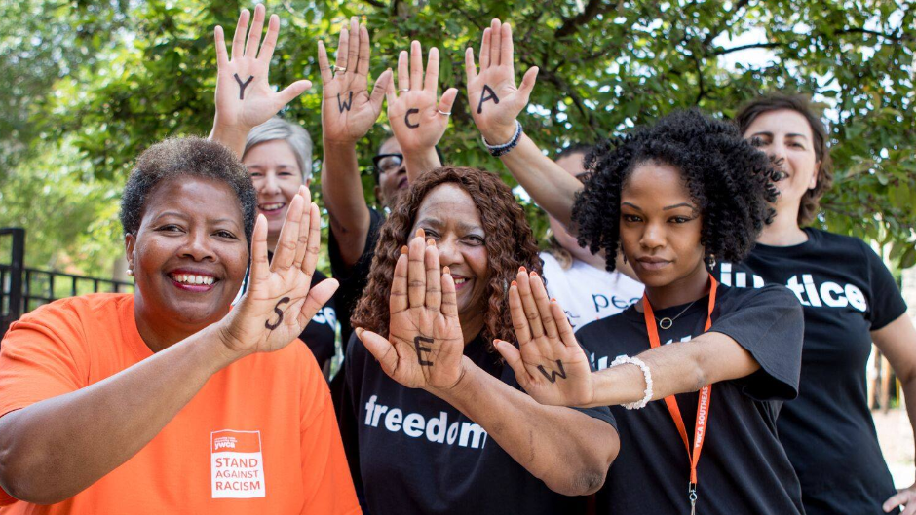

GED Community Partnership Program
YWCA Southeast Wisconsin
Advancing resources for women and their families
Health and safety
Economic empowerment
Access to further education and family-sustaining wages.
9 GED Graduates!

Slide 16
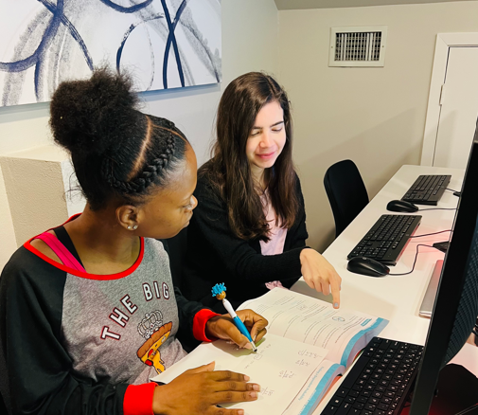

GED Community Partnership Program
The Mission of Yahweh
Houston, Texas
Ending the cycle of homelessness and dependency for women and children
Transitional living program
Community outreach and counseling services to low-income families
Tutoring program: educational and vocational support
2 GED Graduates!

Slide 17
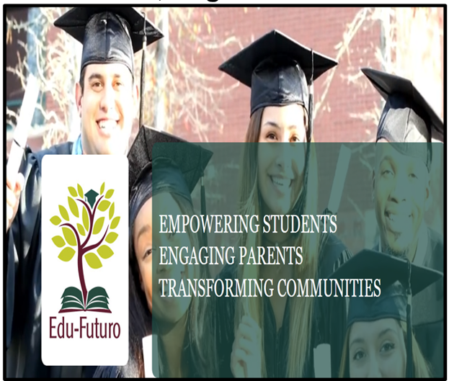
GED Community Partnership Program
  Arlington, Virginia
  Emerging leaders program
  Parent empowerment services
  Chronic absenteeism program
  Workforce development
  GED preparation
  Post-credential college enrollment
  6 GED Graduates!

Slide 18


GED Community Partnership Program
The Pivot Path
Montgomery, Alabama
To strengthen communities and the workforce
Economic empowerment
Sustain families
GED preparation, trainings in soft skills, employability skills, and workforce development
6 GED Graduates!

Slide 19

GED Community Partnership Program
Literacy Minnesota – Open Door
Minneapolis, MN
Literacy eliminates injustice and strengthens communities
Lifelong Learning, Justice, and Advocacy
Training for Educators
GED preparation and tutoring programs
GED Graduates expected soon!

Slide 20

GED Community Partnership Program
Copal
Minneapolis, MN
Member-based organization designed to improve the quality of like for Latine families.
Power-building and visionary transnational organization.
Environmental Justice, Advocacy, Health & Wellness, Youth & Leadership Programs
Workers’ Center - GEDWorks
10 GED Graduates!

Slide 21
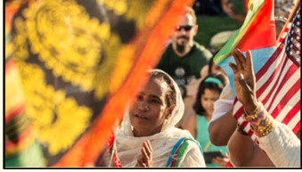
GED Community Partnership Program
Sponsorships or Donations
The City of Aurora, Colorado

Slide 22
GED® Transformation Team

Slide 23
GED® Transformation Team
The Transformation Team is a sounding board for the GED Testing Service to tap into to seek ways of doing business.
GEDTS is determined to work harder to reduce the academic, social, and financial barriers to high school completion.
To help foster ideas that challenge the status quo, fundamental assumptions, and to seek out opportunities for the purpose of closing achievement gaps, setting high expectations, and to create models toward innovative solutions.
This advisory committee consist of multi-faceted professionals from varying backgrounds whose input and advice helps to uphold our learner centric model and aides in thought leadership to implement program improvements, modify organizational policies and procedures, and enhance outreach efforts.

Slide 24
It’s only when we’re all winning that we truly win.
-- Nan Russell

Slide 25
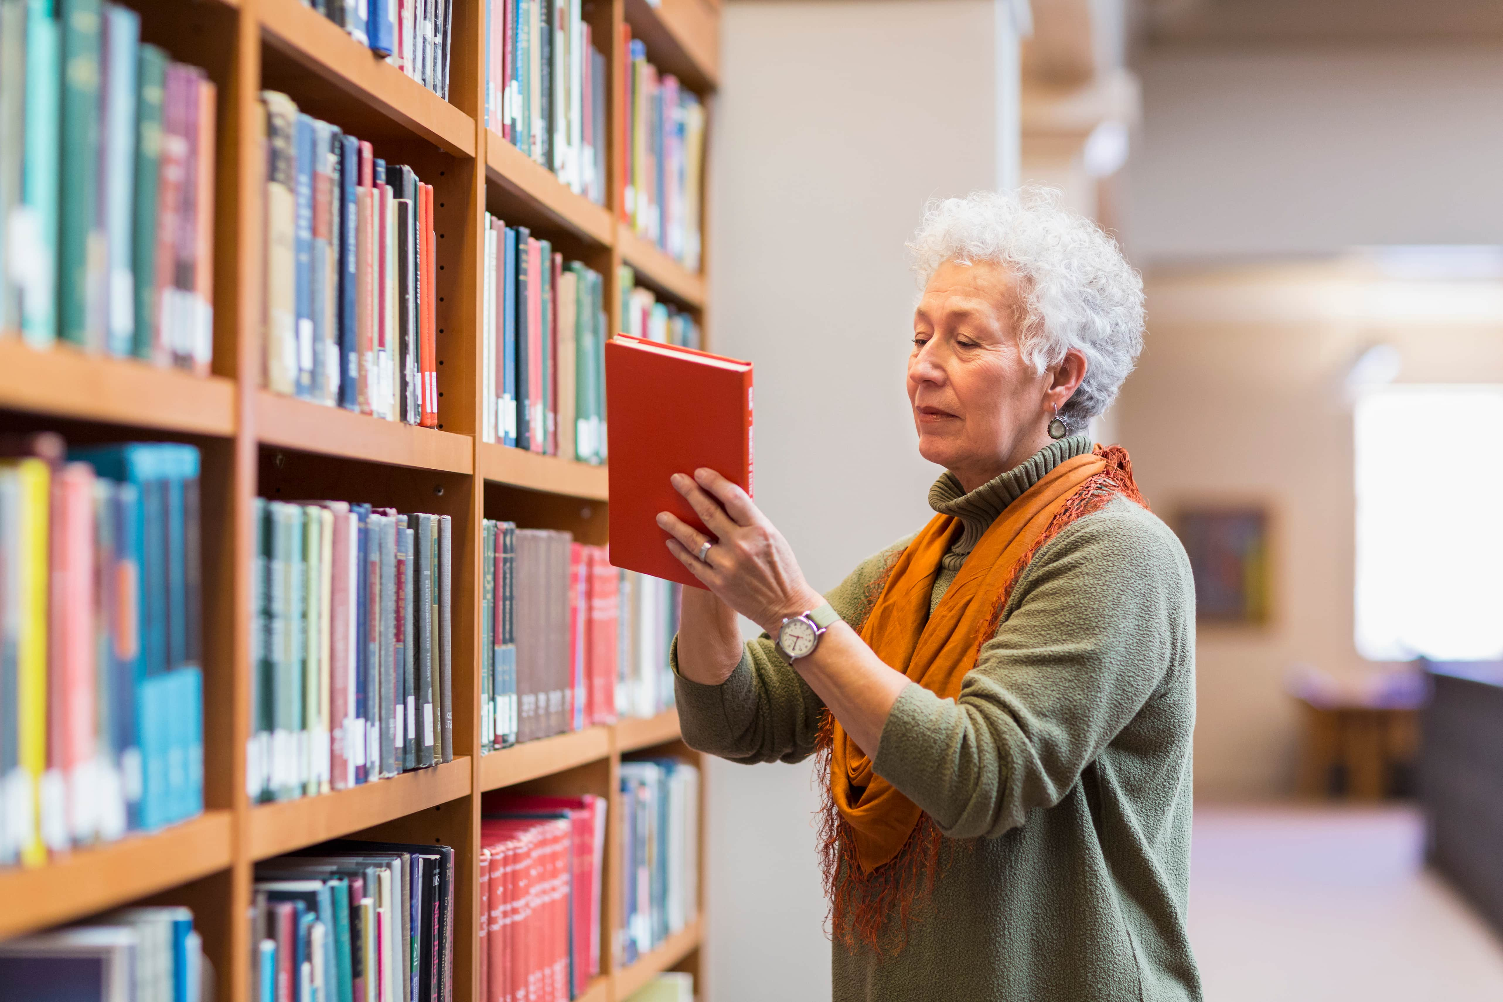
Resources

Slide 26
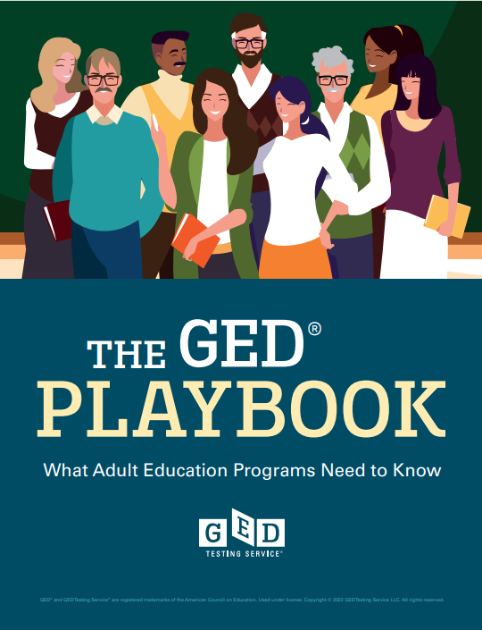
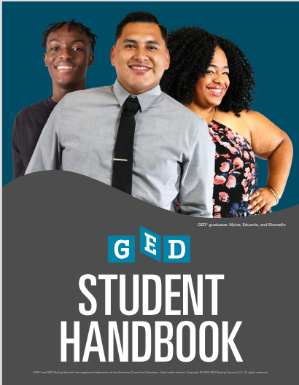
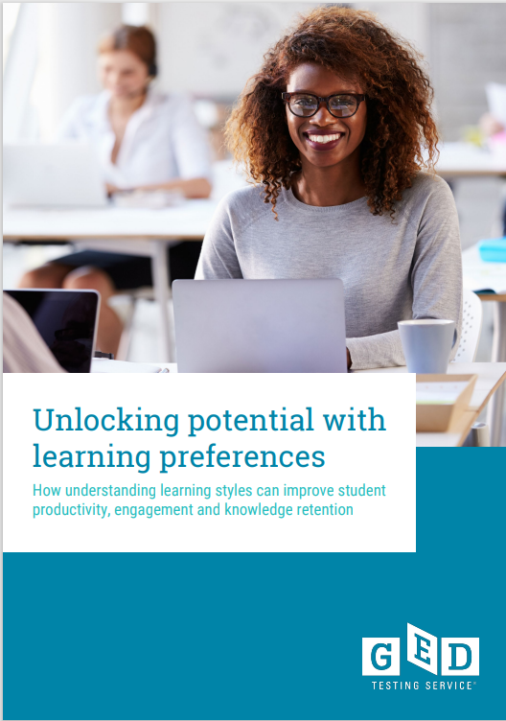
Have you seen these resources?
Teaching Resources - GED
Notes:
Key points:
The GED Playbook (launched at the 2022 GED Conference):
The GED Playbook is for those who oversee and manage the GED adult education program, as well as instructors. It is a good starting point to assist in navigating and understanding the GED program.
GED Student Handbook (to be launched at the 2023 GED Conference):
The Student Handbook serves potential adult education program students, self-paced learners, and advocates of students navigating their GED journey. Within this document you will find many helpful resources and tips.
With You, With Me- Learning Styles e-Book:
The e-book serves to empower students with an understanding of their own learning preference and also encourages them to get to know themselves better and seek out study methods and resources that will be of most benefit to them.

Slide 27

Takeaways &
Recommendations

Slide 28
Crossing the threshold into your program, what messaging do students receive about whether they are welcomed or not?
Do students see themselves reflected in the materials, do they see people that look like them, on the website, can they get information in their language, especially during orientation?
Disaggregate Data
Look at your data by demographics.
Evaluation
Constant evaluation
Inclusion
What about utilizing your alumni groups to help navigate the multiple native languages that students speak? Or, recording in multiple languages.
Metrics & Tracking
Socialization
Phases of Maturation
Very 1st Encounter
How can you provide more support?
How do you get at those students that fall under the “other” category? What is the program/learner gain, there?
Sustainability
Is there something from the cultural perspective that is having an impact around curriculum/instructions or hindering enrollment/engagement?
COABE Podcast
Adult Ed Advocast E11

Slide 29
Takeaways & Recommendations
What We Learned:
Must be learner-centric
Your stakeholders and alliances formed must also be committed to this work
Listen and create feedback loops
Remember that the learning process is ongoing
Measure and evaluate
You need the buy-in and support of your leadership
What about you?

Slide 30

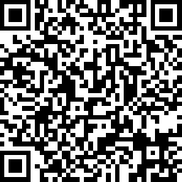
Session Survey
Your feedback is important. Please scan the QR code below to rate this session.

Slide 31

Q&A and Thank you!
Adora Beard
State Relationships, Executive Community & Partner Outreach Manager adora.beard@ged.com
Mobile: (202) 306-0761

