Slide 1
Mastering an Instructional Resource: Guiding RLA Instruction Through the Electronic Scoring Tool
Ann Evers
August 6th
GED® and GED Testing Service® are registered trademarks of the American Council on Education (“ACE”). They may not be used or reproduced without the express written permission of ACE or GED Testing Service LLC. The GED® and GED Testing Service® brands are administered by GED Testing Service LLC under license from ACE.

Slide 2
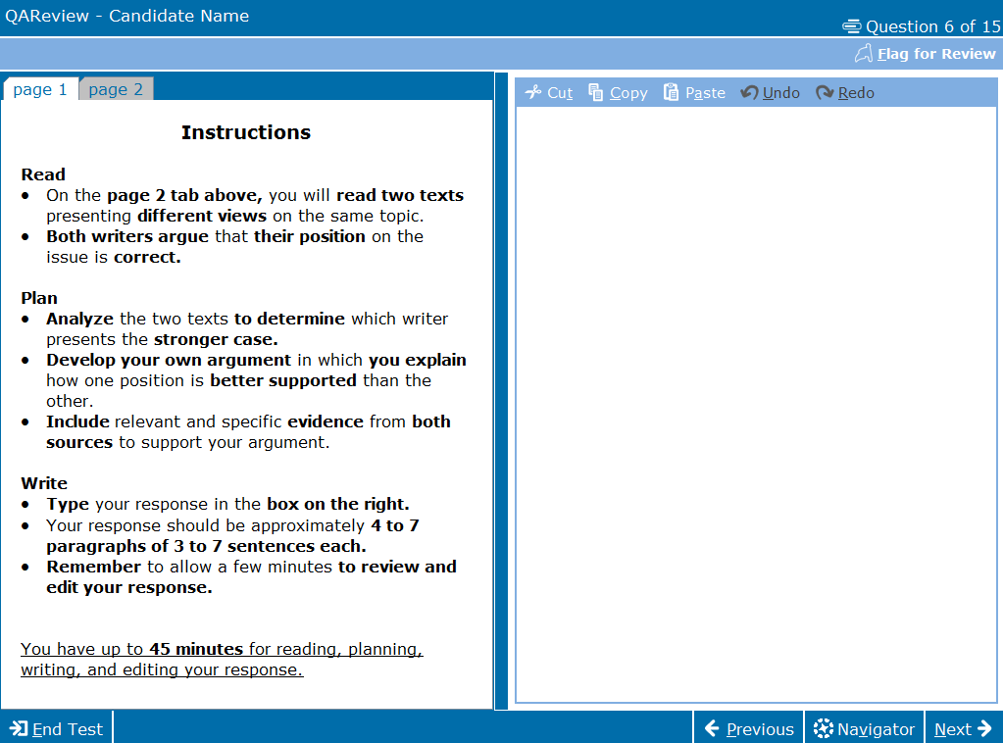
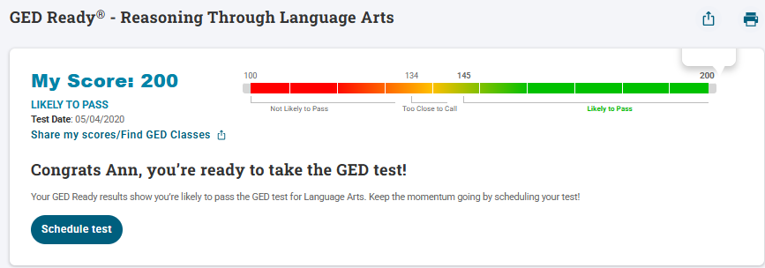
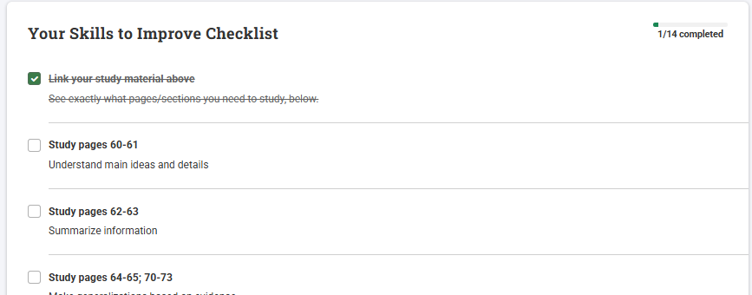
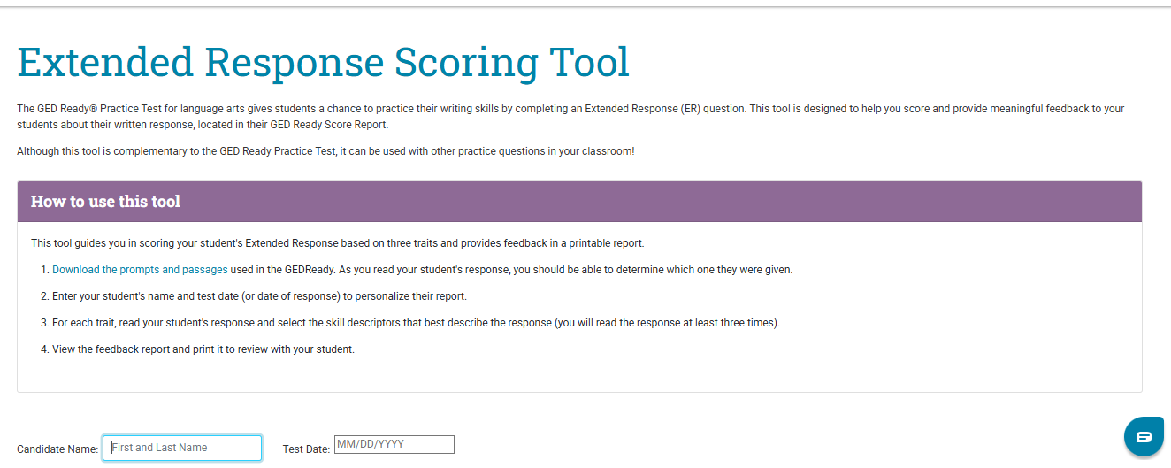
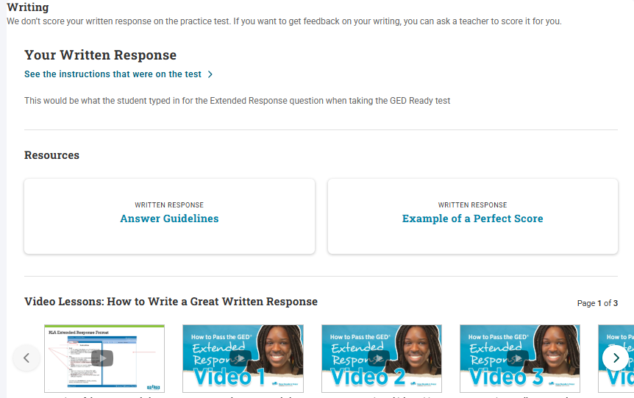
Overview
Essential elements of an effective response
How to use the ER scoring tool

Slide 3
Let’s get started

Slide 4
Begin with the Instructions
Analyze both passages
Decide which argument has more convincing evidence
Explain why the evidence supports your choice

Slide 5
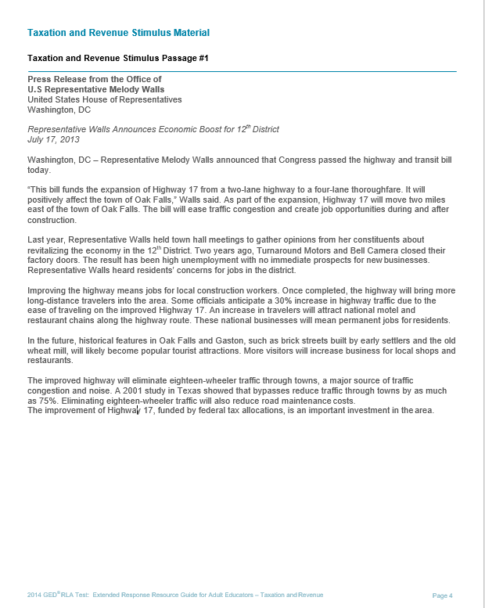
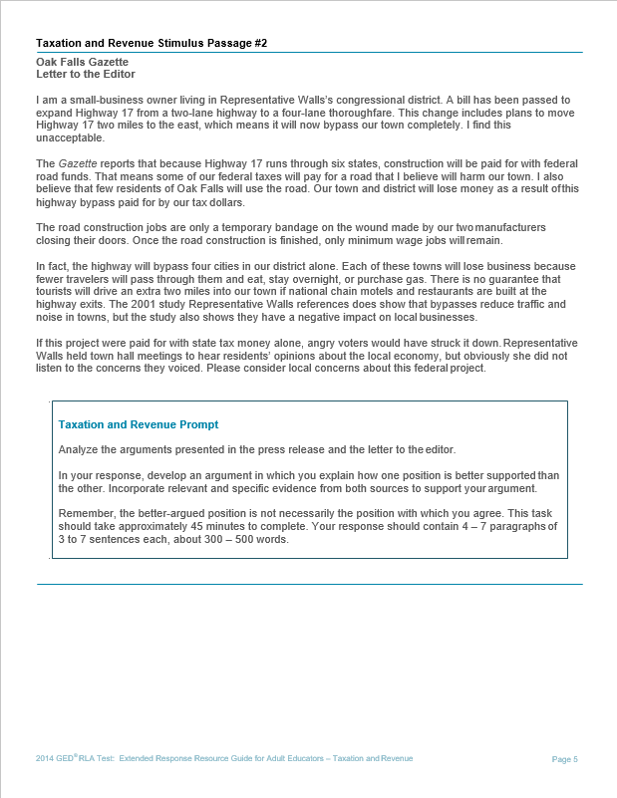
Read and Analyze
Viewpoint 1
Viewpoint 2

Slide 6
Evidence: More than just facts & stats
Type of Evidence | Definition
Factual | Truthful statements that cannot be denied. Statements that the average person may know, or which can be proven.
Statistics or Data | Numerical facts; can be presented in raw numbers, percentages, or fractions.
Examples or Anecdotes | Real-life situations, events, or experiences that illustrate a position; anecdotal stories that help explain an author’s claim.
Expert Testimony | The observations or conclusion of someone who is considered highly knowledgeable because he/she is an expert in a particular field of study or occupation; someone who has firsthand knowledge and experience.
Logical Reasoning | An explanation which draws conclusions that the reader can understand; a discussion which helps the reader understand or make sense out of facts or examples offered.
Emotional Appeal | Use of sympathy, fear, loyalty, etc. to persuade; manipulates the reader’s emotions – ethos, pathos, logos.

Slide 7


Identify the Evidence from Each Viewpoint
Strong Evidence
Research or experts
Reliable sources
Relevant facts
Logical conclusions
  Weak Evidence
  Vague references
  Unnamed sources
  Irrelevant details
  Flawed reasoning

Slide 8
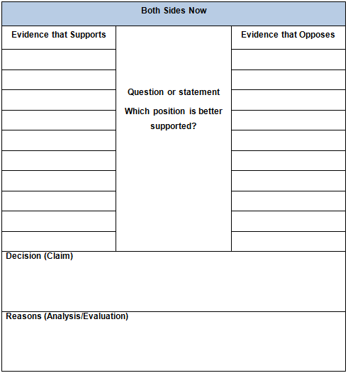
Analyze and Evaluate the Viewpoints
List the evidence that supports
List the evidence that opposes
Evaluate the evidence
Select the position that is better supported
Notes:
use a graphic organizer. It’s an easy way to analyze and evaluate the evidence.
On one side I am going to write in evidence that supports the building of the new road.
On the other side, I will identify evidence that opposes the building of the new road.

Slide 9
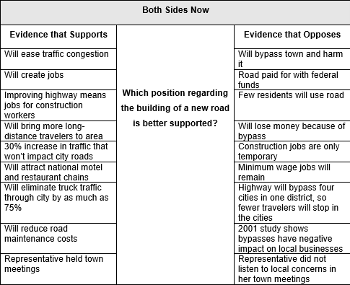
Analyze and Evaluate the Viewpoints
List the evidence that supports
List the evidence that opposes
Evaluate the evidence
Select the position that is better supported
Notes:
use a graphic organizer. It’s an easy way to analyze and evaluate the evidence.
On one side I am going to write in evidence that supports the building of the new road.
On the other side, I will identify evidence that opposes the building of the new road.

Slide 10
An Effective Claim
Must be arguable but stated as a fact. It must be debatable with inquiry and evidence
    it is not a personal opinion or feeling.
A claim is supported by evidence.
A claim defines your writing’s goals, direction, and scope.
The best claims are focused, specific, complex, and relevant.

Slide 11
What’s the Starting Point?
Conclusion
5
The claim
Is the roadmap with signs and markings
Guides the writer and reader through the argument
Provides the position taken
Provides the reason “why”
Evidence & Counterclaim
4
3
Evidence
Evidence
2
1
Claim

Slide 12
Use of Quotations
Students should
Cite specific evidence (phrases and even complete sentences) from the passages that accompany the prompts.
Express their own thoughts about their chosen evidence.
Explain why the evidence they’ve chosen helps make the points they want to make.
Remember: Copied text contributes to a score only if the student fully explains how that text illustrates a point they are making. Simply lifting information from the passages isn’t going to be enough to earn points because that’s someone else’s writing, not the student’s.

Slide 13
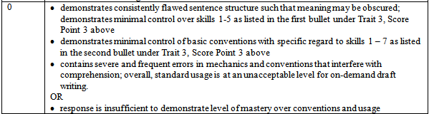
Where is the original text?
Now the safety issue comes up again, in the yearly switch to and from DST. One study shows pedestrian fatalities from cars increased immediately after clocks were set back in the fall. Arguments continue with another study that shows 227 pedestrians were killed in the week following the end of DST compared with 65 pedestrians killed the week before DST ended. lt is also stated that the adjustment period drivers endure each year is a dangerous time for pedestrians, and DST may be the reason. Instead of a gradual transition in the morning or afternoon by just minutes of sunlight each day, the immediate shift of one hour forward or backward fails to provide drives and pedestrians time to adjust. These opponents believe the consideration of cost and confusion are simply not worth all of the trouble. With everything there are pros and cons no matter what, so in the end we can only hope the good outweighs the bad.

Slide 14
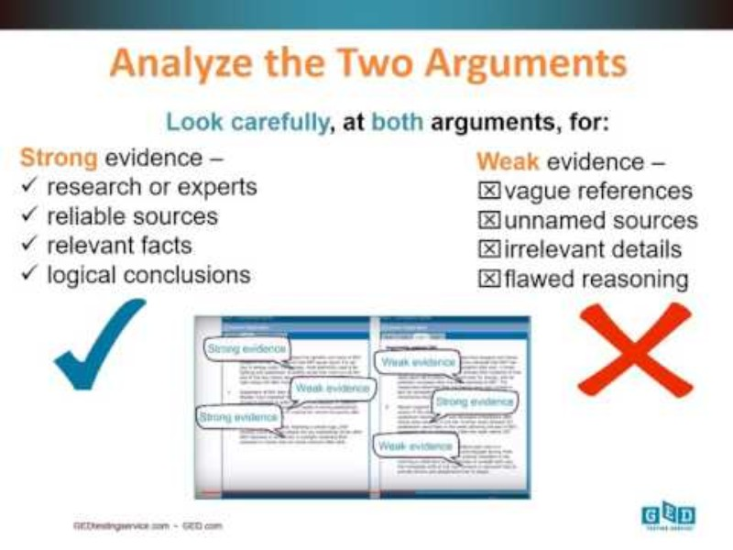
Video link

Slide 15
Score Report
Where should we start???

Slide 16
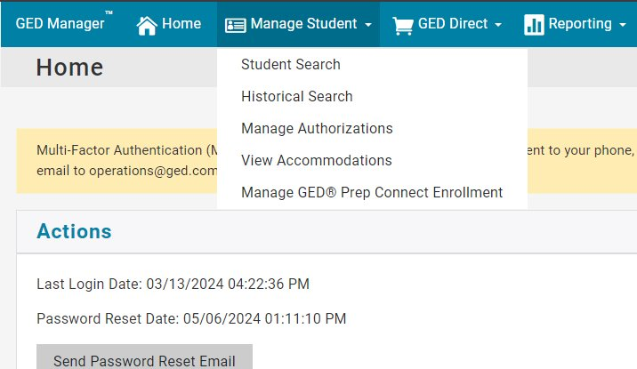
GED Manager as the Source: Can you find it?​

Slide 17
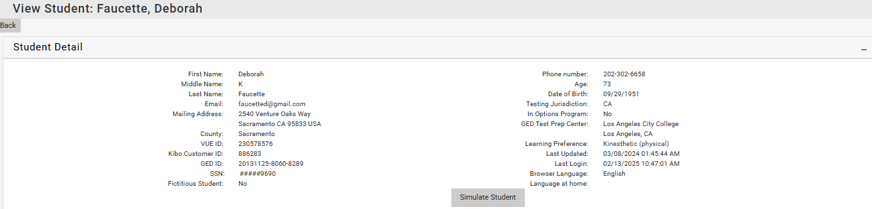
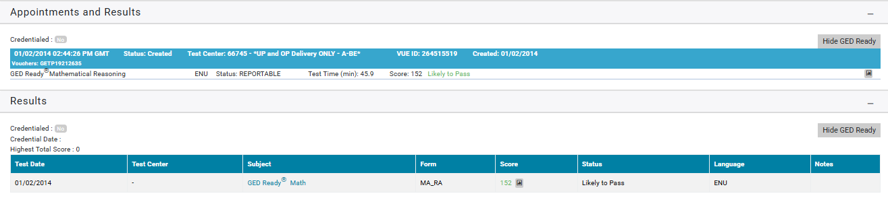
GED Manager as the Source: Can you find it?​

Slide 18
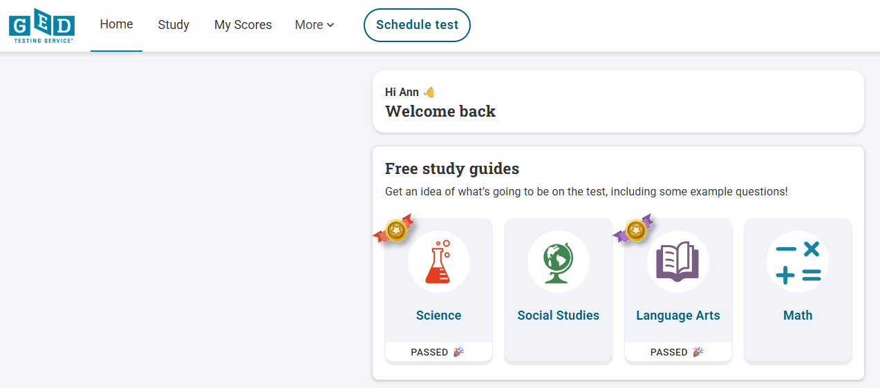
Student Search: Can you find it?​

Slide 19
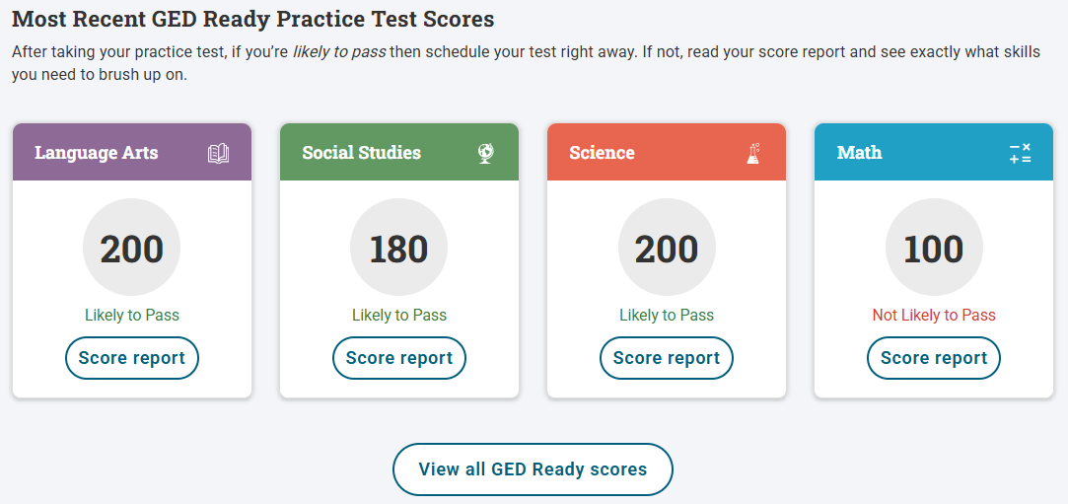
RLA GED Ready Score Report

Slide 20
Prepare to Score
1.Copy the student’s Written Response into a separate Word Doc
2. Open the Scoring Tool

Slide 21
The Extended Response Scoring Tool
Do you know where to find it?

Slide 22

GED.com: Can you find it?

Slide 23

Educators

Slide 24
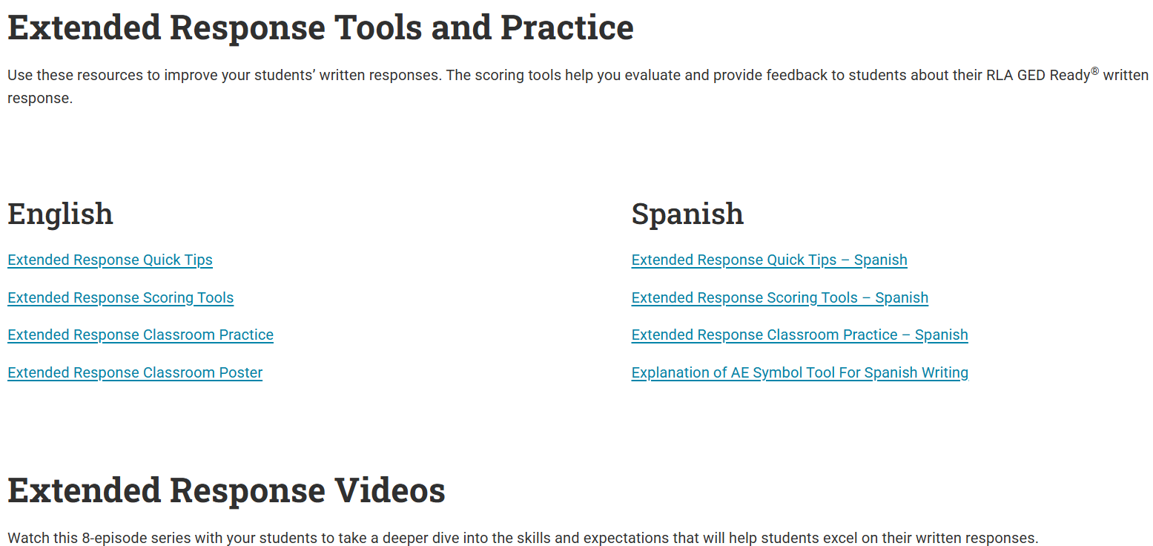
Free Classroom Resources

Slide 25
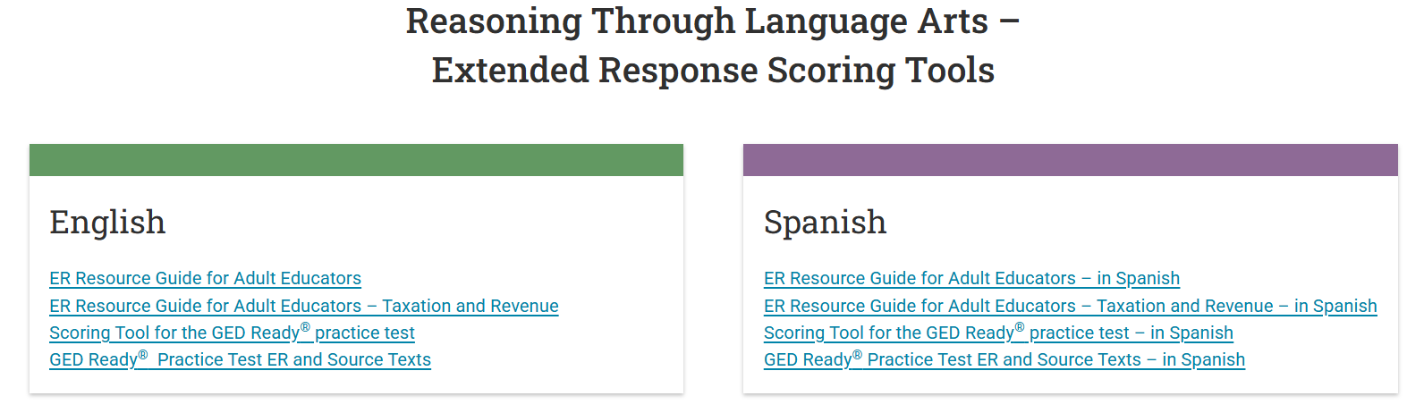
Extended Response Scoring Tools

Slide 26
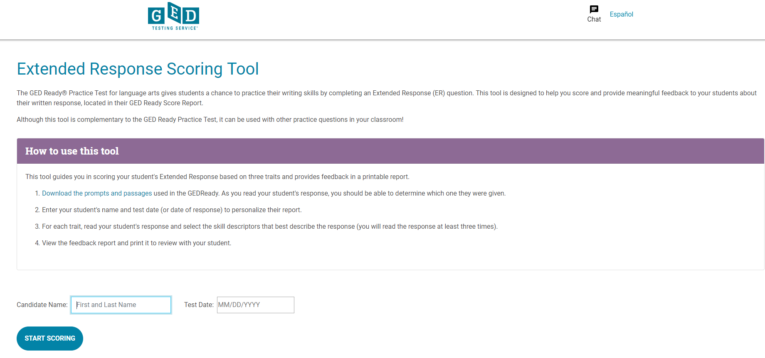
Skim student response to see which set of paired passages were used
Download and read the corresponding passages
Enter student name and date.
Do the first read of the student’s response.
Scoring Tool

Slide 27
The Extended Response Rubric
Three Traits

Slide 28
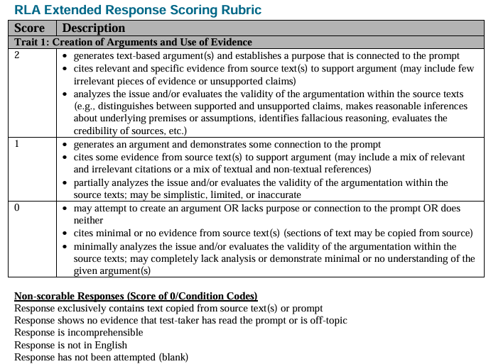
Rubric: Consists of Three Traits
Trait 1: Creation of Arguments and the Use of Evidence​
Trait 2: Development of Ideas and Organizational Structure​
Trait 3: Clarity and Command of Standard English Conventions

Slide 29

Why Focus on Trait 1?
Is pivotal from a skills perspective​
Builds a solid foundation for cross-cutting skills​
Provides the basis for demonstrating Trait 2(organization and development of ideas) and Trait 3 (standard English conventions)

Slide 30
Trait 1
Develop the argument​
Cite relevant evidence​
Explain how the evidence is connected to the argument and why it is important

Slide 31
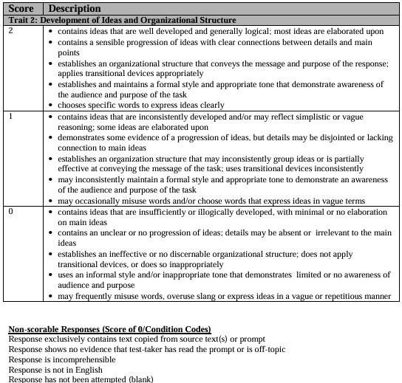
Trait 2
Provide fully developed ideas
Use a structure that is logical and conveys message and purpose of the response
Maintain formal style
Use words to express ideas clearly

Slide 32
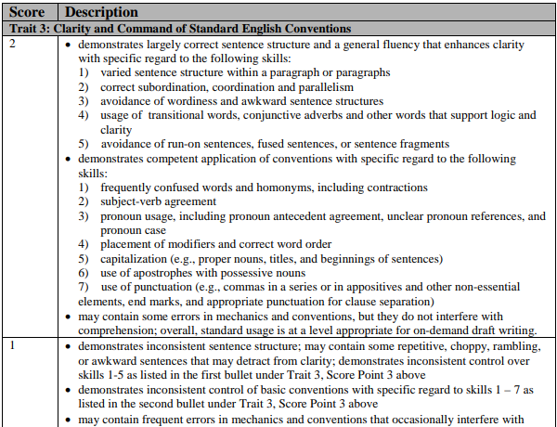
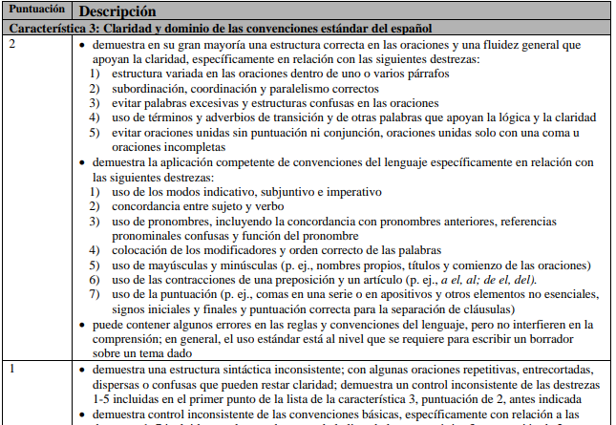
Trait 3: English and Spanish
Use varied sentence structure that provides a level of fluency in the response
Demonstrate competency of language conventions
Limit errors in mechanics and usage by editing as needed

Slide 33
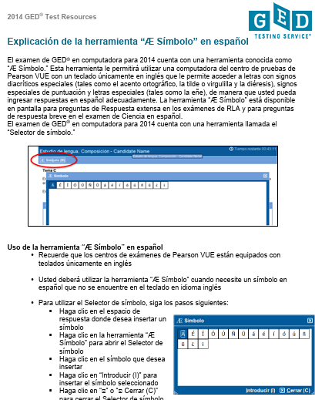
Spanish Symbol Selector
No Spanish keyboards in testing centers
Read
  Explanation of Spanish symbol selector
Practice:
  Computer-based tutorial

Slide 34
Getting Down to the Nitty Gritty
Learn the process
Use the tool

Slide 35

Multiple Reads ARE Necessary
When you review a document…you don’t read for organization, grammar, typos, and overall development of ideas simultaneously​
You must read at least once for each trait​
It becomes easier the more you practice​
The goal is to internalize the process and the characteristics of each trait.

Slide 36
Trait 1

Slide 37
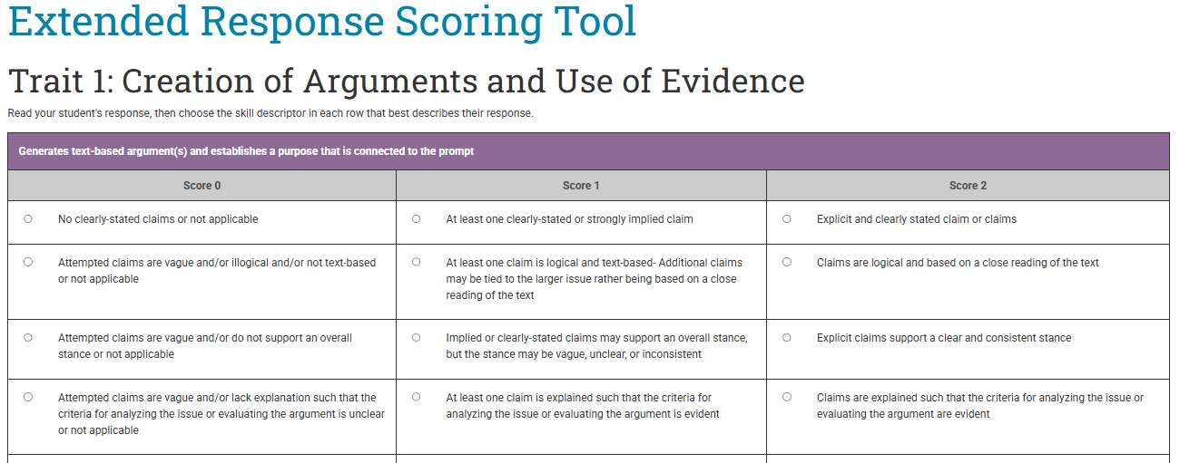
Trait 1 Dimensions & Sub-dimensions
Breaks down each dimension into sub-dimensions within a trait​

Slide 38
Things to Keep in Mind
Each test-taker receives three scores—one for each trait in the rubric​
Although each trait is broken down into sub-dimensions, the trait score is determined holistically ​
When you use the resource guides and study the annotations, you’ll see offsets—high levels in some sub-dimensions balanced by lower levels in others

Slide 39
Let’s do a check!
Did you find your student’s Score Report?
Did you copy and paste their RLA GED Ready Written Response into a Word Doc?
Did you find the Scoring Tool?
Did you read your student’s Written Response?
Did you find, download, read and determine which passages your student read on their GED Ready?
Let’s get started

Slide 40
Live Demo

Slide 41
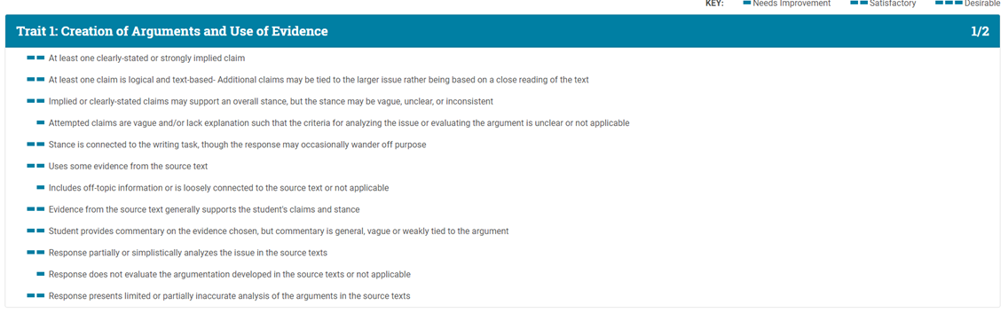
The Report is In!

Slide 42
Where are Students Likely to Get Stuck?
Identifying different types of evidence
Determining the best supported argument
Providing a rationale for why the argument was best supported
Bringing in “outside” information through evaluation of why evidence connects
Opting for personal opinion not reasoned judgment

Slide 43
Resources
GED.com

Slide 44

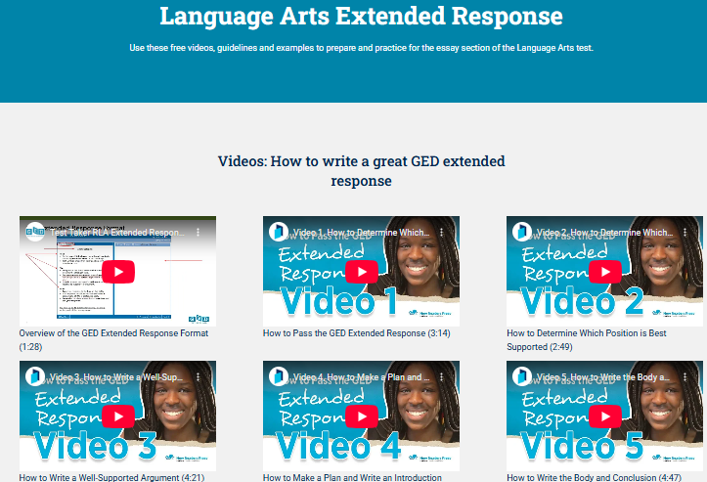
Free Classroom Materials
Tutorials
Free Practice Tests
8 Videos aimed at improving their written responses

Slide 45

Thanks!
Communicate with GED Testing Service®
Help@GED.com
Ann Evers – Ann.Evers@GED.com

Slide 46

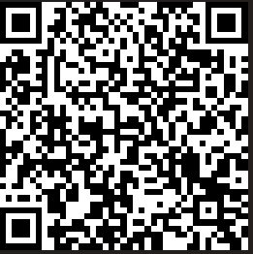
Session Survey
Your feedback is important. Please scan the QR code below to rate this session.

