Slide 1
Mastering Basic Math Skills:
Applying Basic Math and Calculator Skills for Success at All Levels
Kellie Blair Hardt
Hardt2heart Adult Education Services
GED Testing Service, Board of Directors
GED® and GED Testing Service® are registered trademarks of the American Council on Education (“ACE”). They may not be used or reproduced without the express written permission of ACE or GED Testing Service LLC. The GED® and GED Testing Service® brands are administered by GED Testing Service LLC under license from ACE.

Slide 2
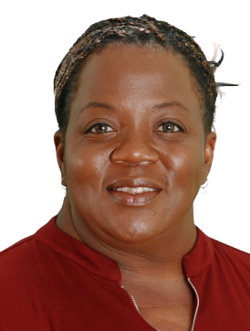

Kellie Blair Hardt
GED Math Tutor & Board Member @ GED Testing Service
20+ years of middle/high school math/science/special education
20+ years of adult adult education, math
Hardt2Heart Adult Education Services, LLC
B.A Psychology, M.Ed Special Ed., PhD candidate (Adult Education)
GED Graduate!
- Kellie’s Story-
- Kellie’s Coloring Book-
- New GEDTS
Board Member-
-GED Testing Service
Podcast-
Kellie B. Hardt

Slide 3

AGENDA
Calculator 101: Unlocking the Basics
Why the TI-30XS Multiview matters at every math level
Navigating the keypad and display
Modes, settings, and essential functions
How the calculator supports instruction and learner confidence
Building Fluency with Core Skills
Hands-on practice with:
Fractions, Decimals & Percentages
Exponents, Square & Cube Roots
Order of Operations (PEMDAS)
Basic Algebra
Basic Geometry & Formula Sheet

Slide 4
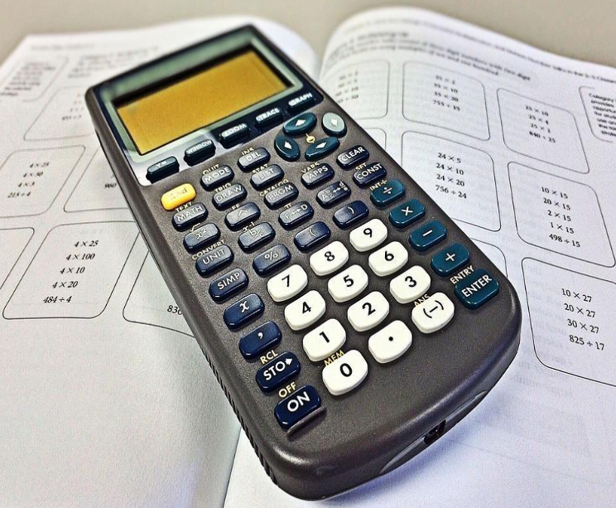
About That Math Exam
As of April 6, 2025:
190,878 adult learners have passed 3 of the 4 required GED tests and never finished the final test
154,224 students/81% need to complete Math
22,158 students/11% need to complete RLA
8,949 students/5% need to complete Social Studies
5,547 students/3% need to complete Science

Slide 5









GED.COM: Your One Stop Shop for Resources

Slide 6
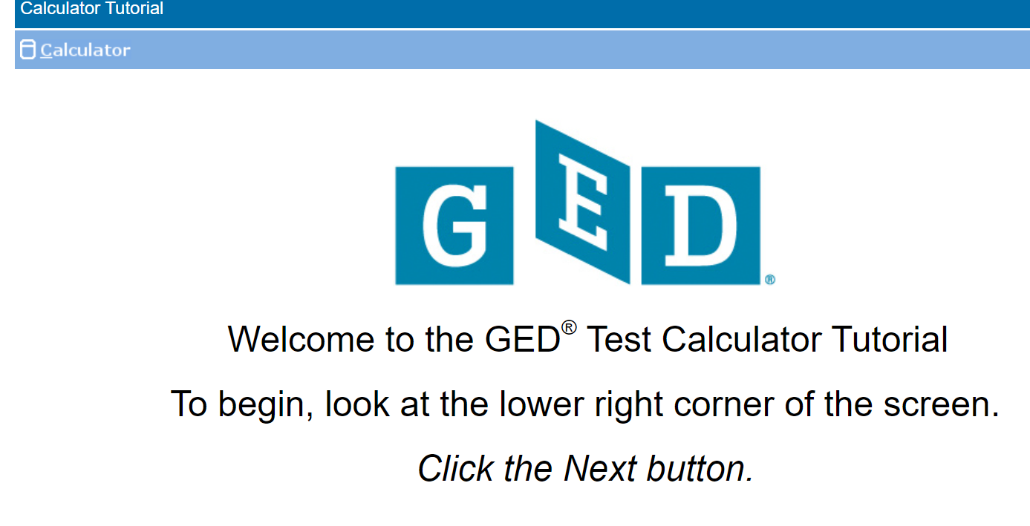
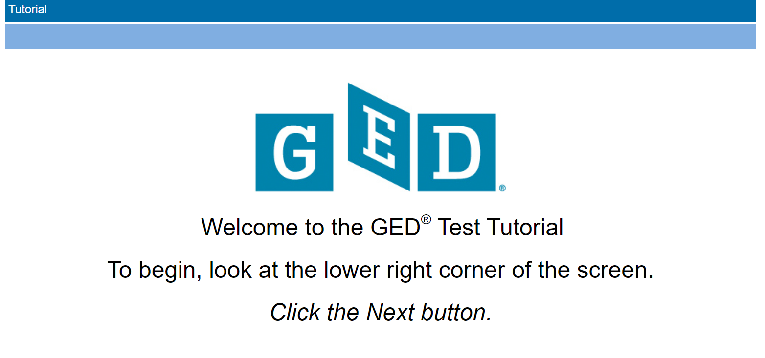

GED.COM: Your One Stop Shop for Resources
Calculator Tutorial
Test Tutorial
Click the pic
Click the pic
Free practice tests!
Click the pic

Slide 7
DID YOU KNOW?
Questions on the GED Math test are not weighted differently—each typically counts equally toward your final score.
That means it's not about doing the hardest problems—it's about answering as many correctly as possible, no matter the type.
Accuracy + Efficiency = Success
Mastering the TI-30XS Multiview can significantly improve both!
Notes:
Learners must understand that, just as any high school test, its measuring how much they know, not how much they don’t know.

Slide 8
CALCULATOR 101: Unlocking the Basics
🖩 Without a Calculator
🖩 With a Calculator
🧱Fundamental Skills
💡Deep Understanding
🧠Critical Thinking
✂️Error Reduction
⏱️Efficiency Boost
🌟Confidence Building

Slide 9
CALCULATOR 101: Unlocking the Basics
🖩 The Power of Daily Calculator Use
🔍 Independent Verification & Study
📆 Use it Daily—Not Just for Test Prep
Embed calculator use into daily instruction, not as a separate unit
Builds fluency, accuracy, and comfort before the test
Reinforces math thinking —not replaces it!
✅ Model how to check work using the calculator
Encourage learners to explore and self-correct
Reduces test anxiety by building confidence

Slide 10
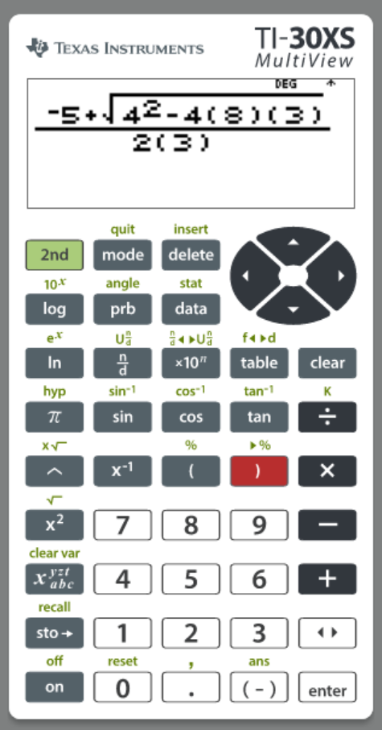
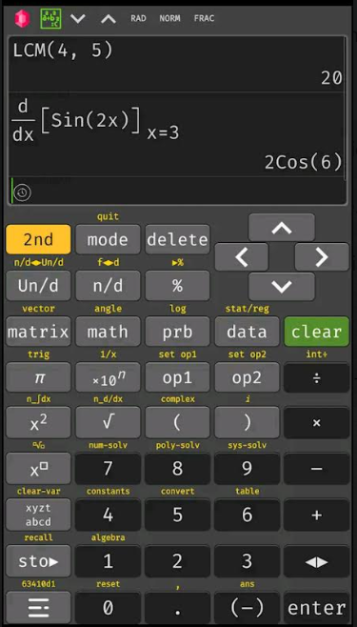

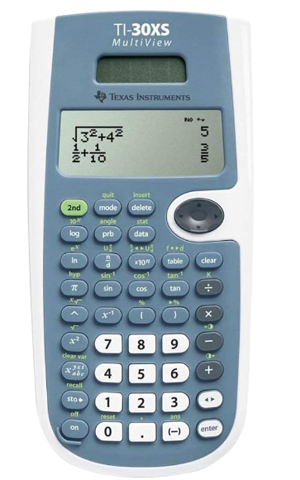
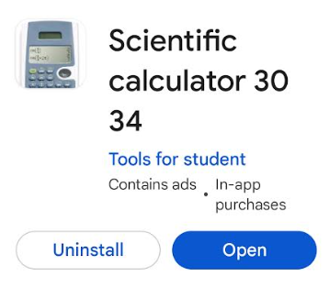
CALCULATOR 101: Unlocking the Basics
T
-Android Google Play-
-Free web based for computers, Android, iPhone (ads)-
-Computer
Emulator -
-Hand held-
-GED calculator
reference sheet-
-TI-30xs Guide
for Teachers-
-Introduction to TI-30xs-

Slide 11
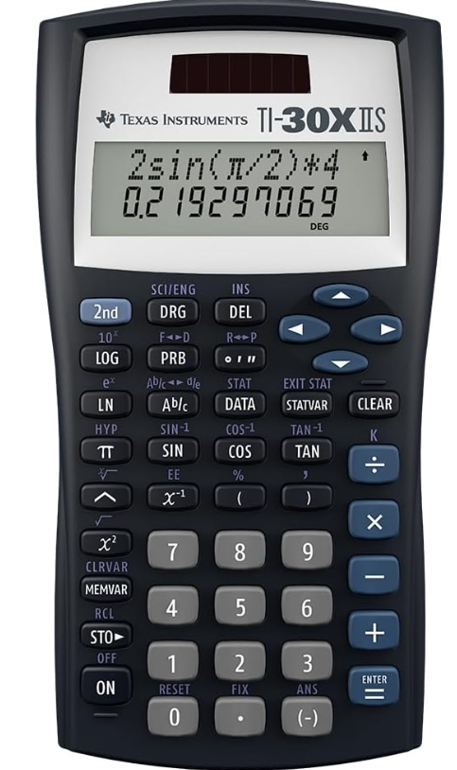
CALCULATOR 101: Unlocking the Basics
NOT THE SAME

Slide 12
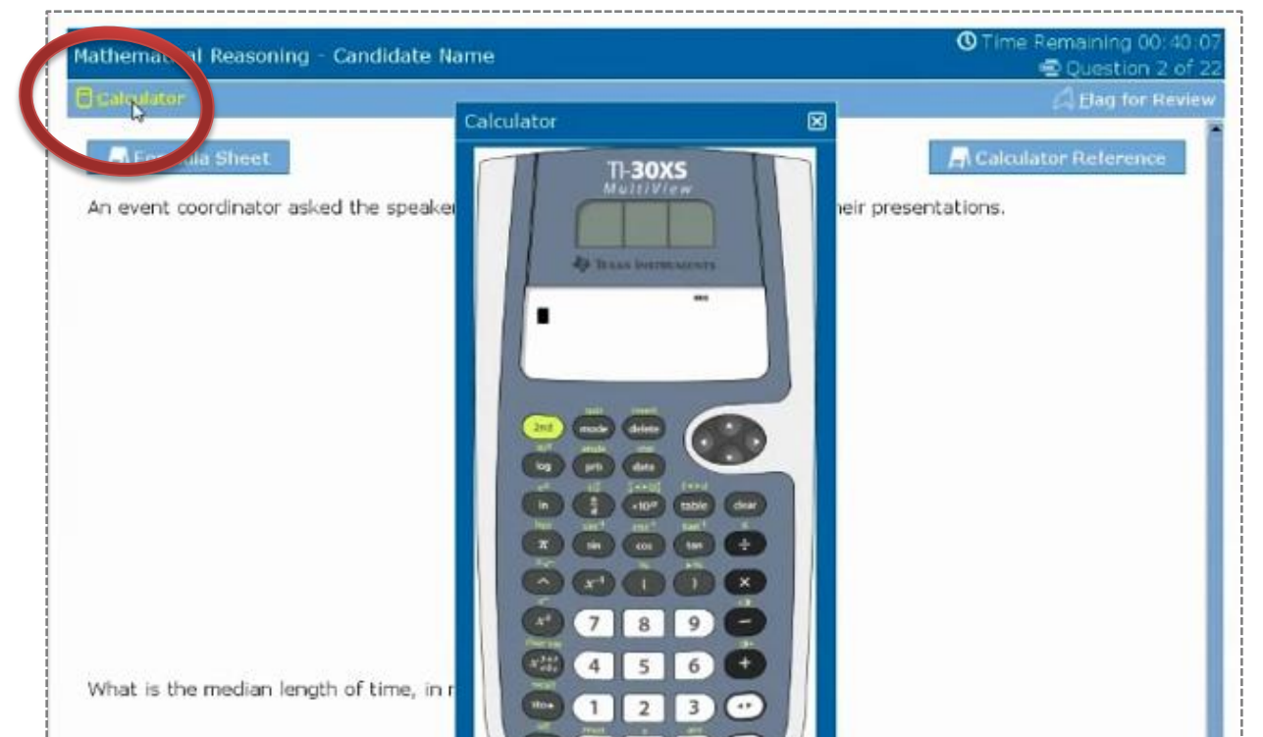
CALCULATOR 101: Unlocking the Basics
The computer-based GED math exam includes an on-screen TI-30XS Multiview Calculator. Learners also have access to a calculator reference sheet and a formula sheet to use during the test.
-Calculator Reference Sheet-
-GED Formula Sheet-

Slide 13
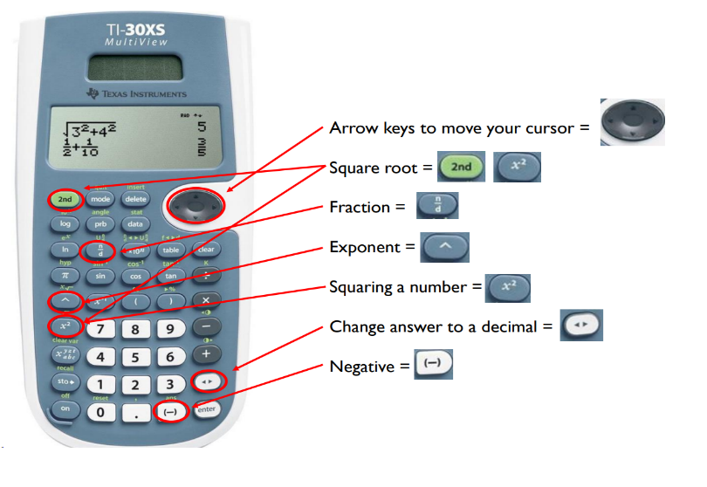
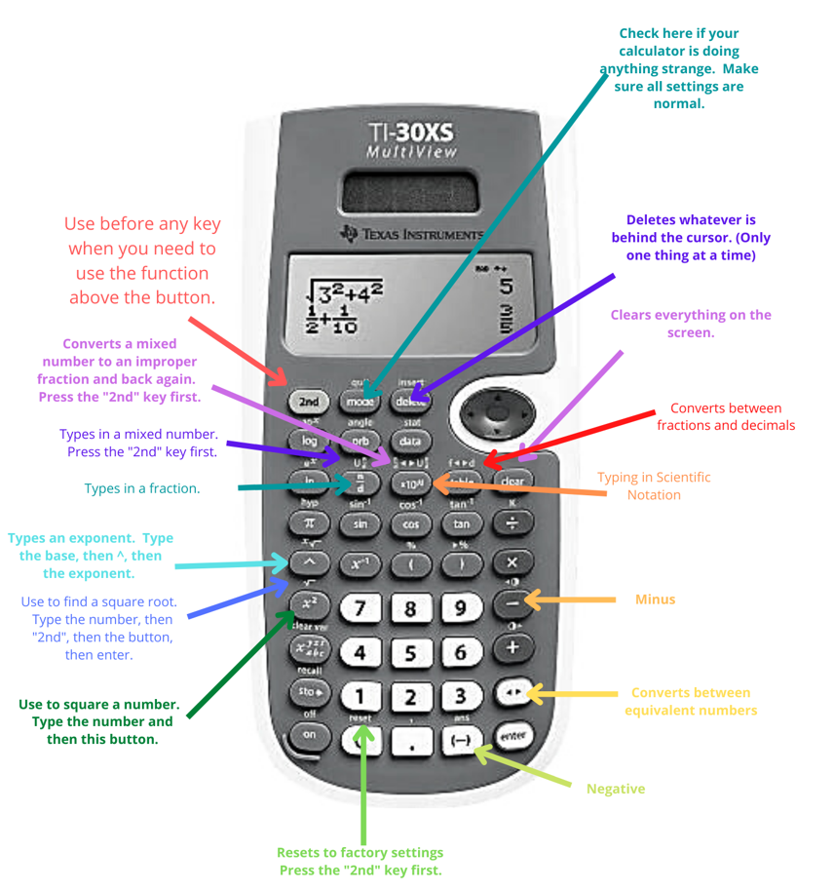
CALCULATOR 101: Unlocking the Basics
Anchor Charts: Navigating the Keypad and Display Guides
Notes:
Anchor charts

Slide 14
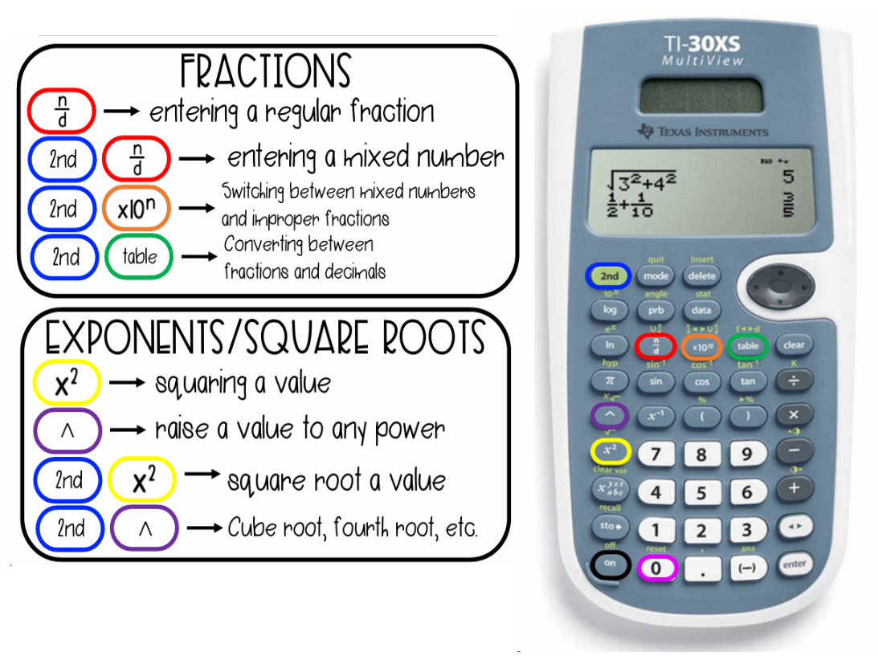
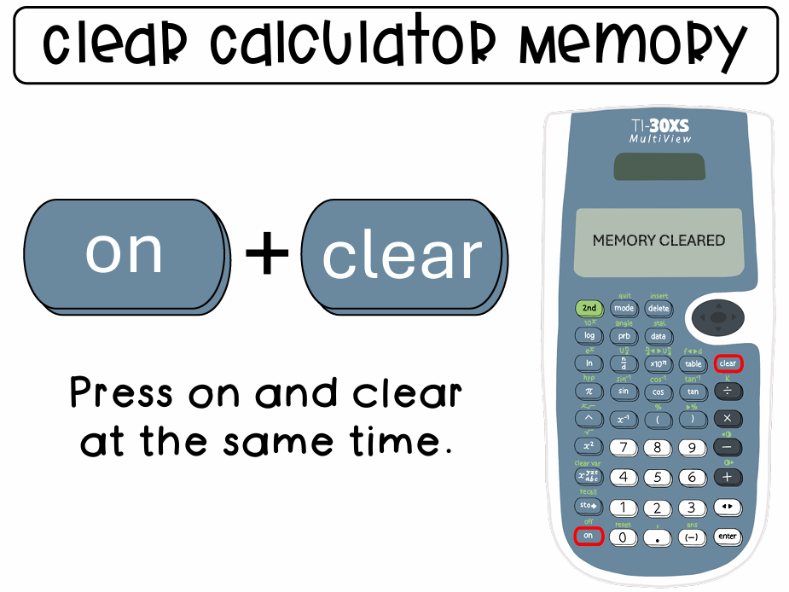
CALCULATOR 101: Unlocking the Basics
Anchor Charts: Navigating the Keypad and Display Guides
Notes:
Anchor charts

Slide 15

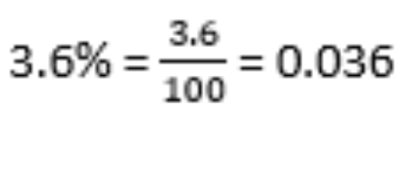
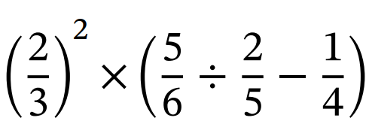


Roll-up Your Sleeves!
Calculator Practice for:
Fractions, Decimals, Percents
Notes:
https://cdn.kutasoftware.com/Worksheets/PreAlg/Fractions%20Decimals%20and%20Percents.pdf
Mathdrills

Slide 16



Do not edit
How to change the design
1. What is 3/4 + 2/5?
Presenting with animations, GIFs or speaker notes? Enable our Chrome extension
Notes:
📣 This is Slido interaction slide, please don't delete it.
✅ Click on 'Present with Slido' and the poll will launch automatically when you get to this slide.

Slide 17
Do not edit
How to change the design
Convert 0.375 to a fraction in simplest form.
Presenting with animations, GIFs or speaker notes? Enable our Chrome extension
Notes:
📣 This is Slido interaction slide, please don't delete it.
✅ Click on 'Present with Slido' and the poll will launch automatically when you get to this slide.

Slide 18
Do not edit
How to change the design
What is 5/8 ÷ 2/3?
Presenting with animations, GIFs or speaker notes? Enable our Chrome extension
Notes:
📣 This is Slido interaction slide, please don't delete it.
✅ Click on 'Present with Slido' and the poll will launch automatically when you get to this slide.

Slide 19
Do not edit
How to change the design
Convert 7/10 to a percent.
Presenting with animations, GIFs or speaker notes? Enable our Chrome extension
Notes:
📣 This is Slido interaction slide, please don't delete it.
✅ Click on 'Present with Slido' and the poll will launch automatically when you get to this slide.

Slide 20
Do not edit
How to change the design
What is 1 1/2 + 2 2/3?
Presenting with animations, GIFs or speaker notes? Enable our Chrome extension
Notes:
📣 This is Slido interaction slide, please don't delete it.
✅ Click on 'Present with Slido' and the poll will launch automatically when you get to this slide.

Slide 21
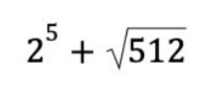



Roll-up Your Sleeves!
Calculator Practice for:
Exponents, Square & Cube Roots
Notes:
https://cdn.kutasoftware.com/Worksheets/PreAlg/Fractions%20Decimals%20and%20Percents.pdf
Mathdrills

Slide 22
Do not edit
How to change the design
What is the cube root of (8 × 27)?
Presenting with animations, GIFs or speaker notes? Enable our Chrome extension
Notes:
📣 This is Slido interaction slide, please don't delete it.
✅ Click on 'Present with Slido' and the poll will launch automatically when you get to this slide.

Slide 23
Do not edit
How to change the design
Evaluate: (5² - 3²) + √16
Presenting with animations, GIFs or speaker notes? Enable our Chrome extension
Notes:
📣 This is Slido interaction slide, please don't delete it.
✅ Click on 'Present with Slido' and the poll will launch automatically when you get to this slide.

Slide 24
Do not edit
How to change the design
What is the cube of 4?
Presenting with animations, GIFs or speaker notes? Enable our Chrome extension
Notes:
📣 This is Slido interaction slide, please don't delete it.
✅ Click on 'Present with Slido' and the poll will launch automatically when you get to this slide.

Slide 25
Do not edit
How to change the design
What is (2³ + 4²) ÷ 2?
Presenting with animations, GIFs or speaker notes? Enable our Chrome extension
Notes:
📣 This is Slido interaction slide, please don't delete it.
✅ Click on 'Present with Slido' and the poll will launch automatically when you get to this slide.

Slide 26
Do not edit
How to change the design
What is the value of √(36 + 64)?
Presenting with animations, GIFs or speaker notes? Enable our Chrome extension
Notes:
📣 This is Slido interaction slide, please don't delete it.
✅ Click on 'Present with Slido' and the poll will launch automatically when you get to this slide.

Slide 27
Do not edit
How to change the design
Simplify: (3² × 2) - √49
Presenting with animations, GIFs or speaker notes? Enable our Chrome extension
Notes:
📣 This is Slido interaction slide, please don't delete it.
✅ Click on 'Present with Slido' and the poll will launch automatically when you get to this slide.

Slide 28
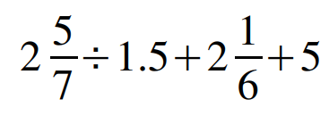
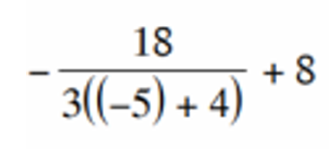
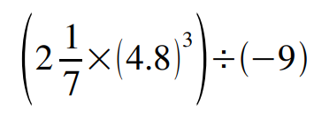

Roll-up Your Sleeves!
Calculator Practice for:
Order of Operations
Notes:
https://cdn.kutasoftware.com/Worksheets/PreAlg/Fractions%20Decimals%20and%20Percents.pdf
Mathdrills

Slide 29
Do not edit
How to change the design
{(12 ÷ 3) + [(2² + 1) × 2]} - 5
Presenting with animations, GIFs or speaker notes? Enable our Chrome extension
Notes:
📣 This is Slido interaction slide, please don't delete it.
✅ Click on 'Present with Slido' and the poll will launch automatically when you get to this slide.

Slide 30
Do not edit
How to change the design
Evaluate: [(8 ÷ 2) + (3² - 4)] × (5 - 1)
Presenting with animations, GIFs or speaker notes? Enable our Chrome extension
Notes:
📣 This is Slido interaction slide, please don't delete it.
✅ Click on 'Present with Slido' and the poll will launch automatically when you get to this slide.

Slide 31
Do not edit
How to change the design
Simplify: 4 + {(10 - 6) × [(3 + 2)² - 9]}
Presenting with animations, GIFs or speaker notes? Enable our Chrome extension
Notes:
📣 This is Slido interaction slide, please don't delete it.
✅ Click on 'Present with Slido' and the poll will launch automatically when you get to this slide.

Slide 32
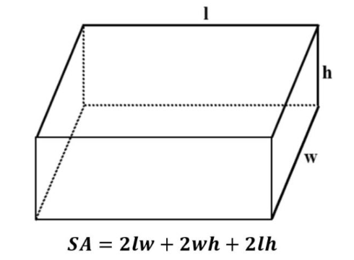
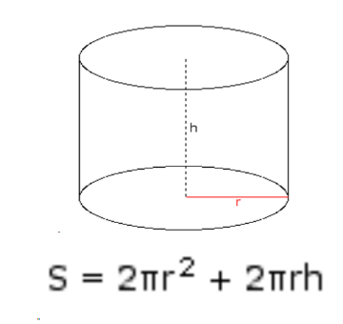
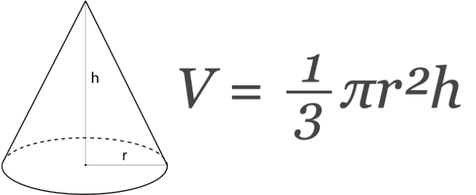
Roll-up Your Sleeves!
Calculator Practice for:
BASIC GEOMETRY
Notes:
https://cdn.kutasoftware.com/Worksheets/PreAlg/Fractions%20Decimals%20and%20Percents.pdf
Mathdrills

Slide 33
Do not edit
How to change the design
A box has a length of 8 inches, a width of 5 inches, and a height of 3 inches. What is its surface area?
Presenting with animations, GIFs or speaker notes? Enable our Chrome extension
Notes:
📣 This is Slido interaction slide, please don't delete it.
✅ Click on 'Present with Slido' and the poll will launch automatically when you get to this slide.

Slide 34
Do not edit
How to change the design
A rectangular fish tank is 10 feet long, 4 feet wide, and 3 feet high. What is the surface area?
Presenting with animations, GIFs or speaker notes? Enable our Chrome extension
Notes:
📣 This is Slido interaction slide, please don't delete it.
✅ Click on 'Present with Slido' and the poll will launch automatically when you get to this slide.

Slide 35
Do not edit
How to change the design
A cone has a radius of 3 cm and a height of 6 cm. What is its volume?
Presenting with animations, GIFs or speaker notes? Enable our Chrome extension
Notes:
📣 This is Slido interaction slide, please don't delete it.
✅ Click on 'Present with Slido' and the poll will launch automatically when you get to this slide.

Slide 36
Do not edit
How to change the design
A cone-shaped cup has a radius of 5 in and a height of 10 in. What is the volume?
Presenting with animations, GIFs or speaker notes? Enable our Chrome extension
Notes:
📣 This is Slido interaction slide, please don't delete it.
✅ Click on 'Present with Slido' and the poll will launch automatically when you get to this slide.

Slide 37
Do not edit
How to change the design
A cylinder has a radius of 4 m and height of 10 m. What is its surface area?
Presenting with animations, GIFs or speaker notes? Enable our Chrome extension
Notes:
📣 This is Slido interaction slide, please don't delete it.
✅ Click on 'Present with Slido' and the poll will launch automatically when you get to this slide.

Slide 38
Do not edit
How to change the design
A cylindrical can has a height of 12 cm and a radius of 3 cm. What is the surface area?
Presenting with animations, GIFs or speaker notes? Enable our Chrome extension
Notes:
📣 This is Slido interaction slide, please don't delete it.
✅ Click on 'Present with Slido' and the poll will launch automatically when you get to this slide.

Slide 39
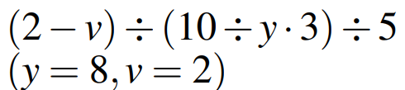
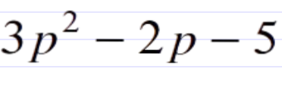
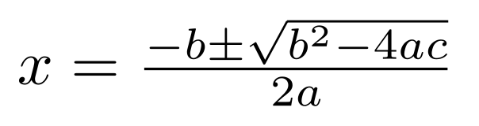
Roll-up Your Sleeves!
Calculator Practice for:
BASIC ALGEBRA
Notes:
https://cdn.kutasoftware.com/Worksheets/PreAlg/Fractions%20Decimals%20and%20Percents.pdf
Mathdrills

Slide 40
Do not edit
How to change the design
If t = 10, u = 6, evaluate: [(t - u)² + t] ÷ u
Presenting with animations, GIFs or speaker notes? Enable our Chrome extension
Notes:
📣 This is Slido interaction slide, please don't delete it.
✅ Click on 'Present with Slido' and the poll will launch automatically when you get to this slide.

Slide 41
Do not edit
How to change the design
If x = 5 and y = 2, evaluate: x³ - y² × 2
Presenting with animations, GIFs or speaker notes? Enable our Chrome extension
Notes:
📣 This is Slido interaction slide, please don't delete it.
✅ Click on 'Present with Slido' and the poll will launch automatically when you get to this slide.

Slide 42
Do not edit
How to change the design
If a = 2, b = 5, evaluate: [(b - a) × (a + b)] ÷ a
Presenting with animations, GIFs or speaker notes? Enable our Chrome extension
Notes:
📣 This is Slido interaction slide, please don't delete it.
✅ Click on 'Present with Slido' and the poll will launch automatically when you get to this slide.

Slide 43
Do not edit
How to change the design
If x = 3 and y = 4, evaluate: x² + y² - 2xy
Presenting with animations, GIFs or speaker notes? Enable our Chrome extension
Notes:
📣 This is Slido interaction slide, please don't delete it.
✅ Click on 'Present with Slido' and the poll will launch automatically when you get to this slide.

Slide 44
Do not edit
How to change the design
If x = 2, y = 3, z = 4, evaluate: x(y + z) - yz
Presenting with animations, GIFs or speaker notes? Enable our Chrome extension
Notes:
📣 This is Slido interaction slide, please don't delete it.
✅ Click on 'Present with Slido' and the poll will launch automatically when you get to this slide.

Slide 45
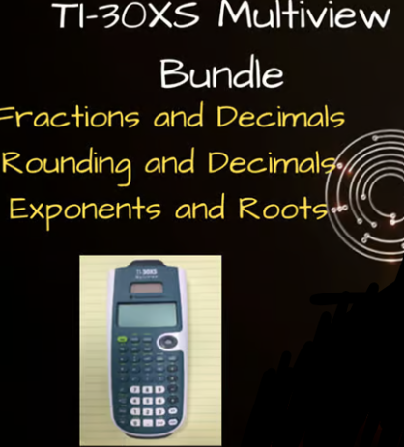
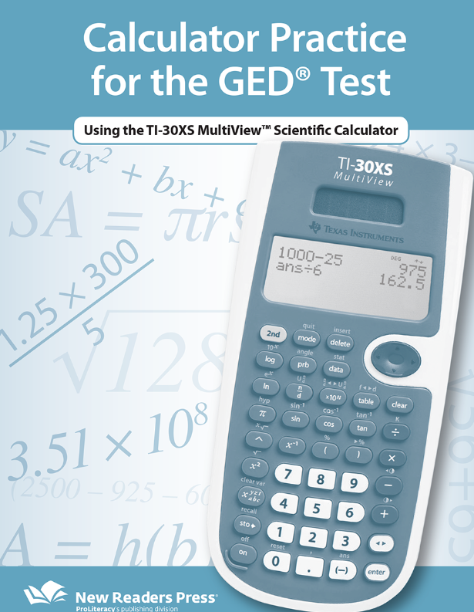


MORE CALCULATOR PRACTICE & RESOURCES
-Exponents & Squares-
-Calculator Practice Sheet-
-Fractions & Decimals-
-Free Adult Education Resources-
-Rounding & Decimals-

Slide 46






Slide 47

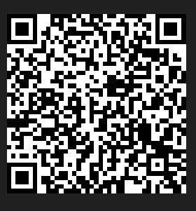
Session Survey
Session Slides
Your feedback is important!
Please scan the QR code below
to rate this session.
Interactive PDF of session slides with hyperlinks!

