Slide 1
Learner Centered Product Solutions
Victor Fitzjarrald, GED Testing Service
August 2025
GED® and GED Testing Service® are registered trademarks of the American Council on Education (“ACE”). They may not be used or reproduced without the express written permission of ACE or GED Testing Service LLC. The GED® and GED Testing Service® brands are administered by GED Testing Service LLC under license from ACE.

Slide 2
Agenda
Data on the profile of the GED learner
Test prep products and efficacy
What’s important to learners?
What’s working for your learners?

Slide 3
The GED Learners
Data about GED Candidates and Graduates

Slide 4

GED.com Average Candidate (last 12mo)
Predominantly non-White (61%) Male (51%)
Non-Hispanic (30%)– predominately English speaking.
15*-24yrs old (45.84% of learners)
Completed ~11th grade
Mostly uses Adult Education (40%) with GED Ready (17%).
Studies with a physical book (14%).
Goes to GED.com in hopes of going to college (37%).
*: While we have a lot of users registering in the 15-18 range, it is rare for them to be able to test
Notes:
Demographic Extracts:
15% ages 16-17, 25% ages 18-19, 22% ages 20-24, 22% ages 25-34, 17% ages 35+
8% middle school or less, 13% 9th grade, 22% 10th Grade, 23% 11th Grade, 25% 12th Grade
40% use adult ed classes, 17% use GEDReady, 14% use Books, 10% online courses.

Slide 5

GED.com Average International Candidate
Female (50%) non-white (99%)
Non-Hispanic – predominately English speaking (international tests are only in English)
17 years old (16-19yo students = 84%)
Completed ~10th grade (higher probability as you progress)
Mostly uses Adult Education with higher percentage use of GEDReady and Study Books.
GED is an entrance point to US education, better employment, and potential migration.
Notes:
Demographic Extracts:
44% Male, 50% Female
46% ages 16-17, 38% ages 18-19, 13% ages 20-24, 2% ages 25-34
8% middle school or less, 14% 9th grade, 29% 10th Grade, 20% 11th Grade, 18% 12th Grade
40% use adult ed classes, 23% use GEDReady, 22% use Books, 10% online courses.

Slide 6

GED & Me Average Candidate
Female (56%) Hispanic (35%) White (39%)
Predominantly English speaking but would like Spanish content.
22yrs old (20-24yo students = 30% with 24-30yo being 28%)
Core focus: taking better care of my family. Accesses GED & Me as a tool to do that.
Notes:
Demographic Extracts:
44% Male, 50% Female
46% ages 16-17, 38% ages 18-19, 13% ages 20-24, 2% ages 25-34
8% middle school or less, 14% 9th grade, 29% 10th Grade, 20% 11th Grade, 18% 12th Grade
40% use adult ed classes, 23% use GEDReady, 22% use Books, 10% online courses.

Slide 7
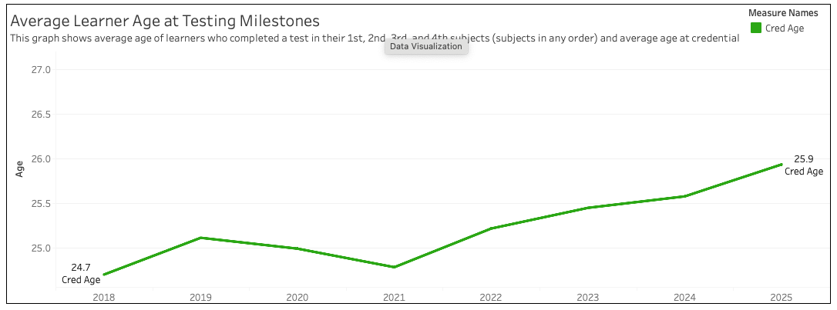
Average Graduate Age: 25.9 (and trending up)

Slide 8
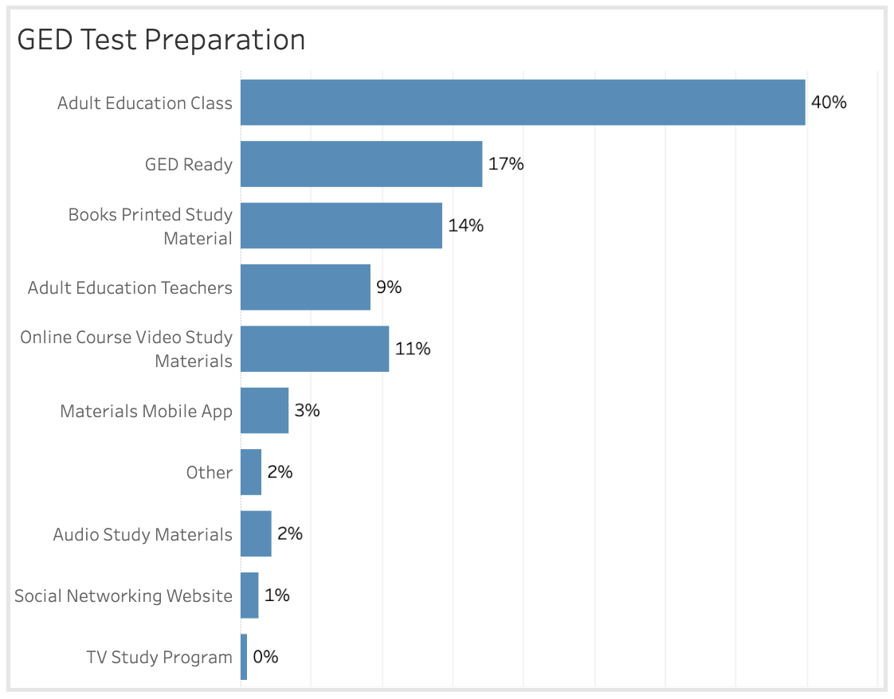
What do we know about the GED learner?
From GED Analytics demographics, 2024
*Note that all learners are asked how they are preparing during GED.com test scheduling; this is an optional question, and not all learners answer.
40% of learners report that they prepared in an adult ed class during the past 18 mos
17% say they use GED Ready
14% say they use printed study materials
9% say they prepared with a teacher or tutor
11% say they are using an online course or videos

Slide 9
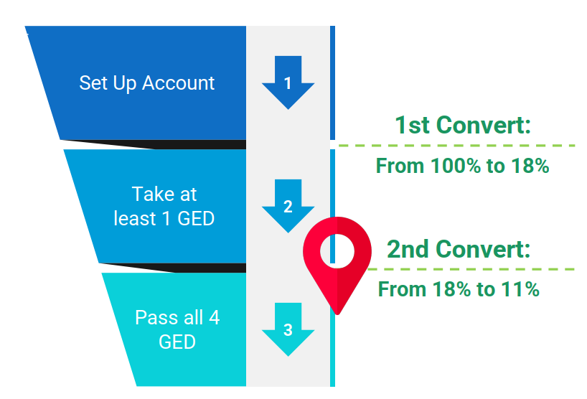
If a learner takes their first test, they are likely to finish all 4
Completers: 61% of learners who start testing, finish taking all 4 tests
Passers: 75% of test-takers passed their test last year
In limbo: 39% are getting stuck along the way, and not completing

Slide 10
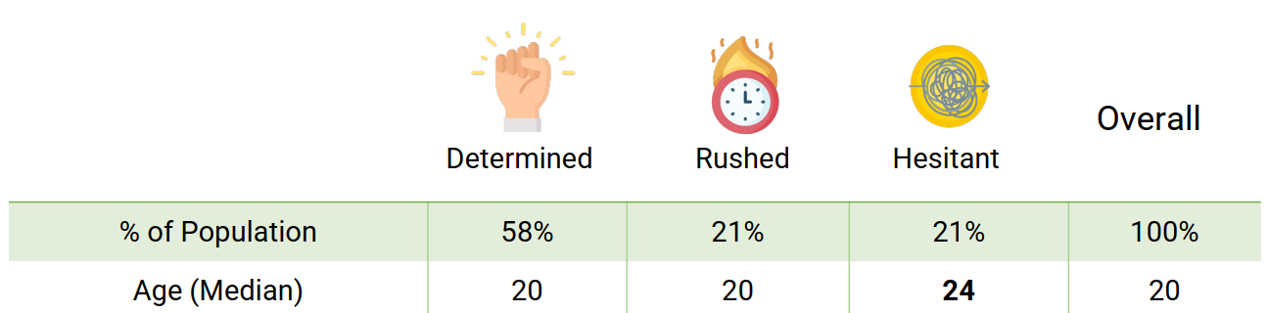
3 Segments of learners identified from those who take & pass all 4 tests

Slide 11
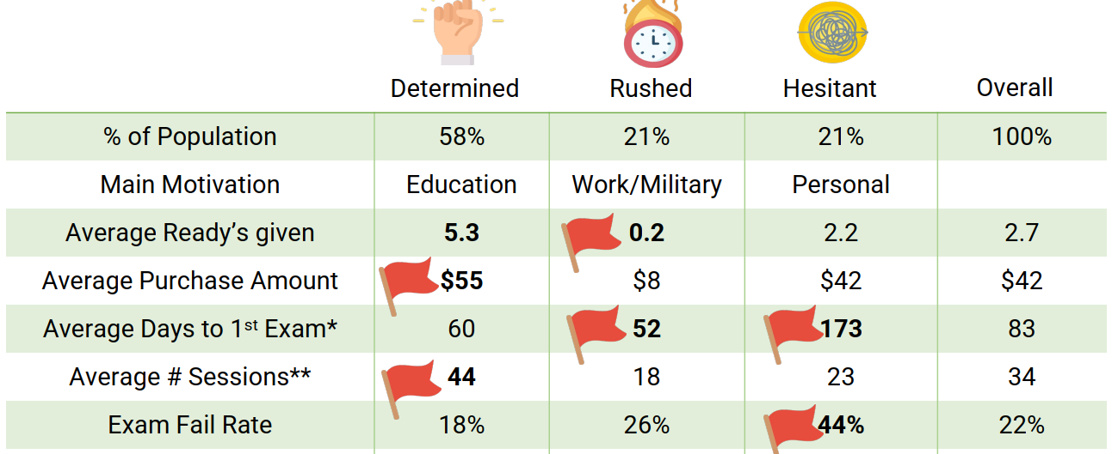
Most successful segment is Determined – they take the most GED Ready tests, purchase the most prep products and take, on average, 60 days, before first test

Slide 12
What’s New?
New Features and New Data!

Slide 13

Love Data? Put this on your Calendar!
Dive into the data with our Data Analyst team
Wednesday August 6th
10:15am-11:30am
Salon C-2

Slide 14
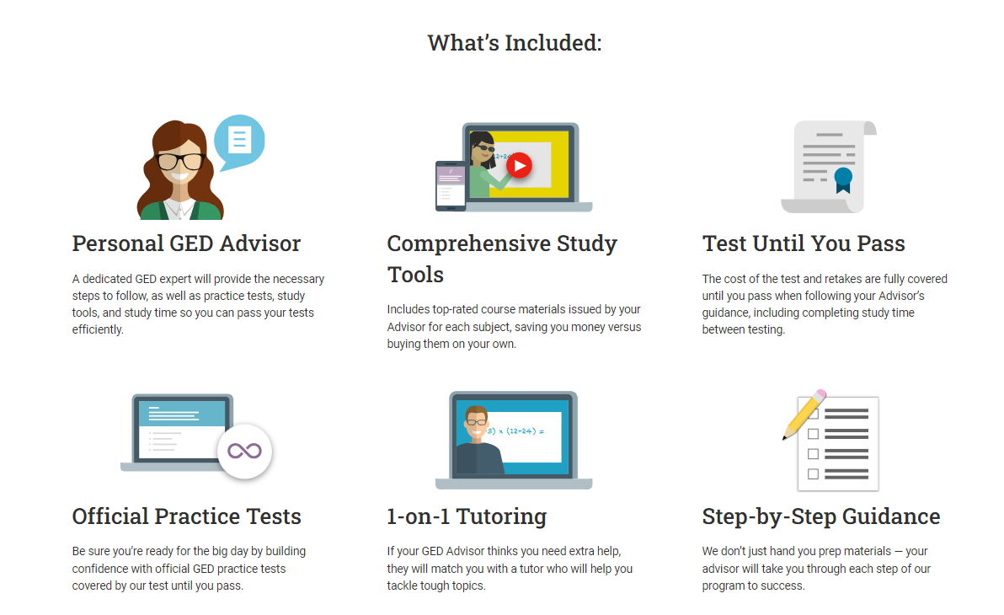
GED+™: An Advisor-led GED journey
GED Advisors are not teachers; they are navigators
Learner Journey includes taking a GED Ready to determine study needs; recommended test prep products and GED Flash for review before testing
Profile of the GED+ learner:
- Very self-motivated
- One subject-at-a-time
- Older than avg age (>23 years)
- Pass the test quickly
- 2X more likely than the average independent learner to pass all 4 tests
NEW: GED Tutor allows for on demand tutoring for students who need that support.

Slide 15
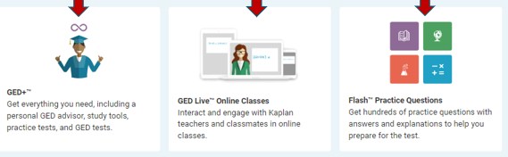
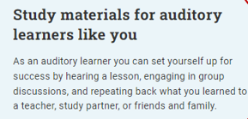
Content recommendations are based on outcomes data, accessibility, and meeting the learner’s preferred learning style
GED+ learners who stick to their GED Advisor’s instructions are 2x as likely to earn their high school credential than those who study on their own.
GED learners who attend GED Live online classes on average improve their pass rate from 49% to 77%
GED learners who practice frequently on GED® Flash scored on average 4 points higher on their GED® test

Slide 16
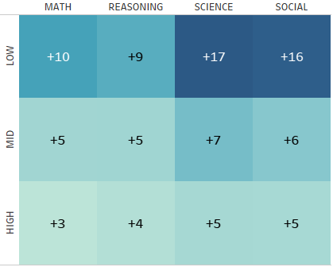
Effectiveness of Products (GED+)
Average score increase by subject and score group
Segmenting users by average
score prior to purchasing GED+
Low – under 135
Mid – 135-140
High – more than 140
Product shows increased effectiveness among low scoring learners
Timeframe: last 2 years
Notes:
We can break this down further, grouping users based on what their average score was prior to purchasing GED+
For ex - people with avg scores under 135 would be in the 'low' grouping, 135-140 in the 'mid' group, and scores averaging over 140 in the 'high' grouping
we can see that GED+ has a positive impact across all score groups, showing its most significance impact for users who had low scores prior to purchasing (below 135)
For ex, users with low scores prior to purchasing showed an average of 17 and 16 point increases in Science and Social studies respectively
This demonstrates that GED+ is an effective product for all learners, regardless of their score group, and drives learner success at all levels.

Slide 17
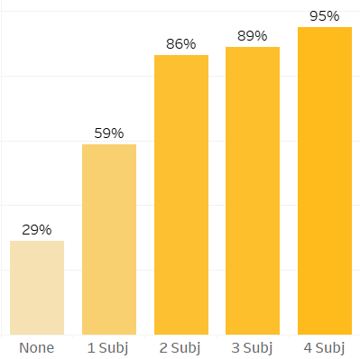
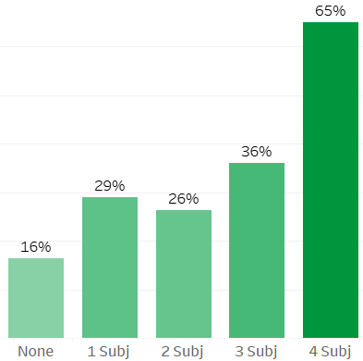
Effectiveness of Products (GED+)
Portion of users to test and credential based on GED+ subjects purchased
Portion of users to take 1st Test
Portion of users to Credential
% take 1st Test
Credential rate
Subject Count
Subject Count
Notes:
Left - looks at the portion of learners to take their 1st test, grouping users based on how many GED+ subjects they purchased
Success drastically ramps up for each additional product purchase
Right - looks at credential rate based on how many GED+ subjects they purchased
Findings -
ANY GED+ purchase (even 1 subject) doubles the likelihood to take 1st test AND to credential
Purchasing the bundle (or all 4 subjects) shows even more significant results, with 95% of these learners taking their 1st test and 65% of them credentialing
This further demonstrates the efficacy of GED+ and the positive impact it has on the success of learners.

Slide 18
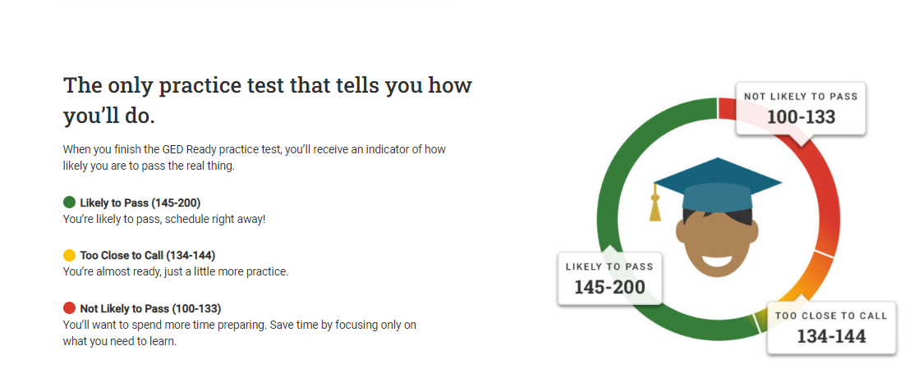
GED Ready® – more than 1 million GED Ready official practice tests taken per year
Learners who take a GED Ready perform on average 10 points higher on the GED test
The most successful ‘Determined’ learners take 5 GED Ready tests, on average, before they credential
Profile of the GED Ready learner
Diverse pool of learners – international, domestic, independent, and adult ed students
Learners can purchase on their own on GED.com
Teachers can purchase in bulk from GED Marketplace or GED Direct (with GED Manager access)
https://app.ged.com/portal/study/practice

Slide 19
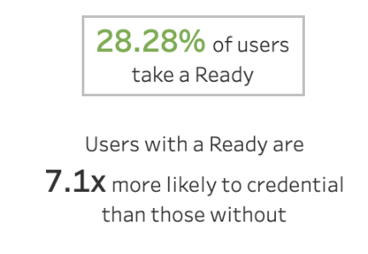
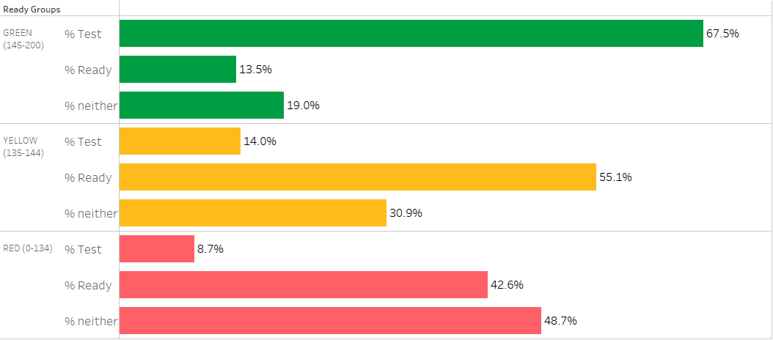
GED Ready Activity Trends
Next activity based on Ready score group
Notes:
What are we looking at?
Portion of time a Ready of that score color led to a specific activity
Ex. 67.5% of GREEN Ready scores resulted in a GED Test being taken in that subject

Slide 20
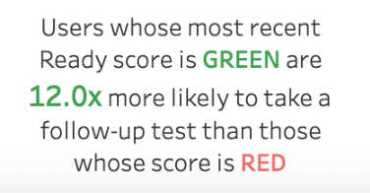
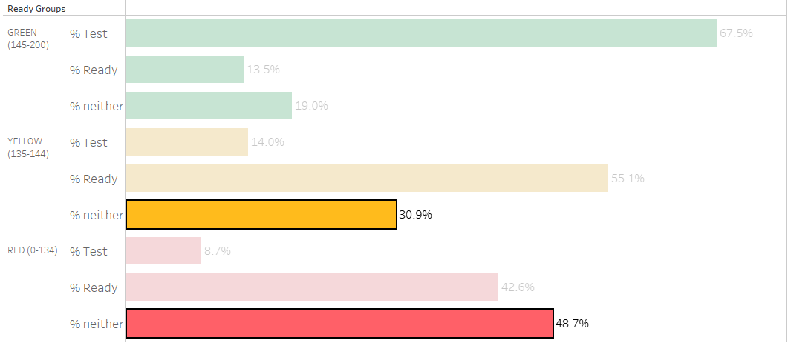
GED Ready Activity Trends
Next activity based on Ready score group
Notes:
Large portion of learners who score in RED/YELLOW are stopping all activity
With nearly 50% of RED scores and over 30% of YELLOW scores resulting in no further activity
While taking a Ready greatly improves likelihood of testing, we can see that a low Ready score can often result in that learner dropping off
If they never continue, these are all learners lost as potential credentialers

Slide 21


Taking a Ready has the most influence on taking 1st Test
Has taken a Ready?
no
yes
13% likelihood to take 1st GED Test
60% likelihood to take 1st GED Test
Questions:
What features drive learners to take a GED Ready?
Why are some Ready takers not taking a GED Test?

Slide 22
Simplified view of activity levels based on Ready score
Ready score >= 145
false
true
Ready score >= 135
80% stay active
false
true
50% stay active
70% stay active
Notes:
Looking at the same data, simplified into a decision tree…
We can see that Ready score >= 145 result in continued activity 80% of the time
With Ready scores < 135 resulting in continued activity only 50% of the time

Slide 23

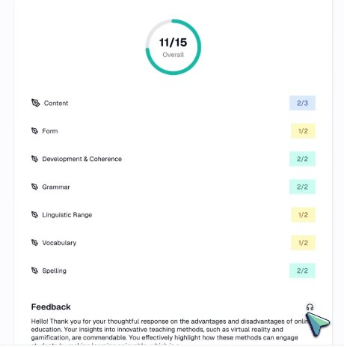
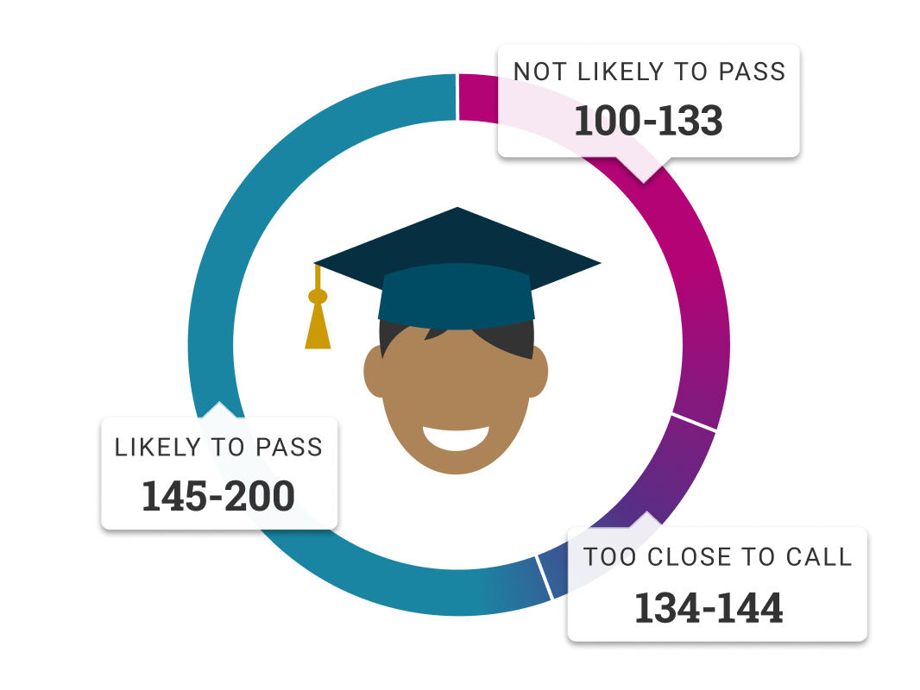
Roadmap for GED Ready
Now
Next
Later
Research
Best Practice
Focus Groups
Card Format?
Scored Essay?
Tablet support?
Color Testing?
Notes:
Looking at the same data, simplified into a decision tree…
We can see that Ready score >= 145 result in continued activity 80% of the time
With Ready scores < 135 resulting in continued activity only 50% of the time

Slide 24
Roadmap for Study Page Redesign
Prototypes / In-Development
Redesigned Study page with faster access to key information and better access to free resources
Next
Now
Notes:
Looking at the same data, simplified into a decision tree…
We can see that Ready score >= 145 result in continued activity 80% of the time
With Ready scores < 135 resulting in continued activity only 50% of the time

Slide 25
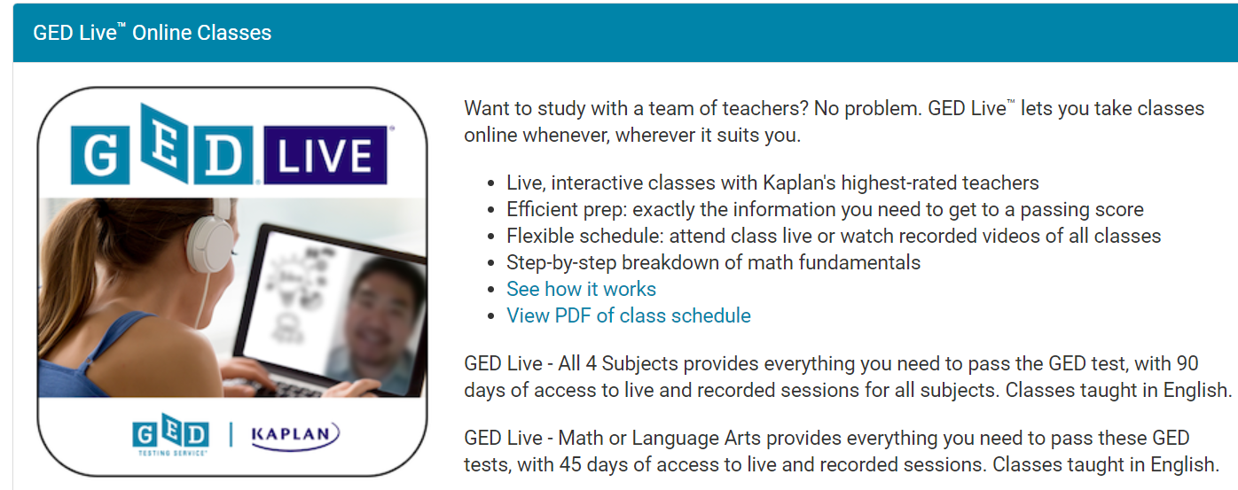
GED Live™ – Live online classes with Kaplan instructors
GED Live classes are held weekday evenings; recorded sessions are available in an online library
Learners can buy Math or RLA as single subjects, or all subjects
Learners who take a test after using GED Live improve their pass rate likelihood to 77%
Profile of GED Live Learners
Prefer an Auditory style of learning
Like to participate with other learners
Want an instructor-led experience but cannot get to a classroom
https://app.ged.com/portal/study/classes#gedLiveOnlineClasses

Slide 26
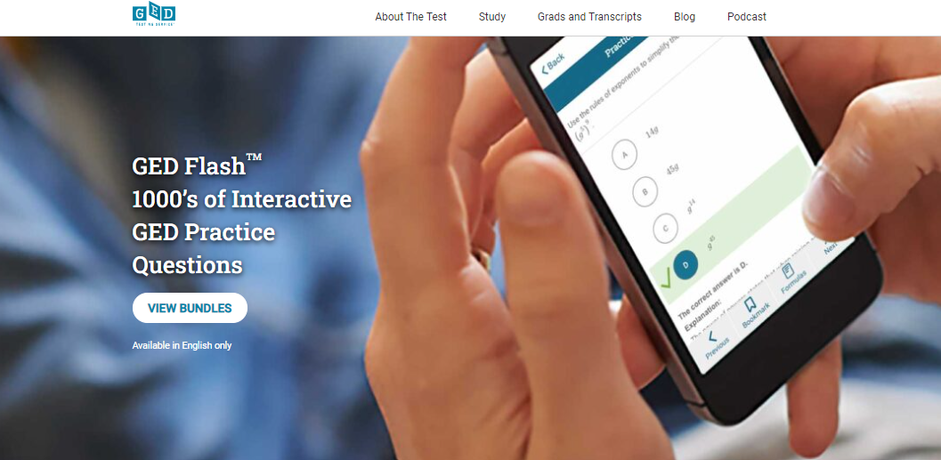
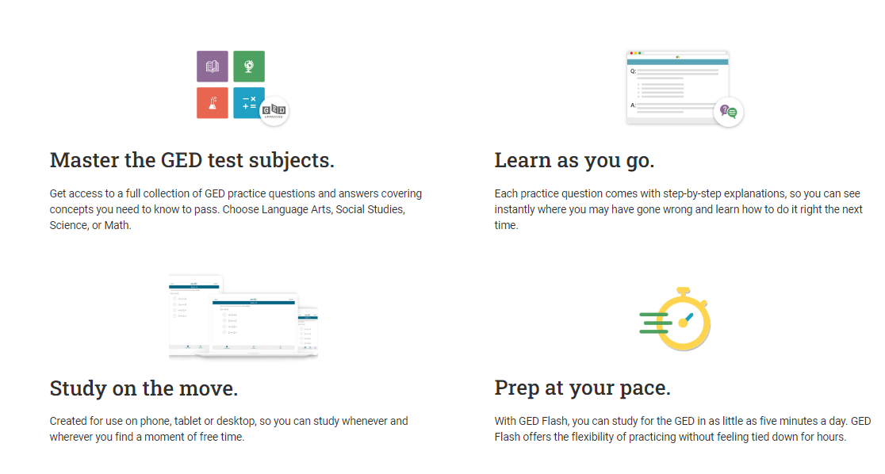
GED Flash™ – thousands of practice questions to help learners skill drill
GED learners use Flash when they want more practice, but don’t need a full course of study
Teachers and GEDWorks advisors use GED Flash as a skill drill just before test day
GED learners who practice frequently on GED® Flash scored on average 4 points higher on their GED® test
Profile of the GED Flash learner
Great for the independent learner – intrapersonal and kinesthetic – who like to practice what they will see on the test
Used in many adult ed classrooms
Spanish Content available
from Aztec Software!

Slide 27

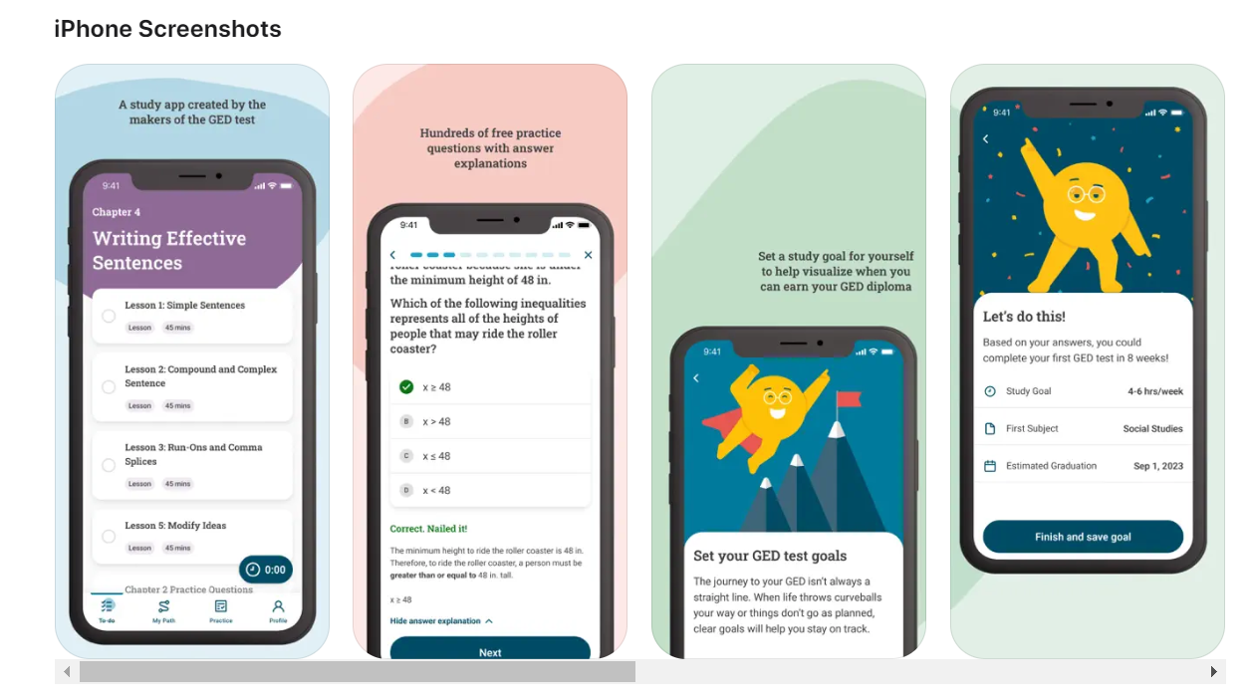

GED & Me™ – the official GED mobile App, is the independent learner’s guided path to a successful testing experience, but teachers like it, too!
App has eliminated the feelings of ‘not confident at all’ and improved the very/extremely confident from 22% to 50%
“Thank you for making a GED App that is the best thing ever! I feel like I can finally feel confident in passing my GED using the practice questions and it works perfectly please don’t change it I really love it. …
I really truly want an education this is much needed in my life“
App user feedback

Slide 28
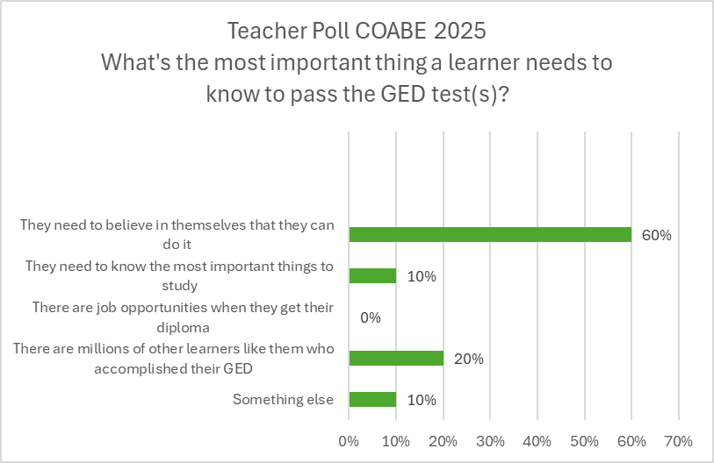

What do teachers think learners need to know to be successful on GED tests?

Slide 29
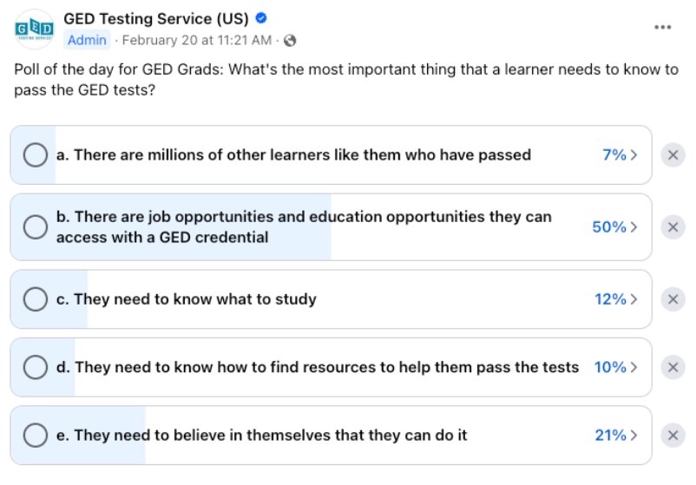
What do GED grads say learners need to know to be successful on GED tests?

Slide 30
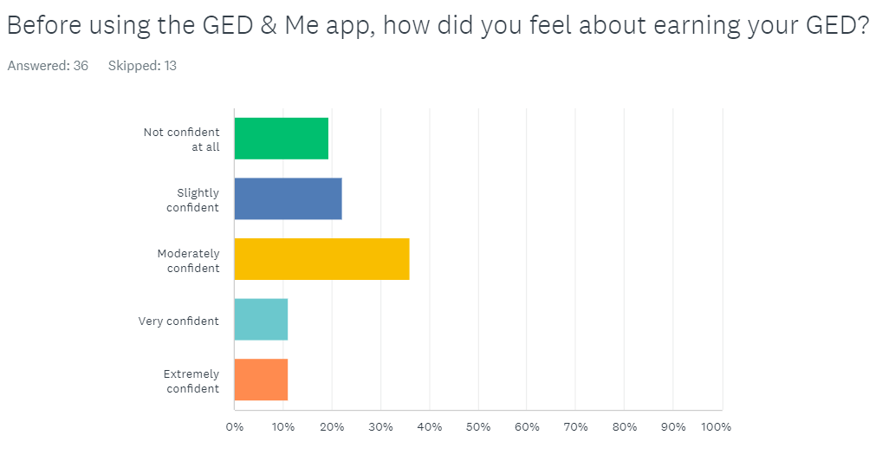
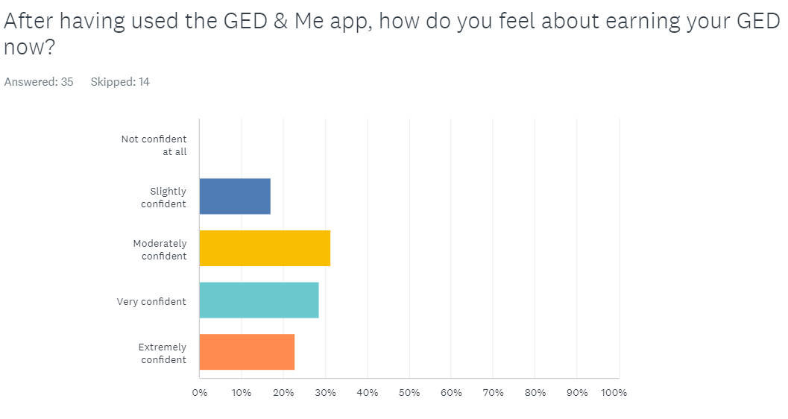
Beta findings: Eliminated the feelings of ‘not confident at all’ and improved the very/extremely confident from 22% to 50%

Slide 31
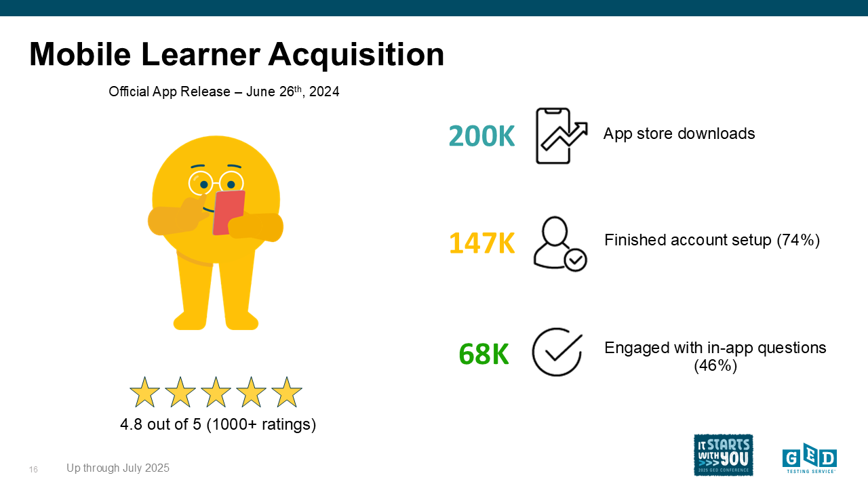




Mobile Learner Acquisition
Official App Release – June 26th, 2024
187K
App store downloads
137K
Finished account setup (73%)
62K
Engaged with in-app questions (45%)
4.8 out of 5 (1000+ ratings)
Up through June 2025
Notes:
Releasing June 26th of 2024, we've seen 187K downloads up through June
137K (73%) of those users opening and using the app at least once.
Of those who opened, over 45% of learners have engaged with practice questions in the app - our key feature for measuring engagement
Positive reactions from GED community - earning us a 4.8 star rating on the app store with 1000+ reviews

Slide 32
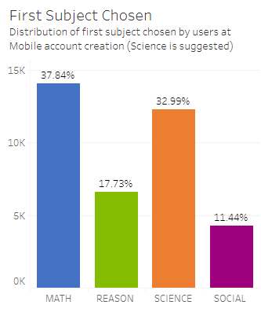

Mastery of content
Notes:
We are interested in seeing if learners are following the guidance in the app or if they are doing their own thing. Early indicators are yes and no. Too soon to tell but we will continue to monitor.
Beyond the app, we found that learners start with RLA then Math – hardest first. We are hoping to flip that with the app and encourage users to go with easiest first – SCI/ SS then hard. We have found that this builds confidence.

Slide 33
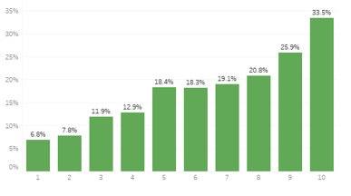

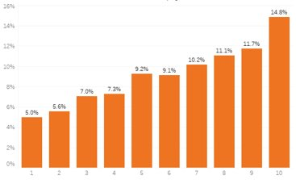
Early Learning: more App sessions correlate to more tests taken & passed
GED Testers – 33% of App users with 10 or more log-ins took tests
GED test credentialers (passed all 4 tests) – 15% of App users with 10 or more sessions credentialled
Notes:
Test taking and GEDReady test-taking: Mobile App Learners are taking more GEDReadys and scoring higher on the test. Volumes are higher for non-mobile but when you compare percentages, the app is higher
Confidence: Watching for signs of confidence building – persistence and test / credential success is an indicator. Direct feedback is another indicator

Slide 34
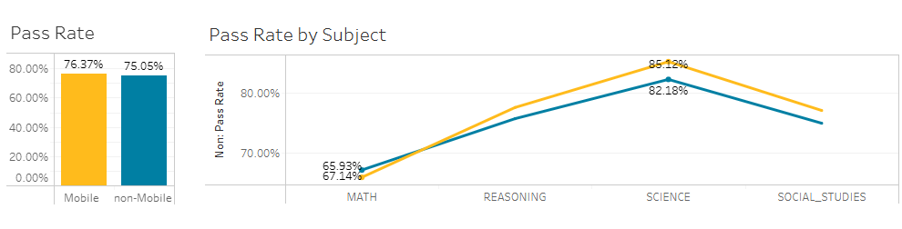
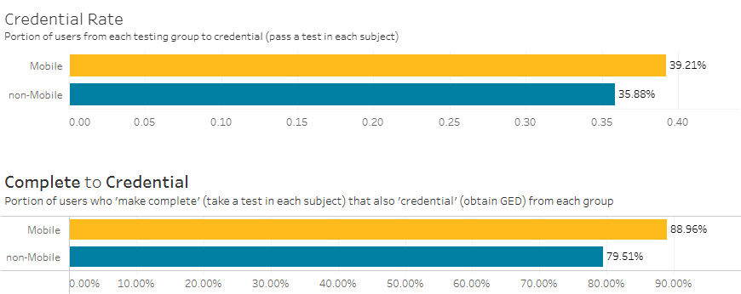
Mobile App users are performing better on most subject area tests and credentialing at a higher percentage than non-App users (July 2024- Feb 2025)
Notes:
We are interested in seeing if learners are following the guidance in the app or if they are doing their own thing. Early indicators are yes and no. Too soon to tell but we will continue to monitor.
Beyond the app, we found that learners start with RLA then Math – hardest first. We are hoping to flip that with the app and encourage users to go with easiest first – SCI/ SS. We have found that this builds confidence.

Slide 35
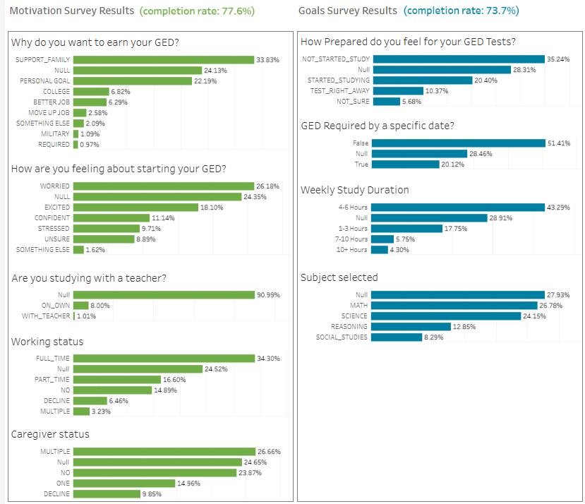
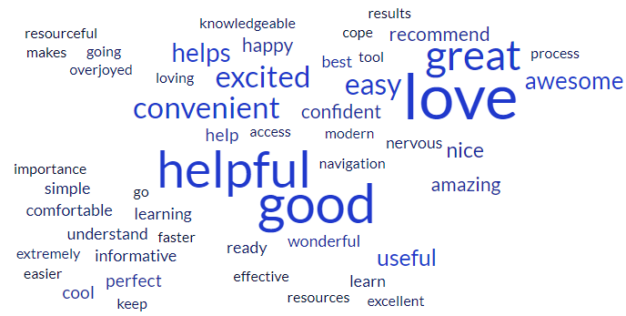

What learners are saying when we ask: How do you feel about the GED & Me app?

Slide 36
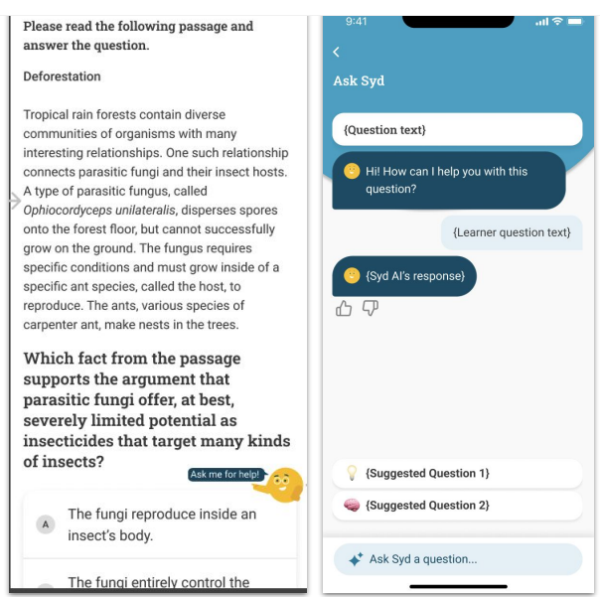
AI Tutor is Live (Math Brain)
AI Tutor introducing more practice content specific to learners’ reading level and native language
Allows for additional study and practice material in Math.
Multiple Language Support

Slide 37

Roadmap for GED & Me
Now
Study Loop
Stability
Syd AI Launch
Next
Android
In App Purchases
Later
Expand Syd (subjects)
More content
More practice
Notes:
Looking at the same data, simplified into a decision tree…
We can see that Ready score >= 145 result in continued activity 80% of the time
With Ready scores < 135 resulting in continued activity only 50% of the time

Slide 38
GED Grads
What got you to the finish line?

Slide 39
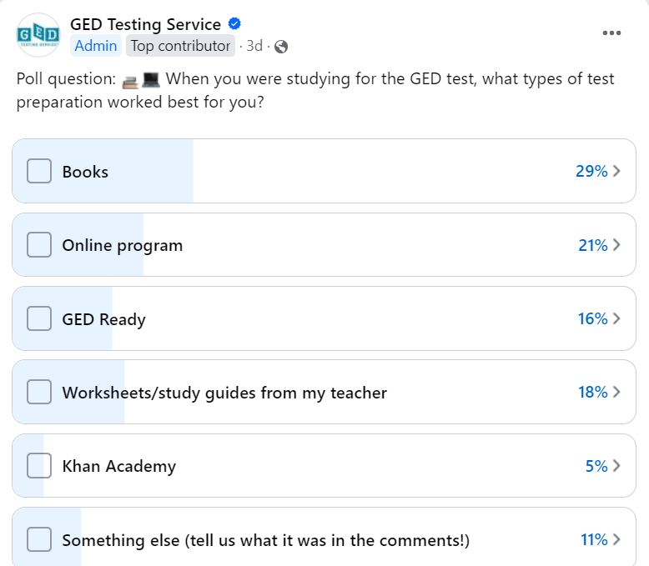
Poll results from GED grads
For independent learners, Books still a favorite resource, followed by online programs.
Something else: community education classes, YouTube, Spanish YouTube videos, Light & Salt Learning, Essential Education

Slide 40





Our Conference sponsors have great products, all aligned with the GED test, and showing good outcomes with learners

Slide 41

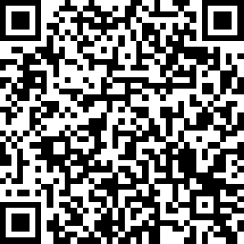
Questions?
Victor Fitzjarrald
Sr. Product Manager, GED Testing Service
Victor.Fitzjarrald@ged.com
Session Survey Link
Notes:
Demographic Extracts:
15% ages 16-17, 25% ages 18-19, 22% ages 20-24, 22% ages 25-34, 17% ages 35+
8% middle school or less, 13% 9th grade, 22% 10th Grade, 23% 11th Grade, 25% 12th Grade
40% use adult ed classes, 17% use GEDReady, 14% use Books, 10% online courses.

Slide 42

Session Survey
Your feedback is important. Please scan the QR code below to rate this session.

Slide 43






In summary - GED learners and resources that work
More than 1 million GED Ready tests are taken each year
Auditory is the preferred learning style for the highest percentage of learners
Determined learners are most successful at passing all tests
61% of learners who start testing, finish taking all 4 tests
A variety of learning materials can help get learners to the finish line
Use the GED & Me App to build confidence in learners

Slide 44
Research conducted on the Learning Preference Assessment indicates a reasonable estimate of a learner’s preferred style
Background
Research
WithYouWithMe’s learning preference test is based on the Multiple Intelligences Developmental Assessment Scale (MIDAS) developed by Branton Shearer PH.D.
It’s a consumer survey (not proprietary) where learners self-select how they prefer to consume content.
Results are presented based on aggregated weighting of most common content consumption preference.
Phase 1 primarily involved a factor analysis with 349 participants.
Phase 2 was a field testing of the questionnaire involving in-depth interviews with a small sample of adult volunteers with a less than a high school education.
Phase 3 examined inter-rater reliability by comparing the agreement rates between 3 different raters and subscale development was also undertaken during this study
Findings:
The validity of the MIDAS scales was examined during six studies. The results of these investigations showed consistent results in content validity, construct validity, concurrent validity, predictive validity and contrasted criterion groups.
MIDAS has adequate reliability and sufficient construct and criterion validity to conclude that when validity indicators are taken into consideration the MIDAS provides a "reasonable estimate" of the person's intellectual disposition in the seven designated areas (Visual, Auditory, Kinesthetic, Interpersonal, Intrapersonal, Verbal, Logical)

Slide 45
