Slide 1
Instructional Resources for the
Reasoning Through Language Arts (RLA) Test
Adora Beard
GED® and GED Testing Service® are registered trademarks of the American Council on Education (“ACE”). They may not be used or reproduced without the express written permission of ACE or GED Testing Service LLC. The GED® and GED Testing Service® brands are administered by GED Testing Service LLC under license from ACE.

Slide 2

In this session, we will focus on Instructional Resources for the RLA test as we…
identify the three areas assessed in the RLA test
have a “high level” review of challenges students exhibit on the RLA test
share resources to address each of the three areas assessed
answer your questions

Slide 3
What we know….
The Reasoning Through Language Arts (RLA) The Extended Response requires all three
test assesses three basic skills: skills in one test item.
Grammar
Writing
Reading
Writing
Grammar
Reading
Extended Response
Notes:
Not just the extended response---the technology enhanced items test all the same qualities of writing that are used in the ER—that’s why practice, practice, practice is important. One of the reasons students some students pass the test without points on the ER: they may continue to find writing difficult…but the skills and strategies they learned as they worked to improved their writing are the EXACT same skills that are tested in the T. E. Items. Do not cheat them out of the learning opportunity that helps them answer the TE items correctly by NOT spending time practicing writing.

Slide 4






We know five essential elements for RLA
Reading Comprehension
Making Inferences
Interpreting Graphics
Analyzing Arguments
Writing Effectively

Slide 5
Reading

Slide 6
Reading Skills Gaps: Challenges in these Overarching Skills
 | Overarching RLA Skills Gaps
Gap 1 | Close Reading of the Text
Gap 2 | Consider the WHOLE Context of the Text
Gap 3 | Think about the Author (Integral to Passage Context)
Notes:
These three overarching skills are interrelated and can overlap each other. Breaking them apart is to try to help students focus on specific ways to improve performance.

Slide 7
Reading Skills Gaps : Challenges in these Indicators
Code | Target or Indicator​
R.3.1​ | Students will order sequences of events in texts.
R.5.1​ | Students will analyze how a particular sentence, paragraph, chapter, or section fits into the overall structure of a text and contributes to the development of the ideas.
R.9.2​ | Students will compare two passages in similar or closely related genre that share ideas or themes, focusing on similarities and/or differences in perspective, tone, style, structure, purpose, or overall impact.​
R.9.3 | Students will compare two argumentative passages on the same topic that present opposing claims […] and analyze how each text emphasizes different evidence or advances a different interpretations of facts.

Slide 8

What is Close Reading?
Why Close Reading?
Helps students understand WHY WE READ
Promotes CRITICAL THINKING and UNDERSTANDING
Is one of the main analytical tools used in HIGHER EDUCATION and the WORKPLACE
Is a SURVIVAL SKILL in our media saturated world
Notes:
Key Points
Let’s face it, close reading isn’t often a skill that comes naturally. When our students get a new reading assignment, their first instinct is often to race to the finish line rather than engage deeply with a text. Getting students to slow down, engage with the text in different ways, and reflect as they read are challenges for every teacher, and are the goals of close reading. Keep in mind that close reading may be the most important skill that you teach your adult education students. Here’s why.
Close reading:
Helps students understand WHY WE READ
Promotes CRITICAL THINKING, PROBLEM SOLVING, conversation, and understanding
Is one of the main analytical tools used in HIGHER EDUCATION and the WORKPLACE
Is a SURVIVAL SKILL in our media saturated world

Slide 9
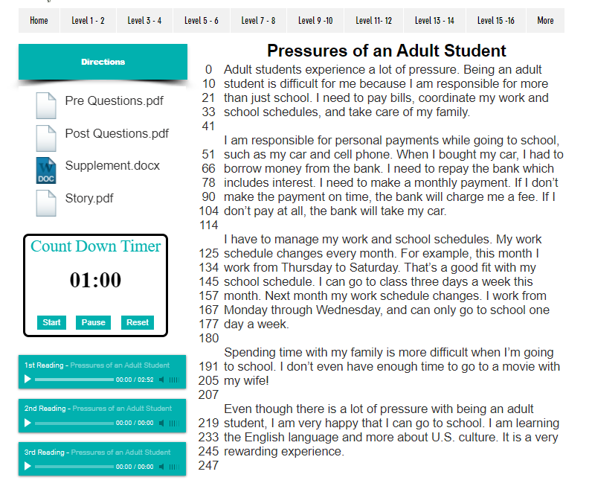
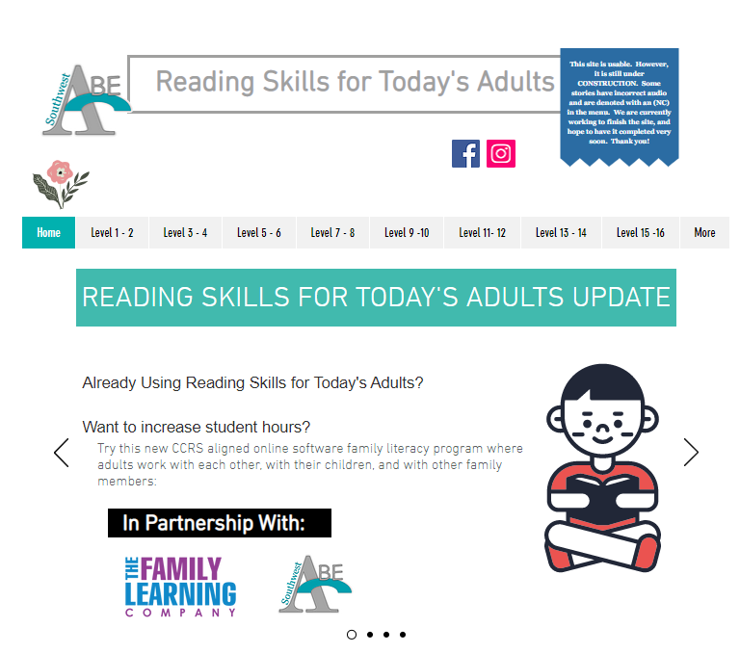
Reading Rate and Fluency
Reading fluency – the speed and ease with which one reads connected text aloud with accuracy, speed, and appropriate phrasing
Reading rate – how quickly you read silently with understanding
https://www.readingskills4today.com/
Notes:
Key Points
Rate and fluency are strongly related to reading comprehension. In fact, as oral reading skill increases – so does reading comprehension. Why – when word recognition becomes automatic – the reader can spend more cognitive resources on understanding what he or she is reading. - if the read rate is low – the reader is spending too much of his/her cognitive resources on word analysis and cannot focus on understanding what he/she is reading.
So what do we do to increase the level of silent reading comprehension? First, determine the students reading rate.
Select a short, easy passage that is one or two GEs below the learner's present oral reading instructional GE level. If you have not given a graded oral reading test, chose a passage one or two GEs below their Word Recognition GE. The purpose here is to see how easily someone can read orally when she/he doesn't have to pause to decode unfamiliar words.
Count the words in the passage.
Have learner read the passage once through orally so that both of you can see that there are no troublesome words.
Tell the learner to read the passage once more, but that this time you are going to time the reading. The learner will read fast and may not pay any attention to punctuation. That's all right.
Record the time in seconds and compute the following: words per minute = (number of words in passage ÷ reading time (in seconds)) x 60

Slide 10
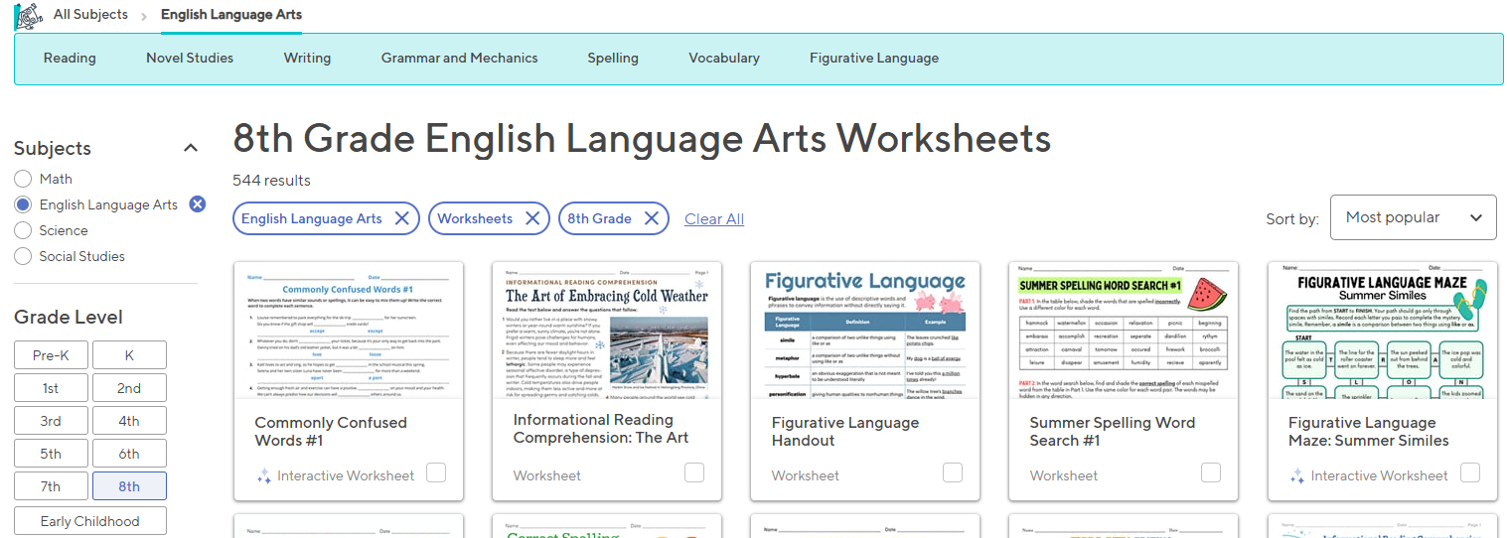
Versatile resources for Language Arts https://www.education.com/

Slide 11
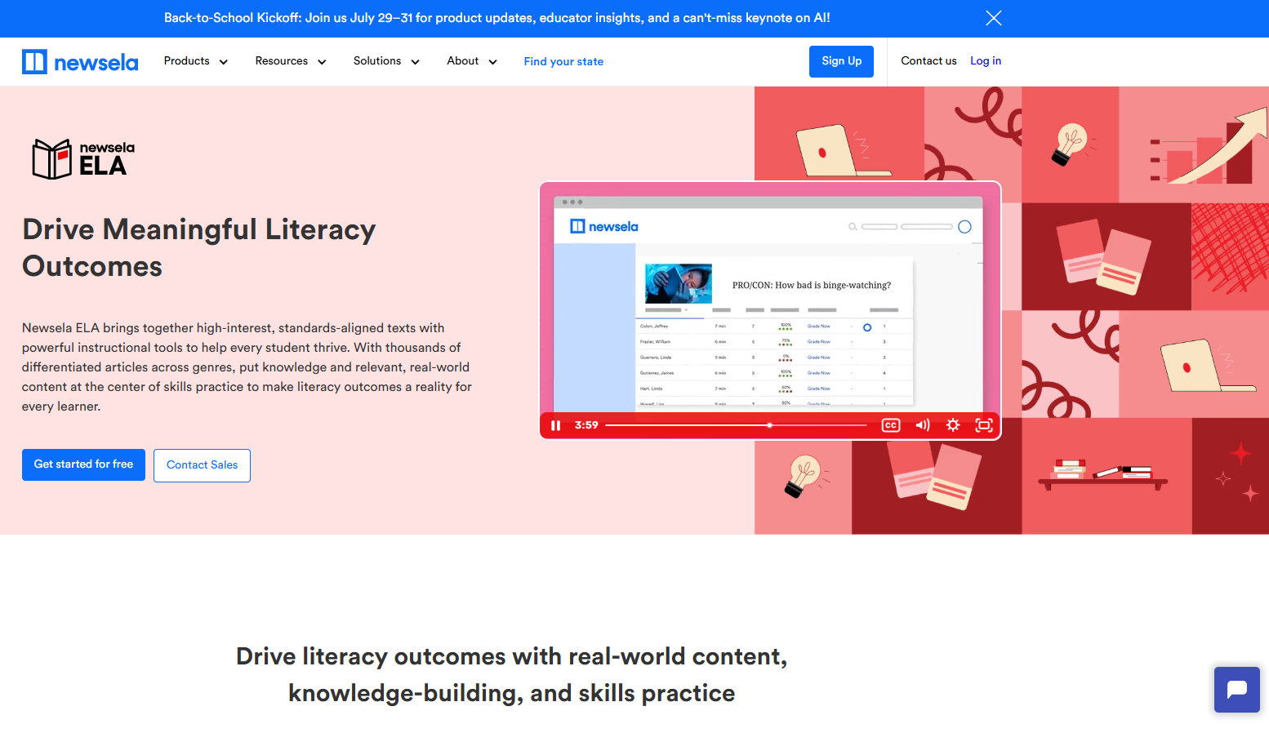
And don’t forget www.Newsela.com
Relevant, engaging articles
Five Lexile levels for each article
Most articles in Spanish
https://newsela.com/products/ela

Slide 12
Teach Skills
Before Reading
During Reading
After
Reading
Look at title
Review headings and subheadings
Identify structure
Activate prior knowledge
Determine Purpose
Ask Question
Make connections based on what they already know
*Use signal words
Use context to identify unfamiliar words
Reread and make notes
Summarize
Ask clarifying questions
Evaluate what has been read
Discuss with the group
Notes:
Key Points
Briefly review the before, during, and after reading strategies. These are the things that students need to know and be able to do, if they are to move from struggling to effective reader.

Slide 13
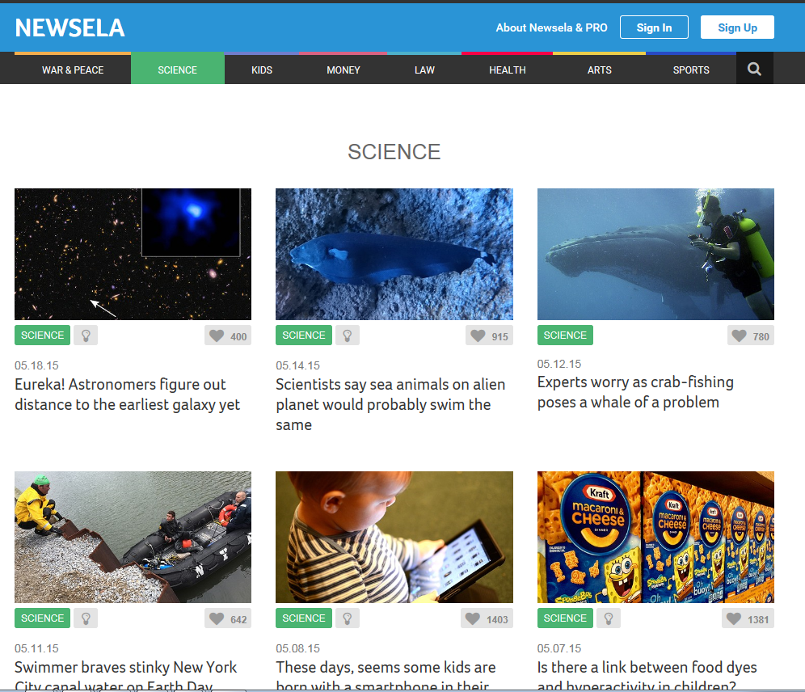
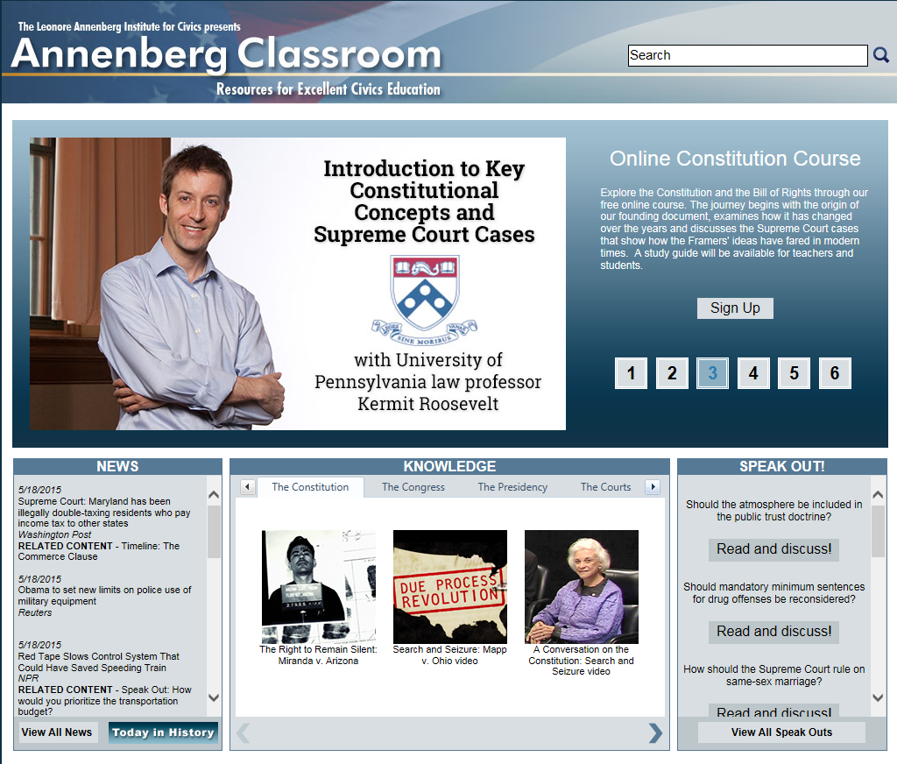

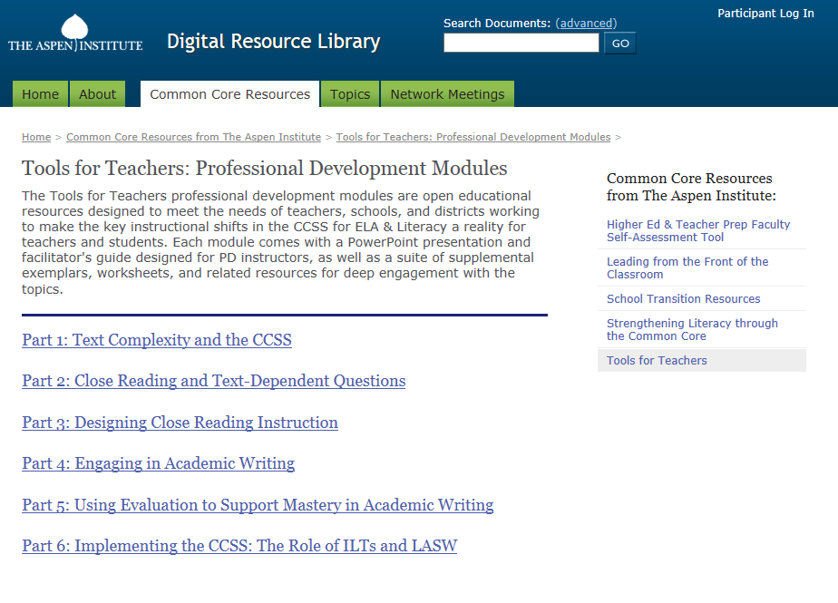
Access Online Reading Materials
Notes:
Key Points
Use the Internet as a resource for a wide range of nonfiction material for students to read and write about. Engage students through materials that are current, relevant, and most of all interesting.

Slide 14

Inferences
Types of Inferences
Location | Time
Action | Instrument
Object | Category
Occupation or Pastime | Cause-Effect
Problem-Solution | Feeling-Attitude
Proficient readers can “read between the lines” and draw deeper understanding and appreciation for what is being read.
Notes:
Key Points
There are different types of inferences. Review the chart. Ask participants what clues in the text would lead them to make an inference about
Location
Occupation
Feeling or attitude

Slide 15
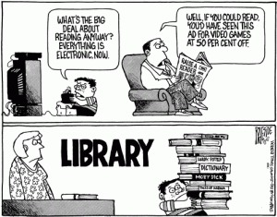
Remember - Inference is Process-Driven
The art of inference:
Using active reading skills (beyond the basics)
Engaging with the text and/or information presented
Questioning
Thinking critically
Making connections
Students need to be reminded that an inference is not a wild guess!
Notes:
Key Points
Review the information on the slide.

Slide 16
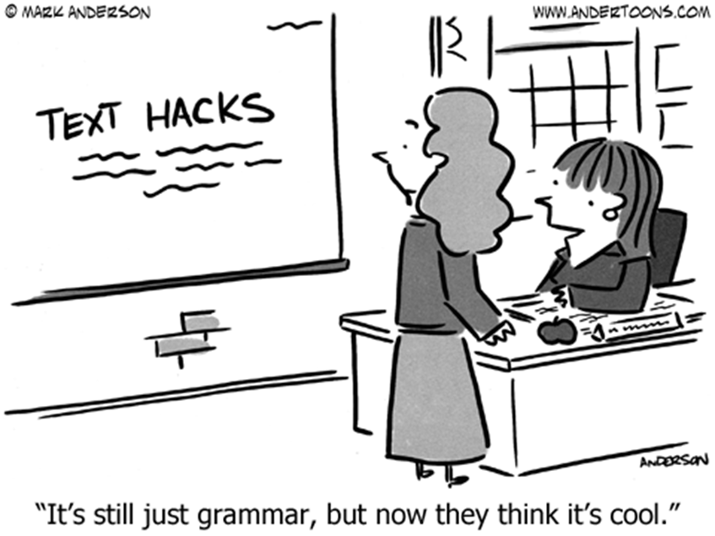
Grammar

Slide 17
Language Skills Gaps: Challenges with the Indicators
Code | Indicator​
L.2.3**​ | Students will edit to ensure correct use of apostrophes with possessive nouns​.
L.1.1 | Students will edit to correct errors involving frequently confused words and homonyms, including contractions (passed, past; two, too, to; there, their, they're; knew, new; it's, its).
L.1.7 | Students will edit to correct errors in subject-verb or pronoun antecedent agreement in more complicated situations (e.g., with compound subjects, interceding phrases, or collective nouns).
L.1.8​ | Students will edit to eliminate wordiness or awkward sentence construction​.
L.2.2 | Students will edit to eliminate run-on sentences, fused sentences, or sentence fragments.
Notes:
NOTE: there is some overlap in these skills among the indicators

Slide 18
How do we teach grammar?
Research indicates that teaching grammar in isolation does not transfer into real communication
Grammar is best taught/practices in communicative contexts
Supportive feedback is more helpful than overt correction
Students may need many opportunities to hear, read, practice a new structure before they internalize it or produce it—months, perhaps years

Slide 19
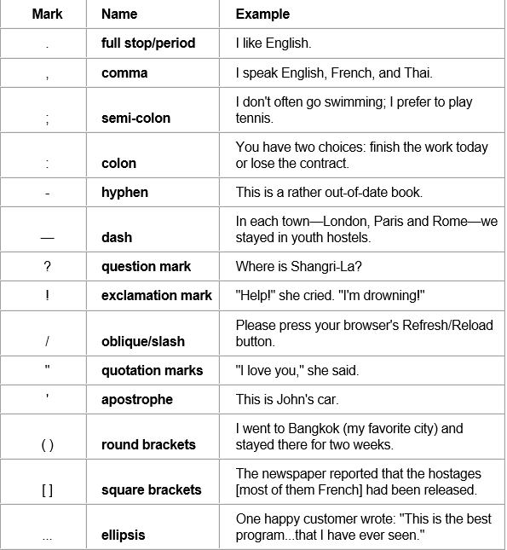
Do you know all the punctuations marks?
Notes:
Key Points
Ask participants which one(s) they had difficulty remembering. Why?

Slide 20
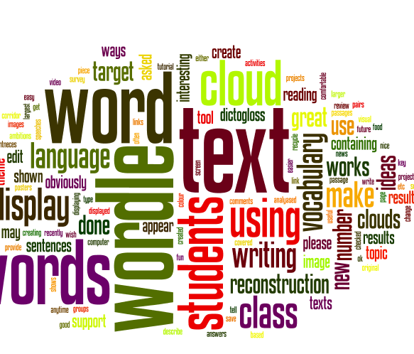
Building Vocabulary
Vocabulary falls into four categories:
Listening: the words we understand when we hear them.
Speaking: the words we use when talking.
Reading: the words we understand when we read
Writing: the words we use when writing
Notes:
Key Points
Edgar Dale identified four stages of knowledge of a word’s meaning listed on the slide.
Review the information on the slide. Have participants think about the disparity that they see between words students know because they have heard them and the words they recognize when they read.

Slide 21
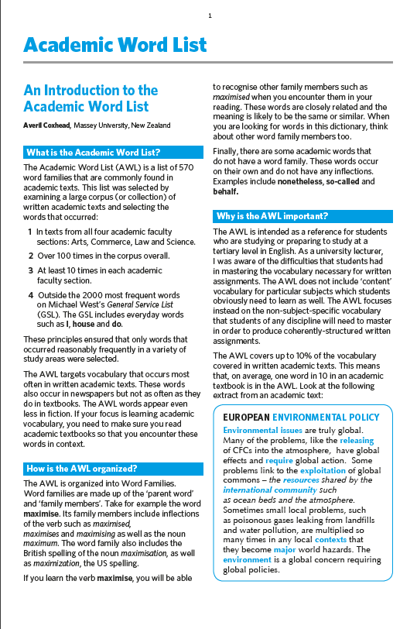
Resource for the Classroom
Sample Word Family - interpret
interpretation
interpretations
interpretative
interpreted
interpreting
interpretive
interprets
misinterpret
misinterpretation
misinterpretations
misinterpreted
misinterpreting
misinterprets
reinterpret
reinterpreted
reinterprets
reinterpreting
reinterpretation
reinterpretations
Most common form of the word family
https://www.academia.edu/6556194/An_Introduction_to_the_Academic_Word_List_What_is_the_Academic_Word_List?auto=download
Notes:
Key Points
The Academic Word List is an excellent resource for the classroom. This resource, Academic Word List, including the actual word list itself, is available at the back of the workbook.
Take a few minutes to describe the list itself and the value of using it in the classroom.

Slide 22
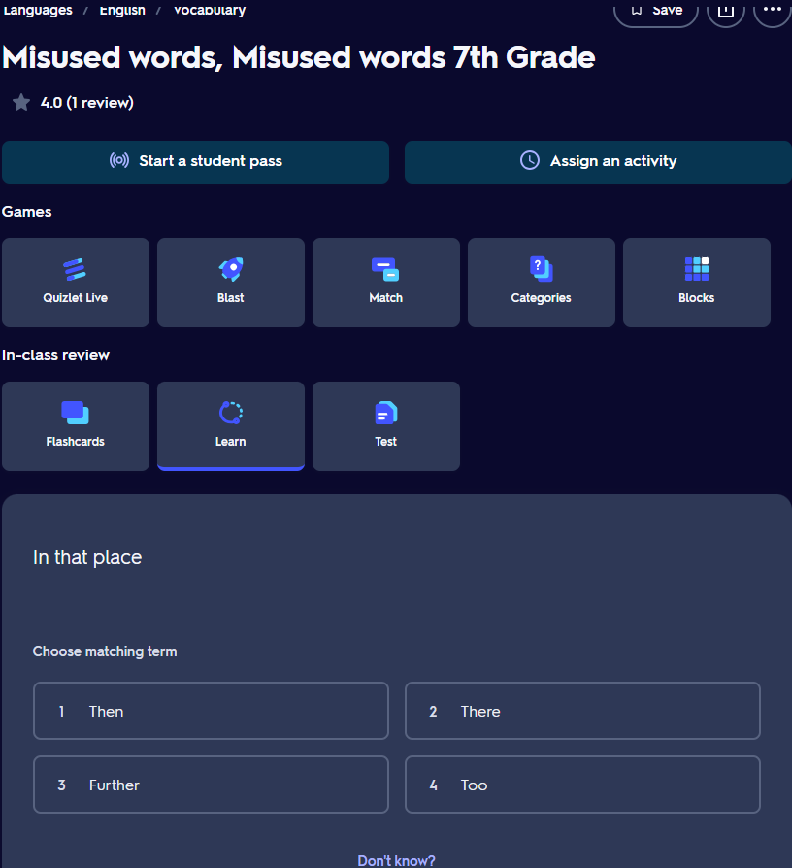
Quizlet http://quizlet.com

Slide 23
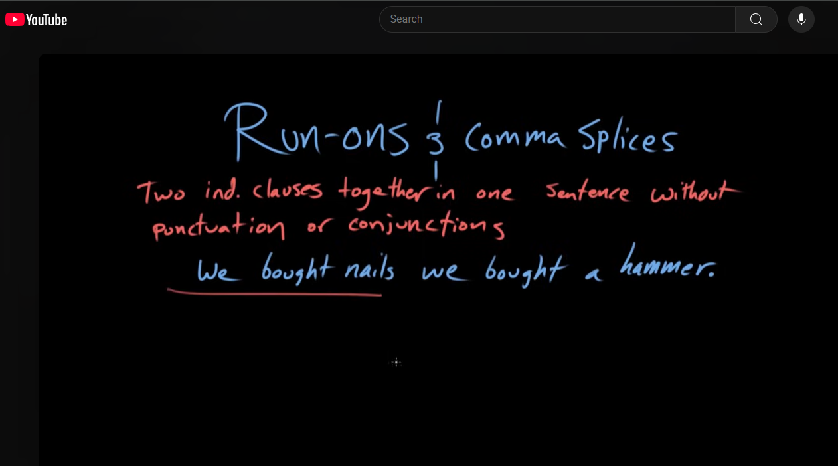
Run-Ons and Comma Splices https://www.youtube.com/watch?v=Fh45mhVsZrU
Khan Academy

Slide 24
Writing Extended Response
Notes:
The nexis where all three skills come together—comprise approximately 20% of the overall score.
We will discuss this a bit differently because:
--this is a session about resources, not about the process of preparing the ER, which would be it’s own multi-hour workshop
--we’ll begin with broad strokes that get to the Scoring Tool which measures how well all three skills were used to complete the task.

Slide 25
Expectations for Constructed Response
When you write . . .
determine which position presented in the passage(s) is better supported by evidence from the passage(s)
explain why the position you chose is the better-supported one
remember, the better-supported position is not necessarily the position you agree with
defend your assertions with multiple pieces of evidence from the passage(s)
build your main points thoroughly
Notes:
Key Points
Test-takers should be familiar with the expectations of the constructed response prior to taking the test. This information should be an integral part of classroom instruction.
[Review the bulleted items on the slide.]

Slide 26
“Stuff to Teach”
Writing about what is read (Hint: Practice, practice, practice!)
Using a plan (e.g,. a graphic organizer or an outline) for organizing the information from the reading and then writing about it
Bringing good grammar to the writing task
Answering the question that is asked
Notes:
Key Points
Review some of the “stuff to teach” that should be an integral part of teaching the process of writing.

Slide 27

The Value of the Word Because
People do things because they provide a benefit or have value.
People choose to live somewhere because of its proximity to schools or work.
People drive a certain car because of its fuel economy, reliability, etc.
If because is a power word, shouldn’t students be using it to make their claims stronger?

Slide 28
What else can students use besides because?
Synonym | Meaning
Due to | Preposition – because of something
Whereas | Conjunction – because of a particular fact that has been considered
Given | Preposition – because of a particular fact
In view of something | Phrase – because of something
On account of | Phrase – because of someone or something
Thereby | Adverb – because of, or by means of, what has just been mentioned
Through | Adjective – happening because of someone or something
With | Preposition – because of the situation that exists
Great Resource – Power Thesaurus at: https://www.powerthesaurus.org/because/synonyms

Slide 29

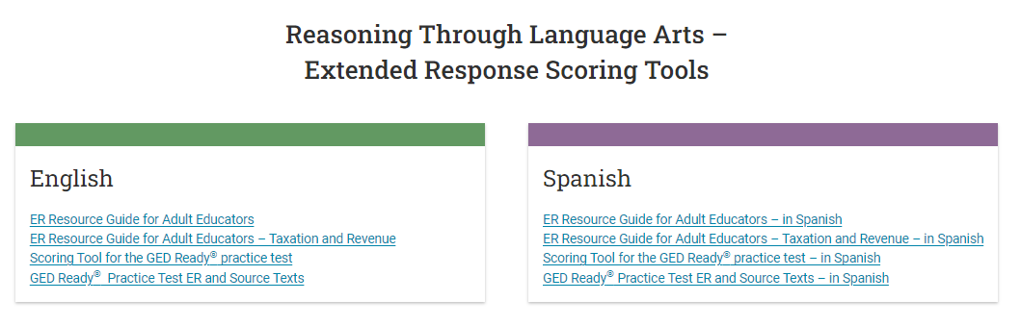

Slide 30
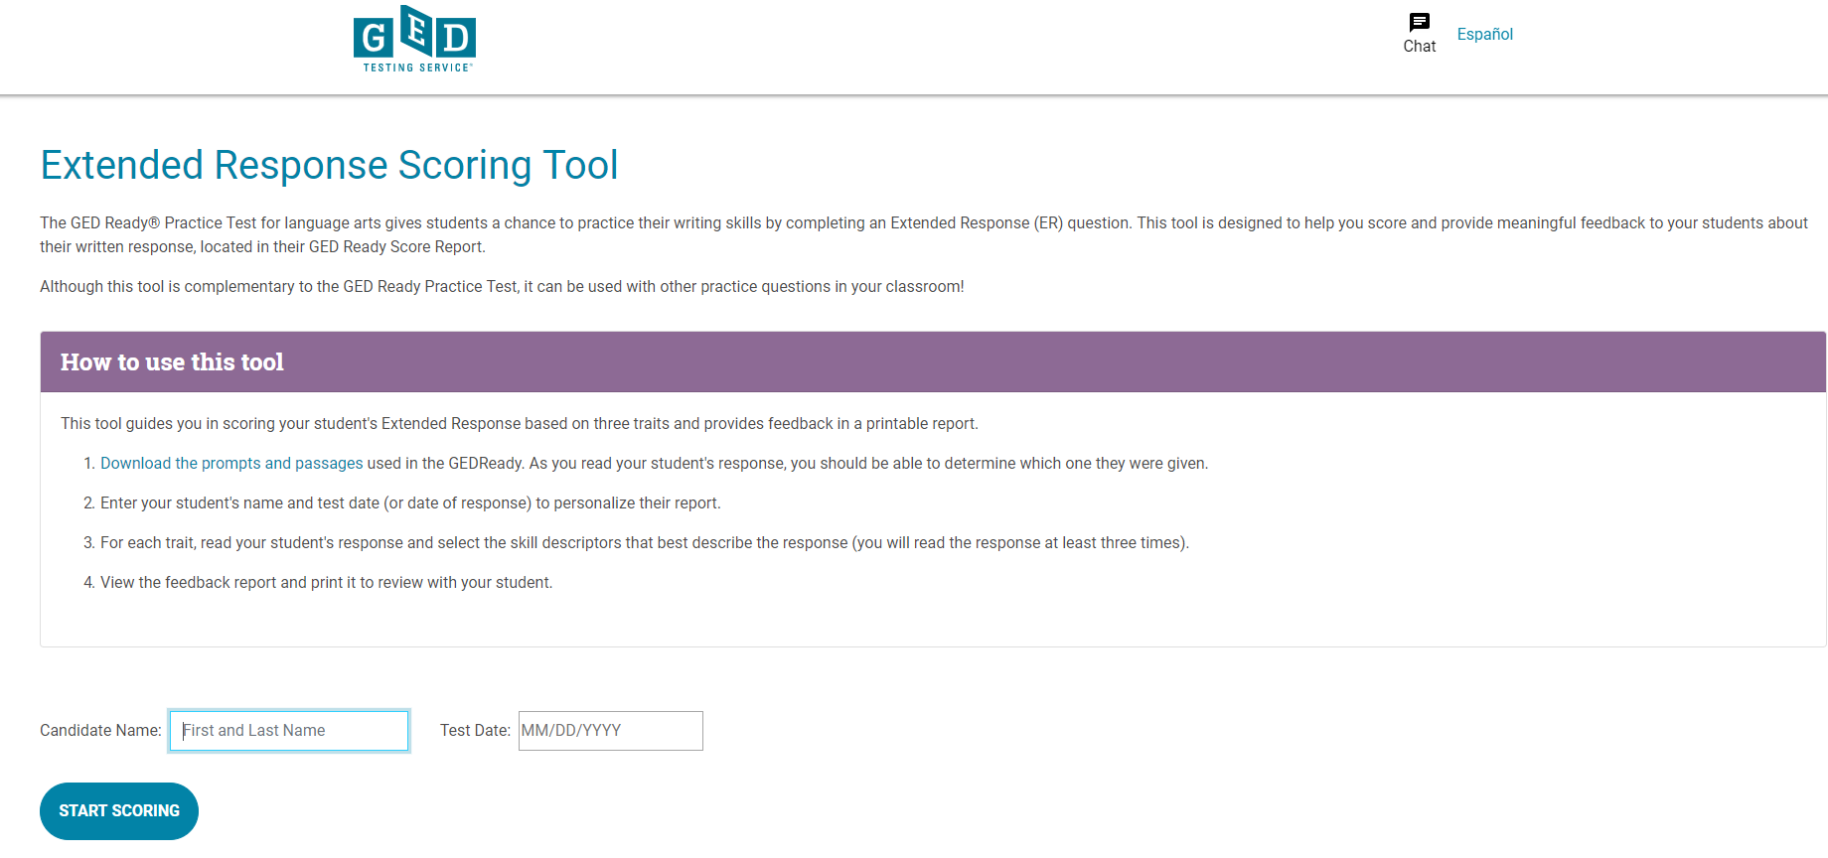
Electronic Scoring Tool!
Skim through student response to see what prompt and passage was used.
Download GED Ready test prompts and passages.
Enter student name and date.
Read the prompt and passage.
Do the first read of the student’s response.
https://ged.com/educators_admins/teaching/classroom_materials/er_scoring_tools/
Notes:
Key Points (This slide includes animations.)
Review the items in the text box. Make special note of items 4-5. Teachers need to read (not skim) the passage and prompt before moving to the student’s response. Teachers need to read (not skim, not look for key words) the student’s response.

Slide 31
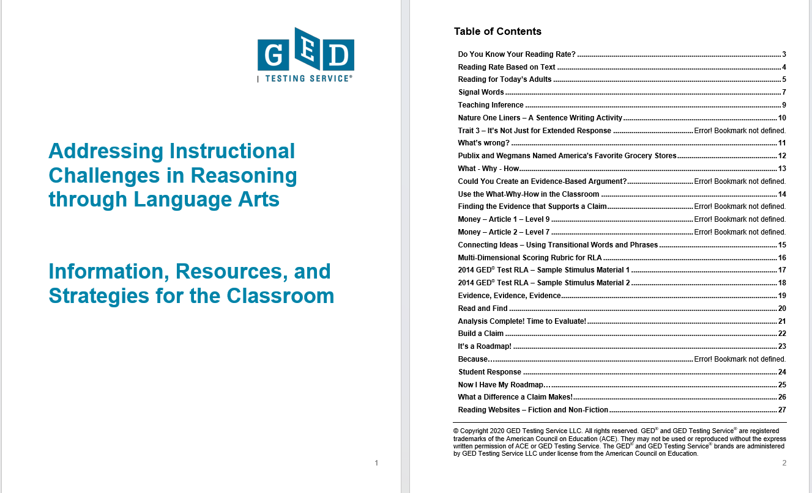
Addressing Instructional Challenges in Reasoning through Language Arts Workbook

Slide 32
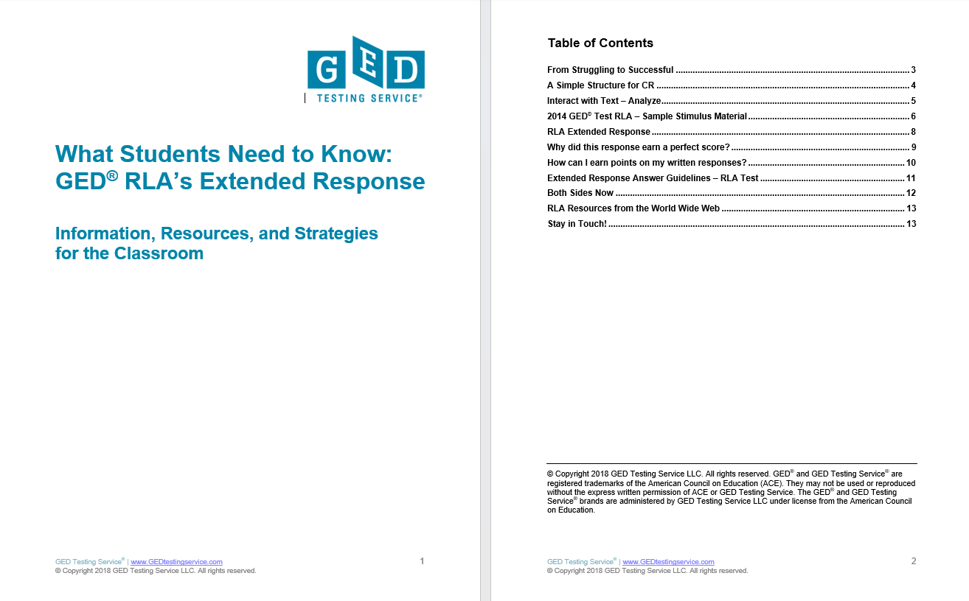
What Students Need to Know-GED RLAs Extended Response Workbook

Slide 33


GED.com click on “Educators & Admins”

Slide 34

Educator
Notes:
READ the tab labels.

Slide 35
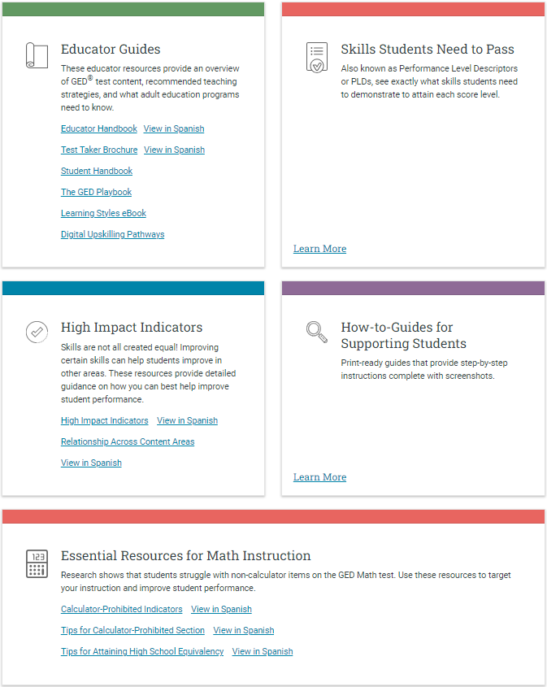
Teaching Resources

Slide 36
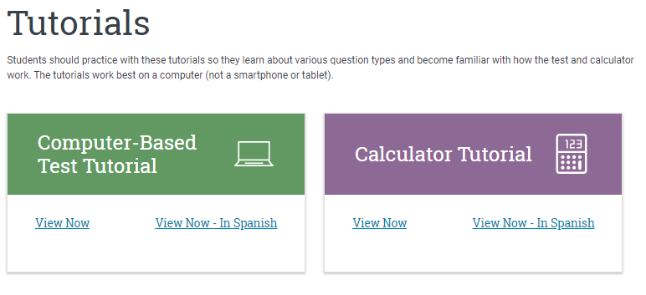
Tutorials
Ensures no surprises on test day
Opportunity to practice and build skills
Familiarity can lead to better performance
Students Will Receive:
Whiteboards and Graph Paper (3)
Formula Sheet
https://ged.com/educators_admins/teaching/classroom_materials/
Notes:
Key Points
Review information on the slide regarding the resource (where it is located and what is included). Reinforce that the tutorials can be accessed online or can be downloaded. Students should be familiar with all of tutorials and should have practiced using them prior to testing.
Computer and calculator tutorials are located at: https://ged.com/educators_admins/teaching/classroom_materials/

Slide 37

Assessment Guide for Educators
The Complete Assessment Guide is 230 pages
It’s also broken down into each subject (40-60+ pages each)
Notes:
Resource Guide – looking under the hood of your car to understand how it works.

Slide 38

Educator Handbook!
Get an overview of GED® test content and recommended teaching strategies.
In other words: Start here!
Download at GED.com/educator_handbook
Notes:
Our ”New Educator Checklist” is located right inside the new Educator Handbook
This is designed to help new teachers focus on the most important resources to get them up to speed on being a GED instructor

Slide 39

News
Notes:
INSession

Slide 40

Professional Development

Slide 41

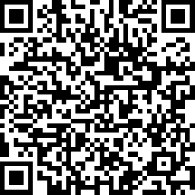
Session Survey
Your feedback is important. Please scan the QR code below to rate this session.

