Slide 1
Helping our Students Persist and Succeed using the Power of GED Manager™
Mellissa Hulstrand, State Relationship Manager
Diane Vaccari, State Relationship Manager
GED® and GED Testing Service® are registered trademarks of the American Council on Education (“ACE”). They may not be used or reproduced without the express written permission of ACE or GED Testing Service LLC. The GED® and GED Testing Service® brands are administered by GED Testing Service LLC under license from ACE.

Slide 2
Session Overview
What the data shows
What is GEDPrep ConnectTM?
How to use GED ManagerTM to combat the data
Answer your questions!

Slide 3

The Data

Slide 4
National GED® Statistics CY 2024
 | January 1, 2024 – December 31, 2024
GED.com Accounts | 675,656
Test Takers | 306,919
Completers | 181,250
Passers | 132,518
Pass Rate | 73%

Slide 5
Candidates Passed 3 Content Areas CYs 2014 - 2024
Some students have only 1 test left to pass.
Many test-takers with 1 test pending require Mathematics to obtain their credential.
Follow through with your follow up strategy and re-engagement plan.
Consider a variety of ways to promote your program.
Consider that GED Testing Service (GEDTS) offers Professional Development Webinars and Math Boot Camps for Educators
Many States/Jurisdictions initiated 3 of 4 campaigns.
Nationally
180,000+
Notes:
This is a NATIONAL ISSUE AND a NATIONWIDE INITIATIVE!! THE GEDTS has been having conversations with state jurisdictions about 3 of 4 students. Those are the students who have taken 3 GED tests, leaving only 1 test to go!
As you begin to work on your own campaign, I ASK PROGRAMS TO CONSIDER THAT MANY OF THESE TEST-TAKERS LAST TESTS TAKEN MAY HAVE BEEN AS FAR BACK AS 2014/2015.

Slide 6
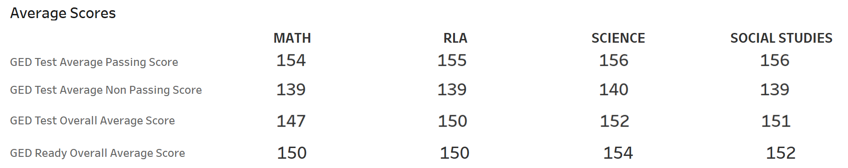
Average Passing Scores Per Content Area CY 2024 – National
Notes:
Avg passing scores by content area is well above the cut score of 145.
Deciles away from helping your student get over the hump to a passing score!!

Slide 7
Benefits of GEDPrep Connect™
Increase awareness of Adult Education programs with GED® candidates
Connect more Students with programs to drive completion and success rates
Promote programs through GED.com
Improve Adult Education programs’ access and management of Student information

Slide 8

GEDPrep Connect™ Raising Student Awareness Begins in the GED.com account for current and new Students

Slide 9
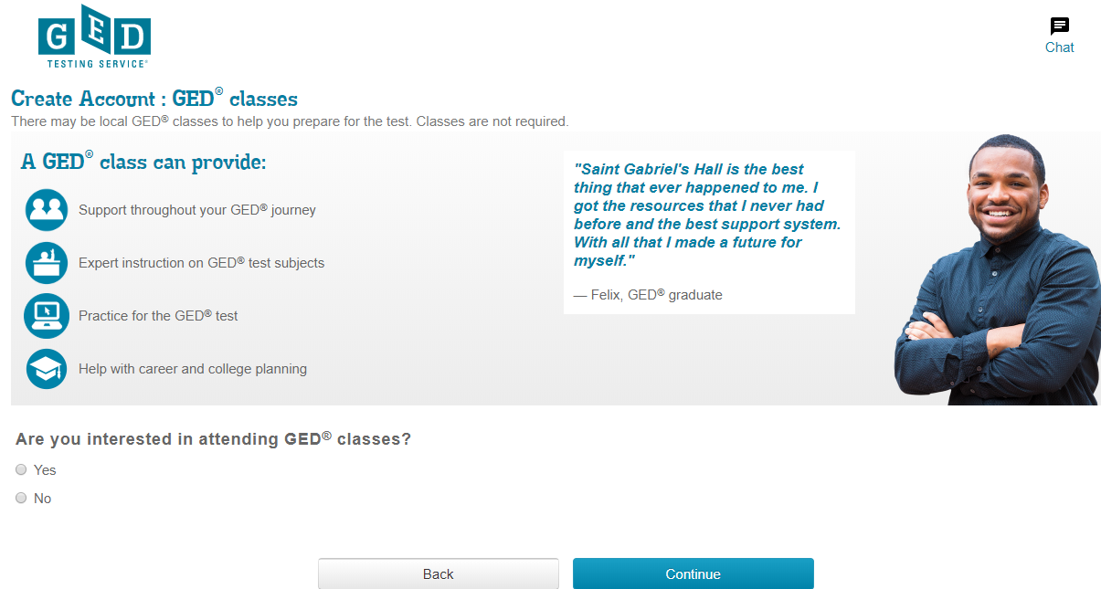
The page to start gathering data
Notes:
When setting up an account on ged.com all students are asked if they are interested in attending ged classes to prepare for the exam. It lists some of the benefits of attending a ged prep class

Slide 10
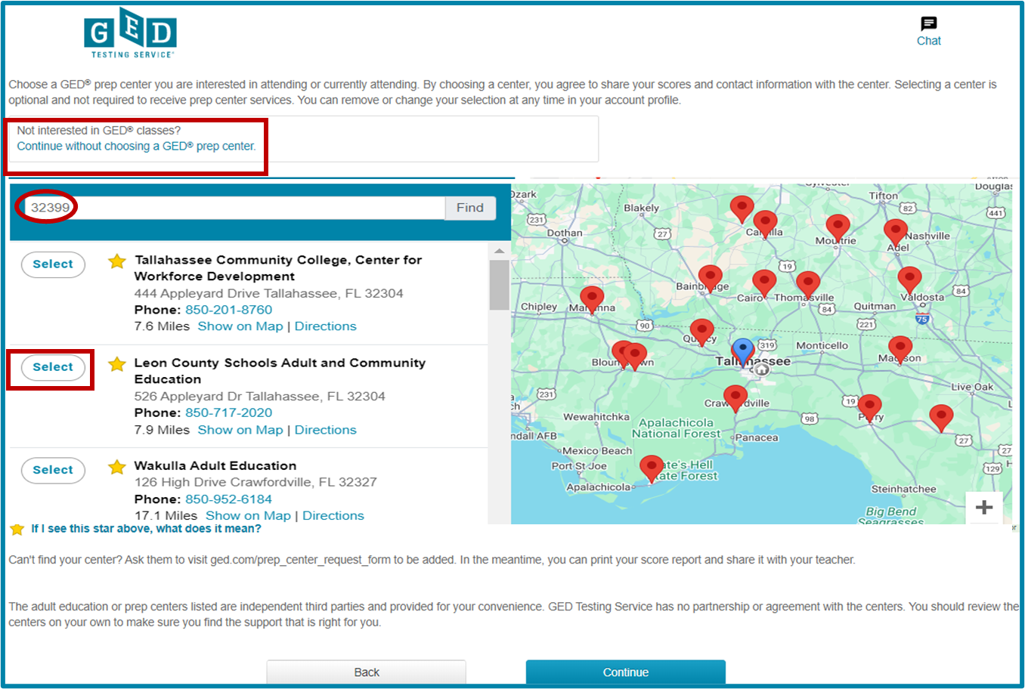
Select a GED® Test Prep Center
Notes:
If the student selects YES to interested in attending ged classes, they will see this page. On this page they can select a GED Prep center. The student has the option to remove the prep center from their account at any time. The zip code entered in the student address will be automatically added as a default to search for the nearest prep centers in that area. If the student does not want to attend a ged prep center they do not need to select a prep center. They can click continue.

Slide 11
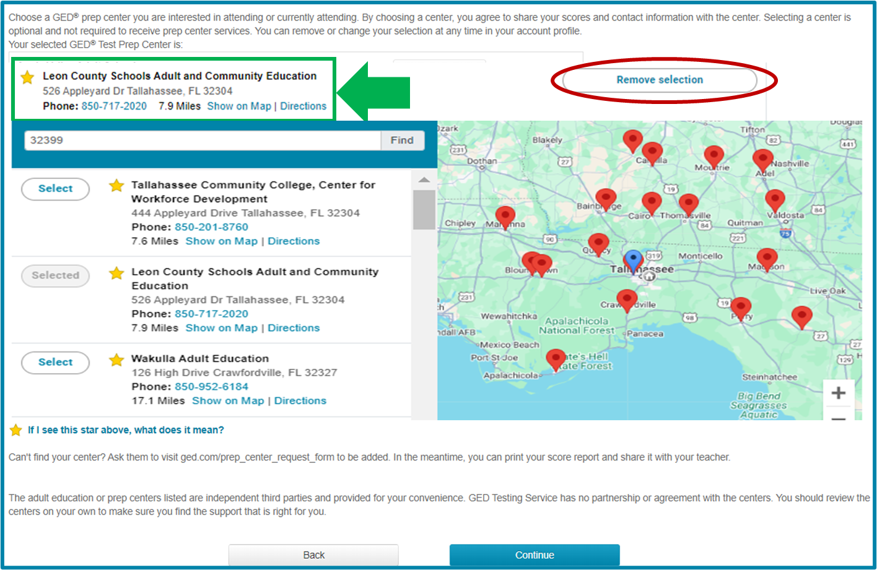
Selected Test Prep Center is listed
Notes:
Once the student selects one of the prep centers listed, on the next page they will see above the map the name and address of the selected prep center will be listed as well as the center's phone number. If the student has second thoughts about the prep center they chose, they can click on the remove selection button to remove the prep center from their profile. Please note that students can only select ONE prep center at a time.

Slide 12
Additional Ways to Connect to a GED® Test Prep Center
There are six different ways for students to connect!

Slide 13
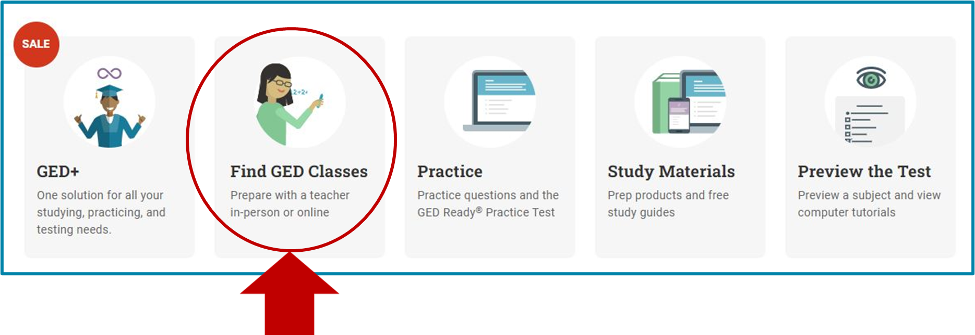
Option 2 – In “Study” Section
Notes:
The student will notice prep center messaging in a few different places in their GED account, for example if students don't select a prep center when they are first presented with the option to do so, they can always opt into this feature later. One area they can go to is the study tab on their dashboard the second tile is devoted to GED test prep centers and students can click here to select a prep center. Doing this will give the prep center access to the students scores and let them know that the student wants to be contacted. If a student is already working with the prep center, they can give that center access to their scores by clicking here and selecting the prep center they've been going to

Slide 14
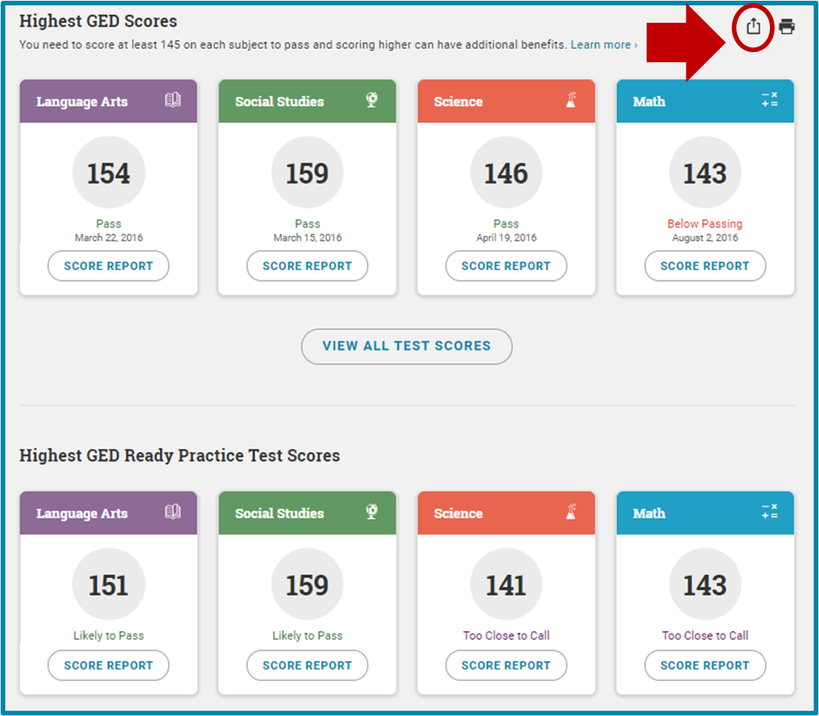
Option 3 – In “My Scores” Section
Notes:
Students can also select the prep center by going to the myscores tab and clicking on the following icon at any time

Slide 15
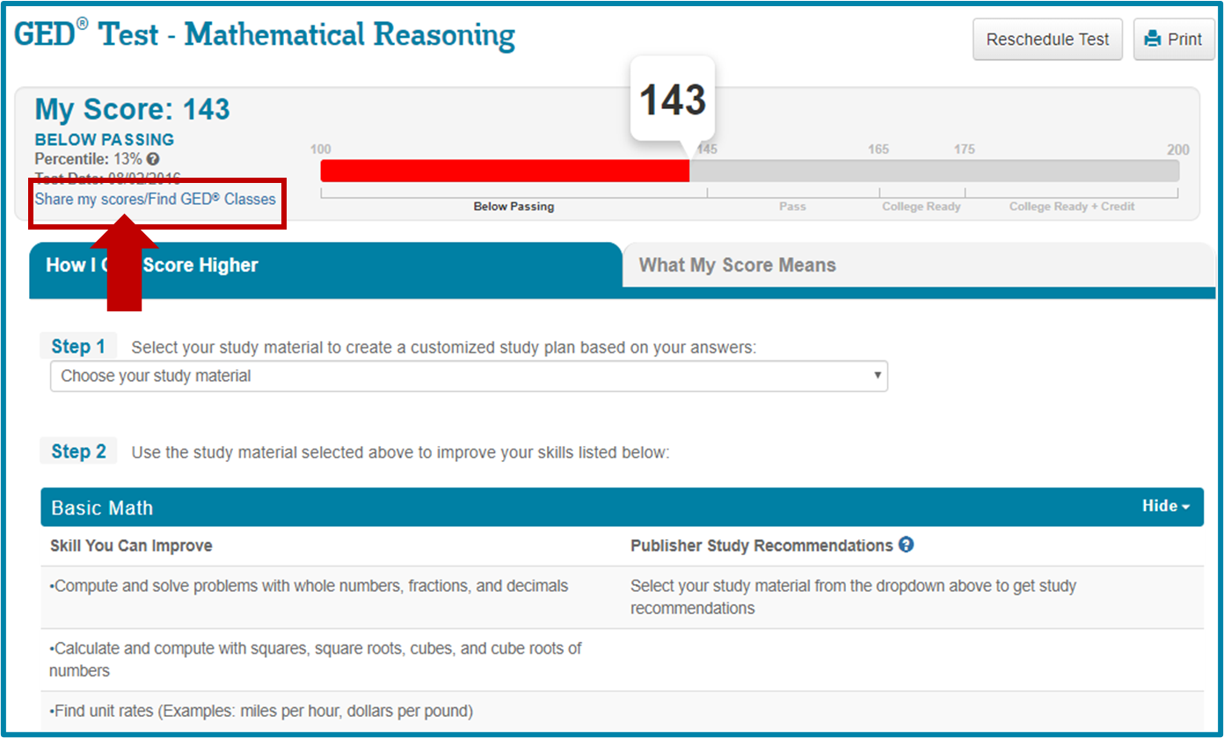
Option 4 – Link in Enhanced Score Report
Notes:
They can also click on the link that is listed on the enhanced score report

Slide 16
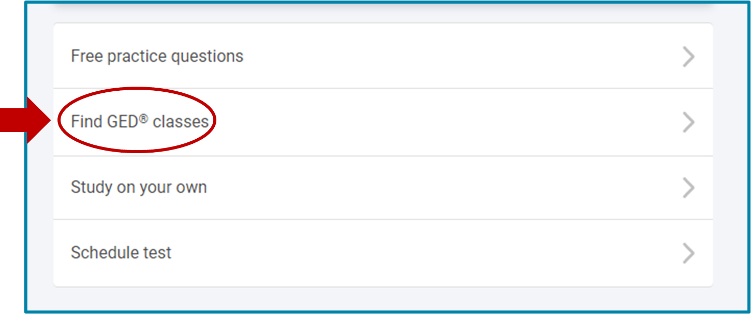
Option 5 – On the Dashboard
Notes:
Note that students will see the find GED classes option even on their dashboard

Slide 17
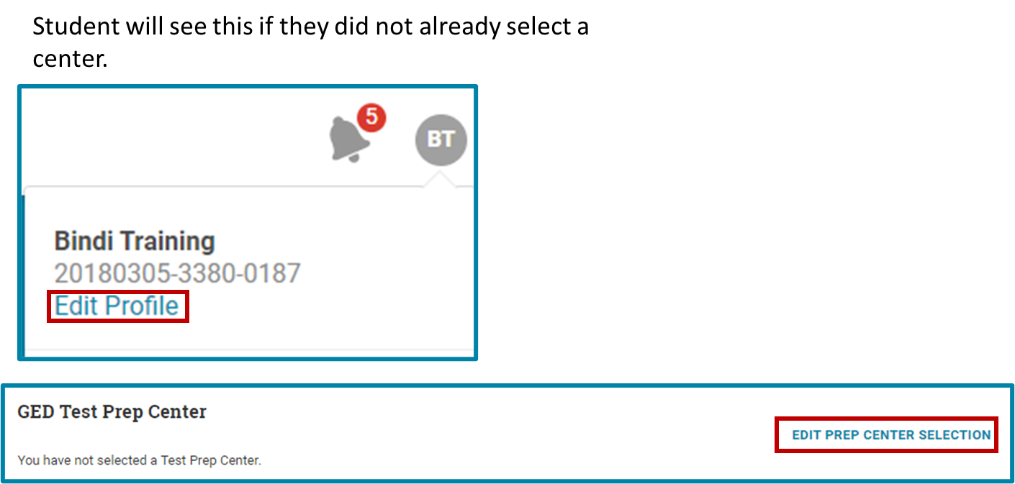
Option 6 – In “Edit Profile” section
Notes:
Another way that students can connect to a prep center, is in the edit profile section of their GED account, if they have not selected a prep center, they have the option to edit and select a prep center

Slide 18
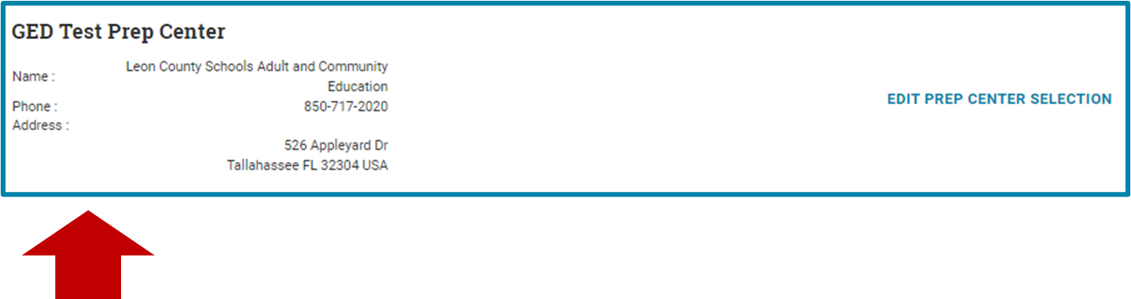
Prep Center will be listed in “Edit Profile” once selection is made
Notes:
After students select a prep center, the name and full address of the center will be listed in the edit profile section of their account again if the student wants to deselect the prep center they can do so at anytime

Slide 19
GED Manager™ A program management tool designed to help educators & administrators manage their state, programs, and students

Slide 20
Enabling Adult Education Staff
To connect with more Students

Slide 21
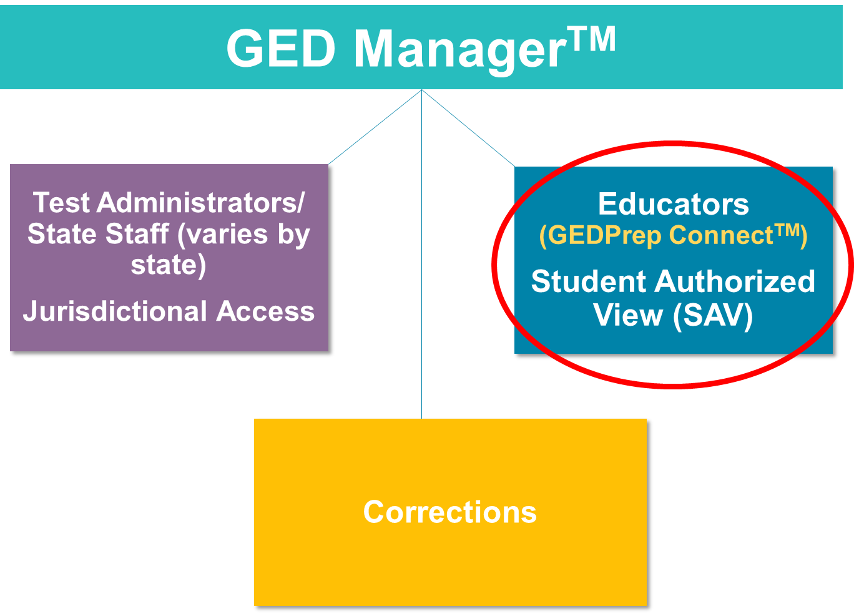

Slide 22





Some things you can do with GED Manager
Student Search
Student Score Reports: GED Ready and GED operational tests
Student Test Activity Report
Passers Report
Manage Enrollments (SAV only)
Notes:
Student Search allows Users to find a specific student by using any or all available filters: ie., First/last name, DOB, or GEDID (assigned when student creates their account on www.ged.com
Student Test Activity Report allows users to apply a number of filters to identify a list of students who fit within those parameters, including test activity status for GED Ready practice tests or the live exam, data ranges, exam subjects, language taken, credential status, or even student specific details such as first/last name, DOB or GEDID
Passers Report allows users to identify passers at a given test center within a requested date range
Manage Enrollments allows users to reach out to interested students and manage their enrollments.

Slide 23
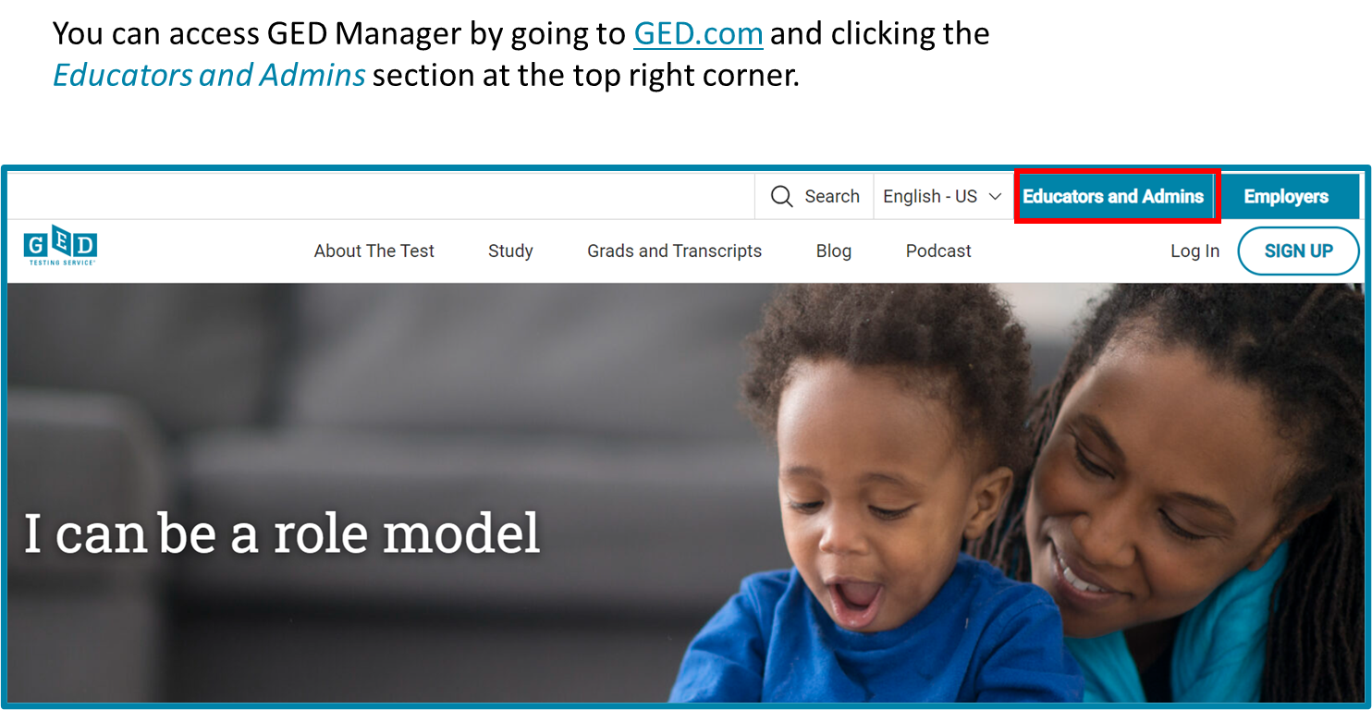
GED Manager™ Homepage

Slide 24
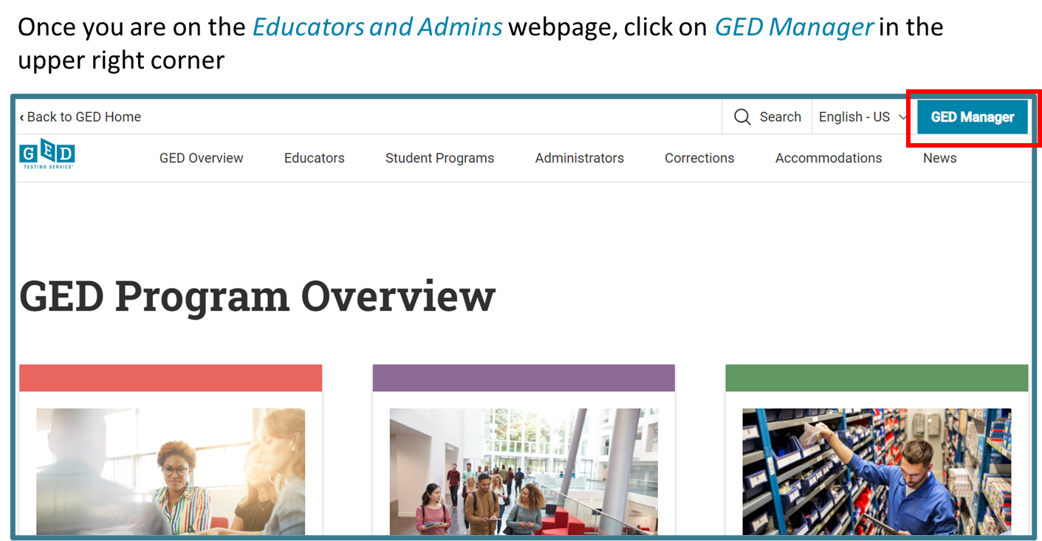
GED Manager™ Homepage

Slide 25
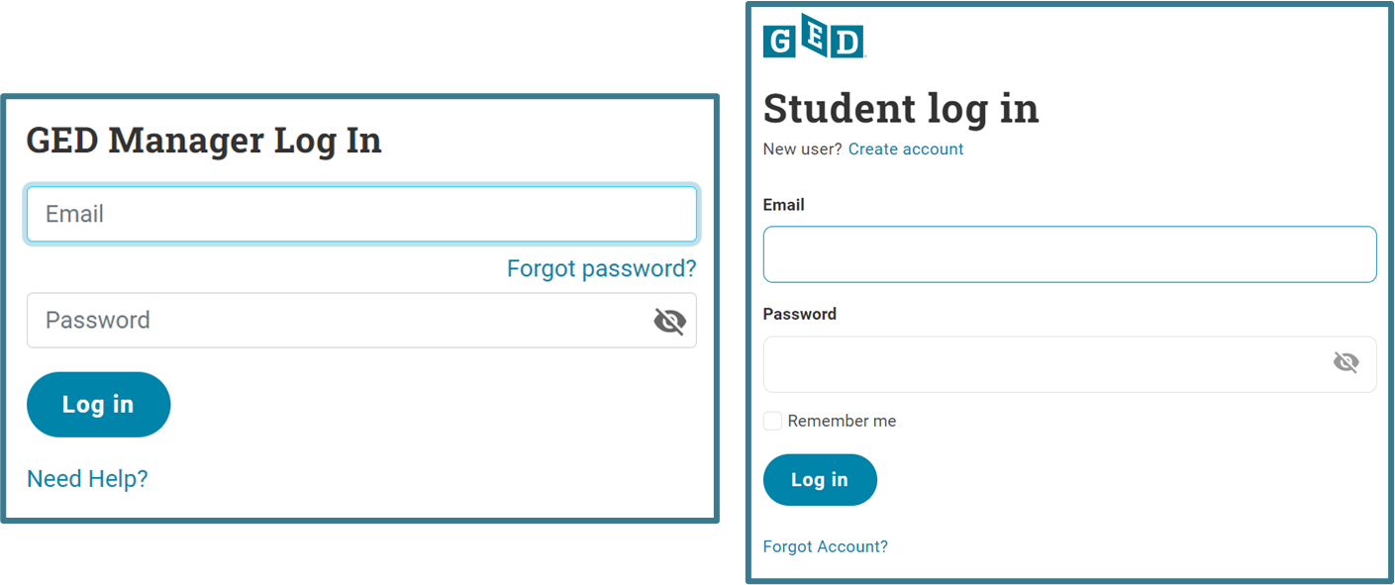
GED Manager™ Homepage
Notes:
Because all students need a ged profile to take the ged exam, students Access their account by going to our website and clicking the login button that is at the top right of the screen. As a GED manager user you can Access your account by bookmarking the link I mentioned earlier or by going to the educators and admins webpage. Here is an example of the different login screens for a student vs GED manager login.

Slide 26
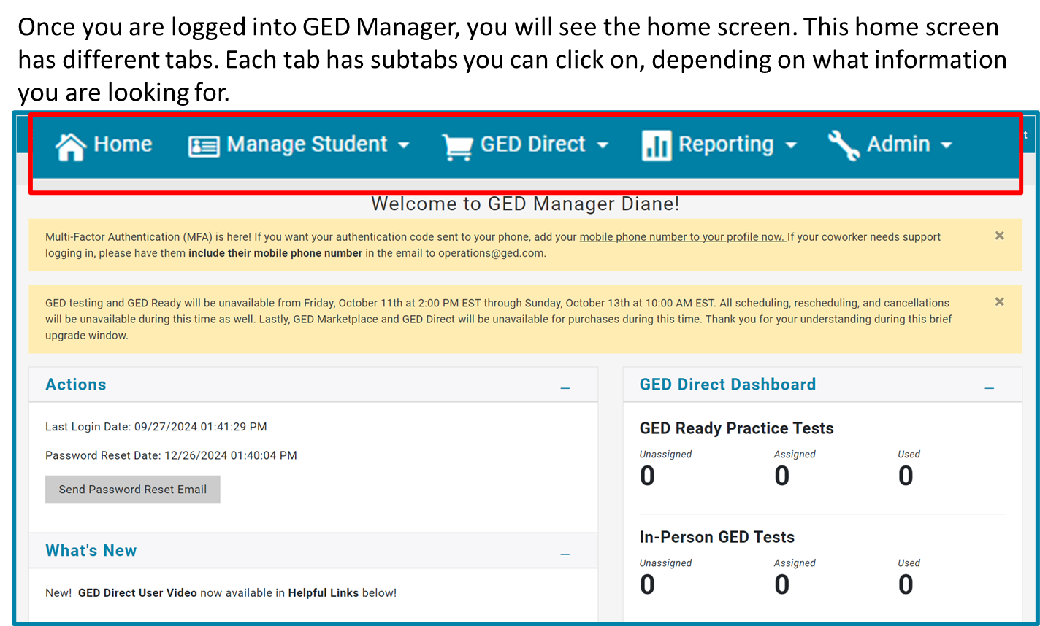
GED Manager™ Homepage
Notes:
Passers Report – Can download a list of graduates for graduation exercises
Manage Prep Connect Enrollment –Can find a list of new Students that are interested in your program
Student Test Activity Report – Can download reports of Students with specific testing activity like GED Ready Reds
Student Search – Can look up one Student at a time

Slide 27
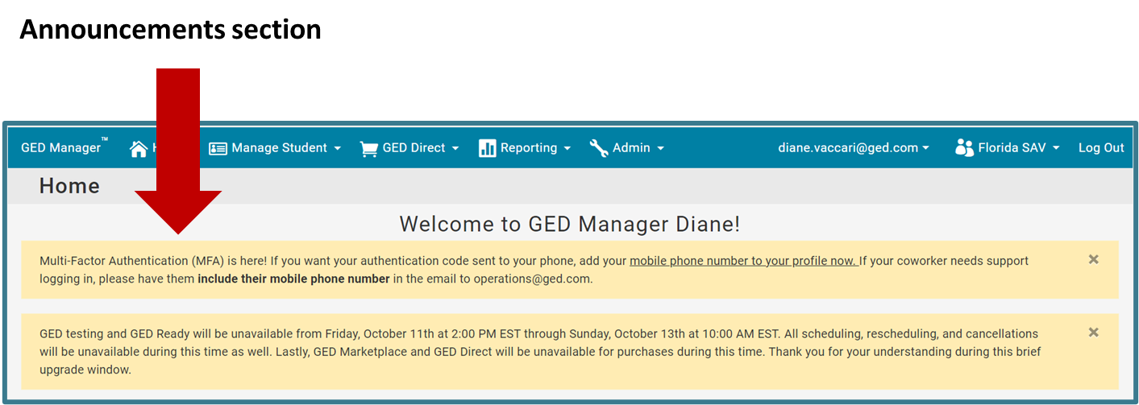
GED Manager™ Homepage
Notes:
The GED Manager homepage for adult educators that will help you connect with more students. Underneath the contact us section you will also find 2 more sections with resources Helpful Links and Helpful Documents.
The Helpful Links section are guides and webpages also found in our ged.com website.
The Helpful Documents section includes a variety of documents that can assist you and they can also be downloaded and saved to your computer.
On the Left side you will see the Statistics section; this section gives you an idea as to how many students have expressed interest in your center as well as the number of students who are currently enrolled in your program.

Slide 28
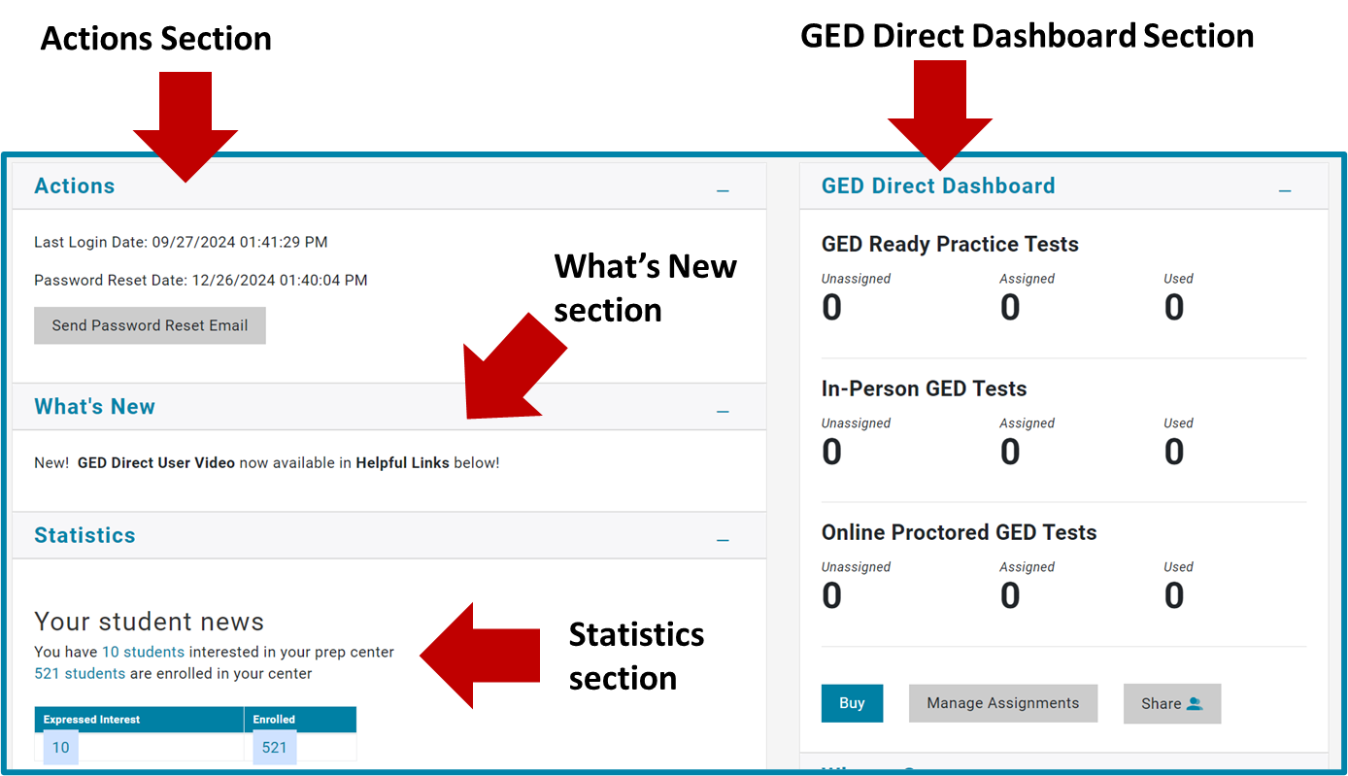
GED Manager™ Homepage
Notes:
The GED Manager homepage for adult educators that will help you connect with more students. Underneath the contact us section you will also find 2 more sections with resources Helpful Links and Helpful Documents.
The Helpful Links section are guides and webpages also found in our ged.com website.
The Helpful Documents section includes a variety of documents that can assist you and they can also be downloaded and saved to your computer.
On the Left side you will see the Statistics section; this section gives you an idea as to how many students have expressed interest in your center as well as the number of students who are currently enrolled in your program.

Slide 29
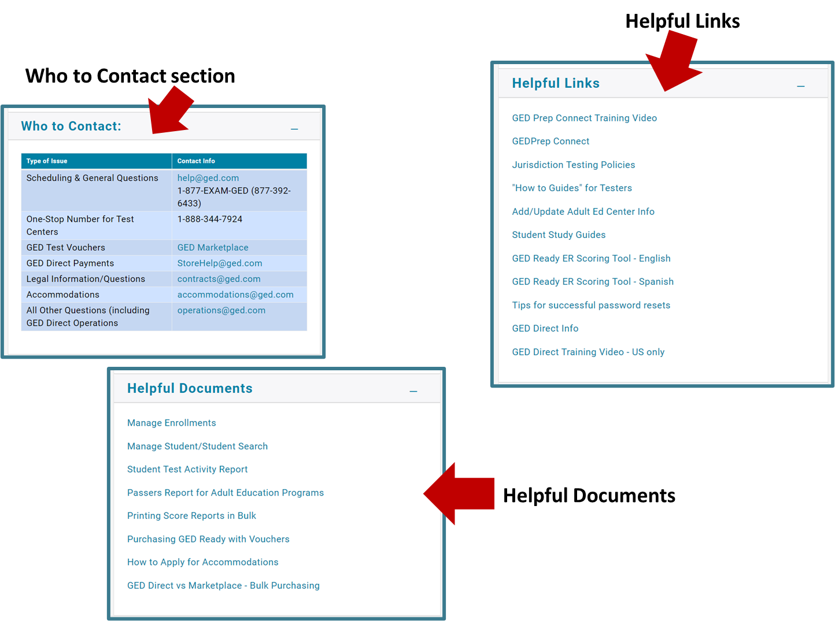
GED Manager™ Homepage
Notes:
The GED Manager homepage for adult educators that will help you connect with more students. Underneath the contact us section you will also find 2 more sections with resources Helpful Links and Helpful Documents.
The Helpful Links section are guides and webpages also found in our ged.com website.
The Helpful Documents section includes a variety of documents that can assist you and they can also be downloaded and saved to your computer.
On the Left side you will see the Statistics section; this section gives you an idea as to how many students have expressed interest in your center as well as the number of students who are currently enrolled in your program.

Slide 30
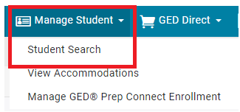
GED Manager™ Student Search
Log in to GED Manager
Hover over Manage Student
Click on Student Search
Notes:
How to search for a Student’s account in GED Manager ™

Slide 31
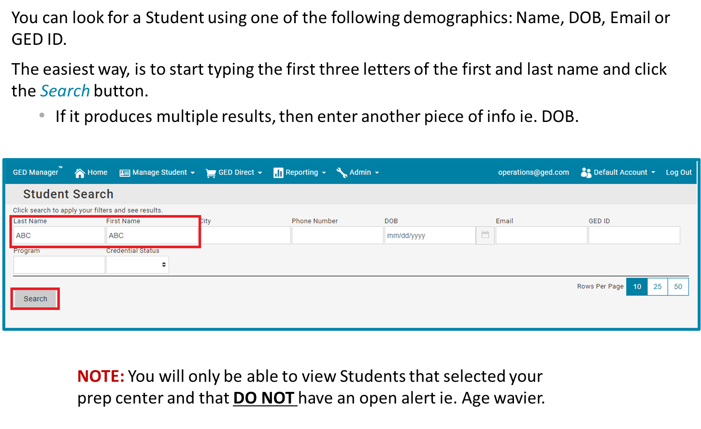
GED Manager™ Student Search

Slide 32
How to Manage Student Enrollment

Slide 33
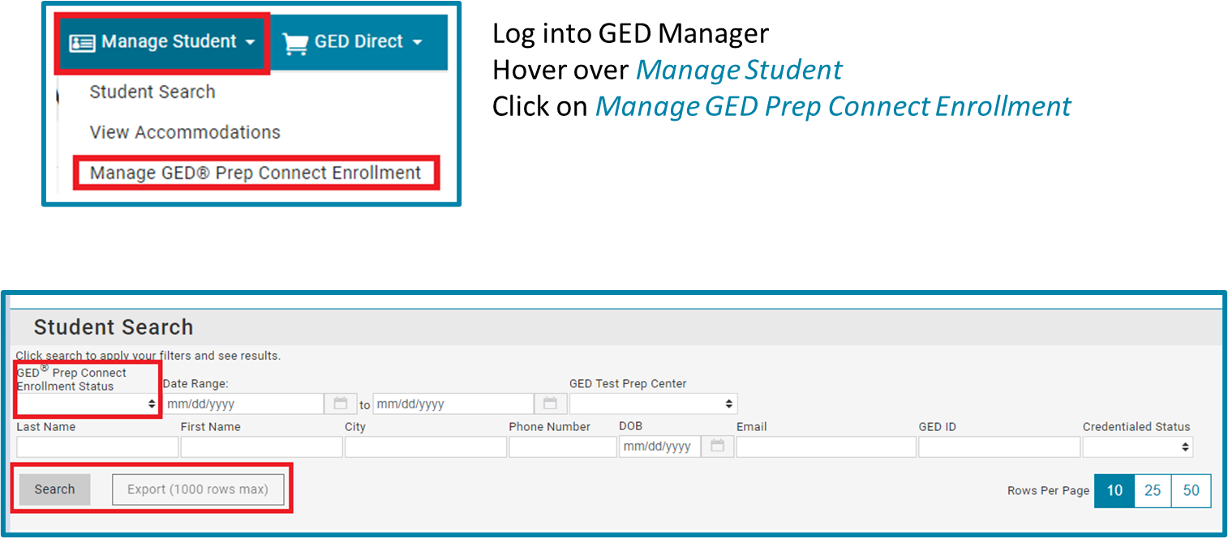
Manage Student Enrollment
Notes:
To manage student enrollment, log into GED manager hover over manage student and click on the manage GED prep connect enrollment tab.
Under Manage Prep Connect Enrollment you will have the option to filter by GED prep connect enrollment status and date range. There is also an export button, that will allow you to download and save the information listed. When a student selects your program in ged.com or clicks on the share my scores button, you should be able to see them in this section. It's important to know that the prep connect enrollment status field will default to enroll status so you must remember to switch it to interested if you're looking to see the list of students will who have recently selected your prep center

Slide 34
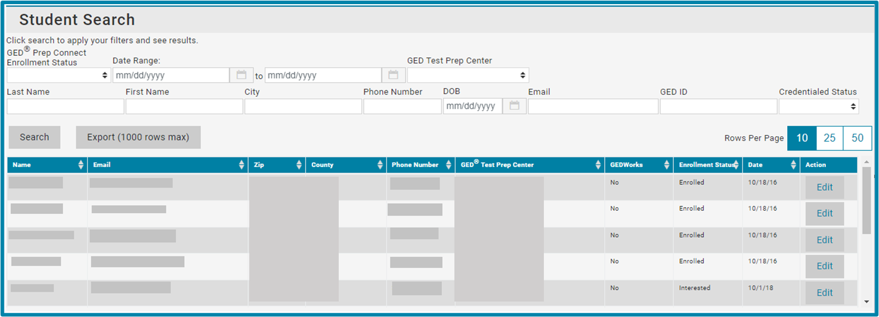
Manage Student Enrollment
Notes:
Here is an example of what you will see when you pull up the list of students who select your prep center.
Educators that have more than one prep center associated with their account, can view students who have expressed interest at each of their prep centers.

Slide 35
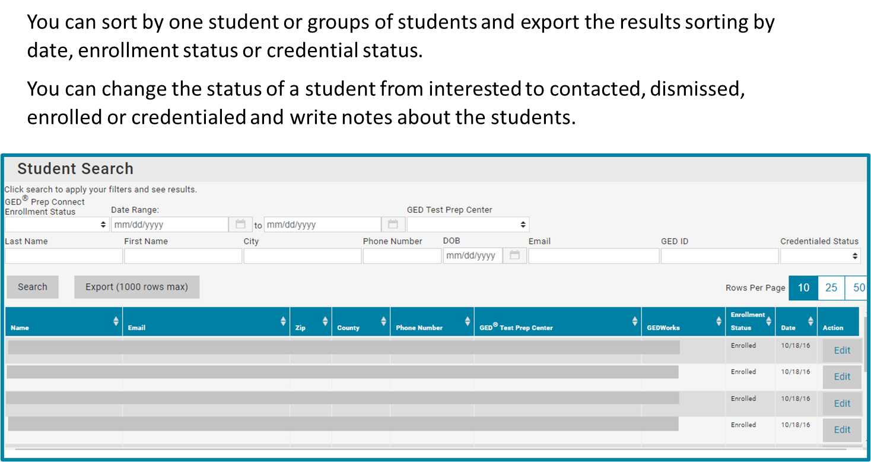
Manage Student Enrollment
Notes:
Educators will also see students' information who are interested in a program but not currently enrolled.
It is up to the adult educator to reach out to those students to get them to enroll.
This makes running reports of your current students much easier.

Slide 36

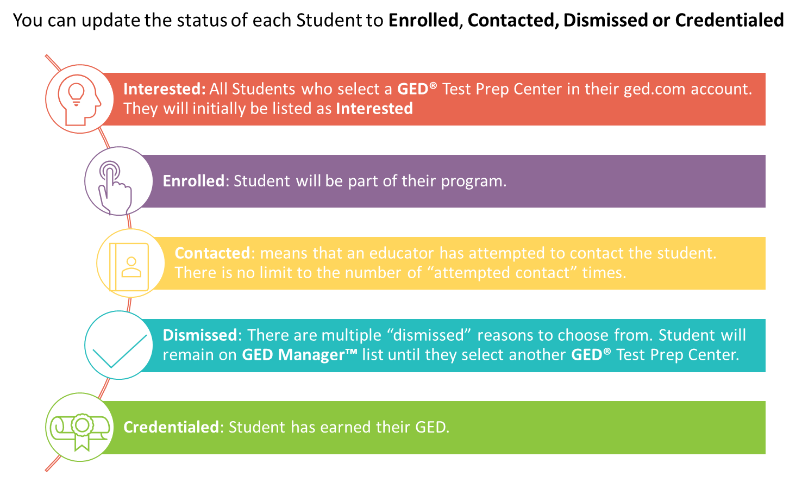
Notes:
Lets go over the 5 statuses to help manage students:
LAST: Now that we have reviewed the different statuses lets go over how to add a comment and change the status.

Slide 37
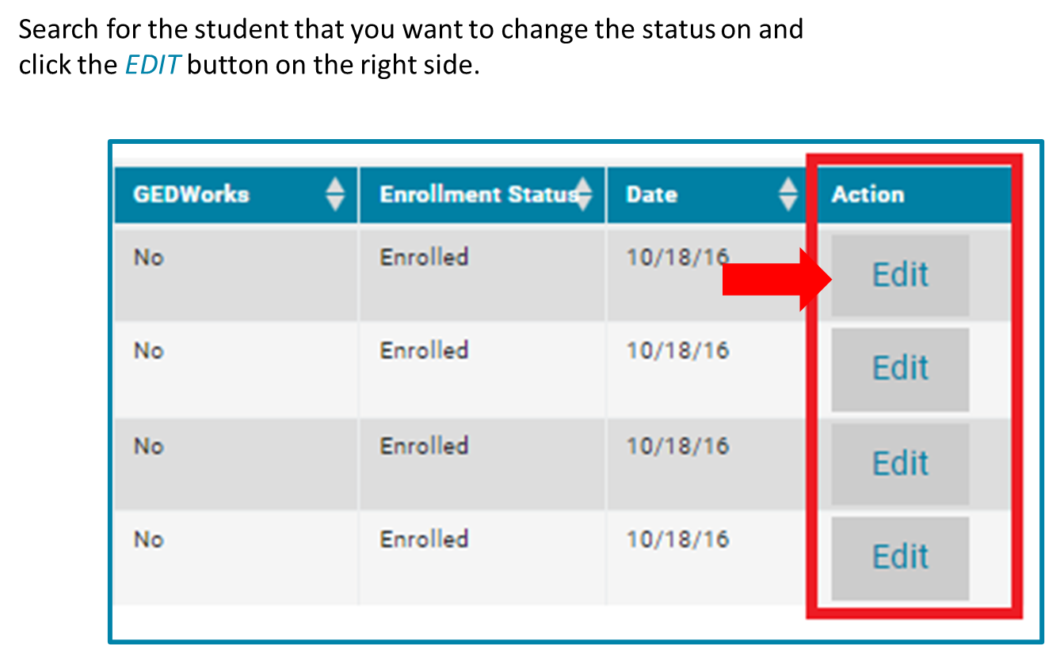
Updating Student Enrollment Status
Notes:
Search for the student that you want to change the status on and click the EDIT button on the right side

Slide 38
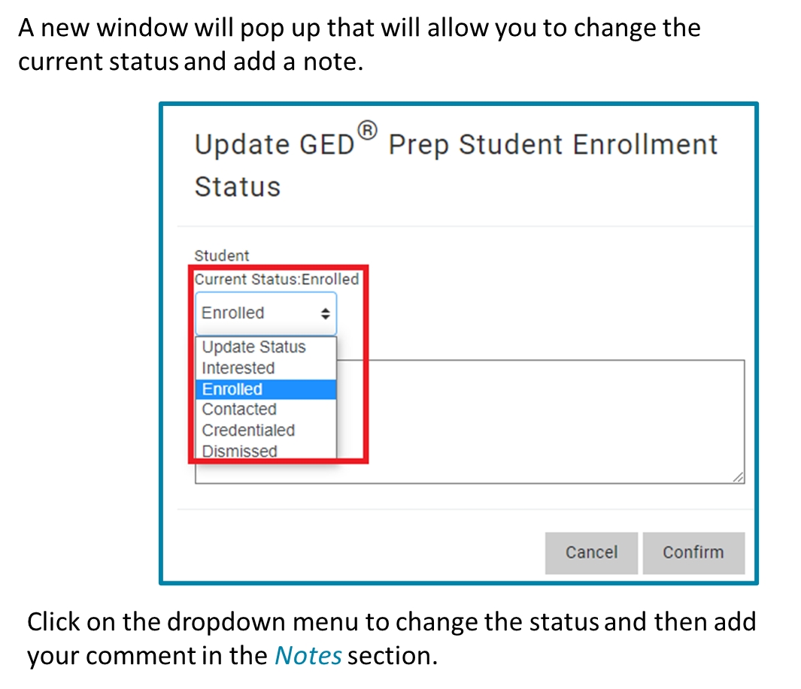
Updating Student Enrollment Status
Notes:
Note: even if your prep center has a different method to keep track of the students in your prep program, we encourage you to utilize this feature in GED manager, as this will help with the reports you run in the future.

Slide 39
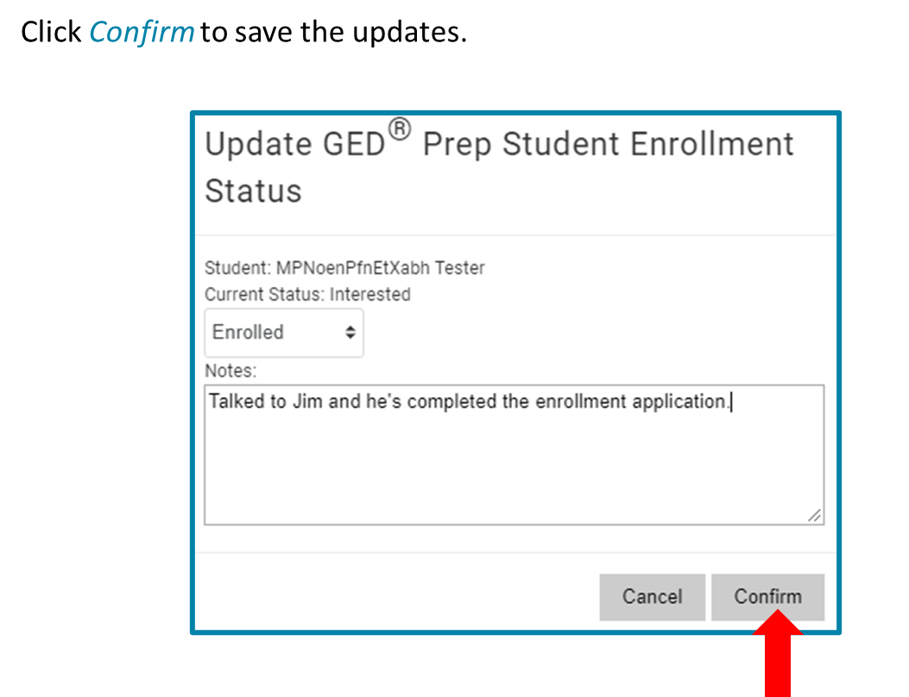
Updating Student Enrollment Status

Slide 40
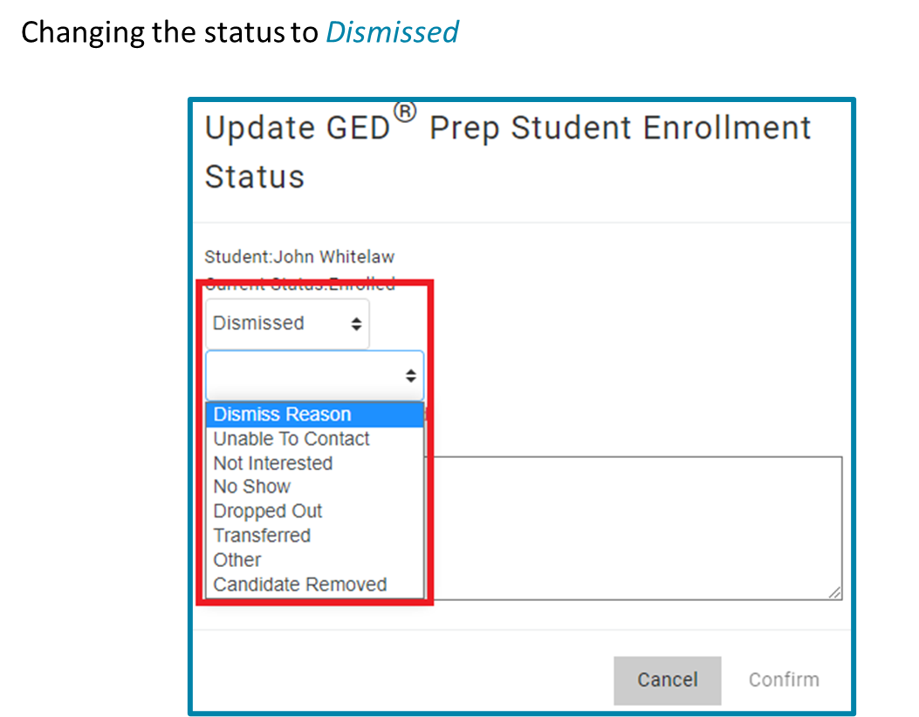
Updating Student Enrollment Status
Notes:
When changing the status of a student to dismissed you will need to select the Dismiss Reason in the second drop down and add a comment in the Notes section. We recommend you … Adult educators are encouraged to specify why the student was dismissed as reporting will be more accurate.

Slide 41
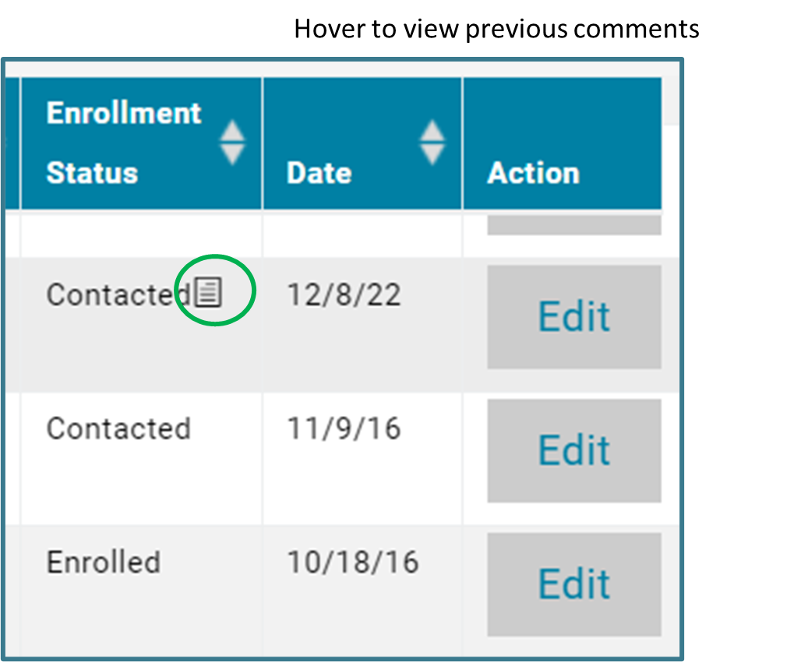
Comments Feature
Notes:
After leaving a comment you will see a sticky note icon next to the current status. When you hover over the icon you will be able to see the notes added for this student. Keep in mind that if the student switches to another prep center, they prep center will not be able to see your notes.

Slide 42
Tips for outreach to interested students
Make sure you update the status of the students in your program
Successful programs have teachers or office staff assigned to monitor GED Prep Connect enrollment and reach out to Interested students
Do not be afraid to call or email students – they shared their contact information for a reason!
Consider using texting to streamline outreach

Slide 43
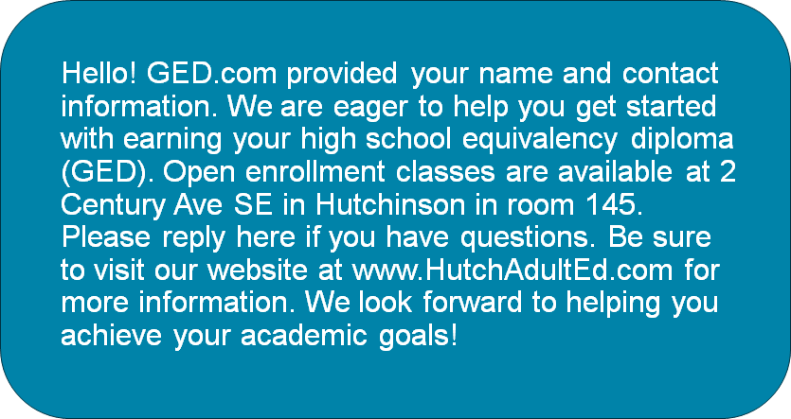
Sample Text Message

Slide 44
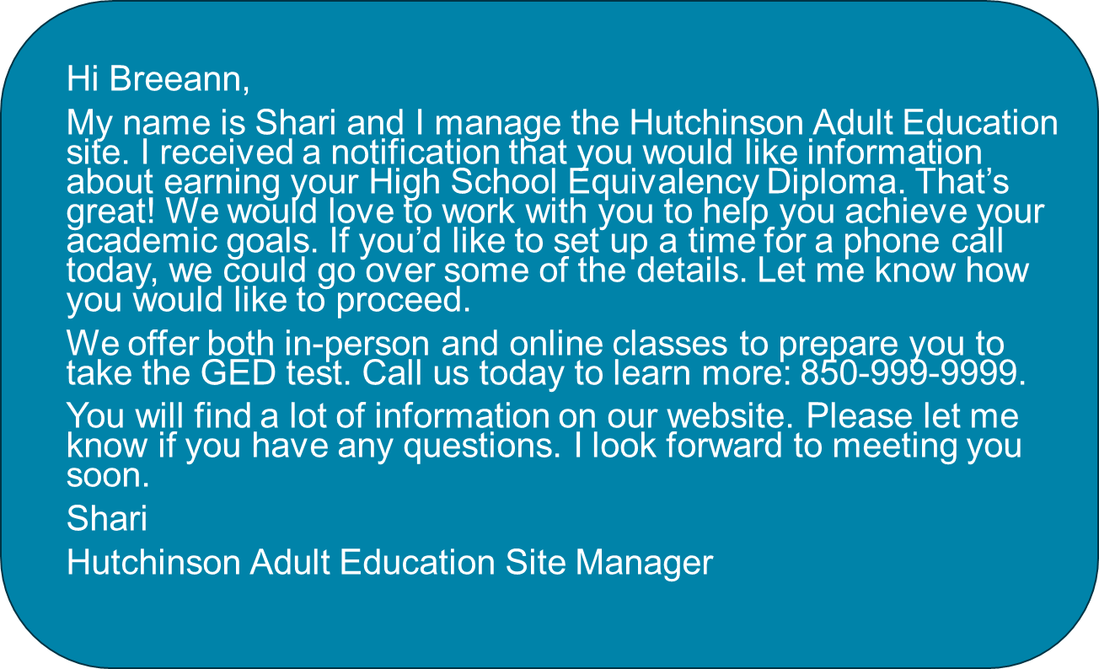
Sample Email

Slide 45
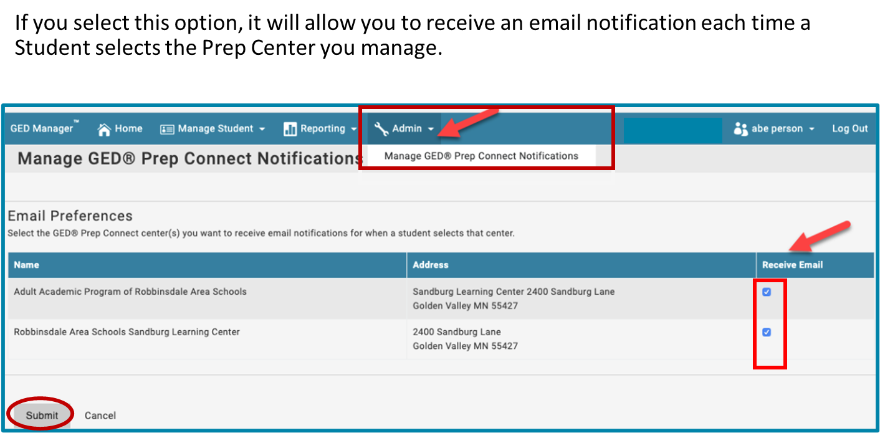
GEDPrep Connect™ Notifications Option
Notes:
You can opt to receive an email notification every time a student selects your prep center by clicking on the Admin tab and selecting Manager GED Prep Connect Notifications. While other prep centers might have someone at their center or themselves check GED manager on a regular basis to see if anyone else has expressed interest in their prep center fairly the choice is up to you.

Slide 46
GED Direct

Slide 47
What is GED Direct?
With access to GED Manager, you can purchase GED Ready practice tests, In-Person GED tests, and Online Proctored GED tests (depending on your jurisdiction) through the GED Direct feature within GED Manager and directly assign these tests to your students.
You don’t need voucher code spreadsheets
There are no expiration dates
Direct student access
For more information visit our FAQ document
In-person
GED Retake Tests
are now available for purchase in
GED Direct!

Slide 48
GED Direct – How it works
Purchase in GED Manager
Buy as many GED Readys as you need and receive our educator discount.
Assign and Share With Ease
Once purchased, you can easily assign tests to your students or share them with other educators in your program.
Manage Your Purchases
Your GED Direct dashboard displays assigned and shared tests. “Manage Assignments” allows you to see the status of each assigned test and adjust as needed, along with order history.
Buy GED tests for online or in-person testing.
You can also unassign and reuse unused tests to different students.

Slide 49
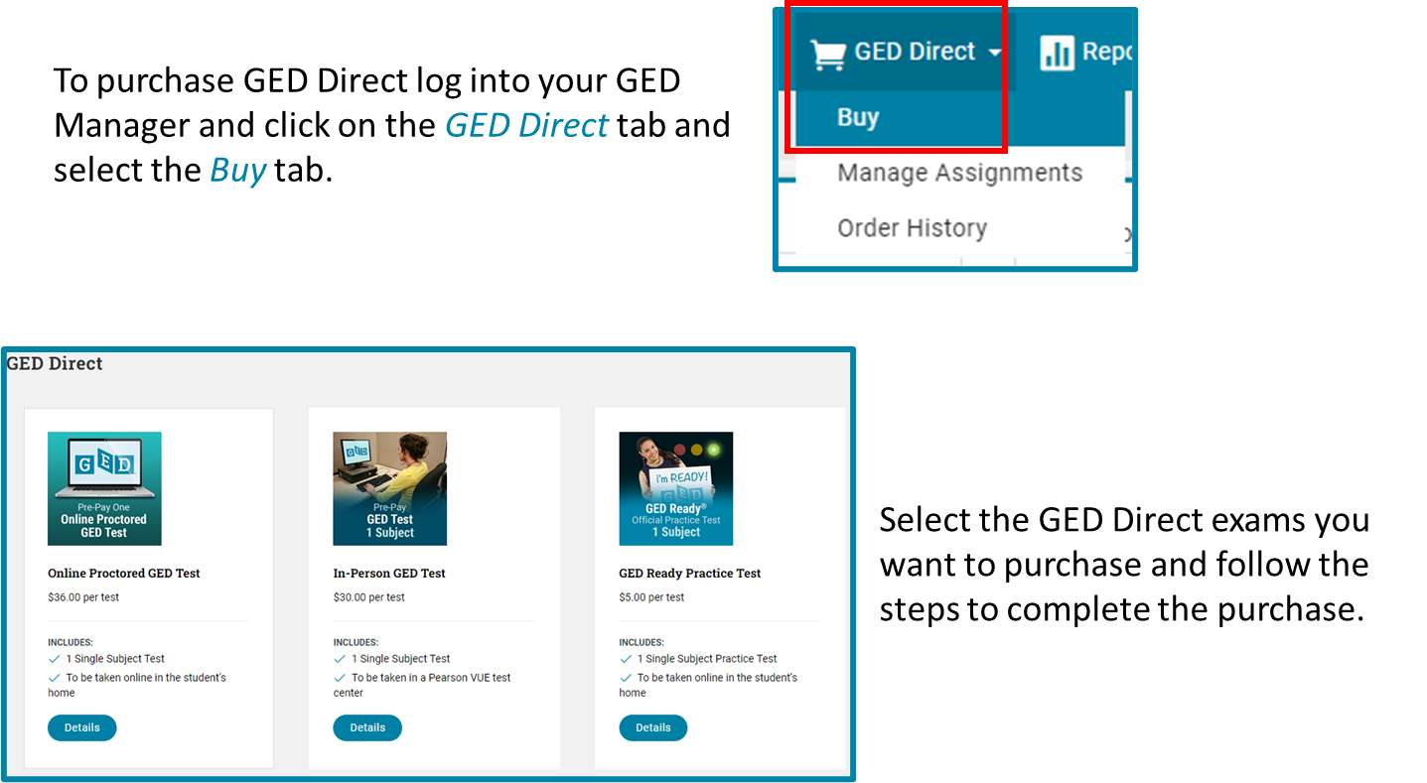
GED Direct – How it works

Slide 50
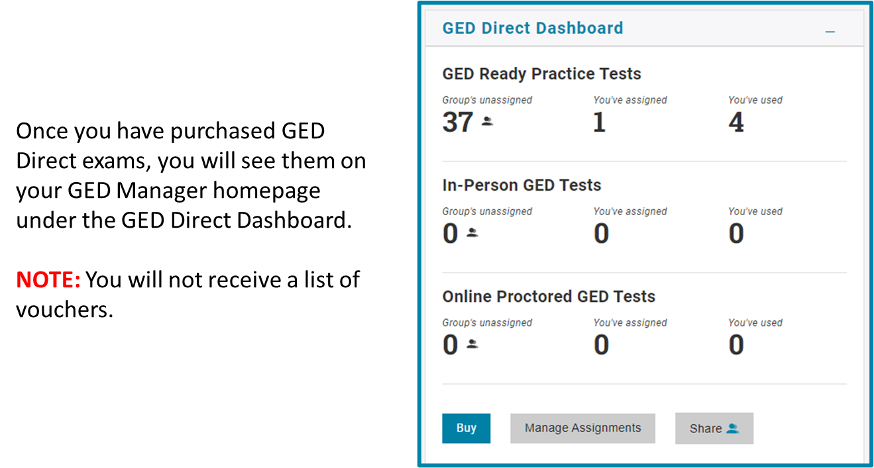
GED Direct – How it works

Slide 51
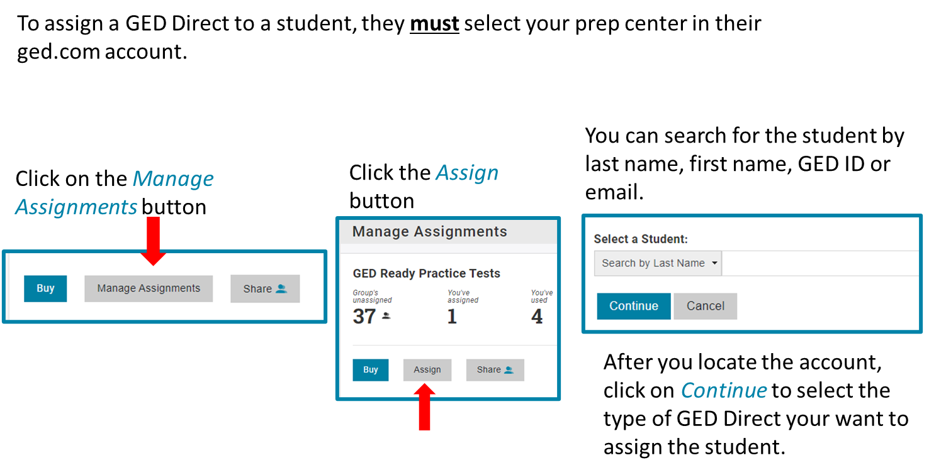
GED Direct – How it works
Notes:
You can search for the student by last name, first name, GED ID or email please remember that you will only be able to see students in your prep center.

Slide 52
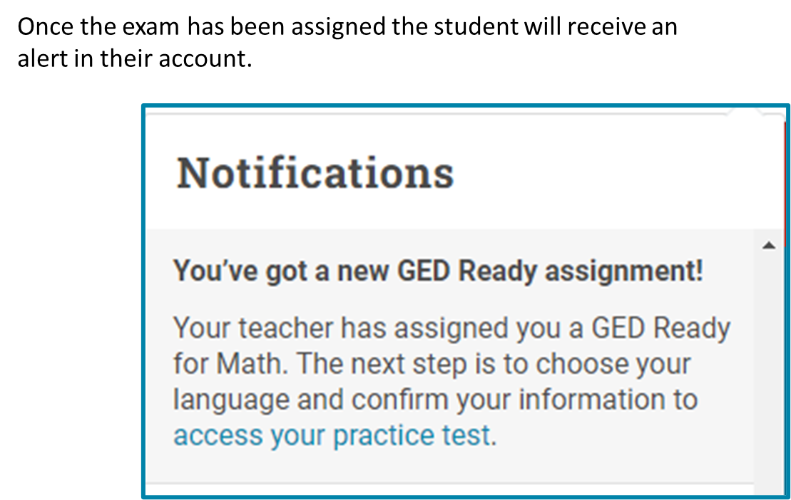
GED Direct – How it works
Notes:
You can assign more than one exam to each student.

Slide 53
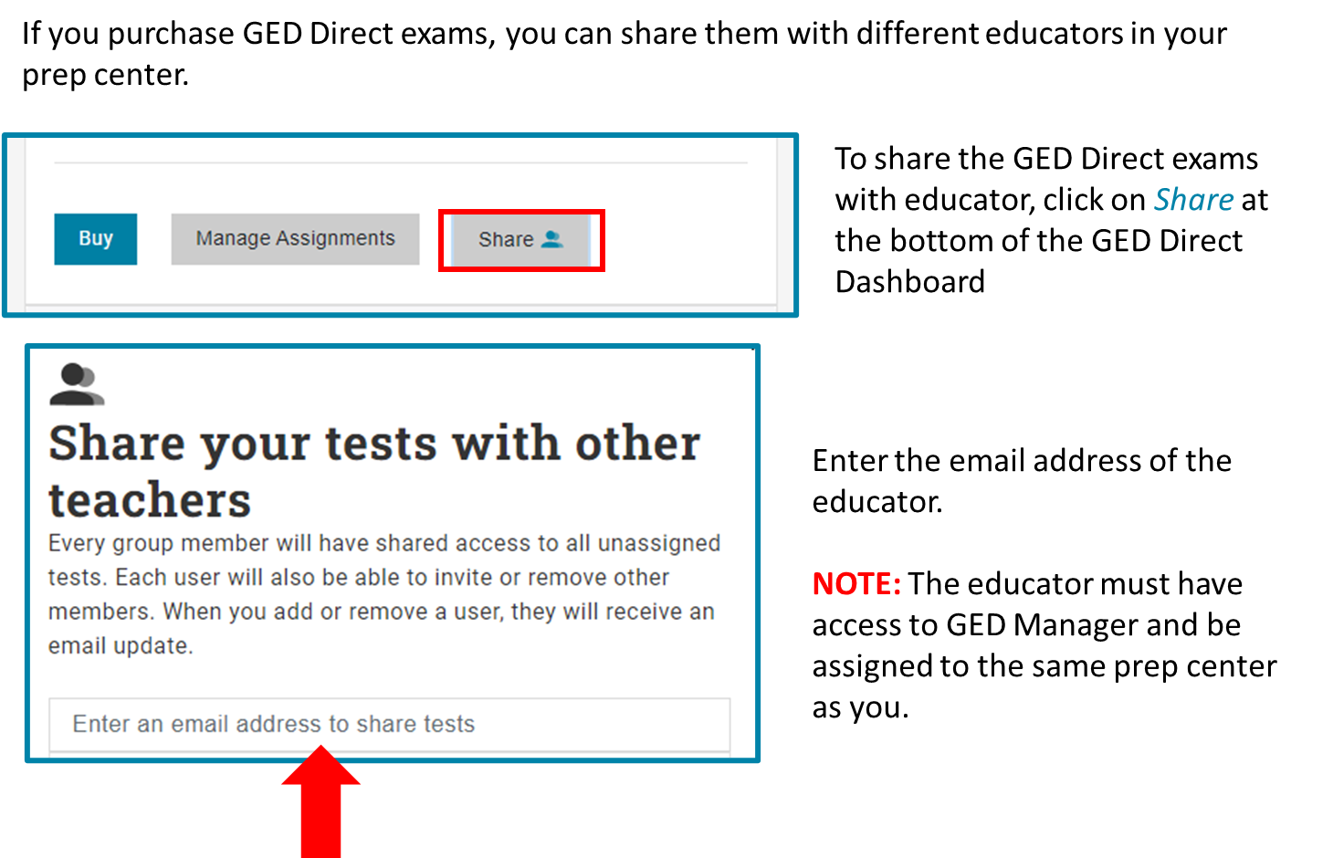
GED Direct – Sharing with Educators

Slide 54
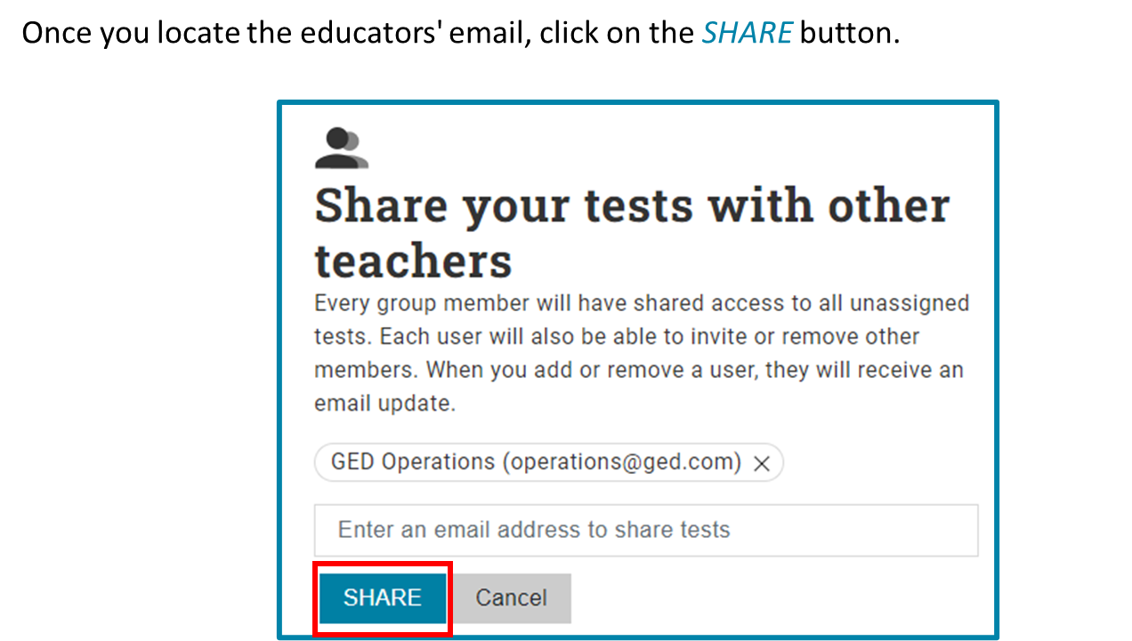
GED Direct – Sharing with Educators

Slide 55
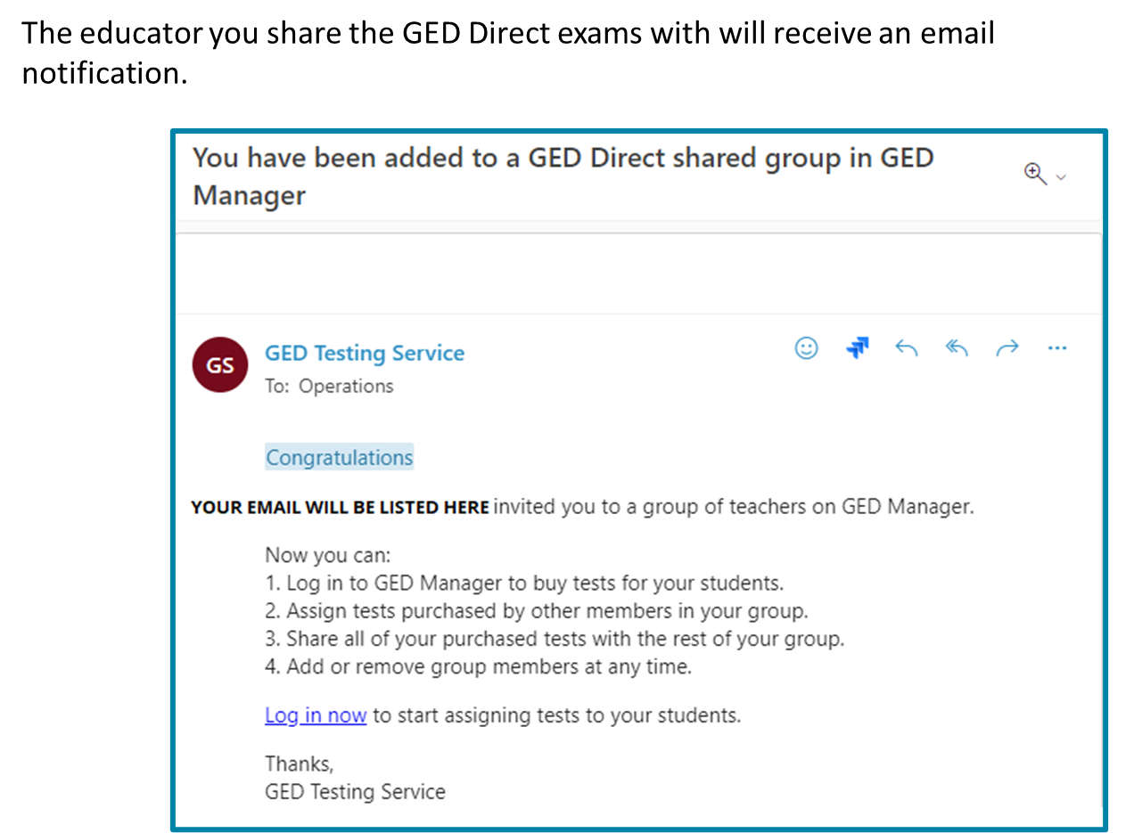
GED Direct – Sharing with Educators

Slide 56
How to View Student Activity

Slide 57
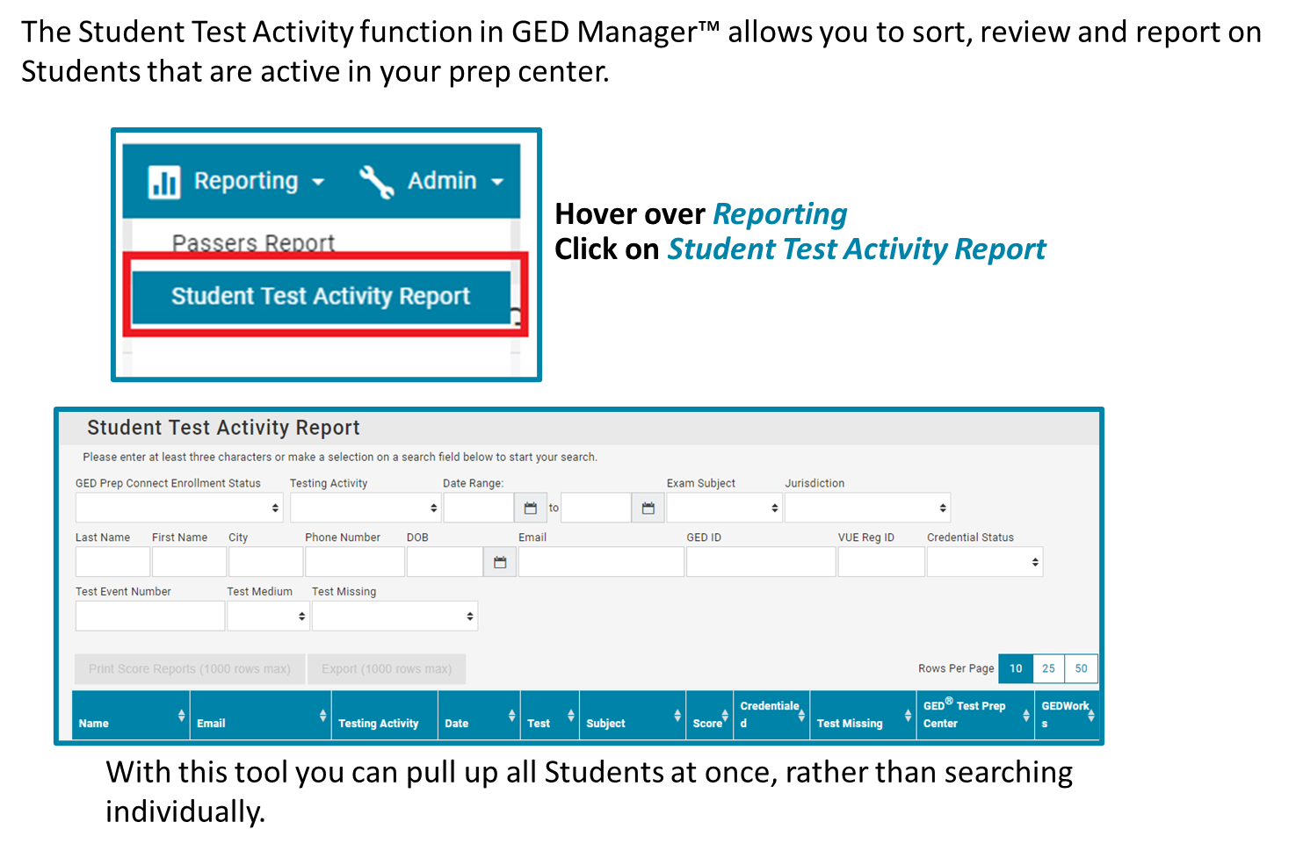
Student Activity Report

Slide 58
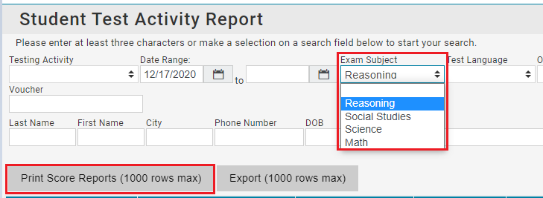
Student Test Activity Report
Use the Exam Subject search field for subject-specific scores for all your Students.
NOTE: You can print Score Reports in bulk directly from this results page without having to open each Student’s individual account. These score reports can be printed in English and Spanish. You can print up to 1000 score reports at a time.

Slide 59
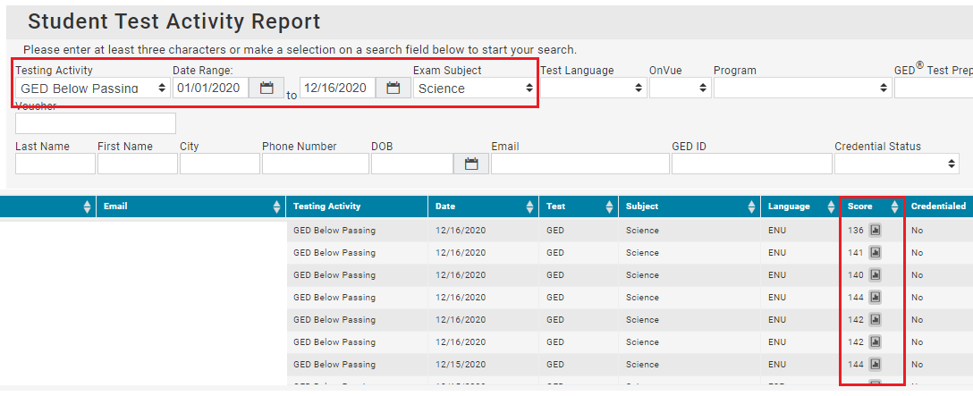

Student Test Activity Report
Using the date range, you can find any Student activities for the time period of your choice. In the following example, we are looking for a list of Students who received a below passing score on the Science test between January 1, 2020 and December 16, 2020.
Click on the
graphics icon
to view the
Students
score report.

Slide 60
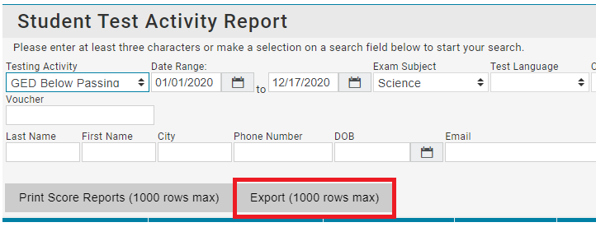
Student Test Activity Report
You can create a report with any of the filters on the page by clicking on the ‘Export’ button.
NOTE: You should limit your date range since a report cannot be generated with more than 1,000 rows of information.
When you export the Student results, it will download to your desktop. You can then sort the columns that are most important to you.
Notes:
This report is manly used by educators.

Slide 61
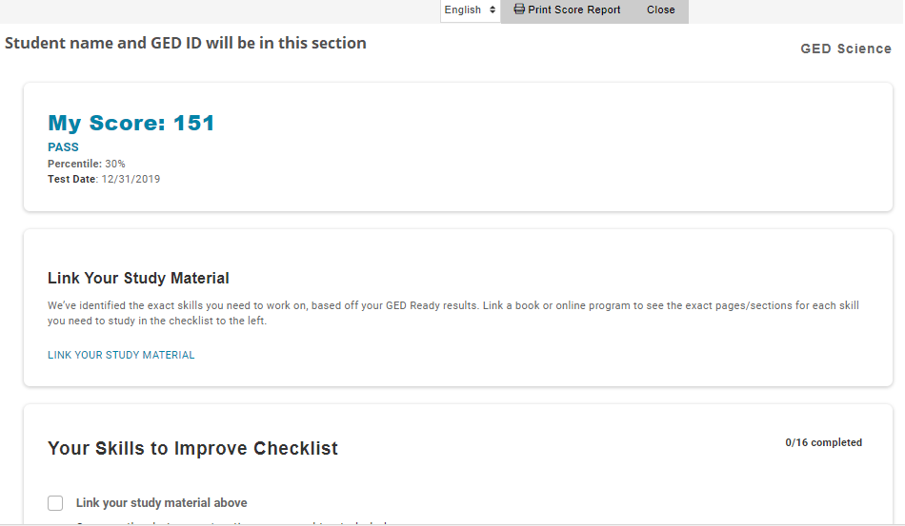
Student Test Activity Report
Notes:
Under the link your study material you will be able to link a book or online program to see the exact paged/sections for each skill the student needs to improve on.

Slide 62
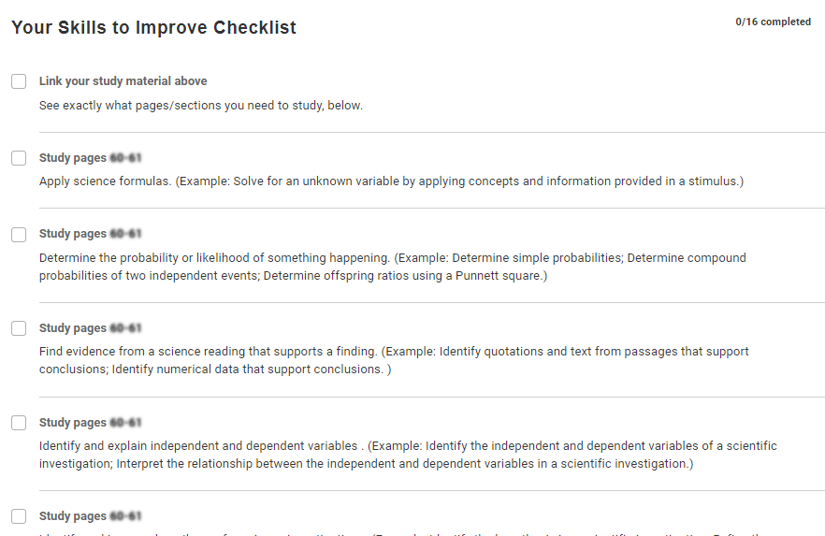
Student Test Activity Report
Notes:
Here is an example of the checklist and the descriptions

Slide 63
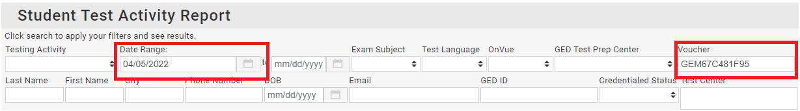
Voucher Search Field
You can search in GED Manager under the Student Test Activity Report if a voucher has been used.
After you enter the voucher number be sure to change the date range for faster results. If the voucher was used, you will see the student's information below the search fields.

Slide 64
Passers Report

Slide 65
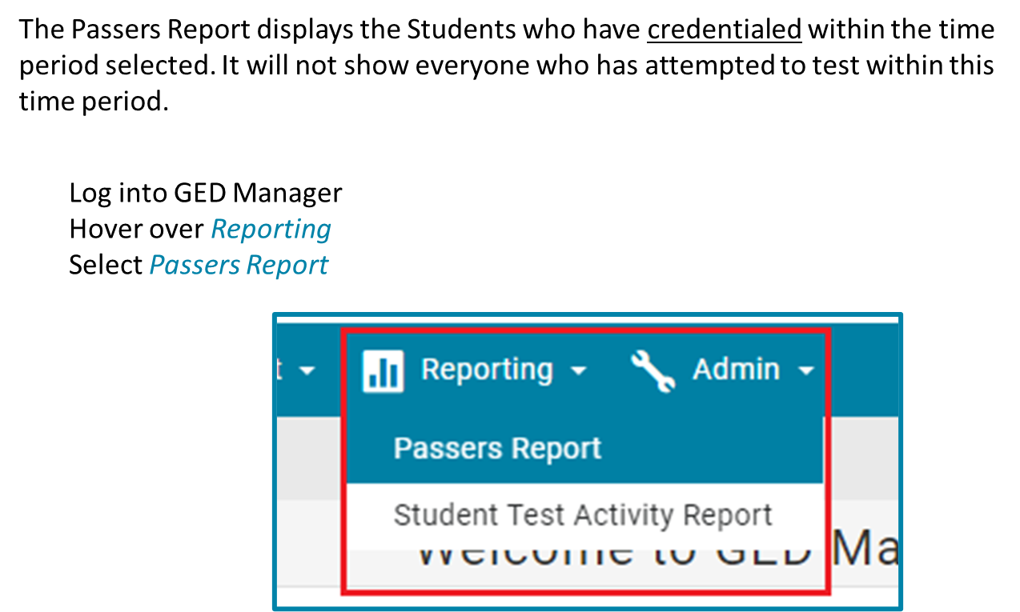
Passers Report

Slide 66
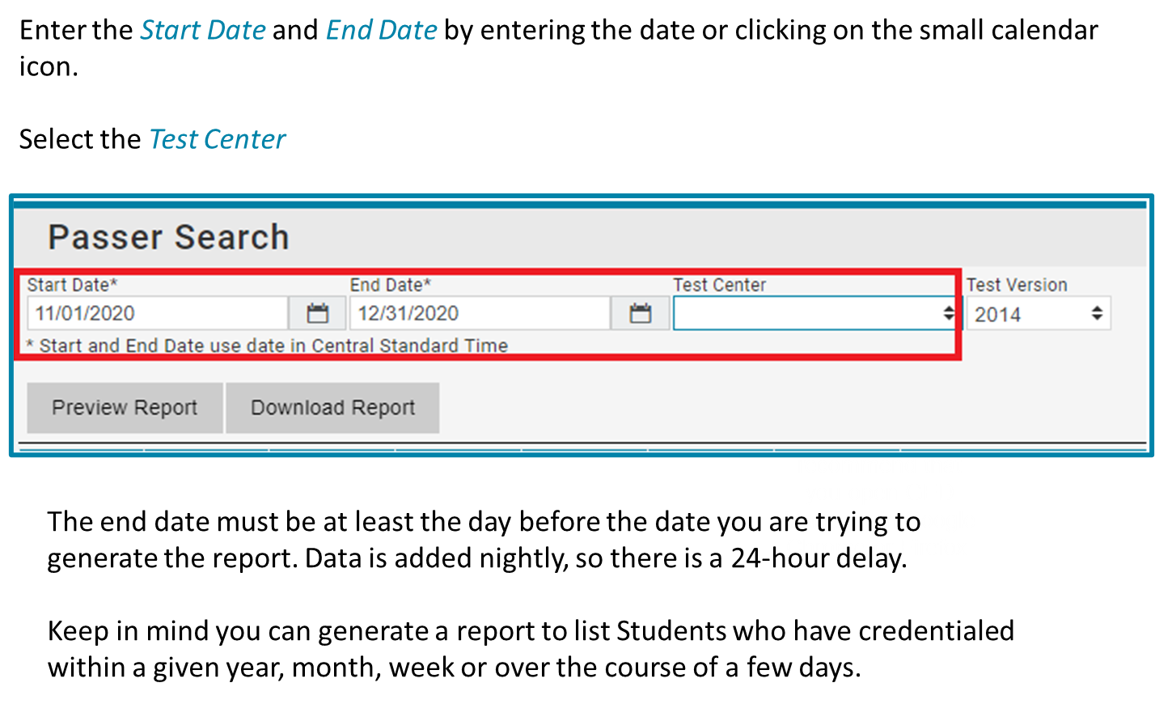
Passers Report
Notes:
You can only select one test center at a time

Slide 67
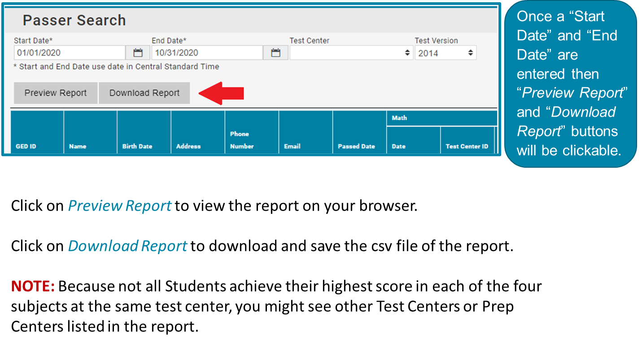
Passers Report
Notes:
NOTE: It’s important to understand Because not all Students achieve their highest score in each of the four subjects at the same test center, you might see other Test Centers or Prep Centers listed in the report.

Slide 68
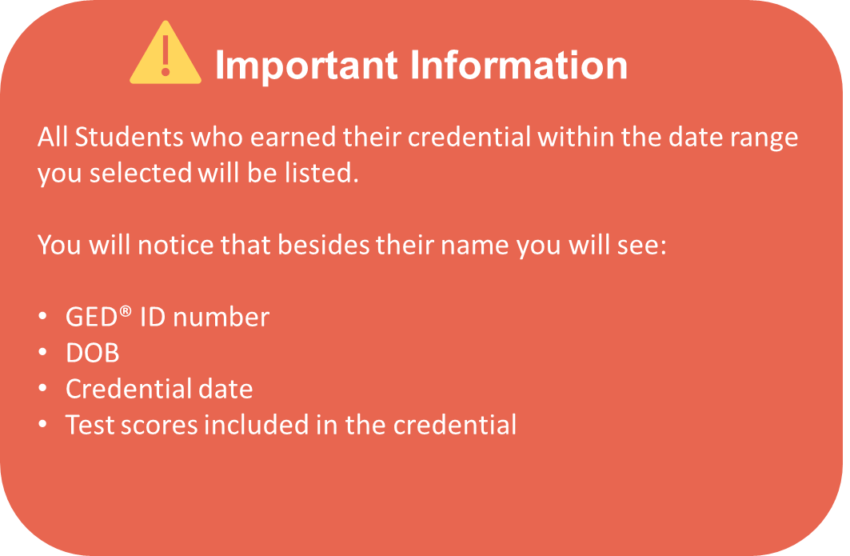
Passers Report

Slide 69

Requesting Access to GED Manager
GED Manager™ & GEDPrep Connect™

Slide 70
Resources

Slide 71

GED Website – Educators & Admins
Notes:
To get to this page you will click on the Educators and admins section on the top right corner. On the left side you will find the recourses available for educators and administrators.

Slide 72

Helpful Links How to Guides for Educators
Notes:
These how to guides have step by step instructions with colored screenshots and arrows pointing on what it is you need

Slide 73

Helpful Links – In Session
Notes:
We also have a free online newsletter we encourage you to sign up for. The newsletter is usually sent out once a month and in it is a variety of information that includes statistics and the latest news on the GED Program

Slide 74

GED Mobile App
Currently available in the Apple App Store
Android & Spanish coming soon!
The GED & Me App and GED.com use the same login credentials
Takes the learner on a guided journey to achieve their goals
NEW! Students will now see the Syd AI icon on applicable Math questions and receive tailored support through suggested or custom prompts.
GED Mobile App
Notes:
Currently only available for iPhone in the Apple App Store.

Slide 75


Slide 76
Upcoming Events
National GED® Day
GED® Grad Day

Slide 77

National GED Day
National GED Day Activity Suggestions
COABE National Adult Education and Family Literacy Week
Notes:
Start planning for next year!

Slide 78

2026 GED Grad Day Virtual Celebration
Sign Up for the InSession Newsletter for the date announcement
Check Out GED Grad Day 2025
Notes:
You and your students can participate in a virtual graduation.
Live-streamed through the "GED Graduates" FB community group
Link in chat. Please join this group if you haven't already!
Commencement speaker, student speakers, celebratory videos

Slide 79

Your State Relationship Team
Mellissa Hulstrand
IL,MI,MN,TN,VT,WI,
PR,VI,MI Prisons
Mellissa.Hulstrand@ged.com
Brian Smith, Director
PA
Brian.Smith@ged.com
Scott Salesses
MA,NY,FBOP
Scott.Salesses@ged.com
Lisa Pool-Osorio AK,AZ,CA,ID,NV,OR,UT, WA, Guam
Lisa.Pool-Osorio@ged.com
Adora Beard
AL,DC,DE,MD,VA,PR
Military
Adora.Beard@ged.com
Liz Lanphear CO,HI,IN,KS,MO,NE,NM,ND,SD
Elizabeth.Lanphear@ged.com
Diane Vaccari
CT,FL,KY,NJ,OH,RI,SC,WV
Bermuda
Diane.Vaccari@ged.com
Shawn Watts (Starting 8/17)
AR,GA,LA
Shawn.Watts@ged.com
Jonna Forsyth
CA,MS,MT,NC,NH,OK,TX,WY
Jonna.Mcdonough@ged.com

Slide 80
Thank You!
Communicate with GED® Testing Service: Contact Us - GED
Diane Vaccari
Diane.Vaccari@ged.com
Mellissa Hultstrand
Mellissa.Hultstrand@ged.com
80
Notes:
When you don’t know your SRM/or all else fails… email us at help@ged.com and your inquiry will be sent to the appropriate team mate when our Operations team cannot answer themselves.

Slide 81


Session Survey
Your feedback is important. Please scan the QR code below to rate this session.

