Slide 1
Getting Students Ready
for Re-entry
Susan Pittman
GED® and GED Testing Service® are registered trademarks of the American Council on Education (“ACE”). They may not be used or reproduced without the express written permission of ACE or GED Testing Service LLC. The GED® and GED Testing Service® brands are administered by GED Testing Service LLC under license from ACE.

Slide 2

Sponsor of the 2025 GED Conference Corrections Strand

Slide 3
In this session, we will
Discuss the services provided by re-entry programs
Identify areas in which teachers can show students how what they learn in their GED classrooms can help them when they start re-entry
Discuss simple ways to contextualize instruction to address re-entry
Share sample activities for the classroom
Notes:
In this presentation, we will discuss the purpose and goals of re-entry programs, the employment services available, housing assistance, health and wellness services, educational and skill-building programs, as well as legal and financial support for former inmates.

Slide 4

Purpose and Goals of Re-Entry Programs
Reducing Recidivism
Promoting Employment
Stable Housing
Healthy Relationships
Notes:
The primary purpose of re-entry programs is to reduce recidivism rates by providing support and resources. Goals include promoting stable employment, housing, and healthy relationships to facilitate successful reintegration.
Reducing Recidivism
Re-entry programs aim to reduce recidivism rates by offering necessary support and resources for individuals transitioning back to society.
Promoting Employment
One key goal is to promote stable employment opportunities, essential for successful reintegration into society and independence.
Stable Housing
Providing stable housing is crucial for individuals re-entering society, helping them establish a secure foundation for their new lives.
Healthy Relationships
Fostering healthy relationships is vital for successful reintegration, supporting emotional well-being and social reintegration.

Slide 5

Importance for Successful Reintegration
Reducing Recidivism
Effective re-entry programs help reduce recidivism rates by providing support and resources for former inmates.
Addressing Key Challenges
These programs address the challenges faced during reintegration, such as finding employment and housing.
Leading Fulfilling Lives
Successful reintegration programs empower former inmates to lead productive and fulfilling lives within their communities.
Notes:
Effective re-entry programs are critical for reducing recidivism and ensuring that former inmates can lead productive, fulfilling lives. These programs address key challenges faced during reintegration.

Slide 6
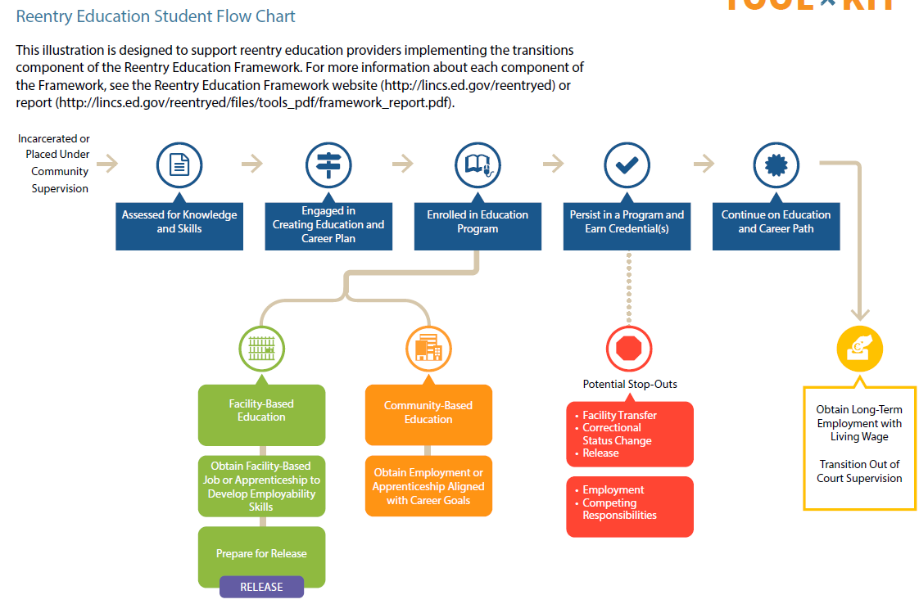

Slide 7
Employment Services
Notes:
Employment is a vital component of successful reintegration. Various services help former inmates secure stable jobs and develop necessary skills.

Slide 8

Job Placement and Career Counseling
Connecting with Employers
Career Development Guidance
Job Search Strategies
Notes:
Job placement services connect former inmates with potential employers, while career counseling provides guidance on job search strategies and career development tailored to individual needs.
Connecting with Employers
Job placement services help individuals reconnect with the workforce by linking them to potential employers who value their skills.
Career Development Guidance
Career counseling offers personalized strategies for job searching and professional growth, addressing individual needs and aspirations.
Job Search Strategies
Guidance on effective job search techniques can empower individuals to find suitable employment opportunities that match their skills.

Slide 9

Vocational Training and Skills Development
Marketable Skills Acquisition
Improving Employability
Boosting Confidence
Notes:
V
Marketable Skills Acquisition
Vocational training programs enable former inmates to acquire hands-on skills in various trades, enhancing their job readiness.
Improving Employability
By gaining practical skills, former inmates increase their chances of securing stable employment and reintegrating into society.
Boosting Confidence
Vocational training builds self-esteem and confidence in former inmates, making them more prepared for workplace challenges.
ocational training programs equip former inmates with marketable skills in various trades, improving their employability and confidence in the workplace.

Slide 10

Workforce Readiness Programs
Interview Skills Training
Workplace Etiquette
Networking Strategies
Notes:
Workforce readiness programs focus on preparing individuals for the workforce by teaching interview skills, workplace etiquette, and networking strategies to enhance their chances of securing employment.
Interview Skills Training
Programs teach effective interview skills, helping individuals present themselves confidently to potential employers.
Workplace Etiquette
Understanding workplace etiquette is crucial for creating a positive impression and fostering good relationships in a professional environment.
Networking Strategies
Workforce readiness programs equip individuals with networking strategies to build connections and expand their professional opportunities.

Slide 11
Housing Assistance
Notes:
Stable housing is essential for successful reintegration. Programs offer various forms of housing assistance to help former inmates secure and maintain housing.

Slide 12
Temporary Housing and Shelters
Immediate Housing Support
Temporary housing options like shelters offer immediate assistance for those lacking stable housing, particularly former inmates.
Safe Environment
Shelters provide a safe and secure environment for individuals while they transition to more permanent housing solutions.
Path to Stability
These services help individuals seek long-term housing solutions, promoting stability in their lives after incarceration.
Notes:
Temporary housing options, such as shelters, provide immediate support for former inmates who may lack stable housing. These services offer a safe environment while individuals seek long-term solutions.

Slide 13
Long-Term Housing Solutions
Housing Assistance Programs
Long-term housing assistance programs provide crucial support in securing permanent residences for former inmates.
Subsidies for Stability
Subsidies are provided to help former inmates afford housing, ensuring they have a stable living environment.
Support Services
Support services are essential for encouraging stability, providing resources like job training and counseling.
Notes:
Long-term housing assistance programs help former inmates secure permanent residences through subsidies, affordable housing options, and support services that encourage stability.

Slide 14

Support for Finding and Maintaining Housing
Navigating the Housing Market
Assistance with Applications
Landlord Negotiations Support
Ongoing Tenancy Support
Notes:
Support services are available to help individuals navigate the housing market, including assistance with applications, landlord negotiations, and ongoing support to ensure successful tenancy.
Navigating the Housing Market
Support services are designed to help individuals understand and navigate the complexities of the housing market effectively.
Assistance with Applications
Individuals can receive guidance and support in completing rental applications to improve their chances of securing housing.
Landlord Negotiations Support
Support services also include assistance with negotiations between tenants and landlords to foster positive relationships.
Ongoing Tenancy Support
Continued support is provided to ensure successful tenancy and address any challenges that may arise.

Slide 15
Health and Wellness Services
Notes:
Access to health and wellness services is vital for the overall well-being of former inmates, addressing both mental and physical health needs.

Slide 16

Mental Health Counseling
Support for Former Inmates
Coping Strategies Development
Building Resilience
Notes:
Mental health counseling services offer support for former inmates dealing with trauma, anxiety, or depression, helping them develop coping strategies and resilience.
Support for Former Inmates
Mental health counseling provides essential support for former inmates adjusting to life after incarceration, addressing their unique challenges.
Coping Strategies Development
Counseling services focus on helping individuals develop effective coping strategies to manage trauma, anxiety, and depression.
Building Resilience
Through mental health counseling, individuals can build resilience which is crucial for overcoming life's challenges and improving well-being.

Slide 17
Educational and Skill-Building Programs
Notes:
Educational programs are essential for equipping former inmates with the knowledge and skills needed to thrive in society. Options range from basic education to advanced studies.

Slide 18

GED and High School Diploma Programs
Opportunities for Former Inmates
Job Requirements
Access to Educational Programs
Notes:
GED and high school diploma programs provide former inmates with opportunities to earn their diplomas, which is often a requirement for many jobs and educational programs.
Opportunities for Former Inmates
GED and high school diploma programs create pathways for former inmates to achieve educational success and reintegrate into society.
Job Requirements
Earning a GED or high school diploma is often essential for accessing many job opportunities in various fields.
Access to Educational Programs
Having a diploma opens doors to further educational programs, enabling continued personal and academic growth.

Slide 19

Higher Education Opportunities
Re-entry Programs
College Education
Vocational Training
Notes:
Many re-entry programs assist individuals in pursuing higher education, including college and vocational training, which can significantly enhance career prospects.
Re-entry Programs
Re-entry programs provide essential support to individuals returning to education, helping them navigate challenges and opportunities.
College Education
Pursuing a college education opens doors to various career paths, increasing employability and earning potential.
Vocational Training
Vocational training equips individuals with specific skills for immediate employment, catering to diverse industries and professions.

Slide 20

Life Skills and Personal Development
Communication Skills
Financial Management
Problem-Solving Skills
Notes:
Life skills programs focus on teaching essential skills such as communication, financial management, and problem-solving, which are crucial for personal development and successful living.
Communication Skills
Effective communication is vital for personal and professional relationships, fostering understanding and collaboration.
Financial Management
Understanding financial management helps individuals budget, save, and make informed financial decisions for stability.
Problem-Solving Skills
Problem-solving skills empower individuals to analyze situations, make decisions, and overcome challenges effectively.

Slide 21
Legal and Financial Support
Notes:
Re-entry programs often provide legal and financial support to help former inmates navigate challenges related to their past and build a stable future.

Slide 22

Legal Aid and Advocacy
Support for Reintegration
Expunging Criminal Records
Navigating the Legal System
Notes:
Legal aid services assist individuals in addressing legal issues that may hinder their reintegration, such as expunging criminal records or navigating the legal system.
Support for Reintegration
Legal aid services provide essential support for individuals facing legal challenges that affect their reintegration into society.
Expunging Criminal Records
One critical aspect of legal aid is assisting clients in expunging criminal records, removing barriers to employment and housing.
Navigating the Legal System
Legal aid services help clients navigate the complex legal system, ensuring they understand their rights and options.

Slide 23

Financial Literacy and Budgeting Assistance
Importance of Financial Literacy
Budgeting Skills
Empowerment Through Education
Notes:
Financial literacy programs teach essential budgeting and money management skills, empowering individuals to make informed financial decisions and achieve stability.
Importance of Financial Literacy
Financial literacy is essential for making informed decisions about budgeting, savings, and investments, leading to financial stability.
Budgeting Skills
Effective budgeting skills help individuals allocate resources wisely, track spending, and achieve their financial goals.
Empowerment Through Education
Financial education empowers individuals to take control of their finances, leading to better financial outcomes and a secure future.

Slide 24
Factors that can “Break” a Returnee’s Success in Re-entry
External
Environmental or Contextual
Internal
Returnee’s Strengths or Limitations
Health issues
Reluctant employers
Reluctant families
Reluctant landlords
Lack of basic literacy and math skills
Lack of high school credential
Limited occupational skills
Limited “navigation” skills
Lack of self-confidence

Slide 25



Connections to the Classroom
Vocational Skills
Workforce Readiness
Housing
Health and Wellness
Financial Literacy

Slide 26
Workforce Readiness
Preparing for an interview
Getting to an interview or job on time

Slide 27
Preparing for an Interview
Returnees often have difficult obtaining employment, in part because they
Were incarcerated
Have gaps in employment
Have difficulty navigating the process
Don’t plan for an interview
Lack personal interaction skills

Slide 28
Planning for an Interview
What I Know | Why I am certain I can do the job. | How I have demonstrated these skills in the past.
I know that I can be a productive and capable employee. | I take initiative to complete tasks, whether assigned or not. | Took and passed optional courses Earned by GED Completed initial re-entry program
 | I am motivated. | Opportunity to prove myself Support my family Meet probation requirements
 | I have learned the importance of good work habits. | On time to work Can work as part of a team Follow directions Listen to feedback

Slide 29
Getting to an Interview on Time
My interview is at 1:10. I should arrive 5-10 minutes early. It’s a 24-minute walk and takes a few minutes for me to get out the door. What time should I start putting my shoes on?
What are the most important facts of the problem? 1:10, 5-10 minutes early, few minutes to get out the door, 24-minute walk.
Plan to arrive at 1:00 PM (10 minutes early). The walk takes 24 minutes, so you need to leave your house by 12:36 PM. Allow a few minutes to get out the door, let's assume 3 minutes. So, you should start putting on your shoes at 12:33 PM.
Set up similar scenarios and have students solve.

Slide 30
Vocational Training
Taking advantage of Integrated Education and Training (IETs) in corrections

Slide 31
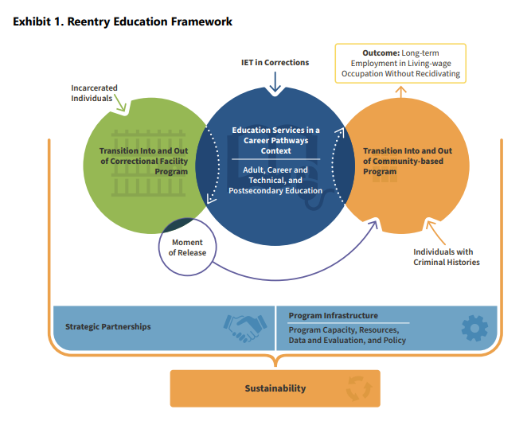
IETs and Re-entry
Sample Industry Sectors
Construction
Logistics
Personal Services
Hospitality
Culinary Arts
Manufacturing
Notes:
f industry sectors, including construction, logistics, personal services, hospitality/culinary arts, and manufacturing,

Slide 32
Housing
Understanding what is explicitly stated in a text
Comparing prices

Slide 33
Understanding What is Explicitly Stated
When leasing an apartment, there are several important things to keep in mind. First, make sure to read and understand the lease agreement thoroughly. This document covers all the terms of your tenancy, such as the rent amount, lease duration, security deposit, and maintenance responsibilities. It also includes policies on pets and guests. Be sure to check for clauses about early termination, renewal options, and late payment penalties to avoid any surprises.
Second, take a close look at the apartment and its neighborhood. Before signing the lease, inspect the apartment for any damages or issues that need fixing. Check for amenities like parking, laundry facilities, and security features. Also, research the neighborhood to make sure it is safe and convenient for your needs, such as being close to work, schools, and other essential services. The quality of the neighborhood can greatly affect your overall living experience.
Finally, consider your financial situation. Besides the monthly rent, you will have other expenses like utilities, renter's insurance, and maintenance fees. Make sure your budget can handle these costs comfortably. It’s also a good idea to have some savings for emergencies or unexpected expenses. By planning your finances carefully, you can manage your lease responsibly and avoid financial stress.

Slide 34
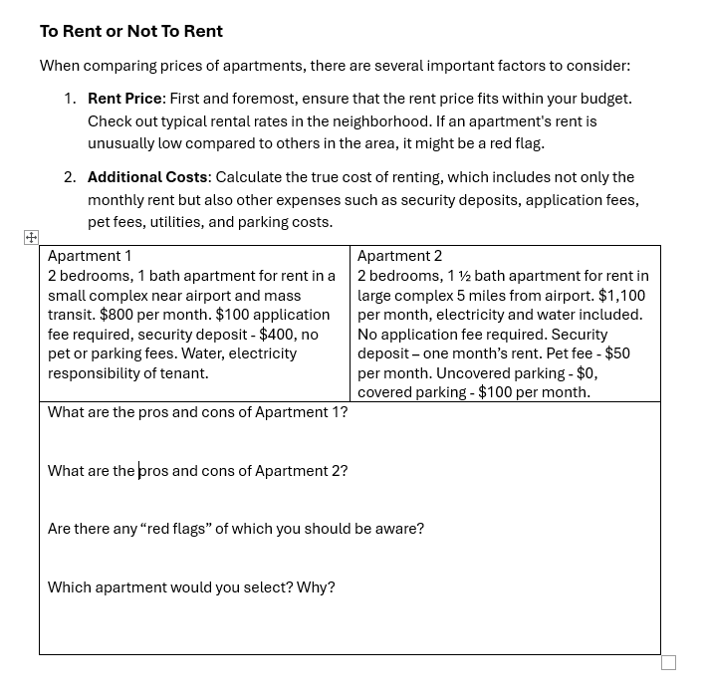
Comparing Prices

Slide 35
Financial Literacy
Understanding banking basics
Taking advantage of sales

Slide 36
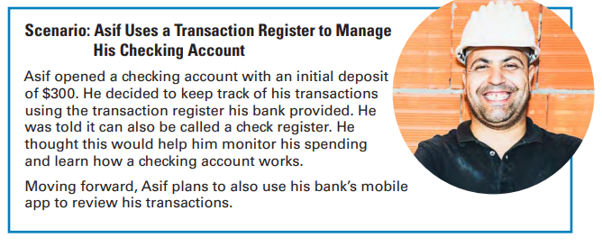
Banking Basics
https://www.fdic.gov/consumer-resource-center/money-smart

Slide 37
Keeping Track
Here are Asif’s transactions:
Purchased groceries at Local Market for $50.00 using debit card on 4/3/25
Purchased gasoline at USA Gas for $30.00 using debit card on 4/3/25
Deposited $280.00 on 4/10/25
Automatic debit payment to Auto Lender USA for $150.00 on 4/13/24
Deposited $300.00 on 4/25/25
Got $50.00 cash from out-of-network ATM on 4/28/25
Paid $4.00 out-of-network ATM fee
Made rent payment to Happy Properties with Check 715 for $500.00 on 5/1/25

Slide 38
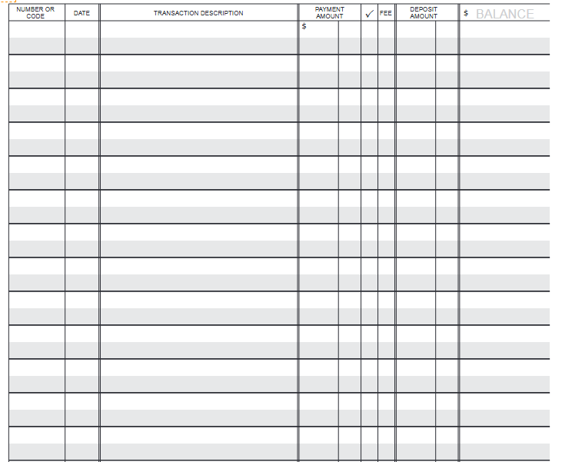
Keeping Track

Slide 39
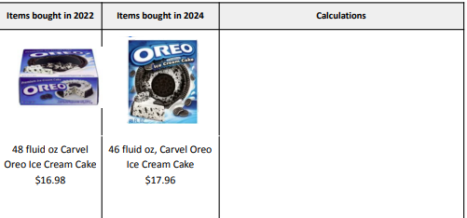
Is Shrinkflation a Real Thing?
Do you think shrinkflation is happening for these items? If so, by how much? Compare each item in 2022 and 2024, and show your work in the calculation column, using any method you think it’s appropriate.
Sample of activity from YummyMath at: https://www.yummymath.com/post/shrinkflation-updated/#

Slide 40
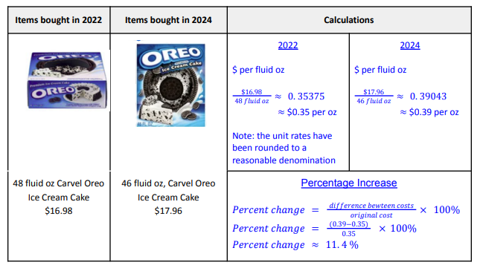
Is Shrinkflation a Real Thing?
Solutions provided to YummyMath members. $35 per year

Slide 41
Health and Wellness
Maintaining Mindfulness
Expecting more from yourself

Slide 42
Mindfulness and Re-entry
Mindfulness is the practice of being aware of the present moment with curiosity, openness, and acceptance. It is secular and supported by scientific evidence.
Transforming Education at: https://transformingeducation.org
Mindfulness helps students
Become more aware of their thoughts
Pause before taking action
Be rather than do
Focus
Adjust attitude about different situations
Notes:
Nine Ways Mindfulness Helps with Stress
You become more aware of your thoughts. You can then step back from them and not take them so literally. That way, your stress response is not initiated in the first place.
You don’t immediately react to a situation. Instead, you have a moment to pause and then use your “wise mind” to come up with the best solution. Mindfulness helps you do this through the mindful exercises.
Mindfulness switches on your “being” mode of mind, which is associated with relaxation. Your “doing” mode of mind is associated with action and the stress response.
You are more aware and sensitive to the needs of your body. You may notice pains earlier and can then take appropriate action.
You are more aware of the emotions of others. As your emotional intelligence rises, you are less likely to get into conflict.
Your level of care and compassion for yourself and others rises. This compassionate mind soothes you and inhibits your stress response.
Mindfulness practice reduces activity in the part of your brain called the amygdala. The amygdala is central to switching on your stress response, so effectively, your background level of stress is reduced.
You are better able to focus. So you complete your work more efficiently, you have a greater sense of well-being, and this reduces the stress response. You are more likely to get into “the zone” or “flow,” as it’s termed in psychology by Mihaly Csikszentmihalyi.
You can switch your attitude to the stress. Rather than just seeing the negative consequences of feeling stressed, mindfulness offers you the space to think differently about the stress itself. Observing how the increased pressure helps energize you has a positive effect on your body and mind.

Slide 43
Why Mindfulness Matters: Research Findings
Attention to mindfulness has risen exponentially in recent years, largely thanks to encouraging research across a wide range of fields and institutions.³ Below are some of the findings which are of particular interest for those in educational contexts.
Mindfulness leads to:
Academic
Mental & Behavioral Health
Decreases in stress levels⁸, emotional over-excitement and depression symptoms¹⁰
Social Behavior
Reduction of implicit bias¹⁴
Improvements in cognitive performance, school self-concept, and engagement⁴
Greater attention⁸
Lower self-harm¹²
Healthier responses to difficult social situations¹³
Increases in emotional well-being and self-compassion¹¹
Increases in compassionate responses to others in need¹¹
Reduction of anxiety in high-stakes testing⁹

Slide 44

Start with the Basics in Class
Notes:
When you introduce a mindfulness practice ,1) invite students to keep their eyes open or closed – based on their comfort level; 2) encourage them to anchor their attention on sound or body part rather than focusing on their breath (which can sometimes be triggering, and 3) incorporating some for of body movement like walking or simple yoga stretches.
Mindfulness is best understood experientially. In this three-minute opening activity, a facilitator will use a script* to guide participants through an exercise which aims to provide an introduction to some basic elements of mindfulness: posture, relaxation, body awareness, and breathing.
Turn & Talk, Whole Group Discussion:
What was that like for you? What did you notice?
Was it difficult? Easy?
With this experience in mind, why do you think mindfulness has recently risen so rapidly in popularity?

Slide 45

Turn and Talk
What was that like for you? What did you notice?
Was it difficult? Easy?
With this experience in mind, why do you think mindfulness has recently risen so rapidly in popularity?
Notes:
Turn & Talk, Whole Group Discussion:
What was that like for you? What did you notice?
Was it difficult? Easy?
With this experience in mind, why do you think mindfulness has recently risen so rapidly in popularity?

Slide 46
Two Ways to View Ability
Fixed Mindset
Born with a certain level of ability
That level of ability cannot be changed
Believe that a person is not in control of his/her own destiny
Growth Mindset
Everyone is in control of his/her own ability
Everyone can learn and improve
Believe that a person is in control of his/her own destiny
Read more at: https://www.skillsyouneed.com/ps/mindsets.html
Notes:
Ability it is fixed or ingrained – in other words, we are born with a certain level of ability, and we cannot change that. This is called a fixed mindset.
We can develop our ability through hard work and effort. This is called a growth mindset.
Having a growth mindset (the belief that you are in control of your own ability and can learn and improve) is the key to success.
Yes, hard work, effort, and persistence are all important, but not as important as having that underlying belief that you are in control of your own destiny.
Read more at: https://www.skillsyouneed.com/ps/mindsets.html

Slide 47

Fixed mindset
Character, intelligence, and creative ability are static and can’t changed.
Creates a need to prove yourself over and over.
Growth mindset
Thrives on challenges and sees failure as a springboard to growth and expanding abilities
Instead of trying to prove yourself, you can improve your self.
Notes:
Students that were taught the belief that people have the ability to change lessened their social stress, helping them to cope better, to keep their bodies calmer, and to do better in school.
One of the most basic beliefs we carry about ourselves, Dweck found in her research, has to do with how we view and inhabit what we consider to be our personality. A “fixed mindset” assumes that our character, intelligence, and creative ability are static givens which we can’t change in any meaningful way, and success is the affirmation of that inherent intelligence, an assessment of how those givens measure up against an equally fixed standard; striving for success and avoiding failure at all costs become a way of maintaining the sense of being smart or skilled. A “growth mindset,” on the other hand, thrives on challenge and sees failure not as evidence of unintelligence but as a heartening springboard for growth and for stretching our existing abilities.
Stanford psychologist Carol Dweck, synthesized in her remarkably insightful Mindset: The New Psychology of Success thrives on challenge and sees failure not as evidence of unintelligence but as a heartening springboard for growth and for stretching our existing abilities.

Slide 48

Nurturing Mindfulness and Growth Mindset
“A gardener can’t force a seed or plant to grow, neither can a teacher make a student more motivated, develop a growth mindset, or perform better at school.”
Jasmine Green &
Andrew Martin
https://www.aare.edu.au
You can
Create the conditions
Monitor and maintain the environment
“Plant the seed” by providing information and presenting the curriculum
Use feedback wisely
Monitor your own mindset

Slide 49
Praise the Process
Say: “ That’s great. You worked hard. Look how well you’ve done.”
Don’t say: “Well done. You are really good at writing.”
Notes:
This is why you should never praise children by talking about their ability, but instead describe the effort that they put in, and how much they have learned and developed their ability through the activity.

Slide 50
Simple Ways to Contextualize Instruction

Slide 51
Show How Skills Relate to Real-Life
Current Events
Discuss current events or news stories related to the topic being taught
Everyday Life
Draw parallels between concepts and situations students encounter daily
Local Context
Use examples from the local area to make learning more relevant
Personal Connections
Have students share their own experiences and perspective related to the material
Notes:
Relate to Real-World Examples:
Current Events: Discuss current events or news stories related to the topic being taught.
Everyday Life: Draw parallels between concepts and situations students encounter daily.
Local Context: Use examples from the local community or region to make learning more relevant.
Simulations and Role-Playing: Simulate real-world scenarios to allow students to practice skills in a safe environment.
2. Incorporate Student Interests:
Student-Chosen Topics:
Allow students to choose topics or projects that align with their interests.
Personal Connections:
Encourage students to share their experiences and perspectives related to the material.
Diverse Perspectives:
Introduce different viewpoints and cultural contexts to broaden understanding.

Slide 52
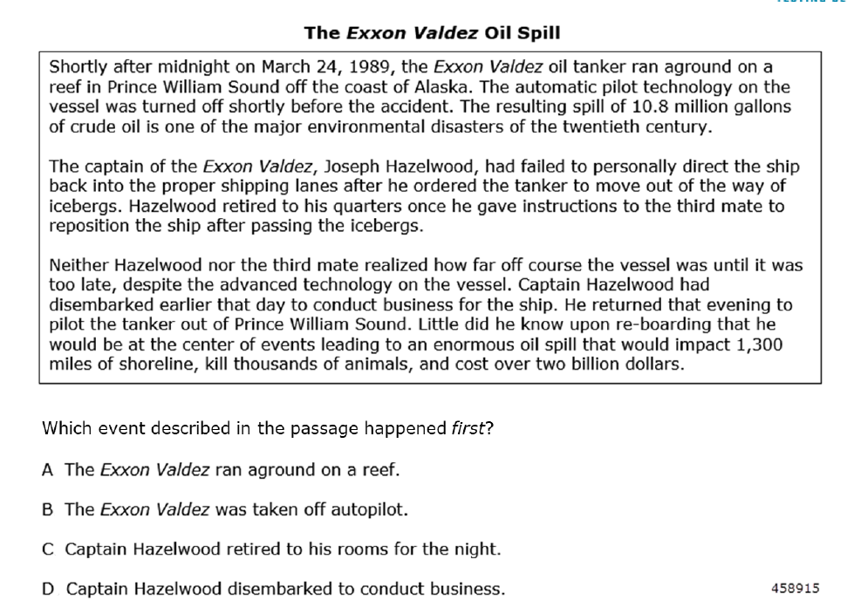
Use Sample Test Questions
Notes:
Relate to Real-World Examples:
Current Events: Discuss current events or news stories related to the topic being taught.
Everyday Life: Draw parallels between concepts and situations students encounter daily.
Local Context: Use examples from the local community or region to make learning more relevant.
Simulations and Role-Playing: Simulate real-world scenarios to allow students to practice skills in a safe environment.
2. Incorporate Student Interests:
Student-Chosen Topics:
Allow students to choose topics or projects that align with their interests.
Personal Connections:
Encourage students to share their experiences and perspectives related to the material.
Diverse Perspectives:
Introduce different viewpoints and cultural contexts to broaden understanding.

Slide 53


Slide 54

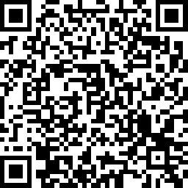
Session Survey
Your feedback is important. Please scan the QR code below to rate this session.

