Slide 1
Gen AI 101:
A Refresher for Educators
Vi Hawes
VH Ed Tech Consulting
GED® and GED Testing Service® are registered trademarks of the American Council on Education (“ACE”). They may not be used or reproduced without the express written permission of ACE or GED Testing Service LLC. The GED® and GED Testing Service® brands are administered by GED Testing Service LLC under license from ACE.

Slide 2
Agenda
Introductions
Icebreaker
Quick Intro to AI / Generative AI
ChatGPT Demo
Prompt Engineering
Choose Your Own Adventure
Strategies for Teachers
Classroom Integration Ideas
AI Resources for Adult Ed

Slide 3

Introductions
Vi Hawes, M.Ed
ESOL Instructor / Ed Tech Specialist
VH Ed Tech Consulting
Pima Community College Adult Basic Education for College & Career
✨Fun Facts!
I’ve completed both a half/full marathon!
I can speak three languages
I completed my Master’s AND gave birth to my second child, AT. THE. SAME. TIME!

Slide 4


Let’s stay connected!

Slide 5
What word comes to mind when you think of AI?
Share your response on Mentimeter

Slide 6




What is Artificial Intelligence?
It refers to systems that perform tasks typically requiring human intelligence:
Pattern recognition
Decision Making
Language Understanding
Visual Perception
Everyday Examples: Siri and voice assistants Google Maps Netflix recommendations Spam filters in email

Slide 7




What is Generative AI?
Generative AI is a subset of AI that creates new, original content based on patterns learned from existing data. Popular examples include ChatGPT, Gemini, Claude, and Copilot

Slide 8
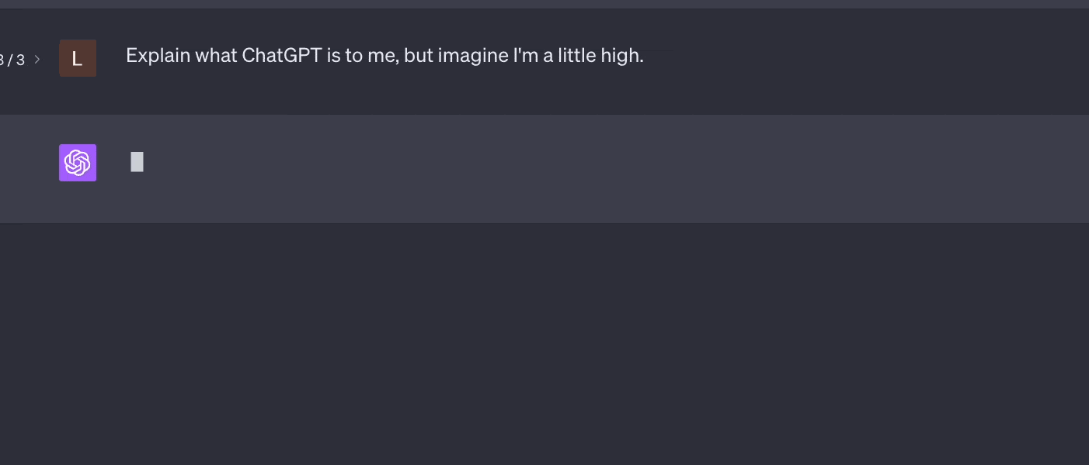
Text Generation
Essays, stories, poems, scripts, lesson plans, and conversational responses

Slide 9

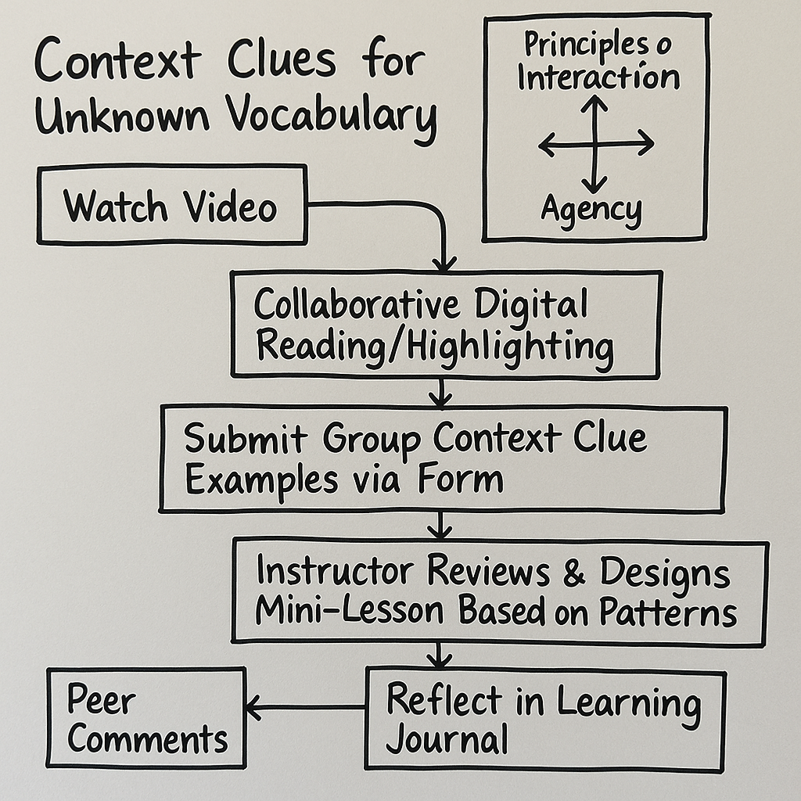
Images
Artwork, photographs, diagrams, and visual representations

Slide 10

Dialogue for ESOL students
Generated by ElevanLabs
Audio
Music compositions, sound effects, and natural-sounding speech
Podcast on Open Network Learning Environments
Generated by NotebookLM

Slide 11
Why It Matters for Educators
Speeds up lesson planning
Generate customized materials, differentiated activities, and assessment tools in minutes rather than hours.
Creates engaging content
Develop relevant, real-world examples, scenarios, and case studies tailored to your specific student population.
Differentiates instruction
Quickly adapt materials for various learning levels, language proficiencies, and learning styles within the same classroom
Assist students in development
Supports language acquisition, critical thinking skills, and provides immediate feedback on student work.

Slide 12
Ethical Considerations
Data Privacy & FERPA Compliance
Ensure AI tool use with student data complies with FERPA.
Avoid entering personal information into public AI platforms.
Bias & Inclusivity
AI may reflect biases from their training data.
Review generated content for cultural sensitivity and inclusivity
Human-Centered Education
Maintain your role as an educator.
AI is a tool, not a replacement for human judgment and empathy.
Prioritize human interactions.
Evaluate AI content

Slide 13
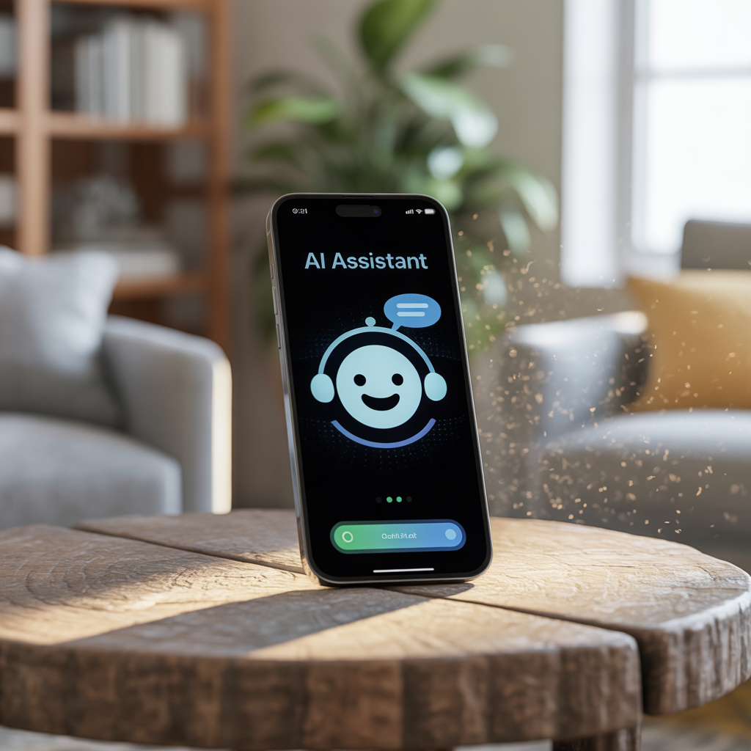
Demo Prompt
“Create a 4-week unit plan for GED reading students with weekly quizzes. Focus on informational texts about environmental science. Include accommodations for ELL students and those with learning disabilities.”
Notes:
This prompt demonstrates how to request specific educational content with parameters that address diverse student needs. The more details you provide, the more tailored the response will be to your classroom context.

Slide 14

Prompt Engineering 101
What is a prompt?
A prompt is the input you give to an AI systems: Your instructions, questions, or requests that guide the AI’s response.
Types of Prompt:
Simple: Basic questions or requests.
Detailed: Specific instructions with parameters
Iterative: Building on previous responses.

Slide 15
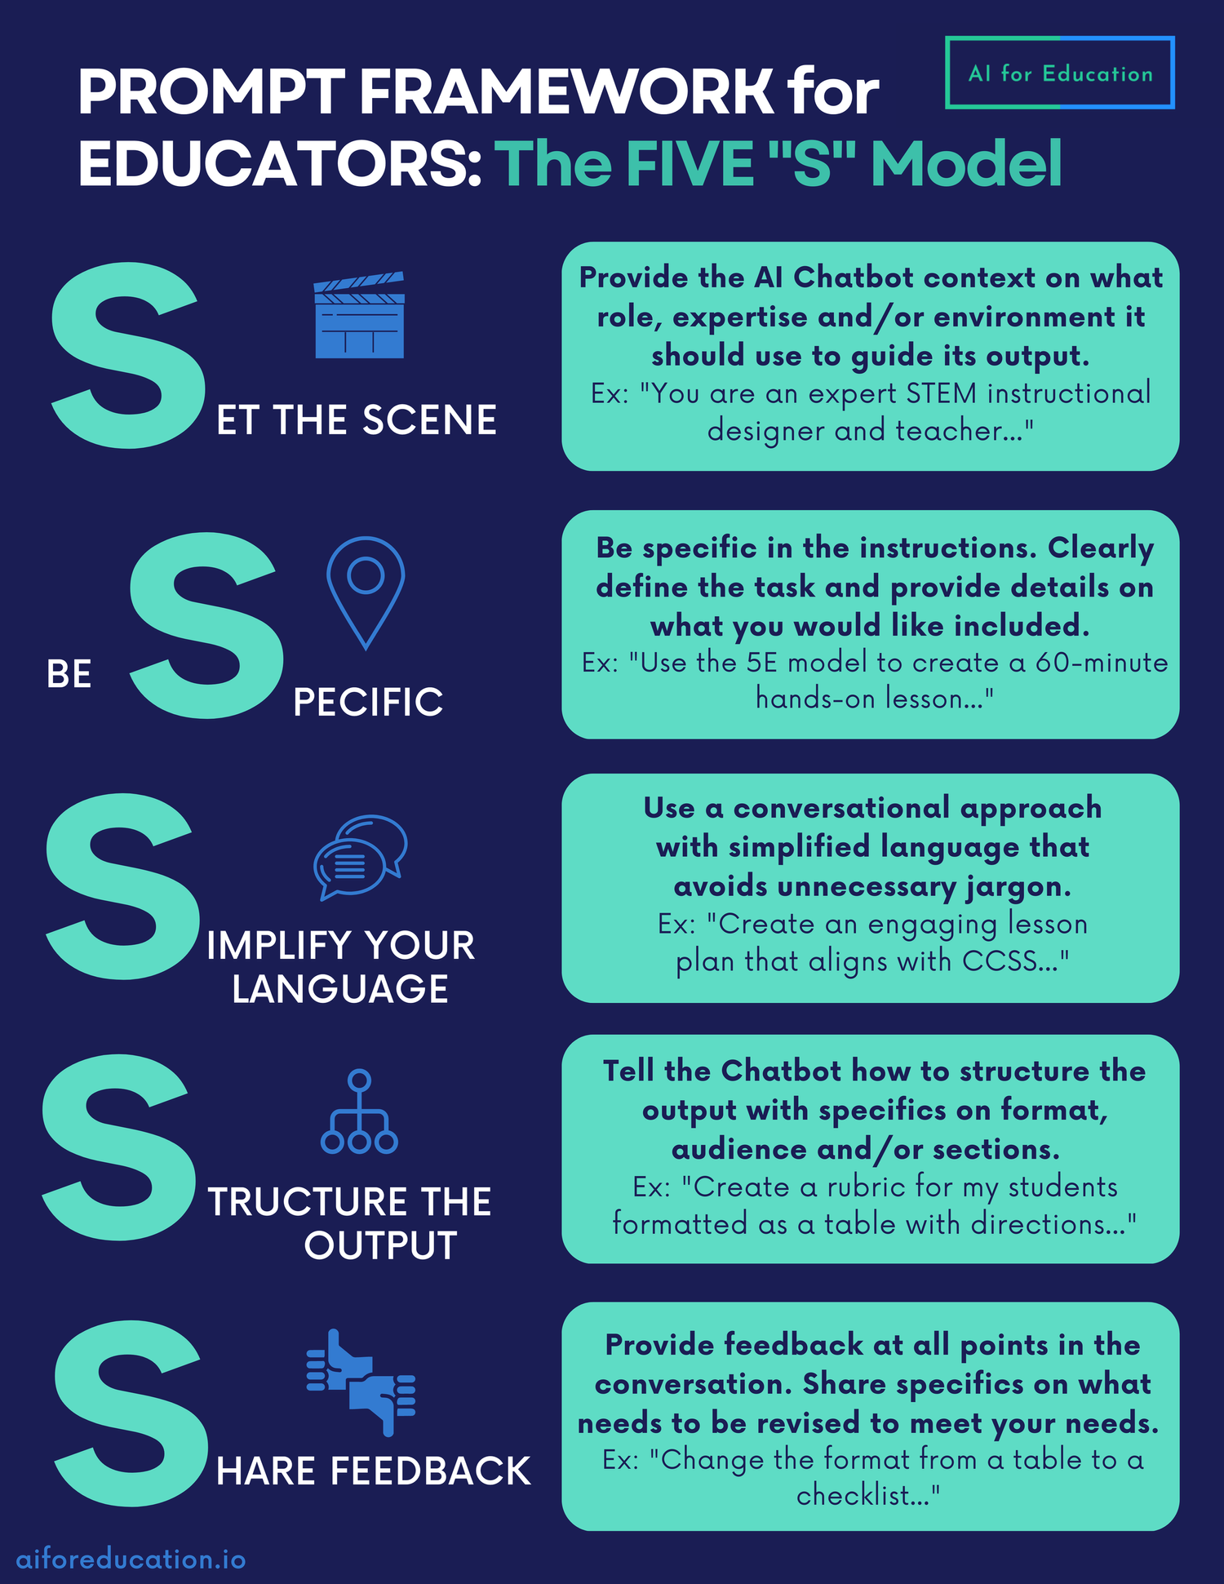

Slide 16
Choose Your Own Adventure
Go to chat.com for accessing ChatGPT without an account.
Form small groups (2-3 people)
Each group will choose one to explore ChatGPT
Use starter prompts
1
2
3
Lesson Plan Wizard
Generate a 30-min GED social studies lesson on the Constitution, including hook, mini-lecture, group activity, exit ticket.
Student Feedback Coach
Review this student’s paragraph on _____ and give constructive feedback in 3 bullet points. [find a student’s work]
Assessment Generator
Create 5 multiple-choice questions (with answers) on solving linear equations.

Slide 17
🗨️Reflection
How did ChatGPT’s response compare to what you expected?
Where might this tool save you the most time in your current teaching / administrative responsibilities?
What are your next steps for implementing AI tools in your classroom?

Slide 18


Strategies for Teachers

Slide 19
The last thing you want to do is explore a new tool on top of teaching and other tasks.
Explore ChatGPT when you’re not teaching.

Slide 20
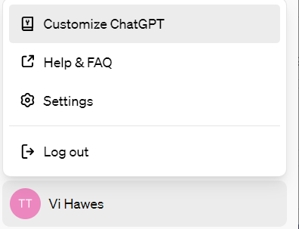
Strategies for Teachers
2. Turn ChatGPT into YOUR assistant.
Add custom instructions to ChatGPT. This allows you to share anything you’d like ChatGPT to consider in its response.

Slide 21
Custom Instruction Ideas
TEACHERS:
NRS Level and subject
Course objectives and outcomes
preferred lesson length
content standards
pedagogical/andragogical approach
class size
inclusion practices and accommodations
assessment preferences
ADMIN / LEADERSHIP
Your role or title
School or district
Specific initiatives or strategic plans
resources that staff, faculty or students might find useful
policies and procedures at school.

Slide 22

Strategies for Teachers
3. Be detailed in your prompts.
The more details you include in your prompts, the better the responses.

Slide 23

Strategies for Teachers
4. Put on your skeptic hat when using AI.
Is the response accurate? Is it biased or misinformed?
Always fact check and cross reference information.

Slide 24

Strategies for Teachers
5. Transparency is KEY!
Establish clear expectations and policies is imperative. Determine how YOU want to use Generative AI in the classroom and how you want your students to use it.
Example:
Create a GenAI (Generative AI) policy and how it will be used in your syllabus or establish that rule at the start of class.

Slide 25
Strategies for Teachers
6. Rethink how you assess your students
Balance traditional written assignments with collaborative and project-based assessments to promote critical thinking and reflection.
Example: Diary entries, lecture summaries, discussion prompts, peer reviews,

Slide 26
Strategies for Teachers
7. Keep it human-centric.
Supplement, don’t replace human interaction.
Facilitate critical thinking and evaluation skills.
Encourage collaboration and peer learning.
Lead by example by demonstrating ethical AI use.
Continue reflection on the use of ChatGPT.

Slide 27
💡Classroom Integration Ideas
Some additional subtitle text

Slide 28
💡Classroom Integration Ideas
🧠Brainstorming Sessions
🔤Vocabulary Building
Use AI to generate diverse perspectives and ideas that students can evaluate, extend, or challenge during class discussions.
Generate contextual examples of new vocabulary words tailored to student interests to career paths.

Slide 29
💡Classroom Integration Ideas
🗨️Role-Play Dialogues
🗣️Peer Critique
Create realistic conversation scenarios for students to practice language in authentic contexts like job interviews or heath visits.
Have students analyze and improve AI-written essays, developing critical editing skills and understanding of effective writing.

Slide 30
✏️Student Activity
Debrief Questions
What surprised you?
Did the AI’s response meet your expectations?
Would you use ChatGPT’s advice?
Prompt Options:
Ask for a healthy meal plan on a budget of $50 per week.
Create a personalized study plan for the GED math section.
Find strategies to improve English speaking skills for job interviews.
Shareout Formats:
Pair-share discussions
Popcorn responses to the whole class
Digital Padlet contributions
Small group reflections

Slide 31




Build Student Agency
Teach Evaluation Skills
Encourage Ethical Use
Let Students Build Prompts
Scaffold with AI Support
Notes:
Teach Evaluation Skills
Guide students in critically assessing AI responses for accuracy, bias, and completeness.
Encourage Ethical Use
Discuss appropriate boundaries for AI use in academic and professional contexts.
Let Students Build Prompts
Allow students to develop their own prompting skills through guided practice and refinement.
Scaffold with AI Support
Design assignments where AI serves as a learning partner rather than a replacement for student work.

Slide 32
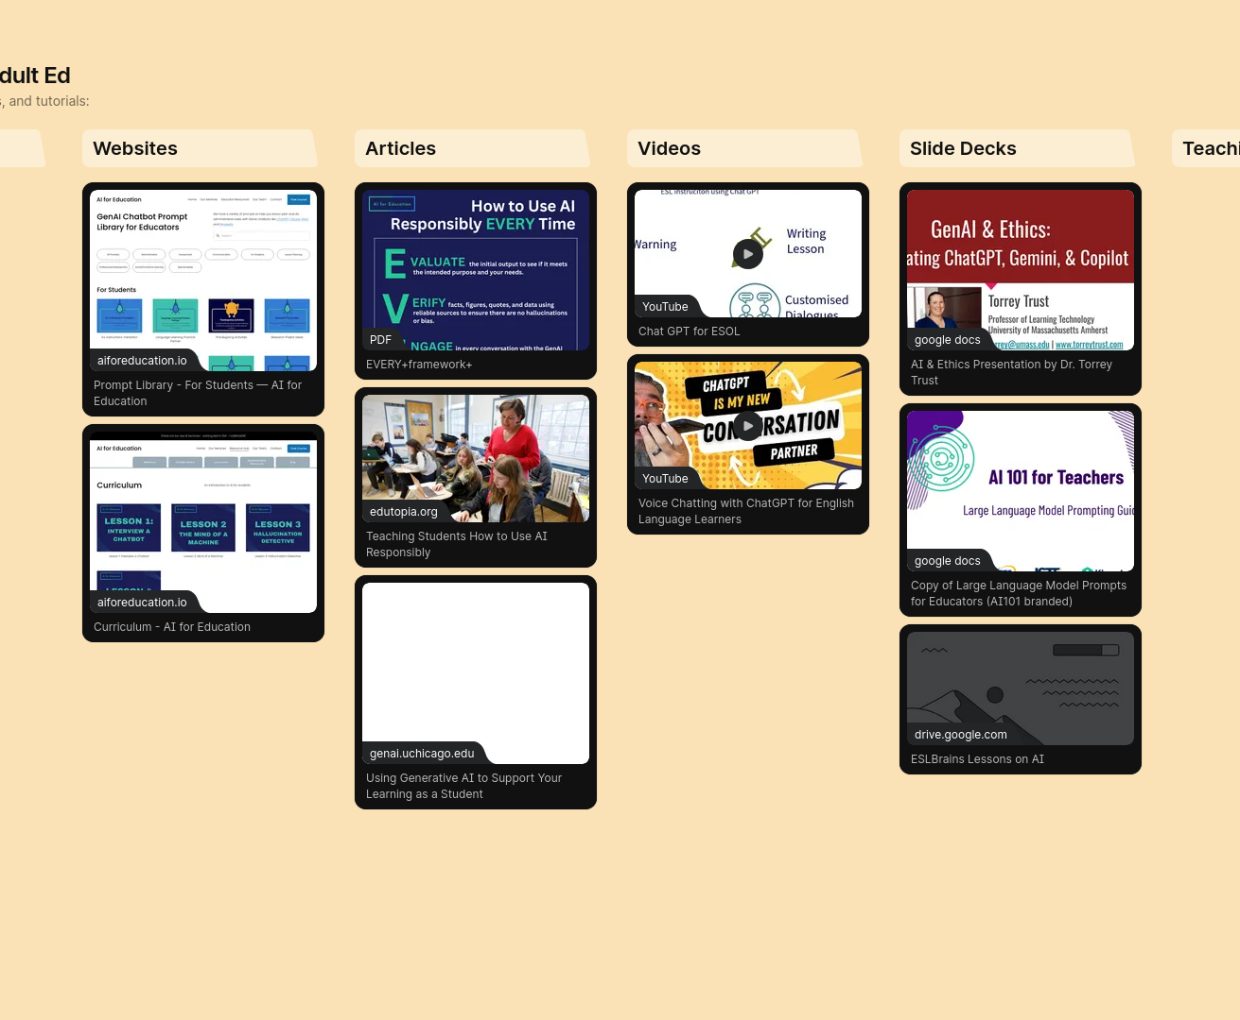

AI Resources for Adult Ed Padlet📲
Contribute to the Padlet and explore other resources from your fellow colleagues!
https://bit.ly/airesourcesforadulted
Notes:
padlet link: https://padlet.com/ttle5/ai-resources-for-adult-ed-19fytjxli3te11zc

Slide 33

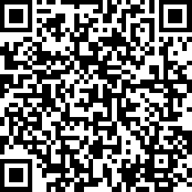
Session Survey
Your feedback is important. Please scan the QR code below to rate this session.

