Slide 1
GED® Testing Centers: Demystifying the Application and Approval Process
Natalie E. Cummins
GED® and GED Testing Service® are registered trademarks of the American Council on Education (“ACE”). They may not be used or reproduced without the express written permission of ACE or GED Testing Service LLC. The GED® and GED Testing Service® brands are administered by GED Testing Service LLC under license from ACE.

Slide 2


Your Presenter
Natalie E. Cummins
Client Channel Operations Manager
Pearson VUE
Natalie.Cummins@pearson.com

Slide 3
Today’s Learning Objectives
Understand GEDTS and Pearson VUE roles regarding testing centers
Understand requirements to become a GED® testing center
Understand the differences between fixed and mobile sites
Understand the different stages of the testing center approval process
Answer your additional questions

Slide 4
Background Information
GED Testing Service (GEDTS) is the creator and owner/operator of the GED® test. GEDTS is currently testing in 48 states.
Pearson VUE is the technology partner for GEDTS. Pearson VUE’s software is used to deliver the GED® test on computer.
In order to deliver the GED® test via computer, an organization must become an authorized Pearson VUE Test Center (PVTC)
To become an authorized PVTC to deliver GED testing you will need to go through an application and installation process with Pearson VUE

Slide 5


Home for GED® Educator & Testing Resources

Slide 6

Key Information
https://ged.com/educators_admins/test_admin/become_a_center/

Slide 7
Test Center Basics

Slide 8
Types of Testing Centers
Fixed – Computers stay in one place
  Public – Students self-schedule
  Private – Test center schedules students
Mobile – Computers can move around to different locations
Corrections – Can be fixed or mobile; designed to serve justice-involved or adjacent

Slide 9
Fixed GED Testing Center
All fixed test centers have the option to be either:
GED Only PVTC - this means your center will become an authorized Pearson VUE Test Center and offer only the GED test from the suite of PV tests.
Full PVTC – offer the GED test and other computer- based certification exams offered via Pearson VUE
GED Only requirements are more relaxed.

Slide 10
What is a Mobile Testing Center?
A mobile testing center is a set of testing laptop computers and other necessary equipment that can be deployed in a remote location to deliver the GED® test. They are almost always GED-only.
Mobile testing centers are usually created as “satellites” of existing fixed testing centers (exceptions may apply).
Mobile testing is most commonly used to serve jails, but it can be very valuable for public testing needs.

Slide 11
Becoming a GED Testing Center -- Costs
The following aspects of Test Center creation are FREE:
Application
Software
Test Administrator Certification
The Enhanced Security Protocol (ESP) Security Kit costs approximately $450 (flat rate from Pearson VUE; you may source the cameras and digital signature pad yourself)

Slide 12
Becoming a GED Testing Center -- Compensation
Public test centers receive Channel Compensation. This is a portion of each test taker’s exam fee.
Each exam delivered by Pearson VUE offers different compensation.
In most states, standard compensation for the GED® exam applies, which is $5.00 for each scheduled hour of testing per test-taker. This works out to about $10.00 per exam.

Slide 13
GED Only PVTC Centers: Key Differences
Laptops ARE allowed (must meet minimum tech specs)
The Test Administrator computer can be a laptop, but it must be locked to the admin’s desk via a locking cable when GED® testing is occurring.
https://www.pearsonvue.com/content/dam/VUE/vue/en/documents/tech-specs/test-center/ged-only-technical-requirements.pdf

Slide 14
GED Only PVTC Centers: Key Differences
Lockable storage for student’s personal items is recommended, but not required. Note, students’ personal items must be stored outside of the testing room.
Temporary desktop partitions are allowed.
No minimum number of hours per week/month you need to be open for testing.
On a case-by-case basis GEDTS can make exceptions to standard Pearson VUE policies.

Slide 15

Key Technical Information to Review
GED Only PVTC
https://www.pearsonvue.com/content/dam/VUE/vue/en/documents/tech-specs/test-center/ged-only-technical-requirements.pdf
Please have your IT staff review
Full PVTC
Technical Requirements – Desktop Computers https://www.pearsonvue.com/content/dam/VUE/vue/en/documents/tech-specs/test-center/pvtc-technical-requirements.pdf
Please have your IT staff review

Slide 16

Technical Restrictions
  See: PVTC Test Center Technical Requirements Document
  PROHIBITED
  Mac hardware running any operating system
  Chromebooks
  Hot Spots for wi-fi
  Wi-fi (unless installing CCT software)

Slide 17

Facility Requirements
Facility Requirements
Testing room must be an enclosed room (quiet and free from distractions)
Must have a check-in desk outside of the testing room
Digital photo and digital signature for each test-taker

Slide 18
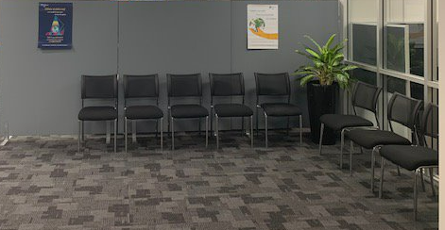
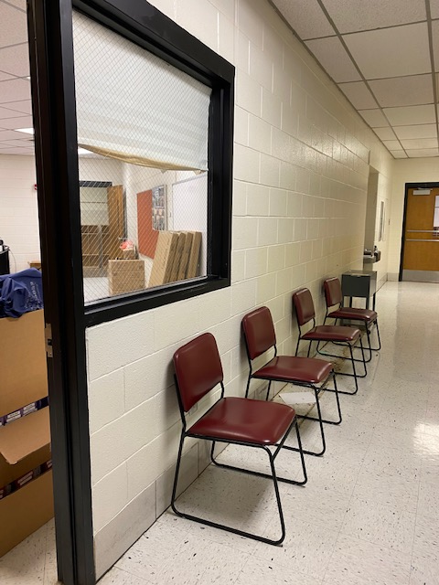
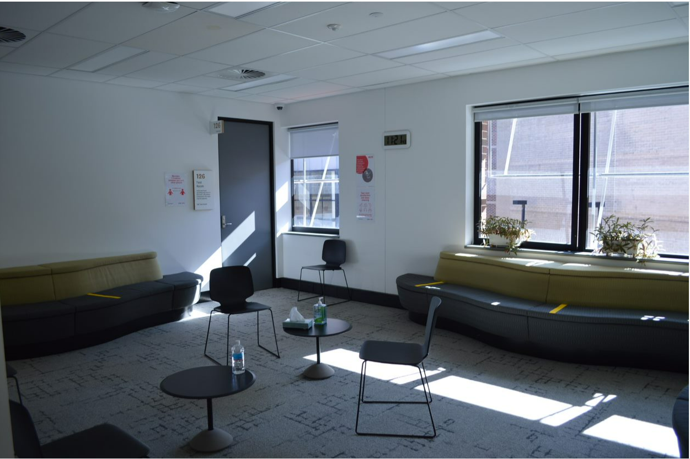
Test Center Admin Area - Reception Area
Pearson Prof. Center
GED Testing Center

Slide 19
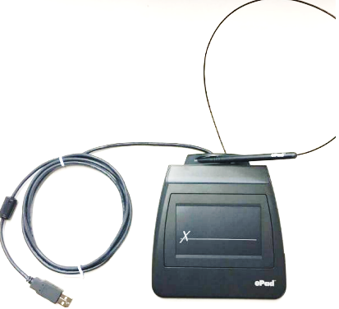
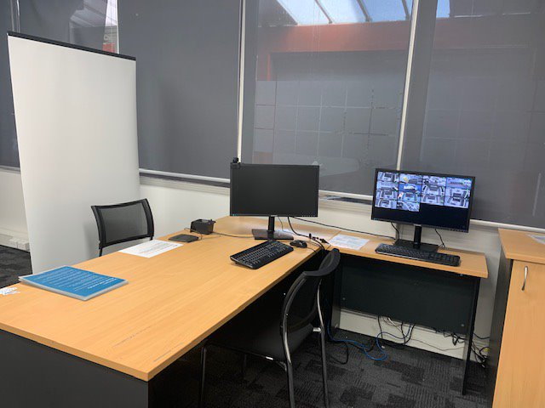

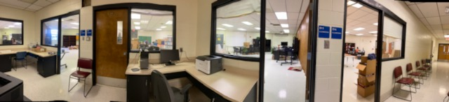
Test Center Admin Area- Check-In Desk
Signature Pad
Neutral Background
Candidate Chair
Admission Equipment
Digital Camera
GED Testing Center

Slide 20
Facility Requirements
Lockable storage is recommended, but not required (for GED only). You will need to have a safe spot to store student belongings
Each test-taker workstation must have approximately 4 feet of separation between workstations or have privacy divider screens

Slide 21
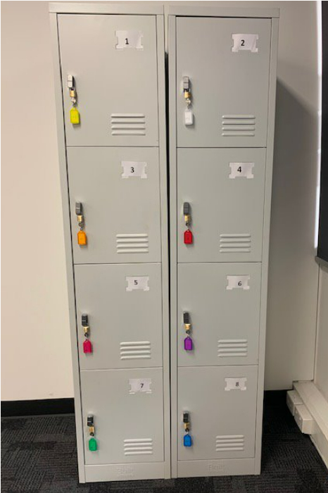
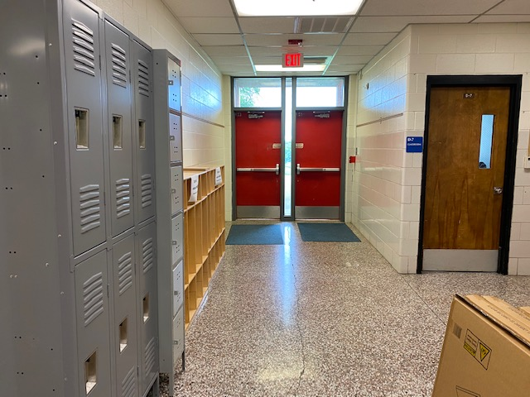
Test Center Admin Area - Lockers
Pearson Prof. Center
GED Testing Center

Slide 22
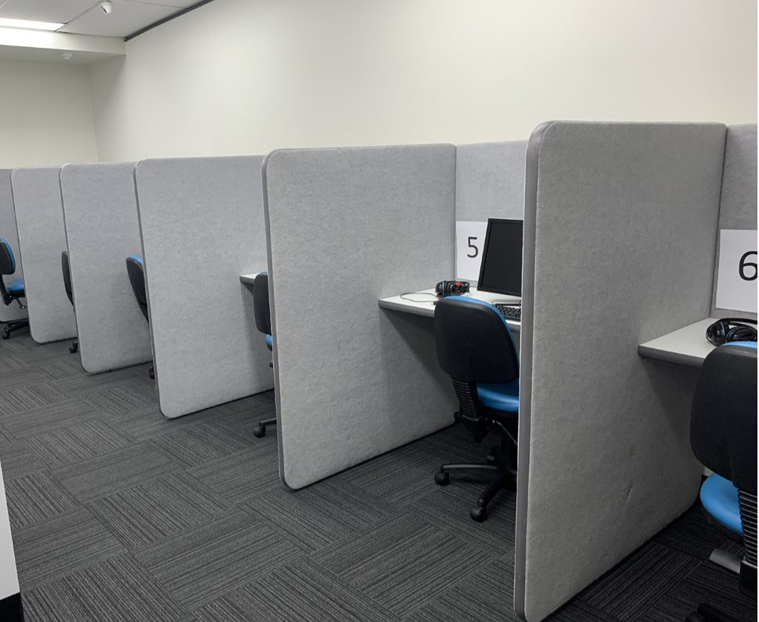
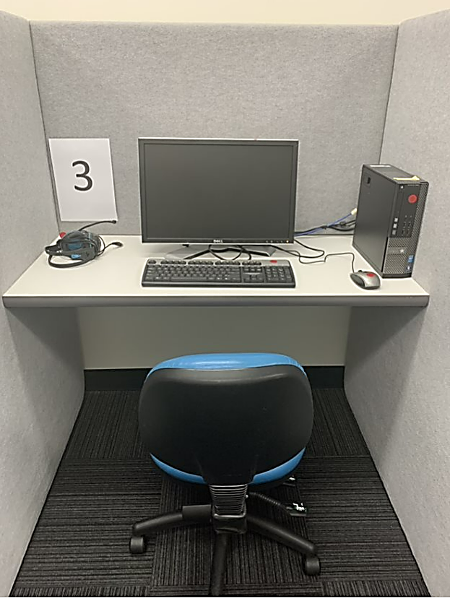
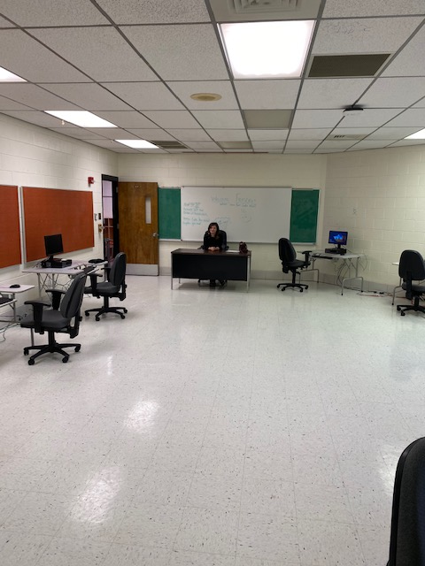
Test Center Testing Room - Workstations
Note: Partitions are not required for a GED testing center. Minimum 4 feet of distance between stations is required.
GED Testing Center
Pearson Prof. Center

Slide 23

Test Administrator (TA) Location
The TA(s) can proctor GED® testing any of the following ways:
TA is in the testing room
TA monitors room from check-in station via video surveillance
TA monitors room from outside the room via a clear glass window or wall that provides a view of all test-takers

Slide 24
TA Location
TA view should allow them to see test-taker hands during testing (this is a very common exception for the GED® test)
TA to test-taker ratio is one examiner for every 15 test-takers

Slide 25
The Application Process

Slide 26





Application Process
Application
Site Agreement and Quality Approval
Software Installation
Test Administrator Certification
Activation and Testing

Slide 27



Application Phase
1. Test center completes PV online application found here: Test center application // Become a test center // Pearson VUE
2. Test center completes state-based application, if required.
3. Pearson VUE contacts SRM for approval.
4. SRM verifies approval with the state’s GED Administrator (if not already known).
Throughout this process the SRM from GED Testing Service and the CCOM from PV will remain involved and help solve any issues that may arise.

Slide 28
Site Agreement and Quality Approval Phase
There are two next steps:
Test center must review and sign the Pearson VUE Test Center Agreement.
Test center must upload & submit digital photos of their test center and those photos must be approved by the Pearson VUE Channel Quality team.
Photo Checklist

Slide 29
Photo Checklist Tips
Current pictures
Label your pictures as directed
Submit “test day ready” photos (Stage it like you’re trying to sell your house!)
If you’re applying for GED exceptions, show the space as it would be used with those exceptions.
Note: A special accommodations room is NOT required.

Slide 30
Software Installation Phase
You will receive a Welcome Email from Channel Care with lots of links! Please note that you have 30 days to install the software.
Your IT staff (with full local admin rights) will need to be involved with installing the necessary software. VUE Support Services (VSS) will be available to troubleshoot if needed.

Slide 31
Software Installation Phase
Security kit – All non-corrections test centers must purchase a security kit which consists of 2 digital cameras and digital signature pad.
  Security kits can be purchased via Pearson VUE or elsewhere as long as test center purchases specific model of camera/pad. Model #s available on p. 6 of the Technology Requirements document.
  Cost of security kit is $450 if purchased via Pearson VUE (one time cost including shipping).

Slide 32
Standard vs. CCT
PV Testing Software
Standard
The test is loaded directly onto the testing stations
Cloud (CCT)
A link is placed onto the testing stations and the test remains in the cloud

Slide 33
Software Installation: Standard Software
You install the software via a provided link (tech support available but not pre-scheduled)
Periodically you will need to run software updates to keep the software up to date and secure.
If you have more than 15 test computers, you need an additional server.
Can administer test offline (no constant internet connection required)

Slide 34
Software Installation: Cloud Control Technology (CCT)
CCT software delivers the GED test with some advantages over the standard software install.
CCT software install is faster to install than the standard software (pre-scheduled with VUE Support Services)
CCT functions as a server in large testing centers with 15 or more computers.
Software updates are handled via the cloud (not manually).
Requires internet connectivity that is stable and reliable.
You must be a GED Only center in order to go the CCT route.

Slide 35
Test Administrator Certification Phase
Test Administrators must take and pass the Pearson VUE certification exam & complete a pre-activation case that VUE will send.
  Training documentation will be available after installation of the testing software.
  Training consists of text and video.

Slide 36
Activation Phase
Test center sets their available testing hours in the VUE system and runs some checks
Pearson VUE conducts a Welcome Call with each new test center in order to make sure they are ready to be activated
Site is activated and may begin testing!

Slide 37
Why Do Mobile Testing?

Slide 38
Mobile Testing Center Statistics
23%
359 Mobile Testing Centers in the US (as of July 2025)
276 Correctional
83 Non-Correctional

Slide 39
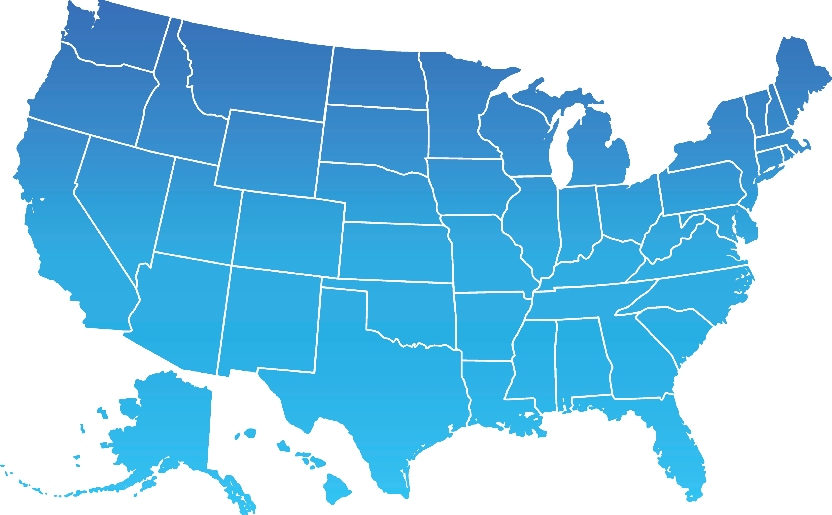
Non-Correctional Mobile Testing Centers
2
5
1
2
2
6
2
1
1
1
2
1
2
3
3
5
15
1
19
1
6
1
3
1

Slide 40
Help Address Capacity Issues
“Testing deserts” create more barriers for adult learners with transportation issues. Distance increases obstacles around:
    Cost
    Time
    Courage

Slide 41
Benefits
Reduced travel costs for students
Reduced wait time for testing
  May increase pass percentage by reducing wait time
Flexibility of testing schedule
Tests may be delivered offline
More reliable than Online Proctored (OP)
You can take testing to where your students are.

Slide 42
How to Set Up Mobile Testing

Slide 43
How to Set Up Mobile Testing
Before You Apply
Consider locations where testing is needed
Identify libraries, schools, churches, businesses, etc. which have a space suitable to meet the security requirements of GED® Testing
Determine how operating costs will be covered

Slide 44
How to Set Up Mobile Testing
One-Time Costs
ESP Kit (digital cameras and digital signature pad)*
Portable storage (if no storage available on-site)
Laptops
Extra monitors, keyboards, mice
*Not applicable for Corrections

Slide 45
How to Set Up Mobile Testing
Recurring Costs
Test Administrator salary
Mileage for travel
Consider private funding sources and alternate grant opportunities to cover these costs.

Slide 46
How to Set Up Mobile Testing
Application
Contact PV Channel Sales (through your SRM)
Sign an Exhibit B as an addendum to your current site agreement (if adding to an existing test center; freestanding Mobile sites go through a deeper application)
Complete a questionnaire
Your fixed site needs to be in operation for 3 months prior to adding mobile testing (exceptions may be available)

Slide 47
How to Set Up Mobile Testing
Questionnaire
Describe the following:
  Reception and check-in area (check-in outside the testing area)
  Personal item storage (locked and outside the testing area)
  Test delivery area (distraction-free and with laptops 4 feet apart or separated by dividers)
  Monitoring (proctor has a clear view of all test-takers at all times)

Slide 48
How to Set Up Mobile Testing
Equipment
Laptops (testing and administrator); separate from any used in the fixed center
Security kit (camera and signature pad)
Peripherals (keyboards, mice, monitors)
Storage for test-takers’ personal items
Storage/transportation for laptops and peripherals
GED Only Technical Requirements (pearsonvue.com)

Slide 49
How to Set Up Mobile Testing
Software
After the Site ID is assigned, you will receive a link to download and install software
Be sure you have someone available who has local admin rights to your computers

Slide 50
Mobile Testing Implementation Flow
Identify areas to conduct testing that will satisfy security needs.
Contact Pearson Sales to set up an application.
Sign and return the Exhibit B.
1
Procure equipment based on Pearson specs.
2
3
Install software to laptops.
Certify additional Test Administrators, if necessary.
4
Begin Testing.

Slide 51
More Mobile Testing Details

Slide 52
More Mobile Testing Details
GED® test may be delivered offline
Download tests to the Admin Computer where internet is available
Connect Admin Computer to Testing Computers at the testing site
Deliver the test
Upload the scores when the Admin Computer is connected again to the internet (ideally within 24 hours)

Slide 53
More Mobile Testing Details
Minimum 1 testing computer (maximum 15)
Mobile testing can be as simple or complex as you like!
It can be customized to fit your budget.

Slide 54
More Mobile Testing Details
Set your own testing hours
Mobile testing centers are Private by default
Testing hours are not visible to test-takers in their GED.com accounts
You can test with extreme flexibility and responsiveness

Slide 55
More Mobile Testing Details
Register test-takers directly in Registration Manager
Mobile testing centers are Private, and test-takers cannot see these centers in their GED.com accounts
The Test Administrator registers students directly for testing, and this can be done immediately before testing

Slide 56

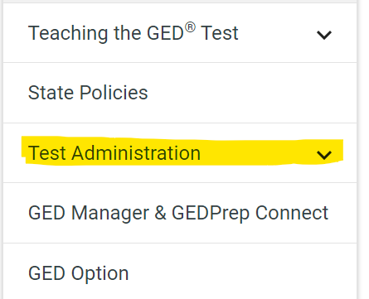
Other Information
GED.com
  Educators and Admins
    Test Administration
General Information about Testing Centers
GED Only Technical Requirements (pearsonvue.com)

Slide 57


Communications
Be on the lookout for emails from multiple entities within Pearson VUE: Sales, Quality, Care, VSS, etc.
Always feel free to copy the SRM and CCOM on your communications with Pearson VUE

Slide 58
Questions?
Natalie E. Cummins
Client Channel Operations Manager
Pearson VUE
(859) 285-7099
Natalie.Cummins@pearson.com

Slide 59

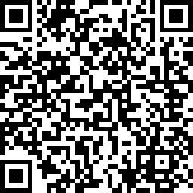
Session Survey
Your feedback is important. Please scan the QR code below to rate this session.

