Slide 1
GED® Program Update for Correctional Educators and Administrators
Scott Salesses & Mellissa Hultstrand
GED® and GED Testing Service® are registered trademarks of the American Council on Education (“ACE”). They may not be used or reproduced without the express written permission of ACE or GED Testing Service LLC. The GED® and GED Testing Service® brands are administered by GED Testing Service LLC under license from ACE.

Slide 2

Sponsor of the 2025 GED Conference Corrections Strand

Slide 3
National Update: GED® Testing in the Correctional Setting

Slide 4
National Correctional Testing Volume in 2024
 | 2024 | Compared to 2023
Test-takers | 57,257 | 4% increase
Completers | 34,981 | 4% increase
Passers | 23,686 | 4% increase
Pass rates | 68% | 68%

Slide 5
2024 Pass Rates by Subject – Correctional Test-takers
Pass Rates by Subject Area
Math: 71%
RLA: 76%
Science: 83%
Social Studies: 79%

Slide 6
2024 Pass Rates by Subject – Correctional Test-takers
Pass Rates by Subject Area (non-correctional students)
Math: 71% (73%)
RLA: 76% (84%)
Science: 83% (89%)
Social Studies: 79% (85%)
The subject area with the biggest delta between the pass rate for correctional testers and non-correctional testers is RLA. 8% point difference.

Slide 7
Demographic Info: Correctional Testers. Data from 2023-2024.
Median Age: 32
For context, median age of non-correctional GED testers is 22.
Gender: 84% male
Highest Grade Completed:
9% finished some of the 12th grade
24% finished the 11th grade
26% finished the 10th grade
18% finished the 9th grade
10% finished less than 9th
Non-correctional test-takers:
24% finished some of the 12th grade

Slide 8
We Are Thrilled that the GED Test Has Returned to these States
Since 2022 the following states are once again offering the GED® test:
Indiana
Louisiana
Missouri
Montana
New Hampshire
New York
Tennessee
West Virginia

Slide 9
GED Testing Service National News
The GED® test is offered in 48 U.S. states, DC and internationally.
Trivia: name the 2 states who don’t currently offer the GED test?
Approximately 17% of GED testing in the U.S. occurs in the correctional setting.
We launched our first ever GED® app!
Learn more at GED.com
Notes:
We know time is of the essence to get NY test centers up and running with GED test delivery for students.
GED Testing Service staff, along with our partners at Pearson VUE, are working closely with test centers across NYS to provide information, answer questions, and move test centers through the onboarding process.
Please know there are 22 GED testing centers currently available for students to test at across NYS. Please visit www.ged.com for more information on locations.

Slide 10
An Overview of the GED® Test

Slide 11
The GED® Test
Available in English and Spanish
A wide array of accommodations are available
Including extended time, additional breaks, reader/recorder, private room, screen reader (JAWS) and many more
Visit the GEDTS Accommodations Information Page
The official GED® Practice test is called the GED Ready
Notes:
Here is where we talk about online vs CBT and security etc for no chrome books and test experience

Slide 12
GED® Test
Test | Time | Notes
Reasoning through Language Arts (RLA) | 150 minutes | Includes 45 minutes for extended response (timed separately) and a 10-minute break
Mathematical Reasoning | 115 minutes | Part 1 – calculator not allowed Part 2 – calculator allowed
Social Studies | 70 minutes
Science | 90 minutes
Notes:
Key Points
Available in English and Spanish
A wide array of accommodations available
Including zoom-text, alternate color palettes, Braille, screen reader, extended time, paper testing for special circumstances
The chart provides an overview of the time for each of the tests, as well as pertinent notes.

Slide 13
Variety of Item Types
Multiple-Choice
Fill-in-the-Blank
Drag-and-Drop
Hot-Spot
Drop-Down
Extended-Response
Notes:
The new GED test includes a wider variety of item types than were on the 2002 Series test. Multiple choice items continue to appear on the test as one of the key item types. Multiple choice items are a reliable method of measuring skills and knowledge at a range of cognitive levels in a standardized manner. But remember that the additional item types allow us to measure a wider range of skills and cognitive levels.
Constructed response items come in two versions – one, we call short answer, and that type can be usually be answered in a few sentences (e.g. Science), and the extended response, which requires a longer response – multiple paragraphs (e.g. Reasoning Through Language Arts)

Slide 14

Overview of RLA Test
Content - Integrated reading and writing
Close reading
Clear writing
Editing and understanding the use of standard written English (or Spanish) in context
Source texts – 75% nonfiction; 25% fiction
Passage length – 400-800 words
Range of text complexity, including texts at the college- and career-ready level
Technology-enhanced items and extended response
Notes:
Key Points
This slide provides a short overview of the content and context of the RLA Test. Review the information on the slide. For additional information, access the Assessment Guide for Educators Reasoning through Language Arts section.

Slide 15
Extended Response on RLA
An extended response item includes:
One or more source texts
Texts offer two positions on a given topic
A prompt that provides instruction on what the student is expected to do
Purpose of Extended Response
To provide test-takers with an opportunity to demonstrate:
Knowledge of writing conventions in English (or Spanish)
Understanding of what they’ve read
How well they use evidence to build arguments
Their ability to clearly communicate their thinking in their own words

Slide 16
Don’t Forget the Little Stuff
Expose students to a structured approach to the writing task and help them understand that they need to:
Write a complete response, not just a short paragraph (300-500 words)
Provide commentary on the evidence cited (explain the “why”)
Fully develop two or three ideas, rather than mention a lot of things without detail
Leave five minutes at the end for proofreading—that is one of the things evaluated
The extended response comprises 20% of the RLA score
Notes:
Key Points
[Review the bullets on the slides.]
Discuss that these are ideas on how to improve scores. Also, note that the length is not about counting words, but rather is indicates that the writing sample needs to be long enough to adequately address the prompt. A short paragraph is not enough.

Slide 17
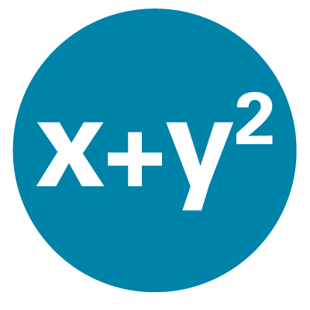
Overview of Mathematical Reasoning Test
Content
45% - Quantitative Problem Solving
Number operations
Geometric thinking
55% - Algebraic Problem Solving
Texas Instruments - TI 30XS Multiview™ (calculator allowed on most items)
Integration of mathematical practices
Formula page, symbols, and calculator page provided
Notes:
Key Points
This slide provides a short overview of the content and context of the Mathematical Reasoning Test. Review the information on the slide. For additional information, access the Assessment Guide for Educators Mathematical Reasoning section.

Slide 18

Overview of Social Studies Test
Content
50% - Civics and Government
20% - United States History
15% - Economics
15% - Geography and the World
Themes
Development of Modern Liberties and Democracy
Dynamic Responses in Societal Systems
Social Studies Practices – analyzing, thinking, reasoning
Technology-enhanced question items
Notes:
Key Points
This slide provides a short overview of the content and context of the Social Studies Test. Review the information on the slide. For additional information, access the Assessment Guide for Educators Social Studies section.

Slide 19

Overview of Science Test
Content
Life Science – 40%
Physical Science – 40%
Earth and Space Science – 20% Themes
Themes
Human Health and Living Systems
Energy and Related Systems
Science Practices – reasoning and thinking scientifically
Question types - Technology-enhanced items
Notes:
Key Points
This slide provides a short overview of the content and context of the Science Test. Review the information on the slide. For additional information, access the Assessment Guide for Educators Science section.

Slide 20
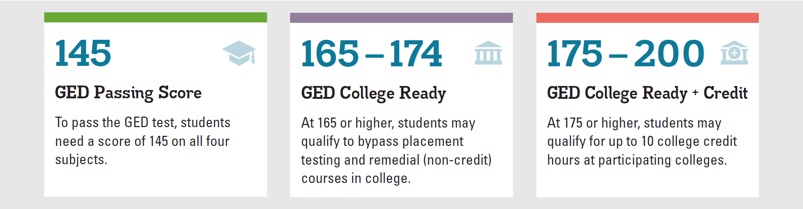
GED Score Levels Explained
GED College Ready scores improve the chances for college success.
Learn more at GED.com/collegeready
Notes:
A 145 or better in each subject will lead to a credential. However, I’ve highlighted the upper score “benchmarks” to acknowledge the opportunity for testers to either enter credit bearing course work, bypassing additional placement tests where approved (165+), OR to earn college credit, similar to AP exams for scores at or above 175, where approved.

Slide 21
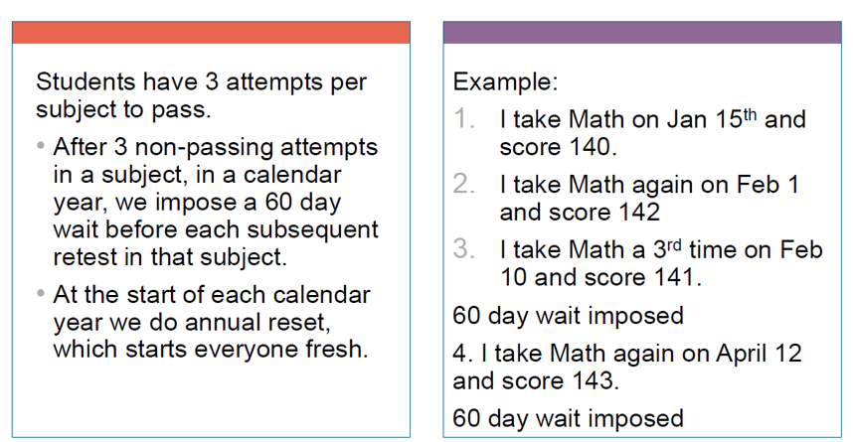
GED Testing Retest Rules

Slide 22
Retest Waiver Requests
If a Tester will be released before they can test again at your facility you can ask if it is possible that they be allowed to test earlier
Send an email to Operations@GED.com with the reason for the request and a screenshot that shows the testing activity in the Tester’s GED account
Be sure to include the Tester’s first and last name as well as their GED ID number
Be sure to state the date of their planned release

Slide 23
Important Resources and Tools for Educators
Free Classroom Materials
Teaching Resources
Professional Development
In Session Educator Newsletter
Adult Education Program Toolkit

Slide 24

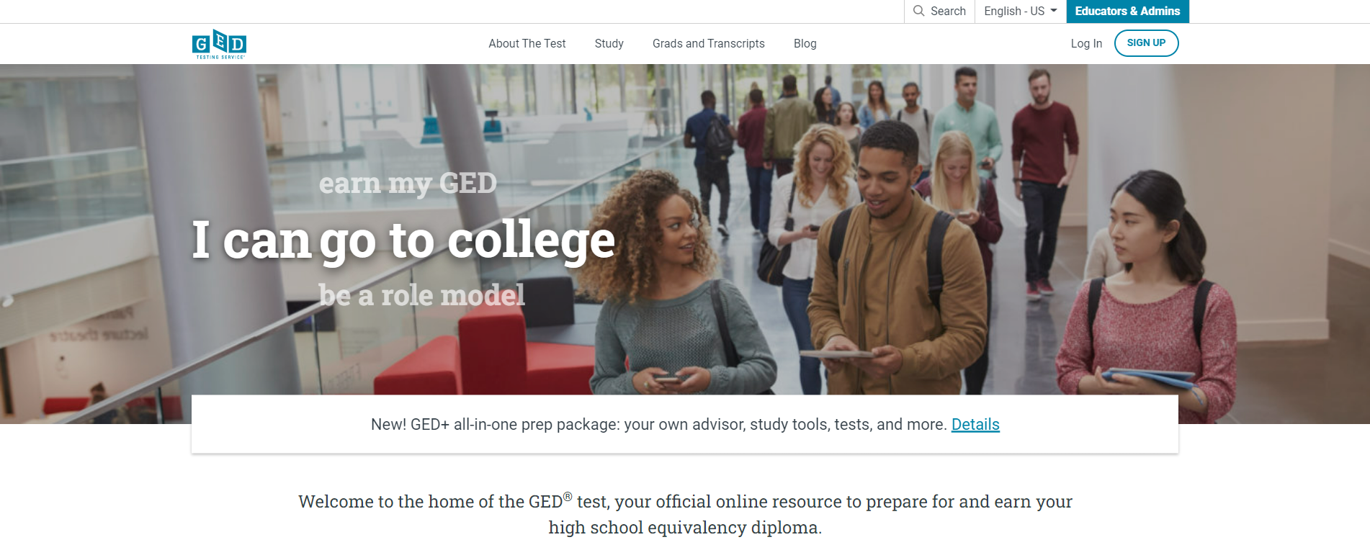
GED.com select Educators & Admins

Slide 25

Free Classroom Materials

Slide 26
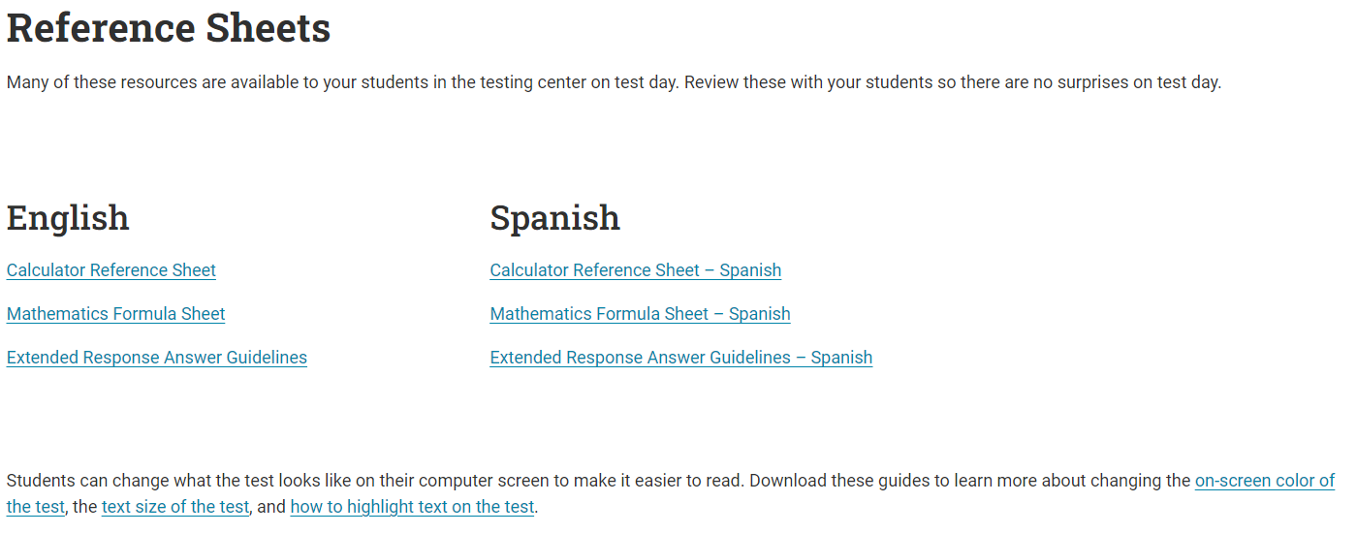
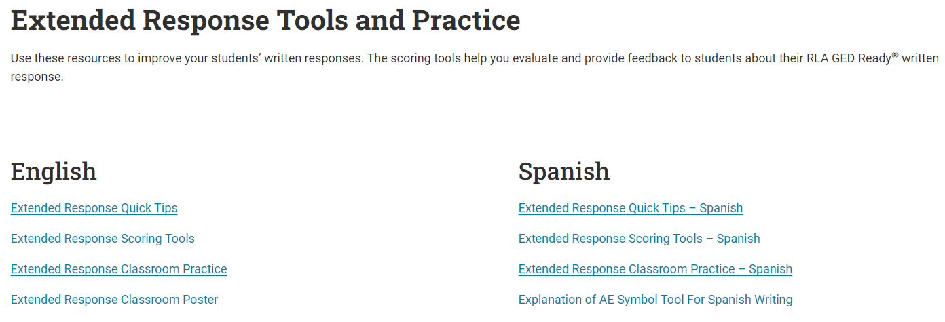
Free Classroom Materials

Slide 27

Free Classroom Materials

Slide 28
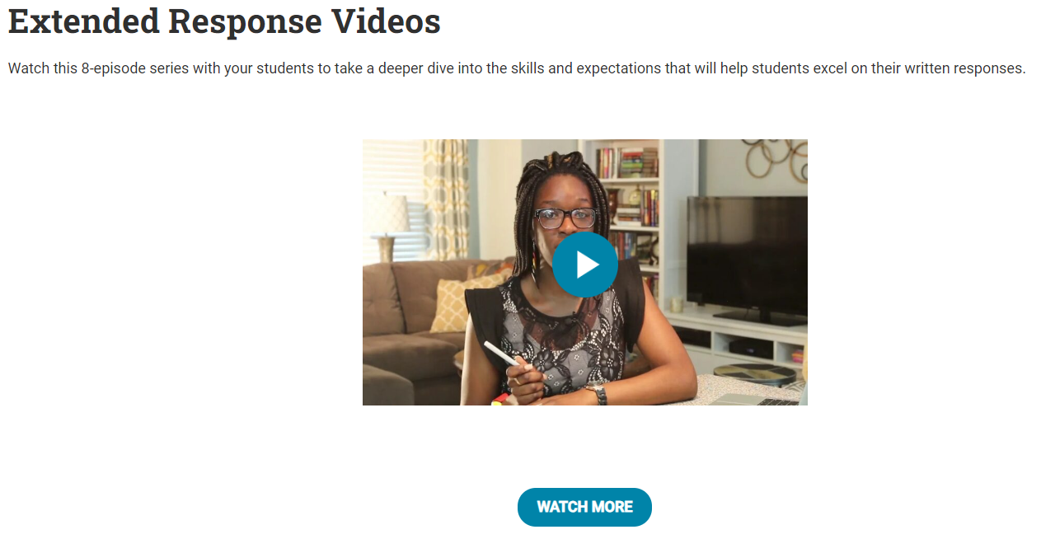
Free Classroom Materials
Also available at: www.newreaderspress.com/writing-for-the-ged-test
Or contact New Readers Press for DVDs that can be sent to your facility:
tlipke@proliteracy.org (Videos are FREE)

Slide 29

Teaching Resources
Teaching Resources

Slide 30
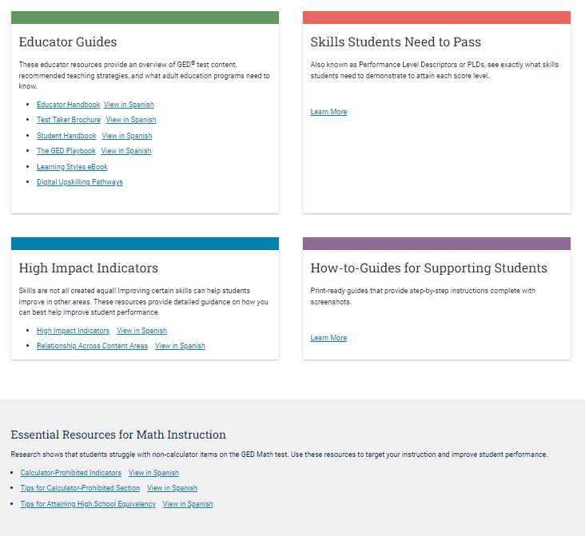
Educator Guides

Slide 31

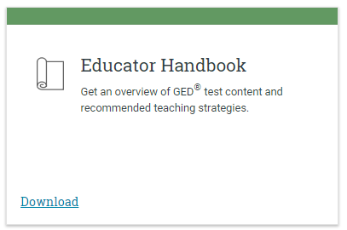
Educator Handbook
Get an overview of GED® test content and recommended teaching strategies.
In other words:
Start here!
Download at GED.com/educator_handbook

Slide 32
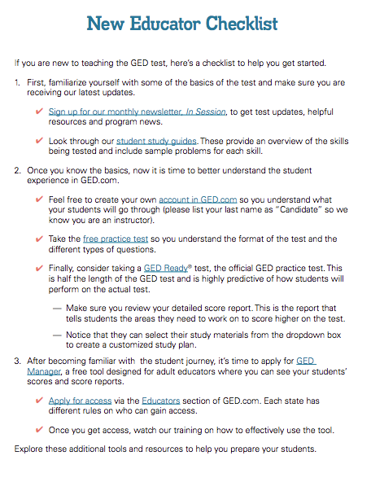
New Educator Checklist!
Our ”New Educator Checklist” is located right inside the new Educator Handbook
This is designed to help new teachers focus on the most important resources to get them up to speed on being a GED instructor

Slide 33
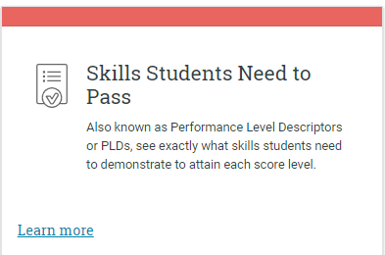
Skills Students Need to Pass
Also known as Performance Level Descriptors or PLDs, see exactly what skills students need to demonstrate to attain each score level
Four Performance Levels
Below Passing
HSE
GED® College Ready
GED® College Ready + Credit
What skills are demonstrated at each level
What skills need development to advance to the next level
PLDs

Slide 34
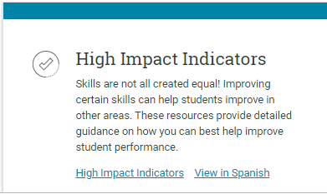
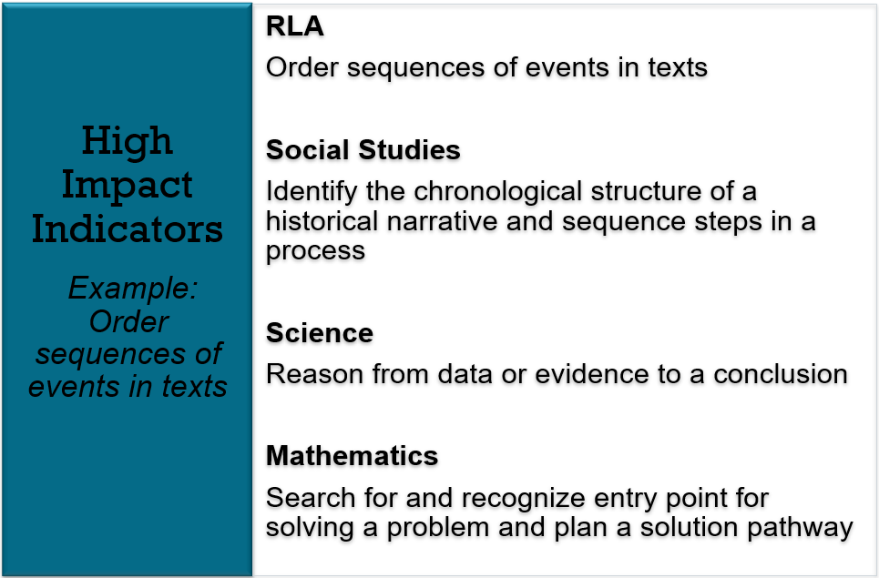
High Impact Indicators
Not all skills are created equal!
Improving certain skills can help students improve in other areas. These resources provide detailed guidance on how you can best help improve student performance.
High Impact Indicators

Slide 35
An Example
RLA
Order sequences of events in texts
Social Studies
Identify the chronological structure of a historical narrative and sequence steps in a process
Science
Reason from data or evidence to a conclusion
Mathematics
Search for and recognize entry point for solving a problem and plan a solution pathway
Notes:
Key Points
Let’s look at an example. Think for a moment about this high impact indicator from Reasoning through Language Arts –order sequences of events in texts. Yes, it is important for RLA, especially in literary texts where students need to determine what happened first, second, etc. However, it is also important in Social Studies where students may need to identify a chronological structure of a historical narrative and sequences steps in a process. In science, students need to be able to reason form data or evidence to a conclusion – a sequential approach. Even in math it is important that students are able to sequence text. Think about problem solving and the need for a student to search for and recognize an entry point and then plan an sequenced approach to solving a problem. One indicator with implications for all four content areas.
All of these indicators are related and so are the strategies that we incorporate in to our classroom. By teaching a strategy for ordering texts and ideas more deeply students can then apply this strategy or a similar strategy throughout the different content areas.

Slide 36

The Assessment Guide for Educators
Covers all content areas
Item types
Assessment targets
Guidelines for how items
are scored
More . . .
https://ged.com/educators_admins/teaching/teaching_resources/
Notes:
Key Points
Review information on the slide regarding the resource (where it is located and what is included).
Complete Assessment Guide for Educators is located at: https://ged.com/wp-content/uploads/assessment_guide_for_educators_all_subjects.pdf

Slide 37
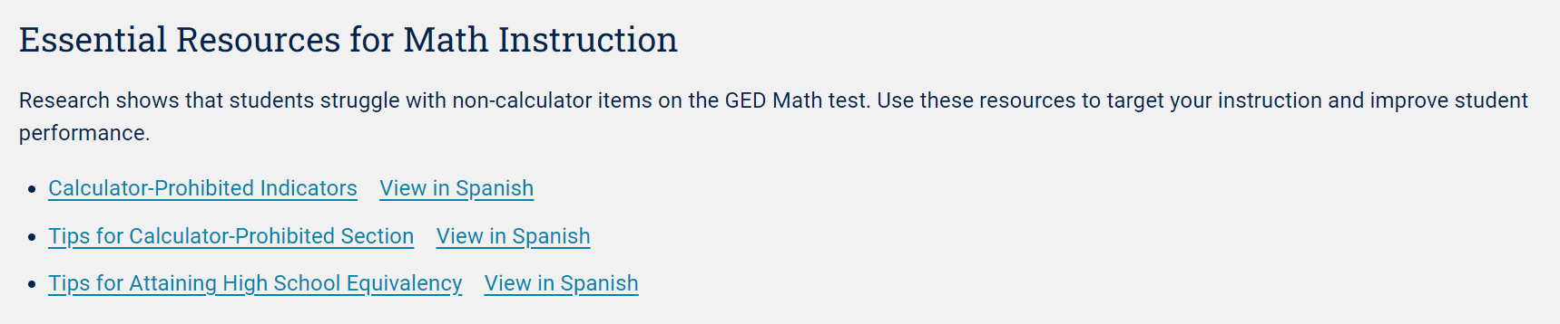
Essential Resources for Math Instruction
Research Shows
Students struggle with non-calculator items on the GED ® Math test. Use these resources to target your instruction and improve student performance.
Essential Resources for Math Instruction

Slide 38

Corrections Tab

Slide 39
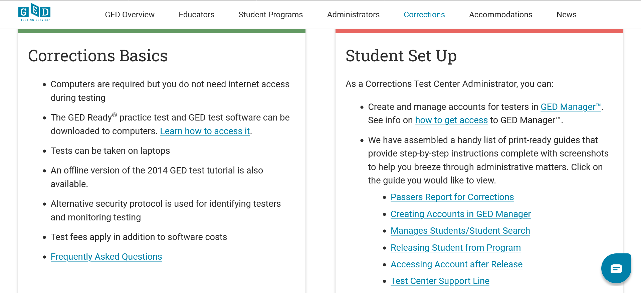
Corrections Information

Slide 40

Resources for Correctional Programs

Slide 41

GED Blog: https://www.ged.com/blog/

Slide 42


Slide 43


Slide 44
GED Manager™

Slide 45
GED Manager™
Test Administrators/ State Staff (varies by state)
Jurisdictional Access
Educators (GEDPrep Connect™)
Student Authorized View
Corrections

Slide 46




Common Capabilities Across All Three Roles:
Student Search
Student Test Activity Report
Passers Report
Student Score Reports: GED Ready™ and GED® operational tests
Notes:
Student Search allows Users to find a specific student by using any or all available filters: ie., First/last name, DOB, or GEDID (assigned when student creates their account on www.ged.com
Student Test Activity Report allows users to apply a number of filters to identify a list of students who fit within those parameters, including test activity status for GED Ready practice tests or the live exam, data ranges, exam subjects, language taken, credential status, or even student specific details such as first/last name, DOB or GEDID
Passers Report allows users to identify passers at a given test center within a requested date range
Each Report allows users to view scores, and to view score reports- giving you a pathway to remediate skills students can improve in order to improve their test performance

Slide 47

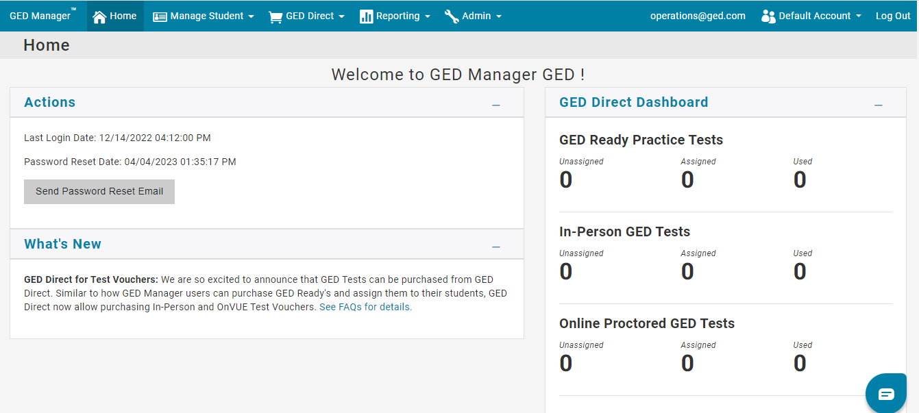

GED Manager™ Access – Home Screen
For a better experience while using GED Manager, we recommend that you open GED Manager in Google Chrome or Firefox.
Notes:
Once you are logged into GED Manager, you will see the home screen. This home screen has different tabs and sections which we will go over their functions through out this training.

Slide 48
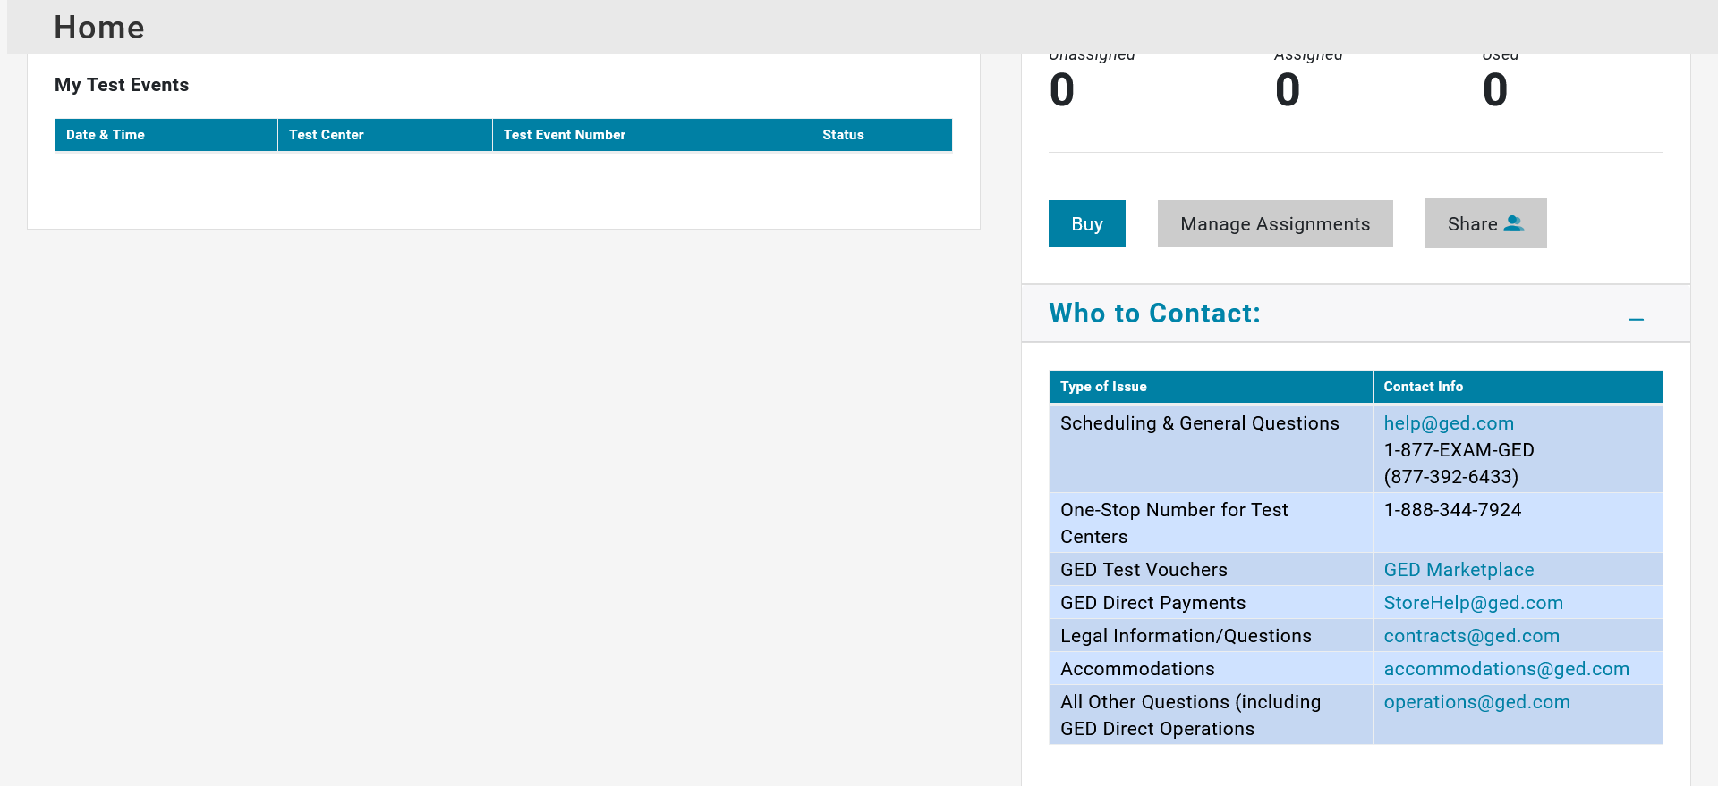
Who to Contact

Slide 49
GED Manager™ Home Page
Helpful Links
Jurisdiction Testing Policies
Corrections GED Manager Training Video
"How to Guides" for Test Centers
Student Study Guides
GED Ready ER Scoring Tool - English
GED Ready ER Scoring Tool - Spanish
Tips for successful password resets
GED Direct Info
GED Direct Training Video
Helpful Documents
GED Manager User Guide
GED Direct vs Marketplace - Bulk Purchasing
Finance and Billing Frequently Asked Questions
Instructions for Testers to Claim Their GED Account Upon Release
Manage Student/Student Search
Creating Student Accounts
Passers Report
Accessing Account After Release
Releasing Student From Program
Scheduling DOC Students

Slide 50
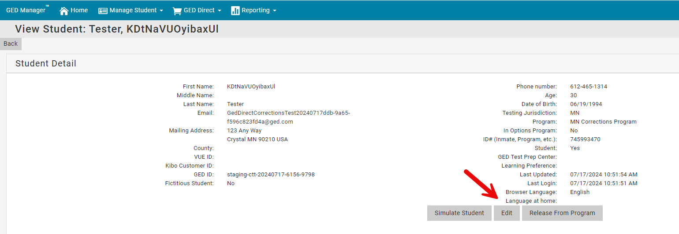
As of July 2024, Corrections Officers will be able to move a student to any Program in their Jurisdiction, even if they aren’t associated (don’t have access) to that Program.
To move a student to a different Program, from Student Detail click Edit

Slide 51
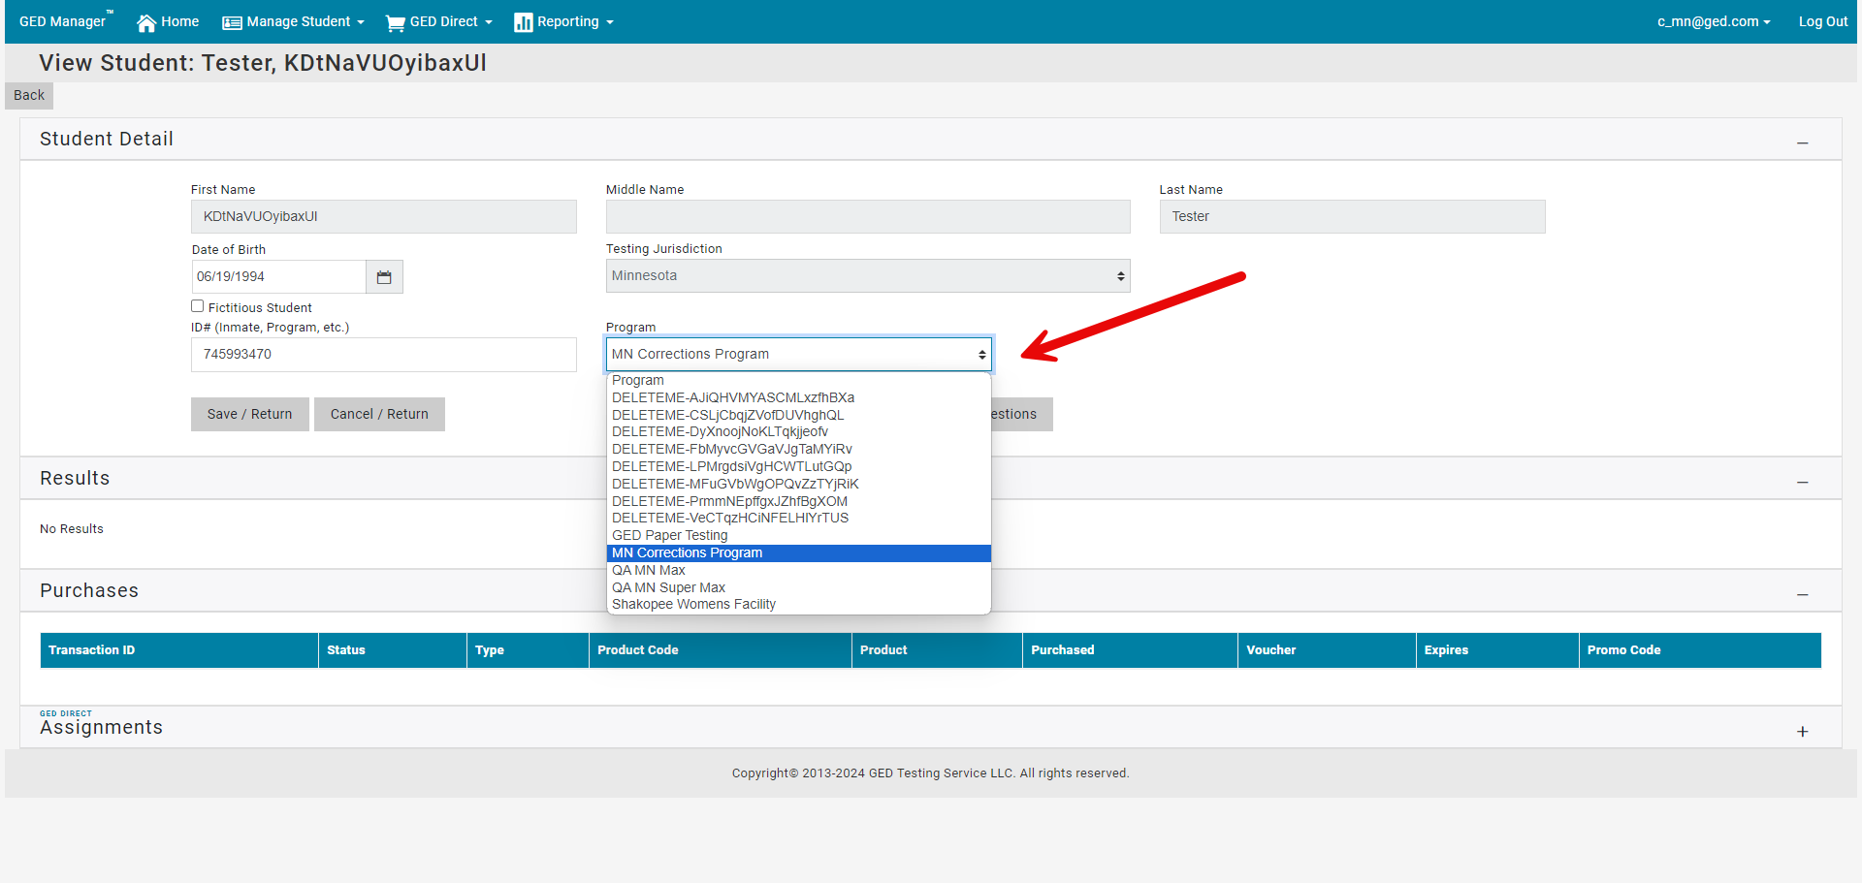
The Program dropdown will contain all Programs in your jurisdiction, even if you are not associated with the Program.

Slide 52
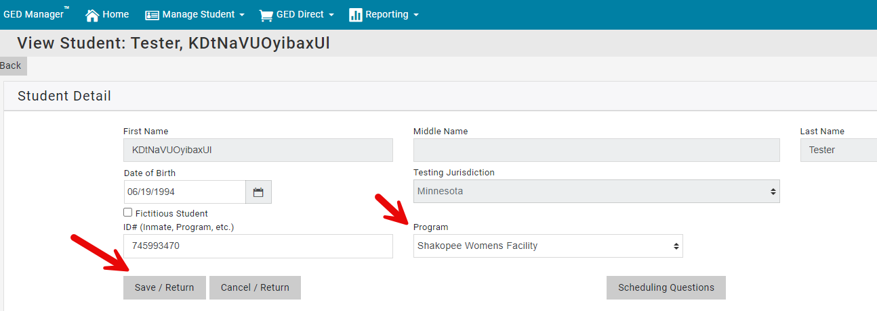
Select the Program you want to move the student into and click Save/Return.

Slide 53
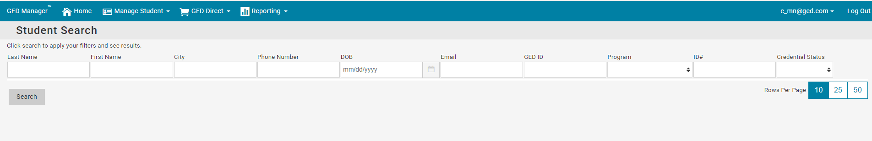
Because you no longer have access to that student (after moving them into a Program you don’t have access to), you will return to the Student Search page.

Slide 54
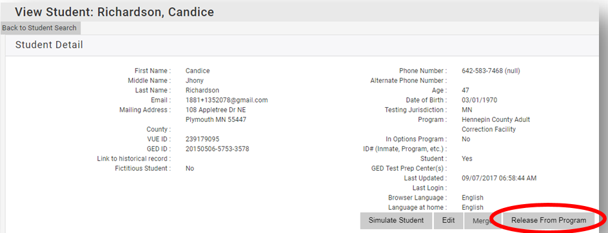
How to Release a Tester’s account from corrections
If you know a Tester is going to be released and they know what email address they are going to use, follow these steps
Locate the Tester’s account in GED Manager™. Once in their account, select the “Release from Program” button

Slide 55
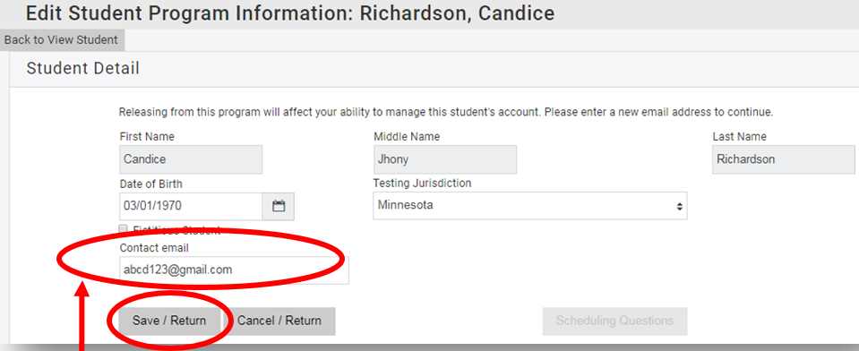
How to Release a Tester’s account from corrections continued….
Enter a valid email address for the Tester, then click “Save/Return”
Instruct the Tester to go to GED.com and click on “Log In” in the top right corner of the screen. They will need to enter their email address and select “Forgot Password”
They will then receive an email to set their password

Slide 56
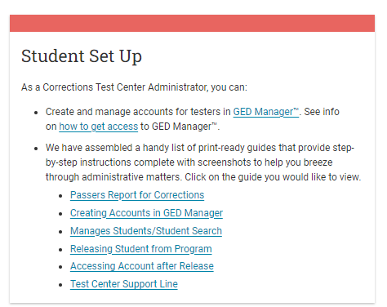
How to Guides available in our Educator Portal https://www.ged.com/educators-admins/test_admin/corrections/

Slide 57
GED Direct
A New Way to Purchase GED Readys

Slide 58

Problems to Solve
GED Ready voucher code spreadsheets are an administrative headache.
Difficult to distribute to educators
Difficult to maintain
Difficult to share codes with students (via email)
Expiring vouchers compound the headache.
Everyone spends too much time dealing with voucher codes.
This Photo by Unknown Author is licensed under CC BY

Slide 59
Solution – GED Ready® Direct
New feature in GED Manager allowing educators to purchase GED Ready tests and assign them directly to students.
Benefits:
Students access GED Ready test directly from their GED account once assigned
No spreadsheets of voucher codes to manage
No expiration dates to extend

Slide 60
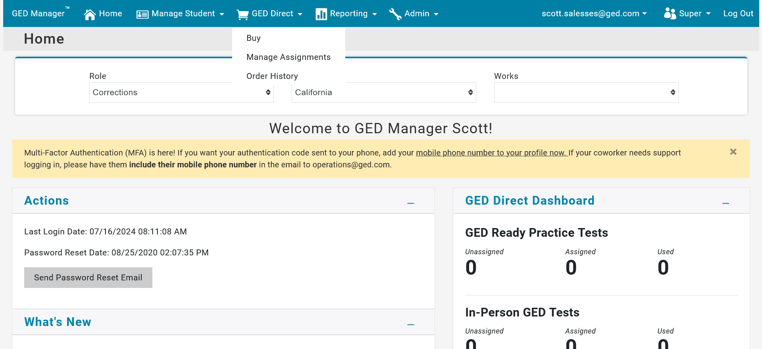

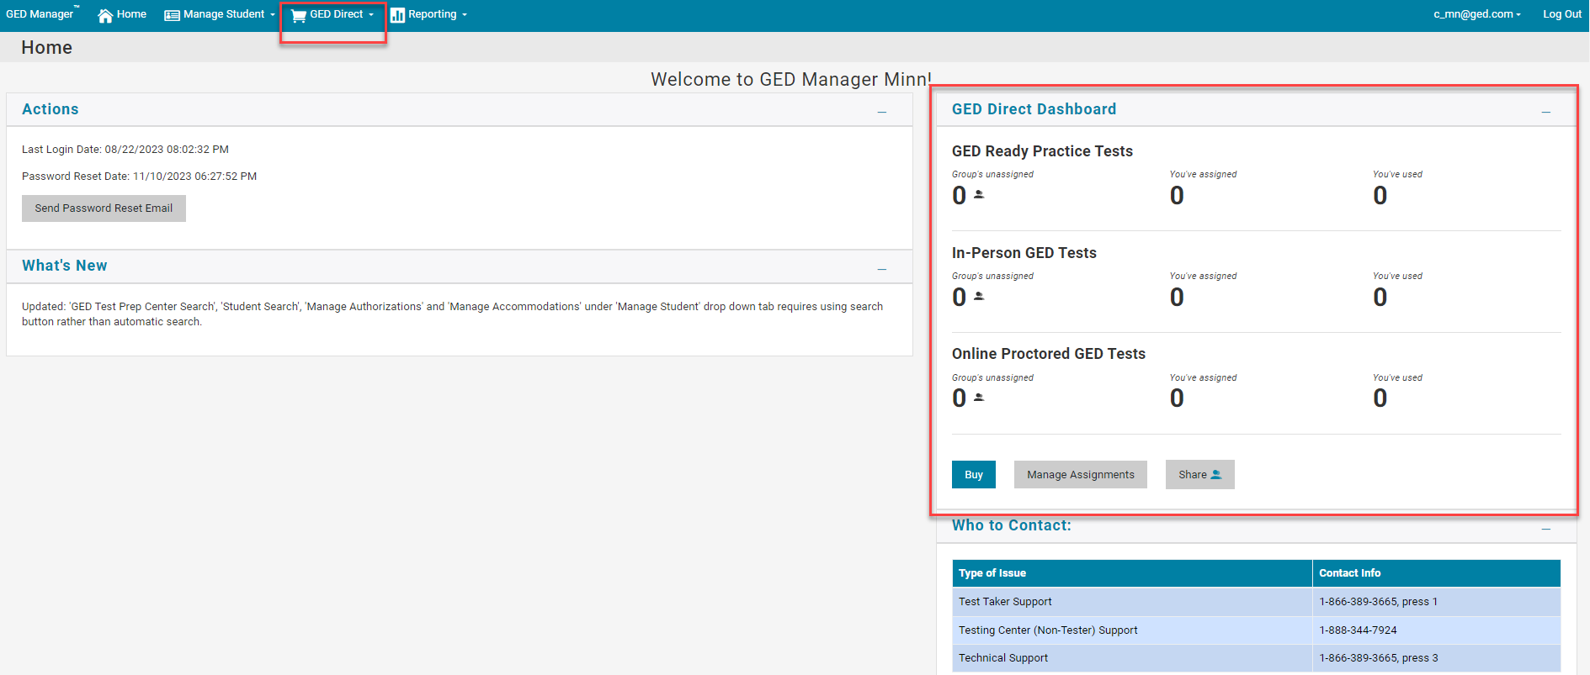
GED Direct - Corrections Officers will now be able to use GED Direct
They will see the GED Direct top nav option and the GED Direct Dashboard on their Home page.

Slide 61
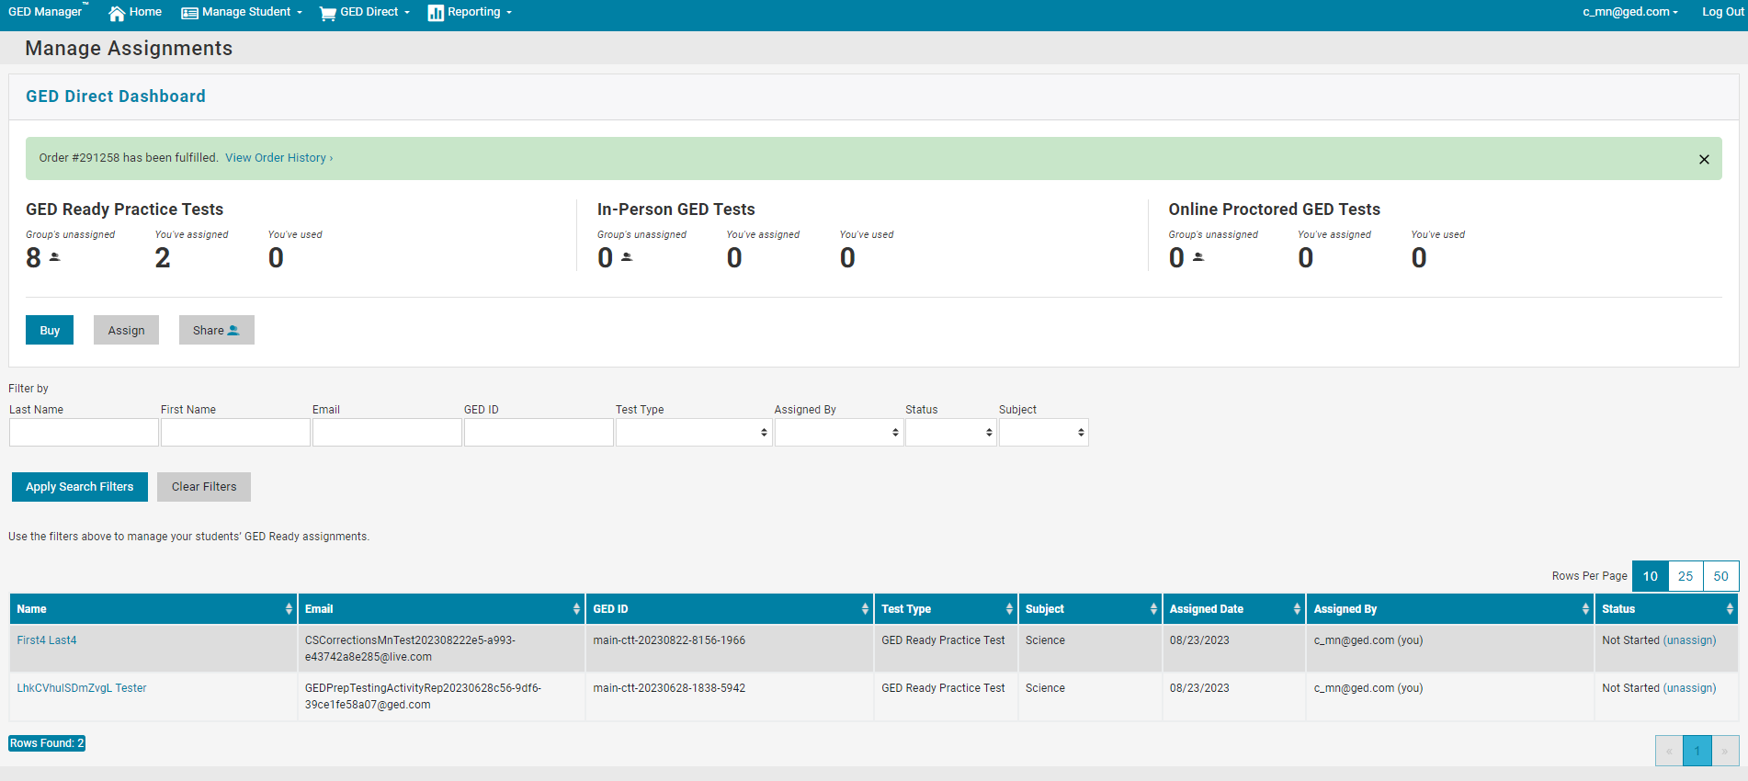
GED Direct - Corrections Officers will now be able to use GED Direct
They will be able to assign GED Ready's to their students and see all their assignments on Manage Assignments page.

Slide 62
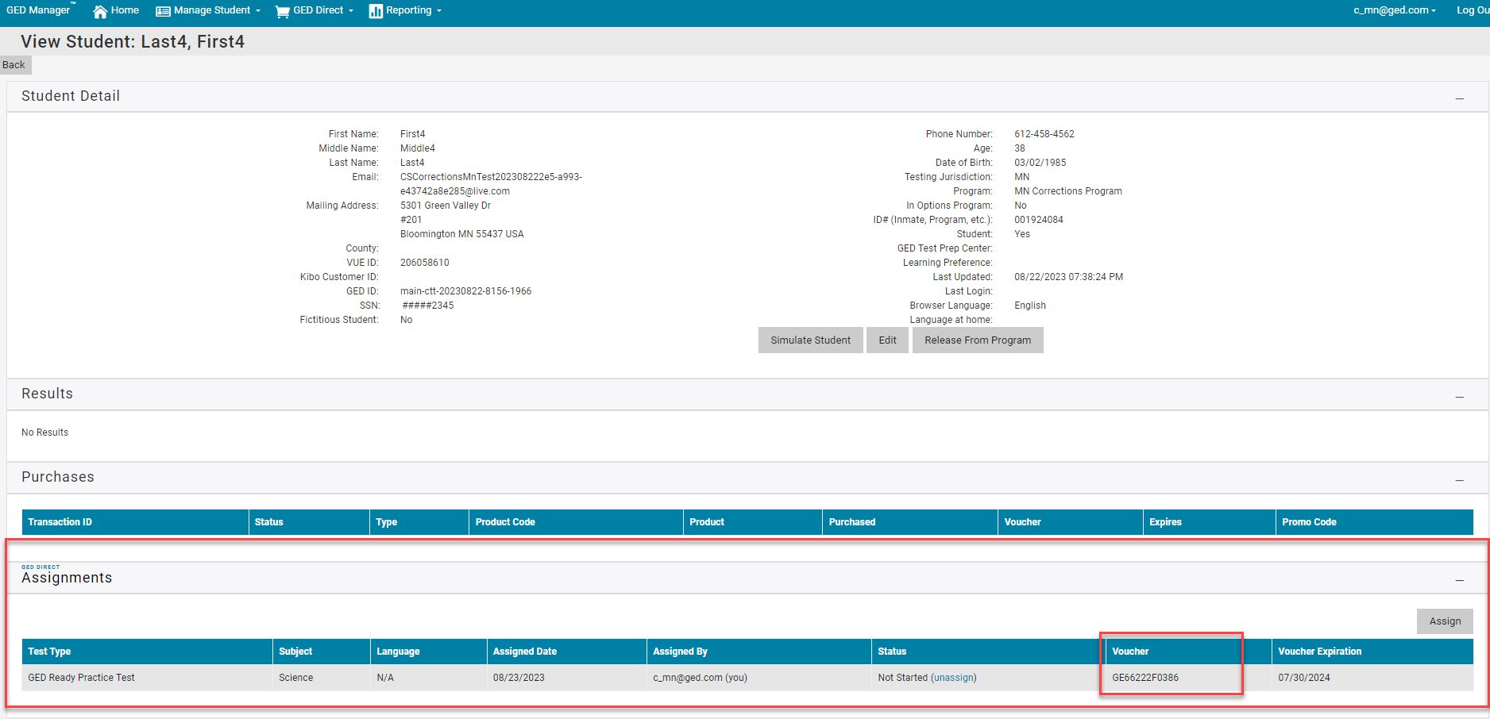
GED Direct - Corrections Officers will now be able to use GED Direct
They will be able to see the "Assignments" section on Student Detail and copy/paste the voucher from that section into RegMan when they are scheduling the student's GED Ready or GED Test.

Slide 63
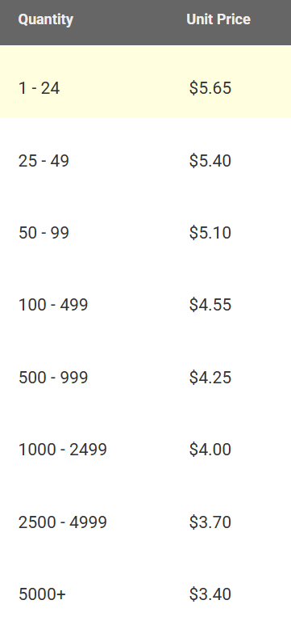
GED Direct™ Volume Discounts for GED Readys®
For comparison GED Marketplace™ unit price for GED Ready™ is $7.99

Slide 64
GED Direct
Purchasing GED Readys via GED Direct will result in correctional facilities receiving bulk pricing and considerable savings off the retail price.
Purchasing GED tests via GED Direct is not advised for most correctional facilities as the price is what the public pays and not the correctional pricing, i.e. correctional facilities do not pay/receive channel compensation thus the price per subject is $10.00 lower for corrections ($26 vs $36 for states with standard pricing).

Slide 65


GED® SUPPORTING PRODUCTS
The Aztec Learning System
Notes:
Transition In: As I mentioned, our outcomes have gained the trust and partnership of many great organizations including the GED Testing Service.

Slide 66


GED FLASH™ FOR ORGANIZATIONS Official Practice Tool
More Practice. Higher Pass Rates. The official practice tool built in partnership with the GED® Testing Service to help students pass the GED® test by providing thousands of completely aligned and vetted questions with immediate feedback.
Notes:
Transition In: GED Flash the official practice tool for the GED test. This is an exclusive product only available through us. GEDTS selected us because of the trust we have gained across the country and our top performing outcomes.
This supplemental tool was developed because the field has never had a true practice tool that allowed student to access thousands of questions that can aid them along their studies.
Teachers and learners had to rely on GED Ready or third party questions that frankly may not have been aligned.
Thus we designed and built this tool.

Slide 67

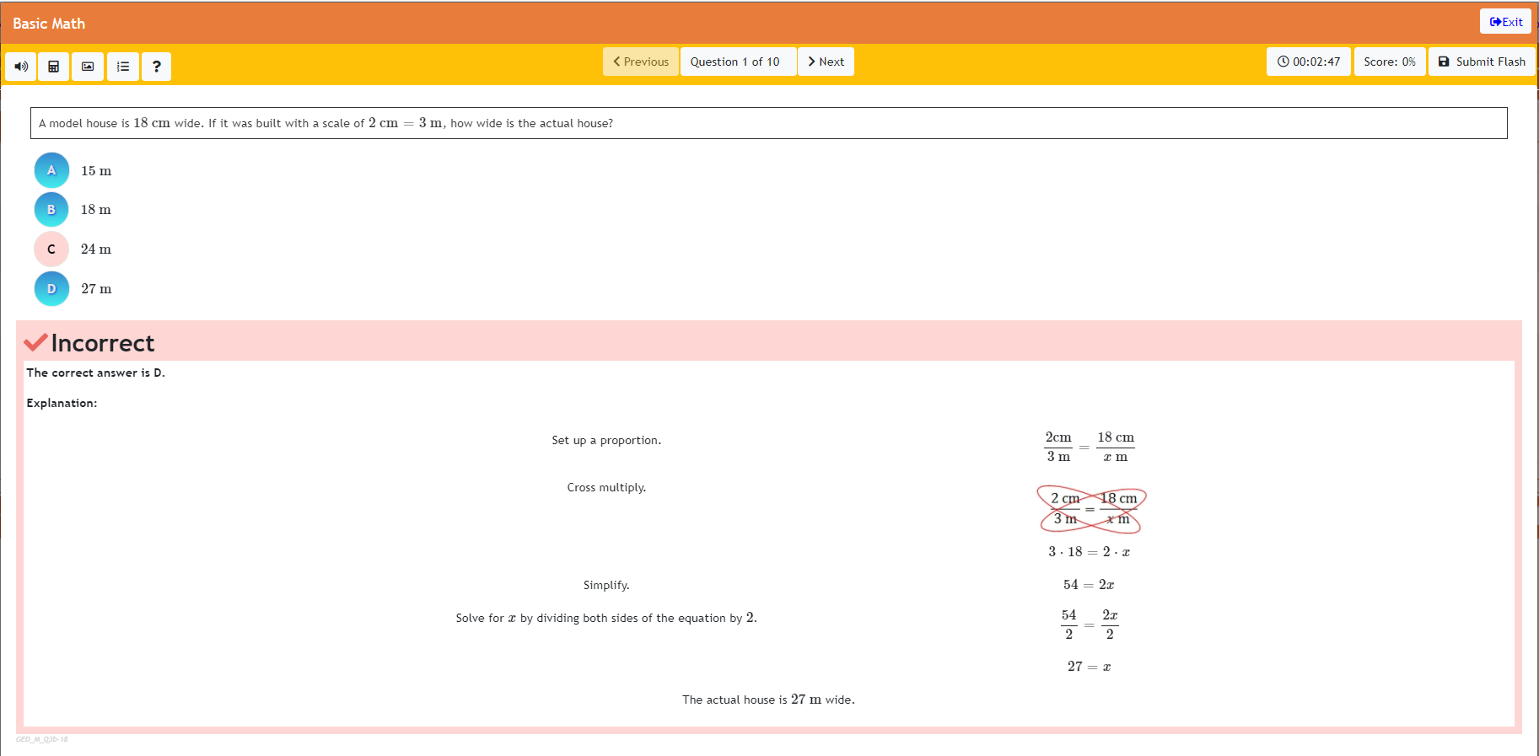
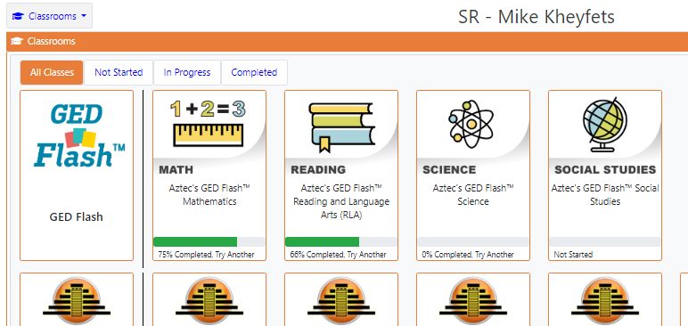
STUDENT ACCESS Practice Preparation Aligned to the Test
Aligned To GED® Blueprint
Similar experience and features to the pre-test.
Questions In All Subjects
1000s of questions across all four subjects.
Immediate Feedback
Step-by-step explanations after each question.
Easy To Use & Assign
Provide support in each subject.
Notes:
Explain the tool.

Slide 68
HIGHER LIKELIHOOD OF PASSING GED® Data Shows Increased Performance
Did You Know?
The average non-passing GED® score nationwide is a 141?
Students who practiced frequently with GED Flash™ scored on average 4 points higher on their GED® test versus those who rarely used it.
4 POINTS
Notes:
The average non passing score in the US in a 141.
4 point increase in Math would make a world of difference.

Slide 69
MORE CONFIDENCE GED® Data Shows Increased Performance
Users feel more confident about taking the GED® test after practicing on GED Flash™.
79%

Slide 70




GED PLAY™
On Demand Video Learning
On Demand Video. On Demand Learning The only on demand video learning program developed by GED Testing Service, Kaplan and Aztec Software to provide targeted video learning support across key GED® measured skills.

Slide 71
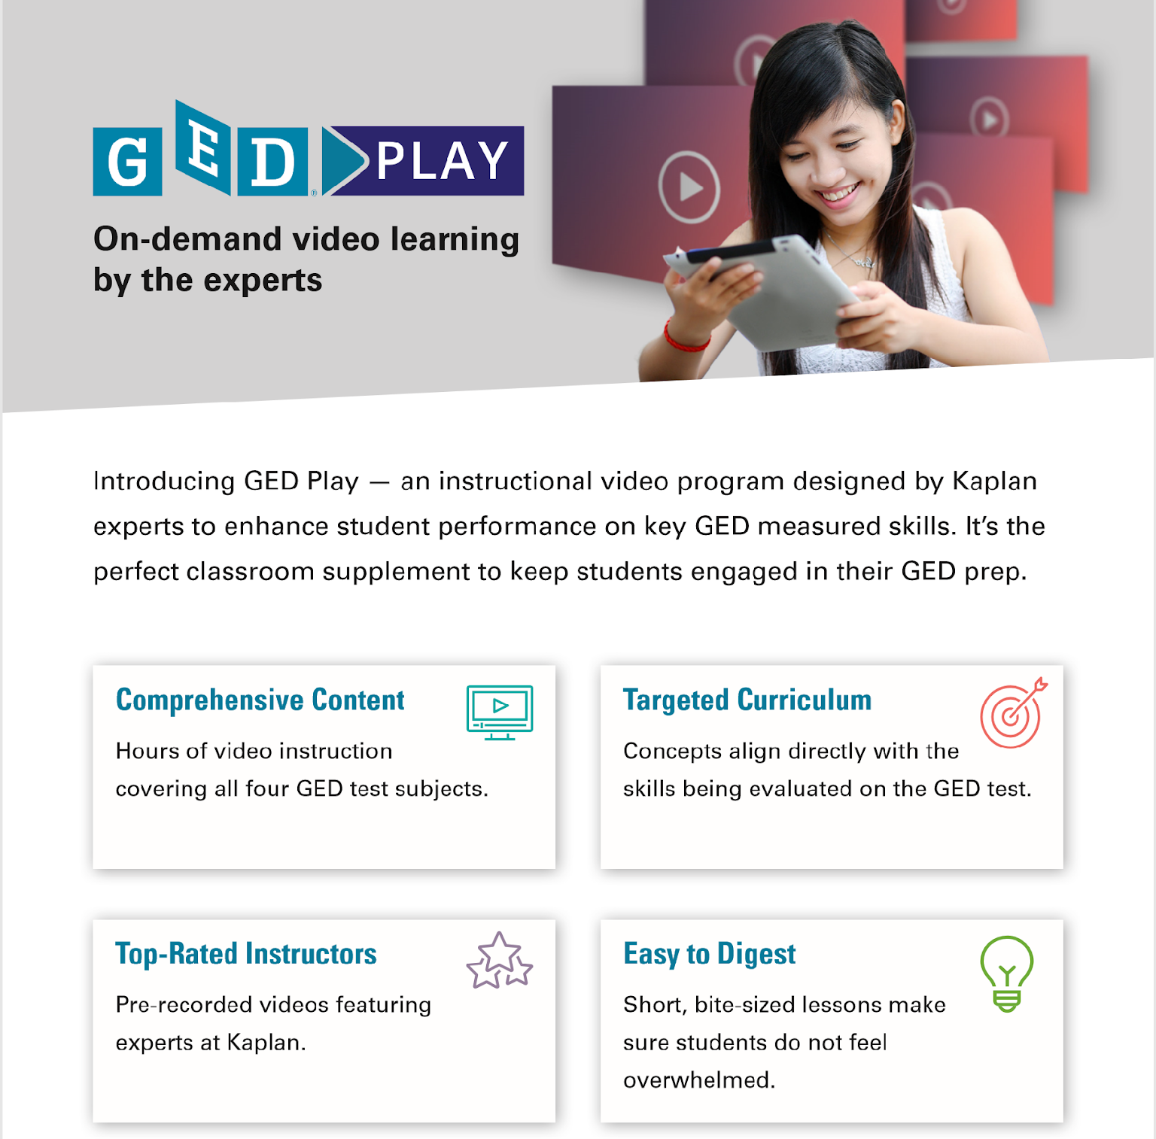
GED PLAY™ On Demand Video Learning
The Perfect Reinforcement Supplement GED™ Play was developed from our experience with GED Flash and the need for quick remediation.
Versatile Use
Can be used as direct instruction and distance learning supplement & reinforcement tool.
Alignment to GED Flash and GED® Test
Questions are aligned to and cover the key skills from the test. Also aligned to GED Flash allowing seamless remediation of specific sections.
Performance Insight
Gain insight on students’ performance and reportable information.
Notes:
GED Play provides:
Comprehensive Content – hours of video lessons covering all GED subjects
Targeted Instruction – videos focus on key GED test skills
Top Rated Instructors – Master Kaplan instructors teach the lesson
Easy to Digest: Designed to be easily digested by students.

Slide 72


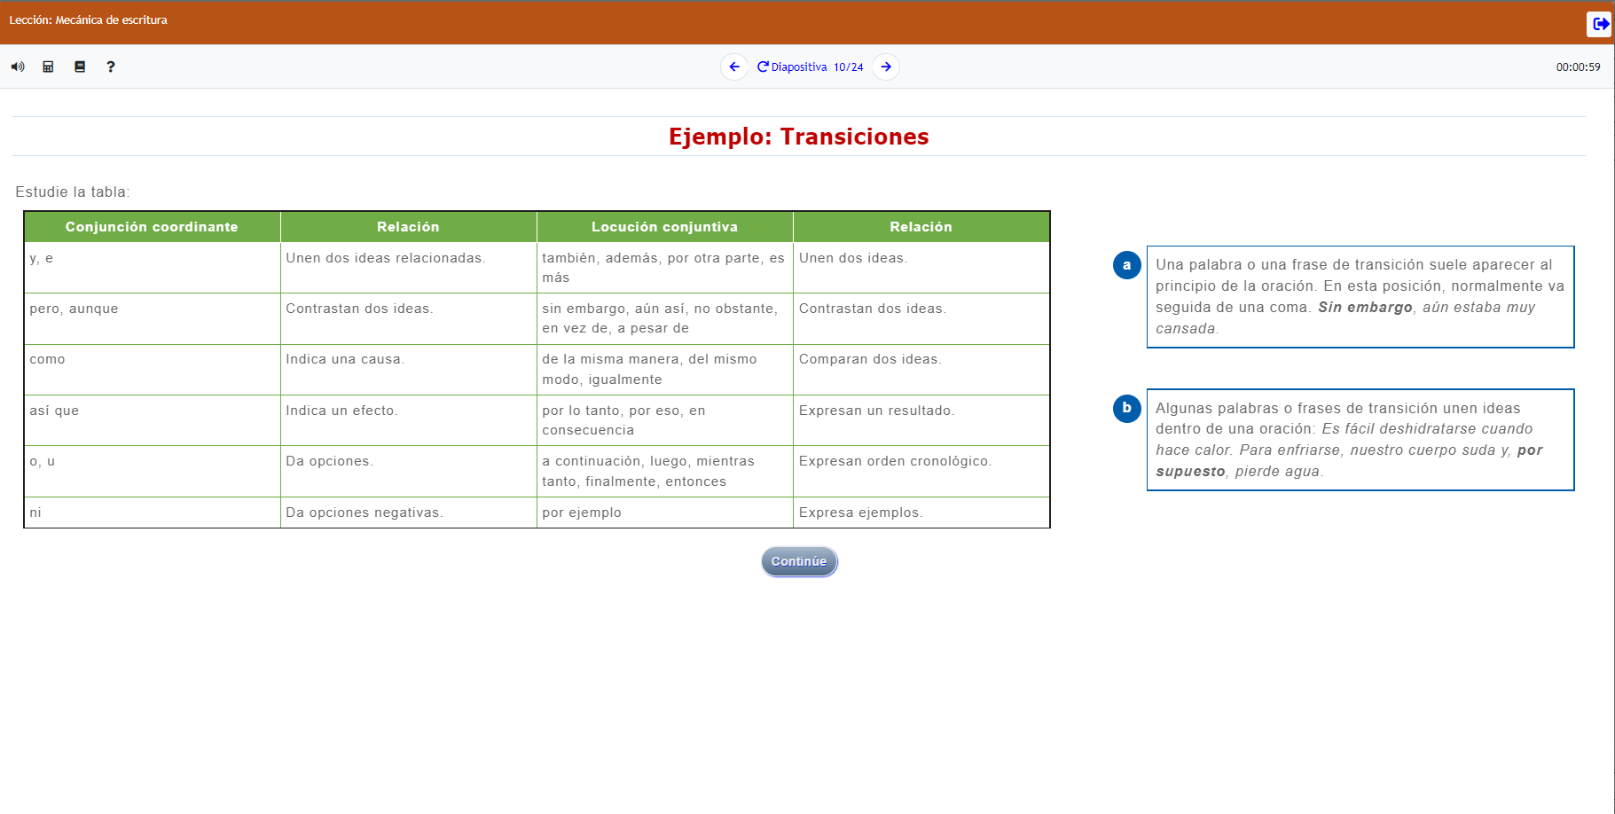
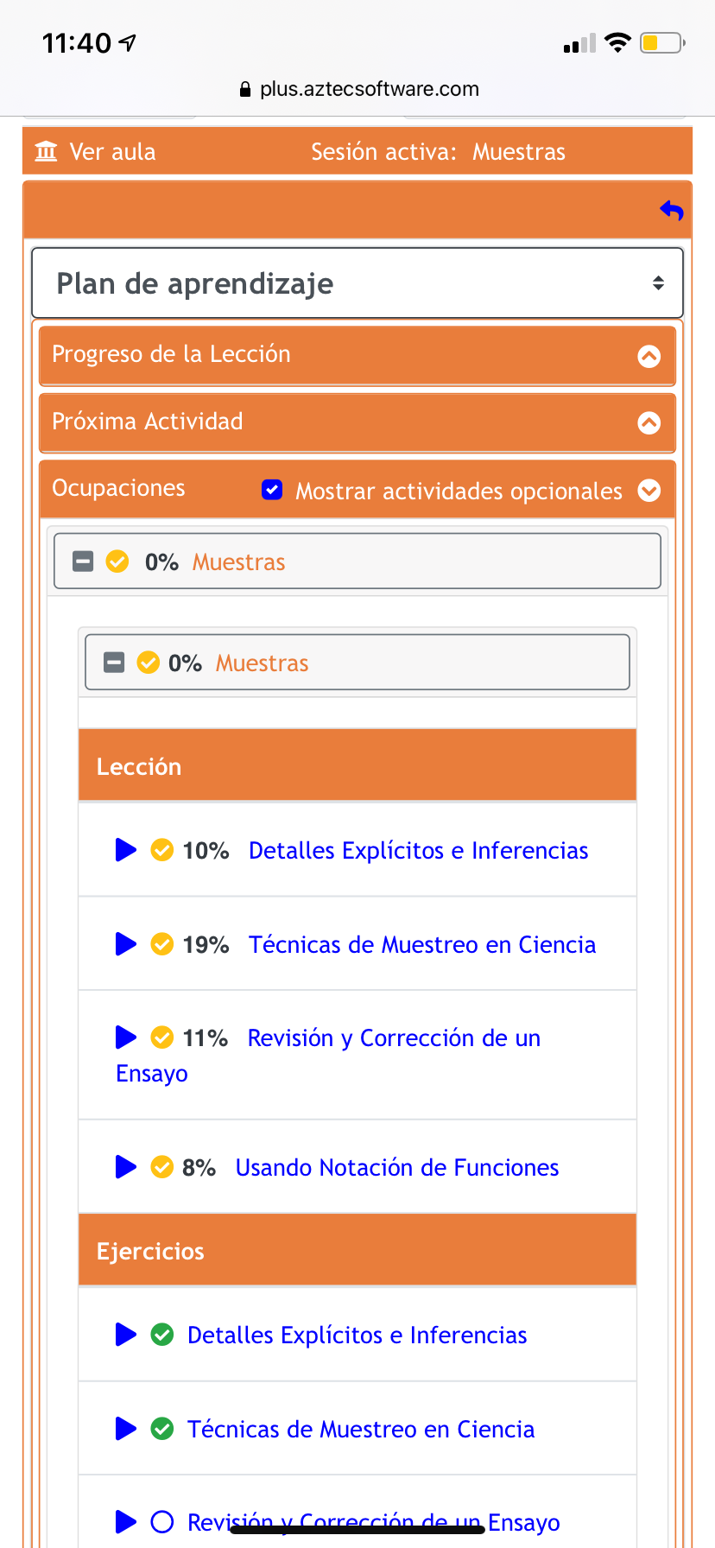
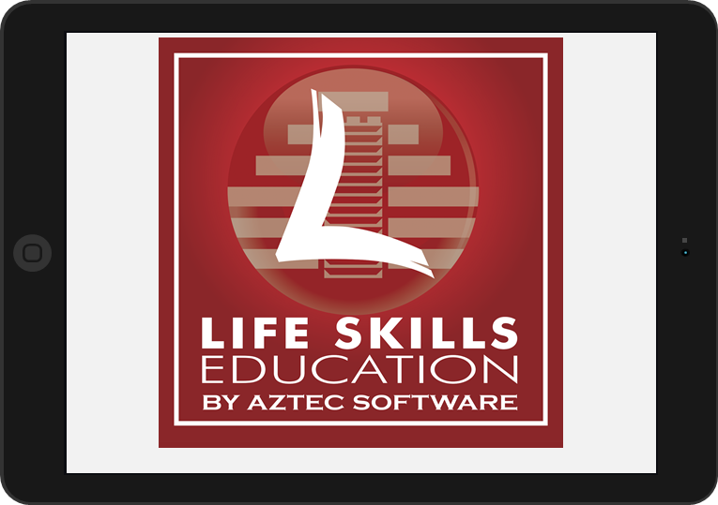
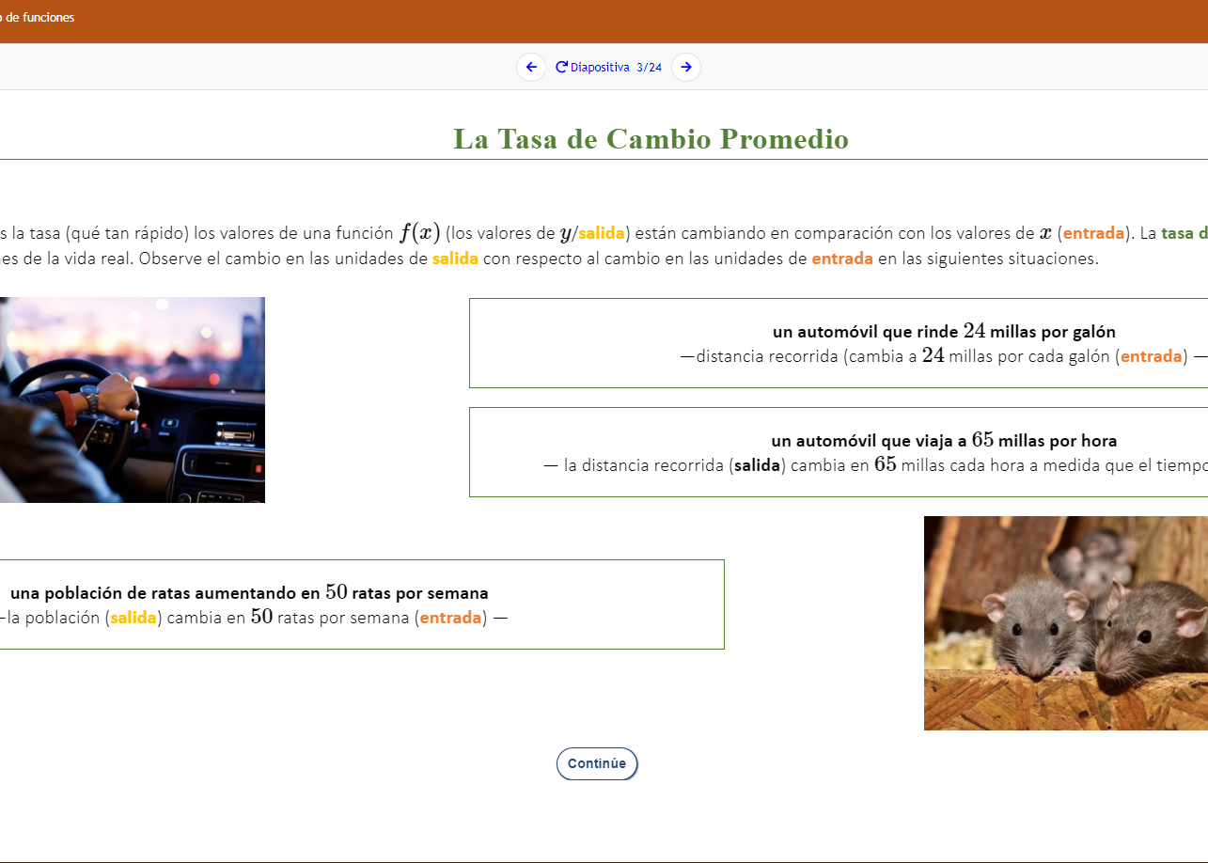
AZTEC SPANISH GED® PREP Official Partnership with the GED Testing Service
Aztec is the GED Testing Service’s Only Preferred Partner
for the Spanish GED® Test
Notes:
We are pleased to announce this new partnership founded upon the shared belief of building equitable pathways of learning and opportunity for Spanish speaking students. Aztec is GED Testing Service’s ONLY Preferred partner for the Spanish GED Test
Aztec’s GED Spanish Prep Series is fully aligned to the Spanish GED test. It is written by a dedicated team of Aztec Spanish instructors for Spanish learners and contextualized for the Spanish GED Tests.
Aztec's NEW Spanish GED Test preparation system builds equity for your students by elevating self-esteem while delivering the academic instruction needed to successfully earn a GED.
It is authentically developed in Spanish and NOT just translated. The prep system supports students with full SPANISH audio ensuring a multi-modal experience.
Lastly, Aztec delivers this incredible resource in their Learning Management System in full Spanish mode.

Slide 73
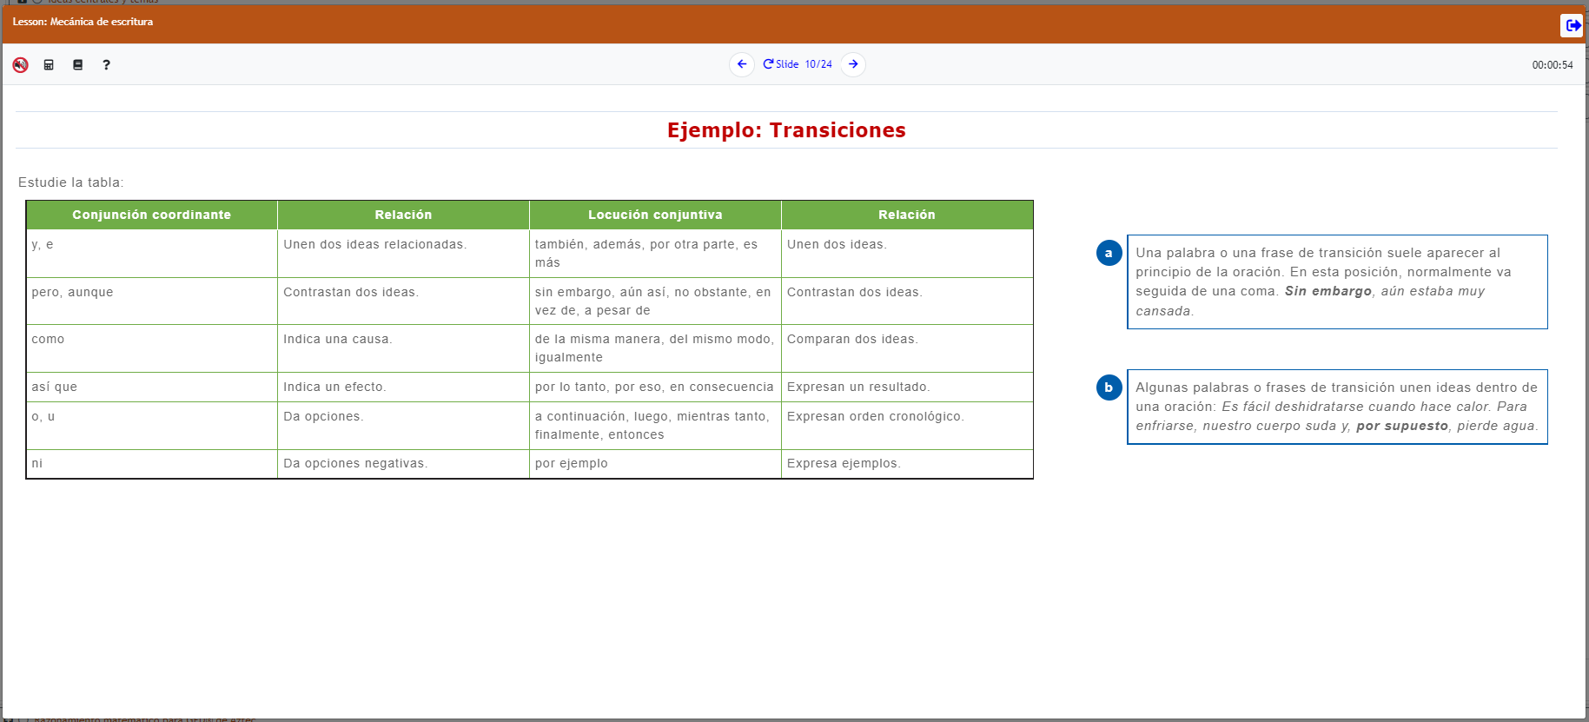

AZTEC IS THE GED TESTING SERVICE’S ONLY PREFERRED PARTNER
FOR THE SPANISH GED® TEST Aztec’s Spanish GED® Preparation Series
Designed from Scratch To The Spanish GED® Test
Our team of Master Spanish Experts designed and built the series from the bottom up, including grammar, ensuring this goes beyond the mere translation.
Aztec Learning System in Spanish
Our Aztec LMS offers a quick and easy dashboard translation feature.
Complete Spanish Audio
Full Spanish audio provides learners with complete support increasing engagement.
Notes:
From the industry leader in GED preparation, Aztec Software's #1 Rated GED instructional methodology has been applied to our Spanish GED Preparation materials!
Written by a dedicated team of Spanish instructors for Spanish learners, and contextualized for the Spanish GED Tests, Aztec's NEW Spanish GED Test preparation system builds equity for your students by elevating self-esteem while delivering the academic instruction needed to successfully earn a high school equivalency.
Aztec's Spanish GED Preparation System meets the stringent demands of the GED Testing Service and aligns to the College and Career Readiness Standards.

Slide 74
ANNOUNCING A NEW PARTNERSHIP Official Partnership with the GED Testing Service
Aztec is the GED Testing Service’s Only Preferred Partner
For The Spanish GED® Test
www.aztecsoftware.com/ged
Notes:
We are pleased to announce this new partnership founded upon the shared belief of building equitable pathways of learning and opportunity for Spanish speaking students.
Aztec’s GED Spanish Prep Series is fully aligned to the Spanish GED test. It is written by a dedicated team of Aztec Spanish instructors for Spanish learners and contextualized for the Spanish GED Tests.
Aztec's NEW Spanish GED Test preparation system builds equity for your students by elevating self-esteem while delivering the academic instruction needed to successfully earn a GED.
It is authentically developed in Spanish and NOT just translated. The prep system supports students with full SPANISH audio ensuring a multi-modal experience.
Lastly, Aztec delivers this incredible resource in their Learning Management System in full Spanish mode.

Slide 75

CONTACT AZTEC SOFTWARE
Here For You
ghealy@aztecsoftware.com
sales@aztecsoftware.com
800.273.0033
www.aztecsoftware.com

Slide 76
A Few Reminders for Test Administrators

Slide 77
Candidate Search Best Practices
Ask the Tester to turn all pockets completely out and show waist/belt area if not visible
Roll up sleeves if down, roll down sleeves if up
Hooded? Ask the Tester to lift the hood to see if anything is underneath
Pull back hair to show ears if hair is in the way to see any devices in ears
View tattoos to ensure that no answers are hidden in them
Ask the Tester to pat him/herself down (arms, waistline, and legs) to show there is nothing hidden
Additional search requirements might be needed depending on your facility

Slide 78
Physical Test Monitoring
Test Administrators should closely monitor testing and be watching for possible cheating
If an administrator catches a Tester cheating, remove the Tester from testing and put the test in unscheduled break mode. Then let the time run out
Remember to create a case in Service Direct as soon as possible as a “Candidate Error” type of case
Code the cases correctly to avoid delays
Circulate through the room every 10-20 minutes during test events
Be aware of any other suspicious activity
Notes:
Possible Cheating could include: notes on paper, notes on body parts/tattoos, communication with other testers

Slide 79
Candidate Misconduct
If you suspect misconduct, ask the Tester to leave the testing room immediately and put the test in unscheduled break mode. DO NOT stop the test.
Inform the Tester that you will be creating a case for conduct review with VUE
Create a case as soon as possible in Service Direct
After the candidate leaves, resume exam and press Ctrl+Shift+F12 and select Abandon Exam option.
Cases in Service Direct should include the following:
Detailed description of Tester behavior
Location or situation when confronting the Tester
Names and roles of all people involved
Tester’s reaction and discussion between TA and Tester including Tester comments

Slide 80

What is Service Direct?
Functions
Report testing misconduct or any other candidate issues
Report group cancellations
Order materials
Provide and receive updates on cases

Slide 81
Service Direct (Resources)
ServiceDirect Training Module
ServiceDirect for Test Center Employees
ServiceDirect ​Quick Reference Cards
QRC – Accessing ServiceDirect
QRC – Add a Comment
QRC – Case Notices
QRC – Configuring Your Browser
QRC – Creating Cases
QRC – Edit Profile Settings
QRC – Logging Out
QRC – Navigating ServiceDirect
QRC – Navigating ServiceDirect Lightning for Test Administrators
QRC – Search Basics
QRC – Taking Ownership
QRC – Training Tracker
QRC – Updating Cases
QRC – Using Knowledge
QRC – Viewing and Working Tasks
QRC – Working with Views
Leverage the tutorials by periodically reviewing the videos and the quick reference cards – ln Connect, click on Resources and then Support materials and then ServiceDirect
If you’ve not used ServiceDirect much, refer to these tools before using different functions

Slide 82
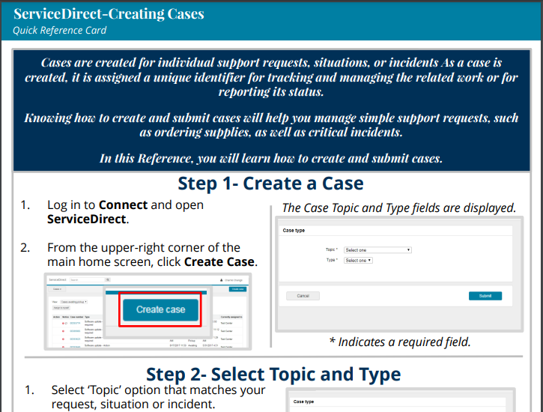

Slide 83
Additional Service Direct functions
Ordering Materials
Items like erasable noteboards and GED Exhibits need to be requested via a case
Create a case and select the options:
Topic: Test Center Request
Type: Test Center fulfillment
Pens cannot be ordered, but should be superfine tip, black, dry erase whiteboard markers
Suggesting changes to documentation or needing clarification
Create a case with the option
Topic: Test Center Request
Type: Test center documentation inquiry
Note the error or discrepancy, outdated information, or policy/procedure that needs clarification
Suggestions for improving information always helpful

Slide 84
GED® Test Delivery
CCT and Chromebooks

Slide 85
Software Installation: Cloud Computing Technology (CCT) is available for Correctional Facilities
CCT software delivers the GED test with some advantages over the standard software install.
CCT software install is faster to install than the standard software.
CCT functions as a server in large testing centers with 15 or more computers.
Software updates are handled via the cloud (not manually).
Requires internet connectivity that is stable and reliable.
You must be a GED Only center in order to go the CCT route.

Slide 86
Standard Software vs CCT (Cloud)
Standard Software
Allows test delivery in an offline manner, i.e. student is testing on a computer, but the computer does not need to be internet connected.
The test administrator computer will need to connect to the internet on test day in order to download/upload the exams.
Once the software is installed there are periodic software updates you will need to run over time in order to keep the software up to date and secure.
Cloud Computing Technology (CCT)
CCT software delivers the GED test with some advantages over the standard software install.
CCT software install is faster to install than the standard software
CCT eliminates the need for a server in large testing centers with 15 or more computers. CCT functions as the server.
No periodic software updates for you as the test center to do. Software updates are handled via the cloud.
Requires internet connectivity that is stable and reliable

Slide 87
CCT Delivery
We are delivering the GED® test via the CCT software at 50-60 GED® testing sites across the U.S.
There are correctional facilities in 7-8 states delivering via CCT.
Feedback from test administrators regarding test delivery via CCT has been positive.
If you are aware of correctional facilities in your state experiencing consistent technical issues contact your GEDTS SRM to discuss a possible transitional to CCT.
Remember, CCT requires internet connectivity that is stable and reliable

Slide 88

Delivering GED® Tests on Chromebooks in Correctional Facilities?
We are currently in pilot mode

Slide 89
GED® Test Delivery on Chromebooks
Michigan DOC and Ohio DOC are now delivering GED tests on Chromebooks This is a significant milestone.
There has been, and continues to be, a major effort by MI DOC/OH DOC staff to make this happen along with Pearson VUE IT staff.
Correctional facilities in other states are looking into this delivery option.
Delivering on Chromebooks is only available to correctional test centers.

Slide 90
Delivering GED Testing on Chromebooks
Please know that GED testing on Chromebooks is in a pilot phase.
Think of GED testing on Chromebooks as a new product. A new product that has many technical challenges, bugs and product documentation is a work in progress.
MI DOC staff have invested considerable time and effort to make this happen as are OH DOC staff.
We need to proceed slowly with expanding, but we are open to conversations with additional correctional sites.
Delivery on Chromebooks is for correctional facilities ONLY.

Slide 91
2025 Correctional Conferences

Slide 92
2025 Correctional Conferences GED Testing Service Has Attended (will attend)
GEDTS has or will attend:
COABE – Dallas, TX (March)
CEA Forum – Omaha, NE (April)
Georgia Dept. Of Corrections (May)
WI CEA –Madison, WI (June)
CEA International Conf – Pittsburgh, PA (August)
State Correctional Conferences (TBD)
We plan to attend as many state correctional conferences as possible so please reach out with conference information.

Slide 93
Final Reminders

Slide 94
Reminder to GED Test Administrators
Please remind correctional staff that they must complete registering individuals in GED Manager™ before they will be able to schedule individuals for the GED® test.

Slide 95
Correctional Verification List
Issue: Correctional facilities have consistently expressed frustration with the difficulty in verifying whether an individual has passed the GED® test in a state outside of the one they are currently incarcerated.
Ex. Ohio DOC has a new inmate who says he passed the GED test in Florida in 2012.
How GEDTS Can Help: We have compiled a correctional verification contact list by state to assist correctional facilities in verifying whether an individual in your facility passed the GED® test in another state.

Slide 96
Your State Relationship Team
Mellissa Hulstrand
IL, MI,MN,TN,VT,WI
PR,VI,,MI Prisons
Mellissa.Hultstrand@ged.com
Brian Smith
GA,IN,PA
Brian.Smith@ged.com
Scott Salesses
FBOP, MA, NY
Scott.Salesses@ged.com
Lisa Pool-Osorio AK,CA,ID,NV,OR,UT,WA, Guam
Lisa.Pool-Osorio@ged.com
Adora Beard
AL,DC,DE,MD,VA
Military
Adora.Beard@ged.com
Liz Lanphear AZ,CO,HI,KS,MO,NE,NM,ND,SD
Elizabeth.Lanphear@ged.com
Diane Vaccari
CT,FL,KY,OH,RI,SC,WV
Bermuda
Diane.Vaccari@ged.com
Jonna Mcdonough
CA,MS,MT,NC,NH,OK,TX,WY
Jonna.Mcdonough@ged.com
Debi Faucette
AR,CA,LA
Debi.Faucette@ged.com

Slide 97
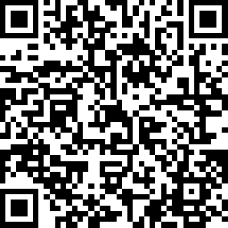
Thank You!
Scott Salesses
Scott.Salesses@GED.com
Mellissa Hultstrand
Mellissa.Hultstrand@GED.com

