Slide 1
GED® Boot Camps – Success Stories from the Field
Susan Pittman
GED® and GED Testing Service® are registered trademarks of the American Council on Education (“ACE”). They may not be used or reproduced without the express written permission of ACE or GED Testing Service LLC. The GED® and GED Testing Service® brands are administered by GED Testing Service LLC under license from ACE.

Slide 2
GED® Math Boot Camps
Intensive Instruction
Target Curriculum
Practice Tests
Expert Guidance
Support Learning Community
Potential for Accelerated Learning
Notes:
GED Math Boot Camps are intensive, short-term programs designed to help individuals prepare for and pass the GED (General Educational Development) Mathematical Reasoning test. These programs often involve focused instruction on key math concepts, practice tests, and strategies for tackling the exam.
What to Expect:
Intensive Instruction:
Boot camps condense GED math preparation into a shorter timeframe, requiring dedicated study and participation.
Targeted Curriculum:
They focus on the specific math skills and knowledge areas assessed on the GED test.
Practice Tests:
Participants typically engage in practice tests to assess their progress and build confidence.
Expert Guidance:
Instructors with experience in adult education and GED preparation provide support and guidance.
Supportive Learning Community:
Boot camps foster a collaborative environment where students can learn from and support each other.
Potential for Accelerated Learning:
If a student is motivated and has a strong foundation, a boot camp can lead to a GED math pass in a shorter timeframe.

Slide 3





Best Practices in Building and Maintaining a GED Boot Camp
Planning for Success
Identifying the Right Students
Determining the Right Design
Exploring Resources
Repeating the Cycle
Notes:
The GED Math test continues to be a challenge for many adult learners. In fact, a significant number of students are just one test away from earning a high school credential - the GED Math test.
This session will focus on the benefits and challenges of implementing a GED Math Boot Camp to help students make that final push to GED success. In this session, we will discuss the various types of boot camps that can be established, review the logistics of getting started, and discuss options for the curriculum to be used. We will share resources that you can take back to your programs and use to set up a boot camp that suits your program and most of all your students. There will be ample time set aside throughout the morning to address your questions and concerns.
Identify the key elements of a content-based boot camp
Discuss the benefits of providing a boot camp
Review and discuss the steps in designing a boot camp
View possible structures of boot camps that can be implemented
Brainstorm ways that boot camps can be implemented in Alabama

Slide 4
Design Steps for a Math Boot Camp
Plan
Determine Your End Goal
Identify the Students You Will Serve
Setting a Schedule
Instruct
Get the Right Resources
Identify Key Staff
Repeat
Evaluate
Adjust
Celebrate
Notes:
Step 1 – What will you teach- Language Arts and Math, Student Success Skills. Start with the end in mind – what will you need students to do prior to boot camp – test in what = we used Ed Ready- post-tested in Ed Ready – but do you want students to
What LMS will you use?
Google Classroom/
Blackboard/
Canvas/
Moodle/
Teams
increase to pass a Ready test/GED test. Why do you want the bootcamp.What days/times will it be offered? One day? Each Day for 4 days, etc.

Slide 5

Planning
Set your goal
Identify potential students
Develop a schedule

Slide 6
Goal Setting
Setting a goal involves deciding what you want to achieve and then outlining the steps to get there.
It's a process that can
boost motivation,
provide direction, and
increase accountability.
Effective goal setting often utilizes the SMART framework (Specific, Measurable, Achievable, Relevant, and Time-bound).

Slide 7

Look at the Big Picture
Do you want to establish a Math Boot Camp to focus on students who
Are missing one test to earn a credential
Have schedules that prevent them from attending regular classes
Need minimal prep before testing
Are in and out of class, but have potential to be successful
Need intensive, short-term instruction
All the above
This Photo by Unknown Author is licensed under CC BY-SA
Notes:
Designing
Days/Times
Curriculum
Programs and Resources to Use
Planning Process
Who Will Teach
What will You Teach
Audience
Pre-Post testing

Slide 8
Goal Setting and Planning
Is the boot camp designed to serve a school/college, a district, a county, a region?
Who needs to be included in the planning process?
  Administrators
  Counselors
  Instructors
  Other
  Students
Who is going to be lead the charge and make sure deadlines are met?

Slide 9



Set Enrollment Criteria
9
Students who
Are currently enrolled
Receive teacher recommendation
Recently left program
Students who
Have passed 3 of 4 tests
Scored 145-150 on GED Ready ®
Scored 140-145 on GED Ready ®
Students who
Inconsistent attendance
Need HSE for work, but score slightly out of range
Upper range of NRS Level 4 on TABE
Lower range of NRS Level 5 on TABE

Slide 10



Boot Camp Schedule
10
Three-Day
3- or 4-hour sessions daily
Deeper dive into content
GED Ready® or GED® test
Weekend
Friday p.m., full-day Saturday
Deeper dive into content
GED Ready® or GED® test
One Week
Half-day sessions each day
Online practice sessions
Skill gap focused content
GED Ready® or GED® test

Slide 11

Boot Camp Schedule
11
Two Weeks+
Evenings (2 hours)
Two or three times per week
Online practice sessions
Skill gap focused content
GED Ready® or GED® test
Hybrid
Established schedule
In-person and virtual instruction provided at/through multiple locations
Skill gap focused content based on initial GED Ready score report review
GED Ready® or GED® test

Slide 12
Design Steps for a Math Boot Camp
Plan
Determine Your End Goal
Identify the Students You Will Serve
Setting a Schedule
Instruct
Get the Right Resources
Identify Key Staff
Repeat
Evaluate
Adjust
Celebrate
Notes:
Step 1 – What will you teach- Language Arts and Math, Student Success Skills. Start with the end in mind – what will you need students to do prior to boot camp – test in what = we used Ed Ready- post-tested in Ed Ready – but do you want students to
What LMS will you use?
Google Classroom/
Blackboard/
Canvas/
Moodle/
Teams
increase to pass a Ready test/GED test. Why do you want the bootcamp.What days/times will it be offered? One day? Each Day for 4 days, etc.

Slide 13
Instruction
Look for Common Problems Your Students Demonstrate
Review GED Ready® Score Reports
Review GED® Score Reports
Review TABE Scores and Reports
Review Tuesdays for Teachers Knowledge and Skills Gaps in Mathematical Reasoning, Part 1
Review Tuesdays for Teachers Knowledge and Skills Gaps in Mathematical Reasoning, Part 2

Slide 14
Trends in Knowledge and Skills Gaps
Session 1:
non-calculator items
exponents/roots
three-dimensional shapes
Session 2:
algebraic computation
inequalities
slope/graphing
multiple correct answers
NOTE: there is overlap between some of these areas
Tuesdays for Teachers
November 16, 2021
3:30 – 5:00 p.m. (ET)
12:30 – 2:00 p.m. (PT)
Notes:
NOTE: there is some overlap in these skills among the indicators

Slide 15
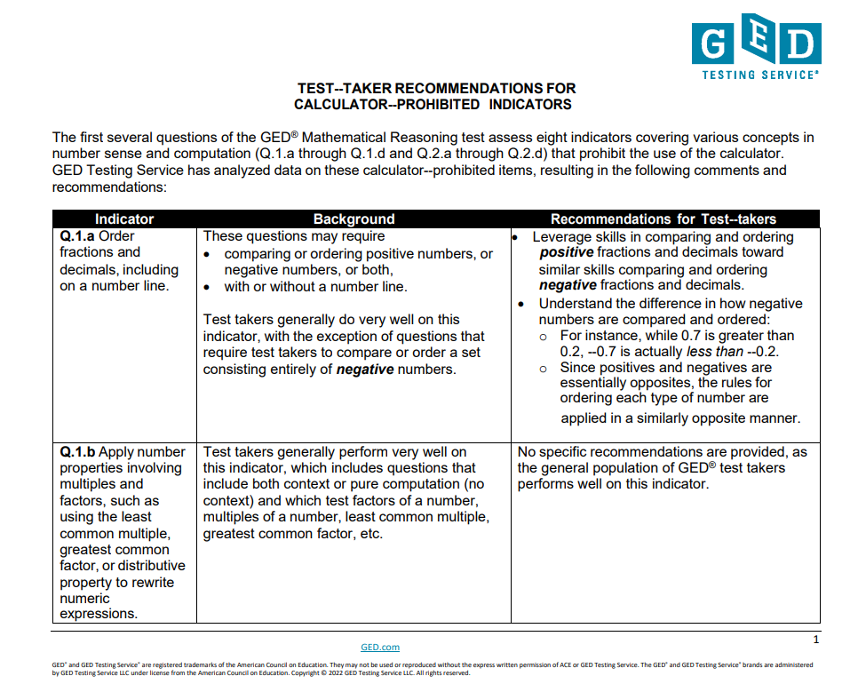
Calculator Prohibited Indicators
Tips for Calculator Prohibited Section

Slide 16

Essential Resources on GED.com
16
Computer Tutorial
Calculator Tutorial
Calculator Reference Sheet
Formula Sheet
Math Study Guide https://www.ged.com/wp-content/uploads/GED_Study-Guide_Math.pdf

Slide 17

Teacher Recommended Workbooks

Slide 18


Teacher Recommended Workbooks

Slide 19
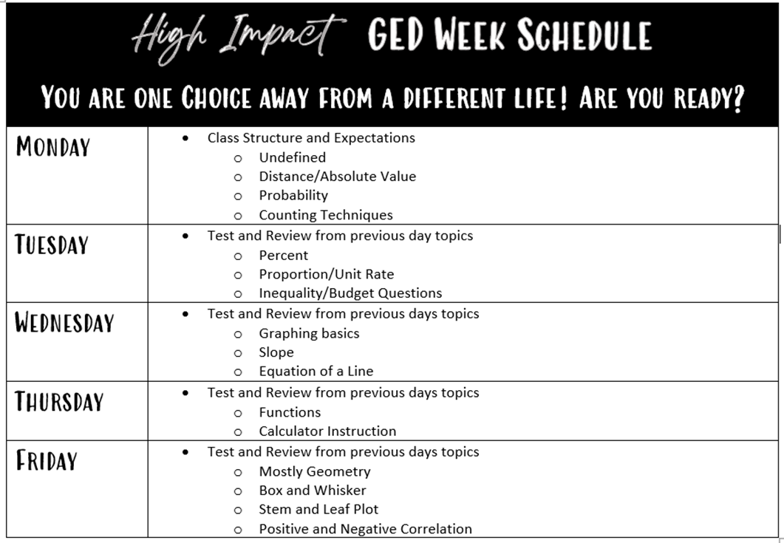
One-Week – Sample Schedule
Hopkinsville Community College
Monday-Friday, 9:00 am to 12:00 noon
(15-minute break)
GED Ready test at 1:00 p.m.

Slide 20
Weekend Model
Friday 5-9 | Absolute Value/Distance on a Number Line Show them how to look for absolute value bars, subtraction, and the numbers in the problem Order of Operations Undefined - 3 ways it might be on the test Typical values (mean, median, mode) Point out where to find mean and median on the Formula Sheet. It helps! Unit pricing - ***If there’s time to do it.
Saturday | Geometry Formulas Model use of the Formula Sheet. Have them tell you which formula(s) are needed and where to locate them. Solving and graphing Inequalities (and equations) Identify and evaluate functions Model how to substitute values by hand AND enter correctly in the calculator. Compare functions in different forms Calculator prohibited items (if time permits)
Sunday 1:00 p.m. | GED Math test
Tri-County Skills U
Instruction Schedule:
Friday, 5-9, Saturday, 9-5
GED Exam:
Sunday 1:00

Slide 21
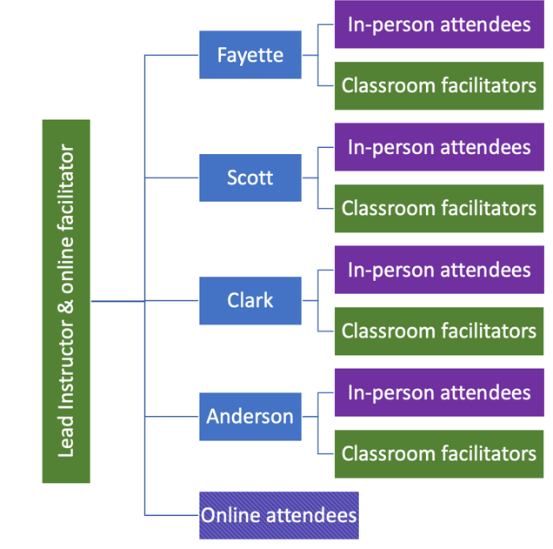
Three-Day Hybrid Model
Bluegrass Community and Technical College Adult Education Program
Tuesday – Thursday
5:00 – 9:00 p.m.
Course Home Page
Bit.ly/3daymath
Notes:
Product Demo

Slide 22



Identify Key Staff
22
Curriculum Development
Identifying existing curricula that may work
Customize
Team?
Instructional or Support Staff
Teacher(s)
TA(s)
Counselor
Data Specialist
Coordinator?
Virtual Staff
Teacher(s)
Facilitator(s)
IT Support

Slide 23
Evaluate and Debrief
What?
So What?
Now What?
What did we learn?
What is the significance of what we learned?
What are we going to do or change going forward?

Slide 24
Design Steps for a Math Boot Camp
Plan
Determine Your End Goal
Identify the Students You Will Serve
Setting a Schedule
Instruct
Get the Right Resources
Identify Key Staff
Repeat
Evaluate
Adjust
Celebrate
Notes:
Step 1 – What will you teach- Language Arts and Math, Student Success Skills. Start with the end in mind – what will you need students to do prior to boot camp – test in what = we used Ed Ready- post-tested in Ed Ready – but do you want students to
What LMS will you use?
Google Classroom/
Blackboard/
Canvas/
Moodle/
Teams
increase to pass a Ready test/GED test. Why do you want the bootcamp.What days/times will it be offered? One day? Each Day for 4 days, etc.

Slide 25
Adjust
Look at the numbers/results
  Enrollments
  Attendees
  Passers/Non-Passers
Review student surveys or evaluations
Review any areas of instruction where students struggled
Consider if any adjustments needed to schedule

Slide 26

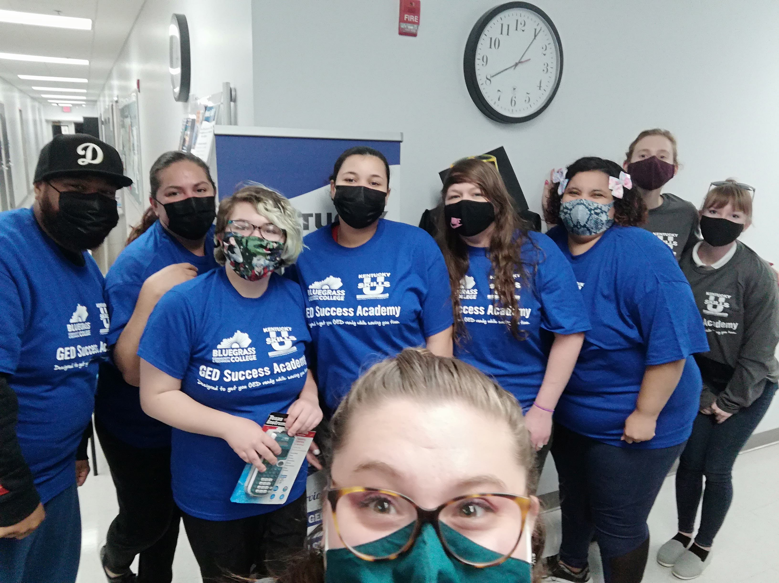


Celebrate

Slide 27
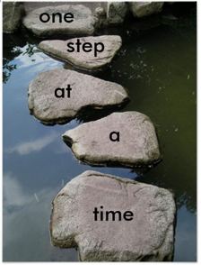

Slide 28


Slide 29

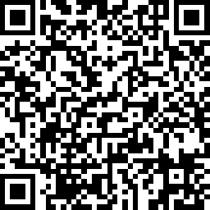
Session Survey
Your feedback is important. Please scan the QR code below to rate this session.

