Slide 1
GED Analytics™
Turning Data into Direction
Insights for GED Power users
Azeem Begum​ - Sr. Systems Product ​Support Analyst
Brent Gerken​ - Manager​ Technical Operations
GED® and GED Testing Service® are registered trademarks of the American Council on Education (“ACE”). They may not be used or reproduced without the express written permission of ACE or GED Testing Service LLC. The GED® and GED Testing Service® brands are administered by GED Testing Service LLC under license from ACE.

Slide 2
Agenda Key discussion goals
Additional reports summary in Tableau
Passed 3 of 4 students
GED PrepConnect™ performance
Key Metrics by Jurisdictions
Students Journey from start to finish
Test Centers performance
Leverage the data to its full potential.
Maximize the value of the insights we uncover.​
Translate what we see in the data into actionable outcomes.
Let’s make the most of what the data is telling us.
We’re not just looking at the data—we’re using it to drive real decisions.

Slide 3

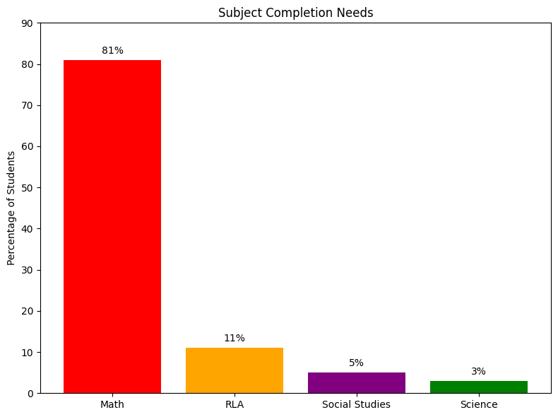
Students in Passed 3 of 4 status overview
Total Students in Category: 194,804 ▸ 🔼 Up 10% from last year
Inmate Students: 35,917
    81% of these still need to pass Math, followed by RLA (11%), Science (3%), and Social Studies (5%)
    Of these students:
          35% did not take the final exam.
          65% took it but failed
      47% selected the Prep Center, up from 35% last year indicating a growing preference for support resources
📱 Syd AI Integration
The GED & Me Mobile App now includes Syd AI, which supports students with Math practice questions using tailored prompts

Slide 4
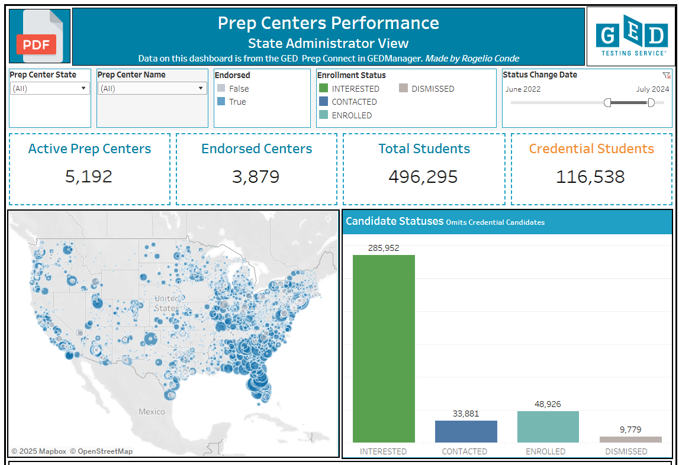

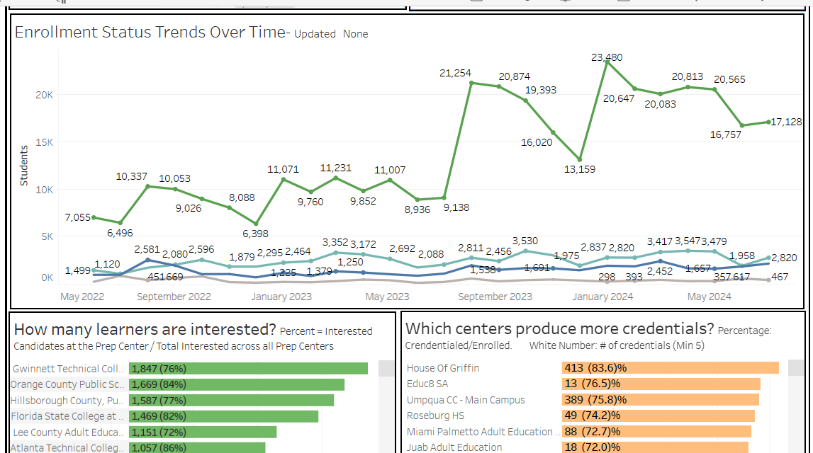

GED PrepConnect™
GED PrepConnect™ tool within GED Manager™ was designed to support Adult education programs in managing and tracking student performance.

Slide 5
GED Prep Connect
📌 Key Functionalities and Insights Student Intent Signals: Student who selected the Prep Center on GED.com signals their interest in Adult Basic Education (ABE) classes and a desire for additional support to guide them through to credential completion. ABE Engagement Opportunities: Please contact the student to update the status in GED Manager™ Interested, Contracted, Enrolled, Denied Jurisdiction and Program Integration: Encourages integration of jurisdictional updates, program inputs, and feedback loops to refine outreach and support strategies. Performance Analytics: Enables analysis to: Highlight top-performing programs. Identify areas of opportunity for increased engagement.

Slide 6
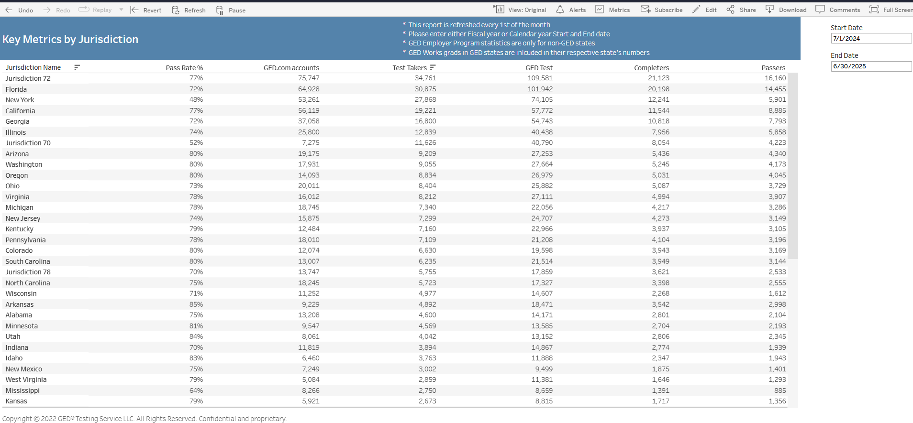

Key Metrics by Jurisdictions
This shows metrics by each state
Less than 50% of GED.com account holders are Test takers
As per GED Testing Service process, records with no test activity in 2 years are deleted/archived
Focus areas:
  continued opportunity to understand 50% profiles created but do not test.

Slide 7
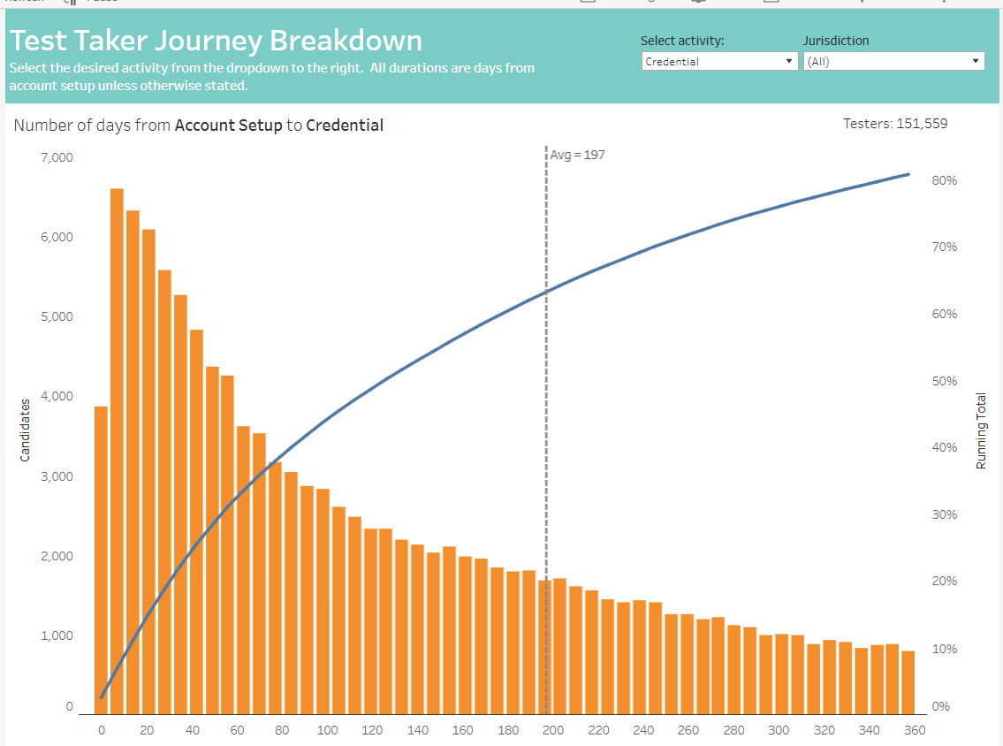
Students journey from start to finish
Histogram showing duration between account setup, testing activity and Credential
~80% of students complete their GED journey within 357 days.
On average, 63% take 197 days from account setup to credential.

Slide 8
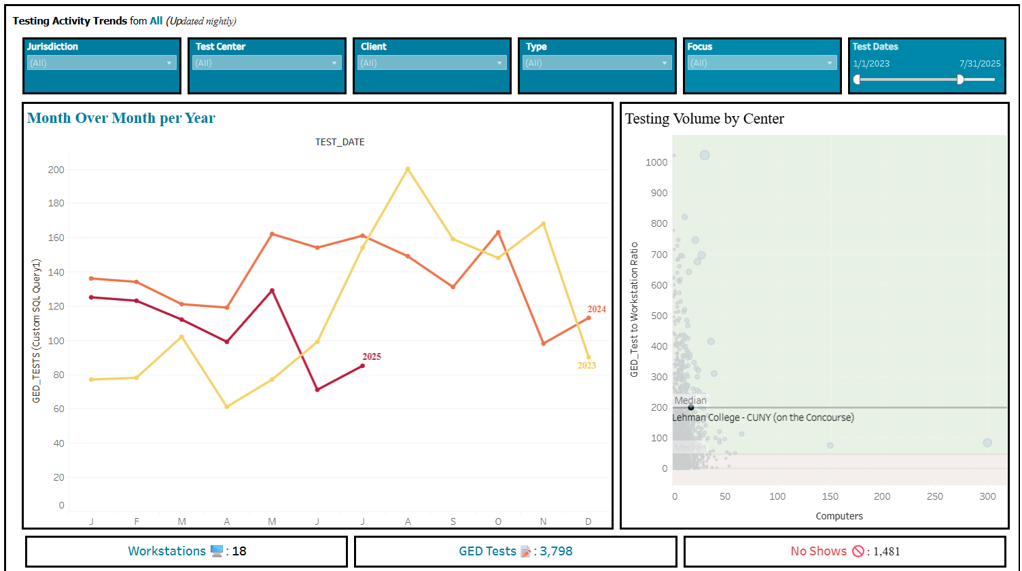
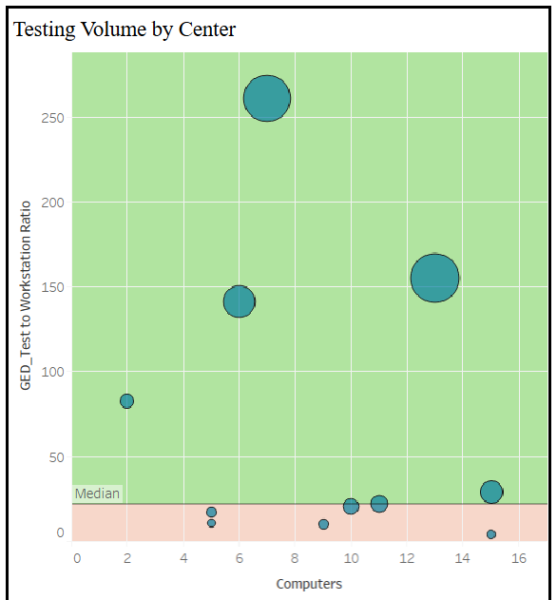
Testing activity – Test Centers
This report is available on demand as needed, reach out to your SRM
This shows the testing activity at Test Centers
Test Centers Open and close schedule, number of days open
Number of available workstations
Number of Revokes and No shows

Slide 9
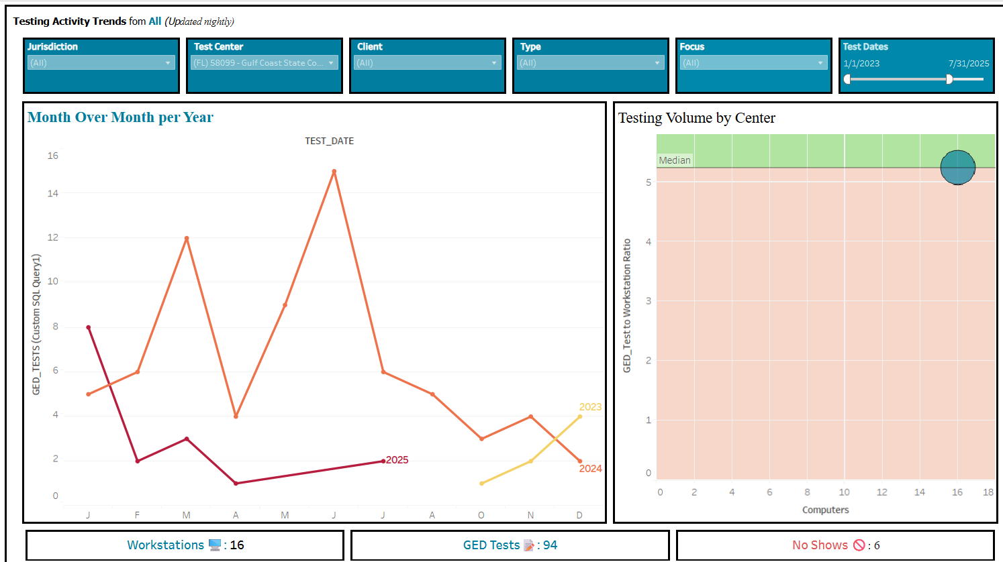
Testing activity – Test Centers
This reports also helps Identify centers with low testing activity:
Understand causes of low testing activity at certain centers
Develop strategies to improve underperforming test centers
  Could the test center’s open/close schedule be impacting performance?
  Is limited testing activity related to the center’s hours of operation?

Slide 10
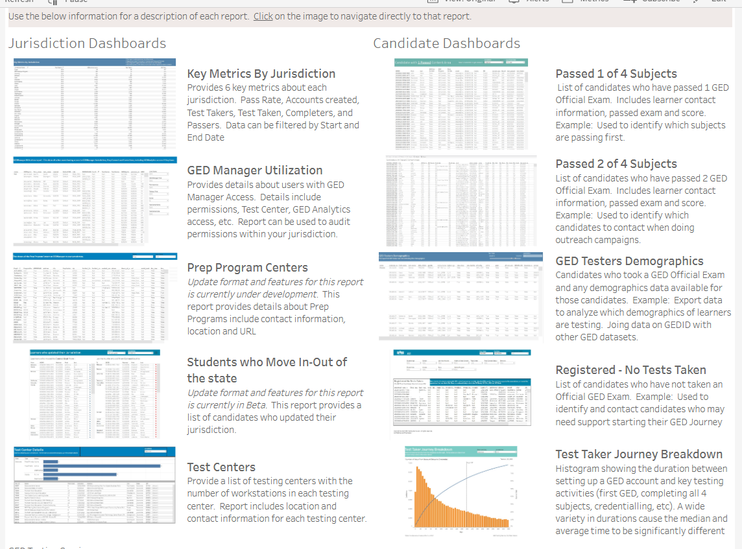
Explore deeper insights and supplemental data in the Additional folder in Tableau

Slide 11


Session Survey
We value your feedback—please scan the QR code to rate this session.

