Slide 1
GED Analytics™ for New Users
Brent Gerken - Manager, GED Technical Operations ​
Azeem Begum - Sr. Systems Product Support Analyst
GED® and GED Testing Service® are registered trademarks of the American Council on Education (“ACE”). They may not be used or reproduced without the express written permission of ACE or GED Testing Service LLC. The GED® and GED Testing Service® brands are administered by GED Testing Service LLC under license from ACE.
Notes:
Generated by Copilot This opening slide introduces the presenters, Brent Gerken and Azeem Begum, who bring expertise in GED Technical Operations and Systems Product Support. The focus is on GED Analytics tailored for new users, setting the stage for understanding how data insights can enhance GED program management. The visual branding reinforces the official nature of the presentation at the 2025 GED Conference. ______

Slide 2
GED Analytics™ for New Users Overview
What is GED Analytics™?​
A reporting tool used to extract GED-related data, empowering users with the information they need to make decisions. ​
An extension of GED Manager™ - SSO​
Jurisdictional view: State-specific data stats and visualizations with date filtering​
Viewer (Aggregate) vs Explorer (Full) access​
Segmented: ​
GED Analytics™ Summary Reports​
Additional Reports
Why is it important? ​
Access to powerful visualization metrics ​
Identify testing trends​
Target Marketing ​
3 of 4 Passers​
Audit user access
Identify high/low performing Prep Centers ​
A GED source of truth for decision makers​
Endless possibilities
Notes:
Generated by Copilot GED Analytics is a powerful reporting tool designed to provide actionable insights from GED-related data. It helps users identify testing trends, target marketing efforts, and evaluate the performance of prep centers. By offering state-specific views and flexible access levels, it serves as a trusted source of data for decision makers. The tool’s segmentation into summary and additional reports allows users to explore data at both high-level and detailed perspectives, unlocking numerous possibilities for improving GED outcomes. ______

Slide 3

Access Permission​ Jurisdiction-restricted - Access granted by GED Administrator™
Viewer​
Aggregate data only ​
High level​
Access to Student-specific data prohibited​
Useful for general trend analysis​
Overall data visualization
Explorer​
Full Access​
Candidate Drilldown​
Test Drilldown​
Power users​
Ability to download reports​
Marketing campaigns​
Specific student grouping​
Personal Identifying Information (PII)
Notes:
Generated by Copilot Access to GED Analytics data is carefully controlled by GED Administrators to protect sensitive information. Users with 'Explorer' access can dive deep into candidate and test details, download reports, and support marketing campaigns, including handling personal identifying information. In contrast, 'Viewer' access is limited to aggregate data, ideal for high-level trend analysis without exposing individual student data. This tiered permission system ensures data security while enabling appropriate data use. ______

Slide 4
Let's Dive In!
GED Analytics™
Test Summary​
Test Taker Summary​
Performance Summary​
Demographics Summary​
Appointment Summary​
3 of 4​
Candidate Drilldown​
Test Drilldown
Additional Reports​
Start Here​
GED Manager Utilization​
Key Metrics by Jurisdiction​
1 of 4 and 2 of 4 Subjects​
Prep Program Centers​
Registered - Not Tested​
Who moved in/out of State​
GED Ready Usage
Tester Journey Breakdown
Notes:
Generated by Copilot This slide previews the comprehensive range of reports available within GED Analytics. The 'GED Analytics' section includes detailed summaries and drilldowns on test performance, demographics, and candidate journeys. The 'Additional Reports' section offers insights into GED Manager utilization, prep program centers, and state-specific metrics. Together, these reports provide a holistic view of GED testing activities, enabling users to explore data from multiple angles to support strategic planning and operational improvements. ______

Slide 5
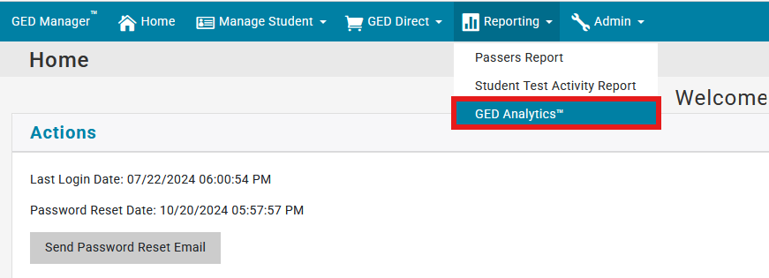
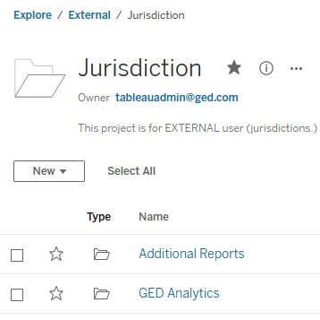
How to Log In
Additional Reports
GED Analytics
Notes:
Generated by Copilot Logging into GED Analytics is straightforward through the GED Manager platform. This slide highlights the login interface, showing how users can select GED Analytics from the dropdown menu under the Home tab. The interface also provides options for password management and report selection, ensuring users can easily access the data they need while maintaining account security. ______

Slide 6
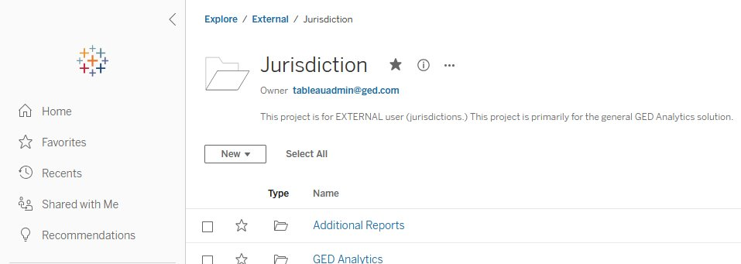
Explore/ External /Jurisdiction
Notes:
Generated by Copilot This slide showcases the user interface for accessing GED Analytics reports within the 'Jurisdiction' project, designed for external users. It demonstrates how users can filter reports by type, such as 'Additional Reports' or 'GED Analytics,' and navigate through various options using the sidebar. This organized layout facilitates efficient report discovery and management, supporting users in finding relevant data quickly. ______

Slide 7
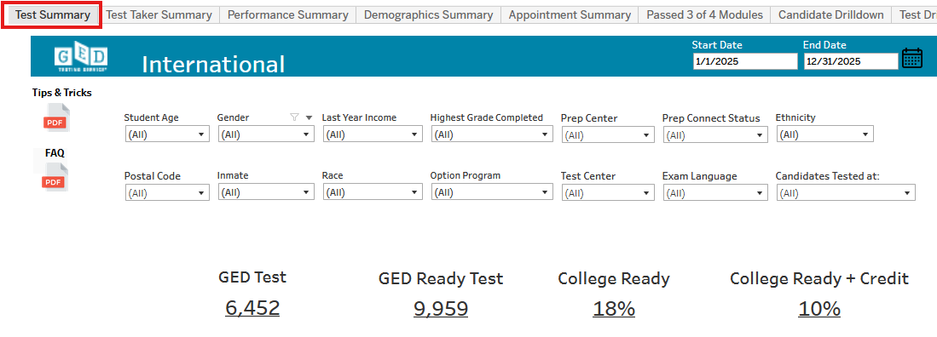
Test Summary
Notes:
Generated by Copilot The Test Summary report provides a snapshot of test participation and readiness within the international category. Key metrics include the number of participants, those ready for college, and those ready with credit. The slide also features demographic filters and navigation tools, allowing users to customize views and drill down into specific data segments, which helps in understanding overall test performance and readiness levels. ______

Slide 8
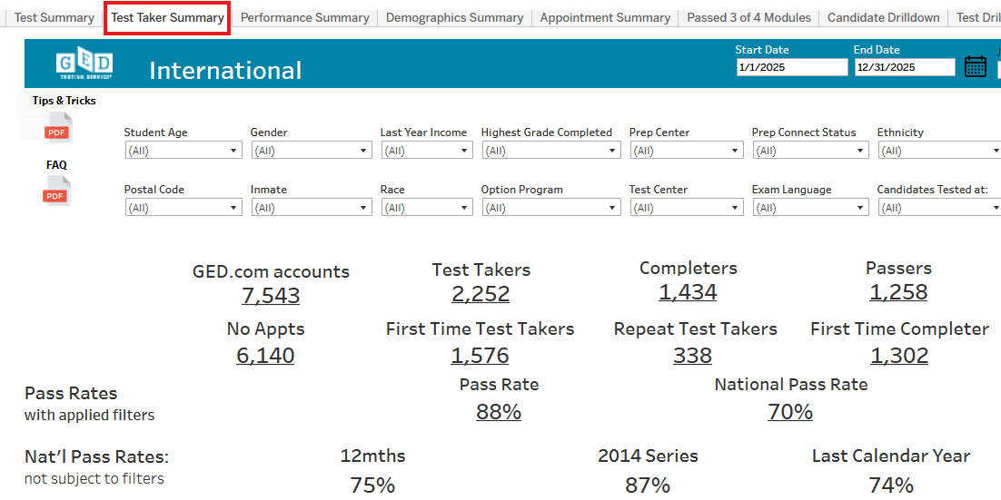
Test Taker Summary
Notes:
Generated by Copilot The Test Taker Summary offers a detailed breakdown of test takers, completers, and passers, comparing current data with national benchmarks. It includes demographic and test-related variables such as age, gender, income, and ethnicity, providing a comprehensive profile of test takers. This level of detail supports targeted interventions and program adjustments to improve GED outcomes across diverse populations. ______

Slide 9
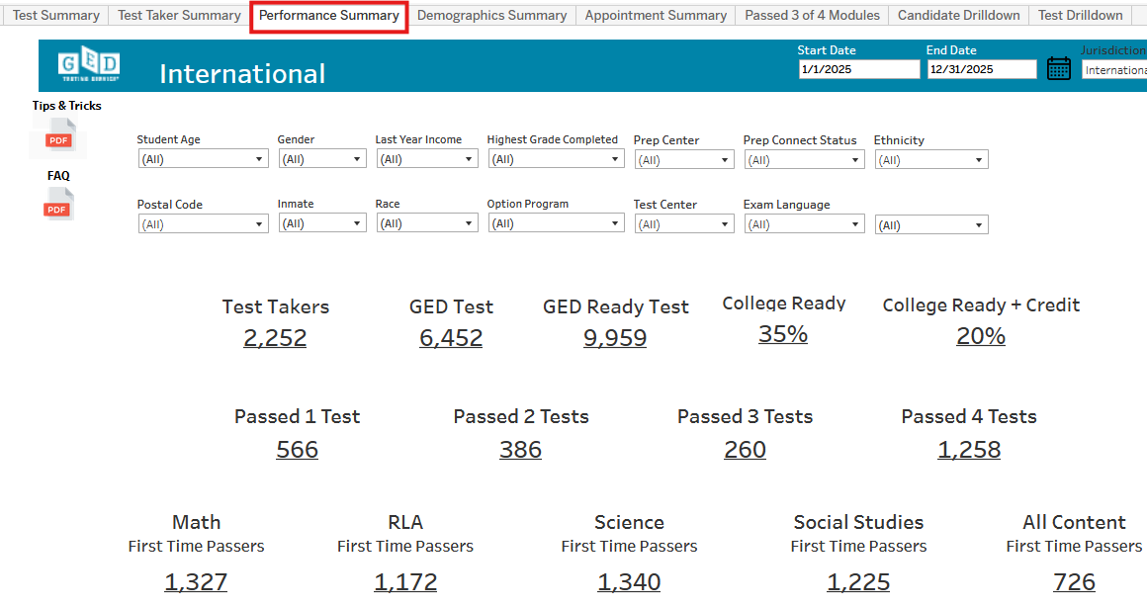
Performance Summary
Notes:
Generated by Copilot This Performance Summary slide presents detailed statistics on test takers and GED tests administered internationally. It highlights the distribution of tests passed across different subjects and the number of first-time passers, offering insights into subject-specific performance. The data helps identify strengths and areas needing improvement, guiding resource allocation and instructional focus to enhance overall success rates. ______

Slide 10
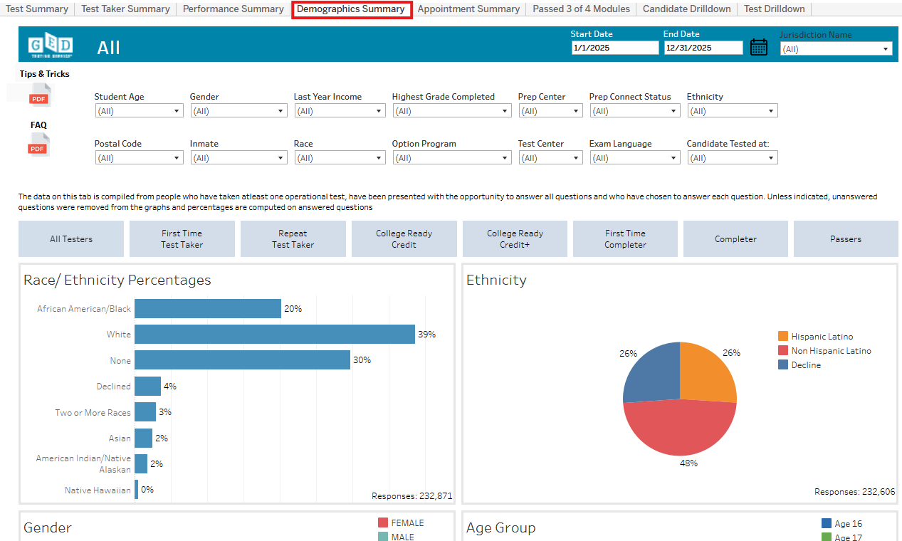
Demographic Summary
Notes:
Generated by Copilot The Demographic Summary visualizes the racial and ethnic composition of GED test takers, showing that the largest groups are White and Hispanic Latino. The charts provide a clear breakdown by race, ethnicity, gender, and age, based on a substantial dataset. Understanding these demographics is crucial for tailoring outreach, support services, and educational programs to meet the needs of diverse learner populations. ______

Slide 11
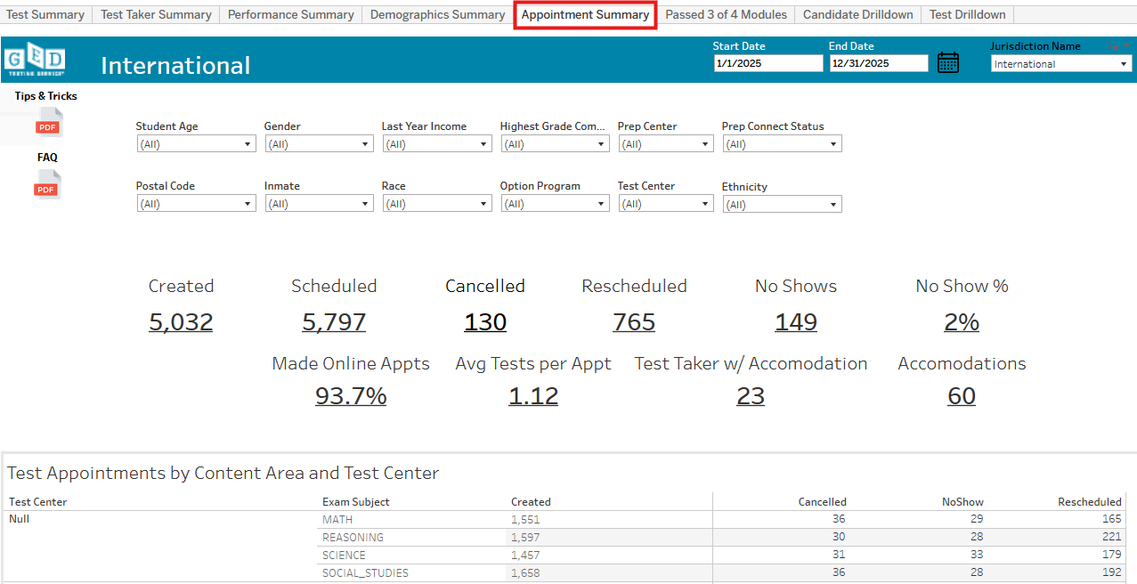
Appointment Summary
Notes:
Generated by Copilot This Appointment Summary slide details appointment metrics for GED testing, including the number of created, scheduled, cancelled, rescheduled, and no-show appointments. The low no-show rate of 2% and high percentage of online appointments indicate efficient scheduling processes. The breakdown by content area and test center helps identify patterns and potential areas for operational improvements to maximize test center utilization and candidate attendance. ______

Slide 12
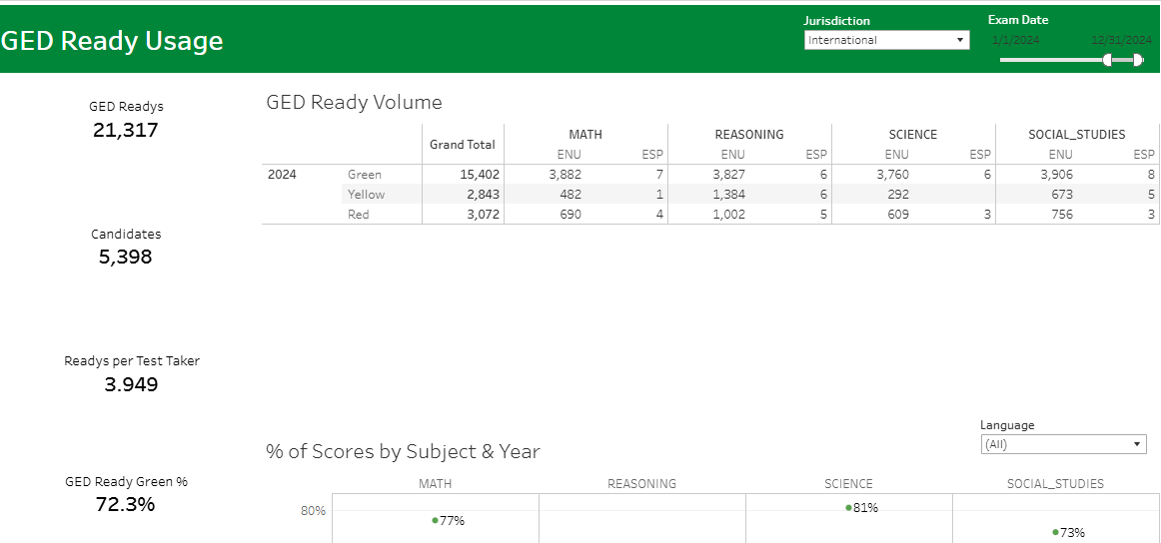
Additional Reports - Available reports for Viewer role
GED Ready Usage
Key Metrics by Jurisdiction
Notes:
Generated by Copilot Additional reports available to users with Viewer roles include 'GED Ready Usage' and 'Key Metrics by Jurisdiction.' These reports provide valuable insights into student readiness, testing volumes, pass rates, and other key performance indicators across jurisdictions. The slide also notes how to refresh reports and includes GED Employer Program statistics, supporting comprehensive data analysis for program management and policy decisions. ______

Slide 13
Use Cases
Case 1: Your Director learns that your state has an opportunity to issue free GED testing. They are asking you to run a report that pulls last year's testing volume from your state.
How can you use GED Analytics to pull this information?
Solution: Using the Test Taker Summary report, you can estimate # of student accounts created, Test Takers, Completers and Passers over desired date range. Additionally...​ You could provide the Passer Funnel visualization. And using Prep Connect Status filter, identify those marked 'Interested' further illustrating the # of students actively pursuing Prep Center support.
Case 2: You want to know the number of students who've achieved a GED Ready pre-test score of 'Yellow' in each subject so you can focus educational funding.
Solution: You could run the 'GED Ready Usage' report in Additional Folders to pull those numbers and monitor trends YoY.
Notes:
Generated by Copilot This slide presents practical use cases demonstrating how GED Analytics can support decision-making. For example, to assess last year's testing volume, the Test Taker Summary report can estimate student accounts, test takers, completers, and passers. The Passer Funnel visualization and Prep Connect Status filter further refine insights into student engagement. Another use case involves monitoring students with 'Yellow' GED Ready pre-test scores to focus educational funding effectively, using the GED Ready Usage report to track trends over time. ______

Slide 14
More Use Cases
Case 3: Your State Board wants to know how your state compares with other states in their GED scores.
Solutions: Using 'Additional Reports' select 'Key Metrics by Jurisdiction' report: ​ Pass Rate %, ​ # Accounts created​ # of Tests taken​ # of Completers​ # of Passers
How can you use GED Analytics to pull this information?
Case 4: Your state offers free GED Testing and you want to know how many appointments end in 'No Show' status per year.
Solution: Using the 'Appointment Summary' tab you can view several testing appointment metrics including 'No Shows' and No Show %'
Notes:
Generated by Copilot Continuing with use cases, this slide shows how GED Analytics can compare state performance using the 'Key Metrics by Jurisdiction' report, which includes pass rates and testing activity metrics. It also addresses tracking appointment outcomes, such as 'No Show' rates, through the Appointment Summary tab. These examples illustrate how the tool supports both strategic comparisons and operational monitoring to improve GED program effectiveness. ______

Slide 15

Questions?
Operations@ged.com​
Tips/Tricks​
FAQ
Notes:
Generated by Copilot For any questions or support needs, users are encouraged to contact Operations@ged.com. The slide also points to available tips, tricks, and FAQs to help users navigate GED Analytics effectively. This ensures users have access to assistance and resources to maximize their use of the platform. ______

Slide 16


Session Survey
Your feedback is important. Please scan the QR code below to rate this session.
Notes:
Generated by Copilot Feedback is vital for continuous improvement, and this slide invites attendees to rate the session by scanning the provided QR code. The simple call to action encourages engagement and helps the organizers gather valuable input to enhance future presentations and resources. ______

