Slide 1
Exploring the GED.com Website as a Teacher and a Student
Scott Salesses Director, Strategic Accounts
Diane Vaccari State Relationship Manager
GED® and GED Testing Service® are registered trademarks of the American Council on Education (“ACE”). They may not be used or reproduced without the express written permission of ACE or GED Testing Service LLC. The GED® and GED Testing Service® brands are administered by GED Testing Service LLC under license from ACE.

Slide 2
In this session, we will…
Welcome to GED.com and Live Demonstrations
Live walk through of the student journey in GED.com
Get Acquainted with the Educators & Admins site
Key tools and resources for educators and students

Slide 3
GED.com
Walk through the Student Journey from account creation to scheduling
Explore what Students are offered in the Student Account

Slide 4
Educators & Admins Site
Learn where to find State-specific Information
Explore tools for Test Administration
Get to know Teaching tools and Classroom materials

Slide 5

GED.com

Slide 6
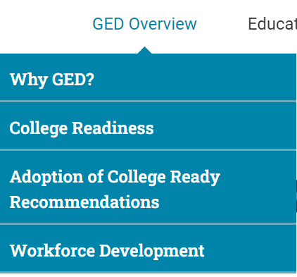

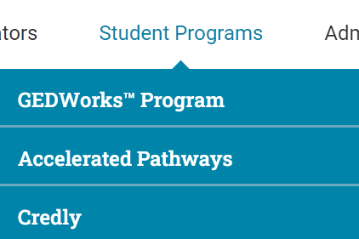
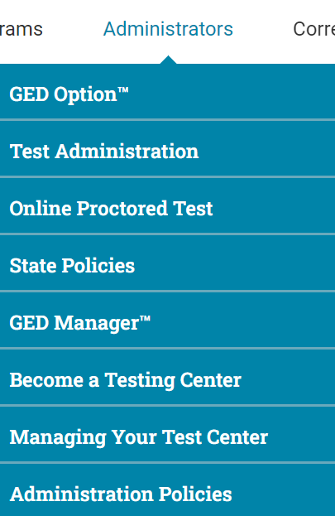
Educators and Admins Site
Notes:
Go through each of the menus.
Corrections, Accommodations, News goes directly to those pages

Slide 7
GED.com and GED Ready®
We encourage educators to:
Create a GED.com account for yourself
Set-up your GED.com using a personal email address
Use a fake last name such as “Educator” or “Adult Educator”
Being familiar with the questions/flow of GED.com will allow you to help your students more.
We encourage educators to:
Take at least one subject of the GED Ready® Official Practice Test
Questions on the GED Ready® are just like the ones on the actual test
Test interface on the GED Ready® is the same as on the GED® test
Students should be familiar with the test interface, tools and resources prior to test day. This is very important.
Taking a GED Ready® as a small group is something education programs have told us works well for them.

Slide 8

GED Mobile App
Currently available in the Apple App Store
Android & Spanish coming soon!
The GED & ME™ App and GED.com use the same login credentials
Takes the learner on a guided journey to achieve their goals
NEW! Students will now see the Syd AI icon on applicable Math questions and receive tailored support through suggested or custom prompts.
GED Mobile App
Notes:
Currently only available for iPhone in the Apple App Store.

Slide 9
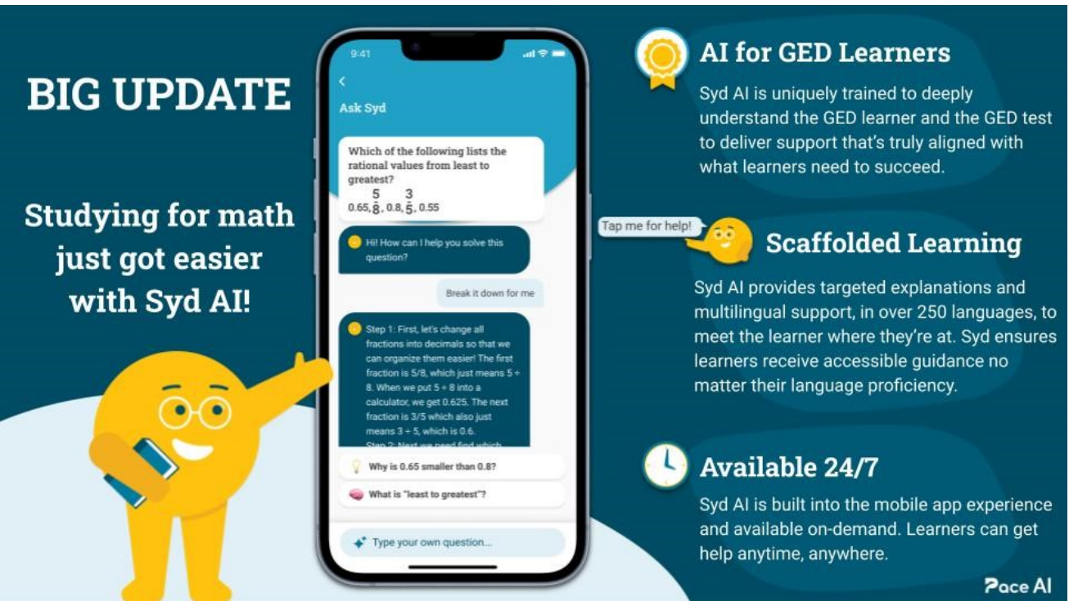

Slide 10
Your State Relationship Team
Mellissa Hulstrand
IL,MI,MN,TN,VT,WI,
PR,VI,MI Prisons
Mellissa.Hulstrand@ged.com
Brian Smith, Director
PA
Brian.Smith@ged.com
Scott Salesses
MA,NY,FBOP
Scott.Salesses@ged.com
Lisa Pool-Osorio AK,AZ,CA,ID,NV,OR,UT, WA, Guam
Lisa.Pool-Osorio@ged.com
Adora Beard
AL,DC,DE,MD,VA,PR
Military
Adora.Beard@ged.com
Liz Lanphear CO,HI,IN,KS,MO,NE,NM,ND,SD
Elizabeth.Lanphear@ged.com
Diane Vaccari
CT,FL,KY,NJ,OH,RI,SC,WV
Bermuda
Diane.Vaccari@ged.com
Shawn Watts (Starting 8/17)
AR,GA,LA
Shawn.Watts@ged.com
Jonna Forsyth
CA,MS,MT,NC,NH,OK,TX,WY
Jonna.Mcdonough@ged.com

Slide 11
Thank You!
Communicate with GED® Testing Service: Contact Us - GED
Diane Vaccari
Diane.Vaccari@ged.com
Scott Salesses
Scott.Salesses@ged.com
11
Notes:
When you don’t know your SRM/or all else fails… email us at help@ged.com and your inquiry will be sent to the appropriate team mate when our Operations team cannot answer themselves.

Slide 12

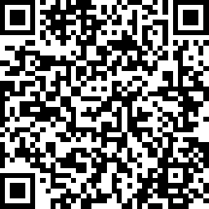
Session Survey
Your feedback is important. Please scan the QR code below to rate this session.

