Slide 1
Civics and Government
Debi Faucette
GED® and GED Testing Service® are registered trademarks of the American Council on Education (“ACE”). They may not be used or reproduced without the express written permission of ACE or GED Testing Service LLC. The GED® and GED Testing Service® brands are administered by GED Testing Service LLC under license from ACE.

Slide 2
Access Materials
https://bit.ly/GEDSS2025

Slide 3
Think About It!
Like Pearl Harbor for their grandparents, and the Kennedy assassination for their parents, 9/11 is an historical event.
The primary use of a phone has always been to take pictures.
There have always been indecisive debates regarding the future of the Electoral College.
Because of Richard Reid’s explosive footwear at 30,000 feet, passengers have always had to take off their shoes to slide through security o the ground.
PayPal has always been an online option for purchasers.
With flyovers, honor guards, and “God Bless America,” sporting events have always been marked by emphatic patriotism.
YouTube has become the video version of Wikipedia.
Quarterback Troy Aikman has always called the plays live from the press booth.
Congress has always banned human cloning completely.
Blackboards have never been dumb.

Slide 4
Today’s Focus
4
What does the research say?
What can you do?
Session Q&A
What do students really need to know?
What does the test require?

Slide 5
The Good News
87% know that the first 10 amendments to the Constitution are called the Bill of Rights
88% know that the Declaration of Independence marked independence from Great Britain
84% know the rule of law means no one is above the law
78% know the speaker of the U.S. House of Representatives is next in line after the president and vice-president
69% know the three branches of government can check the powers of the other two
Notes:
While 53% supported compromise by elected officials on Social Security, support was stronger among younger residents age 18-34 (about 60%) than among their older counterparts who may be planning for retirement or already retired (49% for age 50+). As part of the annual survey, respondents also answered 14 multiple-choice questions measuring their knowledge of U.S. democracy, with questions based on the current U.S. Naturalization Test. As in previous years, the majority knew the first 10 amendments of the U.S. Constitution are called the Bill of Rights (87%) and that the Declaration of Independence marked the nation’s independence from Great Britain (88%). Nearly 9 in 10 also knew that the rule of law means no one is above the law (84%). More than 3 in 4 (78%) knew the speaker of the U.S. House of Representa
As part of the annual survey, respondents also answered 14 multiple-choice questions measuring their knowledge of U.S. democracy, with questions based on the current U.S. Naturalization Test. As in previous years, the majority knew the first 10 amendments of the U.S. Constitution are called the Bill of Rights (87%) and that the Declaration of Independence marked the nation’s independence from Great Britain (88%). Nearly 9 in 10 also knew that the rule of law means no one is above the law (84%). More than 3 in 4 (78%) knew the speaker of the U.S. House of Representatives is next in line to run the country if the president and vice president can no longer serve. Also, more than half (52%) knew the U.S. House of Representatives has 435 members and half knew that serving on a federal jury is a responsibility that is only for U.S. citizens (50%). And when asked to define the separation of powers, 69% correctly said each of the three branches of government can check the powers of the other two — the highest percentage recorded since 2020.

Slide 6
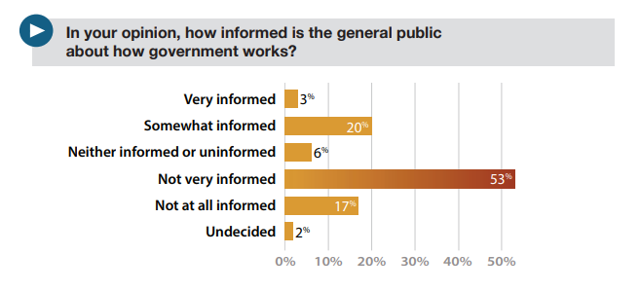
The Bad News!
American Bar Association (ABA) Survey of Civic Literacy, 2023
Notes:
While 53% supported compromise by elected officials on Social Security, support was stronger among younger residents age 18-34 (about 60%) than among their older counterparts who may be planning for retirement or already retired (49% for age 50+). As part of the annual survey, respondents also answered 14 multiple-choice questions measuring their knowledge of U.S. democracy, with questions based on the current U.S. Naturalization Test. As in previous years, the majority knew the first 10 amendments of the U.S. Constitution are called the Bill of Rights (87%) and that the Declaration of Independence marked the nation’s independence from Great Britain (88%). Nearly 9 in 10 also knew that the rule of law means no one is above the law (84%). More than 3 in 4 (78%) knew the speaker of the U.S. House of Representa
As part of the annual survey, respondents also answered 14 multiple-choice questions measuring their knowledge of U.S. democracy, with questions based on the current U.S. Naturalization Test. As in previous years, the majority knew the first 10 amendments of the U.S. Constitution are called the Bill of Rights (87%) and that the Declaration of Independence marked the nation’s independence from Great Britain (88%). Nearly 9 in 10 also knew that the rule of law means no one is above the law (84%). More than 3 in 4 (78%) knew the speaker of the U.S. House of Representatives is next in line to run the country if the president and vice president can no longer serve. Also, more than half (52%) knew the U.S. House of Representatives has 435 members and half knew that serving on a federal jury is a responsibility that is only for U.S. citizens (50%). And when asked to define the separation of powers, 69% correctly said each of the three branches of government can check the powers of the other two — the highest percentage recorded since 2020.

Slide 7
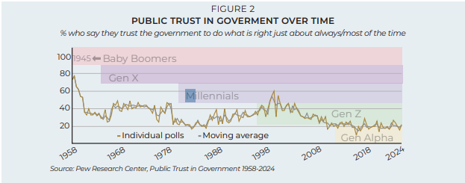
Trust in Government
A lack of civics knowledge goes hand-in-hand with a lack of trust in government institutions— research has shown that these states reinforce each other.
©SANDRA DAY O’CONNOR INSTITUTE FOR AMERICAN DEMOCRACY | OCONNORINSTITUTE.ORG

Slide 8
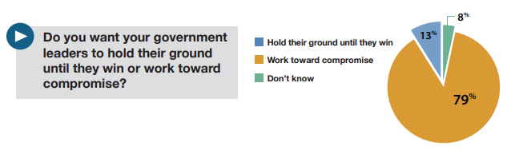
What People Want!
American Bar Association (ABA) Survey of Civic Literacy, 2023
Notes:
While 53% supported compromise by elected officials on Social Security, support was stronger among younger residents age 18-34 (about 60%) than among their older counterparts who may be planning for retirement or already retired (49% for age 50+). As part of the annual survey, respondents also answered 14 multiple-choice questions measuring their knowledge of U.S. democracy, with questions based on the current U.S. Naturalization Test. As in previous years, the majority knew the first 10 amendments of the U.S. Constitution are called the Bill of Rights (87%) and that the Declaration of Independence marked the nation’s independence from Great Britain (88%). Nearly 9 in 10 also knew that the rule of law means no one is above the law (84%). More than 3 in 4 (78%) knew the speaker of the U.S. House of Representa
As part of the annual survey, respondents also answered 14 multiple-choice questions measuring their knowledge of U.S. democracy, with questions based on the current U.S. Naturalization Test. As in previous years, the majority knew the first 10 amendments of the U.S. Constitution are called the Bill of Rights (87%) and that the Declaration of Independence marked the nation’s independence from Great Britain (88%). Nearly 9 in 10 also knew that the rule of law means no one is above the law (84%). More than 3 in 4 (78%) knew the speaker of the U.S. House of Representatives is next in line to run the country if the president and vice president can no longer serve. Also, more than half (52%) knew the U.S. House of Representatives has 435 members and half knew that serving on a federal jury is a responsibility that is only for U.S. citizens (50%). And when asked to define the separation of powers, 69% correctly said each of the three branches of government can check the powers of the other two — the highest percentage recorded since 2020.

Slide 9
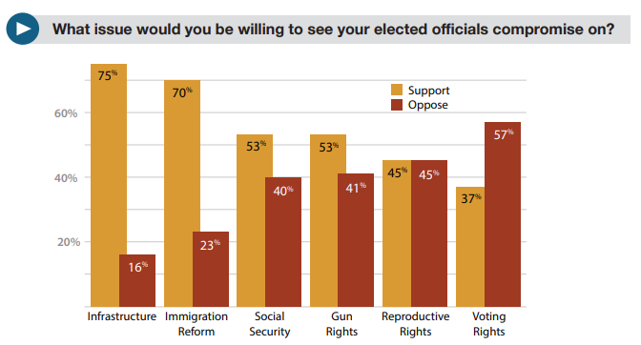
What People Want!
American Bar Association (ABA) Survey of Civic Literacy, 2023
Notes:
While 53% supported compromise by elected officials on Social Security, support was stronger among younger residents age 18-34 (about 60%) than among their older counterparts who may be planning for retirement or already retired (49% for age 50+). As part of the annual survey, respondents also answered 14 multiple-choice questions measuring their knowledge of U.S. democracy, with questions based on the current U.S. Naturalization Test. As in previous years, the majority knew the first 10 amendments of the U.S. Constitution are called the Bill of Rights (87%) and that the Declaration of Independence marked the nation’s independence from Great Britain (88%). Nearly 9 in 10 also knew that the rule of law means no one is above the law (84%). More than 3 in 4 (78%) knew the speaker of the U.S. House of Representa
As part of the annual survey, respondents also answered 14 multiple-choice questions measuring their knowledge of U.S. democracy, with questions based on the current U.S. Naturalization Test. As in previous years, the majority knew the first 10 amendments of the U.S. Constitution are called the Bill of Rights (87%) and that the Declaration of Independence marked the nation’s independence from Great Britain (88%). Nearly 9 in 10 also knew that the rule of law means no one is above the law (84%). More than 3 in 4 (78%) knew the speaker of the U.S. House of Representatives is next in line to run the country if the president and vice president can no longer serve. Also, more than half (52%) knew the U.S. House of Representatives has 435 members and half knew that serving on a federal jury is a responsibility that is only for U.S. citizens (50%). And when asked to define the separation of powers, 69% correctly said each of the three branches of government can check the powers of the other two — the highest percentage recorded since 2020.

Slide 10
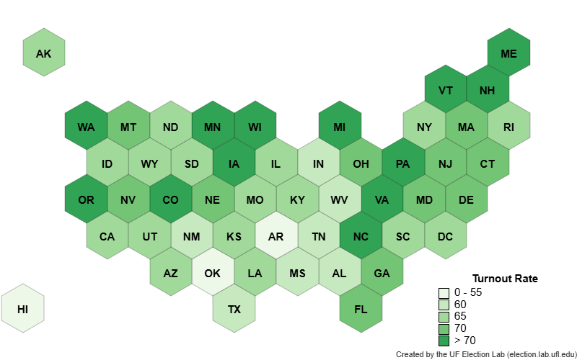
Voter Turnout Rate 2024

Slide 11
Voter Turnout Rate 2024
Population of US
341,777,675
Voting Eligible Population
244,666,890
Registered Voters
In 2024
174,000,000
Voters in 2024
156,766,239
Voting Age Population
264,798,961
Non-Voters in 2024
89,278,948

Slide 12
Skill and Knowledge gaps
12
Gap 1 – Identify evidence to support inferences
Gap 2 – Sequence of events
Gap 3 – Compare differing ideas
Gap 4 – Discrepancies between sources
Gap 5 – Content knowledge
Notes:
We will discuss 5 gap areas in Social Studies.
The focus will be on:
Making and identifying inferences in primary and secondary sources
Sequencing events, which includes sequencing steps in a process.
Comparing different ideas
Analyzing differences in primary and secondary sources
Finally, we will look at the student's gaps in social studies content knowledge. Greater than 90% of GED SS questions do not require prior knowledge. In most cases, the item stimulus provides the answer

Slide 13
What is a skills gap?
13
A gap is the difference between the actual performance and the expected performance.
When student performance on a skill does not match what is expected, such as a straightforward skill that students seem to answer incorrectly.
Or a common skill that is difficult but that students could answer correctly with more instruction.
Guidance and clarification on these skills could help students improve their overall performance.
Notes:
A gap is the differences between the actual performance and the expected performance.
It is the difference between what our students know and we expected they would know.

Slide 14

Possible Reasons for Gaps
14
The students may need to improve their critical thinking and/or reading skills.
Students may need additional instruction on skills identified as gaps and on specific knowledge in content topics during GED® test preparation​.
Students tend to underperform on certain items simply because the concepts are difficult.
Notes:
Let’s look at the possible reasons for gaps.
The students may need to improve their critical thinking and/or reading skills. We see evidence of this across all four GED Subjects.
Most GED SS questions do not require content knowledge. In other words, the question stimulus provides the answer.
That said, all of the questions require reading comprehension and critical thinking skills.
The students may have specific knowledge or skill gaps that need more coverage during GED® test preparation.
Our students learn at different paces. Some students may simply need to put in more time before they understand the concept or can perform the skill.
Students tend to perform less well on certain items simply because the concepts are difficult.
Our students are not all on the same academic level and that is okay. We don't expect every student to get a perfect score.
The student's score is indicative of what they know and what they can do. We have test items at a variety to difficulty levels and a variety of complexity levels.
This is necessary so we can distinguish between students who know enough to earn their credential and those who are College and Career ready. Or those who are at the College and Career Ready+ Credit level.

Slide 15
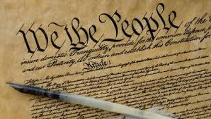

Content Knowledge
15
Test questions assume students have a basic understanding of the social studies subject matter and terminology used in the content topics and indicators.
The gap:
Civics/Government
Economics
Notes:
Basic social studies content knowledge is required. By my reckoning, basic knowledge is slightly more than definitional knowledge, but only slightly more.
The GED SS test does not require a lot of prior knowledge.
For most items, probably about 95%, the stimulus will provide the knowledge required to answer the question.
The required social studies content knowledge is based on the Social Studies Content Topics and Subtopics, found in the GED® Assessment Guide for Educators.
The biggest knowledge gaps are in Civics and Government and Economics.

Slide 16
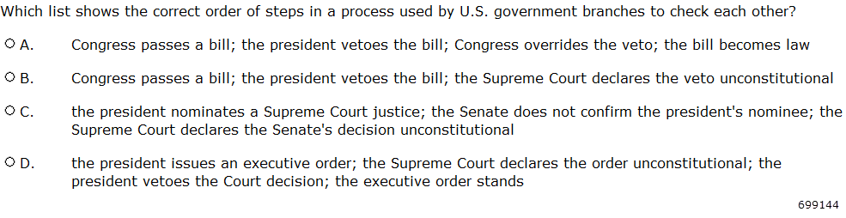

Gap 2 Example #2
16
Notes:
[699144—Rejected DR]
3.a Identify the chronological structure of a historical narrative and sequence steps in a process.
Topic CG.b.5 Checks and balances or CG.c.1. Structure, powers, and authority of the federal executive, judicial, and legislative branches
Prior knowledge required. This one asks for steps in a process and requires prior knowledge. The stem asks for a focus on branches CHECKING each other. Students must know what “checking” means and the process whereby government branches check each other.
Key = A

Slide 17
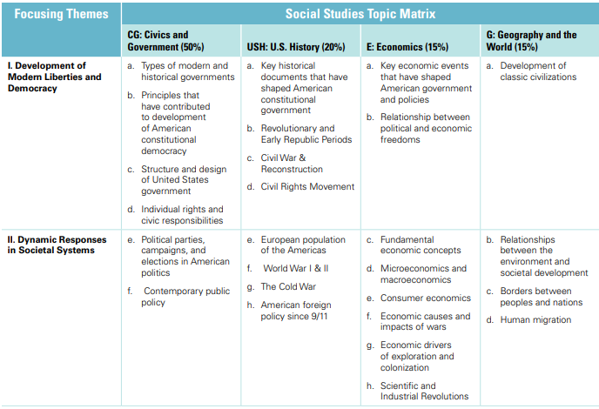
17
Notes:
This list is from the Civics and Government Content Topics.
The biggest gaps in Civics and Government knowledge are in red boxes.

Slide 18
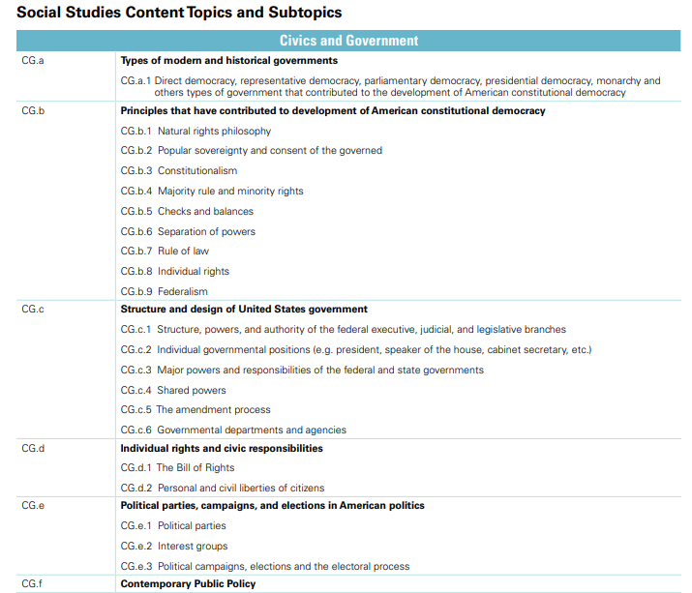
18
Notes:
This list is from the Civics and Government Content Topics.
The biggest gaps in Civics and Government knowledge are in red boxes.

Slide 19
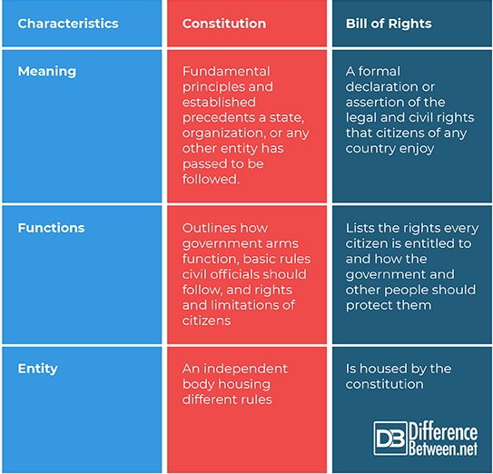
What is the Difference?
19

Slide 20
Explore the Basics
20
Article I
Article II
Article III
Article IV
Congress
President
Courts
States
Notes:
Key Points
Briefly discuss with participants Articles I-IV of the Constitution.
© Copyright GED Testing Service LLC. All rights reserved.
20

Slide 21
Explore the Basics
21
Coin Money
Establish the Budget
Regulate Commerce
Declare war and support an army and navy
Make other laws to carry out powers
Article I
Article II
Article III
Article IV
Congress
Act as Commander-in-Chief
Maintain cabinet of advisers
Negotiate treaties
Appoint Supreme Court Justices
Execute laws
President
Interpret the meaning of laws
Decide whether a law is relevant to a particular set of facts
Rule on how a law should be applied
Determine whether a law is constitutional
Courts
Create and enforce their own laws
Respect laws of other states
Extradite criminals
Have a representative government
Follow “supreme law of the land”
States
Notes:
Key Points
Briefly discuss with participants Articles I-IV of the Constitution.
© Copyright GED Testing Service LLC. All rights reserved.
21

Slide 22
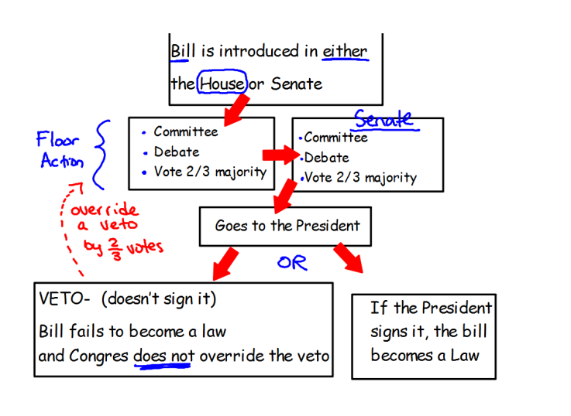
From Bill to Law
22

Slide 23
Amending the Constitution
Proposed in Congress
2/3 Vote in Both Houses
Ratified by ¾ of state legislatures
23
Proposed in Congress
2/3 Vote in Both Houses
Ratified in conventions in ¾ states
2/3 of state legislatures call for a national convention
Ratified by ¾ of the state legislatures
Notes:
The US Constitution can be amended through four distinct methods, outlined in Article V:
1. Proposed by Congress, ratified by state legislatures:
.Opens in new tabA two-thirds vote in both houses of Congress is needed to propose an amendment, and then it must be ratified by three-fourths of the state legislatures.
2. Proposed by Congress, ratified by state conventions:
.Opens in new tabA two-thirds vote in both houses of Congress is needed to propose an amendment, and it must be ratified by conventions in three-fourths of the states.
3. Proposed by a convention of the states, ratified by state legislatures:
.Opens in new tabTwo-thirds of the state legislatures must call for a national convention to propose an amendment, which then needs to be ratified by three-fourths of the state legislatures.
4. Proposed by a convention of the states, ratified by state conventions:
.Opens in new tabTwo-thirds of the state legislatures must call for a national convention to propose an amendment, and it must be ratified by conventions in three-fourths of the states.

Slide 24
What are my rights?
24
Amendment 1 | (5)
Amendment 2 | (1)
Amendment 3 | (1)
Amendment 4 | (1)
Amendment 5 | (5)
Amendment 6 | (5)
Amendment 7 | (1)
Amendment 8 | (1)
Amendment 9 | (1)
Amendment 10 | (1)

Slide 25
25
“If there is a bedrock principle underlying the First Amendment, it is that the government may not prohibit the expression of an idea simply because society finds the idea itself offensive or disagreeable.”
– Justice William J. Brennan
Associate Justice of the Supreme Court, 1956-1990

Slide 26
What are my rights?
26
Amendment 1 | (5) Freedom of speech, religion, press, assembly, petition the government
Amendment 2 | (1) Right to keep and bear arms
Amendment 3 | (1)Protection against housing soldiers without owner’s permission
Amendment 4 | (1) Protection against unreasonable search and seizure
Amendment 5 | (5)Right to be indicted by a grand jury, protection against double jeopardy, right against self-incrimination, right of due process, just compensation if government takes property
Amendment 6 | (5) Right to speedy trial, right to an impartial jury, right to be informed of criminal charges, right to be confronted by adverse witnesses, right to assistance of counsel
Amendment 7 | (1) Right to a jury trial in federal civil cases
Amendment 8 | (1) Protection against cruel and unusual punishment
Amendment 9 | (1) People have other rights that are not specified in the Constitution
Amendment 10 | (1) Any power not listed is left to the states or the people

Slide 27
27
RIGHTS
RESPONSIBILTIES
Bill of Rights
Vote
Life, Liberty, and Property
Freedom of Religion
Freedom of Speech and Press
Right to Bear Arms
Right to Assemble and Petition
Right to Trial by Jury
Protection from Unreasonable Searches and Seizures
Pay Taxes
Obey Laws
Serve on Jury
Notes:
Key Points
Check to see if all of the responsibilities included on the slide were listed by the participants. If one or more is missing, discuss why that responsibility is important.

Slide 28
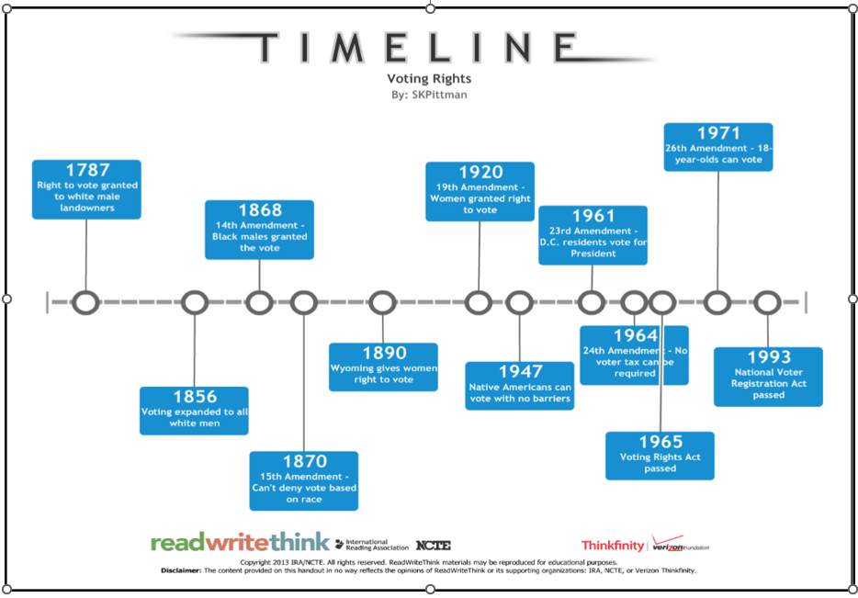
28
U.S. History through Voting Rights

Slide 29
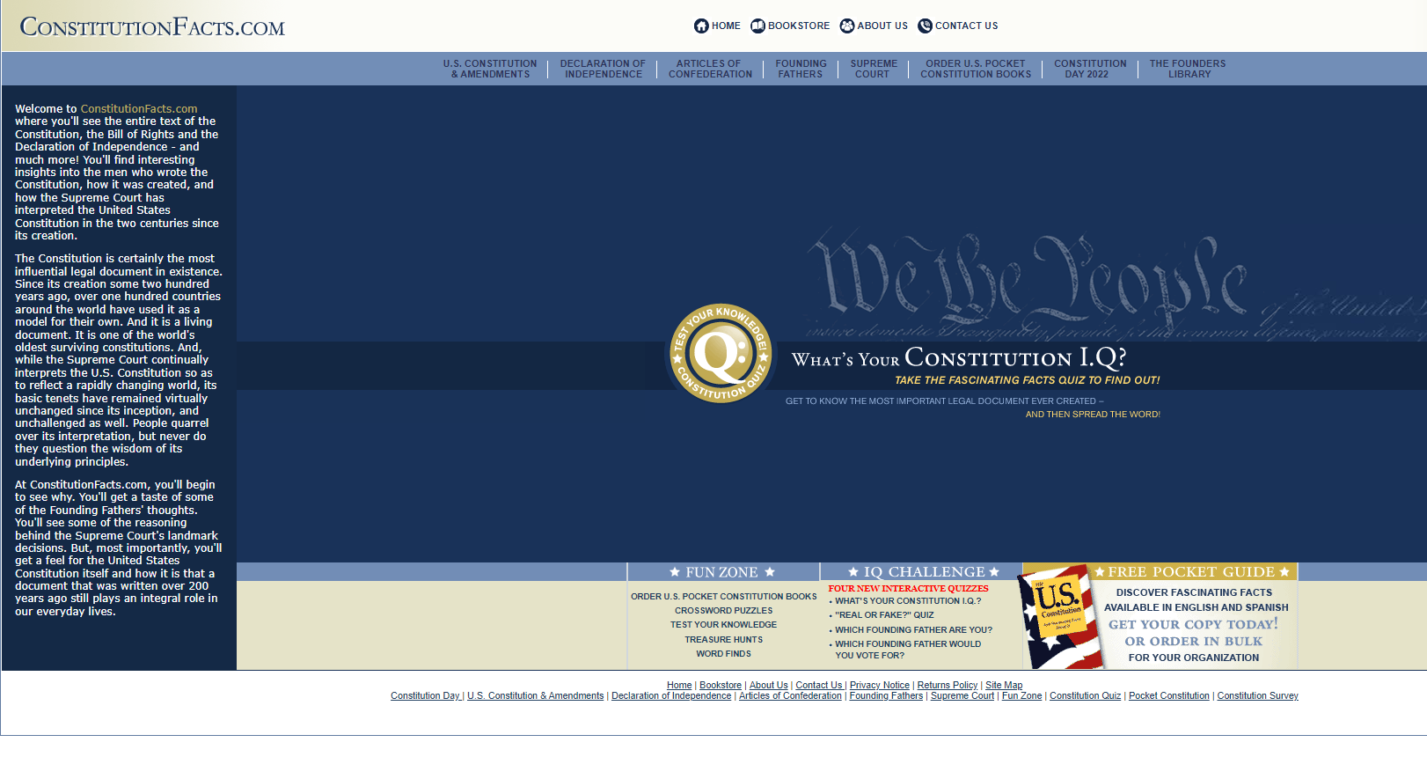
29
https://www.constitutionfacts.com/
Notes:
[726911—Rejected DR]
3.d Compare differing sets of ideas related to political, historical, economic, geographic, or societal contexts; evaluate the assumptions and implications inherent in differing positions.
CG.b.1 Natural rights philosophy
Prior knowledge not required.
C is the correct answer. If there is “no legal obligation for fair conduct and good behavior,” then “fear and constant danger from others,” is implied,
In field test, many chose B. "He has no need for rules or government."
However, B is incorrect because if there are “no laws and no legal obligation for fair conduct and good behavior,” the implication is that unfair conduct and bad behavior will occur, creating a need for government.
The “Supremacy Clause” of the Constitution states that any state or local law that directly conflicts with a valid federal law is void. • The Supremacy Clause is the common name given to Article VI, Section 2 of the U.S. Constitution. It declares that the “Constitution, and the Laws of the United States . . . shall be the supreme Law of the Land.”

Slide 30
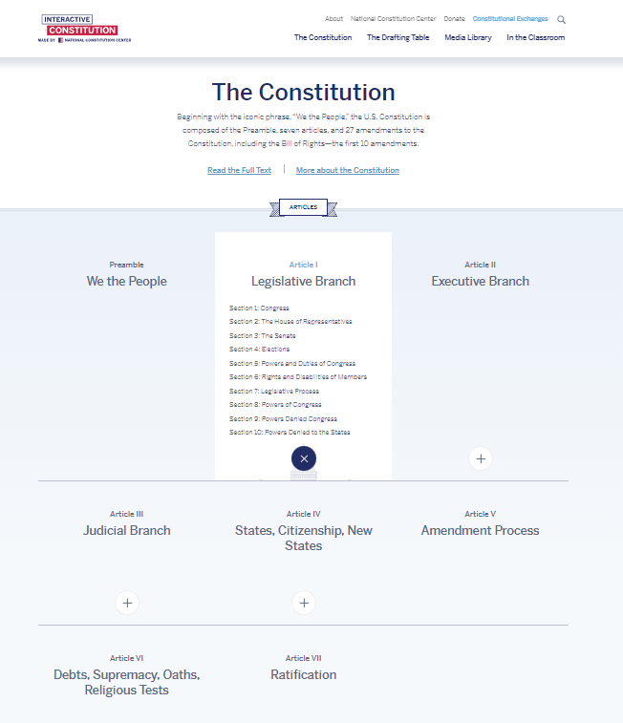
30
https://constitutioncenter.org/interactive-constitution/the-constitution

Slide 31
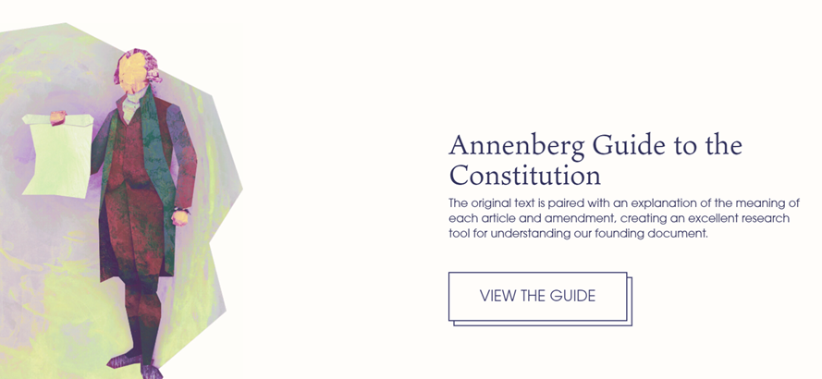
Content Knowledge – Access Online Resources
31
http://www.annenbergclassroom.org
Copyright and Use of AnnenbergClassroom.org Books:
All AnnenbergClassroom.org books are free for viewing at AnnenbergClassroom.org and may be downloaded only by teachers and students without charge.
Notes:
[726911—Rejected DR]
3.d Compare differing sets of ideas related to political, historical, economic, geographic, or societal contexts; evaluate the assumptions and implications inherent in differing positions.
CG.b.1 Natural rights philosophy
Prior knowledge not required.
C is the correct answer. If there is “no legal obligation for fair conduct and good behavior,” then “fear and constant danger from others,” is implied,
In field test, many chose B. "He has no need for rules or government."
However, B is incorrect because if there are “no laws and no legal obligation for fair conduct and good behavior,” the implication is that unfair conduct and bad behavior will occur, creating a need for government.

Slide 32
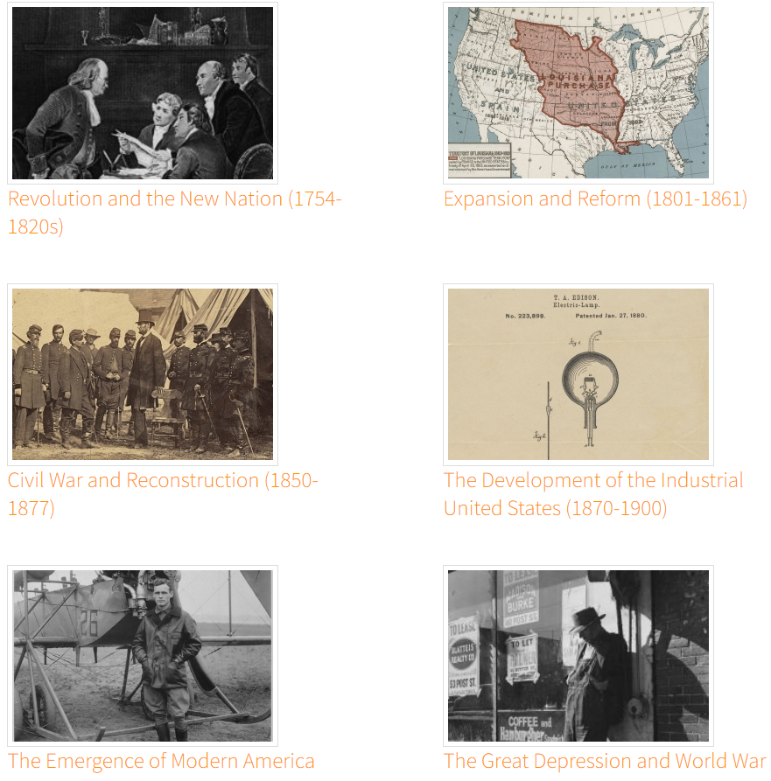
Content Knowledge – Access Online Resources
32
http://docsteach.org/
DocsTeach is a product of the National Archives education division.
Except where otherwise noted, DocsTeach is licensed under a Creative Commons Attribution-NonCommercial-ShareAlike 4.0 International License. Primary source documents included on this site generally come from the holdings of the National Archives and are in the public domain, except as noted. Teaching activities on this site have received the CC0 Public Domain Dedication; authors have waived all copyright and related rights to the extent possible under the law. See our legal and privacy page for full terms and conditions

Slide 33
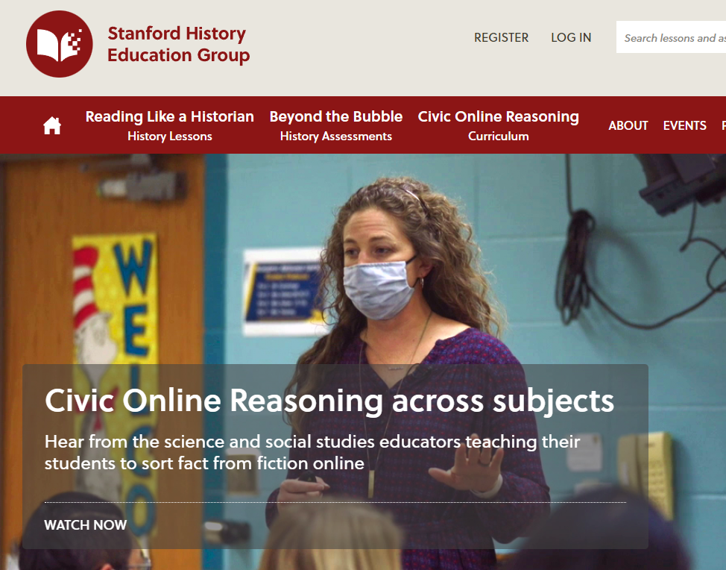
Content Knowledge – Access Online Resources
33
http://sheg.stanford.edu/?q=node/21
The lessons and assessments available on this website via PDF download or Google Drive hyperlink are governed by Creative Commons Licenses.

Slide 34
General Strategies
34
Share the GED® indicators and content topics with your students. The content topics can be used as a teaching/study guide.
Review key foundational concepts/content.
Remind students to carefully read the questions and excerpts.
Encourage students to study key definitions and terms.
Encourage students to read more. Strong reading skills will benefit students in all 4 subject area tests.
Encourage students to analyze the content they read on a daily basis. Strong critical thinking skills will benefit students in all 4 subject area tests.
Notes:
[699080—DR Reject]
8.a Compare treatments of the same social studies topic in various primary and secondary sources, noting discrepancies between and among the sources.
CG.a.1 Types of modern and historical governments—Direct democracy, representative democracy, parliamentary democracy, presidential democracy, monarchy and other types of government that contributed to the development of American constitutional democracy
Prior knowledge not required.
A. Both mention specific powers of the president, but more so in the blog
B. Both mention the relationship between branches, the letter with more detail.
C. Both mention the presidential elections, but the letter points out that presidential elections "rightly" attract much attention," which is a recognition of the election's importance.
D. Correct. The letter does not defend strong presidential powers. But the blog says, "Powers this extensive can be justified by the fact that the president is elected by the people"
Key = D

Slide 35

35

Slide 36
Thank you!
36
Susan Pittman – skptvs@gmail.com

Slide 37

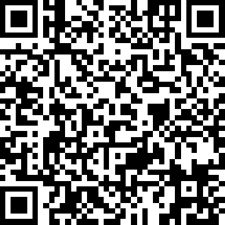
Session Survey
Your feedback is important. Please scan the QR code below to rate this session.

