Slide 1
Bridging Math Skill Gaps, Part 2:
Identifying Math Skill Gaps and Test-Taking Strategies for Success
Kellie Blair Hardt
Hardt2heart Adult Education Services
GED Testing Service, Board of Directors
GED® and GED Testing Service® are registered trademarks of the American Council on Education (“ACE”). They may not be used or reproduced without the express written permission of ACE or GED Testing Service LLC. The GED® and GED Testing Service® brands are administered by GED Testing Service LLC under license from ACE.

Slide 2
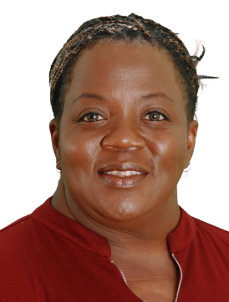

Kellie Blair Hardt
GED Math Tutor & Board Member @ GED Testing Service
20+ years of middle/high school math/science/special education
20+ years of adult adult education, math
Hardt2Heart Adult Education Services, LLC
B.A Psychology, M.Ed Special Ed., PhD candidate (Adult Education)
GED Graduate!
- Kellie’s Story-
- Kellie’s Coloring Book-
- New GEDTS
Board Member-
-GED Testing Service
Podcast-
Kellie B. Hardt

Slide 3

Agenda
Interactive Session for Educators
Strengthen & share math teaching methods.
Awareness of Challenging GED Math Skill Gaps
Quick review of common nationwide math concept difficulties test takers face.
Utilizing the TI-30XS Multiview Calculator
To enhance test-taking efficiency and accuracy.
Practical Exercises
Simplify concepts for learners.
Explore teaching & test-taking strategies for quadratic equations, factoring,
writing and graphing linear equations, and more!

Slide 4

Review: Bridging Math Skill Gaps, Part 1
About That Math Exam
  Statistics & Test Structure
Did You Know?
  Test-Taking Tips & Instructional Strategies For All Levels
Your One Stop Shop For Resources
  Handbooks, Study Guides, Admin & Educator Resources Located on GED.com
Roll-Up Your Sleeves!
  Hands-on Calculator Practice/Polynomials
-Bridging Math Skill Gaps, Part 1-

Slide 5
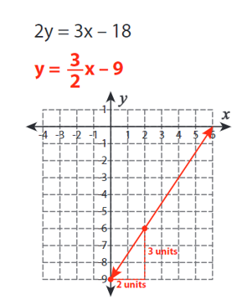
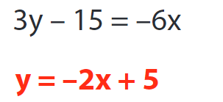
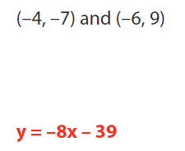
GED Knowledge & Skill Gaps, Part 2
Slopes/Graphing/Linear Equations
Indicators
calculate slope from a table, graph or equation
graph a two-variable equation
Related indicators
unit rate as slope
writing equations from points and/or slope; working with parallel and perpendicular slopes

Slide 6
Before We Begin Our Practice…
Solving With & Without The Calculator
WITHOUT:
Skills Fundamental Critical
Development Understanding Thinking
WITH:
Error Efficiency Confidence
Reduction Building

Slide 7
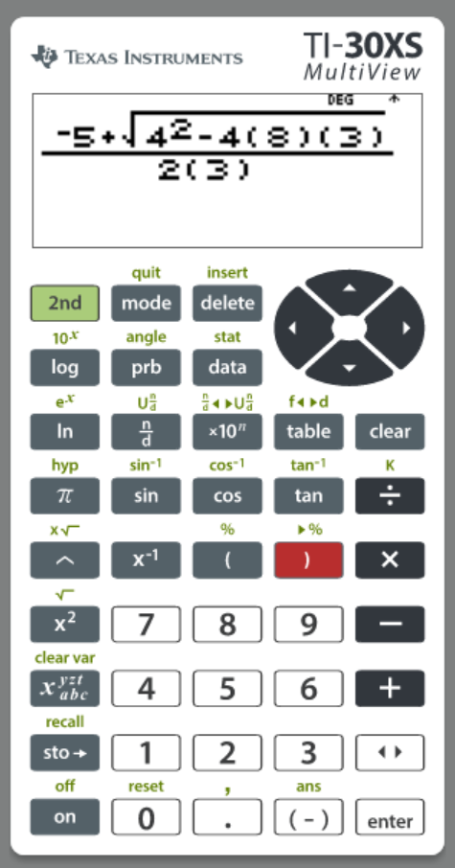
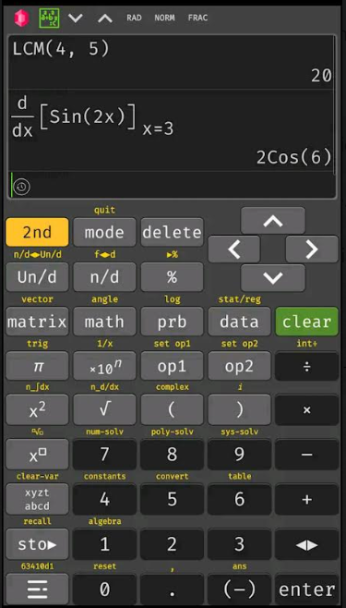
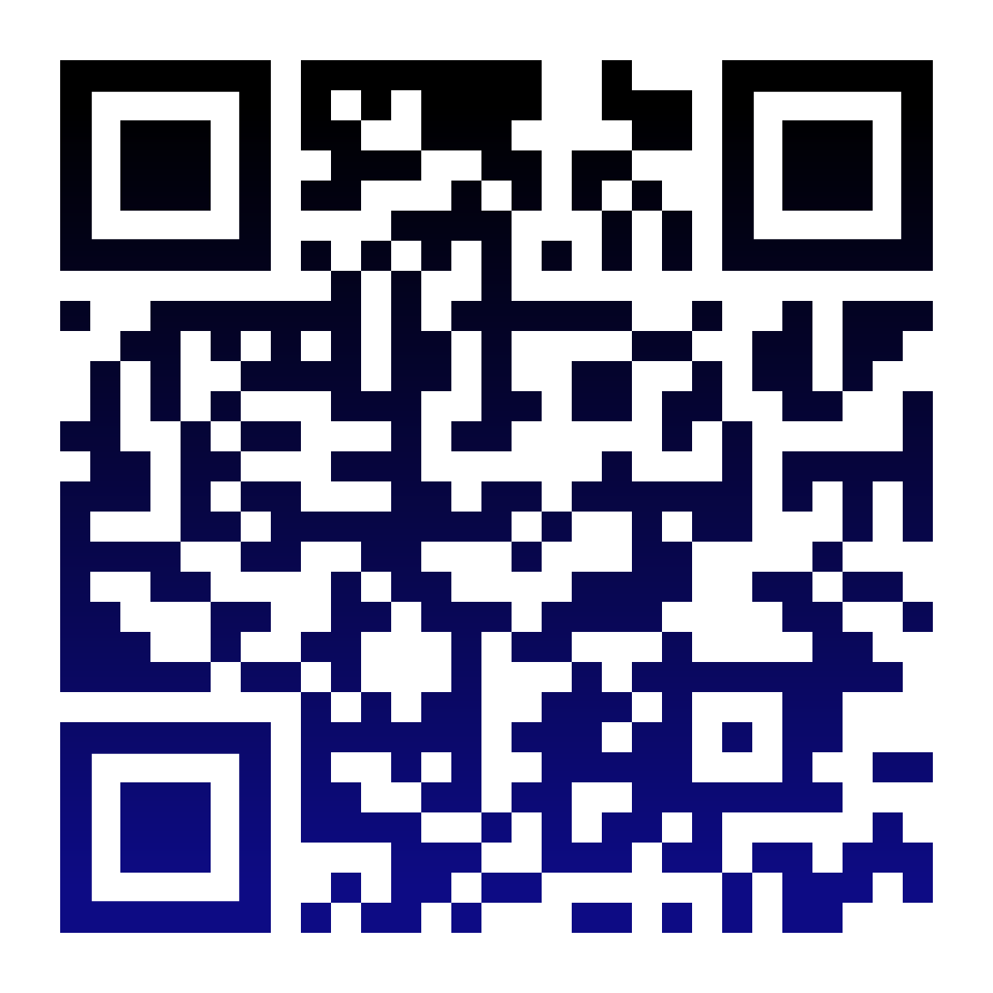


About the TI-30xs Multiview Calculator
T
-Android Google Play-
-Free web based for computers, Android, iPhone (ads)-
-Computer
Emulator -
-Hand held-
-GED calculator
reference sheet-
-TI-30xs Guide
for Teachers-
-Introduction to TI-30xs-

Slide 8

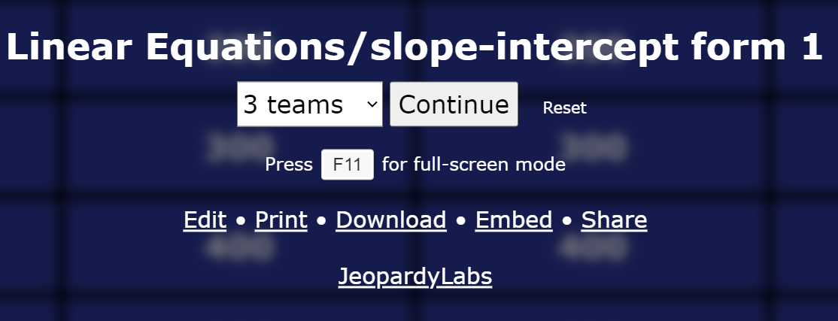

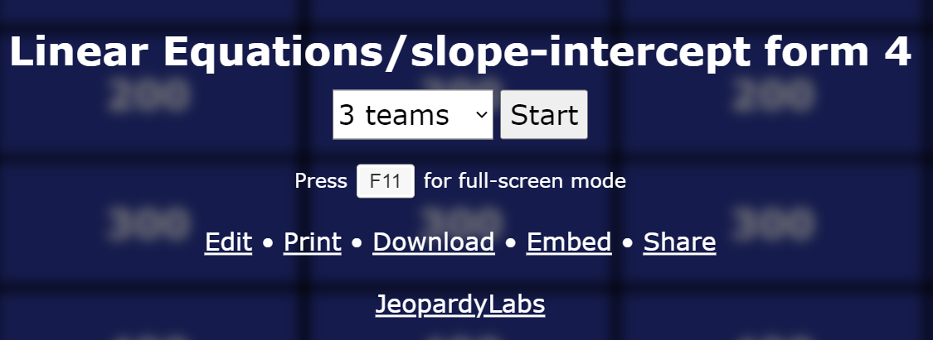

Roll-up Your Sleeves!
…but wait, there’s more!
Convert to Slope- Intercept Form Resources

Slide 9
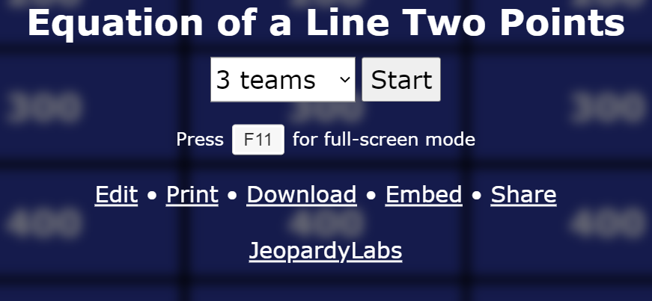
Roll-up Your Sleeves!
…but wait, there’s more!
Write the Equation of a Line Given Two Points
Resources
Manual
Calculator

Slide 10
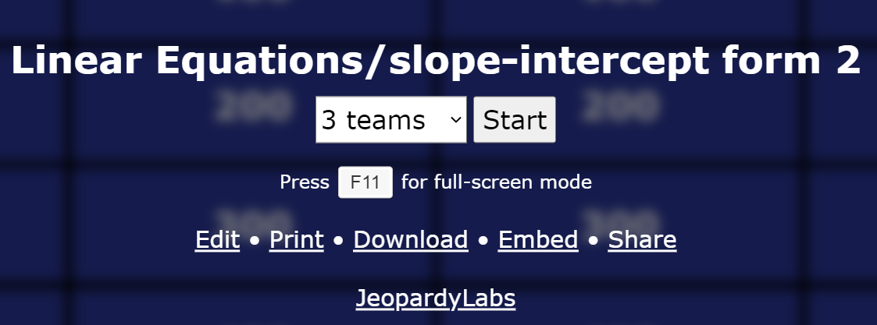
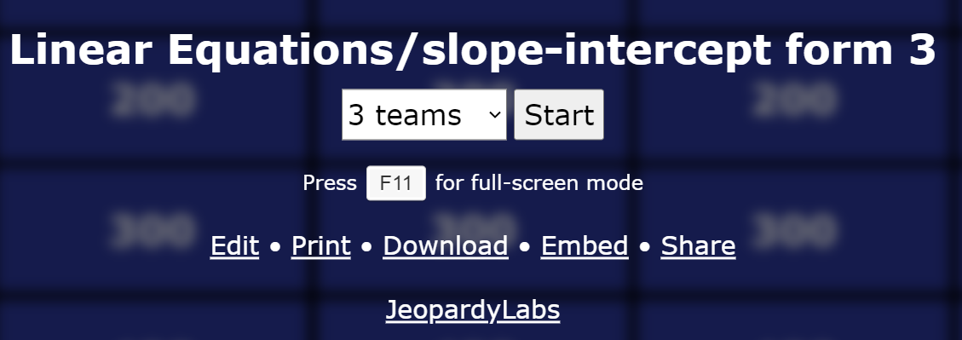
Roll-up Your Sleeves!
…but wait, there’s more!
Graphing an Equation in Slope-Intercept Form
Resources

Slide 11
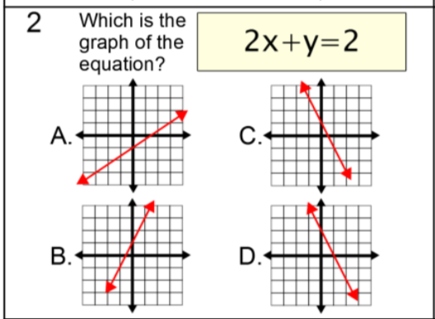
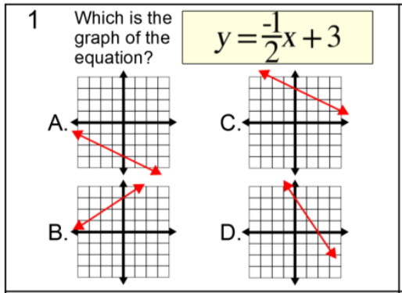
Roll-up Your Sleeves!
…but wait, there’s more!
Multiple Choice
Graphing an Equation in Slope-Intercept Form
Resources

Slide 12
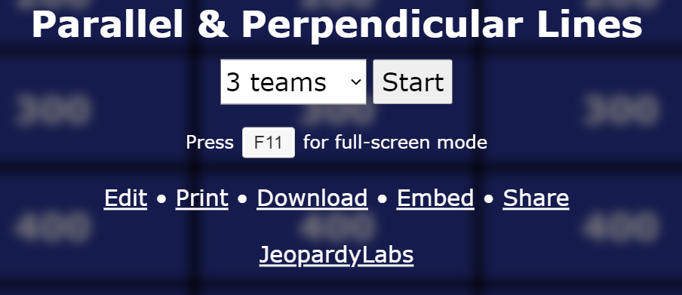
Roll-up Your Sleeves!
…but wait, there’s more!
PARALLEL & PERPENDICULAR LINES
IN SLOPE INTERCEPT FORM
Resources

Slide 13
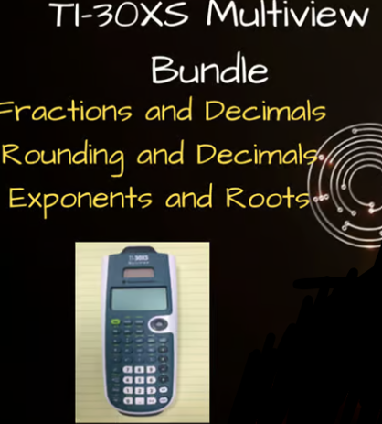
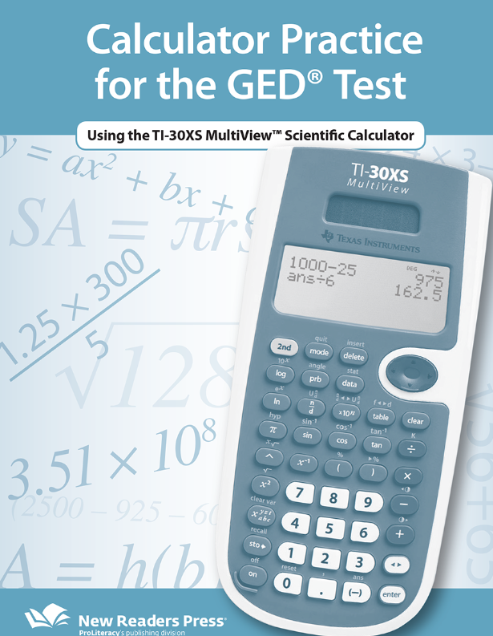


MORE CALCULATOR PRACTICE & RESOURCES
-Exponents & Squares-
-Calculator Practice Sheet-
-Fractions & Decimals-
-Free Adult Education Resources-
-Rounding & Decimals-

Slide 14



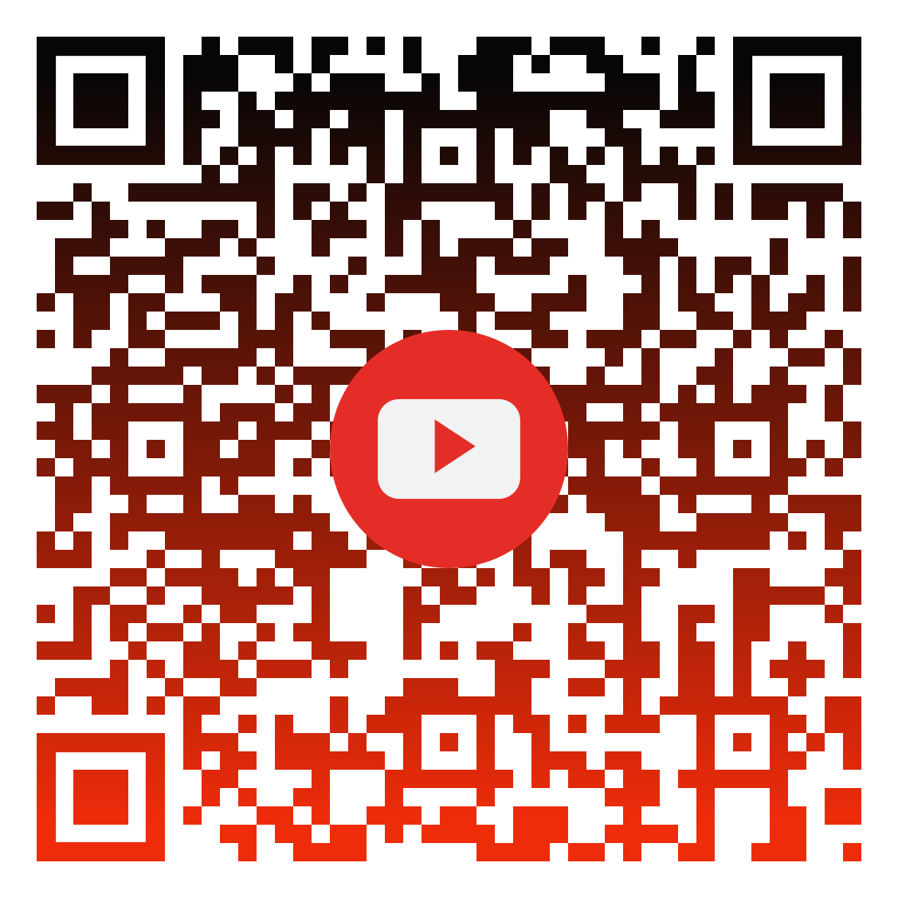


Slide 15

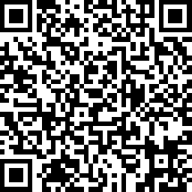
Session Survey
Session Slides
Your feedback is important!
Please scan the QR code below
to rate this session.
Interactive PDF of session slides with hyperlinks!

