Slide 1
Bridging Math Skill Gaps, Part 1:
Identifying Math Skill Gaps and Test-Taking Strategies for Success
Kellie Blair Hardt
Hardt2heart Adult Education Services
GED Testing Service, Board of Directors
GED® and GED Testing Service® are registered trademarks of the American Council on Education (“ACE”). They may not be used or reproduced without the express written permission of ACE or GED Testing Service LLC. The GED® and GED Testing Service® brands are administered by GED Testing Service LLC under license from ACE.

Slide 2
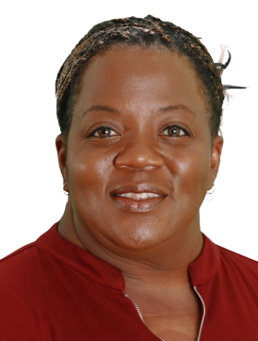

Kellie Blair Hardt
GED Math Tutor & Board Member @ GED Testing Service
20+ years of middle/high school math/science/special education
20+ years of adult adult education, math
Hardt2Heart Adult Education Services, LLC
B.A Psychology, M.Ed Special Ed., PhD candidate (Adult Education)
GED Graduate!
- Kellie’s Story-
- Kellie’s Coloring Book-
- New GEDTS
Board Member-
-GED Testing Service
Podcast-
Kellie B. Hardt

Slide 3

Agenda
Interactive Session for Educators
Strengthen & share math teaching methods.
Awareness of Challenging GED Math Skill Gaps
Quick review of common nationwide math concept difficulties test takers face.
Utilizing the TI-30XS Multiview Calculator
To enhance test-taking efficiency and accuracy.
Practical Exercises
Simplify concepts for learners.
Explore teaching & test-taking strategies for quadratic equations, factoring,
writing and graphing linear equations, and more!

Slide 4
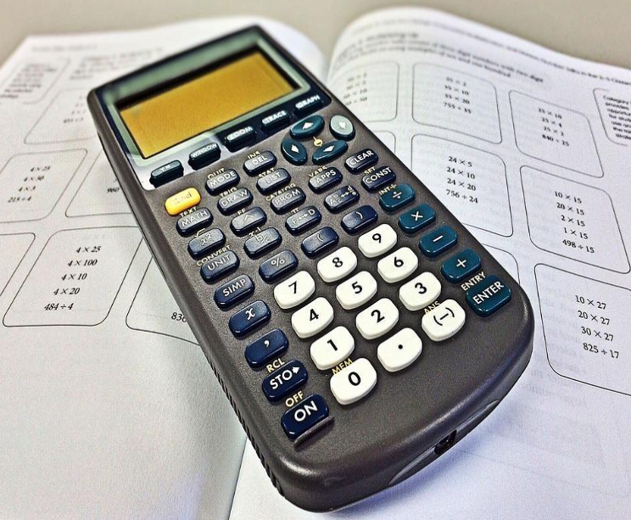
About That Math Exam
As of April 6, 2025:
190,878 adult learners have passed 3 of the 4 required GED tests and never finished the final test
154,224 students/81% need to complete Math
22,158 students/11% need to complete RLA
8,949 students/5% need to complete Social Studies
5,547 students/3% need to complete Science

Slide 5
About That Math Exam
There are about 46 questions on the GED math test. These questions are split into two parts; about 5 questions on the first part (no-calculator) and about 41 questions on the second part (calculator permitted). 115 minutes
45% Content: Quantitative Problem Solving • Number operations • Geometric thinking
55% Content: Algebraic Problem Solving
Most of the questions will be multiple-choice with four options (A through D).
Fill-in-the-blank questions will require the learner to type a numerical answer to a problem or to enter an equation, words or phrase.

Slide 6
About That Math Exam
Drop-down questions give the learner an opportunity to click the word “Select” and choose the option that correctly completes the statement.
Drag-and-drop items require the learner to click on an image, number, or symbol and to drag and drop it to a specified location on the computer screen to create an expression, equation, or inequality.
Hot-spot questions are based on a graphic such as a number line, coordinate grid, or geometric figure. The learner will need to click on a specific place or places on the figure.

Slide 7
NOTE: If a concept is not described in the GED Mathematical Reasoning Indicators,
then it is not assessed on the GED Mathematical Reasoning test.
➢ Geometric proofs
➢ Trigonometry
➢ Exponential functions
➢ Two-variable inequalities
➢ Graphing quadratic equations
➢ Determining lines of best fit
About That Math Exam

Slide 8
About That Math Exam:
DID YOU KNOW?
Questions on the GED Math test are not weighted differently—each typically counts equally toward your final score.
That means it's not about doing the hardest problems—it's about answering as many correctly as possible, no matter the type.
Accuracy + Efficiency = Success
Mastering the TI-30XS Multiview can significantly improve both!
Notes:
Learners must understand that, just as any high school test, its measuring how much they know, not how much they don’t know.

Slide 9
About That Math Exam:
DID YOU KNOW?
Wrong answers do not count against a learner on the GED Math exam.
Like any high school-level exam, the GED measures what they know, not what they don’t.
Only correct answers count towards a score.
There’s no penalty for guessing. So even if a learner is unsure—encourage them to take their best shot. Leaving answers blank means missing out on points they might earn!

Slide 10
About That Math Exam:
DO YOU KNOW?
Time management is Key
Learners spend too much time on a single question. Help them practice strategies to pace themselves, so they don’t get stuck on one problem and run out of time.This approach ensures enough time to attempt every question, increasing the chance of completing the test and
maximizing the score.

Slide 11
About That Math Exam:
DO YOU KNOW?
“Three minutes to win it!” Strategy
Prioritize Questions: Start with questions that can be answered quickly. This will help build confidence and save time.
Choose & Flag: If a question takes longer than three minutes, choose an answer, flag it, and move on. If there's time, come back to it later.
Watch the clock: Keep an eye on the clock. With the “three minutes to win it” strategy, test takers should have plenty of time to go back, review, and pick up more points.

Slide 12
About That Math Exam:
Strategies For All Levels:
Provide and practice the -formula sheet- in class often, especially surface area & volume and algebra sections (slopes, quadratic, etc.), no matter content level of class.
Know how to use calculator (TI-30XS Multiview), and promote calculator practice in class, no matter learner level; even during non-calculator practice problems.
Tell learners about the “Did You Know” scoring information & the “Three minutes to win it””
Create your own learner account using last name as “CANDIDATE.”
Take the GED READY PRACTICE TEST several times & utilize GED FLASH.

Slide 13




Your One Stop Shop for Resources
- all resources for educators & admin-

Slide 14



Your One Stop Shop for Resources
- all resources for educators & admin-

Slide 15

Your One Stop Shop for Resources
Want to know what your student’s scores mean? Find out with these Performance Level Descriptors. Each explains the skills a student demonstrates through scoring into each performance level on the GED® test and the GED Ready® practice test.
- all resources for educators & admin-

Slide 16

Your One Stop Shop for Resources
…BUT WAIT…. THERE’S MORE!
Tuesdays for Teachers Webinar Series
Tuesdays for Teachers is a free professional development webinar series designed for educators. This bi-monthly webinar series will take a deeper dive into classroom strategies and techniques for the GED test.
- all resources for educators & admin-

Slide 17
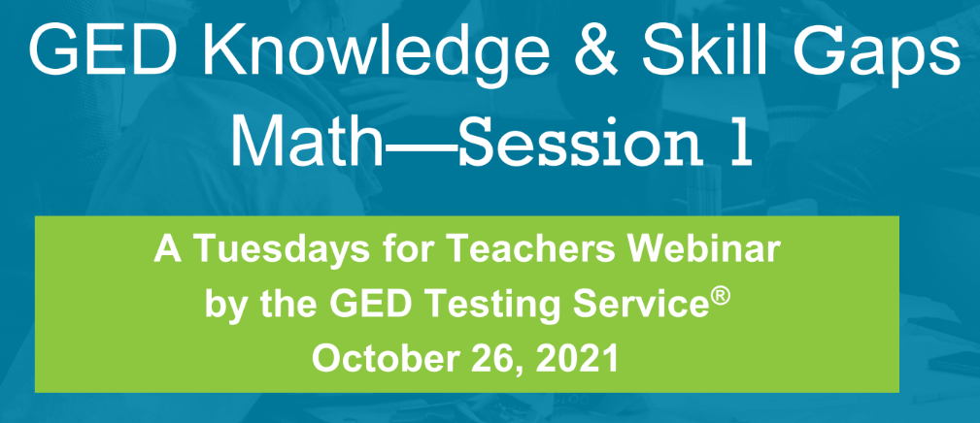
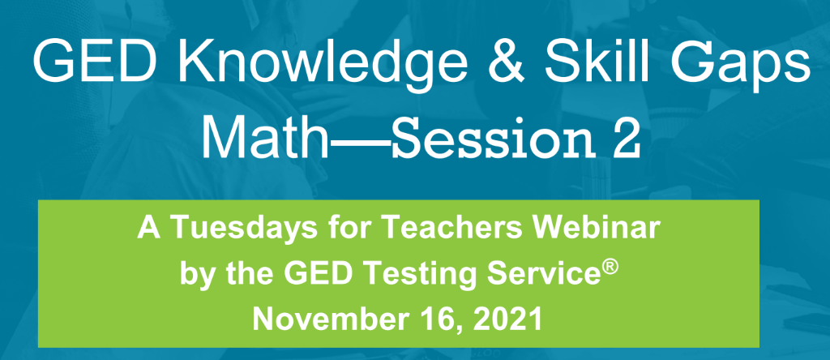
Your One Stop Shop for Resources
Click the pic
Click the pic

Slide 18
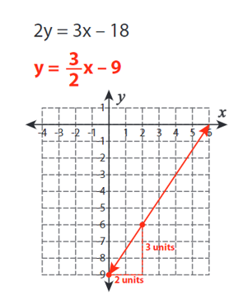
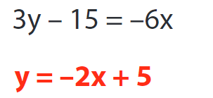
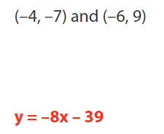
GED Knowledge & Skill Gaps, Part 2
Slopes/Graphing/Linear Equations
Indicators
calculate slope from a table, graph or equation
graph a two-variable equation
Related indicators
unit rate as slope
writing equations from points and/or slope; working with parallel and perpendicular slopes

Slide 19
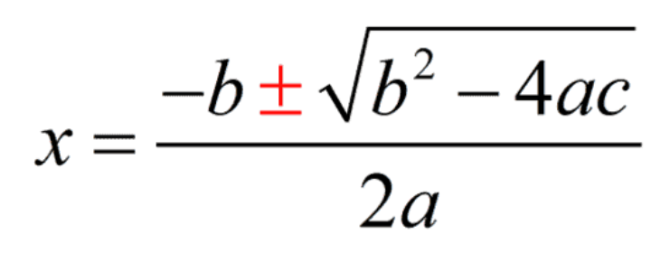
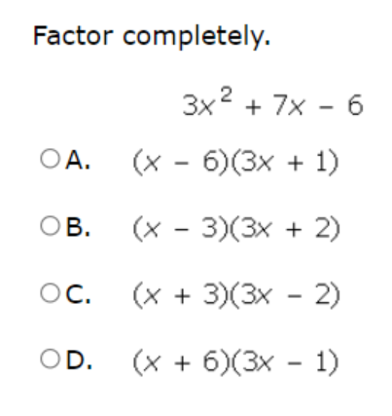
GED Knowledge & Skill Gaps, Part 1
Algebraic Computations
Indicators:
factoring, computing w/linear expressions
computing w/polynomials
factoring polynomials
Skills:
add/subtract
multiply/divide
multiple operations
quadratic equations

Slide 20
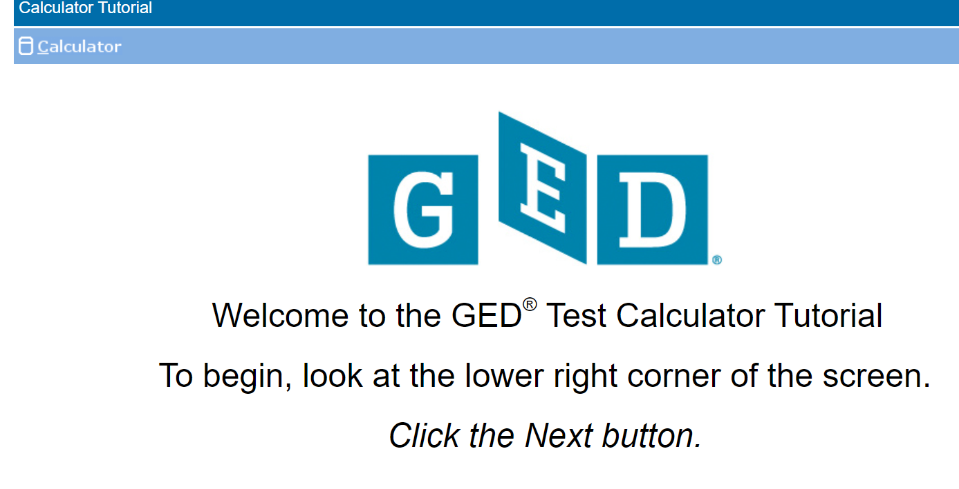
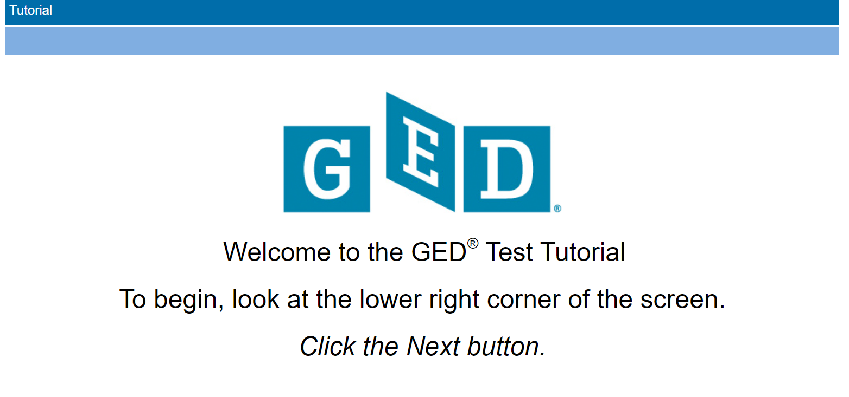
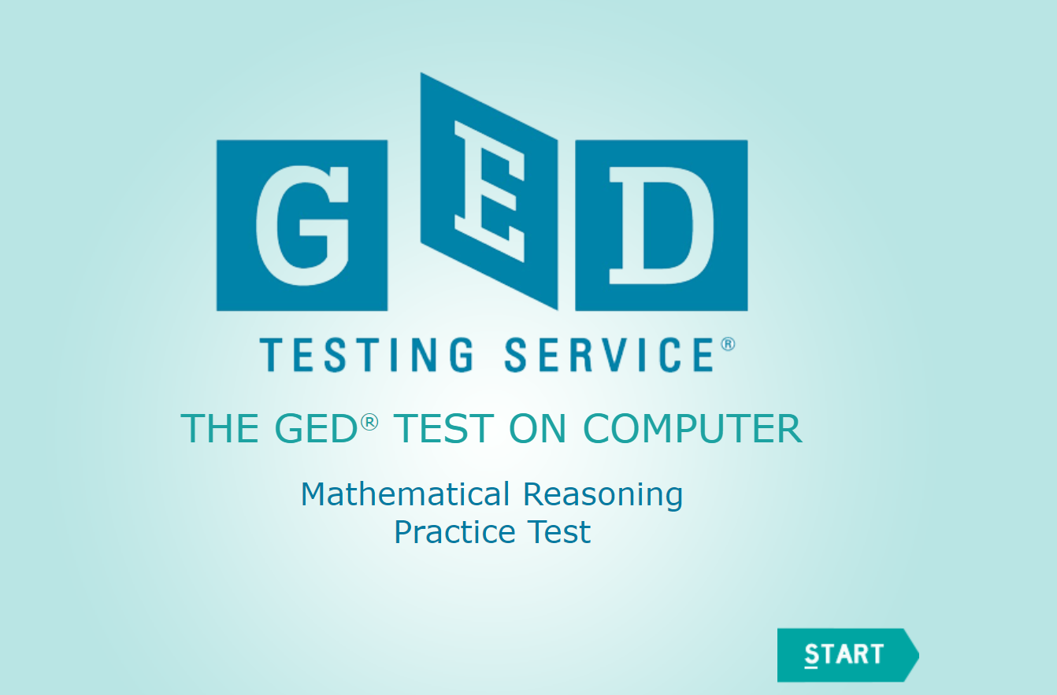
Your One Stop Shop for Resources
Calculator Tutorial
Test Tutorial
Click the pic
Click the pic
Free practice tests!
Click the pic

Slide 21
Before We Begin Our Practice…
Solving With & Without The Calculator
WITHOUT:
Skills Fundamental Critical
Development Understanding Thinking
WITH:
Error Efficiency Confidence
Reduction Building

Slide 22
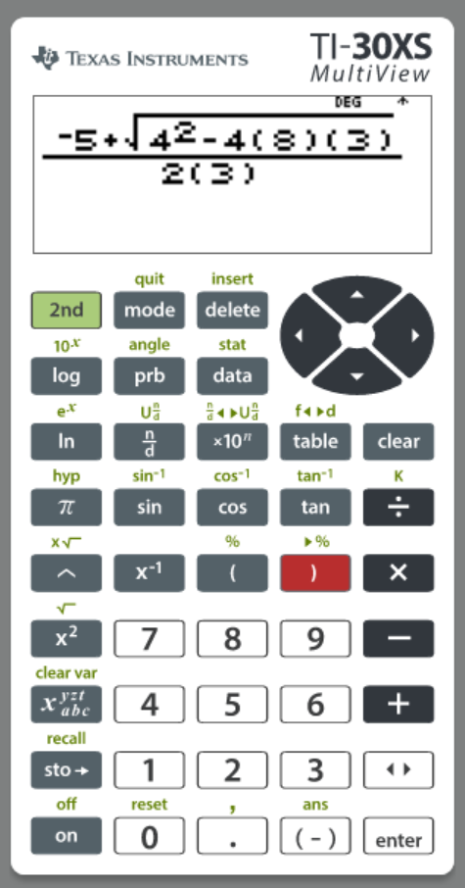
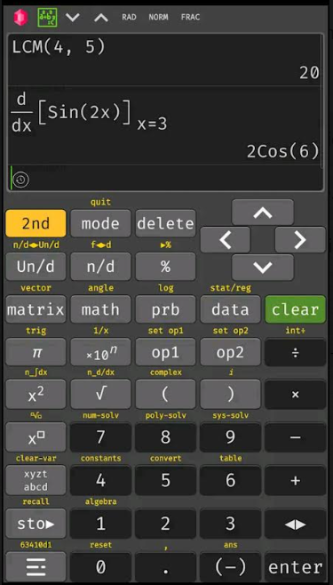

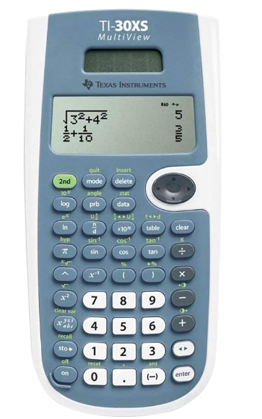
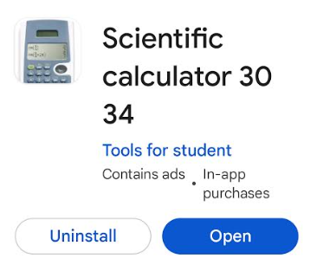
About the TI-30xs Multiview Calculator T
-Android Google Play-
-Free web based for computers, Android, iPhone (ads)-
-Computer
Emulator -
-Hand held-
-GED calculator
reference sheet-
-TI-30xs Guide
for Teachers-
-Introduction to TI-30xs-

Slide 23
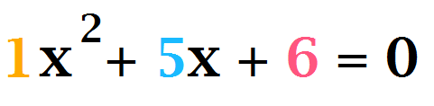
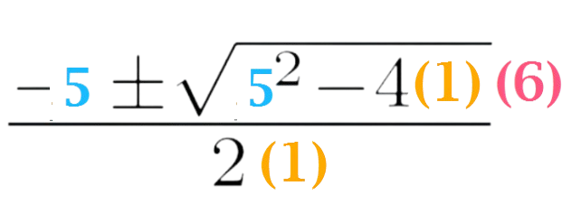
Join the Quad Squad!
Start With the Quadratic Formula & Factoring?!
Learn several calculator functions with one type of problem, no matter skill level!
BASIC SKILLS w/ ANDRAGOGIC APPROACH:
Fractions
Order of Operations
Integers
Squares & Square Roots
Factoring Using
Quadratic Formula

Slide 24


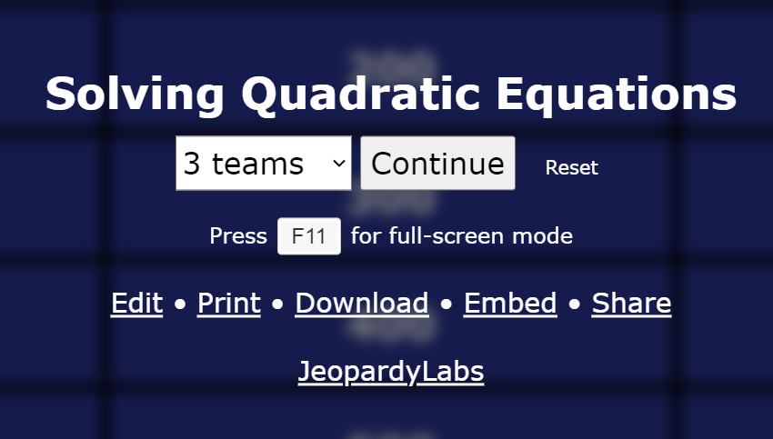

Roll-up Your Sleeves!
…but wait, there’s more!
QUADRATIC EQUATION RESOURCES

Slide 25
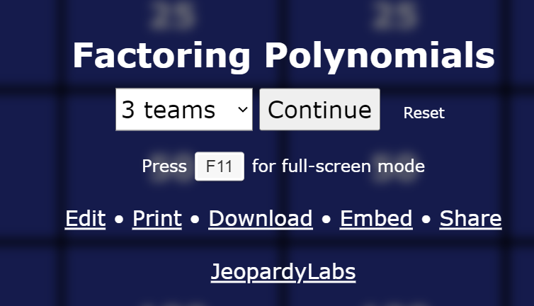
Roll-up Your Sleeves!
…but wait, there’s more!
FACTORING POLYNOMIALS RESOURCES

Slide 26
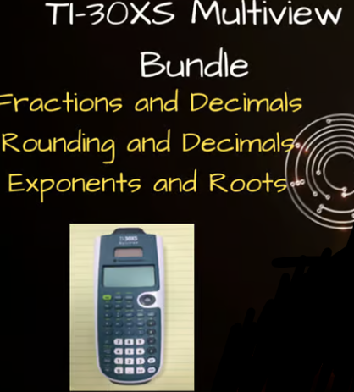
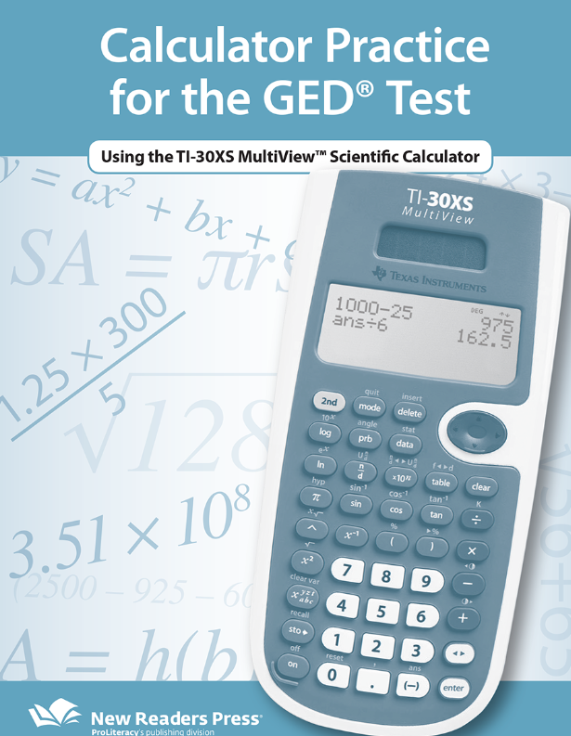


MORE CALCULATOR PRACTICE & RESOURCES
-Exponents & Squares-
-Calculator Practice Sheet-
-Fractions & Decimals-
-Free Adult Education Resources-
-Rounding & Decimals-

Slide 27
JOIN ME FOR PART 2…
Slopes/Graphing/Linear Equations
Indicators
calculate slope from a table, graph or equation
graph a two-variable equation
Related indicators
unit rate as slope
writing equations from points and/or slope; working with parallel and perpendicular slopes

Slide 28






Slide 29

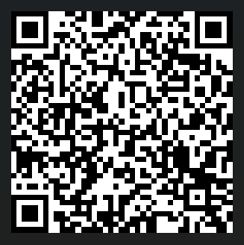
Session Survey
Your feedback is important!
Please scan the QR code below
to rate this session.

