Slide 1
Beyond GED 101
Liz Lanphear, State Relationship Manager
Diane Vaccari, State Relationship Manager
GED® and GED Testing Service® are registered trademarks of the American Council on Education (“ACE”). They may not be used or reproduced without the express written permission of ACE or GED Testing Service LLC. The GED® and GED Testing Service® brands are administered by GED Testing Service LLC under license from ACE.

Slide 2
Today’s Agenda
Important Tools and Strategies for the Classroom
Exploring the Program
What do the numbers say?
GED® and GED Testing Service® are registered trademarks of the American Council on Education (ACE). They may not be used or reproduced without the express written permission of ACE or GED Testing Service. The GED® and GED Testing Service® brands are administered by GED Testing Service LLC under license from the American Council on Education
Resources

Slide 3
3 Things Every Educator Should Do
Create
Create an account at GED.com & familiarize yourself with the student experience in order to help your students (use a non-work email address). Use CANDIDATE as your last name.
Take
Take at least one subject of the GED Ready®. Your SRM can provide you with a GED Ready® voucher.
Bookmark and Utilize
Bookmark and utilize GED.com – Educators & Admin
Notes:
3

Slide 4

GED.com - Educators and Administrators

Slide 5

GED® Testing Program Results National Statistics

Slide 6
National GED Statistics CY 2024
 | January 1, 2024 – December 31, 2024
GED.com Accounts | 675,656
Test Takers | 306,919
Completers | 181,250
Passers | 132,518
Pass Rate | 73%

Slide 7
Candidates Passed 3 Content Areas CYs 2014 - 2024
Some students have only 1 test left to pass.
Many test-takers with 1 test pending require Mathematics to obtain their credential.
Follow through with your follow up strategy and re-engagement plan.
Consider a variety of ways to promote your program.
Consider that GEDTS offers Professional Development Webinars and Math Boot Camps for Educators
Many States/Jurisdictions initiated 3 of 4 campaigns.
Nationally
180,000+
Notes:
This is a NATIONAL ISSUE AND a NATIONWIDE INITIATIVE!! THE GEDTS has been having conversations with state jurisdictions about 3 of 4 students. Those are the students who have taken 3 GED tests, leaving only 1 test to go!
As you begin to work on your own campaign, I ASK PROGRAMS TO CONSIDER THAT MANY OF THESE TEST-TAKERS LAST TESTS TAKEN MAY HAVE BEEN AS FAR BACK AS 2014/2015.

Slide 8
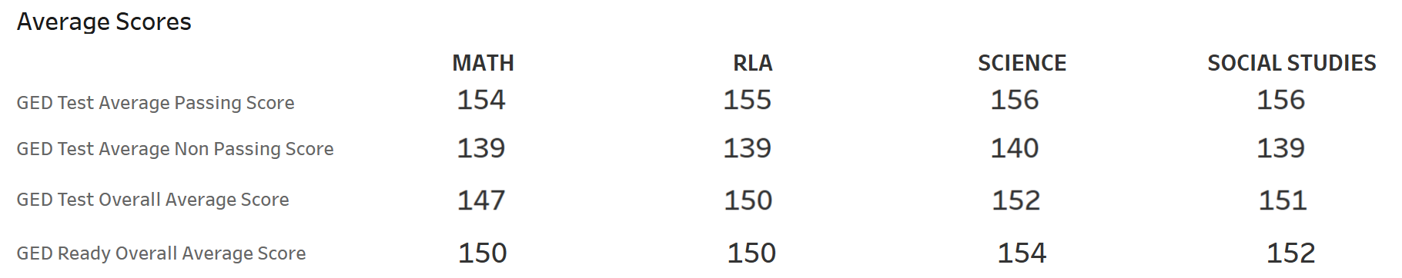
Average Passing Scores Per Content Area CY 2024 – National
Notes:
Avg passing scores by content area is well above the cut score of 145.
Deciles away from helping your student get over the hump to a passing score!!

Slide 9
Important Tools and Strategies for the Classroom What’s In Your Bag?

Slide 10

Webinars

Slide 11


Teaching Resources
THIS IS YOUR RESOURCE GUIDE!
THE source for getting under the hood of the GED® test
Updated regularly
Crosswalk 2002 versus 2014 (by content area)
Item types (explained)
Scoring (explained)
Rubrics for constructed response
Norming & standardization
Comprehensive (may appear daunting!)

Slide 12
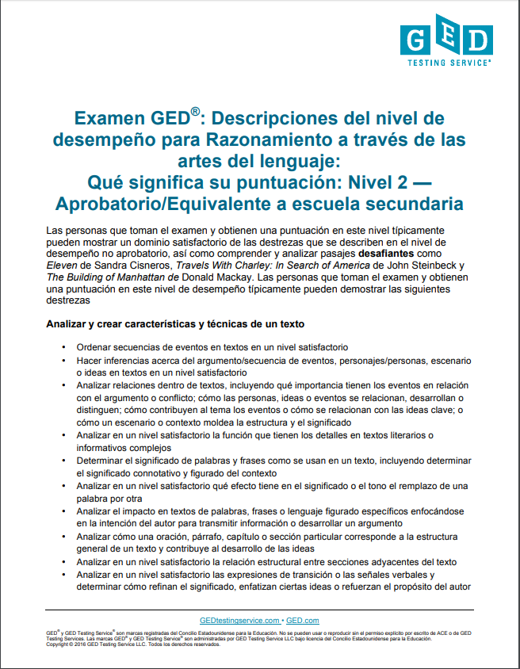
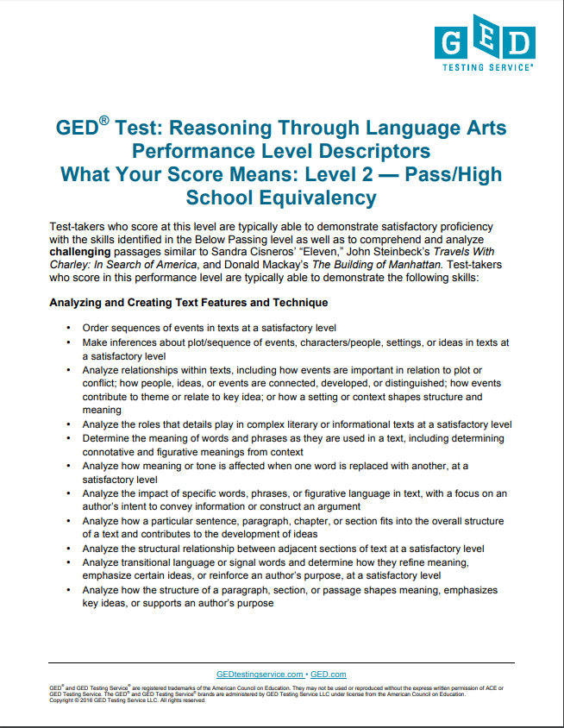
Performance Level Descriptors (PLDs)
Most under-used and undervalued resources
Helpful tool for the classroom
Details the skills students need to pass the test
Two formats
Official Version
Test-taker Version
Four Performance Levels
Below Passing
HSE
GED® College Ready
GED ® College Ready + Credit
What skills are demonstrated at each level
What skills need development to advance to the next level
PLDs
Notes:
Key Points
-A roadmap (extremely detailed) of the skills demonstrated at each performance level (1, 2, 3, or 4) by individual content area
-In addition…what’s needed to achieve the next performance level (gap analysis)
They are important tools for the classroom. There are two formats that you can access – the official version and the test-taker version (a “friendlier” scripted version of each descriptor).

Slide 13
Assess where your students are
Can use as a basic checklist to determine current skill levels (diagnostic based on observations)
Identify where to focus in order to develop skills at the next level
Notes:
Determine whether a student should sit for GED® Ready
Determine whether a student is ready for the operational test
Do you need to change your approach to the content?

Slide 14
Unprecedented to Test-Takers and Educators
In the past, it may not have been clear what specific skill levels were required to meet the passing standard
PLDs change all that—instructors and test-takers can know what skills must be demonstrated
Use PLDs to provide an on-the-spot snapshot of knowledge and skills…and then use it to create better outcomes

Slide 15
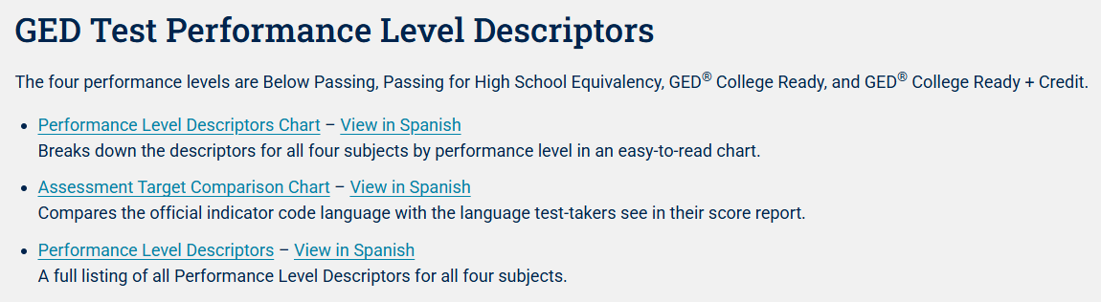
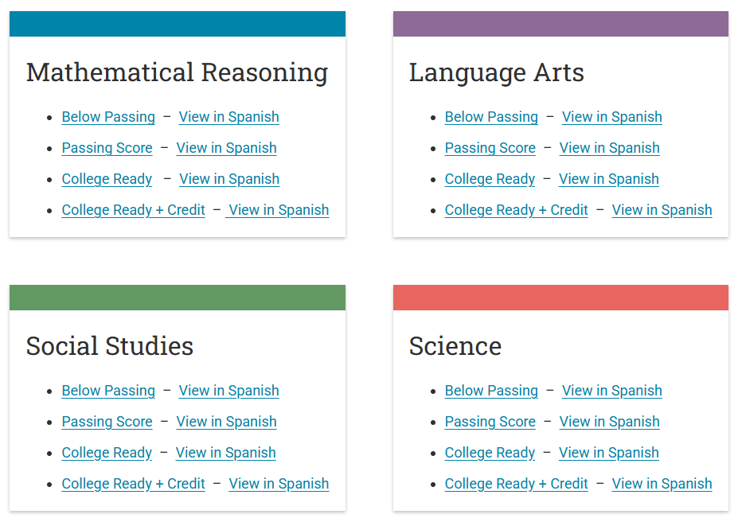
Where to Access PLDs?
Skills Needed to Pass - Educators and Admins

Slide 16
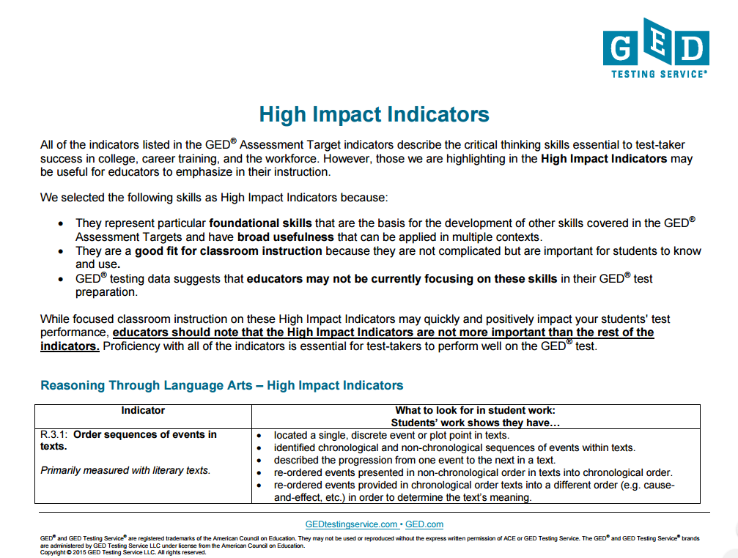

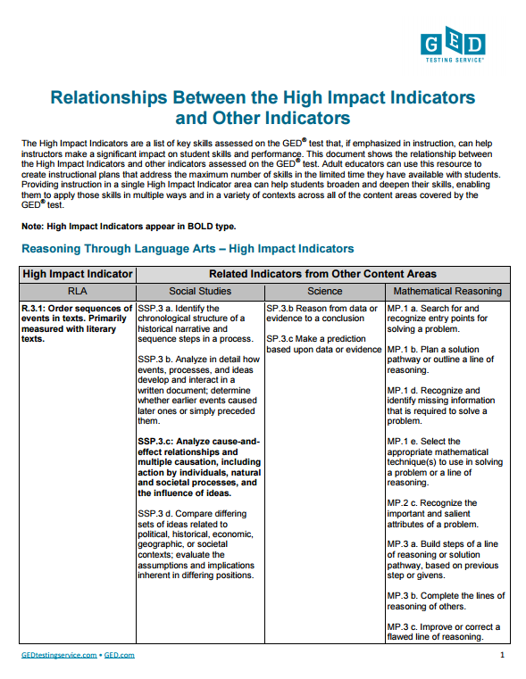
High Impact Indicators
Assist instructors in creating instructional plans that address the maximum number of skills
Assist students in applying skills in multiple ways and in a variety of contexts
It’s all about relationships!
Relationships between HII and other indicators
Notes:
HII = Is about relationships.
Allows you to make skill connections and for educators to help build the relationship of skills across content areas.
HIIs= If used properly as a tool in the classroom, it will enable students to identify a particular skill set no matter what content area it sits in.

Slide 17
An Example:
Relationships between HII and other indicators
RLA
Order sequences of events in texts
Social Studies
Identify the chronological structure of a historical narrative and sequence steps in a process
Science
Reason from data or evidence to a conclusion
Mathematics
Search for and recognize entry point for solving a problem and plan a solution pathway
Notes:
Key Points
Let’s look at an example. Think for a moment about this high impact indicator from Reasoning through Language Arts –order sequences of events in texts. Yes, it is important for RLA, especially in literary texts where students need to determine what happened first, second, etc. However, it is also important in Social Studies where students may need to identify a chronological structure of a historical narrative and sequences steps in a process. In science, students need to be able to reason from data or evidence to a conclusion – a sequential approach. Even in math it is important that students are able to sequence text. One indicator with implications for all four content areas.
All of these indicators are related... and allow you to create a strategy for the classroom. Order sequencing is not jus a province of RLA.
You want your student to be able to identify it and then apply it not matter what content area it falls in.

Slide 18

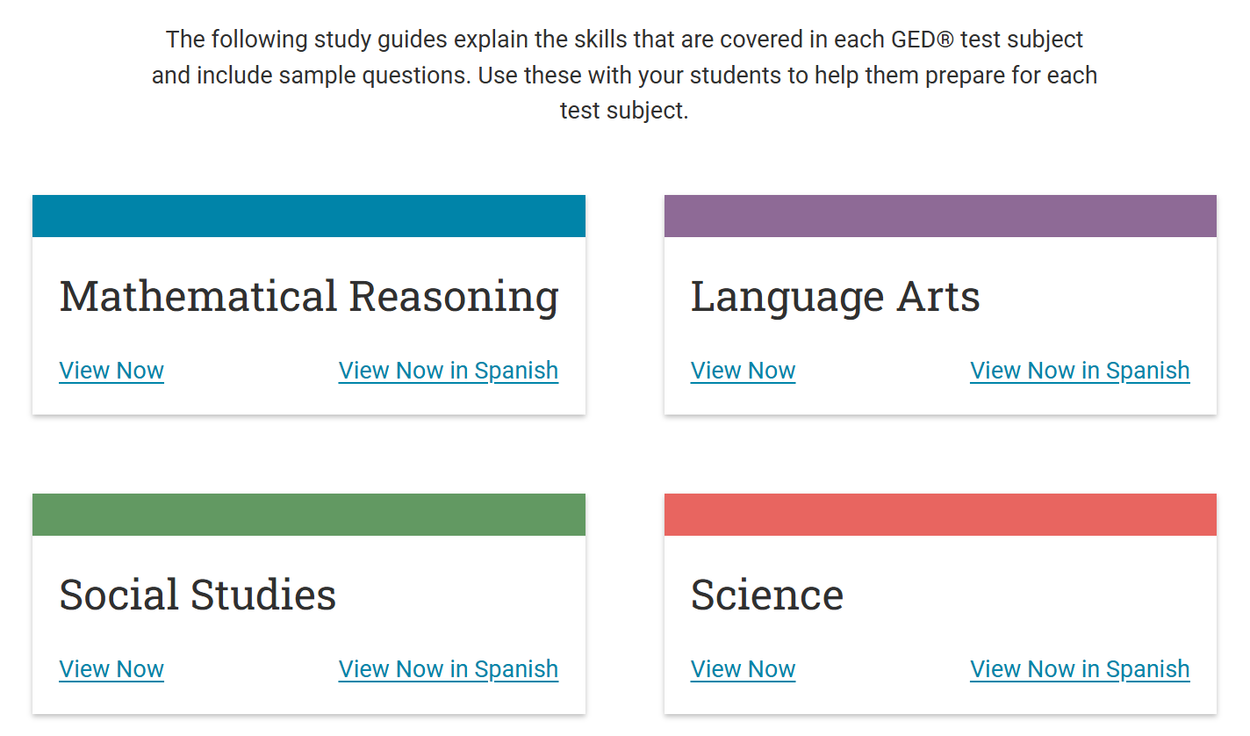
Study Guides
Notes:
Study Guides - A resource for adult educators to use in their preparation with students, under Educators & Admins tab on ged.com

Slide 19
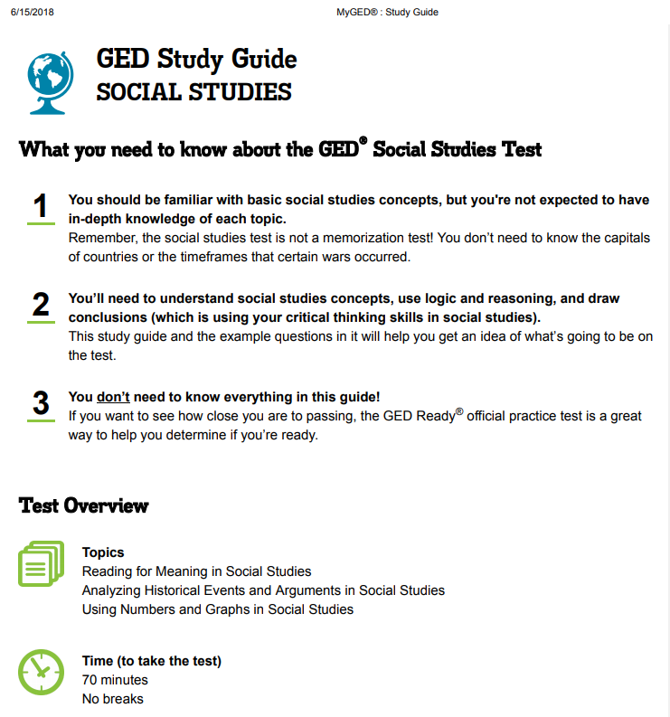
https://ged.com/

Slide 20
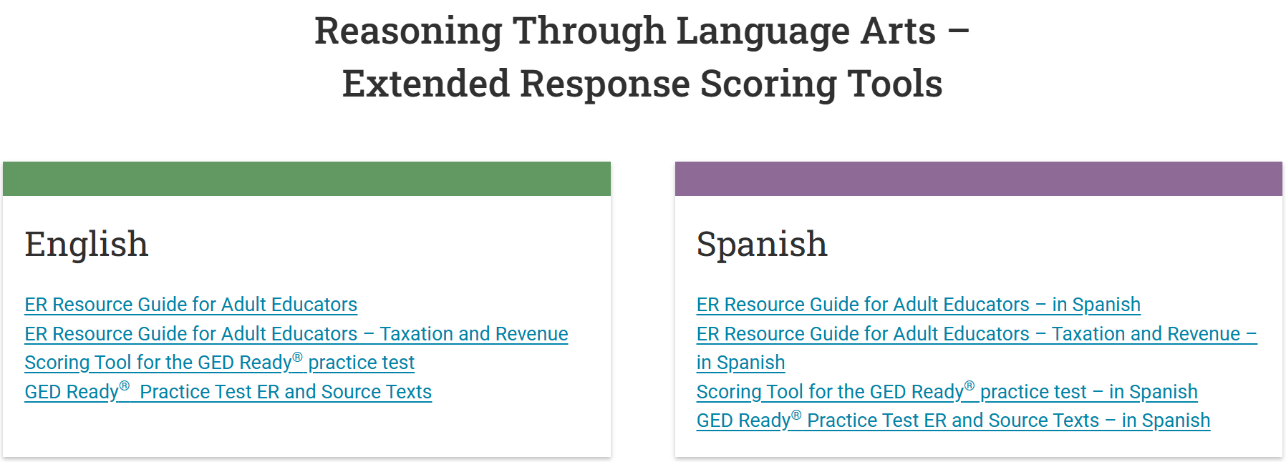
Extended Response Resources
Extended Response Tools and Practice
Use these resources to improve your students’ written responses. The scoring tools help you evaluate and provide feedback to students about their RLA GED Ready® written response.
ER Resource Guide for Adult Educators ER Resource Guide for Adult Educators – Taxation and Revenue Scoring Tool for the GED Ready® practice test GED Ready® Practice Test ER and Source Texts
ER Resource Guide for Adult Educators – in Spanish ER Resource Guide for Adult Educators – Taxation and Revenue – in Spanish Scoring Tool for the GED Ready® practice test – in Spanish GED Ready® Practice Test ER and Source Texts – in Spanish

Slide 21
GED Ready® Three Score Level Indicators
Not Likely to Pass | Too Close to Call | Likely to Pass
100-133 | 134-144 | 145-200
Notes:
Key Points
Many participants want to know how they can ensure that their students are ready to take the official test. The GED Ready® practice test is the best predictor or readiness.
Individuals taking GED Ready® receive a detailed score report with a scaled score indicating their likelihood of passing the operational GED® test. Test-takers will receive a score within one of three levels: Red Zone (not likely to pass), Yellow Zone (too close to call), or Green Zone (likely to pass). Note the scores for each of the levels.

Slide 22
When should we test?
“Green” = Test as soon as possible
“Yellow” = May attempt, but advise accordingly because more remediation may be necessary
Keep unnecessary testing to a minimum
Prevent test-takers from becoming discouraged by non-passing scores on the operational exam

Slide 23






Arsenal of Tools
Enhanced Score Report
Publisher’s Recommendations (Chapters/Pages)
Performance Level Descriptors
High Impact Indicators
GED Ready Scoring Tool
Assessment Guide for Educators
Educator Handbook
Study Guides
Professional Development

Slide 24
Exploring the Program
Notes:
So, now that you have some data behind you and know what tools are out there for you.
Let’s explore more that can help to enhance what you are already doing in the classroom,
Especially for those students that may still be struggling?

Slide 25
Inquiring Minds Want to Know
RLA Extended Response
Notes:
Key Points
This section will provide a very brief overview of the RLA extended response, urban myths, and general scoring information.

Slide 26
Why Should I Spend Time on the Extended Response (ER)
The ability to write is one of the critical differentiators of long-term success
Writing skills help develop thinking skills that impact performance on the entire test
Any score point earned counts towards the overall score
Notes:
Key Points
[Review the bulleted items on the slide.]

Slide 27
The Urban Legends: Student Remix
NO ONE earns any points on the ER
You can game the system by using key words and phrases
Forty-five minutes isn’t enough time to read, plan, and write
The instructions don’t tell you what you have to do
There is definitely a “right” answer—they are just not admitting it
Notes:
Key Points
A few more urban legends are that test-takers do not earn points on the extended response. This is false. Many test-takers do earn points. There is a correlation between the RLA score and the number of points received on the extended response. Students who receive higher scores complete more effective writing samples (earning more points there as well).
Regarding the actual writing of the extended response, there are NO key words or phrases that will ensure a better score. It’s all about effective writing skills and writing to the prompt. From the studies completed with actual students, forty-five minutes does provide enough time for the writer to read, plan, and write. It’s all about whether or not the test-taker has a process that he/she uses. Effective writers don’t just “free-write”. They have a process for close reading, planning, writing, and revising. Plus, test-takers should already be familiar with the instructions prior to taking the test. These instructions are shared with test-takers through accessing the GED.com website. Plus, there are numerous resources, such as videos, handouts, writing samples, etc. that can be accessed by instructors or students.
It is often difficult to tell students that there is not a “right” answer. Students can take either argument as the better supported. It’s all about analyzing and evaluating which side was better supported and why. The use of evidence and connections to support the claim form a major segment of Trait 1.

Slide 28
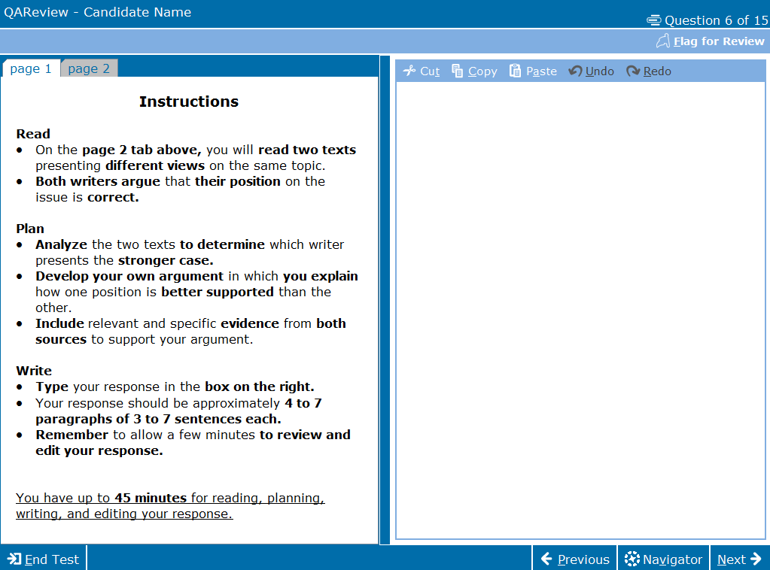
ER Format English and Spanish
Classroom Materials - Computer-based Tutorial
Notes:
Let’s jump into RLA Extended Response.
And, we are going to just hover here for a little while.

Slide 29
Expectations for Constructed Response
When you write . . .
determine which position presented in the passage(s) is better supported by evidence from the passage(s)
explain why the position you chose is the better-supported one
remember, the better-supported position is not necessarily the position you agree with
defend your assertions with multiple pieces of evidence from the passage(s)
build your main points thoroughly

Slide 30
A Few Insights to Improve Student Performance
What Earns Points?
Notes:
Key Points
Let’s look at what earns points, so we have a better idea on what we need to do in the classroom.

Slide 31
Are Your Students Still Struggling?
Text-based writing requires:
Proficient reading skills (at a minimum)
Organized thinking processes to enable analyzing and evaluating
Ability to recognize and write about evidence
A routine (an effective habit) that becomes a “go-to”
Sufficient practice
Use the full 45-minutes!
Write enough to be scored!
Tutorials are a must!
Notes:
Key Points
Test-takers should be familiar with the expectations of the constructed response prior to taking the test. This information should be an integral part of classroom instruction.
Not utilizing an outline or plan from which to write
Not taking a structured approach to the task
Not writing enough to be scored (still!) Write a complete response, not just a short paragraph (300-500 words)
Not fully utilizing the available time (45 minutes)
Leave five minutes at the end for proofreading—that is one of the things evaluated

Slide 32
Interact with Text – Analyze
Purpose/Context | What is the text about? What type of text is it? What overall purpose does the text serve?
Author | Who is the author of the text? What qualifies him/her to write on this subject?
Audience | Where does the text appear? What does the author expect the reader to do or think based on the argument/information presented?
Proof/Evidence | What type of evidence is provided? Is more than one type of evidence provided? Is evidence provided for both sides of an argument?
Organization/ Structure/Style | What is the organization of the text? What is the tone? What type of sentence structure/complexity, figurative language, rhetorical questions are used?
Notes:
Key Points
The skill of analyzing text does not just happen.
It is important that you model for students how you interact with the text.
Students often have difficulty in analyzing instead of summarizing text.
Show students how you ask questions as you read or interact with text.
In order to analyze instead of summarize, the reader needs to ask himself/herself questions throughout the reading.
Questions about the purpose/context, author, audience, proof/evidence, in order to effectively evaluate the information prior to writing.

Slide 33
What Earns Points
Analyzing the issue or the quality of the argument through which both sides are presented
Evidence cited must support overall message and must be analyzed in some way
Demonstrating that the test-taker has engaged with the text and has created a text-based argument
Notes:
Key Points
Let’s look at other ways that test-takers earn points.
It’s not just about listing evidence. It’s about analyzing the issue or the quality of the arguments through which both sides are presented. Evidence that test-takers cite must support the message and must connect in some way to the claim. Test-takers must be able to engage with the text and then create a text-based, not a personal, argument. Remember, there is no one “right answer”. Rather, the test-taker needs to analyze and evaluate the evidence in order to determine which side is better supported by the evidence.

Slide 34
Evidence in Text Sources
Type of Evidence | Definition
Factual | Truthful statements that cannot be denied. Statements that the average person may know or which can be proven.
Statistics or Data | Numerical facts; can be presented in raw numbers, percentages, or fractions.
Examples or Anecdotes | Real-life situations, events, or experiences that illustrate a position; anecdotal stories that help explain an author’s claim.
Expert Testimony | The observations or conclusion of someone who is considered highly knowledgeable because he/she is an expert in a particular field of study or occupation; someone who has firsthand knowledge and experience.
Logical Reasoning | An explanation which draws conclusions that the reader can understand; a discussion which helps the reader understand or make sense out of facts or examples offered.
Emotional Appeal | Use of sympathy, fear, loyalty, etc. to persuade; manipulates the reader’s emotions – ethos, pathos, logos.
Notes:
Key Points
Discuss that evidence is more than just facts and stats.
And using different types of evidence to develop a claim as they read the source texts.

Slide 35

What Earns Points
Going beyond merely stating which side is better supported
A single statement of a stance is considered insufficient
Needs to include the “why”
Doing more than just using quotations
Evidence cited must support the overall message and must be analyzed in some way
Notes:
Key Points
What earns points? Remember, it’s not which side the test-taker likes best, but rather which side the test-taker believes is better supported and why. Maybe one side was better supported because it included more current and factual research. Maybe one side of an argument provided stronger statistical data. Whatever the reason, a single statement of stance is insufficient. To earn points, the test-taker also needs to provide more that just quotations. Evidence that is cited must be analyzed so that it supports the overall message. This requires that the test-taker “connects” the evidence back to the claim.

Slide 36
From Struggling to Successful
 | Struggling Writers | Successful Writers
Plan | Are unaware of purpose or process of writing Have little or no knowledge of the text structure of an essay Have difficulty developing plans and staying focused on the topic Experience greater writing anxiety and decreased motivation | Analyze the task Understand and apply all the elements of an essay Create goals for their writing Develop plans to achieve their goals Discuss how and why a plan will work
Organize | Produce fewer ideas Fail to organize their thoughts | Develop multiple ideas Organize their ideas
Draft/write | Plan what they are going to say as they write Use imprecise and nonspecific vocabulary Struggle to convey their thoughts, ideas, and opinions Write fewer sentences Focus on mechanics rather than on clarity and organization | Write using an organized plan, but adjust goals when obstacles arise Use vocabulary accurately Experience fewer difficulties with the elements of an essay Generate sentences that support their ideas
Edit and Revise | Experience problems with grammar, punctuation, and spelling Place words and letters too close or too far from each other Do not review and make correction | Edit spelling, capitalization, and punctuation Make more content revisions Correct overall appearance
The IRIS Center Vanderbilt Peabody College
Notes:
Key Points
Look familiar? We all have the struggling writer in our classrooms, as well as the successful writer. We know that writing is a complex task. To assist our struggling writers become more effective writers (both for the test and for real-world situations), we need to ensure that our struggling writers are taught various thinking routines so that they can move towards being more successful. This requires a “one step at a time” process.

Slide 37
Do these examples of summarization and personal information look familiar?
Summarization
Personal Information
If those are the arguments that are made, then people just need to be more responsible if they are having trouble adjusting with the time change.
Back when it was thought of it made sense – but times have changed and now its time to not have it.
Educators often work with both of these types of writing in the classroom. However, this is not the type of writing being assessed by constructed response on the RLA test.
Notes:
Key Points
Let’s look at a couple of examples of summarization and personal information. Look familiar? We often work with both of these types of writing in the classroom. However, this is not the type of writing being assessed by the constructed response on the RLA test.

Slide 38
What to Avoid
Responses should not
Be composed of a summary of the passage or authors’ positions
Include personal information (e.g. opinion = I think, I feel, or I know)
Be written in first person
Notes:
Key Points
There are some things that test-takers should avoid. First, this type of writing is not a summarization. Just summarizing an author’s opinion does not answer the prompt which asks for the test-taker to analyze and evaluate both sides and determine which one is better supported. Personal information should also be avoided. This task is not a personal opinion piece, so phrases such as the following should be avoided: I think. I feel. I know.
Although an occasional use of “I” may not result in a scorable “0”, students should be taught to use the more formal third person style.
Discuss the different uses of the different styles.

Slide 39
Keep it Simple!
The introduction states the main idea or position. It begins with a topic sentence/thesis statement. The beginning restates the question and sets the stage to answer the prompt. Beginning
Middle
Answer the question first.
Write a closing that summarizes the position taken or restates the thesis statement in a different way.
Ending
Provide important information the author stated and meant. This is where you go to the text(s) and provide examples/evidence and important details to support the answer.
Sample phrases to introduce each text reference include: … stated; in the text …; for example . . .
Include background information as required through the prompt.
Beginning
Notes:
Key Points
Structure is important to the writing task. Instead of a five-paragraph structure, the more effective structure to teach is that all writing has a beginning, middle, and ending. Ideas should drive structure, rather than structure driving ideas.

Slide 40
Simple Techniques to Improve Scores Expose students to a structured approach to the writing task and help them understand that they need to:
Write a complete response (300-500 words), not just a short paragraph
Provide commentary on the evidence cited (explain the “why”)
Develop two or three ideas fully, rather than mention a lot of things without detail
Leave five minutes at the end for proofreading
Practice, practice, practice!
Use a plan (e.g,. a graphic organizer or an outline) for organizing the information from the reading and then write about it
Bringing good grammar to the writing task
Answer the question that is asked
Notes:
Key Points
[Review the bulleted items on the slide.]
Discuss that these are ideas on how to improve scores. Also, note that the length is not about counting words, but rather it indicates that the writing sample needs to be long enough to adequately address the prompt. A short paragraph is not enough.

Slide 41
Dig Deeper into Students’ Writing Samples
Using the Electronic Scoring Tool
Professional Development Webinar:
Taking the Angst Out of Scoring the GED® RLA Extended Response

Slide 42
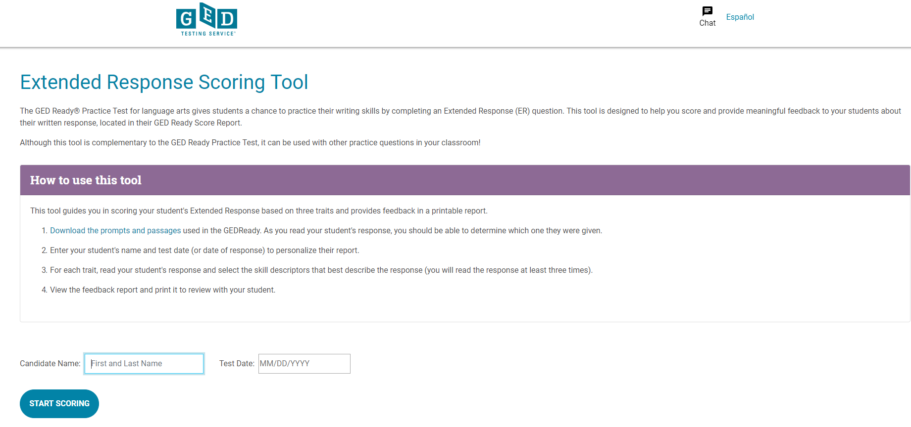
GED Ready® Scoring Tool!
Extended Response Scoring Tools
Notes:
Key Point
Briefly point out the new scoring tool and how easy it is to use to score students GED Ready extended responses. Point out the location of the scoring tool. The same 3 traits and scoring rubric that our own expert hand scorers use.

Slide 43

For Your Information… Hand Scoring of Spanish RLA Tests
ALL of the Spanish RLA ERs are hand-scored
Every single response is scored by at least 6 expert scorers (2 per each of the three traits)
Sometimes as many as 9 expert scorers (if there are scoring disagreements among any of the pairs of scorers)
This takes a bit of time, although we still return scores on the Spanish RLA relatively quickly, usually within a couple of days at most
Notes:
English – Automated Scoring Engine

Slide 44
A short reminder about the importance of reading skills…
Reading…IS fundamental
Is essential for developing or enhancing higher order thinking skills (e.g. critical thinking, problem solving, and reasoning)
Is at the heart of all content—without reading skills, content cannot be accessed or learned
Provides the necessary framework that enables learning
Notes:
It’s the underpinning for everything!

Slide 45

Teach Close Reading Strategies! Incorporate reading and writing into every classroom, every day.
Students who read
Write better
Students who write
Read more
Reading strategies should lead to writing
Writing strategies should encourage further reading

Slide 46
Focus on Concepts and Problem Solving
Mathematical Reasoning
Notes:
Key Points
Explain that students need to build their conceptual understanding of mathematics as well as how to apply those concepts in word problems. Students often lack consistency in solving problems because they do not truly grasp the concepts and/or skills they need to use.

Slide 47

Teach the Big Ideas in Algebra
Variable
Symbolic Notation
Equality
Ratio and Proportion
Pattern Generalization
Equations and Inequalities
Multiple Representations of Functions
Notes:
Key Points
Ask participants what they are currently teaching from this list. Chances are very good:
ratio and proportion and possibly variables or symbolic notation.
Narrow your focus and teach the “big” ideas and to build algebraic reasoning skills.
Build their reading skills
Increase their conceptual knowledge in math
Build math vocabulary
This math test is beyond rote memory and more on conceptual knowledge
You want to encourage perseverance when solving problems

Slide 48
Help Students . . .
Tackle problems in three waves
Do problems that are easily and quickly completed
Go back to problems that will take a little longer
Save the most challenging problems for last
Take advantage of the erasable whiteboards
Build
Build their reading skills
Increase
Increase their conceptual knowledge in math
Encourage
Encourage perseverance when solving problems
Build math vocabulary
Depend less on rote memory
Notes:
48
Think about the skills that effective readers have.
[Review the bullets on the slides.]
Now, think how this ability would impact their ability to read and solve math problems. Each of the items listed is essential in students being able to understand what the math problem is telling them, as well as what they need to do to solve that problem.

Slide 49
Building Student Knowledge and Critical Thinking Skills
Social Studies
Notes:
Key Points
Share with participants that in order to be successful on the test, students need to be able to closely read complex text. Building student knowledge can be done in conjunction with the teaching of critical reading skills.

Slide 50
Social Studies Themes
 |  | Social Studies Example Topics
 |  | Civics & Gov’t (50%) | US History (20%) | Economics (20%) | Geography & World (15%)
Focusing Themes | Development of Modern Liberties and Democracy | Types of modern and historical governments Structure and design of U.S. government | Key historical documents Civil War and Reconstruction | Key economic events that shape American government and policies | Development of classical civilizations
 | Dynamic Responses in Societal Systems | Political parties, campaigns, and elections Contemporary public policy | World War I & II Cold War | Fundamental economic concepts Economic causes and impacts of war | Borders between peoples and nations Human migration
Notes:
Key Points
GED Testing Service® has taken those four areas and incorporated the content under two Focusing Themes. That helps tremendously in narrowing the focus of instruction in social studies.
Development of Modern Liberty and Democracy is the first focusing theme. This theme explores how democracy and human and civil rights have changed overtime. Think – major events such as the founding of the U.S., the civil rights movement, as well as some of the big thinkers of American government such as Thomas Jefferson and James Madison.
Dynamic Responses in Societal Systems looks at how systems, structures, and policies have evolved over time because of different conditions and events that have occurred. Think – major events that have shaped policy such as the Great Depression or the Cold War.
Key Points
SS is about applying skills of analyzing and evaluating and this should help to narrow your focus about how to deliver on this in the classroom?

Slide 51
What Should I Teach?
Social Studies Content
(GEDTS Assessment Guide – Social Studies)
Social Studies Focusing Themes
Social Studies Practices
Students apply skills of analyzing and evaluating to create meaning and understanding
Notes:
Key Points
Here is where the Assessment Guide for Educators becomes useful.
SS practices of applying skills of analyzing and evaluating.
So, what should you teach in the social studies classroom?

Slide 52
Test-taking Tips for Social Studies
Remind students to read closely and carefully, especially primary sources
Examine graphics closely
Use calculator for data and statistics items

Slide 53
Building Student Knowledge and Critical Thinking Skills
Science
Notes:
Key Points
Share with participants that in order to be successful on the test, students need to be able to closely read complex text. Building student knowledge can be done in conjunction with the teaching of critical reading skills.

Slide 54
Focusing Themes of Science
 |  | Science Content Topics
 |  | Life Science (40%) | Physical Science (40%) | Earth & Space Science (20%)
Focusing Themes | Human Health and Living Systems | Human body and health Organization of life Molecular basis for heredity Evolution | Chemical properties and reactions related to human systems | Interactions between Earth’s systems and living things
 | Energy and Related Systems | Relationships between life functions and energy intake Energy flows in ecologic networks (ecosystems) | Conservation, transformation, and flow of energy Work, motion, and forces | Earth and its system components Structure and organization of the cosmos
Notes:
Key Points
It is often difficult to determine what to teach in the science classroom. The GED® Science test has identified focusing themes for this test. These two themes have application across all domains of science.
The two focusing themes are human health and living systems and energy and related systems. Each science content topic is assessed using one of these focusing themes.

Slide 55
What Should I Teach?
Science Content
(GEDTS Assessment Guide – Science)
Science Focusing Themes
Science Practices
Students apply skills of science to develop an understanding of the scientific concepts.
Notes:
Key Points
Again, referring to the Assessment Guide for Educators and the importance of understanding content structure.
Science practices are students applying skills of science to develop scientific concepts.
So, what should you teach in the classroom?

Slide 56
Instructor Focus -- Can your students . . .?
Evaluate whether data supports a hypothesis?
Identify variables in an experimental process?
Determine a method for collecting data?
Determine the correct process for an experiment?
Draw a conclusion based on scientific data?
Design a scientific investigation based on a given hypothesis?
Create a hypothesis?
Notes:
Key Points
Begin the discussion on the scientific method by asking participants if their students can do the items listed. Reinforce that these skills are necessary for both technology-enhanced items.

Slide 57
Resources

Slide 58
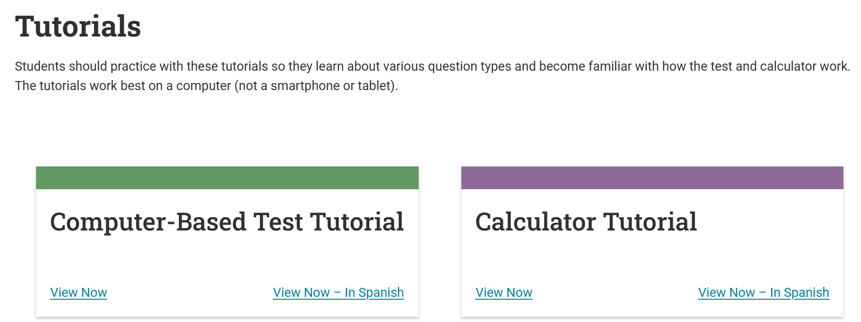
Tutorials
Ensures no surprises on test day
Opportunity to practice and build skills
Familiarity can lead to better performance
Practice using the annotation tools (highlighter and white boards)
Students Will Receive:
Whiteboards (3)
Math, Social Studies, Science
Math Formula Sheet
Calculator Reference Sheet
RLA
Extended Response Answer Guidelines
Classroom Materials

Slide 59
Reference Sheets
Many of these resources are available to your students in the testing center on test day. Review these with your students so there are no surprises on test day.
English
Calculator Reference Sheet
Mathematics Formula Sheet
Extended Response Answer Guidelines
Spanish
Calculator Reference Sheet – Spanish
Mathematics Formula Sheet – Spanish
Extended Response Answer Guidelines – Spanish
Educators and Admins - Classroom Materials

Slide 60
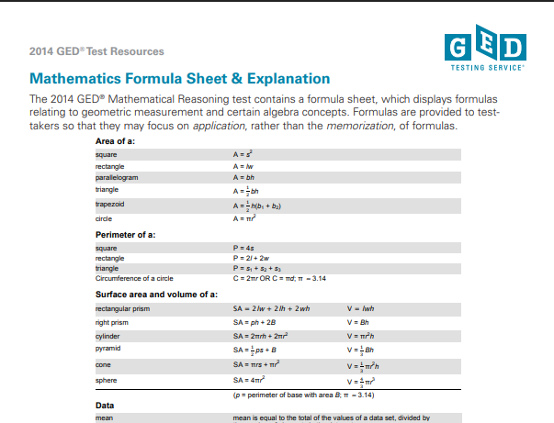
Sample: Math Formula Sheet

Slide 61
Math Resources
Research shows that students struggle with non-calculator items on the GED Math test. Use these resources to target your instruction and improve student performance.
Calculator-Prohibited Indicators View in Spanish
Tips for Calculator-Prohibited Section View in Spanish
Tips for Attaining High School Equivalency View in Spanish

Slide 62




Resources!
Educator Handbook
GED Playbook
Student Handbook
Learning Preferences eBook
Notes:
Key points:
The GED Playbook (launched at the 2022 GED Conference):
The GED Playbook is for those who oversee and manage the GED adult education program, as well as instructors. It is a good starting point to assist in navigating and understanding the GED program.
GED Student Handbook (to be launched at the 2023 GED Conference):
The Student Handbook serves potential adult education program students, self-paced learners, and advocates of students navigating their GED journey. Within this document you will find many helpful resources and tips.
With You, With Me- Learning Styles e-Book:
The e-book serves to empower students with an understanding of their own learning preference and also encourages them to get to know themselves better and seek out study methods and resources that will be of most benefit to them.

Slide 63

Sign up for InSession

Slide 64

GED Mobile App
Currently available in the Apple App Store
Android & Spanish coming soon!
The GED & ME™ App and GED.com use the same login credentials
Takes the learner on a guided journey to achieve their goals
NEW! Students will now see the Syd AI icon on applicable Math questions and receive tailored support through suggested or custom prompts.
GED Mobile App
Notes:
Currently only available for iPhone in the Apple App Store.

Slide 65


Slide 66
Your State Relationship Team
Mellissa Hulstrand
IL,MI,MN,TN,VT,WI,
PR,VI,MI Prisons
Mellissa.Hulstrand@ged.com
Brian Smith, Director
PA
Brian.Smith@ged.com
Scott Salesses
MA,NY,FBOP
Scott.Salesses@ged.com
Lisa Pool-Osorio AK,AZ,CA,ID,NV,OR,UT, WA, Guam
Lisa.Pool-Osorio@ged.com
Adora Beard
AL,DC,DE,MD,VA,PR
Military
Adora.Beard@ged.com
Liz Lanphear CO,HI,IN,KS,MO,NE,NM,ND,SD
Elizabeth.Lanphear@ged.com
Diane Vaccari
CT,FL,KY,NJ,OH,RI,SC,WV
Bermuda
Diane.Vaccari@ged.com
Shawn Watts (Starting 8/17)
AR,GA,LA
Shawn.Watts@ged.com
Jonna Forsyth
CA,MS,MT,NC,NH,OK,TX,WY
Jonna.Mcdonough@ged.com

Slide 67
Thank You!
Communicate with GED Testing Service®: Contact Us - GED
Diane Vaccari
Diane.Vaccari@ged.com
Liz Lanphear
Elizabeth.Lanphear@ged.com
67
Notes:
When you don’t know your SRM/or all else fails… email us at help@ged.com and your inquiry will be sent to the appropriate team mate when our Operations team cannot answer themselves.

Slide 68

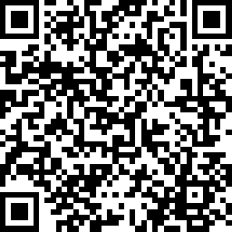
Session Survey
Your feedback is important. Please scan the QR code below to rate this session.

