Slide 1
Amplify Your Impact: PR and Marketing Strategies for Adult Education Programs
Kate Slivinski, Director of Communications Victoria Velez, Director of Marketing
GED® and GED Testing Service® are registered trademarks of the American Council on Education (“ACE”). They may not be used or reproduced without the express written permission of ACE or GED Testing Service LLC. The GED® and GED Testing Service® brands are administered by GED Testing Service LLC under license from ACE.

Slide 2
What is PR, really?
Public Relations is Strategic Storytelling
PR helps manage how the public sees your program, not just advertising it
Goal:
Amplify GED's exposure by sharing learner stories and leveraging opportunity
Earn trust, visibility and credibility
Why PR is powerful
Highlights transformational stories
Drives partnerships and funding opportunities
Helps reduce stigma by reframing narratives
Notes:
PR is all about storytelling and leading the voice, tone and messaging across channels
We want to control the narrative of how GED is perceived in the public eye
Goal: make more noise around GED and our learners. Partner with media for more external exposure – build trust and credibility in the market
PR is so powerful because it helps us highlight our learners – how far they've come, how they've moved past tragedy and done something big for themselves or their family.
These stories can help drive partnership and funding opportunities
And we're always reframing our narratives to reduce the stigma of the GED and showcase how much grit, determination and resilience our learners have. They are the hardest working most employable people

Slide 3
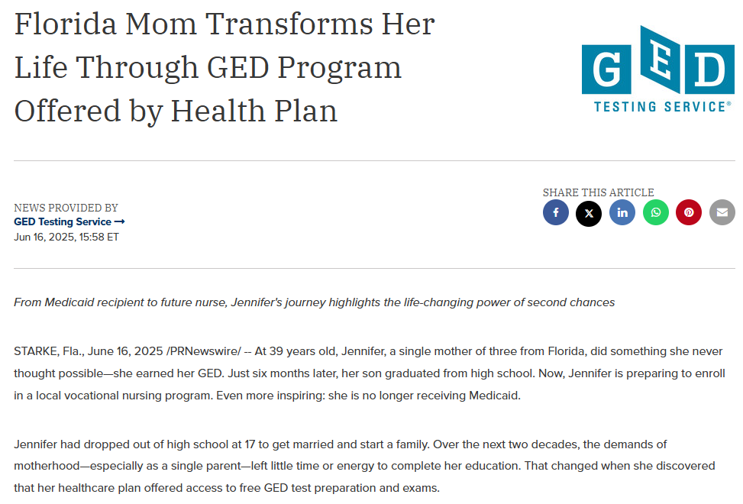
The Impact of PR – Real Stories, Real Results
Jennifer Jackson's GED Journey
From a challenging background to success
Change perception of who GED® learners and graduates are
LinkedIn, Instagram, Facebook
GED website and GED Newsroom
Pearson Blog and The Hub
In Session Newsletter
Media + PR
Social media results averaging up to 15% engagement and media outlet audience of 108M+ with 3500 views
Notes:
Example of Jennifer Jackson's story

Slide 4
Thought Leadership
Shape industry trends and discussion
Blend visibility with storytelling
Leverage Partnerships
Social Networks
Notes:
Goal: Position GED Leadership as credible leader in adult education, workforce readiness and alternative pathways
In process of implementing our 2025 TL plan:
Shape industry trends and discussion – experts in our field, engage in all adult ed discussions related to workforce readiness, our learners and pathways – plus GED to Jobs
Build visibility with storytelling – learner success stories
Leverage Partnerships – work with chambers across the United States; speaking at events
Digital Platforms – utilize social media, website to share our story

Slide 5
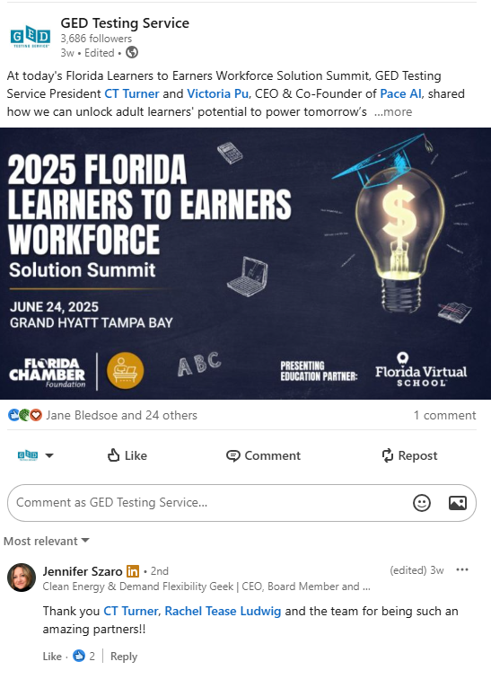
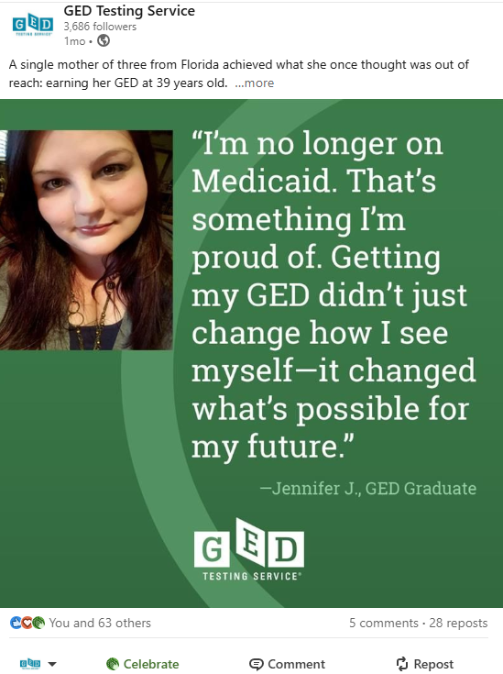

How We Can Work Together
Listen for impactful moments with learners
Ask Questions
Engage with us on social

Slide 6



How We Can Support You
Storytelling and shaping
Media
Visibility/Support
Kate.Slivinski@ged.com

Slide 7




Why Marketing Matters in Adult Education
Pro Tip: Reframe your mindset from "selling" to promoting.
Remember: Marketing ≠ Sales
Marketing creates relationships, desire, and demand.
Sales is the act of converting that demand into tangible results through transactions.
You’re connecting people to opportunity
Funding often tied to enrollment & outcomes
If you don’t tell your story, someone else will
Students don’t enroll if they don’t know you exist
Notes:
You’re connecting people to opportunity: A lot of educators feel uncomfortable with the idea of “marketing... like it’s too salesy or not aligned with your mission. But let’s reframe it: You’re not selling a product. You’re opening doors. You're helping someone picture a better future — one they might not even think is possible yet. Marketing is a form of service when it’s done with heart and purpose. Reframe it as "educational outreach", not advertising.
Funding is often tied to enrollment and outcomes: Many of programs rely on enrollment numbers and performance outcomes to maintain funding. If people aren’t finding and enrolling in our programs, it affects more than just attendance — it can affect whether they continue running. Marketing helps keep your program visible and relevant, so you’re not scrambling to recruit every semester or cycle.
Students don’t enroll if they don’t know you exist: This seems obvious, but we can’t underestimate how unaware many potential students are. Just because a program is free or life-changing doesn’t mean people will know about it. Adult learners may may be juggling jobs, kids, and other challenges, and may not know what options are out there. That’s where simple, consistent marketing comes into play.
If you don’t tell your story, someone else will (or no one will): Your program has powerful stories. You’ve seen these transformations first-hand... learners who overcame challenges, who found confidence, who reentered the workforce or supported their families. If those stories aren’t being told, the public fills in the blanks. They might think adult education is outdated, low quality, or only for people in crisis. The GED "stigma". Telling your story changes the narrative and helps the community understand your value and builds trust.
Marketing is about creating demand and building relationships, while sales converts that demand into tangible results through transactions and sales.

Slide 8

Know Your Audience
Adult learners are busy, practical, and often skeptical
Ask yourself:
What problems are they trying to solve?
Where do they spend time (online/offline)?
What holds them back from enrolling?
Pro Tip: Survey current students for real insights
Notes:
They’re often juggling work, kids, caregiving, maybe even multiple jobs. They want clear, direct answers: How will this help me? Is it worth my time? Can I trust this program? Also, some carry past educational trauma or feel shame about not finishing school, so they may be hesitant or defensive at first. Your marketing has to speak to those realities with empathy, not just promotion.
"What holds them back from enrolling?" -- This is big. Many potential students aren’t saying “no,” they’re saying “not yet”. We know that the #1 thing holding learners back from earning their GED is fear of failure. Many also have self-doubt, lack of information, or real barriers like transportation or childcare. Your marketing should directly address and ease those concerns. For example, “Don’t worry if you’ve been out of school for a while — we’ll help you every step of the way,” or “We offer evening classes for working adults.” Remove the guesswork. Speak to their anxieties as much as their aspirations.

Slide 9
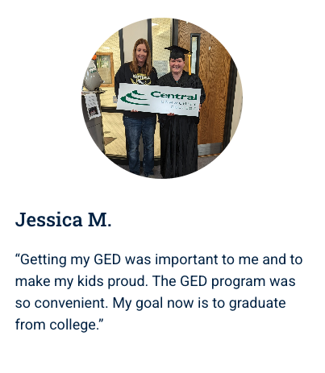
💬 Tell The Story
"Facts tell. Stories sell."
Let students speak for you
Written quotes with photos = powerful
Even more powerful: short "selfie-style" videos
Prompts:
Why did you get your GED® Credential?
How did an adult educator change your life?
What would you tell someone thinking about joining?
Notes:
Telling the Story = Marketing and Promotion of your program

Slide 10

🎥 Videos, videos, videos
Video grabs attention better than text or images
Keep it authentic. Using a smartphone is fine.
Ideas:
Student testimonials
Quick program tour
Instructor intro videos
“A Day in the Life” clips
Pro Tip: Add captions — most watch on mute!
Notes:
Reference the opening video from CT's opening speech

Slide 11
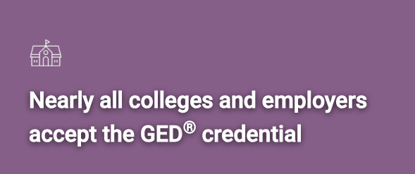
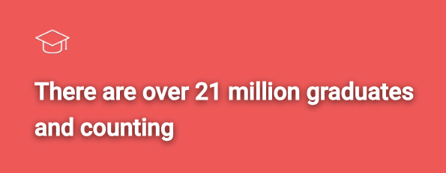
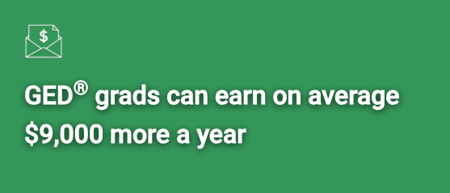
Use Data & Stats
Stats + stories = persuasive
What to share:
Program completion rate
Job placement % or outcomes
Number of students served
GED pass rate
Stats alone aren't enough. Put them into context.
Good: "85% of our students pass the GED® test"
Better: "85% of our students pass the GED® test — even if they’ve been out of school for 10+ years"
Notes:
We know stories are powerful. They connect emotionally, but numbers help back that up. They add credibility. When people outside your program (potential students, funders, partners, even the general public) see real, measurable outcomes, it builds trust.

Slide 12

Where's Your Audience?
Social media: Facebook, Instagram, YouTube, TikTok
Website: Clear, mobile-friendly, easy to navigate
Email/Texting: Use for reminders, inspiration, and nudges
Pro Tip: Keep messages short, friendly, and human
Instead of:
“We offer high-quality adult education services to support your long-term academic success.”
Try: 👉 “Need your GED? We’ll help — for free.”
Notes:
Short attention spans are real, but it’s not a bad thing. It’s just how we process information now. When they’re scrolling through Facebook or reading a text message, they’re looking for something that speaks to them quickly and clearly.
This means:
Short headlines
Simple language
Direct benefits
One clear call to action

Slide 13
💡 Content Ideas for Educators
“Student of the Month” spotlight
Behind-the-scenes photos of your class or staff
“Why I Teach” stories from instructors
Share local job opportunities or GED® success paths
Awareness months: GED Grad Day (May), National GED Day (September), Adult Education & Family Literacy Week (September), etc.

Slide 14
🗣️ Discussion / Q&A
What marketing or PR challenges are you facing?
What’s one small tactic that’s worked surprisingly well for you?
Have you ever posted something on social media that got a great response?
What local partnerships have helped you spread the word?
Ideas you’re excited to try?
Facebook group: Facebook.com/groups/658529525237168

Slide 15

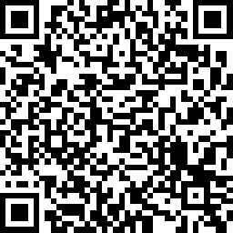
Session Survey
Your feedback is important. Please scan the QR code below to rate this session.

