Slide 1
Addressing Emotional Poverty for Adult Learners
Liz Lanphear, MS
GED® and GED Testing Service® are registered trademarks of the American Council on Education (“ACE”). They may not be used or reproduced without the express written permission of ACE or GED Testing Service LLC. The GED® and GED Testing Service® brands are administered by GED Testing Service LLC under license from ACE.

Slide 2



Today’s agenda
What is Emotional Poverty?
Impacts of Emotional Poverty on Adult Learners
Empowering Adult Learners

Slide 3
Do you have learners who don’t persist or “drag their feet”?
Do you have learners who:
Stop out multiple times
Drag their feet - you know they are capable but yet they won’t take their test(s)
Come but don’t engage
Exhibit Mental Health issues
Depression
Acting out
Anger – argue, pick fights with others
What else do you see?

Slide 4
Have you ever thought:
If only they’d apply themselves.
If only they’d get some discipline.
I know they are capable, but why won’t they show up?
If they would just get out of their own way.
They are ready, why won’t they go take the test?
What else have you thought?

Slide 5

What’s the missing piece???
We know we can teach them the skills.
…but they just “short-circuit”
We know they are capable

Slide 6
What is Emotional Poverty?

Slide 7
History of Emotional Poverty
2018
Ruby K. Payne introduces “emotional poverty” to describe hidden emotional struggles affecting behavior and learning.
2021
The concept gains attention among educators and parents as a factor in discipline and family life.
2024
Emotional poverty is called a “silent epidemic” impacting people of all backgrounds.
2025
Research links emotional poverty to systemic inequality and calls for comprehensive solutions.

Slide 8
What is Emotional Poverty?
It’s an unrecognized/unseen, widespread struggle.
It can affect anyone
Children and adults
Rich or poor
People with emotional poverty can appear to function in their daily lives but they struggle to thrive.
There are hidden impacts on their ability to learn, work, and engage in relationships.

Slide 9
What is Emotional Poverty?
Emotional poverty is a lack of emotional resources, often due to unstable relationships.
Such unstable relationships lead to a shortage of
Consistency
Emotional regulation
Consequently, this can cause
Limited capacity to handle emotions effectively
Diminished self-esteem, low self-worth

Slide 10
What is Emotional Poverty? Similar topics
Emotional Intelligence
Social Emotional Learning - SEL
Trauma-informed education

Slide 11
Impacts of Emotional Poverty on Adult Learners

Slide 12
How does Emotional Poverty present in learners?
Imposter syndrome, fear of failure
Low confidence and motivation
Difficulty with relationships
Lack of problem-solving skills
Physical and mental health issues
Attendance issues
Behavior problems
High levels of stress and anxiety
Lack of coping mechanisms
Fear of success
Difficulty focusing, engaging, learning

Slide 13

How does Emotional Poverty present in learners
What other things do you see?

Slide 14
Empowering Adult Learners

Slide 15
Empowering Adult Learners Why is this important?
Learners with emotional poverty can’t learn effectively.
Addressing emotional poverty and moving learners toward emotional intelligence helps them gain the skills to move forward in life.
Any other thoughts?

Slide 16
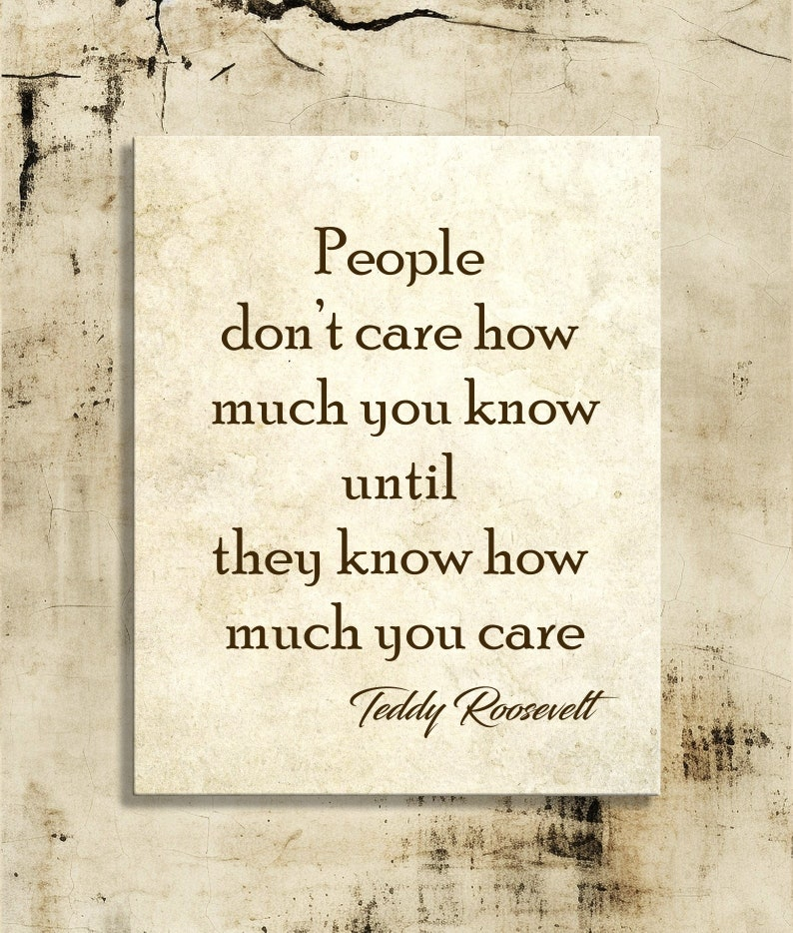
Empowering Adult Learners
“But I’m just a GED® instructor…”
Approach from a place of compassion and understanding.
They don’t care how much you know until they know how much you care
We must recognize and address the importance of building emotional intelligence, in addition to academics. If we don’t help them move forward emotionally, they will short-circuit now and in the future.

Slide 17

Empowering Adult Learners
It’s a process… and it starts with you…
Examine your own emotional poverty/emotional intelligence.
You have to understand where you are before you can help others recognize where they are.
Then you can help learners with their personal growth toward building emotional intelligence.

Slide 18
Empowering Adult Learners
Awareness
Recognize a learner’s behaviors aren’t due to laziness or lack of discipline, etc.
Empathy
Realize you need to get to the core of what resources they are lacking.
What are they feeling?
What are their triggers?
Show learners they are seen and valued to build trust.

Slide 19
Empowering Adult Learners
What wraparound/community services can you tap into?
Mental Health resources
Community Mental Health
Community Based Partners
Catholic Charities
School Counselors
Faith based organizations
Colleges/Universities

Slide 20



Empowering Adult Learners
Create a supportive community in the classroom
Build relationships
Develop trust

Slide 21
Empowering Adult Learners
Get to their core beliefs
Strip away the limitations
What do they want in life?
If money (or any limitation) wasn’t a factor – what would you want to do…
CAUTION
This can take time… many of won’t allow themselves to think this way. It’s too painful because it doesn’t fit their “reality”

Slide 22
Empowering Adult Learners
Journaling – helps them get in touch with their feelings and set them aside for the moment. This allows them to concentrate on studying. Plus, it’s a great way to improve writing skills by writing every day
Normalize discussions about feelings and emotions. Emphasize that everyone has feelings and emotions and they are all valid.
What other activities can you do?

Slide 23
Empowering Adult Learners Resources from Ruby Payne at aha! Process, Inc.
https://www.ahaprocess.com/ep1/
Assessing the Student’s Emotional Age https://www.ahaprocess.com/wp-content/uploads/2021/04/EP-Activity-Assessing-the-Students-Emotional-Age-041221.pdf
Less Than and Separate From https://www.ahaprocess.com/wp-content/uploads/2021/04/EP-Activity-Less-Than-Separate-From-042621.pdf
The Validation Process https://www.ahaprocess.com/wp-content/uploads/2021/04/EP-Activity-The-Validation-Process-041221.pdf
Questions for Students and Parents (use the Step and Questions for students columns) https://www.ahaprocess.com/wp-content/uploads/2021/04/EP-Activity-Questions-to-Address-Emotional-Issues-041221.pdf
Positive Childhood Experiences PowerPoint, download from https://www.ahaprocess.com/ep/1

Slide 24

Resources
GED TestPreppedTM coaching Program

Slide 25
Why GED TestPreppedTM Coaching? Gain new tools to help your students on their GED® journeys
Many students languish 140-145
Serves as a tool for educators to help students go beyond academic preparation
Gives the educator insight and actionable points to coach students
Alternative to repeatedly taking practice tests

Slide 26
GED TestPrepped™ Coaching Program
Educator becomes “Coach Certified” and earns a badge
Participate in six learning modules that take a total of 45 minutes
Student takes the assessment
Student receives a report
Four Dimensions: Motivation, Confidence, Responsibility, Resilience
Sixteen competencies further define the dimensions
Coach works with the Coaches Guide to counsel the student
Outcome of improved student test mastery and awareness
Free Program with access from GED Manager
Link: https://ged.com/educators_admins/program/testprepped/

Slide 27
GED TestPrepped™ Coaching Program
What is the pilot?
Looking for participants to
Take the Coaching program (Educators) (45mins)
Sign up for their free account (Students)
Send Assessment to student (GEDTS) (1 test per student)
Interpret Report with student (Educators)
Create new study plan including skills identified from the Assessment (Educator and Student)
Report student’s progress (Educator)

Slide 28
Resources
For more information on the pilot, contact Ann Evers, ann.evers@ged.com
GED TestPreppedTM Coaching Program Course, https://www.ged.com/educators-admins/program/testprepped/

Slide 29

Resources for Emotional Poverty

Slide 30
Resources
Payne, R. K. (n.d.). aha! Process, Inc.: a Ruby Payne Company. Retrieved from [http://www.ahaprocess.com](http://www.ahaprocess.com)
Payne, R. K. (2018). Emotional Poverty in All Demographics: How to Reduce Anger, Anxiety, and Violence in the Classroom. Aha! Process, Inc.
Payne, R. K. (2020). Emotional Poverty Volume 2: Safer Students and Less-Stressed Teachers. Aha! Process, Inc.
Payne, R. K., & Ott, J. (2021). Navigating Emotional Realities with Adults: Emotional Poverty at Work. Aha! Process, Inc.

Slide 31
Resources
Manasia, L., & Parvan, A. (2025). Emotional Poverty: How Inequalities Shape Engagement and Connection. IntechOpen. (https://doi.org/10.5772/intechopen.1009681)
NeuroLaunch editorial team. (2024, October 18). Emotional Poverty: Recognizing and Overcoming the Hidden Struggle. NeuroLaunch. (https://neurolaunch.com/emotional-poverty/)
Wisniewski, R., & Foster, L. R. (2021). Addressing the Social-Emotional Needs of Adult Learners to Ensure Workplace Success: Combined Practices That Integrate Social Emotional Learning and Employability Skills. American Association for Adult and Continuing Education. (https://files.eric.ed.gov/fulltext/ED611625.pdf)
Paule, S. (2021, January 21). What is Emotional Poverty?. Military Mom Collective. (https://militarymomcollective.com/health-and-wellness/what-is-emotional-poverty/)
Crisis Prevention Institute. (n.d.). How Trauma-Informed Schools Help Every Student Succeed. (https://www.crisisprevention.com/blog/education/how-trauma-informed-schools-help-every-student-succeed/)

Slide 32
Your State Relationship Team
Mellissa Hulstrand
IL,MI,MN,TN,VT,WI
PR,VI,MI Prisons
Mellissa.Hulstrand@ged.com
Brian Smith
GA,PA
Brian.Smith@ged.com
Scott Salesses
MA,NY
FBOP
Scott.Salesses@ged.com
Lisa Pool-Osorio AK,AZ,CA,ID,NV,OR,UT, WA, Guam
Lisa.Pool-Osorio@ged.com
Adora Beard
AL,DC,DE,MD,VA,PR
Military
Adora.Beard@ged.com
Liz Lanphear CO,HI,IN,KS,MO,NE,NM,ND,SD
Elizabeth.Lanphear@ged.com
Diane Vaccari
CT,FL,KY,NJ,OH,RI,SC,WV
Bermuda
Diane.Vaccari@ged.com
Jonna Forsyth
CA,MS,MT,NC,NH,OK,TX,WY
Jonna.Mcdonough@ged.com
Debi Faucette
AR,CA,LA
Debi.Faucette@ged.com

Slide 33

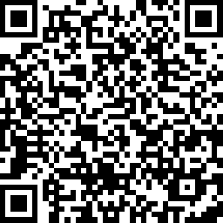
Session Survey
Your feedback is important. Please scan the QR code below to rate this session.

