Slide 1
JUMPSTARTING YOUR GED PROGRAM WITH ACTION RESEARCH
Jocelynn Mosher
GED® and GED Testing Service® are registered trademarks of the American Council on Education (“ACE”). They may not be used or reproduced without the express written permission of ACE or GED Testing Service LLC. The GED® and GED Testing Service® brands are administered by GED Testing Service LLC under license from ACE.

Slide 2

From INSIGHT to IMPACT
JUMPSTARTING YOUR GED PROGRAM WITH ACTION RESEARCH
Presenter
School Address
Website
August 2025
Jocelynn Mosher
ABE/ASE Teacher
200 Branstetter St, Roseville, CA 95678
https://rosevilleadult.rjuhsd.us/
jmosher@rjuhsd.us

Slide 3


TABLE OF CONTENTS
From INSIGHT to IMPACT
01
04
Hello There!
Problems & Solutions
02
05
Action Research
Examples
03
06
Program Goals
Contact

Slide 4

HELLO THERE!
ROSEVILLE ADULT SCHOOL, CA
Roseville Adult School, located in Roseville, California, has been serving the community since 1921. As part of the Roseville Joint Union High School District, the school offers a variety of programs, including but not limited to English as a Second Language (ESL), High School Diploma completion, GED preparation, and Career Technical Education (CTE) courses. RAS operates across multiple campuses and offers Pearson Vue Testing to extend access to quality adult education in the greater community. ​
Nice to meet you!
Notes:
Can I have you shout out some of your roles and educational contexts?

Slide 5

IN WHAT AREAS OF YOUR LIFE WOULD YOU LIKE TO SEE OR EXPERIENCE IMPROVEMENT?
Notes:
To get a feel for the process of action research… Ask the crowd to shout out. Looking for budget, relationships, social media consumption, etc. These lead us to a broad question.

Slide 6


2023
01
Enrollment
OUR STORY
High Enrollment, low engagement
02
Access
Reading and Math levels
03
Persistence
Dismal Pass Rate
Notes:
This whole process started in 2023, when I walked into the GED Classroom at my School.
1. My first day, we had 92 students enrolled and only a small fraction of those had come in in the past 60 days.
2. About 1/3 of the students coming in tested below High School Level Reading, and over 1/2 below High School Level Math. - Couldn't access lesson 1.
3. Of all the students who had been in the program throughout the year, 130+ , only 6 passed all 4 sections of the GED.
**Our program was failing students, and we had to do something to change that.

Slide 7


DEFINITION
Action research is a form of investigation designed for use by teachers to attempt to solve problems and improve professional practices in their own classrooms. It involves systematic observations and data collection which can be then used by the practitioner-researcher in reflection, decision making and the development of more effective classroom strategies.
- Parsons and Brown (2002)
Notes:
What is action research?
Action research shies away from a one-size-fits-all approach and selects instead a tailor-made approach responsive to the strengths and needs of your specific classroom. Just like your class, it should be dynamic and ever-changing, reflecting the class you have at any given time.
Since the time this was written, they've broadened this term to apply to other workspaces with fluid needs and developing research like medicine and military strategies.

Slide 8

ACTION RESEARCH
BOOSTING STUDENT PERSISTENCE
INSIGHT
Through data analysis, program coordinators and teachers develop clarity: what’s working, what’s not working, and why. Action Research is the lived-out curiosity of responsive, student-centered, course management.
IMPACT
Once you have a clear picture of what your students need to succeed, you become better prepared to meet that need. The result is a successful program tailored to the needs and goals of your specific learning community.
Notes:
The reason we conduct action research is twofold

Slide 9


ACTION RESEARCH
Guiding Questions
Data Analysis
Action research is focused on the need to improve instruction, as perceived by the faculty.
  Glickman, Gordon & Ross Gordon 2018
Reflect & Evaluate
Take Action

Slide 10


INSIGHT
FOCUS & Guiding Questions
Take Action
What do you want to see change about your program? What questions open the door to investigating problems and solutions?
Based on your data and aligned with your guiding question, enact a plan that addresses the problems you discovered.
Data Analysis
Look at the data relevant to your guiding question. What is that data telling you?

Slide 11

FOCUS & GUIDING QUESTIONS
Think “Why” and “How” questions.
  Start with a clearly defined FOCUS for improvement
  Identify guiding questions that get to the heart of the FOCUS issue.
  They’re the jumping off point for everything that follows.
Notes:
Let's consider some of the non-work areas you'd like to improve. What are some guiding questions that could help us investigate the problem further?

Slide 12
WHAT DO YOU WANT TO FOCUS ON TO IMPROVE YOUR PROGRAM?
We wanted to improve GED® persistence.
Notes:
How do we get more people across the finish line to their goal?

Slide 13
WHAT GUIDING QUESTIONS HELP YOU INVESTIGATE YOUR AREA OF FOCUS?
Notes:
How do we get more people across the finish line to their goal?

Slide 14

Guiding Questions
  At what point are we losing the most students?
  Where are students stagnating in their studies?
  How are we keeping track of student progress in real-time?
Notes:
Jocelynn - Your BIG question will lead to a lot more questions like… The more specific will lead you to the data you need.

Slide 15


“MAYBE STORIES ARE JUST DATA WITH A SOUL”
BRENE BROWN

Slide 16

Identify data sources that provide context for your guiding questions.
  At what point are we losing the most students? - Attendance Data
  Where are students stagnating in their studies? - GED Prep Curriculum
DATA ANALYSIS
*How are we keeping track of student progress in real-time?
Notes:
Jocelynn - Your BIG question will lead to a lot more questions like… The more specific will lead you to the data you need.

Slide 17
WHAT DATA MIGHT YOU NEED TO LOOK AT OR COLLECT?
Notes:
How do we get more people across the finish line to their goal?

Slide 18
PROBLEMS
01
Onboarding
IDENTIFYING PAIN POINTS
Orientation consisted of introductions, relaying office hours, and adding the student to the study platform. We lost a huge percentage of our students in the first 12 hours of study.
02
Accountability
Students came in when they wanted to receive tutoring and program guidance. All coaching was student initiated.
03
Progress Tracking
If a student presented a question, the teacher could react by accessing the student portal but reports were severely limited.
Notes:
1. Engages students right away with one-on-one face time with the teacher, connection about non-academic life, and leveled curricular support to avoid initial overwhelm.
2. Contract with clearly outlined teacher and student roles (empowering, not dependent or passive), weekly, student-led check-ins for accountability and ownership of progress.
3. Visual Progress tracking and a 3-strikes policy help students measure progress and celebrate victories while building resiliency through choice and prioritization of their goals (always room for flexibility and teacher discretion ).

Slide 19
TAKE ACTION
MAKE YOUR MOVE
01
Onboarding
Revamp the first 12 hours based on student feedback.
02
Accountability
03
Progress Tracking
Create an additional resource portfolio specific to the problem areas we identified in the curriculum & empower student progress monitoring
Design and implement a case management approach so each student’s plan can be tailored to the kind of support they need.

Slide 20
PROBLEMS
SOLUTIONS
-
-
Belonging
Onboarding
We revamped our orientation to reflect a holistic approach to student support. A get-to-know-you interview and regular wrap around questions are reflective of a new, more student-centered approach.
Orientation consisted of introductions, relaying office hours, and adding the student to the study platform. We lost a huge percentage of our students in the first 12 hours of study.
-
-
Ownership
Accountability
Students came in when they wanted to receive tutoring and program guidance. All coaching was student initiated.
We established a contract including study hours and in-person check-ins. Through data-driven insights, students record weekly improvement, engage in goal setting, visually display their progress, and regularly reflect on long term goals.
-
Progress Tracking
-
Resiliency
If a student presented a question, the teacher could react by accessing the student portal but reports were severely limited.
By leveraging small victories and data-supported evidence of competence, we build self-efficacy in students. We also review life management skills like scheduling and prioritizing that help our students remain consistent despite life’s unpredictability.
Notes:
1. Engages students right away with one-on-one face time with the teacher, connection about non-academic life, and leveled curricular support to avoid initial overwhelm.
2. Contract with clearly outlined teacher and student roles (empowering, not dependent or passive), weekly, student-led check-ins for accountability and ownership of progress.
3. Visual Progress tracking and a 3-strikes policy help students measure progress and celebrate victories while building resiliency through choice and prioritization of their goals (always room for flexibility and teacher discretion ).

Slide 21
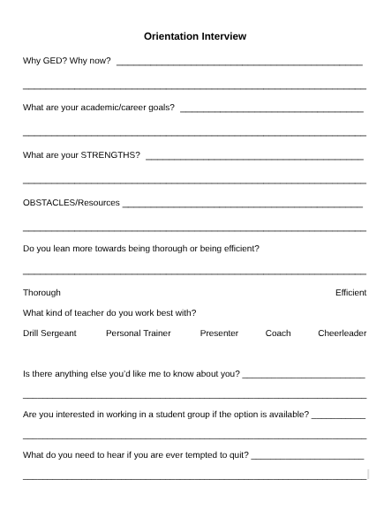
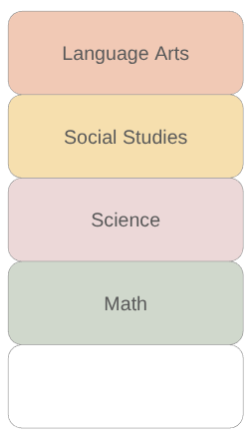
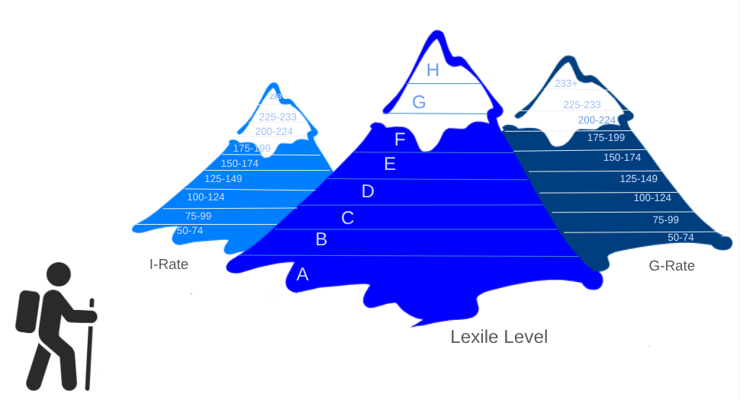
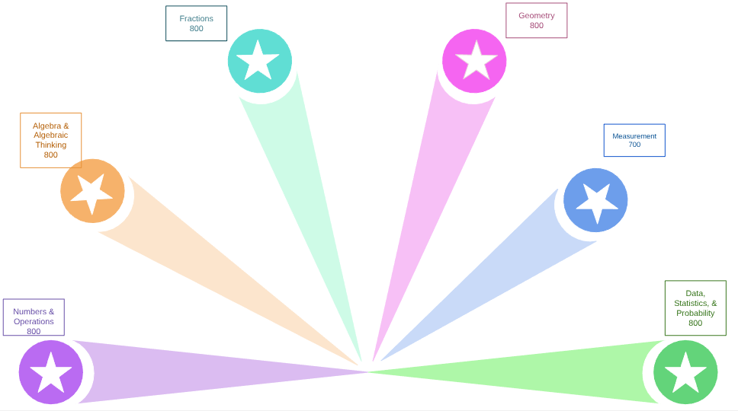
Notes:
If you have specific program goals (such as those from your WASC, for example), your focus might come from there.
Our FOCUS came directly from our WASC. We needed to address persistence to improve student outcomes.

Slide 22
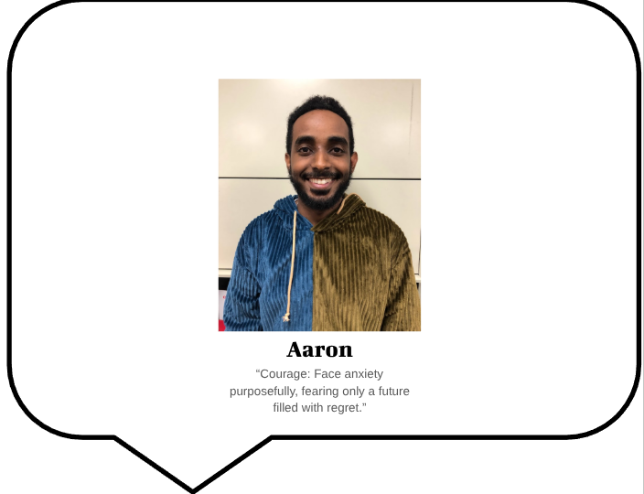

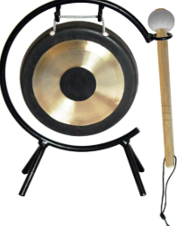

Slide 23



EVALUATE
WHAT HAPPENED
Onboarding → ???
Accountability → Ownership
Progress Tracking → Resiliency
We have more people come back after orientation but still drop before the 12-hour mark. Our next plan is to be OVERLY clear about the difficulty of the program and ask if they have they time and motivation to embark on this journey.
Students often comment on the board and take home completed progress sheets to put on their fridges when they graduate. This way, they know and can find evidence of the hours they studied each week.
Tracking progress and planning weekly goals helps students stay on track. Accountability and average weekly hours are up. Eighteen students passed last year, up from fourteen the year before that, and six the year before that.

Slide 24
WHAT LINGERING QUESTIONS DO YOU HAVE?
Notes:
How do we get more people across the finish line to their goal?

Slide 25
THANK YOU
FOR COLLABORATING WITH ME TODAY
Presenter
School Address
Website
Jocelynn Mosher
ABE/ASE Teacher
200 Branstetter St, Roseville, CA 95678
https://rosevilleadult.rjuhsd.us/
jmosher@rjuhsd.us

Slide 26

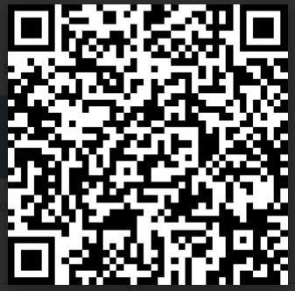
Session Survey
Your feedback is important. Please scan the QR code below to rate this session.

