Slide 1
AI Empowerment for Educators: Transforming your Classrooms with Custom AI Assistants
Vi Hawes
VH Ed Tech Consulting
GED® and GED Testing Service® are registered trademarks of the American Council on Education (“ACE”). They may not be used or reproduced without the express written permission of ACE or GED Testing Service LLC. The GED® and GED Testing Service® brands are administered by GED Testing Service LLC under license from ACE.

Slide 2

✅Agenda
Introductions
Icebreaker
Understanding GenAI & CustomGPTs
Exploring CustomGPT tools
Access Poe Platform
Get Inspired! Custom GPT Ideas
Reflections & Takeaways

Slide 3

👋Introductions
Vi Hawes, M.Ed
ESOL Instructor / Ed Tech Specialist
VH Ed Tech Consulting
Pima Community College Adult Basic Education for College & Career
✨Fun Facts!
I’ve completed both a half/full marathon!
I can speak three languages
I completed my Master’s AND gave birth to my second child, AT. THE. SAME. TIME!

Slide 4


Let’s stay connected!

Slide 5
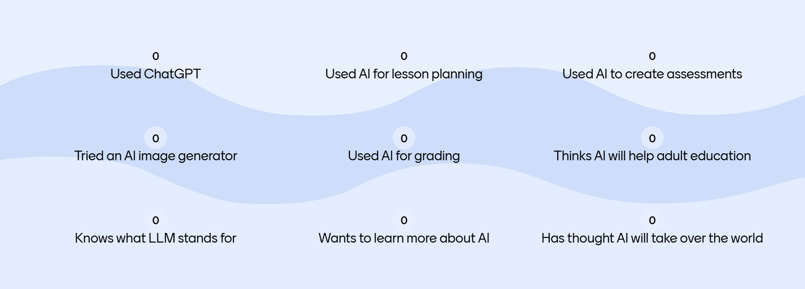
How much do you know?
Tick the ones you have done on Mentimeter
Notes:
GO TO MENTIMETER

Slide 6






🤷‍♀️What is Generative AI?
Generative AI is a subset of AI that creates new, original content based on patterns learned from existing data. Popular examples include ChatGPT, Gemini, Claude, and Copilot

Slide 7

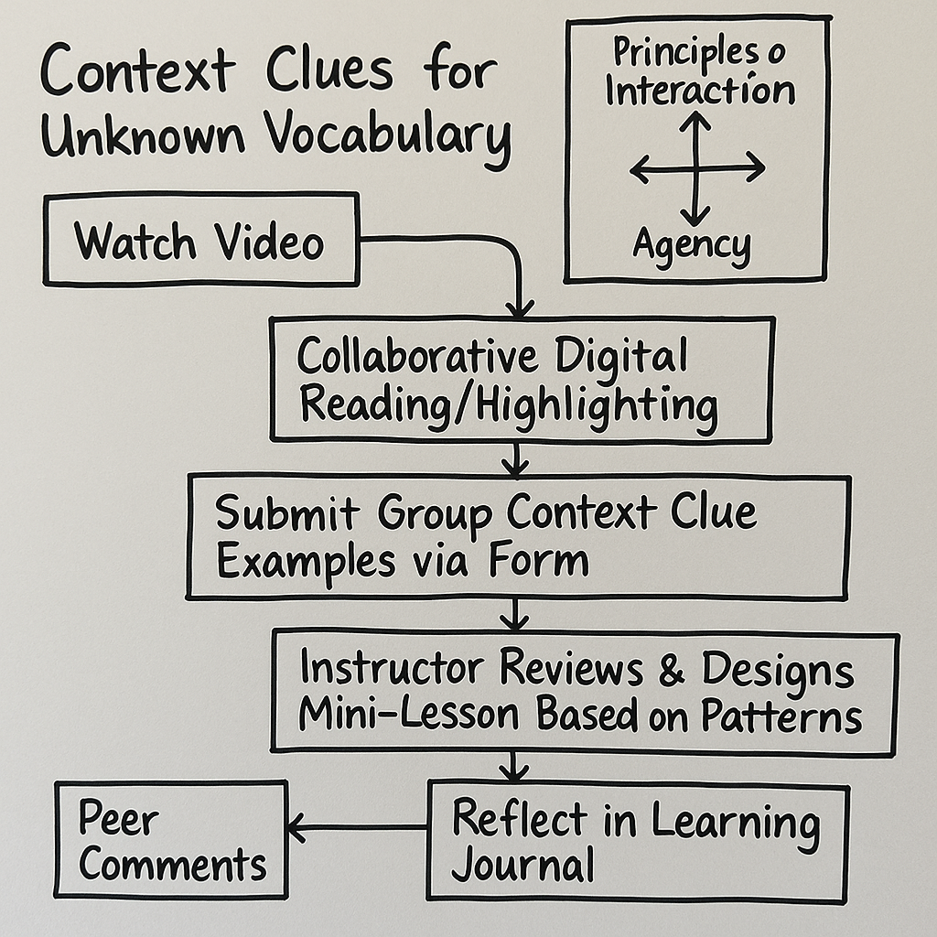

Text Generation
Audio
Essays, stories, poems, scripts, lesson plans, and conversational responses
Music compositions, sound effects, and natural-sounding speech
Images
Dialogue for ESOL students
Generated by ElevanLabs
Artwork, photographs, diagrams, and visual representations
Podcast on Open Network Learning Environments
Generated by NotebookLM

Slide 8
Why AI in Adult Education?
Addresses Diverse Learner
Provides differentiated support for various backgrounds, language proficiency levels, and learning styles.
Personalized Instruction
Creates customized learning pathways tailored to individual student goals and progress.
Enhances Lesson Creation
Reduces planning time while increasing quality and relevance of instructional materials.
Support Language & Career Development
Provides contextualized practice for English acquisition and workplace preparation.

Slide 9
Ethical Considerations
Data Privacy & FERPA Compliance
Ensure AI tool use with student data complies with FERPA.
Avoid entering personal information into public AI platforms.
Bias & Inclusivity
AI may reflect biases from their training data.
Review generated content for cultural sensitivity and inclusivity
Human-Centered Education
Maintain your role as an educator.
AI is a tool, not a replacement for human judgment and empathy.
Prioritize human interactions.
Evaluate AI content

Slide 10

🤖What is a CustomGPT?
GPT - Generative Pre-Trained Transformer
Tailored for a Purpose
Instead of general conversation, they’re designed for specific tasks, topics, or users, like ESOL learners or educators.
Custom Knowledge & Instructions
Equipped with unique instructions and custom knowledge bases (e.g. documents, curriculum), enabling highly relevant responses.
Enhanced Interaction
Provide more focused, precise, and relevant interactions, making AI a truly personalized assistant for your needs.

Slide 11



✨Meet the Custom GPTs
https://poe.com/EmpowerEdAI
EmpowerEd AI
Specialized for adult education instruction
Creates standards-aligned lesson plans
Generates language scaffolding resources
Differentiated activities

Slide 12


✨Meet the Custom GPTs
https://poe.com/MyGrammarBuddy
MyGrammarBuddy
Provides clear grammar explanations
Constructive feedback on writing
Creates targeted correction
Explains errors in accessible language

Slide 13
🔍Explore EmpowerEd AI & MyGrammarBuddy
Some additional subtitle text

Slide 14






🤔Why Create Your Own CustomGPT?
Tailored Solutions
Reusable Resources
Saves Time
Consistent Design
Accessible Empowerment
Enhanced Reliability
Notes:
Tailored Solutions
Adjust AI behavior to precisely match your unique classroom environment and student requirements, ensuring relevance and impact.
Reusable Resources
Build assistants for common tasks like lesson planning, grammar support, or content generation, promoting efficiency and consistency.
Save Time
Leverage automated and personalized responses to streamline workflows, freeing up valuable time for direct student engagement.
Consistent Design
Encourage a unified instructional approach aligned with educational standards across all generated materials and activities.
Accessible Empowerment
Enable non-tech-savvy colleagues to easily access and utilize powerful AI tools, democratizing advanced educational technology.
Enhanced Reliability
By setting specific parameters, you can significantly reduce the likelihood of AI hallucinations, misinformation, and biased outputs, ensuring more dependable resources.

Slide 15
ℹ️Creating a Poe.com Account

Slide 16

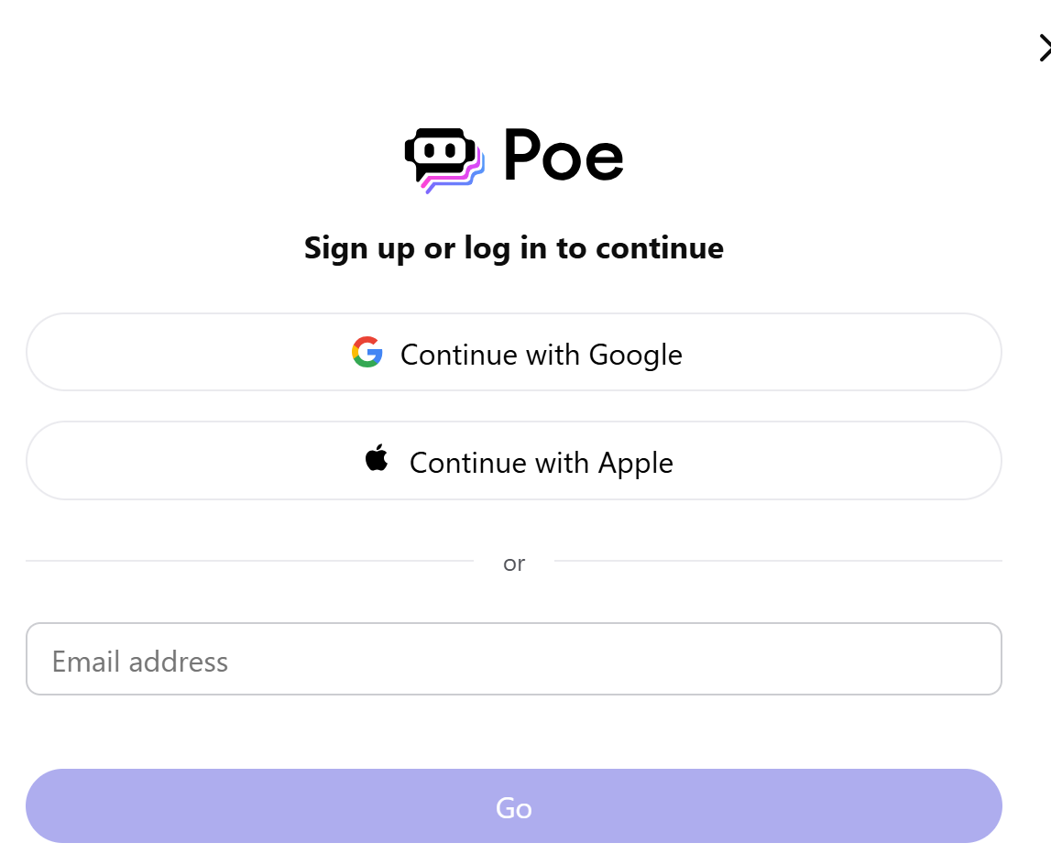
ℹ️Creating a Poe.com Account
Visit Poe.com or download the app
Sign up using your Google, Apple, or email address
Verify your email
Once logged in, you can start exploring and interacting with various CustomGPTs.
Notes:
demonstrate on the computer as well

Slide 17

🎉Activity—Explore the CustomGPTs
Work in Pairs or Work Solo
2. Generate a Mini Lesson
Use EmpowerEd AI to create a brief lesson plan for your specific context.
3. Try Grammar Correction
Ask MyGrammarBuddy to correct and explain a sample text with errors.
4. Reflection
Consider how these tools might fit into your teaching practice

Slide 18


💡Get Inspired! CustomGPT Ideas
🧠 Ideas for classroom-focused CustomGPTs:
Writing Feedback Assistant
Provides constructive feedback on student writing with specific suggestions for improvement while maintaining the student’s voice and ideas.
Job Interview Practice Bot
Simulates industry-specific interviews, provides feedback on responses, and suggests improvements for professional communication.

Slide 19

💡Get Inspired! CustomGPT Ideas
🧠 Ideas for classroom-focused CustomGPTs:
Study Guide Bot
Condenses long texts or lecture notes into concise summaries, key points, or comprehension questions to aid studying.
Class Discussion Facilitator
Generates thought-provoking questions, conversation starters, or debate prompts for classroom discussions on various topics.
🗨️Discuss with a partner how you might create a CustomGPT to address specific challenges in your classroom

Slide 20


💭Reflection & Next Steps
Which CustomGPT are you most excited to try?
What specific classroom challenge could you address with a custom GPT?
💡Resource Access:
CustomGPT Tutorial for Educators

Slide 21


Slide 22

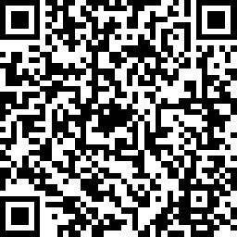
Session Survey
Your feedback is important. Please scan the QR code below to rate this session.

