Slide 1
Writing with Evidence for the GED Test, Work and Real-World Communication
Susan Pittman, Educational Consultant

Slide 2
1
4
What We Know About Students and the GED Extended Response
Workplace Writing
2
5
CER Strategy for Writing
Audience, Tone and Style
3
Teacher Checklist for Improving Writing

Slide 3
Writing for the GED Test

Slide 4
We know…
The Extended Response requires that students
Develop a claim
Back it up with evidence
Explain how the evidence connects to the claim
The Extended Response requires that students
Organize the response
Develop their ideas
Maintains formal style and tone
Use words to express ideas clearly
The Extended Response requires that students
Use appropriate sentence structure
Apply grammar conventions
*may contain errors but those errors don’t interfere with comprehension

Slide 5
Also, we know that…
Some students don’t even attempt to write an extended response
Some students simply summarize the source texts
Some students struggle with understanding the source texts
Many students lack a process for writing
Many students fail to proofread, revise and/or edit their writing

Slide 6
So, what can we do?
Use the CER (Claim, Evidence, Reasoning) strategy to build a solid argumentative response. CER breaks your writing into three logical steps
Starting your argument
Backing it up with facts
Explaining how those facts connect to your main point
Notes:
The CER (Claim, Evidence, Reasoning) strategy is an effective framework to build a solid argumentative essay. It breaks your writing into three logical steps: stating your argument, backing it up with facts, and explaining how those facts connect to your main point.

Slide 7
CER Strategy in Writing
Claim
Main argument or thesis statement
Should directly answer the prompt
Take a clear stance
Be provable
Evidence
Objective data, expert quotes or examples that support the claim
The “what” of your argument
Ensures your position is based on facts not opinion
Reasoning
Is the “how” and “why”
Explains to the reader why the evidence supports your claim
Connects the dots
Addresses the logic of your argument

Slide 8
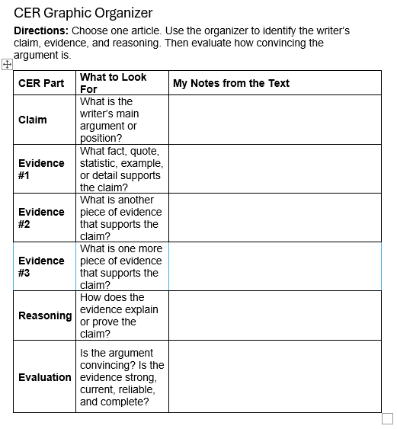
So, what can we do?

Slide 9
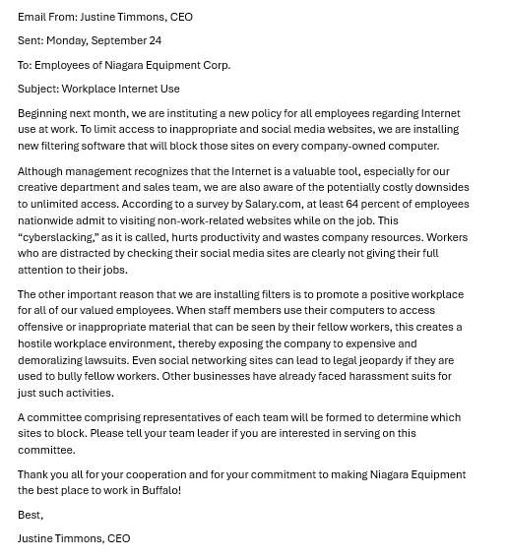
Sample 1

Slide 10
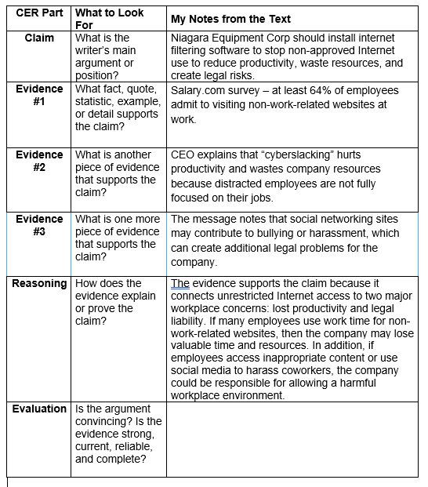
Using CER as a Planning Tool

Slide 11
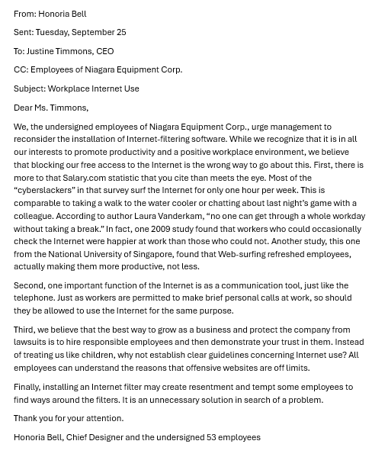
Sample 2

Slide 12
Using CER as a Planning Tool

Slide 13
Sample Response
Honoria Bell’s email makes the stronger argument overall. Her argument is stronger because she directly responds to the CEO’s evidence instead of just presenting a separate opinion. She takes the Salary.com statistic and explains that most employees only used the Internet for about one hour per week, which weakens the CEO’s claim that Internet use is a major productivity problem. She also supports her argument with multiple types of evidence: comparisons to normal workplace breaks, expert opinion, research studies, and practical reasoning about employee trust.
Justine Timmons makes a serious argument about productivity and legal risk, but her evidence is more general and assumes that Internet use will usually cause harm. Bell’s reasoning is more balanced because she admits the company’s concerns are valid while arguing that clear guidelines would solve the problem better than filters.

Slide 14
Teacher Checklist for Improving On-Demand Writing – Before Writing
☐ Clearly identify the writing purpose and genre, such as argument, explanation, narrative, analysis, or response to sources.
☐ Review the prompt for clarity, specificity, and student-friendly wording.
☐ Name the intended audience so students can make appropriate choices about tone, content, and level of detail.
☐ Provide concise success criteria or a rubric focused on the most important expectations.
☐ Prioritize the skills that matter most for this task, such as claim, organization, evidence, reasoning, clarity, or development.
☐ Set a realistic time frame and communicate how students should divide time among planning, drafting, and editing.
☐ Select source material, if used, that is relevant, accessible, and manageable within the time limit.
Notes:
Teacher Checklist for Improving an On-Demand Writing Task
Before Writing
☐ Clearly identify the writing purpose and genre, such as argument, explanation, narrative, analysis, or response to sources.
☐ Review the prompt for clarity, specificity, and student-friendly wording.
☐ Name the intended audience so students can make appropriate choices about tone, content, and level of detail.
☐ Provide concise success criteria or a rubric focused on the most important expectations.
☐ Prioritize the skills that matter most for this task, such as claim, organization, evidence, reasoning, clarity, or development.
☐ Set a realistic time frame and communicate how students should divide time among planning, drafting, and editing.
☐ Select source material, if used, that is relevant, accessible, and manageable within the time limit.

Slide 15
Teacher Checklist for Improving On-Demand Writing – During Writing
☐ Build in a brief planning step so students can analyze the prompt, brainstorm ideas, form a thesis or main idea, and sketch an outline.
☐ Remind students to manage their time across planning, drafting, and quick editing.
☐ Encourage students to support ideas with details, examples, or source evidence.
☐ Prompt students to explain how their evidence connects to the main point.

Slide 16
Teacher Checklist for Improving On-Demand Writing – After Writing
☐ Use grading expectations that reflect the task as a first draft rather than a polished final piece.
☐ Plan how the results will inform instruction, such as grouping students by need or choosing a focused mini-lesson.
☐ Include a quick reflection after writing so students identify a strength, an area for improvement, and a goal for next time.

Slide 17
Evidence-Based Writing in the Workplace

Slide 18
What Do Employers Want?
They want employees who can:
communicate effectively verbally and in writing
select and use formal, informal, literary, or technical language appropriate for the audience
produce effective work-related texts

Slide 19
Workplace writing should be…
Clear – easy to understand by the audience
Accurate – factual, correct, and free of bias
Correct – grammatically and technically
Comprehensive – includes all the information the audience needs
Concise – does not have a lot of verbiage
Accessible – is organized and has appropriate headings and subheadings

Slide 20
RAFTS
Role, Audience, Format, Topic, Strong Verb

Slide 21
Getting Started with RAFTS
Role – assume a different point of view
Audience – write to a specific audience other than the teacher
Format – develop using a specific genre or type of writing
Topic – cover any topic assigned
Strong Verb – write with more purpose
Notes:
When writing to a R.A.F.T.S. prompt in any content area, students must access higher level thinking in order to respond. This process, if the assignment is designed well, will not allow the regurgitated information that other types of assigned writing often do. While most writing assignments ask students to simply report on information they’ve learned, R.A.F.T.S. ask students to shift perspective in order to show their knowledge on a topic
R.A.F.T.S. Writing PromptsRole – assume a different point of view
Audience – write to a specific audience other than the teacher
Format – develop using a specific genre or type of writing
Topic – cover any topic assigned
Strong Verb – write with more purpose

Slide 22
Sample RAFTS
Prompt
You are a bookkeeper for a small bakery that provides a variety of baked goods, including cookies, muffins, and brownies, to local childcare providers. The cost for ingredients, such as milk and eggs, has steadily increased over the past 6 months. However, there has been no price increase to local customers. The company manager has refused to increase prices because the manager is afraid that customers will switch to another bakery. After analyzing the costs and the income for the last six months, you know that something must change, or the company will see a lot of red ink. Write your one-page report to persuade the manager to make changes.
Role: a bookkeeper
Audience: company’s manager
Format: a one-page summary report
Topic: status of the company’s income and expenditures
Strong verb: persuade
Notes:
R.A.F.T.S. Sample
Role: a bookkeeper
Audience: company’s manager
Format: a one-page summary report
Topic: current status of the company’s income and expenditures
Strong verb: persuade
R.A.F.T.S. Prompt
You are a bookkeeper for a small bakery that provides a variety of baked goods, including cookies, muffins, and brownies, to local childcare providers. The cost for ingredients, such as milk and eggs, has steadily increased over the past 6 months. However, there has been no price increase to local customers. The company manager has refused to increase prices because the manager is afraid that customers will switch to another bakery. After analyzing the costs and the income for the last six months, you know that something must change or the company will see a lot of red ink. Write your one page summary report so th

Slide 23
Writers in the Workplace - Brainstorming
Have students brainstorm the different types of audiences they encounter in their own jobs.
A student who works at a fast-food restaurant would have the following audiences: co-workers, supervisor/shift manager, customers (young people, mature adults, seniors, and children), and suppliers.
A student who works as a mechanic might have co-workers (mechanics and non-mechanics), supervisors, customers, suppliers, and local car dealers as their potential audience.
Have students discuss how they would write things differently depending on who was going to read their work

Slide 24
Audience, Tone and Style

Slide 25
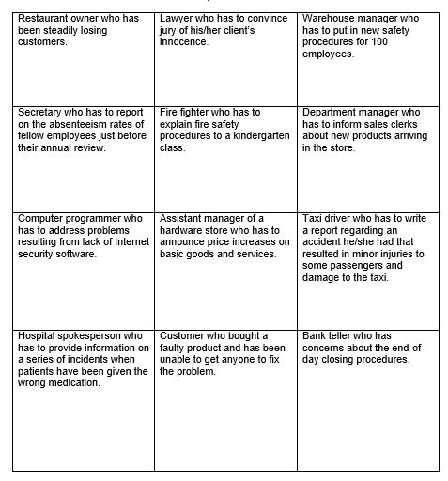
Who would be your audience?
How would you write things differently depending on the audience?
Would your tone or style change?

Slide 26
Scenario: A vendor delayed a software delivery, pushing back your launch timeline
Goal: Inform them of the change, adjust shared workflows, and maintain a friendly team dynamic.
Subject: Heads up - launch date moving back 🚚
Hey Sarah,
Quick update on the software project. The vendor just told me they need another week to fix a bug, so our launch date is moving from this Friday to next Friday (the 17th).
Since we have a buffer now, do you want to push our sync back to Tuesday? Let me know what works for you.
Best,
[Your Name]
Notes:
Who are you writing to?
Scenario: A vendor delayed a software delivery, pushing back your launch timeline.
1. Writing to a Peer (Collaborative & Casual)
Goal: Inform them of the change, adjust shared workflows, and maintain a friendly team dynamic.
Subject: Heads up - launch date moving back 🚚
Hey Sarah,
Quick update on the software project. The vendor just told me they need another week to fix a bug, so our launch date is moving from this Friday to next Friday (the 17th).
Since we have a buffer now, do you want to push our sync back to Tuesday? Let me know what works for you.
Best,
[Your Name]

Slide 27
Scenario: A vendor delayed a software delivery, pushing back your launch timeline
Goal: State the impact immediately, take ownership of the next steps, and provide a clear solution for them to approve.
Subject: Project Update: 1-Week Launch Delay & Mitigation Plan
Hi Jennifer,
The software launch date has been moved from July 10 to July 17 due to a critical vendor-side bug fix.
To minimize the impact of this delay, I have updated our timeline and reallocated the team's focus this week to finalize the user documentation. This ensures we will be fully ready for deployment on the new date.
I have attached the revised project roadmap for your review. Please let me know if you would like to discuss this strategy further.
Sincerely,
[Your Name]
Notes:
Who are you writing to?
Goal: State the impact immediately, take ownership of the next steps, and provide a clear solution for them to approve.
Subject: Project Update: 1-Week Launch Delay & Mitigation Plan
Hi Jennifer,
The software launch date has been moved from July 10 to July 17 due to a critical vendor-side bug fix.
To minimize the impact of this delay, I have updated our timeline and reallocated the team's focus this week to finalize the user documentation. This ensures we will be fully ready for deployment on the new date.
I have attached the revised project roadmap for your review. Please let me know if you would like to discuss this strategy further.
Sincerely,
[Your Name]

Slide 28
Scenario: A client is furious because a marketing campaign went live with an incorrect discount code, causing confusion for their customers.
Subject: Re: Code Error
Hi Mark,
I received your email. The error happened because the system had a glitch when uploading the promo codes last night. It wasn't entirely our fault, but the code has been updated now and should be working.
We are sorry for the confusion this caused your customers. We will investigate why this happened, so it doesn't happen again. Let me know if you need anything else.
Thanks,
[Your Name]

Slide 29
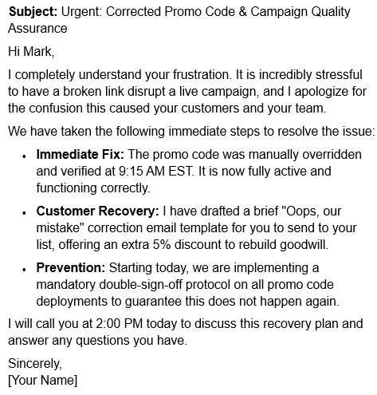
Scenario: A client is furious because a marketing campaign went live with an incorrect discount code, causing confusion for their customers.

Slide 30
“You can always edit a bad page. You can’t edit a blank page.”
-Jodi Picoult

Slide 31

Bringing it all together!
Spend more time writing
Keep the early focus on ideas
Move to using evidence-based writing about real-life situations
Incorporate close reading into the process
Help students find evidence and evaluate it
Scaffold the process – move from claims to evidence to conclusions
Incorporate some form of writing into all content areas

Slide 32

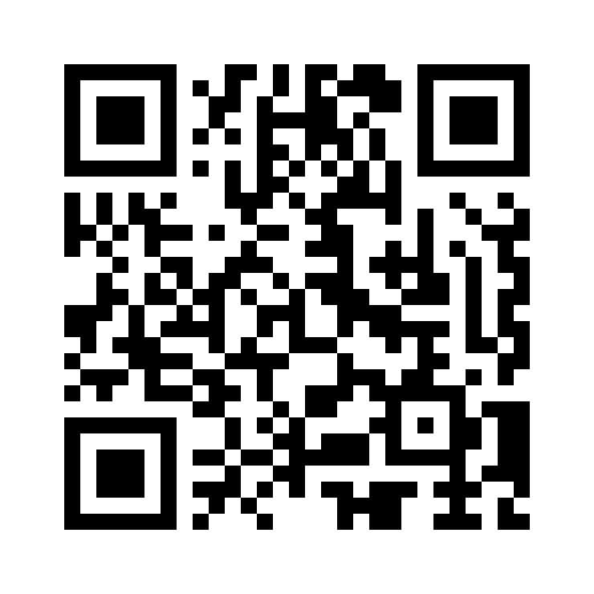
Session Survey
Your feedback is important. Please scan the QR code below to rate this session.

