Slide 1
Why Learners Persist—or Don’t
What GED Data Reveals About Motivation, Momentum, and Success
Kris Meehan

Slide 2

Objective
Understand the activation gap: Where GED learners struggle across the journey from account setup to credential completion
Identify what drives momentum: Behaviors and signals that separate successful learners from those who stall
Move from reporting to action: How to use data strategically to support learners and increase credential attainment

Slide 3
National GED Trends
The Activation Gap
The “successful” learner journey
The 3-of-4 Stallers
What’s Actually Working

Slide 4
National GED Trends
A changing landscape

Slide 5
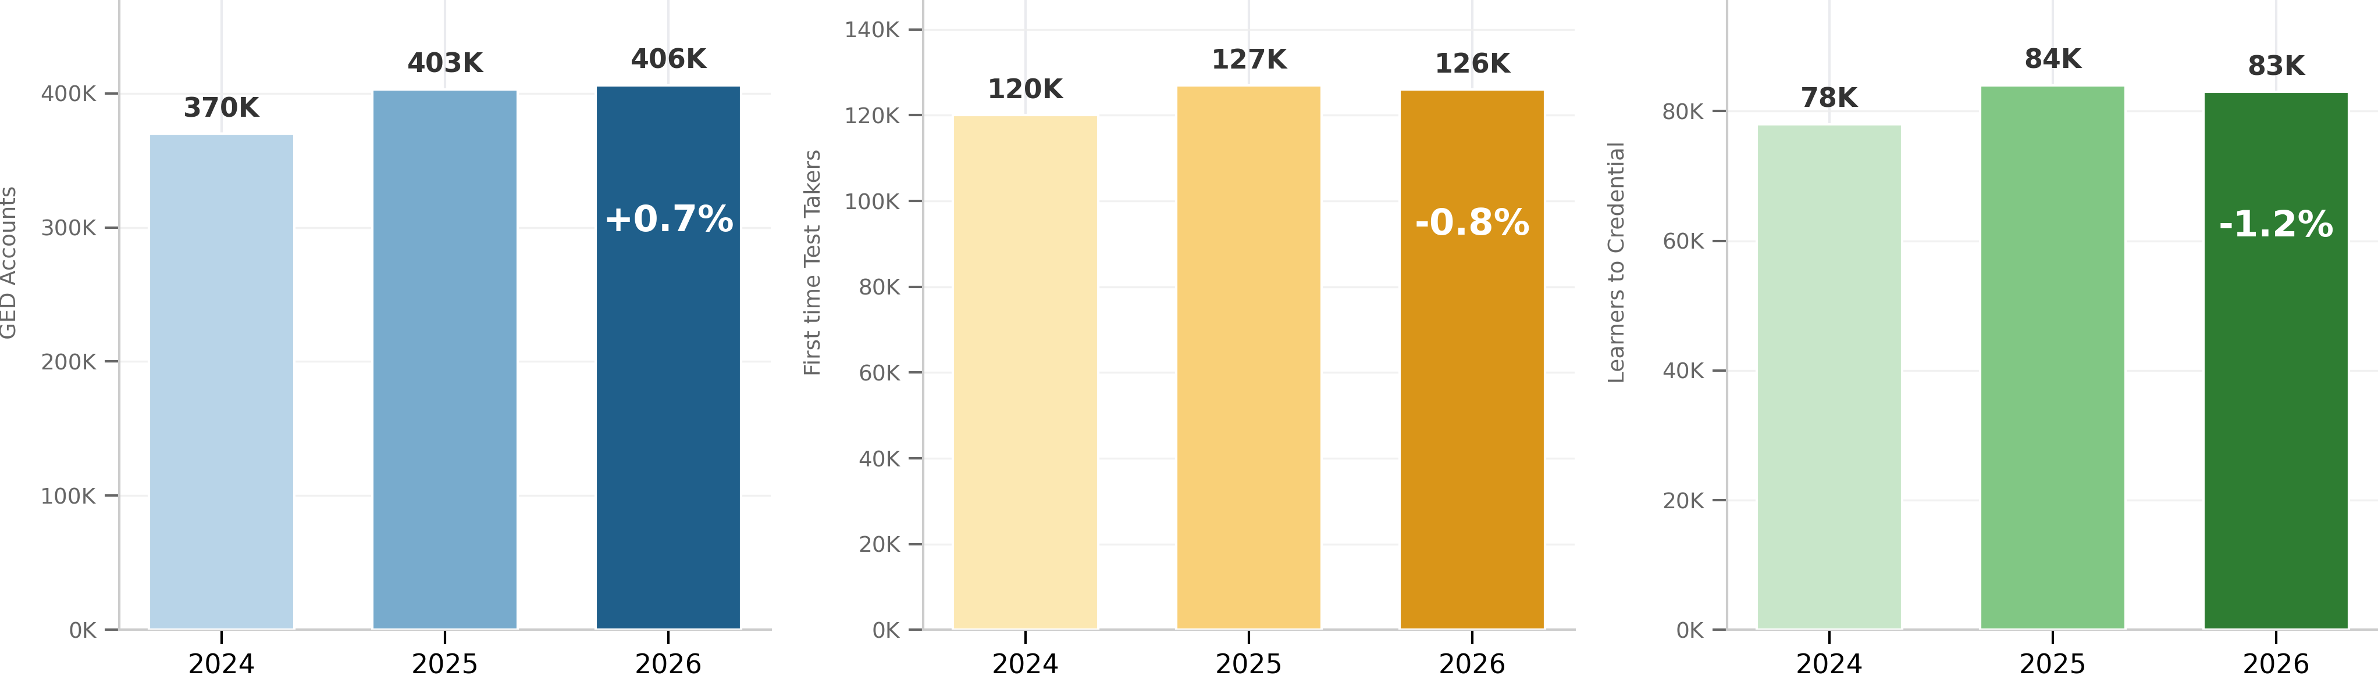
Accts Setup Growing – First Time Testers and Credentialers flat
Accounts Setup
First-Time Testers
Credentialers

Slide 6
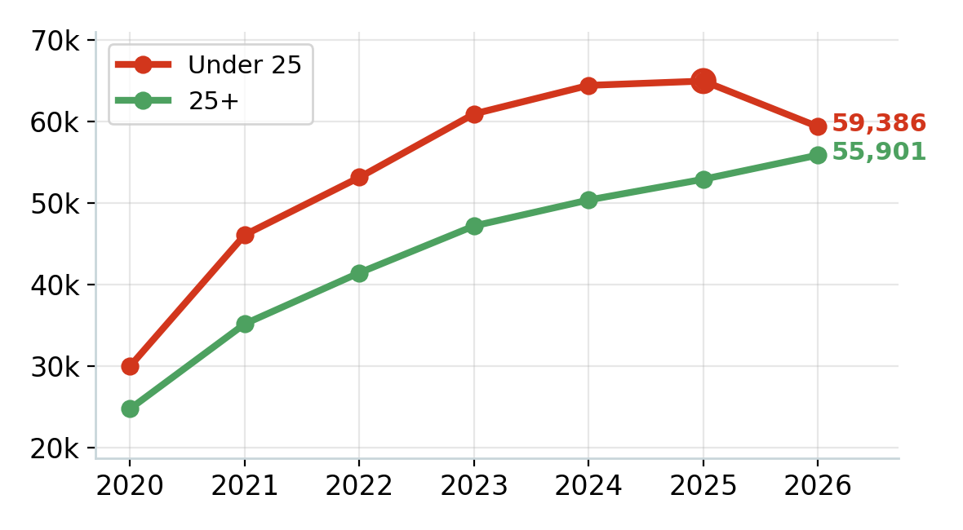
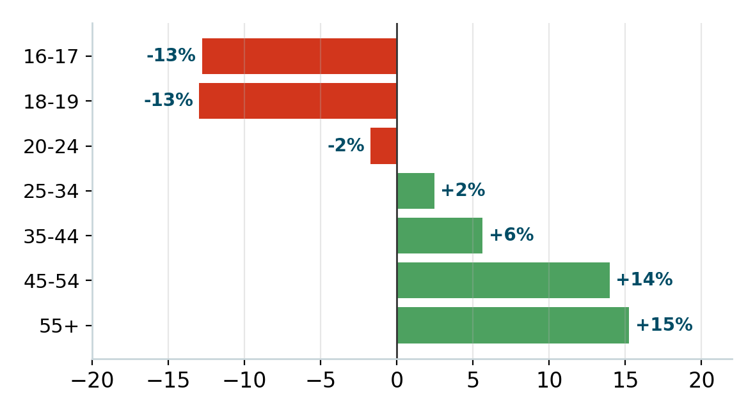
Young growth engine has stalled – learner demographics are changing
Under-25 vs 25+ first-time test-takers
Test-taker volume change by age bucket (2025 -> 2026)

Slide 7
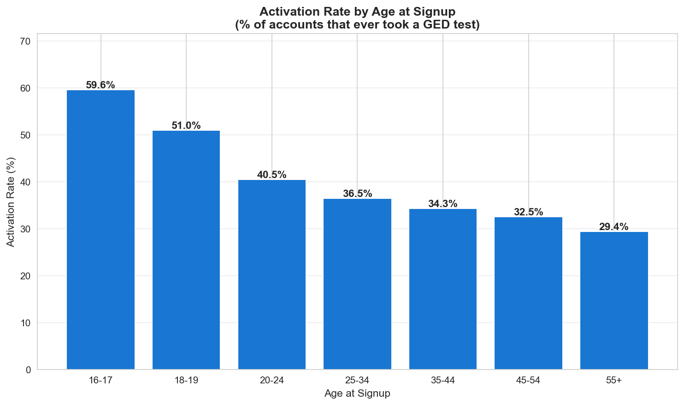
Older cohorts tend to struggle more
Lower activation rates and pass rates
Pass Rate by Age
Age Range | Pass Rate
16-17 | 89%
18-19 | 87%
20-24 | 85%
25-34 | 82%
35-44 | 75%
45-54 | 70%
55+ | 64%

Slide 8
Activation Drop-Off
Who are our sidelined learners?

Slide 9
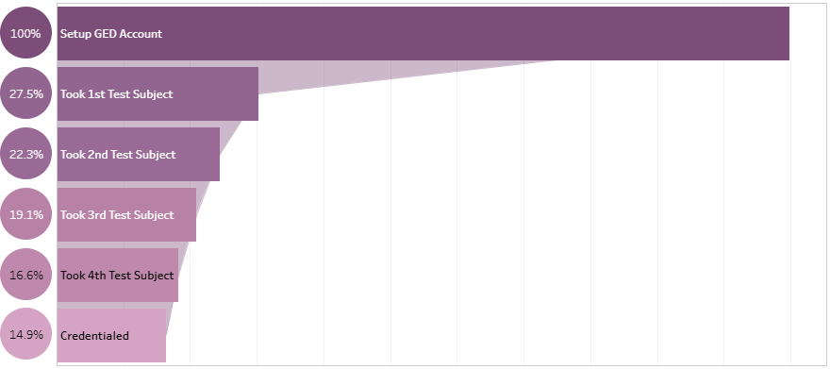
Learner Funnel
Stage Persistence
Setup → 1st Test | 1st → 2nd Test | 2nd → 3rd Test | 3rd → 4th Test | 4th → Credential
28% | 81% | 86% | 87% | 84%

Slide 10
Activation Drop-Off - Cohorts
Metric | Quick Activator | Late Activator | Non-Activator
Share of total | 19% | 10% | 71%
Age at signup (median) | 22 | 20 | 27
% who studied for the GED | 82% | 80% | 53%
% testing for Work-Related reasons | 20% | 23% | 33%
% who took a Ready | 68% | 81% | 16%
First Ready score (median) | 153 | 150 | 144
First Ready Pass Rate | 79% | 69% | 47%
% on mobile app | 12% | 21% | 10%
Credential Rate | 52% | 45% | -
Non-Activators are typically older (median age of 27), motivated for work-related reasons, and are not engaging with learner tools like the GED & Me Mobile app

Slide 11
Activation Drop-Off - Cohorts
Metric | Quick Activator | Late Activator | Non-Activator
Share of total | 19% | 10% | 71%
Age at signup (median) | 22 | 20 | 27
% who studied for the GED | 82% | 80% | 53%
% testing for Work-Related reasons | 20% | 23% | 33%
% who took a Ready | 68% | 81% | 16%
First Ready score (median) | 153 | 150 | 144
First Ready Pass Rate | 79% | 69% | 47%
% on mobile app | 12% | 21% | 10%
Credential Rate | 52% | 45% | -
Non-Activators are typically older (median age of 27), motivated for work-related reasons, and are not engaging with learner tools like the GED & Me Mobile app

Slide 12
Sidelined users – what do we know about them?
Location
Age
Motivation

Slide 13

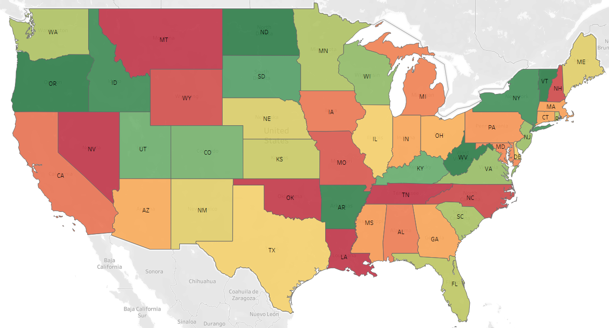
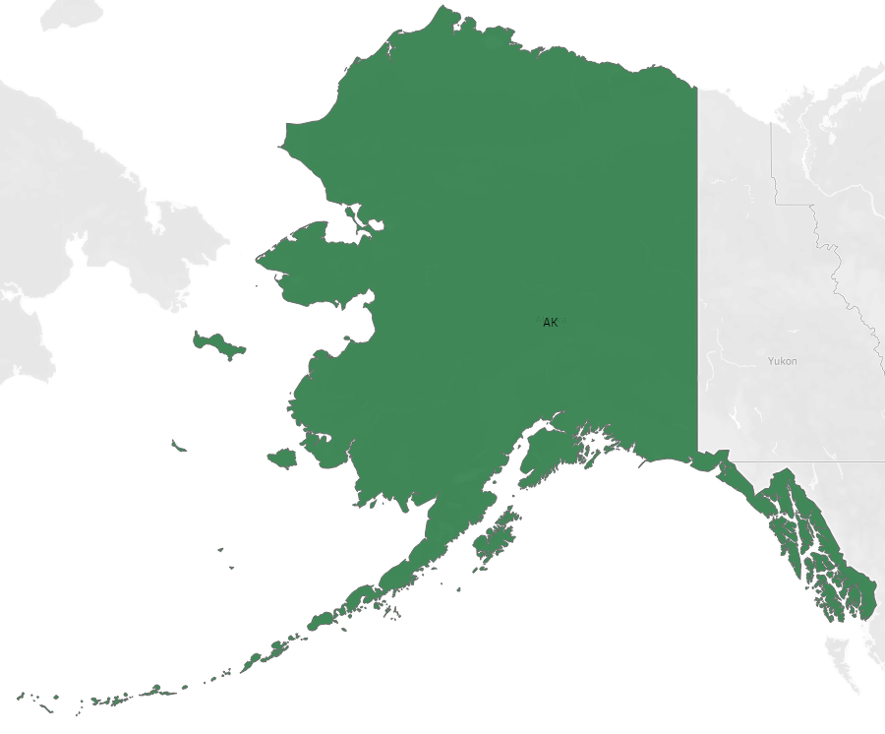

Activation Rates Vary by State
Activation Rate National Average: 27.5%
Activation Rate
AK

Slide 14
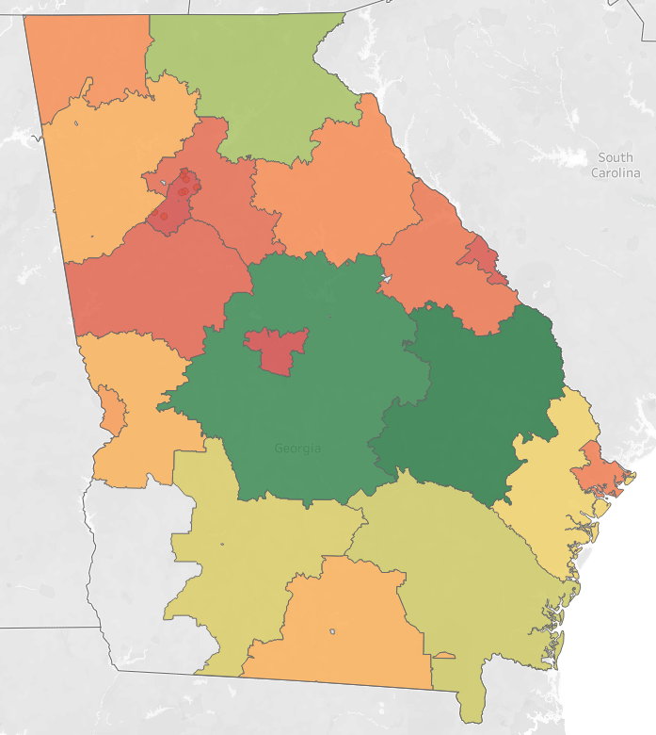
Activation Rate Varies within States
Activation Rate
Atlanta

Slide 15
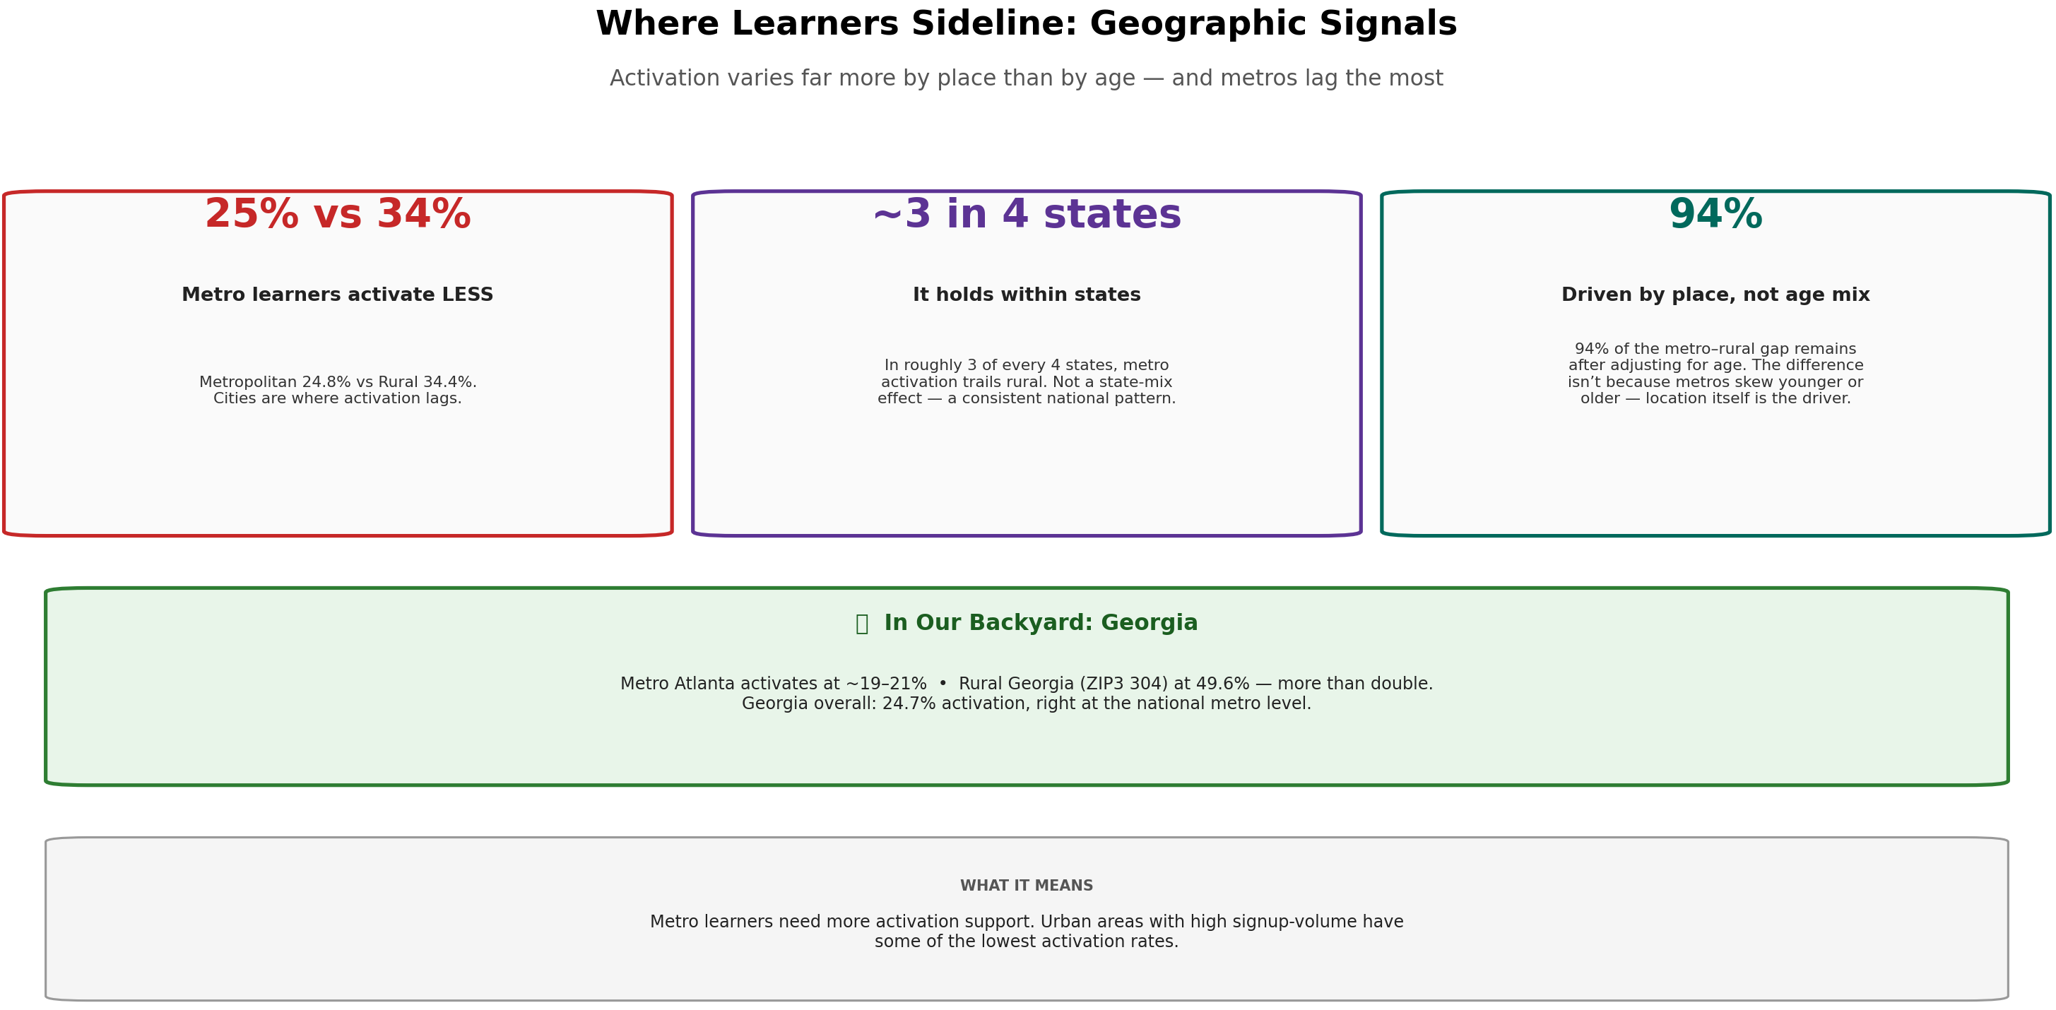

Slide 16
Successful Learner Analysis
What does a Credentialed learner’s journey look like?

Slide 17
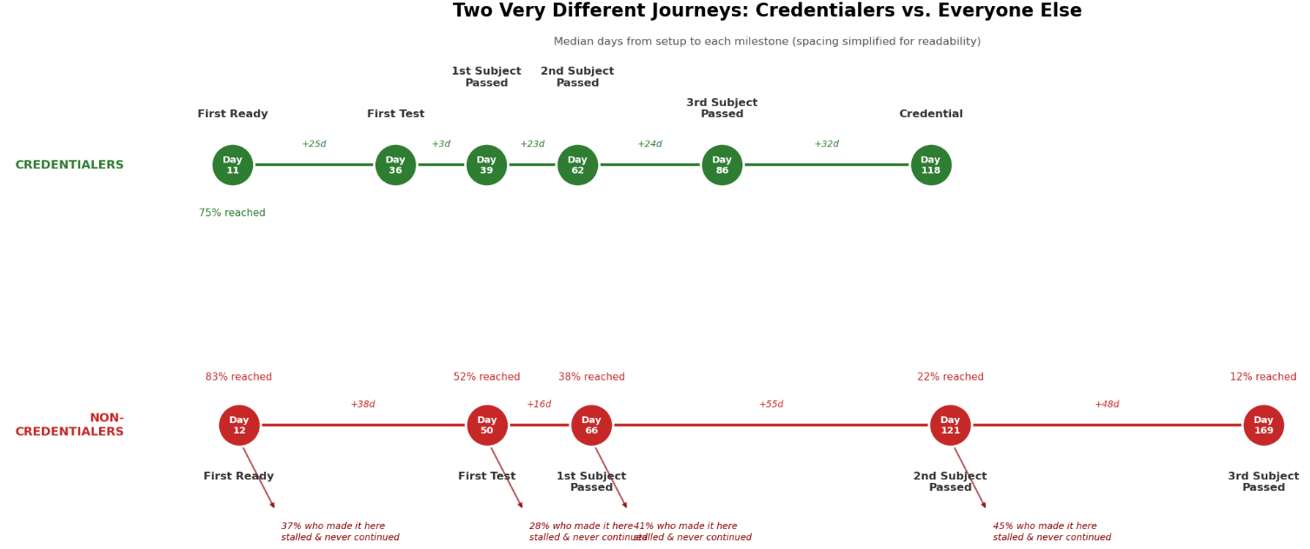
What does the Credentialed learner journey look like?
*68% never failed a Test subject

Slide 18
How this compares to a non-credentialed test taker
Credentialers: 32% failed 1+ Tests
Non-Credentialers: 67% failed 1+ Tests

Slide 19
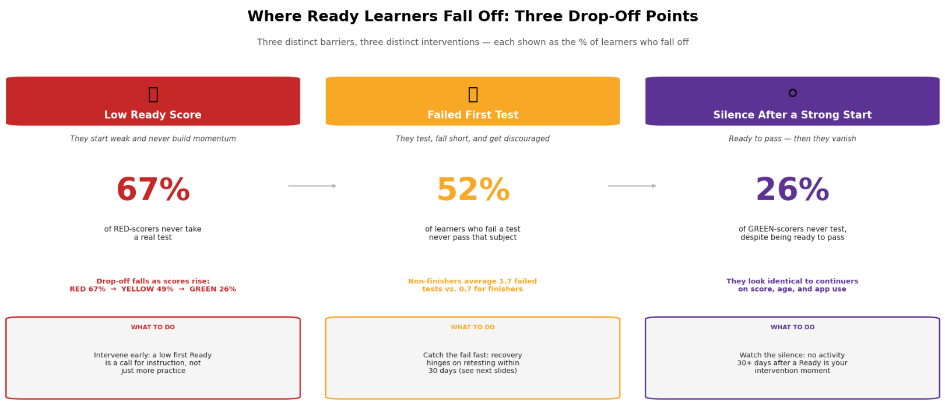

Slide 20
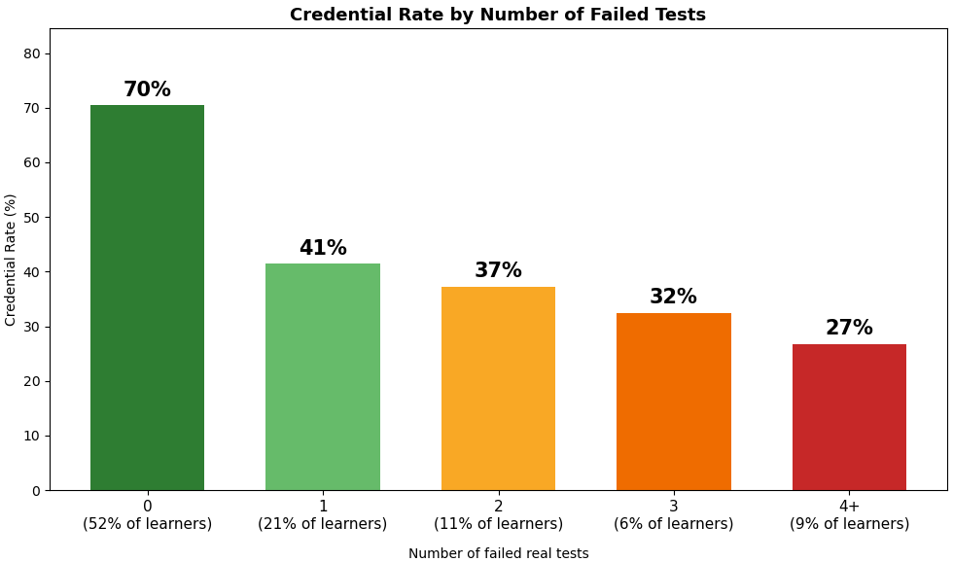
How much does failing a test hurt a test taker?
Has Failed
any Test?
yes
no
40% likelihood to Credential
70% likelihood to Credential
Questions:
What drives success for learners who have failed a GED Test?
Why are some GED Test takers not Credentialing despite never failing?

Slide 21
Of learners to fail a test, what factors eventually lead them to success?
High impact
Time to
re-test
*of learners who fail a Test, 52% never pass that subject
Initial test score
Obtaining a Green Ready
Other Test data (subject etc.)
Low impact

Slide 22
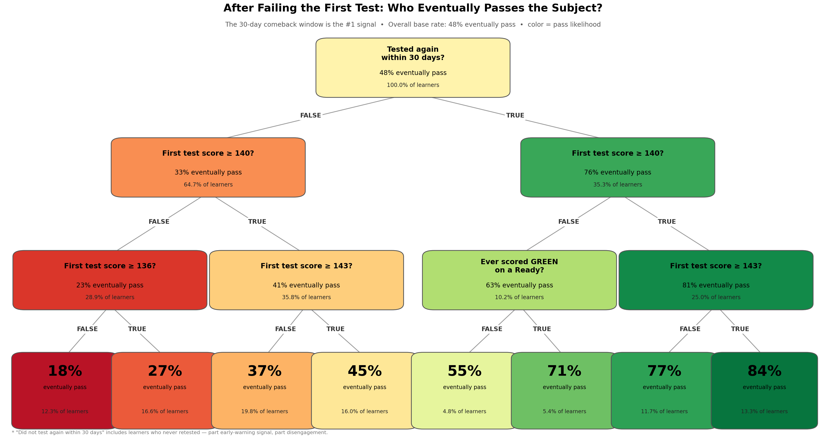

Slide 23
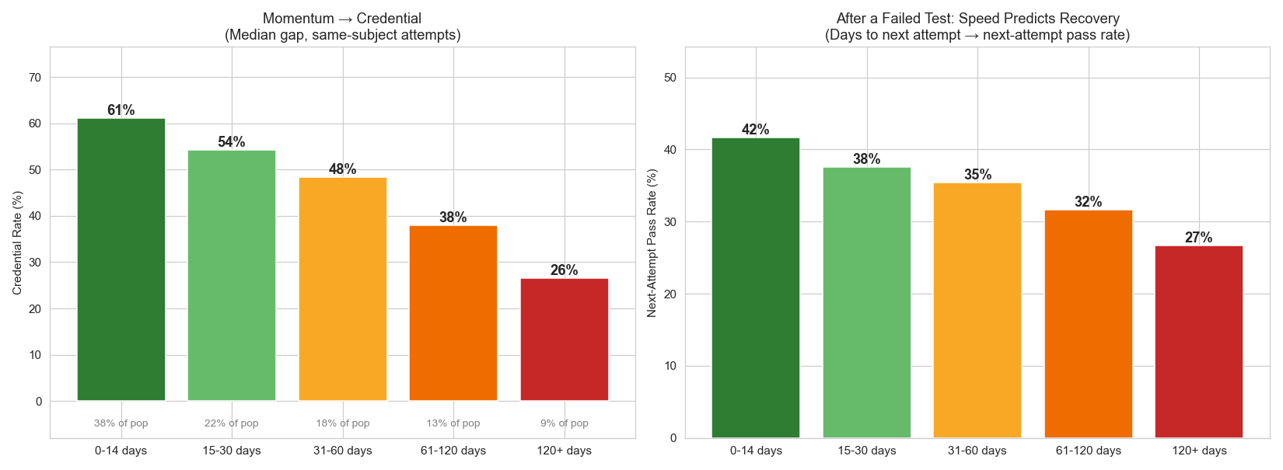
It’s not just about re-testing – it’s about when learners retest

Slide 24
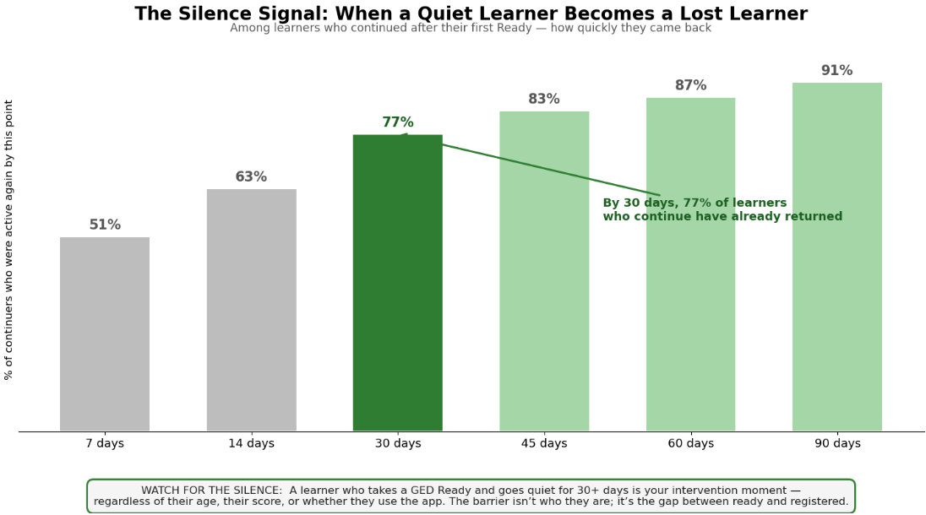

Slide 25
3-of-4 Stallers
Where are they getting stuck?

Slide 26
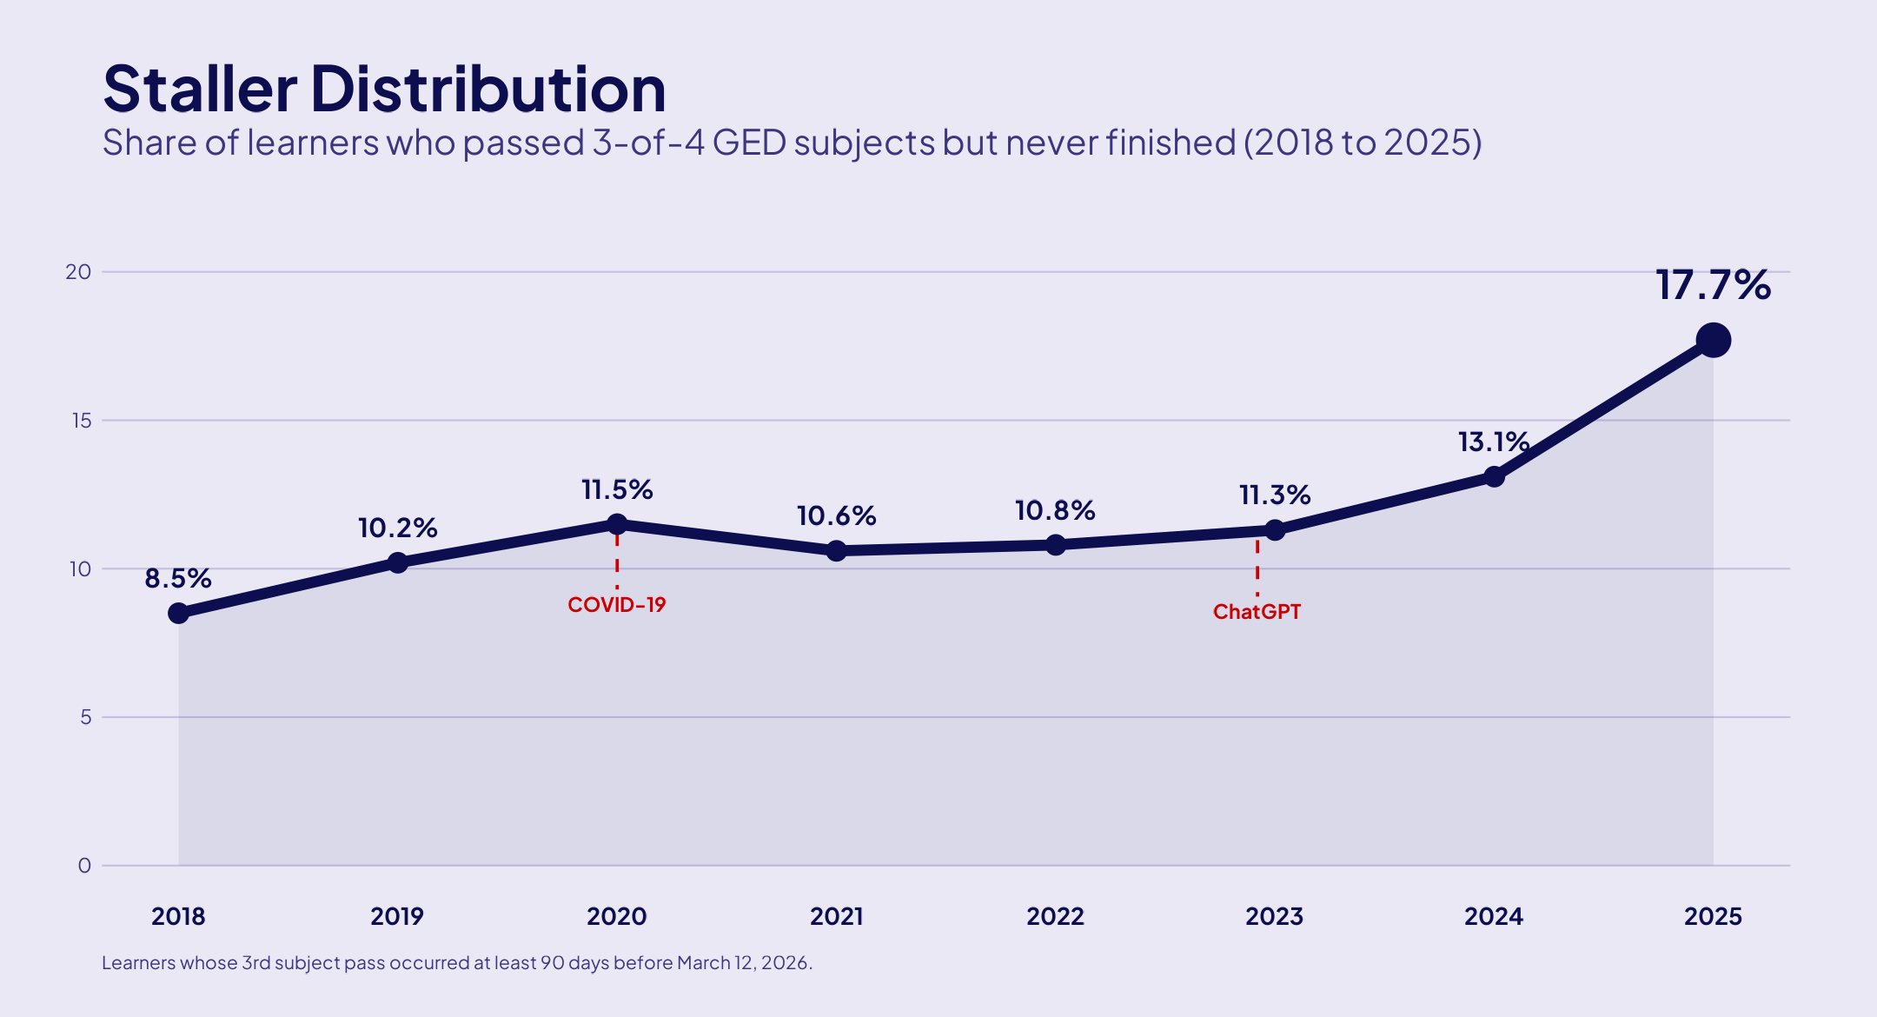
Stalling – a growing problem
Staller rate has nearly doubled since 2018: nearly 1-in-5 never finish

Slide 27
Who are the stallers?
METRIC | STALLERS | FINISHERS
Median Age | 24 | 20
Median Logins | 60 | 50
Avg. Ready Attempts | 5.1 | 4.0
GED Plus | 2.2% | 0.9%
GED Works | 1.6% | 0.8%
Mobile Users | 11.2% | 3.7%
Studied for GED | 82.3% | 81.6%
Stallers don’t lack motivation – they outwork finishers
So, what’s the problem?

Slide 28
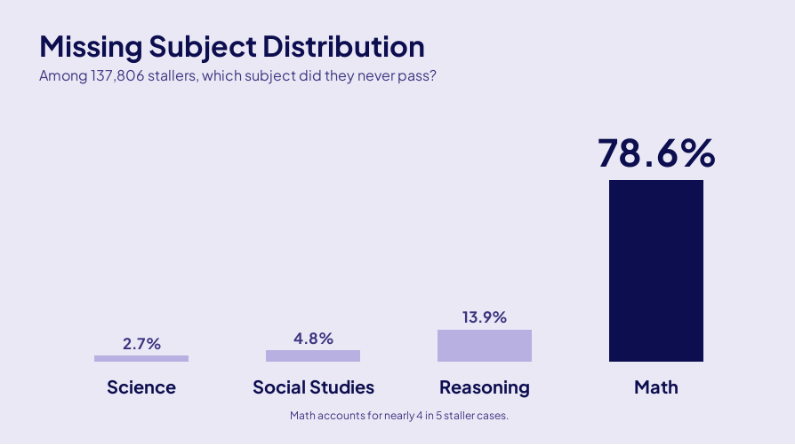
The Math Skill Gap
79% of stallers are missing Math

Slide 29
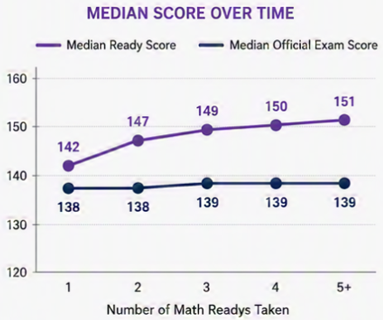
The Ready: Thermometer, Not Medicine
IT WORKS…
…AS A SIGNAL
NOT AS A CURE…
Readys give learner the confidence to test
But more Readys != higher scores
The Ready is a diagnostic tool – not a study resource
99.9%
with a Math Ready attempted the official exam
WHAT THE READY DOES
Measure current readiness
Predicts likelihood of passing the official exam
Gives learners the confidence to test
52.6%
without a Math Ready attempted the official exam
WHAT THE READY DOESN’T DO
Replace studying / instruction
Close the skill gap
Build new Math skills

Slide 30
So, how do we get stallers to pass?
Studying specific skills
Targeted instruction
Learning products

Slide 31
What’s Actually Helping?
GED & Me Mobile App

Slide 32
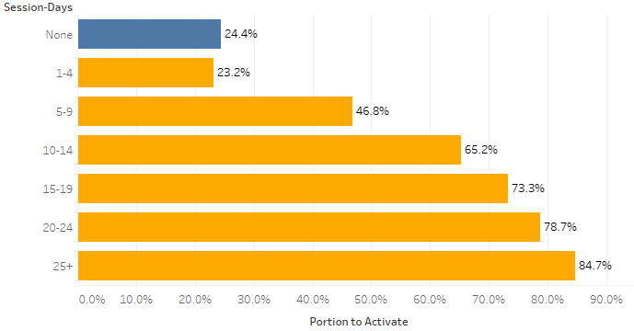
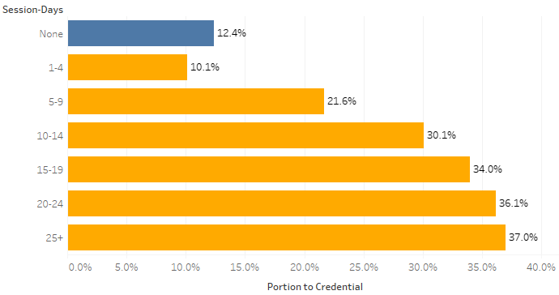
Mobile Activity Correlates with Higher Activation and Credential Rates
Activation Rate by Mobile Activity
Credential Rate by Mobile Activity
GED Learners with 5+ mobile session-days activate at significantly higher rates

Slide 33
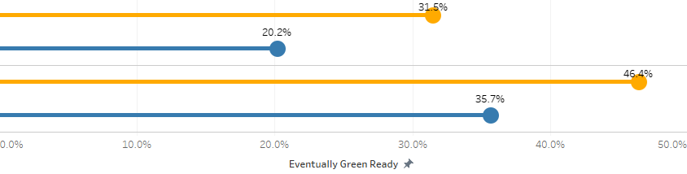
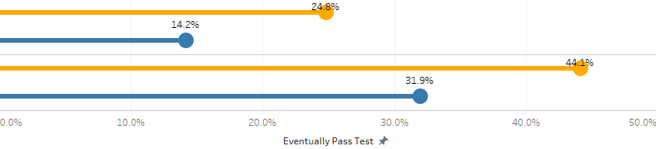
Mobile accelerates progress after low Ready score
Progress to “Green Ready”
Percentage of learners who eventually reach Green Ready, by first Ready band
RED
(<135)
Mobile Engaged
Non-Mobile
YELLOW
(135-144)
Mobile Engaged
Non-Mobile
Progress to “Passed Test
Percentage of learners who eventually pass the GED Test, by first Ready band
RED
(<135)
Mobile Engaged
Non-Mobile
YELLOW
(135-144)
Mobile Engaged
Non-Mobile

Slide 34
Mobile App – Math Practice
Practice Questions
Syd – AI Tutor
Instructional Videos
Contains a wide variety of Math questions targeting all the fundamental concepts needed to pass the official GED Test
Allows learners to ask questions about questions and concepts they are struggling with, offering free, instant feedback
Short & long-form videos used to build understanding of fundamental concepts that appear on the GED Test

Slide 35
Mobile App – Math Practice
“How to measure the effectiveness of the mobile app at helping stuck learners?”
Look at mobile users who have taken and failed Math at least once
Compare success on subsequent Math exams based on engagement level with mobile learning features (questions, Syd, videos)

Slide 36
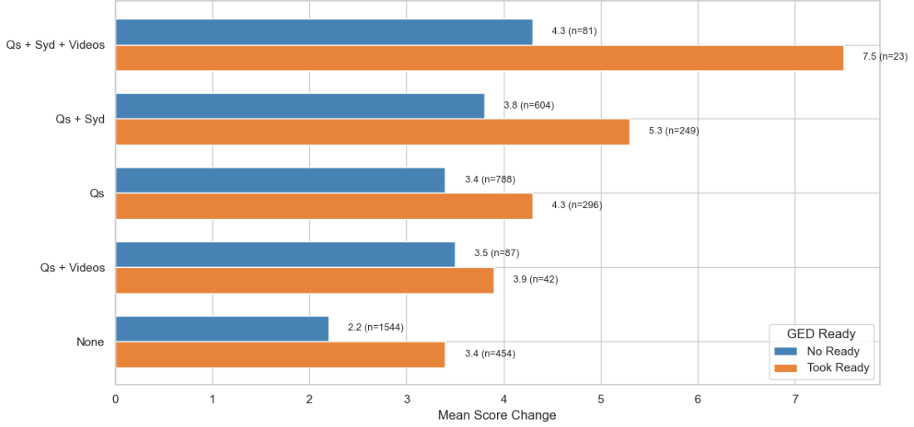
Mobile Math Practice Helps Close the Gap
Average Score Increase from a Failed Test -> Next Attempt

Slide 37
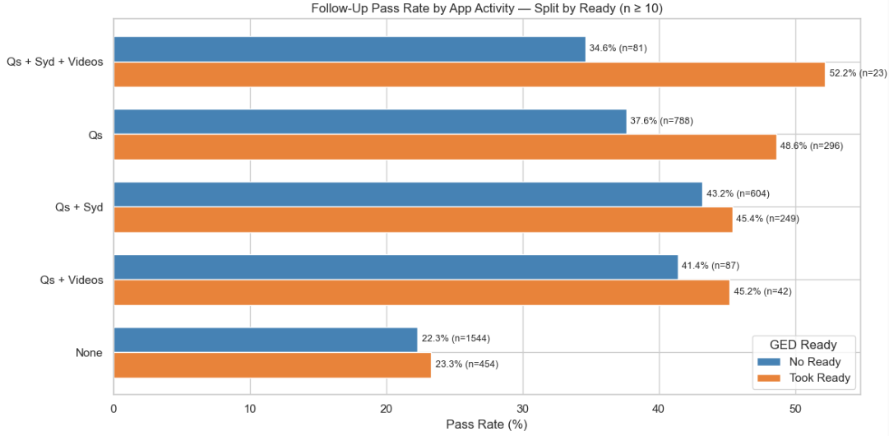
Mobile Math Practice Helps Close the Gap

Slide 38
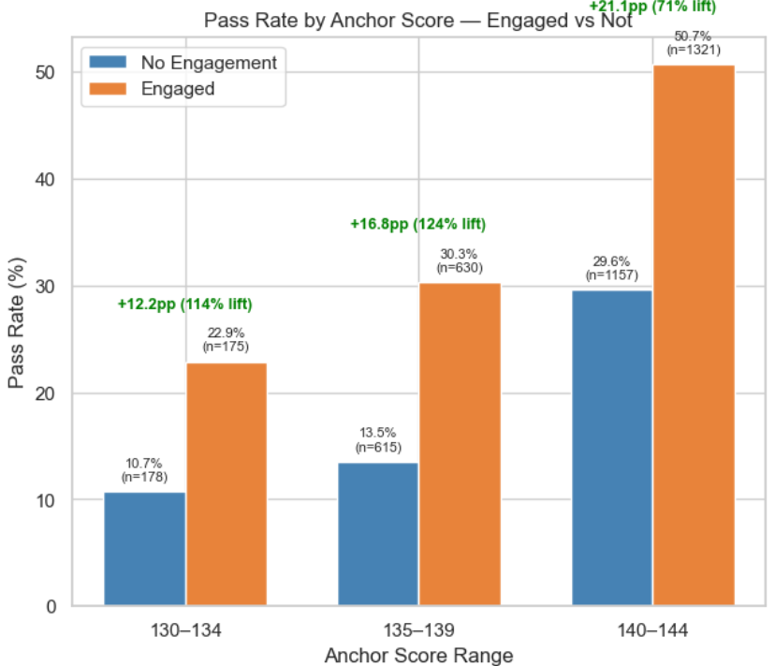
Pass Rate on Follow-Up Attempt
Separated by engagement level

Slide 39
Conclusion
How to best help learners

Slide 40
Take aways
Get learner to a Ready early: taking a Ready continues to be the #1 predictor of testing & overall success
Encourage the GED & Me app: especially for learners struggling with Math, mobile-engaged learners show higher pass rates and persistence across the learner journey
Protect momentum: Credentialers often move at a steady rhythm. Look out for silence after a failed Test or low Ready score – learners are unlikely to return after 30+ days of inactivity
GED Ready is diagnostic: the GED Ready is great at identifying areas a learner needs to improve, but should not be used alone as a study resource

Slide 41

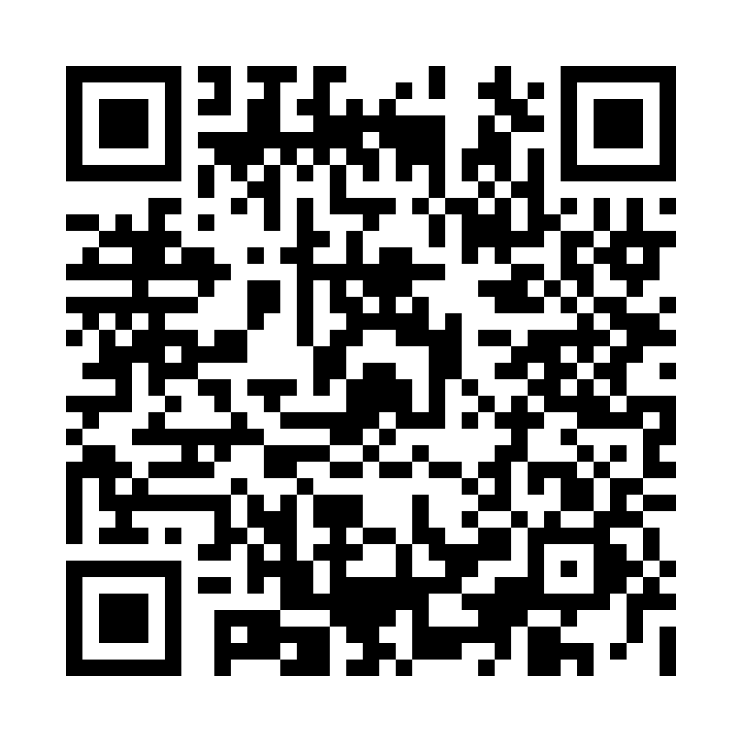
Session Survey
Your feedback is important. Please scan the QR code below to rate this session.

