Slide 1
When Systems Align: How State and Local Partnerships Increase GED Completion for Adults on Probation and Parole
Rebecca Ellis, Technical College System of Georgia
Andy Semones, Southern Regional Technical College

Slide 2
Introductions
Notes:
Andy and I introduce ourselves survey who is in the room (teachers, test administrators, program administrators, states, etc.)

Slide 3
1
2
About Georgia's Reentry Partnerships
Partnership
2
4
Partnership Timeline and Impact
Considerations for Other States and Programs
3
5
Bringing it All Together
Success Stories

Slide 4
What challenges do you face when helping individuals in the reentry process earn a GED?
Notes:
Discussion and reflection on challenges. Weave in later how partnerships have helped solve some of these challenges.

Slide 5
About the Partners
Georgia’s Reentry Partnerships

Slide 6
Corrections in Georgia
State Systems
Department of Juvenile Justice
County Systems
County Jails
Department of Corrections
Department of Community Supervision
County Prisons/Correctional Institutions
Accountability Court Systems
Notes:
Department of Juvenile Justice supports youth offenders (at age 17 they transition to a DOC facility)
Regional Youth Detention Centers, Youth Development Centers, School Districts
Mostly offer their own HSE programs
Department of Corrections
Individuals who have been convicted
Several different types of facilities
Department of Community Supervision
Individuals with felony charges on probation and parole
County Jails
Individuals who have not been convicted
County prisons – individuals who have been convicted, house Dept. of Corrections inmates, but DOC does not operate the facility
Accountability Court systems (drug court, infant toddler court, etc.) – diversion programs run by local court systems
Ensure we mention that programs can partner with type of correctional facility (it is not just state prisons)

Slide 7
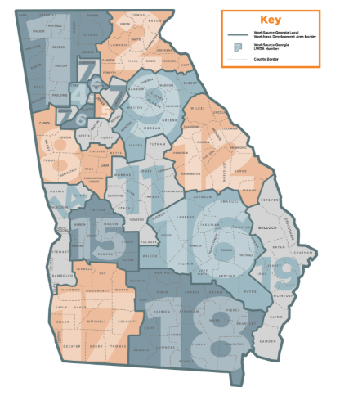
Technical College System of Georgia (TCSG)
30
Adult education providers throughout the state
30,000
Adult education students served annually
3
Workforce Innovation and Opportunity Act core programs housed at TCSG
Notes:
Rebecca
The Technical College System of Georgia receives federal AEFLA funds and grants them out to 30 adult education providers throughout the state, including 22 technical colleges, 3 community based organizations, four school districts and one university.
We serve around 30,000 students per year which is our NRS number (12 hours or more)
TCSG is unique in that three of the WIOA core programs (Title I, Title II and Title III are housed at the same agency) and we are also quite large with 17 local workforce development areas.

Slide 8
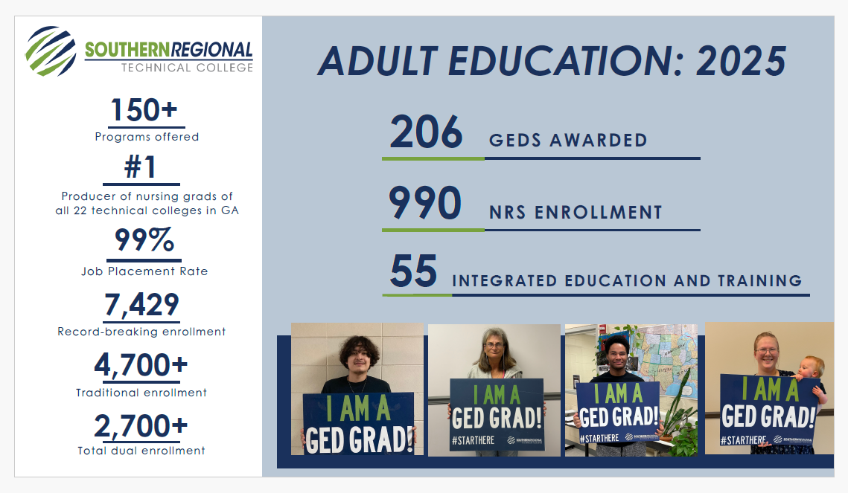
Notes:
Andy

Slide 9

Georgia Department of Community Supervision (DCS)
DCS and Community Supervision
What is Community Supervision?
Created by HB310 in the 2015 Georgia Legislative Session
Part of Georgia’s executive branch of government
Responsible for the community supervision of approximately 200,000 adult felony individuals
Pivotal component of the criminal justice system
Includes probation and parole
Offers an alternative to traditional incarceration
Allows individuals to serve their sentences in the community
Notes:
The organization that supervises all of Georgia's individuals under probation and parole supervision
We were created by HB 310 that decided that if an individual is being supervised in the community there is no need to have probation and parole doing the same job
There are over 200,000 individuals across the state of ga on community supervision
The most important thing to remember about us is that all of our individuals are free an being supervised in the community

Slide 10

DCS Statewide Education and Employment Program
Provides statewide oversight for:
  Integrated Education Training (IET)
  GED Programming/GED Vouchers
  HiSet
  Vocational Training
  Continuing Education
  Technical College Certifications
  Career Plus High school Diploma Program
  Technical College Liaison
  Statewide Employment Initiatives
Provides statewide oversight for:
Integrated Education Training (IET)
GED Programming/GED Vouchers
HiSet
Vocational Training
Continuing Education
Technical College Certifications
Career Plus High school Diploma Program
Technical College Liaison
Statewide Employment Initiatives
Provides statewide oversight for:
  Integrated Education and Training
  GED Programming/GED Vouchers/HSE Preparation
  Vocational Training
  Continuing Education
  Technical College Certificates
  Career Plus High School Diploma Program
  Statewide Employment Initiatives
  Continuing Education
Notes:
Carolyn
DCS is committed to providing justice-involved individuals with access to certification-yielding programs that lead to meaningful, career-tracked employment.
DCS is not a education organization, we have implemented education support services by partnering with the Technical College System of Georgia by referring students to their educational programming
Through partnerships with technical colleges, we connect individuals to high-demand, second-chance-friendly industries and are open to expanding these opportunities through cohort-based training programs.
Our reentry staff actively work to build statewide and local collaborations to support employment opportunities through:
WorkSource Georgia
Recruiting second-chance-friendly employers
Expanding networks with industry partners
The programs featured on this slide showcase the programs we partner with TCSG to offer our clients.
We welcome the opportunity to collaborate and introduce Integrated Education and Training (IET) programs that align with emerging workforce needs.

Slide 11
Partnership Timeline and Impact
Notes:
Discussion and reflection on challenges. Weave in later how partnerships have helped solve some of these challenges.

Slide 12
History of the Partnership
Provides statewide oversight for:
  Integrated Education Training (IET)
  GED Programming/GED Vouchers
  HiSet
  Vocational Training
  Continuing Education
  Technical College Certifications
  Career Plus High school Diploma Program
  Technical College Liaison
  Statewide Employment Initiatives
Provides statewide oversight for:
Integrated Education Training (IET)
GED Programming/GED Vouchers
HiSet
Vocational Training
Continuing Education
Technical College Certifications
Career Plus High school Diploma Program
Technical College Liaison
Statewide Employment Initiatives
Prior to 2023, there were scattered local partnerships.
2015
2023
2024
Department of Community Supervision Established
Intergovernmental MOU, better referral processes, and monthly meetings established
Statewide Partnership Work Begins
Notes:
- Rebecca This slide shows a timeline of key dates in our partnership. Prior to 2023, there were scattered partnerships throughout the state with Day Reporting Centers. One of those was Southern Regional Technical College.
Andy – discuss local partnership efforts at SRT
Carolyn – discuss merge from DCS and DOC in 2015 and then how the partnership work started with you beginning to understand TCSG’s work
Rebecca – discuss 2024 intergovernmental MOU ad months meetings (Carolyn to add in when needed!)

Slide 13
Goals of the Current Partnership
To provide education, training and other supportive services that help justice-involved individuals advance in their education and career.
To align and coordinate criminal justice, education, and training systems to better serve Georgians.
Notes:
Rebecca to read the goals. Carolyn to add on as needed.

Slide 14
Statewide Partnership Impact
Notes:
Rebecca: Since the start of our state level meetings and intergovernmental MOU, the number of referrals from DCS to adult education has increased from 91 in FY2024 to 663 in 2025. We are working on ways to better share data to be able to look at specific outcomes like GED attainment, employment and credentials.
Carolyn: Discuss the referral process from DCS to adult education
One thing that we recognized in establishing our partnership with TCSG is that we needed a true process in which we are intentional about our student referrals and support
Potential students are identified through multiple methods, including:
Agency assessments that indicate an education need.
Referrals from officers or counselors who recognize a candidate's potential.
Adult Education Referrals offered by local Community Coordinators.
Introduce TCSG to programs at DCS resource events.
Technical colleges providing overviews during intake.
Student-initiated requests for assistance in connecting to educational opportunities
Student is identified as a candidate for adult education.
An in-house Adult Education referral sheet is completed.
A DCS Regional Reentry Manager contacts the student to assist with connecting them to their local technical college.
The Regional Reentry Manager or local designee notifies the technical college of the referral.
Student receives orientation information to begin the enrollment process.

Slide 15
Local Partnership Impact: Fiscal Year 2025
2
Day Reporting Centers where Southern Regional Technical College Offers Classes
88
Students from DCS served
17
Students that either completed their High School Equivalency or have started testing
Notes:
Andy: discuss local impact
2 classes and 1 agreement
Thomasville Class
Tifton Class
Patula District in Southwest GA Agreement
88 Students Served
3 High School Equivalencies
14 started GED Testing

Slide 16
Bringing it All Together
Notes:
Discussion and reflection on challenges. Weave in later how partnerships have helped solve some of these challenges.

Slide 17
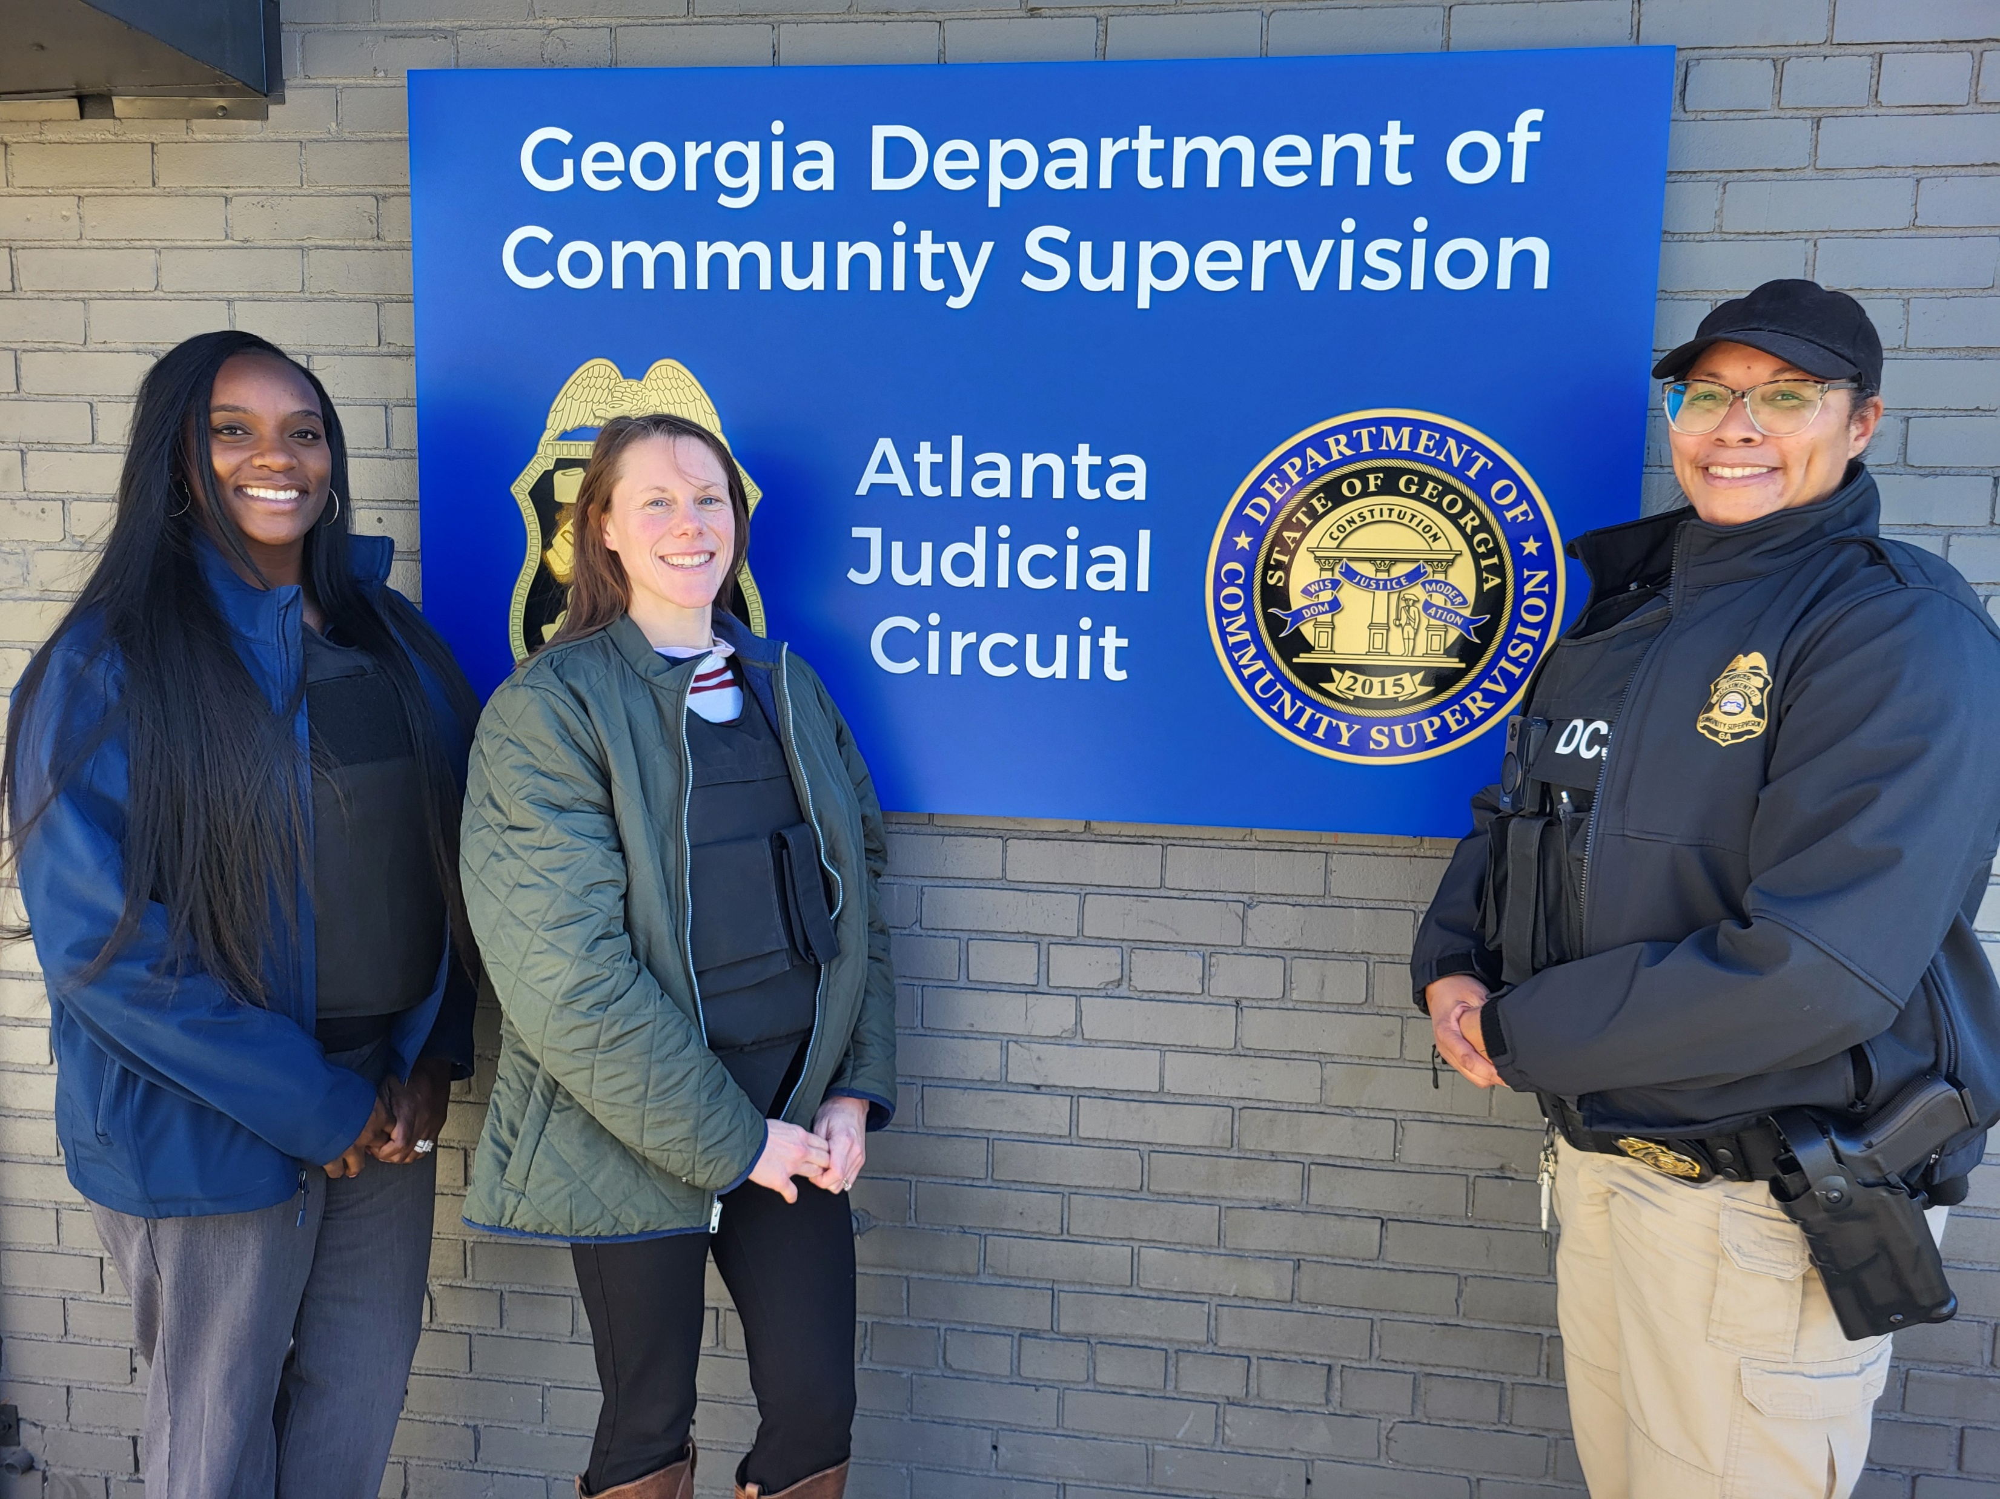
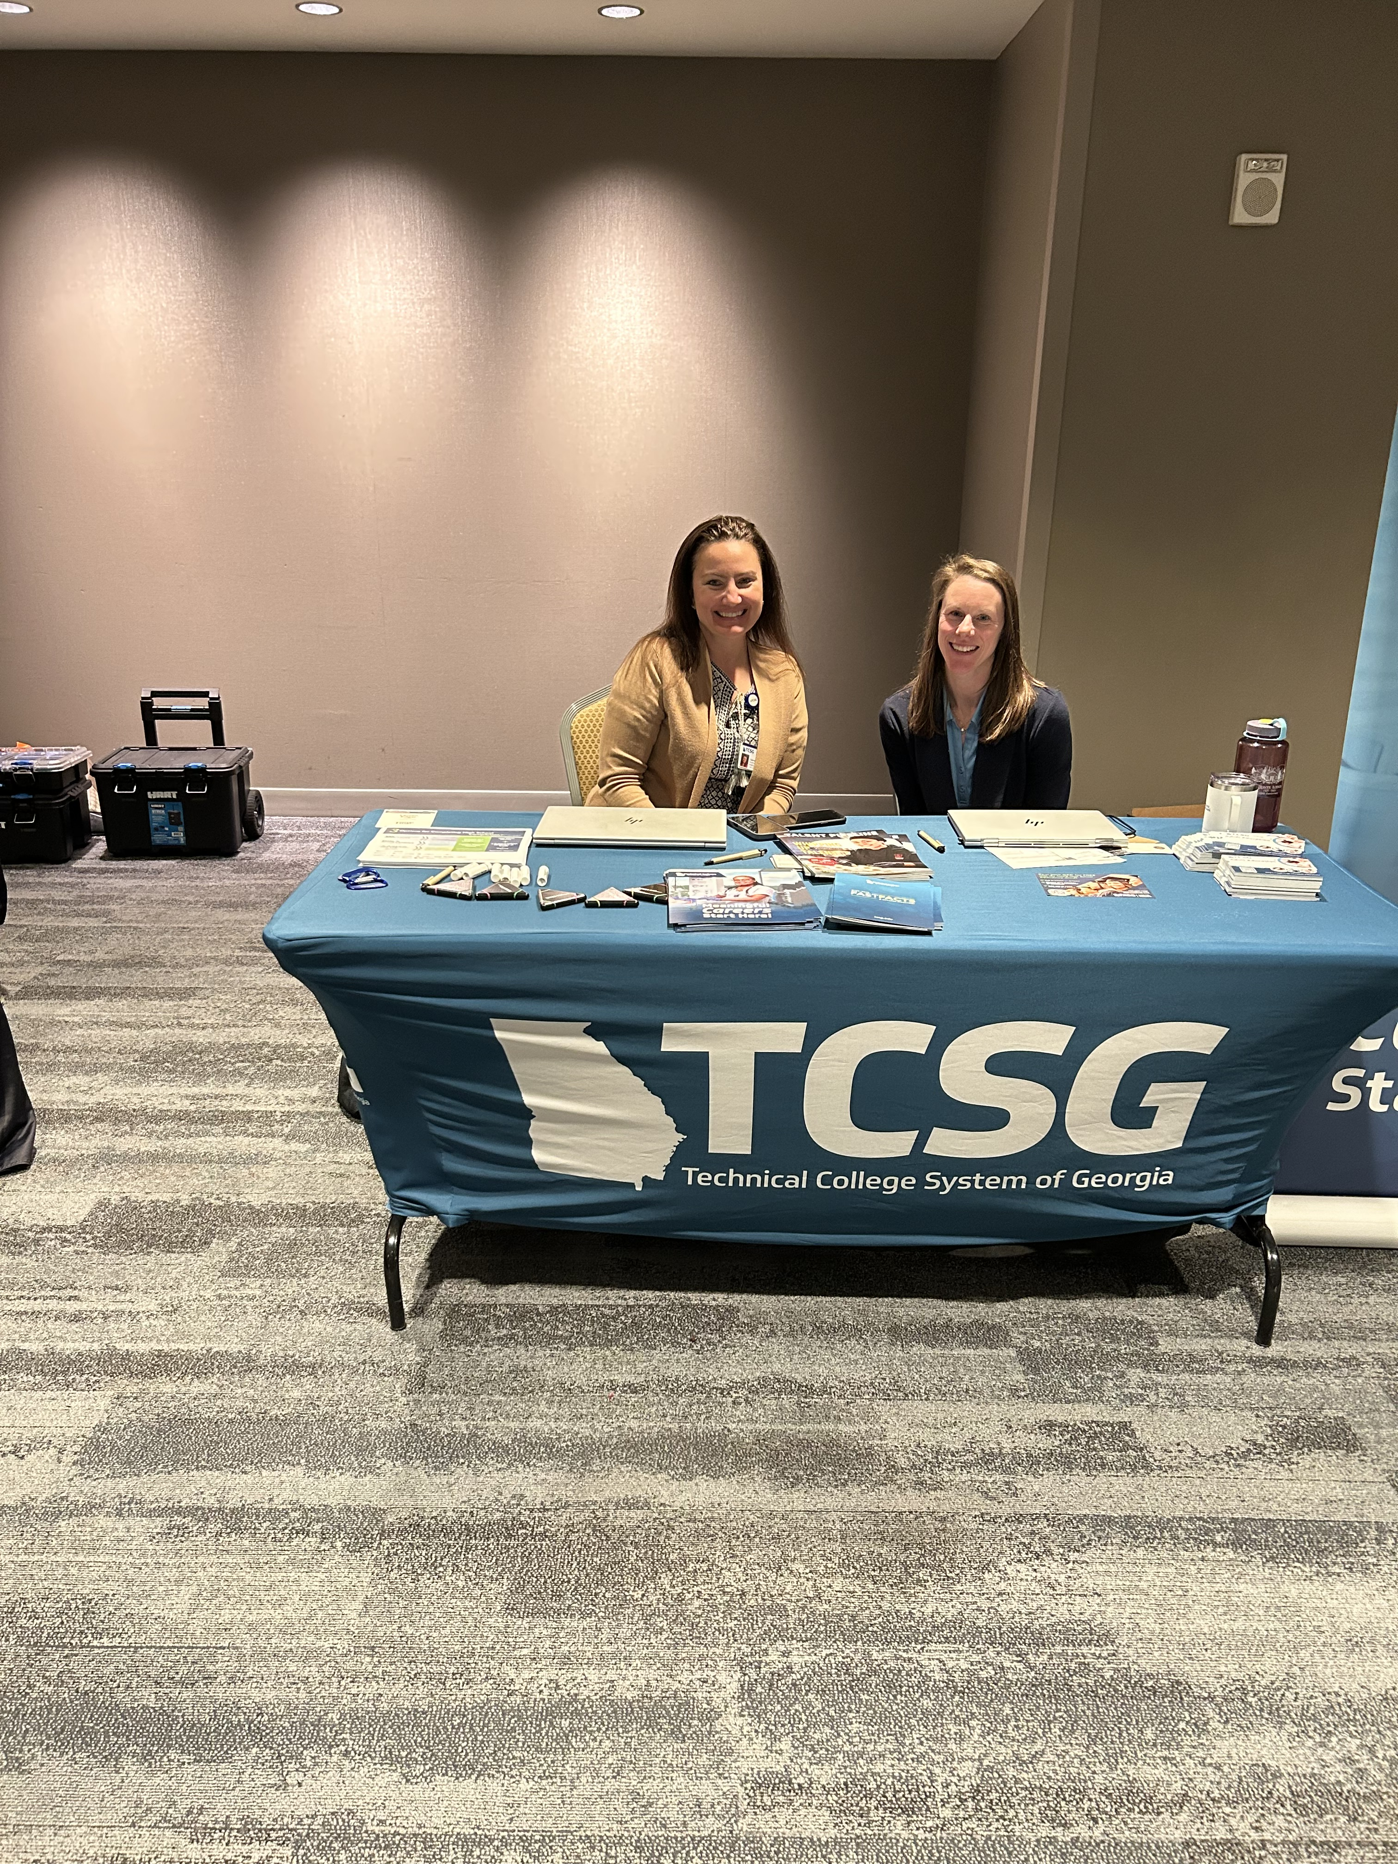
The 3 C’s of Effective Partnerships

Slide 18
The 3 C’s of Effective Partnerships
Curiosity
CARING
Communication
Notes:
Curiosity – not judging but always seeking to understand about the partner’s goals, policies and systems. (example DCS visited all our programs and TCSG staff went on a ride along with a parole officer to see the day to day)
Caring – Willing to go the extra mile to help a partner and deeply and genuinely caring about their organization and the individuals they serve. (example: We had an employer partner that wanted to hire individuals with criminal backgrounds. It ended up not being anything related to adult ed, btu we still passed the information along to DCS which led to two individuals getting a job as an electrician journeyman and an electrician apprentice).
Communication – Having formal and informal pathways to communicate and being willing to share challenges as they arise (ex: DCS lets us know if they are not getting a response of referrals).
Andy to talk about how Thomasville site grew.

Slide 19
The Web of Partnerships
Policy Development
Student Support Coordinators
Technical College System of Georgia
Department of Community Supervision
DCS Community Coordinators
Adult Education
Academic Affairs
College and Job Fairs
Southern Regional Technical College
Day Reporting Centers and Field Offices
Housing and Other Support
RML Transportation
Local Court Systems
Transportation for Students
Local Judges
Notes:
Rebecca: This slide shows the web of partnerships that contribute to student success. As you will see there are so many different agencies, organizations and people who contribute to students. And because our stance is caring, we always put students in the center and ask what they might need to be successful?
Carolyn: Talk through the Community Coordinators and what they do, as well as other supports available (housing, etc.). How DCS supports the local offices.
Rebecca: Talk through the child care and transportation and support pilot, as well as the work that went into developing the pilot. Talk about the feedback we gained from SRTC and other colleges in developing this (communication, curiosity)
Andy: Talk about relationship with Day Reporting Center and local accountability courts. Mention the way the transportation is set up and other support provide from the college (such as dual enrollment opportunities and job fairs)
Dean requests GED and GED Ready vouchers
Dean meets with Accountability Courts
Job Fairs
College Fairs

Slide 20
Considerations for Other States (State Administrators)
Helping Students Overcome Reentry Barriers
Understand your local/state criminal justice system
Which organizations serve which populations of individuals (currently incarcerated, probation, parole, etc.)
Peel the onion! Unpack student reentry myths and barriers
“I have to start over once I get out of jail.”
“My scores won’t transfer.”
Check your state policies
Which open doors for students during reentry and which close them?
Notes:
Andy to lead talking about barriers. Rebecca/Carolyn to add in if needed.

Slide 21
Considerations for Other States (Local Programs)
Helping Students Overcome Reentry Barriers
Transiency
Constant communication
Balancing Responsibilities
Flexible schedules
Online learning
Getting to Class
Transit bus
Transportation vouchers
Where was someone transferred?
Notes:
Andy to lead talking about barriers. Rebecca/Carolyn to add in if needed.

Slide 22




Outcomes and Success Stories
Jessica was our Student of the Year in FY23
Davis earned his GED and became a firefighter
DCS graduates helped propel a program record of 206 GEDs.
Lillian is dual enrolled in CNA and Adult Ed
ThePhoto by PhotoAuthor is licensed under CCYYSA.
Notes:
Andy to share success stories at the local college.

Slide 23
What partnerships does your organization already have to support individuals during the reentry process?
What partnerships could you develop or strengthen in your state to support students during reentry?
Notes:
Discussion and reflection on challenges. Weave in later how partnerships have helped solve some of these challenges.
Turn and Talk and Share Out

Slide 24
Additional Resources
Testing in Corrections - Educators and Admins
Notes:
Discussion and reflection on challenges. Weave in later how partnerships have helped solve some of these challenges.
Turn and Talk and Share Out

Slide 25

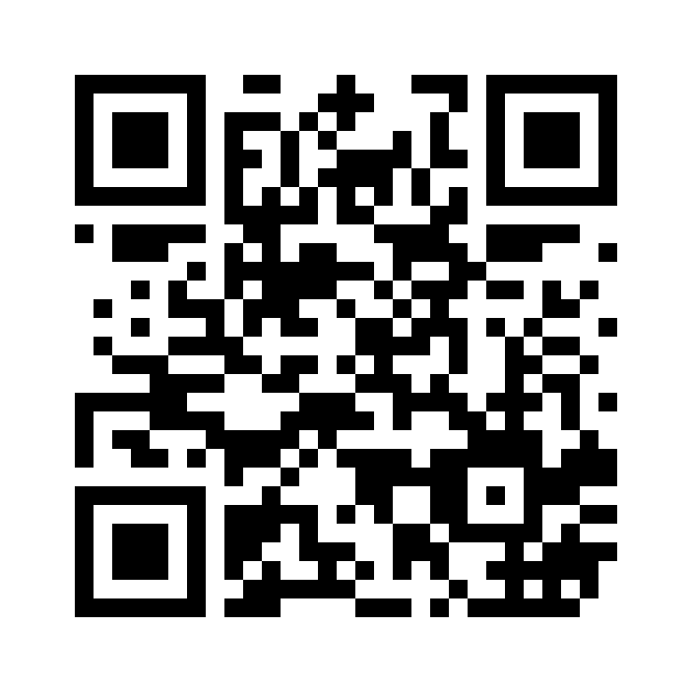
Session Survey
Your feedback is important. Please scan the QR code below to rate this session.

