Slide 1
When Math is the Barrier:
Recognizing and Support Dyscalculia in Adult Learners
Jean Perrini
Lead Teacher Dorsey Run Correctional Facility
July 29,2026

Slide 2
1
4
How Dyscalculia Presents
Lessons, Games & Activities
2
5
Strategies for the Classroom
Discussion
3
6
Classroom Tools
Resources

Slide 3
1
How Dyscalculia Presents

Slide 4
Learners with Dyscalculia
…have difficulty with:
patterns
mental calculations
estimation
number line
number sense
subitizing
place value
can do math but cannot explain how
have visual-spatial issues
forget math that has been mastered
have trouble with time, money and essential math concepts
…are people who:
…will have:
different ways of processing information
struggles with understanding math language
problems counting forward and/or backward
unpleasant memories with math
slow processing speed

Slide 5
Learners with Dyscalculia
You will need to:
find their strengths and weaknesses.
find math that they can do and see success quickly.
access and discuss progress continually.
help them practice timing.
explain each part of the math test to them.
  They do not handle surprises well!
give GED Ready tests.
listen closely to them.

Slide 6
2
Strategies for the Classroom

Slide 7
Strategies to help with Math
Strategies you use with ABE/GEN ED may not help dyscalculia students
BUT
Strategies you use with Dyscalculia students will help all math students

Slide 8
Strategies
Explicit teaching
Re-teach, review, repeat
Let students use their own strategies
Listen to them think
Make it a positive experience
Promote real growth of understanding
Use real life examples
Slow down
Break it down
Rebound

Slide 9
Strategy: Explicit Teaching
Learning about centimeters cubed cm³
Learner asks, “But you told me that cm³ means I have to multiply the number 3 times. Where’s the number…that’s the problem with math teachers you tell me one thing and then you change it.”
Misunderstanding causes frustration.
Harder to replace wrong information with right information, then to get it right the first time.

Slide 10
Strategy: Re-teach, review, repeat
A learner asks, “Is this right?”
Response, “What makes you think it isn’t right?”
Need to check, recheck and then probably change a correct answer
  Unsure of their abilities
Need to be taught how to be sure that their answer is correct.

Slide 11
Strategy: Re-teach, review, repeat
During class a learner exclaims “No, I can’t remember how to do division. What goes next?”
Need to stop everything and explain what division is and the various ways the problem could be solved
Dyscalculia learners have short term memory
Left intraparietal sulcus is like a sieve. What goes in spills out shortly after!

Slide 12
Strategy: Make it a Positive Experience
Notetaking is difficult for some people. They cannot listen, watch and write.
Have class notes available for those students who appear frustrated.

Slide 13
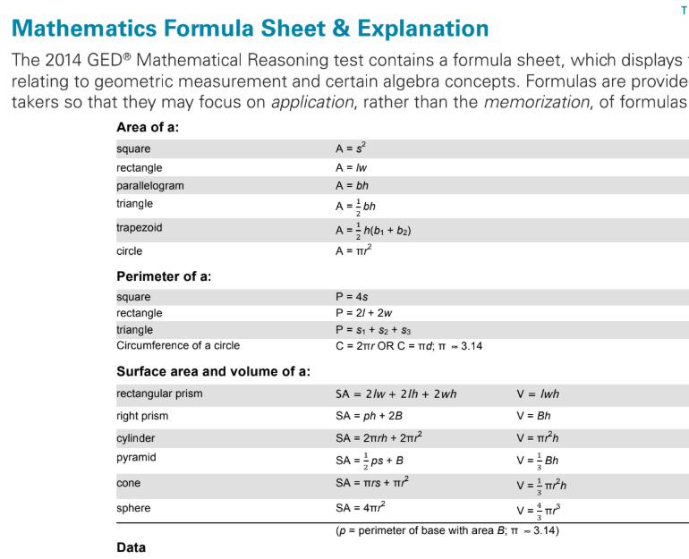
Strategy: Break it Down
A learner asks, “What am I supposed to do with this thing? There are numbers and letters all over the page?”
Break the Formula sheet down for them

Slide 14
3
Classroom Tools

Slide 15
Recommended Tools
Tools
More Tools
Six-sided dice
Playing, vocabulary and symbol cards
Money
Games
Popsicle sticks
Bead strings
Calculators and counters
Charts 1-100, multiplication, formulas
Explicit procedural notes
Reference sheets with worked examples
Items to count, sort, order, combine
Drawing materials, colors
Coordinate plane paper
Real world examples
Number lines
Fingers provide reliable strategy for solving problems

Slide 16

TI-30XS Calculator
Use the calculator intentionally and strategically to support mathematical reasoning and reduce working memory strain.
Teach learners that tools are supports, not shortcuts.
Model calculator use while narrating your thought process.
  Example: Use the “Table” function to explore linear relationships or verify multiple-choice options quickly.
Hardt2Heart Adult Education Services, LLC E-mail: hardt2heart75@gmail.com

Slide 17
Technology & Apps
Integrate assistive technology and visual learning Apps
Technology helps make abstract math more concrete and accessible
For instruction, try tools like Kami, a document annotation platform with features such as:
  Voice-to-text and text-to-voice
  Embedded media and instructional videos
  Example: Add personalized video or audio feedback directly to math worksheets.
Hardt2Heart Adult Education Services, LLC E-mail: hardt2heart75@gmail.com

Slide 18
Technology & Apps
Integrate and encourage use of Apps
  Microsoft Math Solver,
  MathPapa,
  Photomath,
  ModMath (especially helpful for dysgraphia & dyscalculia)
Hardt2Heart Adult Education Services
  Follow on YouTube and TikTok for GED math videos created specifically for adult learners with Dyscalculia—built to support at their pace and in their learning style.
Hardt2Heart Adult Education Services, LLC E-mail: hardt2heart75@gmail.com

Slide 19
4
Lessons, Games & Activities
Notes:
Why use games and puzzles?
If students play games, it will boost their cognitive strength, processing speed, and executive function.

Slide 20
Why Games, Puzzles, Activities & Projects?
Dyscalculia learners find joy in frequent use of games in math class.
  Modifying the activities, projects and games to the current level of understanding can reverse that negative feeling.
Use number sense puzzles to build relationships with numbers
Learners become more confident and solve problems more efficiently
Any fun, untimed and non- competitive game with numbers will be beneficial.

Slide 21
Games & Puzzles for Number Sense
Game | Learning Objective
Battleship | Coordinate plane, graphing, coordinate locations
UNO | Number sense
Playing Cards | Number sense
Football | adding, subtracting positive and negative numbers
Computer games | patterns
Dominoes | dot recognition, subitizing
Racko | number placement
Yahtzee | counting, number placement
ONO | addition
SkipBo | number placement

Slide 22
Activities & Projects for Math
Polynomials
Geometric shapes
Projects
Variables
Numbers
Properties
+,-, X, /
Positive & Negative integers
Hands-on
Rulers
Tape Measures
Area Volume formulas
Getting a mortgage
Painting a house
Building a porch
Reusing old wind vanes

Slide 23
5
Discussion

Slide 24
Your Turn
Do you have any questions about what you just learned?

Slide 25
6
Resources: Books, Websites, Organizations and Programs

Slide 26
Books
Dyscalculia From Science to Education,
Brian Butterworth, Second Edition, Routledge Taylor Francis Group, London and New York, 2026
Dyscalculia Guidance Helping Pupils with Specific Learning Differences,
Brian Butterworth and Dorian Yeo, Nelson Publishing, 2004
Dyscalculia Action plans for Successful Learning in Mathematics,
Glynis Hannell Routledge, Taylor and Francis Group, 2013
Teaching Students with Dyscalculia, Practical Teaching Strategies for Educators and Parents,
Ah-Ha! Games for the Brain, 2025
Dr. Honora Wall, Ed.D.,PolyMath publishing, 2022 EduCalc Learning

Slide 27
Books
Effective Teaching Strategies for Dyscalculia and Learning Difficulties in Mathematics Perspectives from Cognitive Neuroscience,
Marie Pascale-Noel and Giannis Karagiannakis, Routledge Taylor Francis Group, London and New York 2022
How We Learn,
Stanislaw Dehaene Penguin Books Random House 2020
Math Workbook for Kids with Dyscalculia, A resource toolkit book with 100 math activities to overcoming difficulties with numbers, Volume 1, Easy Math Brain Child Growth 2021

Slide 28
Books
Mathematics for Dyslexics and Dyscalculics, A Teacher Handbook, 4th Edition,
Steve Chinn and Richard Ashcroft, Wiley Blackwell Oxford, UK, MA USA 2017
The Dyscalculia Toolkit: Supporting Learning Difficulties in Math
Ronit Bird, Corwin UK 2021
The Dyscalculia Solution, Teaching Number Sense
Jane Emerson and Patricia Babtie Bloomsbury Publishing London, Dublin, New York
The Maths and Dyscalculia Assessment
Jane Emerson and Robert Jennings John Murray Press London, UK 2025
The Routledge International Handbook of Dyscalculia and Mathematical Learning Difficulties, Steve Chinn Routledge Publishing 2014

Slide 29
Websites
www.scientificamerican.com/article/numbers-games-devised-to-aid-people-with-dyscalculia
www.dyscalculiaassociation.uk
https://www.bdadyslexia.org.uk/
www.childmindinstitute.org
www.dyscalculia.org
www.brainchildgrowth.com
www.ldaamerica.org
www.understood.org
www.edutopia.org
www.adultdyscalculia.com
www.discoveringdyscalculia.com
www.clevelandclinic.com
www.reddit.com
www.brainbalance.centers.com

Slide 30
Organizations & Programs
The Dyscalculia Network, Number Sense Center- Verbal, Visual , Spatial Processing
Anneke Schreuder, Math in Real Life videos
Dyscalculia Training and Research Institute, Dr. Honora Wall

Slide 31
Thank you!
jean.perrini@Maryland.gov
Ann.Evers@GED.com

Slide 32

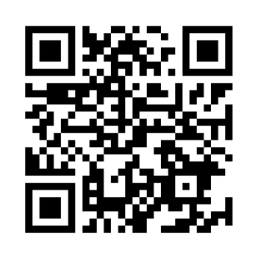
Session Survey
Your feedback is important. Please scan the QR code below to rate this session.

