Slide 1
Universal Design for Learning (UDL) and High Impact Indicators for GED Lesson Development
By Sandra Gonzalez, Ed.S.

Slide 2



Explore
Engage
The principles of Universal Design for Learning and how they can be effectively integrated into lesson planning.
Participants will engage in discussions, activities, and collaborative exercises.
Create
A lesson planning framework that incorporates UDL Principles and GED High Impact Indicators.

Slide 3
Objective One:
Objective Two:
To understand UDL Principles: Familiarize participants with the three main principles of UDL: Engagement, Representation, and Action & Expression.
Identify High Impact Indicators: Discuss the high-impact indicators for GED instruction and their importance in fostering student success.
Objective Three:
Objective Four:
Develop Interactive Lesson Frameworks: Collaboratively create lesson frameworks that integrate UDL principles and high-impact indicators.
Foster Collaboration: Encourage sharing of ideas and strategies among participants to enhance lesson framework effectiveness.

Slide 4
Engage: UDL and High Impact Indicators for GED:
Creating Inclusive and Effective Lessons
Turn and Talk
What I know about UDL…
What I know about inclusive and effective lesson planning…
Turn and Talk
What I would like to know about UDL…
What I would like to know about inclusive and effective lesson planning…

Slide 5
Explore: Intro to UDL
Define UDL
A framework that provides multiple means of engagement, representation, and action/expression to accommodate diverse learners.
Importance of UDL in Education
In adult education, especially for GED learners, UDL supports learners who may have varied backgrounds and learning needs.
Overview of Principles
Multiple Means of Engagement
Multiple Means of Representation
Multiple Means of Expression
Notes:
Multiple Means of Engagement
Example: Use real-life scenarios to motivate learners. For instance, discuss budgeting in basic math.
Multiple Means of Representation
Example: Use visual aids like charts or infographics to explain reading comprehension strategies. Show a graphic organizer to help with understanding story structure.
Multiple Means of Action and Expression
Example: Allow students to demonstrate understanding through different methods, such as oral presentations, written assignments, or hands-on activities.

Slide 6
High Impact Indicators for GED
Overview of GED High-Impact Indicators and their importance in lesson planning.

Slide 7



Explore: Why the High Impact Indicators?
They are a good fit for classroom instruction because they are not complicated but are important for students to know and use.
GED® testing data suggests that educators may not be focusing on these skills in their GED® test preparation.
They represent particular foundational skills that are the basis for the development of other skills covered in the GED® Assessment Targets and have broad usefulness that can be applied in multiple contexts.
Notes:
See handouts

Slide 8



Interactive Activity: Engage
Break into small groups 3-4
Brainstorm ideas on how to incorporate UDL principles and High Impact Indicators for lesson planning
Share ideas with larger group

Slide 9


Interactive Activity: Create
Independently or in a group read the
Step-by-Step Framework.
Write/Type the UDL & HII Lesson Planner
Focus on one specific High Impact Indicator

Slide 10

Interactive Activity: Use AI to Support Planning
Use AI to support you.
Example: Notebook LM
Notes:
demonstrate

Slide 11
Share Your Experience
Reminder:
Universal Design for Learning (UDL) focuses on removing barriers so all learners can learn.
GED High-Impact Indicators (HII), GED assessment focus areas, emphasizing critical thinking skills across reasoning, science, social studies, and math. Key indicators include sequencing, vocabulary, evidence evaluation, hypotheses, variables, geometric calculations, inequalities, and functions. Educators are encouraged to target these high-impact skills to improve student performance, ensuring proficiency across all indicators for success.
Thank you! Thank you! Thank you!

Slide 12

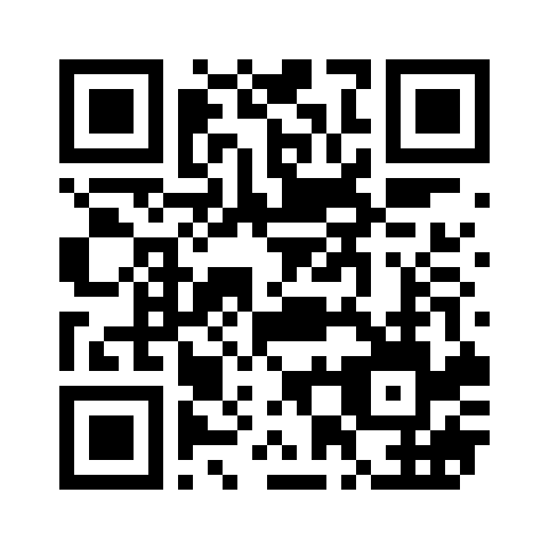
Session Survey
Your feedback is important. Please scan the QR code below to rate this session or use this link:
https://www.surveymonkey.com/r/KRSQ9G5

