Slide 1

Teaching Smarter with AI
Using AI Tools & Custom Bots for Lesson Planning and Instruction
Vi Hawes, M.Ed. • VH Ed Tech Consulting, LLC

Slide 2
Before We Start…
You are welcome to…
Stand as you work.
Take breaks
Work with those that best support you.
Work with those outside your comfort zone to grow and learn from others.
You can show your learning by…
Writing on paper.
Drawing your ideas.
Talking to your group
Listening
Use your preferred AI chatbot to assist you.
Use other technology that may be helpful.

Slide 3

Introductions
Vi Hawes, M.Ed
Ed Tech Specialist / Consultant
VH Ed Tech Consulting
✨Fun Facts!
I’ve completed both a half/full marathon!
I can speak three languages
I completed my Master’s AND gave birth to my second child, AT. THE. SAME. TIME!

Slide 4


Let’s stay connected!

Slide 5
1. Practical AI Workflows
3. Two Free Custom Bots
Ready-to-use strategies for lesson planning and instruction.
EmpowerEd AI and MyGrammarBuddy
2. Standards-Aligned Support
4. A Starter Template
A planning framework and resource list you keep building from
Tools for GED content areas, assessments, and differentiation

Slide 6
How Much Do You Know? (Insert Mentimeter)
I have used AI for lesson planning.
I have used AI to build quizzes, rubrics, or assessments.
I have used AI for career-readiness or workplace content.
I know what a “custom bot” is.
I want to use AI but worry about cheating or accuracy.
Respond your way: Mentimeter, with a partner, or just reflect silently. No wrong choice.

Slide 7
Part 1: AI & Custom Bots
Getting on the same page before we build

Slide 8
What is Artificial Intelligence?
It refers to systems that perform tasks typically requiring human intelligence:
Pattern recognition
Decision Making
Language Understanding
Visual Perception
Everyday Examples: Siri and voice assistants Google Maps Netflix recommendations Spam filters in email

Slide 9



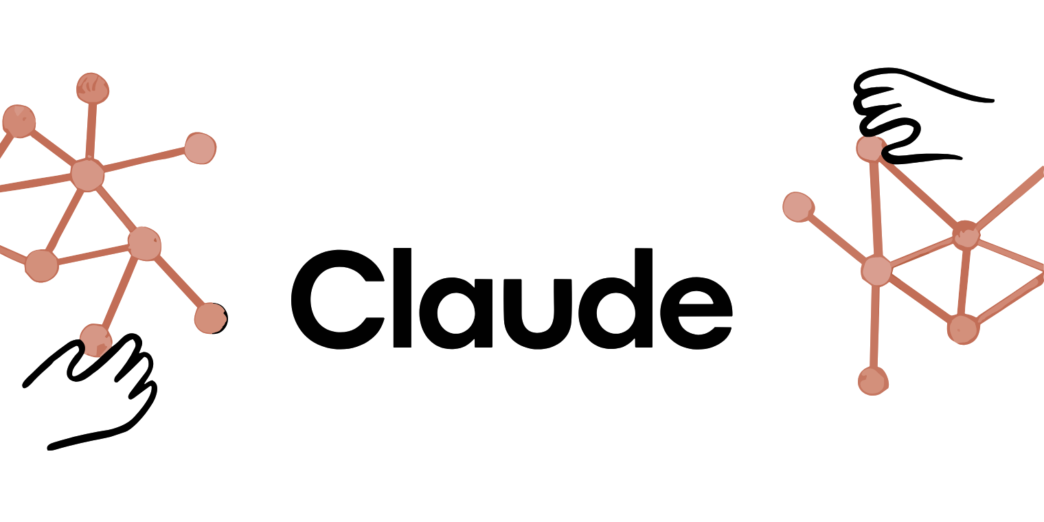


What is Generative AI?
Generative AI creates new content: text, images, code by learning patterns from vast amounts of data. It responds to your prompts in natural language.
Notes:
Generative AI creates new content — text, images, code — by learning patterns from vast amounts of data. It responds to your prompts in natural language.
Tools you may already know:
ChatGPT — OpenAI's conversational assistant
Claude — Anthropic's thoughtful AI writer
Gemini — Google's integrated AI assistant
Copilot — Microsoft's AI built into Office 365
Think of it as a knowledgeable co-planner — fast, flexible, and always available. You still own the professi

Slide 10
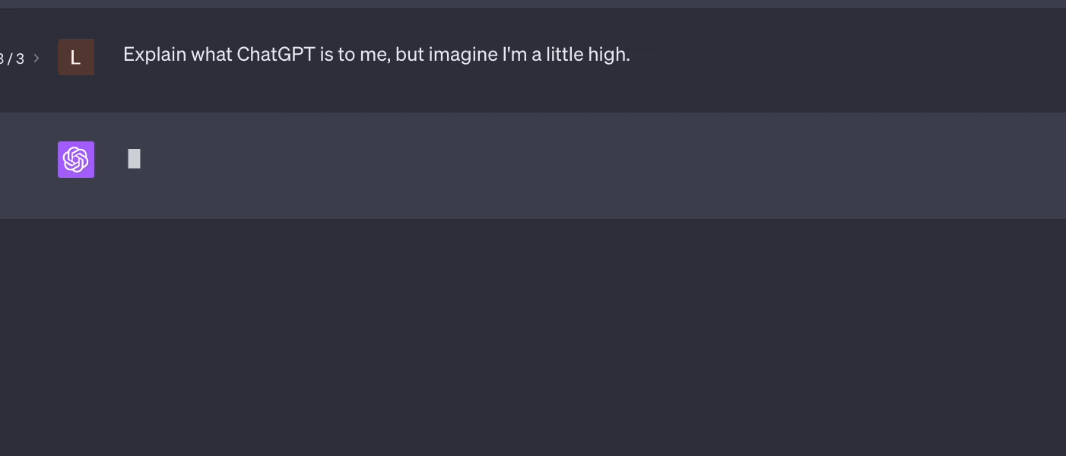
Text Generation
Essays, stories, poems, scripts, lesson plans, and conversational responses

Slide 11

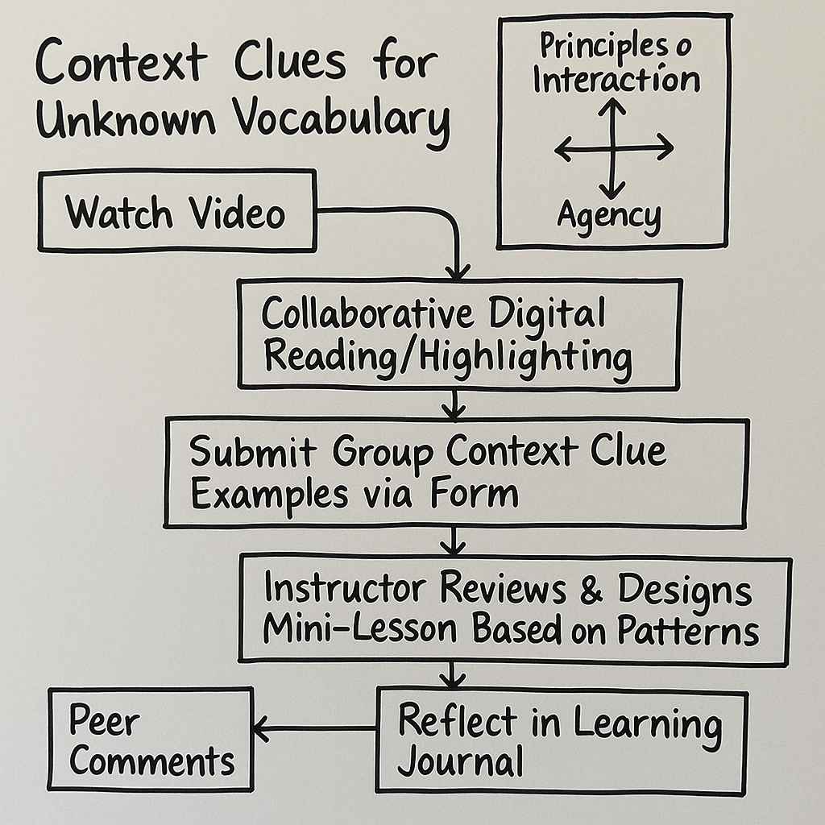
Images
Artwork, photographs, diagrams, and visual representations

Slide 12

Dialogue for ESOL students
Generated by ElevenLabs
Audio
Music compositions, sound effects, and natural-sounding speech
Podcast on Open Network Learning Environments
Generated by NotebookLM

Slide 13

Video
Realistic video renderings with just a text prompt.

Slide 14




Why AI in Adult & Workforce Education?
Differentiates for diverse learners
Personalized Pathways
Cuts planning time
Supports career readiness
Builds workplace and digital literacy together
Frees you for coaching and relationships
Notes:
Differentiates for diverse learners: Multilevel GED classrooms get leveled content from a single source.
Personalized pathways: tailored materials that meet learners where they are academically and professionally.
Cuts planning time: Generate a draft lesson in minutes, not hours, then refine with your expertise.
Supports career readiness: contextualized, workplace-relevant instruction aligned to IET and employment goals.
Builds workplace and digital literacy together
Frees you for coaching and relationships.

Slide 15
Ethical & Responsible Use
Data Privacy & FERPA Compliance
Ensure AI tool use with student data complies with FERPA.
Avoid entering personal information into public AI platforms.
Bias & Inclusivity
AI may reflect biases from their training data.
Review generated content for cultural sensitivity and inclusivity
Human-in-the-loop
Maintain your role as an educator.
AI is a tool, not a replacement for human judgment and empathy.
Prioritize human interactions.
Evaluate AI content

Slide 16
Part 2: Planning & Instruction with AI
Putting AI to work in your weekly workflow

Slide 17
The Educator-in-Control Workflow
👩‍💻
✨
📝
💬
Prompt
Generate
Review
Deliver
Notes:
The four-step loop
1. Prompt—tell the AI the level, standard, time frame, and context.
2. Generate—let it produce a first draft in seconds.
3. Review & revise—check accuracy, bias, and fit for your learners.
4. Deliver—you decide what actually reaches students.
AI accelerates the draft. You own the final product. Every step in this workflow is a place where your expertise matters — from how you frame the prompt to how you adapt the output for your specific learners.

Slide 18
AI for Lesson Planning
Example Prompt:
“Write a lesson on reading.”
❌Weak Prompt:
Vague, no context, no level.
You’ll get a generic result that needs heavy revision

Slide 19
AI for Lesson Planning
Example Prompt:
“Create a 45-minute GED RLA lesson for NRS level 4 learners on reading a workplace email for tone and purpose. Align to CCRS W.4 and include a short formative assessment.”
✅Strong Prompt:
Specific, contextualized, and format-ready.
Aligned to GED content areas and IET frameworks.

Slide 20
Fix This Prompt (3 minutes)
The task: take this weak prompt and make it strong
“Write a lesson on resumes.”
Why this matters to your workflow
The goal: leave able to write a prompt that saves you real planning time. A strong prompt is the difference between a draft you can use and one you rewrite from scratch—this is the single skill that makes every other AI tool today pay off.

Slide 21


Fix This Prompt:
“Write something about money for my class.”
1
2
Add a Level
Add a Standard
What NRS level or GED domain does this address?
Which CCRS or GED content area should it align to?
3
4
Add Context
Add an Output Format
Is this workplace literacy? Financial readiness? A specific life skill?
Do you want a lesson plan, a reading passage, an activity, or an exit ticket?

Slide 22
Part 3: Meet the Bots—Live Demos
Choose how you explore: solo, duo, or crew

Slide 23

What Is a Custom AI Bot?
What makes it “custom”
Tailored instructions that define its tone, purpose, and boundaries.
A defined role: lesson builder, writing coach, interview practice partner.
A specific knowledge base you provide: standards, handbooks, your materials.
It behaves like a specialist, not a generalist.

Slide 24
Why Build Your Own Custom Bot?
Tailored to your students, content, and context
Reusable—create once, use all term, share with colleagues
Saves time on feedback, quizzes, and scaffolding
🎯
♻️
⌛
Consistent—every learner gets the same quality of support
Accessible—lowers barriers and adds language scaffolds
Reliable—you control the tone, rules, and boundaries
✅
👐
⚓
Notes:
Tailored
Built around your learners, your curriculum, your context.
Reusable
Build once, use all semester or share with your whole team.
Time-saving
Stop re-explaining context every session. It’s already baked in.
Consistent
Same tone, level and standards alignment every time.
Accessible
Learners access via link, no account, no barriers
Reliable
Grounded in the knowledge based you choose.

Slide 25
Live Demo: EmpowerEd AI—Choose Your Way In
Solo
Open EmpowerEd AI on your own device.
Type: a topic + level + time frame.
Watch it draft a lesson in seconds.
Go at your own pace.
Duo
Pair up and share one screen.
One types, one suggests the prompt.
Compare what you would keep or change.
Two sets of eyes, one draft.
Crew
Form a small group to brainstorm prompts.
Or just watch the demo—no device needed.
Prefer a scaffold? Use the pre-filled prompt card or the short demo video.
Everyone participates their way.

Slide 26
Live Demo: MyGrammarBuddy—Solo, Duo, or Crew
Solo
Pretend you are an adult English learner.
Try: “Fix this: He go to school every day.”
Notice the tone and the encouragement.
Explore at your comfort level.
Duo
Partner up and test one prompt together.
Try: “Quiz me on present-tense verbs.”
Talk about how it adjusts to the learner.
Share what surprised you.
Crew
Brainstorm prompts as a small group.
Or follow along with the demo video instead.
Debrief: what did the bot do a generic chat would not?
No pressure to type if you would rather watch.

Slide 27
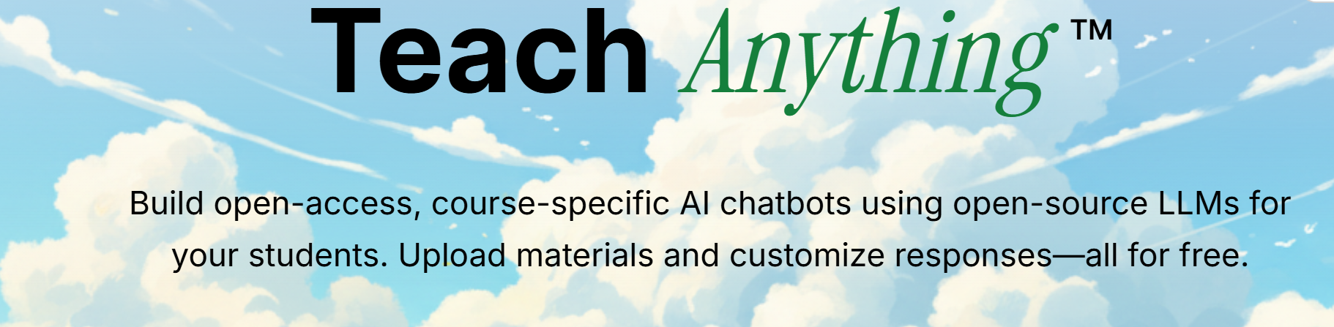
Build Your Own: Where to Start & What to Make
Where to build: TeachAnything.ai
Free, open-access, and privacy-focused—built for educators.
Sign up with any .edu email; no institutional license required.
Students access your bot via a simple link—no login, no account.
Alternatives: Custom GPTs in ChatGPT, or Gemini Gems.
Bot ideas for adult & workforce ed
Lesson Plan Builder & Assessment Generator—save hours of prep.
IET & Workplace Readiness Aligner—document framework alignment fast.
Job Interview Practice Bot—encouraging, realistic mock interviews.
Writing Feedback Assistant & Study Guide Generator for ESOL learners.

Slide 28
Recommended AI Assistants for Adult Educators
General planning partners
ChatGPT, Claude, Gemini, Copilot for drafting and differentiating.
Great for prompts, leveling, and brainstorming.
Free tiers available; check privacy terms.
Start here if you are new.
Educator-specific tools
Diffit—leveled texts and resources for multilevel rooms.
MagicSchool AI & SchoolAI—lesson, rubric & assessment suites.
Brisk Teaching—leveling and feedback inside Google Docs/Slides.
Built with classrooms in mind.
Your custom bots
EmpowerEd AI—lesson & assessment builder for GED.
MyGrammarBuddy—patient writing & grammar coach.
Build more on TeachAnything.ai.
Try one, not all—vet before student use.

Slide 29



Reflect Your Way, Then Keep Building
Talk it out: share one takeaway with a neighbor
Post it: drop a quick summary in the digital chat
Keep it private: jot notes for your eyes only
Reflect: which tool will you try first, and for what challenge? • Thank you!

Slide 30

Session Survey
Your feedback is important. Please scan the QR code below to rate this session.

