Slide 1
Strategic Partnerships that Lead to Better Lives for Students and the Economy!
Dr. Jeff Arnott @JefferyArnott
President of Lot 12 Education, Las Vegas, NV

Slide 2
#1
#4
Building Strategic Partnerships
Learn practical strategies for developing partnerships that increase student opportunities and strengthen adult education programs.
Building an Outreach Team
Explore leadership strategies for creating a team that supports recruitment and community engagement.
#2
#5
Marketing Adult Education
Discover proven outreach techniques to increase enrollment and improve community awareness.
Community Engagement Strategies
Learn creative ways to connect with businesses, organizations, and local leaders to expand your program's reach.
#3
#6
Creating an Outreach Plan
Develop a simple, effective marketing plan with clear goals, strategies, and measurable results.
Measuring Success
Identify practical ways to evaluate marketing efforts and continuously improve outreach results.

Slide 3
Let’s Define a Partner!
Is it an employer?
Is it an organization?
Is it a work-based learning opportunity?
Is it a donor?
Is it a vendor?
Is it an alumnus or alumna?
Partnerships have the potential to grow!
Apply the SMELL Test! (Sound, Moral, Ethical, Legitimate, and Legal)
Aim to reach a YES!
No partner is too large or too small!

Slide 4
Each GED Program is Unique! What You Need to do to Outreach to Partners!
Each Program is…….
…unique.
…serves different economies.
…has different leadership structures.
…has unique priorities.
…has politics.
What you must do!
You must advocate to your supervisors!
Get to know your business & community!
Make partnerships your highest priority!
You might have to get political!
Have options for students!
Ask students what is important to them!
P.S. It is a short & long game!

Slide 5
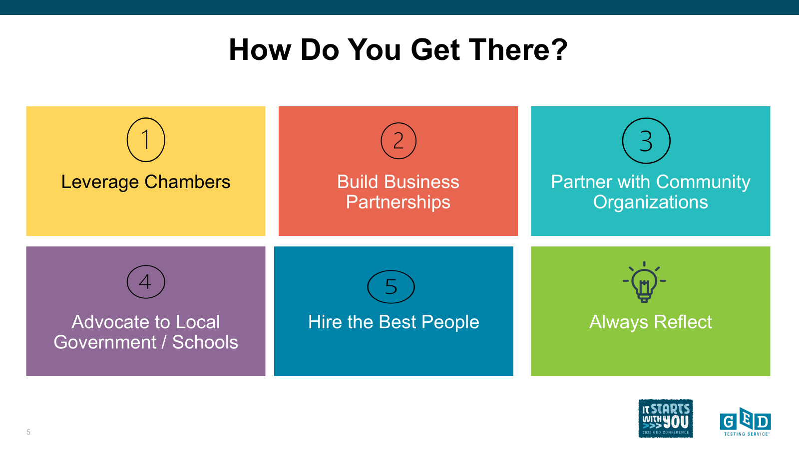

Slide 6
Here are some partners I have used in the past!
Large Companies & Number of Employees
Large Theme Park 75,000
Advent Health System 36,000
Orlando Health 20,400
Small Companies & Number of Employees
One Fat Frog 100
Touchless Boat Covers 50
Competitive Edge Contractors 50

Slide 7
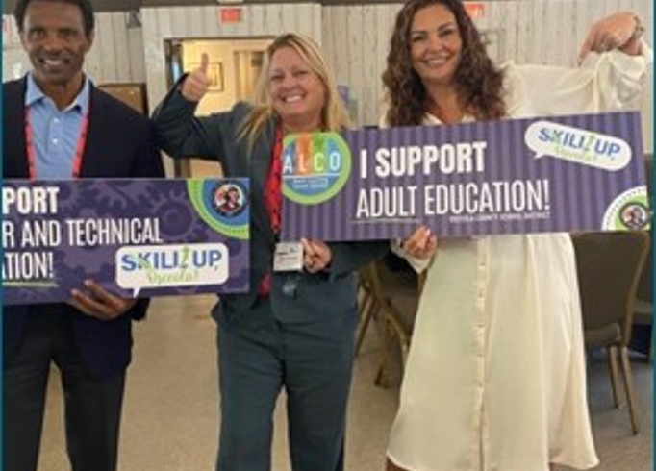
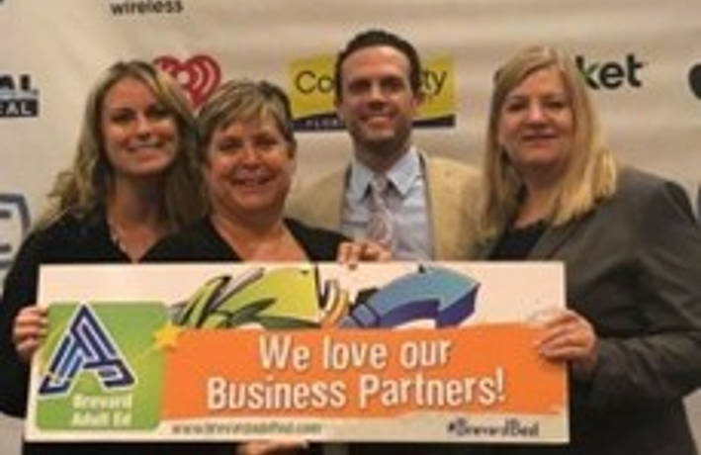
Leverage Chambers!
Become a member of the chamber!
​
Participate in as many events as you can.
Chambers connect you with a variety of businesses, both large and small – real hidden opportunities.
They can guide you toward the most beneficial events for your needs.
Consider speaking at their gatherings.
Support their events through sponsorship.
Leverage the chamber to help form an advisory board if necessary.
Encourage your team to get involved with the chambers.

Slide 8
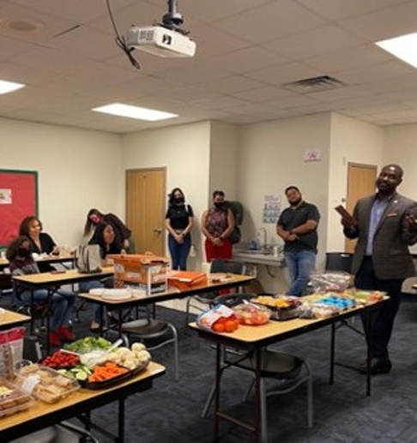
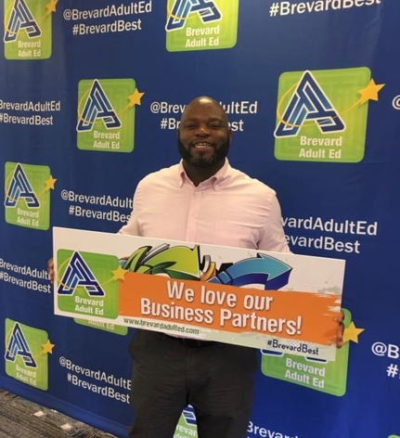

Leverage Community Partners!
Examples:
Department of Labor (One Stop)
  We have received over $500K to start apprenticeships programs.
Local Community College and other educational providers.
Local agencies like the Urban League.
  We received $75K to for short term trainings.
Faith-Based groups.
  Put on a PROM for our students!
Military
P.S. ALWAYS THANK THEM!

Slide 9
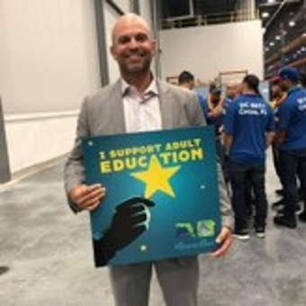
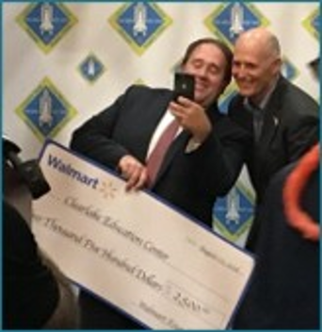
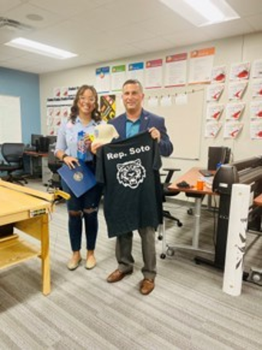
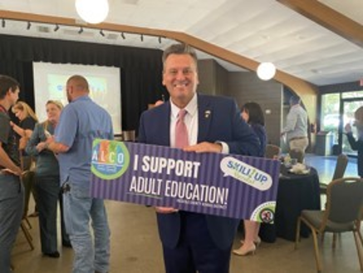
Advocate to Local Leaders!
Examples:
​
Meet with County Commissioners, Mayors, and City Managers.
Connect with State Legislators during their visits to town.
Keep in mind that individuals involved in politics may move to different roles over time.
Invite them to your campus and events.
I have yet to encounter a legislator who doesn’t support adult and workforce education. Always link it to economic development. Avoid partisan approaches.

Slide 10
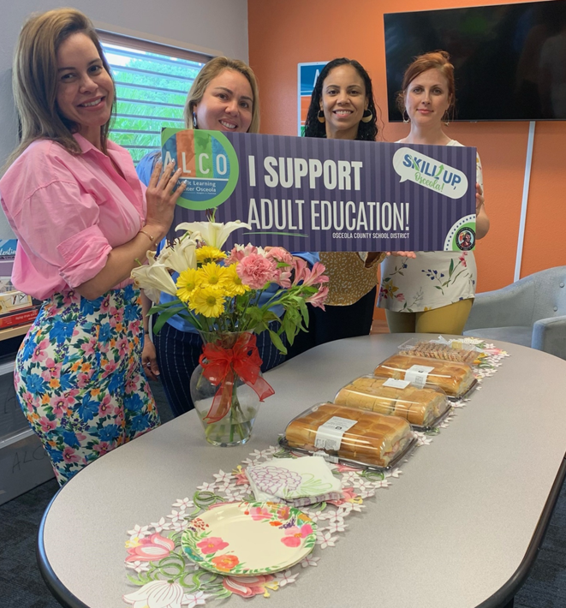
Building a Legendary Team to Free Up Your Time!
​
The process will require patience, but the results will justify the effort.
Assemble a team with varied backgrounds, combining individuals familiar with the system and those new to the organization.
Create a team that capitalizes on each member’s strengths.
Invest in marketing and community engagement efforts.
This approach will allow you, as the leader, to focus on your own strengths.
Rather than seeking a “family,” aim to develop a high-performing organization.

Slide 11
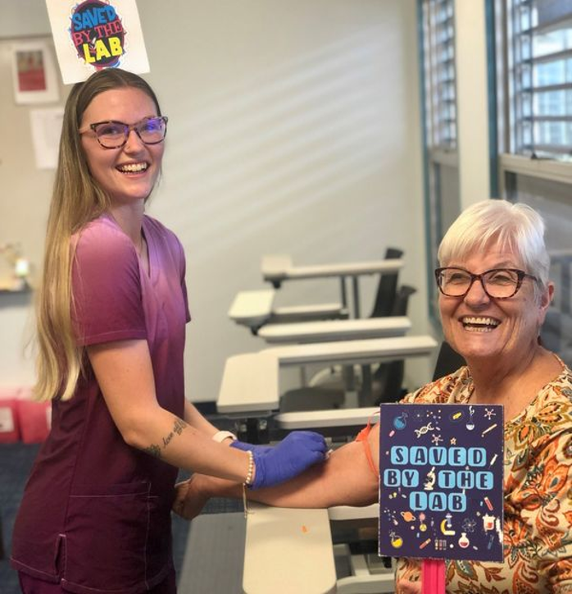
Reflect! Essential Questions!
​Are the staff members in their current roles the best fit?
In what ways are your partners supporting you?
What strategies could enhance your engagement with partners?
Have you made improvements to your marketing plans?
Are your partners the right ones for your goals?
How do you celebrate achievements? Do you include partners in these events?
Are genuine opportunities available for students?
How effective is your messaging?

Slide 12
Let’s Now Talk About Outreach!

Slide 13
Common Marketing Mistakes!
  ​According to Forbes (Griffin, 2022), marketers make nine common mistakes.
  Providing education content without entertainment.
  Lacking understanding about their target audience.
  Marketing too broadly.
  Running paid ad campaigns for quick results instead of gaining traction organically.
  Using the wrong platform or medium.
  Focusing too much on services, not students.
  Assuming the customer knows more than they do.
  Ignoring content marketing like storytelling with blogs.
  Relying only on traditional marketing methods.

Slide 14
Make Language Clear!
  ​Don’t use acronyms like ESL and IETs in ads.
  Don’t talk about rules in ads.
  Have a phone number and website in ads (QR Codes work)!
  Use social media DM links.
  Keep legal language to a minimum.
  Discuss career readiness in ads.
  Invest in top notch customer service training, expand orientations, and make sure staff return calls in hours, not days.

Slide 15
Develop an Outreach Plan!
​Define your outreach objective and clarify what you aim to accomplish.
Understand your target audience and analyze your competitors. Consider that different sectors can be marketed through various platforms.
Prioritize outreaching in your budget.
Establish clear deadlines.
Choose appropriate outreach channels and strategies.
Monitor results and evaluate analytics.
Assemble a team to implement the plan and conduct follow-ups.

Slide 16
Outreach Strategies!
  ​Use a balanced approach, promote students first! Showcase graduates and success. Promote new programs. Celebrate staff accomplishments. Promote economic partners and news!
  Use social media platforms to connect with your audience.
    Facebook, X, Instagram, LinkedIn, Tik Tok, and more.
    Get the blue checkmarks!
  Post several times a week on social media. Pay for followers.
  Try digital advertising in your marketing budget.
  Modernize website that is mobile friendly.
  Encourage students to leave online reviews.
  Create and use engaging video content.
  Promote trends in the economy.
  Create educational apps.
  Promote other educational sites and partners.
  Track your data and shift according to promotion.
  There are 18 marketing types.

Slide 17
Other Ideas that Work!
Expand beyond Facebook by adopting offline marketing techniques.
Make it a habit to participate in community events.
Allocate resources for tabletop displays.
Work with a professional agency to create your printed marketing materials.
Hire staff specifically to promote your programs.
Involve teachers and school administrators in promoting the program within the community.
Introduce your services at elementary schools to connect with local parents.
Equip your staff with branded T-shirts.
Establish relationships with your local Department of Labor contacts for student referrals.
Collaborate with organizations that can provide venues for classes.
Offer your facilities for use by community groups.

Slide 18
Outcomes!
Enrollment increased from 5% to 20%, varying by year.
Received the 2016 SUNSPRA Award for Brevard Adult Education.
Staff were invited to present at events across the state.
Student participation improved.
Received positive feedback from senior leadership.
Enhanced promotion of workforce programs.
Fostered a very positive organizational culture.
Strengthened relationships with business partners.
Increased engagement with elected officials.
Raised community awareness of our activities.

Slide 19
Resources!
  ALCO Facebook Page
  (5) Facebook
  COABE Educate and Elevate Campaign
  Lots of great resources to promote literacy weeks, awareness campaigns etc.
  https://coabe.org/social-media-messaging-center/
  GED Testing Center
  https://ged.com/educators
  Many of these sites have locator tools for students to find your program! Make sure they are up to date.
  The GED Testing Service has a referral portal and lists of students who are interested in classes in your area.
THANK YOU!
Dr. Jeff Arnott X @JefferyArnott LinkedIn: Jeff Arnott Ed.D.
Jeff@Lot12Education.com
407-719-7123

Slide 20

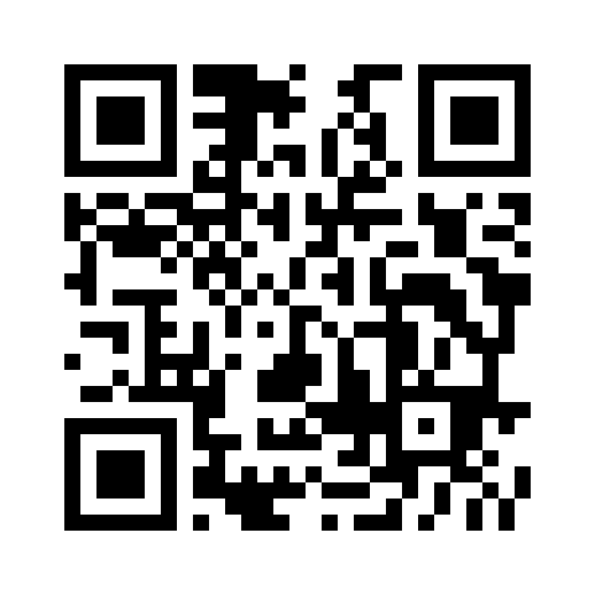
Session Survey
Your feedback is important. Please scan the QR code below to rate this session.
QR CODE PLACEHOLDER

