Slide 1
GED Prep Connect™ and GED Direct™
Azeem Begum — Business Analyst
Sharon Webb-Testing Coordinator Dept of Adult Workforce and Comm Ed ACE Testing Centers
Cameron Gross – Group Product Manager

Slide 2




Why this matters
What GED Direct adds
Programs are balancing recruitment, enrollment, testing, budgets, and reporting at the same time.
A simpler way to purchase, assign, and share GED Ready® tests and GED® exams.
What Prep Connect adds
Combined result
Visibility into interested learners so programs can prioritize outreach and connect at the right moment.
An end-to-end workflow that saves time, reduces administrative effort, and improves confidence in program oversight.

Slide 3





Recruit Smarter, Manage Better
GED Prep Connect™ and GED Direct™ — how these help strengthen adult education programs
Programs juggle recruitment, enrollment, testing, budgets, and reporting — this session shows how both tools work together end‑to‑end.
GED Prep Connect™ (in GED Manager™): find GED® candidates who've expressed interest, connect at the right moment, prioritize follow‑up, and boost enrollment.
GED Direct™ (in GED Manager™): purchase, assign, and share GED Ready® tests and GED® exams, and monitor usage — no voucher codes or expiration tracking.
Combined: save time, cut administrative burden, and strengthen program oversight.
GED & Me™ the official GED mobile app. Teachers can now leverage the mobile app's study and practice tools to better support learner success.

Slide 4
GED Prep Connect: turn learner interest into timely outreach
What it does
Why programs care
Key Benefits
• Identifies GED® candidates who have expressed interest in adult education
• Makes it easier to connect with learners at the right moment
• Guides learners into local programs through timely action
• Strengthens outreach efforts
• Helps staff prioritize follow-up
• Supports increased enrollment by meeting learners where they are
• Increase Awareness: Reach GED® candidates directly
• Boost Engagement: Improve completion and success rates
• Access Student Insights: View reports and student scores
• Simplify Test Management: Buy and assign tests via GED Direct

Slide 5




End-to-end workflow for adult education programs
Identify
Prep Connect surfaces interest
Engage
Staff contact and guide learners
Assign
GED Direct supports testing
Track
Programs monitor usage and progress
When these steps are connected, programs can move from passive review to deliberate action across recruitment, testing, and oversight.

Slide 6
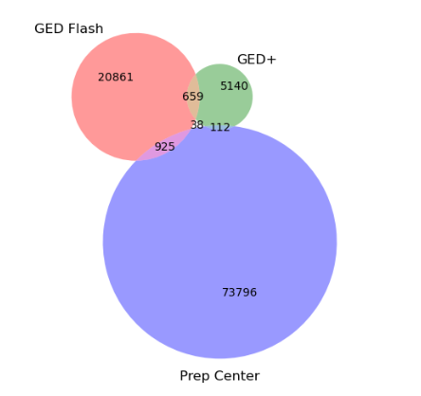
Learners are staying, not switching
Cross-product engagement since the start of 2025.
Only small number of these learners overlap in more than one product at the same time.
How many Prep Center learners also use GED Flash or GED+?
Learners are not switching to alternatives.

Slide 7
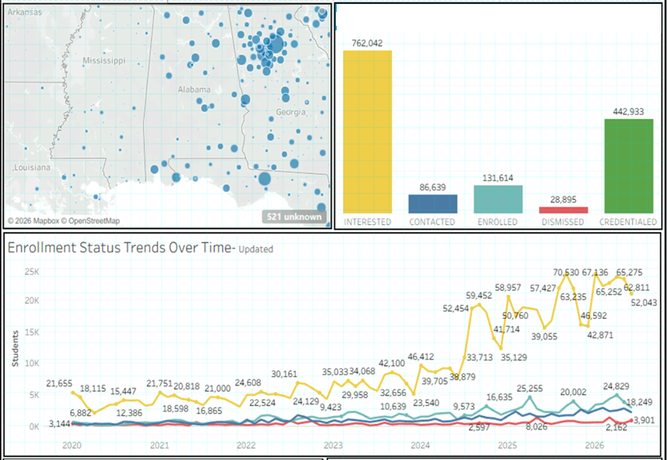
GED Prep Connect Dashboard Snapshot
Interest far outpaces follow-up. Most of the interested learners haven’t yet been contacted or updated in GEDManager.
A large conversion opportunity waiting to be captured.
The window is narrowing. Inactive profiles are deleted after two years, so this count reflects only still-active learners.
the Interested (yellow) bar drops only when ABEs advance learners in GEDManager to Contacted, Enrolled, or Dismissed — its size reflects pending follow-up.

Slide 8




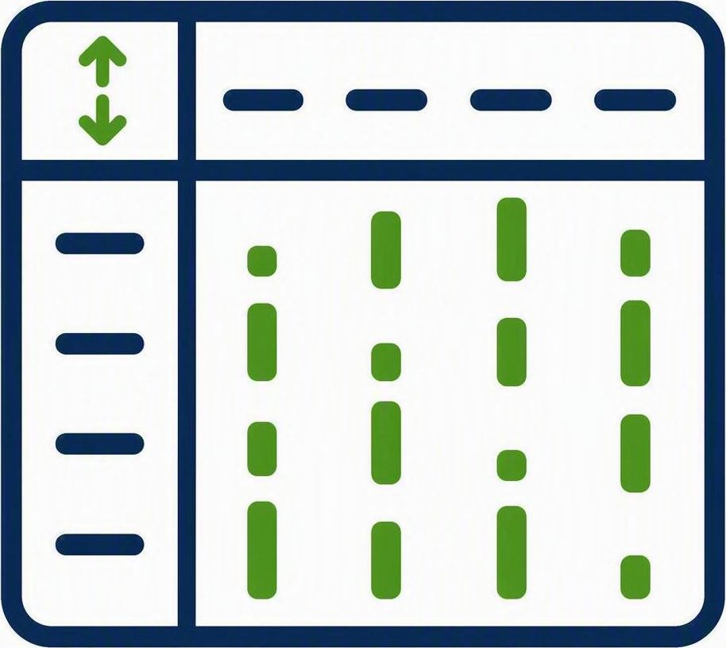

COMPLETED
Foundational Improvements to GED Prep Connect in GED Manager
Improve Prep Connect Tool
Prep Connect Messaging
Several features and filters added/enhanced to help cut manual overhead; keeps statuses current.
Portal language nudges students to contact prep centers.
Automate Credentialed Status
Access to State Admins
Auto-sets status to Credentialed on GED earn
"Manage Prep Connect Enrollment" now a default permission.
Test Results Activity Columns
Prep Center Locator Redesign
Sortable GED Ready & GED Passed columns speed follow-up.
Redesigned locator: sticky search, star ratings, mobile-ready.

Slide 9
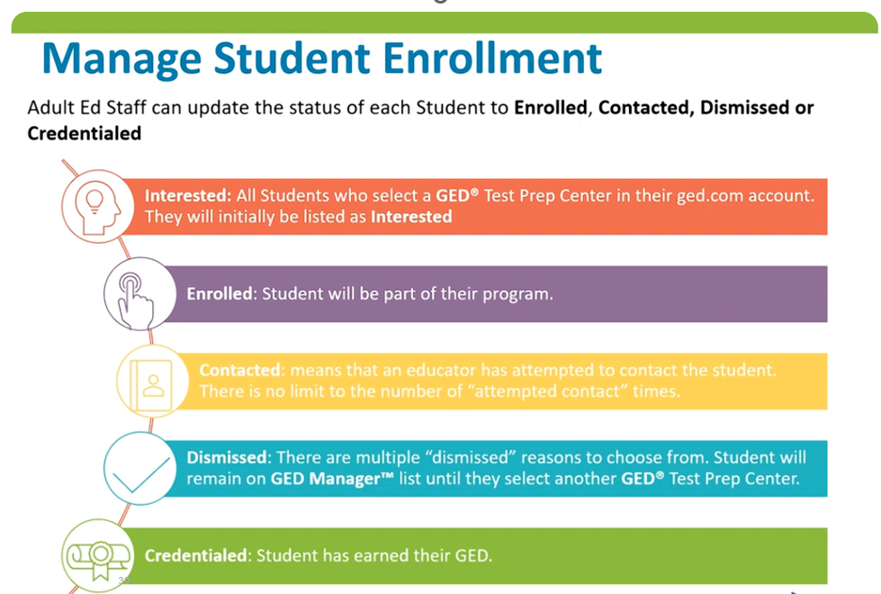

Slide 10
What this means for programs
• Recruit learners more effectively by acting on expressed interest
• Prioritize follow-up instead of relying on broad outreach
• Simplify test purchasing, sharing, and monitoring
• Reduce administrative burden while improving visibility
Teachers can now leverage the mobile app's study and practice tools to better support learner success.
Front-end outreach
Enrollment support
Testing operations
Progress oversight

Slide 11
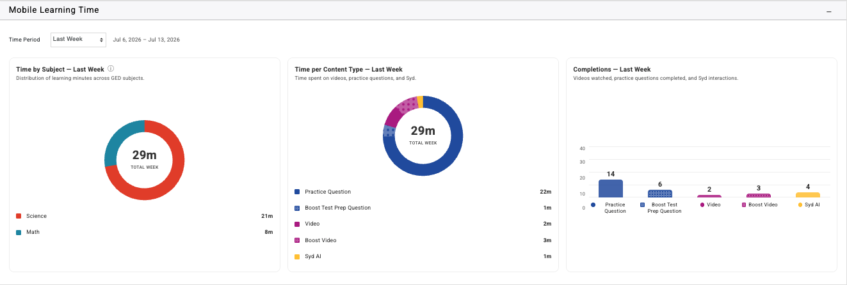
Track time spent by subject area (Math, Science, Social Studies,RLA)
Mobile Learning Time now available in GED Manager: Search by learner name, then see drop down for Mobile Learning Time
1
Track time spent by content type: practice questions, video, Syd-The AI Tutor, and in free and paid (Boost) products
2
Introducing mobile learning time
3
Front-end outreach
Track number of practice questions, videos and Syd AI interactions
1
2
3

Slide 12
GED Direct: simplify purchasing, assignment, and monitoring
We heard you and made more enhancements!
Purchase
Assign / Allot (New)
Monitor
• Buy GED Ready® practice tests, GED® exams and GED® Retakes inside GED Manager
• Reduce reliance on voucher codes and expiration tracking
• Share tests with ease
• Create a smoother experience for educators and administrators
• Track usage with greater clarity
• Support oversight without extra administrative work

Slide 13
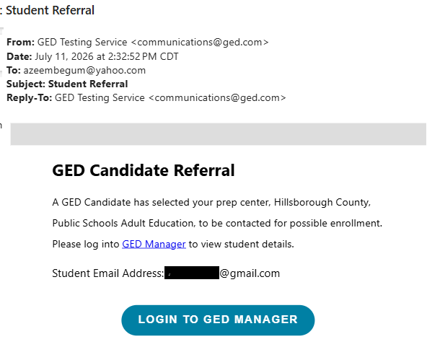
Get notified the moment a student picks you
With email alerts enabled, you’ll receive a referral like this each time a student selects your prep center—your cue to log in and take action.
YOUR NEXT STEPS
1
Open the referral email
2
Log in to GED Manager
3
Reach out to your new student

Slide 14
sharon.webb@palmbeachschools.org

Slide 15

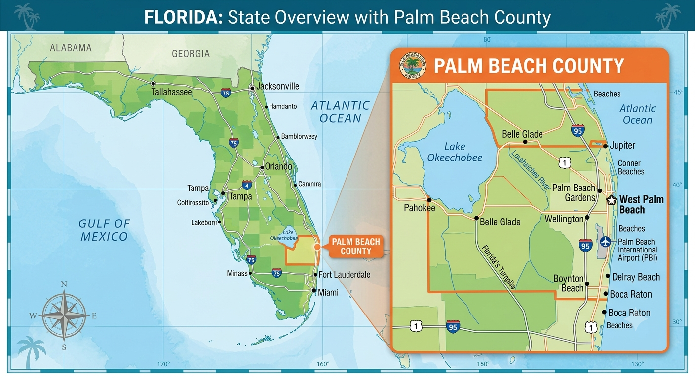

Local Prospective
4 Technical Education Centers
21 Community School Sites
  17 offer ABE/GED®
4 Public Testing Centers
2 Mobile Corrections Sites
ABE/GED® Enrollment 1,800
10th Largest School District in the Nation
5th Largest School District in Florida

Slide 16
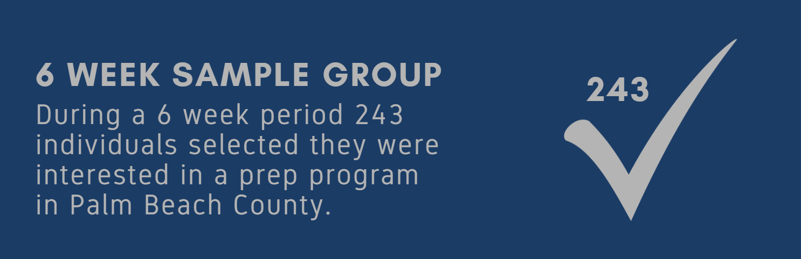

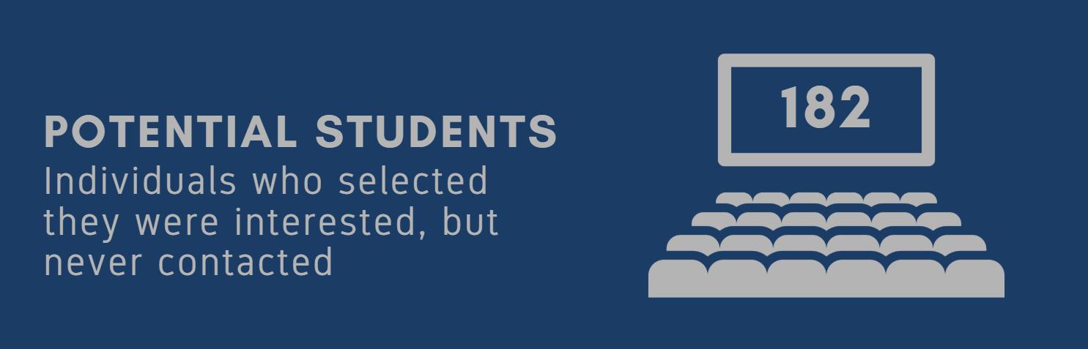
Importance of Follow up

Slide 17
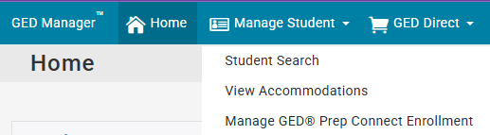
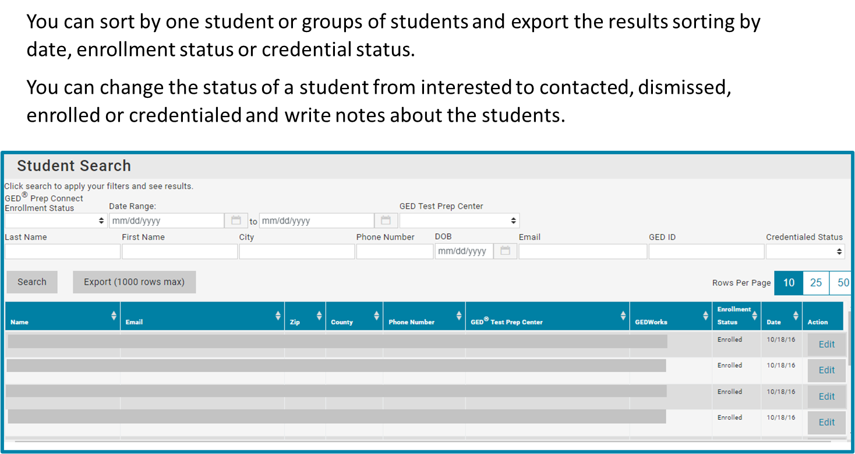
Manage GED Prep Connect™

Slide 18
Manage GED Prep Connect™
Sort and Export information
Prep Center Site
Enrollment Status
Results
Date

Slide 19
Ways I track information
Why I track the information
Track Prep Connect usage manually for each site
GED Manager Usage with the help of my State Administrator
Communications with Site Administrators
Trainings with Site Coordinators with GED Manager Access

Slide 20
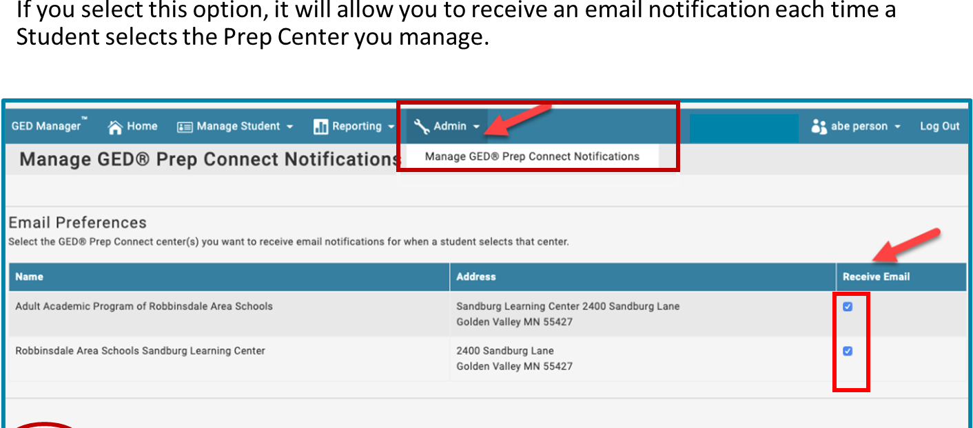
Connection Notification
Receive email notifications when a student selects the prep center you manage.

Slide 21
Best Practices
Outreach Works
  Internal
  External

Slide 22
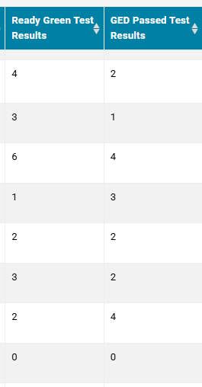
Best Practices
Outreach Works
  Internal
  External
Use Results to Frame Communications
Data Driven 3 of 4 Outreach

Slide 23
Sample Communications
Interested
Outreach
Congratulations on taking the first step and creating your GED.com account! Setting up your profile is a huge milestone toward earning your State of Florida High School Diploma.
While studying on your own is an option, you don't have to do it alone. The School District of Palm Beach County offers dedicated Adult Education programs designed to help you prepare for and pass all four GED subject tests. Whether you prefer online flexibility or structured in-person classes, local help is available. Click here for more information.
Reach out to a local Community School where coordinators and teachers are standing by to help you cross the finish line.
Life can get busy, did you know your GED test scores are still valid! You only have one more test to complete to earn your High School Diploma.
How to Log Back In
If you don't remember your login details for your account at GED.com, don't worry. It's very easy to recover:
Go to the GED.com Sign-In page.
Click on the "Forgot Password?" link right below the log-in boxes.
Enter the email address you originally used to create your account.
Check your inbox for a password reset link and follow the quick instructions to set a new password.
Where You Can Test
When you log into your GED account to schedule, it will show you a list of the closest centers to your ZIP code.
You can choose the day of the week and time of day that works best for your schedule.
You have already done the vast majority of the hard work by passing three sections. Now it’s time to finish what you started and open up new doors for your career and education.
Log into your account today to see which test you have left and schedule your appointment. If you have any questions, please reach out, we are here to help.

Slide 24
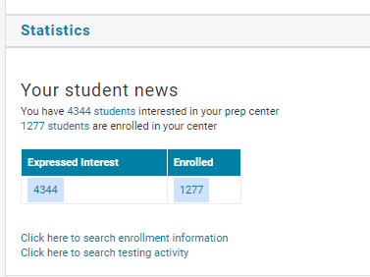
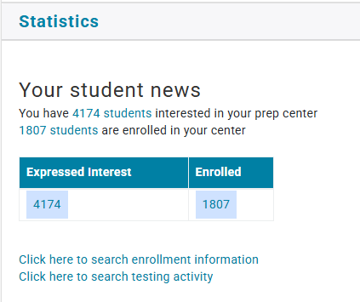
Statistics
July 2025
July 2026

Slide 25
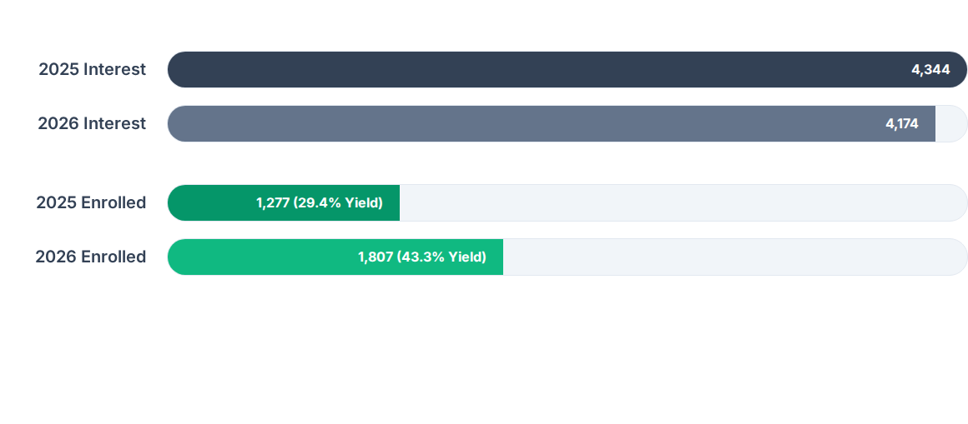
Statistics

Slide 26
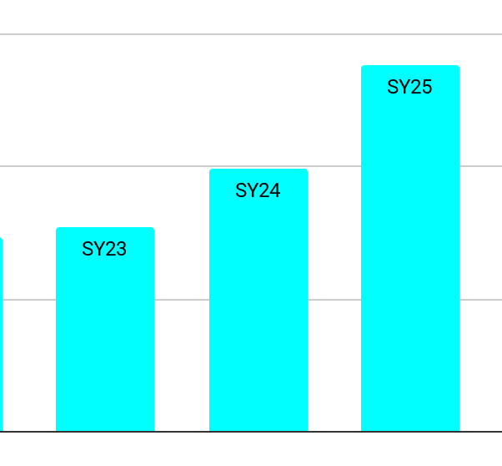
Statistics
SY24 - SY25 Increased Credentialed
SY25 - SY26 Prep Connect Enrollment
40% more credentialed
+41.5%CHANGE IN
GED Prep Connect Enrollment
Academic Year | Expressed Interest | Enrolled | Yield Rate
2025 | 4,344 | 1,277 | 29.4%
2026 | 4,174 | 1,807 | 43.3%

Slide 27
Questions
Sharon.Webb@palmbeachschools.org
School District of Palm Beach County
Department of Adult Workforce and Community Education

Slide 28


GED Direct: Dashboards, Vouchers & Analytics
Dashboard Redesign
Voucher Distribution
Redesigned Dashboard UI
Voucher Usage, Groups You Manage, and Groups You're In — with one-click actions to Allot Vouchers, Create Group, and Manage Assignments.
Group-Based Voucher Allotment
Admins assign blocks of vouchers to balance distribution across the program.
Assign to programs, facilities, or individuals
Create groups and manage members
Allot or remove vouchers per group
Voucher Usage Dashboard
View of voucher status across every product type (GED Ready, In-Person, Online Proctored, Retake), broken out by Available, Allotted, Assigned, and Used breakdown

Slide 29
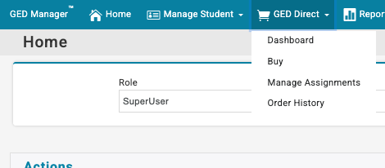
GED Direct: Dashboard Redesign
Introducing...

Slide 30
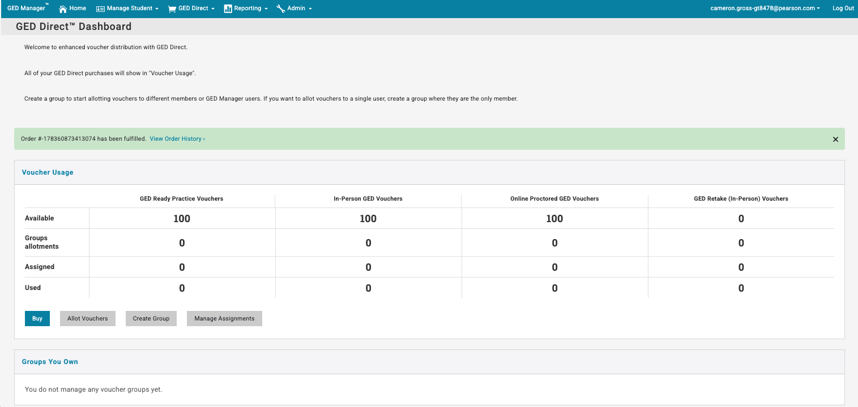
GED Direct: Dashboard Redesign

Slide 31
GED Direct: Dashboard Redesign
Voucher Usage Dashboard
Create groups
Allot vouchers from Available

Slide 32
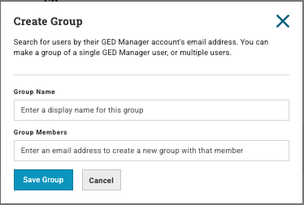
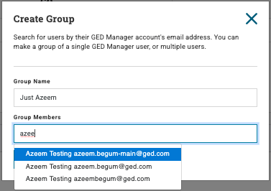
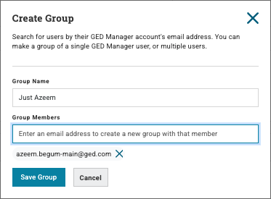
GED Direct: Groups
Click "Create Group" Add a Group Name & group members Save Group

Slide 33

Expect a fancy confirmation toast message
Click "Create Group" Add a Group Name & group members Save Group

Slide 34
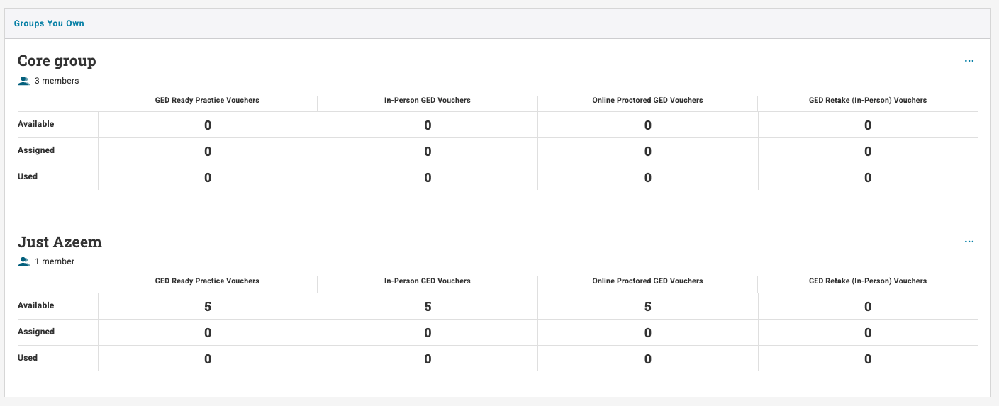
GED Direct: Groups
Groups can have one or more members

Slide 35
GED Direct: Groups
GED Direct: Groups
Groups can have one or more members

Slide 36
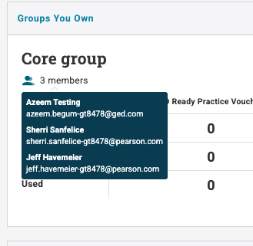
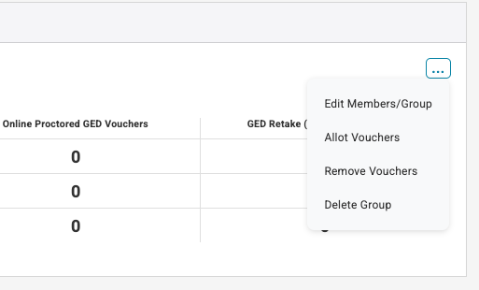
GED Direct: Groups
Group actions

Slide 37
GED Direct: Allotting Vouchers
Allotting vouchers to an existing group begins with clicking "Allot Vouchers."

Slide 38
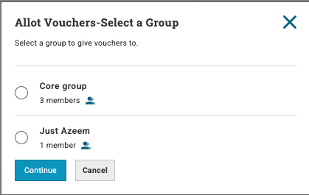
GED Direct: Allotting Vouchers
Select the group to allot vouchers

Slide 39
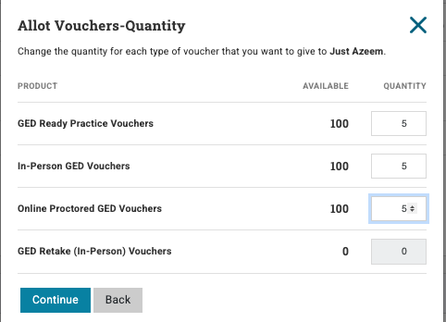
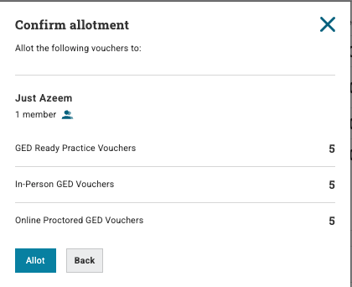
GED Direct: Allotting Vouchers
Enter voucher quantities for that group
Confirm by clicking "allot"

Slide 40

Expect a fancy confirmation toast message

Slide 41
GED Direct: Manage Assignments

Slide 42
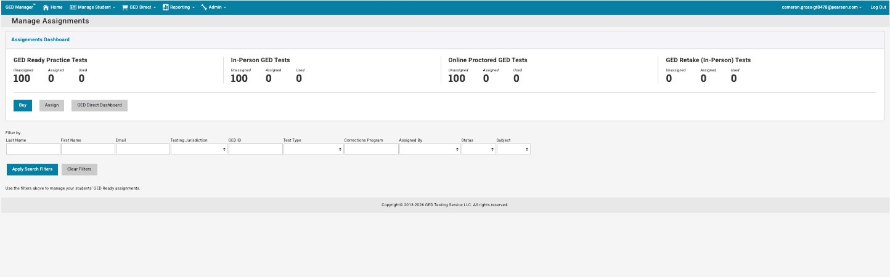
GED Direct: Manage Assignments

Slide 43
Questions?
Reach us at Operations@ged.com

Slide 44

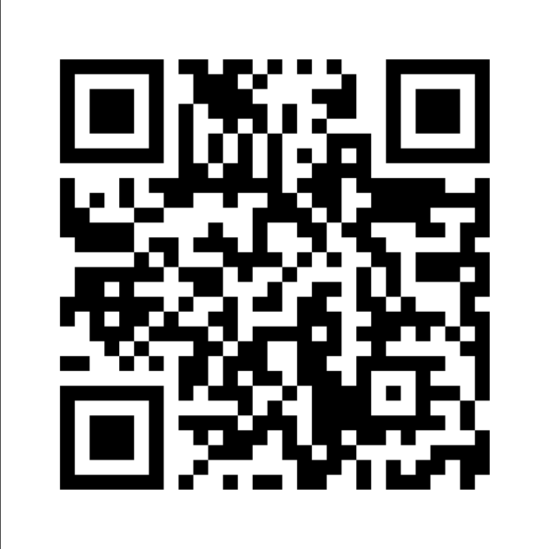
Session Survey
Your feedback is important. Please take a moment to rate this session and help us improve future ones.
https://www.surveymonkey.com/r/RWB66L3

