Slide 1
Reading – Moving Students Beyond Basic Comprehension
Susan Pittman, Educational Consultant to the GED Testing Service®

Slide 2
1
4
Reading Issues
SPAM – Analyzing Rhetoric
2
5
4 Ps of Pre-Reading
Text Structure
The CER Strategy of Reading
6
3
TDQs – Text Dependent Questions
Questions and Concerns

Slide 3

What We Know About Reading Issues
Students
Skim texts rather than reading them closely
Don’t highlight or made notes to identify facts, details, evidence
Read only when assigned rather than daily
Focus on basic comprehension – main idea and details
Lack analysis and evaluation skills
Notes:
Remind students to carefully read the questions and to read through all four options before selecting their answer.
Remind students to use the highlighter and the white board that are provided.
Encourage students to read more. Strong reading skills will benefit students in all four subject area tests.
Encourage students to analyze the content they read on a daily basis. Strong critical thinking skills will benefit students in all four subject area tests.
Read and re-read to determine the details of what the text says explicitly and to make logical inferences from it
Notice significant language
Draw conclusions and make generalizations from synthesizing the information in the text and/or illustrations
Cite specific textual evidence that supports conclusions drawn from the text

Slide 4
4Ps of Pre-Reading
Preview, predict, prior knowledge, purpose
Notes:
The 4 Ps of reading is a highly effective pre-reading strategy designed to boost comprehension and engagement before diving into a text. The framework involves four steps: Purpose, Preview, Prior Knowledge, and Predict.
Purpose: Determine why you are reading the text. Are you looking for specific answers, preparing for an exam, or reading for general enjoyment?
Preview: Skim the text like a movie trailer. Scan the titles, headings, subheadings, images, charts, and the first and last paragraphs to understand the "big picture" and structure.
Prior Knowledge: Connect the material to what you already know. Accessing your background schema helps make new concepts easier to digest.
Predict: Anticipate what the material will cover. Formulating guesses about the content or the author's argument keeps your brain actively engaged while reading.

Slide 5
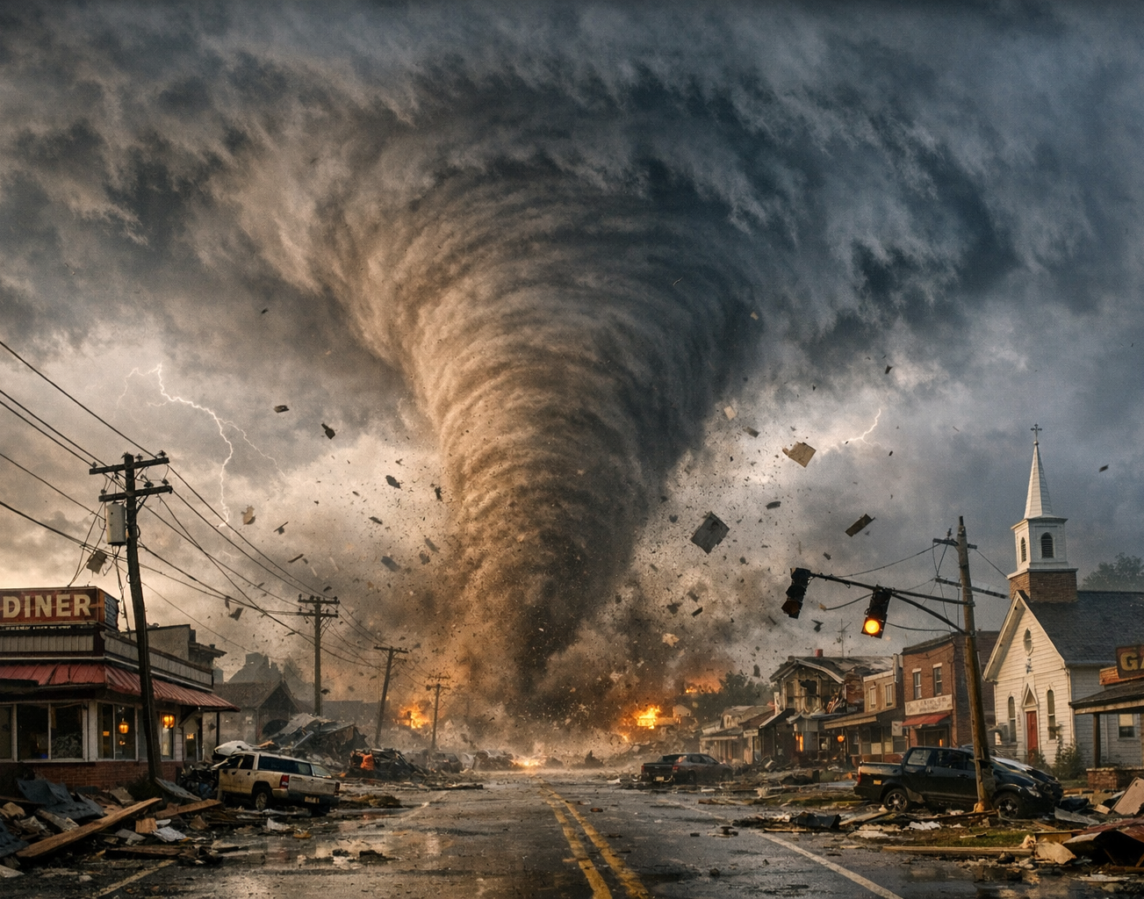
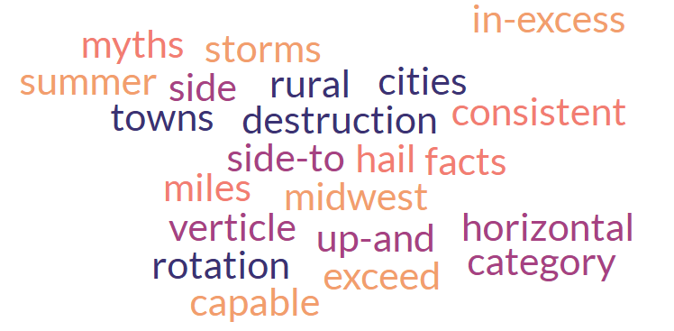
Preview, predict, prior knowledge, purpose

Slide 6
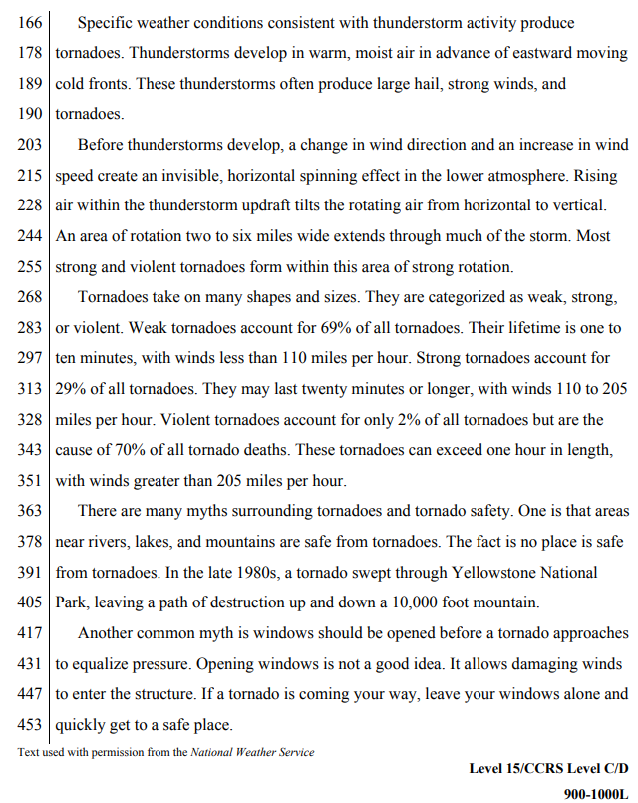
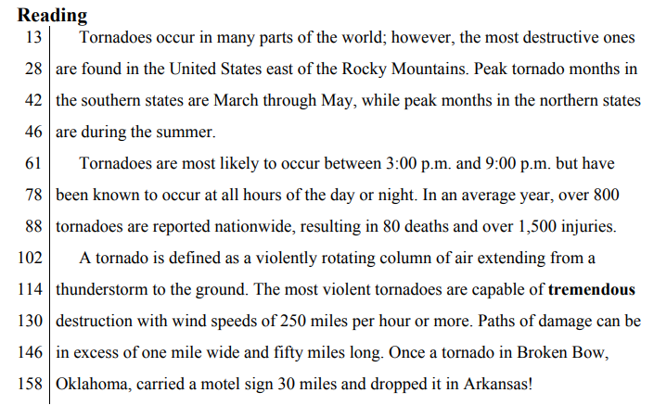
Tornadoes – Nature’s Most Violent Storms

Slide 7
Expand Student Knowledge
Natural Hazards
Earthquakes
Hurricanes
Tornadoes
Floods
Drought
Effects
Frequency
Severity
Short- and long-term effects
Mitigation
Dams, Seawalls
Storm Shelters
Building Practices
Earth and Space Science Content Subtopics

Slide 8
Structure of Text
Fact or Opinion

Slide 9

Fact or Opinion
Jim’s Sweet Shop located at 480 Hampton Avenue serves coffee, donuts, soup, and sandwiches. Customers can eat in or take out.
Maria’s Deli located at 735 North Front Street is the area’s best place for homemade soup and sandwiches.
The Club Room located at the corner of Rainer and Duncan is the place to see and be seen. Enjoy fabulous desserts after a five-star dinner featuring fresh seafood, steaks, and wild game.
Renaldo’s located at the Westend Country Club is a full-service restaurant. Soups and desserts made daily. Private room available for small parties.

Slide 10
Fact or opinion
Determine whether each sentence is a fact or an opinion and then tell why.
(1) A storm carrying the threat of more snow and ice moved across the Southern Plains on Friday as more than 100,000 homes and businesses remained in the dark from earlier blasts of cold, wet weather. (2) Winter storm warnings covered much of New Mexico and parts of Texas and Oklahoma, with a half-foot to more than a foot of snow and sleet expected. (3) In Texas, 90 National Guard members were activated. (4) It is possible that even more will be needed. (5) At a plaza in El Paso, where large crowds usually gather near bus stops and restaurants, only a few people braved the biting wind. (6) "We prepared, getting all our winter clothes out, but it's difficult because the bus is late," said Alicia Lozano, 62, who wrapped a purple scarf around her head.
(7) In tiny Oaks in northeastern Oklahoma, carpenter and rancher Garland Whorton has been without power for a week. (8) He spent three days using a chain saw to cut a path through the ice to his barn so he could reach his horses and mules. (9) "When that snow hits, it's going to finish us off," said Whorton, 59.
Adapted from article at USAToday.com
Notes:
(1) A storm carrying the threat of more snow and ice moved across the Southern Plains on Friday as more than 100,000 homes and businesses remained in the dark from earlier blasts of cold, wet weather. (2) Winter storm warnings covered much of New Mexico and parts of Texas and Oklahoma, with a half-foot to more than a foot of snow and sleet expected. (3) In Texas, 90 National Guard members were activated. (4) It is possible that even more will be needed. (5) At a plaza in El Paso, where large crowds usually gather near bus stops and restaurants, only a few people braved the biting wind. (6) "We prepared, getting all our winter clothes out, but it's difficult because the bus is late," said Alicia Lozano, 62, who wrapped a purple scarf around her head.
(7) In tiny Oaks in northeastern Oklahoma, carpenter and rancher Garland Whorton has been without power for a week. (8) He spent three days using a chain saw to cut a path through the ice to his barn so he could reach his horses and mules. (9) "When that snow hits, it's going to finish us off," said Whorton, 59.
Adapted from article at USAToday.com

Slide 11


Text-Dependent Questions
Opinion
Speculation
Background Knowledge
Notes:
Text-Dependent Questions
At the heart of the process, is your use of text-dependent questions or as they are often called TDQs. TDQs serve as a tool to enable students to see what it means to dive deeper into text and extract meaning. So what are text-dependent questions and how are they different from the questions that are normally seen or used with text.
[Read following text with Animation 1.]
TDQs move beyond a cursory look at the 5Ws and H, especially the first Ws that are normally used – who, what, when, where. The emphasis moves more deeply into the “why” and “how”. They are questions that require analysis and evaluation – higher=order thinking skills.
[Read following text with Animation 2.]
TDQs do not rely on personal opinion, background knowledge, or speculation. TDQs focus on what the text is telling the student.
[Read following text with Animation 3-5.]
Keep in mind that text-dependent questions do not rely on the student’s personal opinion, background information, or even speculation on the part of the student.

Slide 12
There is a Difference!
Not Text-Dependent
Text-Dependent
In “Casey at the Bat,” Casey strikes out. Describe a time when you failed at something.
In “Casey at the Bat,” what makes Casey’s experiences at bat humorous?
In “The Gettysburg Address” Lincoln says the nation is dedicated to the proposition that all men are created equal. Why is equality an important value to promote?
“The Gettysburg Address” mentions the year 1776. According to Lincoln’s speech, why is this year significant to the events described in the speech?
In “Letter from a Birmingham Jail,” Dr. King discusses nonviolent protest. Discuss a time when you wanted to fight against something that you felt was unfair.
What can you infer from Dr. King’s “Letter from a Birmingham Jail” about the letter that he received?
Notes:
There is a Difference!
Take a few minutes to review each of the following questions. Think about what you know about text-dependent questions. Notice the depth of understand that would be required to answer each of the questions.
[Read following text with Animation 1.]
Read the first question. Notice that it asks students to relate a “personal” experience that they have had rather than referencing back to the story itself.
[Read following text with Animation 2.]
Now notice the difference in this question. In this case the student is ask to convey what the text said about Casey’s experiences.
[Read following text with Animation 3.]
Read the question. This question involves a quote from the Gettysburg Address, but rather than ask what the text is saying, the question asks for an opinion.
[Read following text with Animation 4.]
Now notice the difference in this question. In this question, the student has to provide direct evidence from the Gettysburg Address about the significance of 1776. It does not ask for the student’s opinion as to why 1776 “might” have been important.
[Read following text with Animation 5.]
Read the question. The question would not require that the student even read the Gettysburg Address. Rather, the student is to write about a personal experience.
[Read following text with Animation 6.]
Take a look at the last question. Notice that the student is asked to dig deeper into the content of the Dr. King’s Letter from the Birmingham Jail and make an inference about the motivation behind Dr. King’s letter.
[Note to developer, the following questions are non text-dependent. Note to narrator, the following text should not be read.]
In “Casey at the Bat,” Casey strikes out. Describe a time when you failed at something.
In “Letter from a Birmingham Jail,” Dr. King discusses nonviolent protest. Discuss, in writing, a time when you wanted to fight against something that you felt was unfair.
In “The Gettysburg Address” Lincoln says the nation is dedicated to the proposition that all men are created equal. Why is equality an important value to promote?
[Note to developer, the following questions are text-dependent.]
What makes Casey’s experiences at bat humorous?
What can you infer from King’s letter about the letter that he received?
“The Gettysburg Address” mentions the year 1776. According to Lincoln’s speech, why is this year significant to the events described in the speech?

Slide 13
  Did Lincoln think that the North was going to “pass the test” that the civil war posed?
  Have you ever been to a funeral? Compare your experience to that at Gettysburg.
  What is the unfinished work that Lincoln asks those listening to commit themselves to at the end of the speech?
  What are the people who are assembled at Gettysburg there to do?
  Lincoln says that the nation is dedicated to the proposition that “all men are created equal.” Why is equality an important value to promote?
  Why does Lincoln shift the focus of his speech from what he says is the purpose at the end of the second paragraph?
  Explain the logical progression of Lincoln’s argument.
Notes:
[Set up a drag-and-drop activity, where the participant moves the question to the correct column. The animations are currently set up in a random manner with a mix of non text-dependent and text-dependent questions.]
[Narrator to read the following directions for the activity.]
In this activity, you are going to use your critical thinking skills to determine which of the questions are non-text dependent or text-dependent. Several of these questions require no familiarity with Lincoln’s speech in order to answer them. Some questions elicit a personal response that relies on individual experience and opinion.
Read the questions closely and think about whether you could answer the question without reading the text. Could you answer the question based on your own background knowledge or through speculation? Could you give your opinion as a way of answering the question. Keep in mind that text-dependent questions do not rely on opinion, background knowledge, or pure speculation. Big broad questions can take up lots of time so the question of equality would get students talking, but get them away from the actual point Lincoln is making regarding equality
[The following questions should be placed in the Non Text-Dependent category.]
What are the people who are assembled at Gettysburg there to do?
Have you ever been to a funeral? Compare your experience to that at Gettysburg.
Lincoln says that the nation is dedicated to the proposition that “all men are created equal.” Why is equality an important value to promote?
[The following questions should be placed in the Text-Dependent category.]
What is the unfinished work that Lincoln asks those listening to commit themselves to at the end of the speech?
Did Lincoln think that the North was going to “pass the test” that the civil war posed?
Why does Lincoln shift the focus of his speech from what he says is the purpose at the end of the second paragraph?
Explain the logical progression of Lincoln’s argument.

Slide 14




The Value of Using TDQs
14
Notes:
The Value of Using TDQs
So why the big focus on text-dependent questions?
[Read following text with Animation 1.]
TDQs draw the students back to the text to discover what the text has to say. They require concrete and explicit answers rooted in the text.
[Read following text with Animation 2.]
Answering these questions requires focused reliance on the language and mechanics of the text itself, rather than personal experience or opinion. The questions have concrete and explicit answers rooted in the text, which means an understanding of not just what the author is saying, but also how the author says it.
[Read following text with Animation 3.]
The questions probe the specifics of the text and avoid “canned” questions that could be asked of any text. Students move away from answer the basic questions. Who was there, what was happening, and when did this occur? Rather there is an analysis of the text to get to the underlying “why” and “how.” TDQs help students build a solid understanding of the text and all that surrounds it.
[Read following text with Animation 4.]
Text-dependent questions identify the text as the “expert” in the room. It is the text that drives the answers to the questions. Students build knowledge through “close reading” of materials facilitated by text-dependent questions that require evidence drawn from what they have read.

Slide 15
SPAM – Analyzing Rhetoric
Situation, Purpose, Audience, Method
Notes:
. Rhetoric is the overarching art of effective communication, while an argument is a specific, logic-driven component of rhetoric used to prove a point. Persuasive speech is the broader application of these tools to influence an audience. [1, 2, 3, 4]
To break down the distinctions:
Argument: Relies strictly on logical reasoning, evidence, and facts to justify a claim. [1, 2, 3]
Rhetoric: The broader "toolbox." It includes argumentation, but also uses stylistic devices, storytelling, emotional appeals (pathos), and establishing credibility (ethos) to move an audience. [1, 2, 3]
Persuasive Speech: The actual delivery or writing. It is the ultimate goal, which is achieved by combining robust arguments with skillful rhetoric. [, 2]

Slide 16
Effective Communication
Argument
Relies strictly on logical reasoning, evidence and facts to justify a claim
Rhetoric
Toolbox of communication. It includes argumentation, but also uses stylistic devices, storytelling, emotional appears, establishes credibility to move an audience
Persuasive Speech​
The actual delivery or writing. It is the ultimate goal, which is achieved by combining robust arguments with skillful rhetoric
Notes:
Rhetoric is the overarching art of effective communication, while an argument is a specific, logic-driven component of rhetoric used to prove a point. Persuasive speech is the broader application of these tools to influence an audience. [1, 2, 3, 4]
To break down the distinctions:
Argument: Relies strictly on logical reasoning, evidence, and facts to justify a claim. [1, 2, 3]
Rhetoric: The broader "toolbox." It includes argumentation, but also uses stylistic devices, storytelling, emotional appeals (pathos), and establishing credibility (ethos) to move an audience. [1, 2, 3]
Persuasive Speech: The actual delivery or writing. It is the ultimate goal, which is achieved by combining robust arguments with skillful rhetoric. [, 2]
Why do I include this? Think about the texts used on the GED test. Narratives, arguments, speeches, etc.

Slide 17
SPAM Framework
Situation | What is the context, setting, or surrounding events that prompted the argument? What is the historical context, cultural moments or current events that the person making the argument is responding to.
Purpose | What is the goal of the writer? What does heshe want the audience to believe or do? What is the intent of the argument? (persuade, motivate, defend)
Audience | What is the target listener or reader? A successful argument is tailored to its audience’s values, belief, and biases.
Method | How does the author deliver the message? What strategies do they use to persuade the audience (statistics, personal stories, or emotional pleas)?
Notes:
S - Situation
The Question to Ask: What is the context, setting, or surrounding events that prompted the argument?
Why it matters: An argument never happens in a vacuum. Analyzing the situation means looking at historical context, cultural moments, or current events that the arguer is responding to. [1, 2]
P - Purpose
The Question to Ask: What is the ultimate goal of the arguer? What do they want the audience to believe or do?
Why it matters: Every argument has a specific intent (e.g., to persuade, to motivate, to condemn, to raise money, or to defend a policy). Identifying the purpose helps you see if the arguer successfully achieved their goal. [1, 2, 3, 4, 5]
A - Audience
The Question to Ask: Who is the target demographic, listener, or reader?
Why it matters: A successful argument is tailored to its audience's values, beliefs, and biases. Analyzing the audience helps you determine why the speaker chose specific vocabulary, emotional appeals, or evidence. [1, 2, 3, 4, 5]
M - Method
The Question to Ask: How does the author deliver their message? What rhetorical strategies (like using statistics, personal stories, or emotional pleas) do they use to persuade the audience? [1, 2, 3, 4, 5]
Why it matters: This covers the "how" of persuasion. You can further analyze the method by looking at the classical rhetorical appeals: Ethos (credibility), Pathos (emotion), and Logos (logic). [1]

Slide 18
How to Apply the SPAM Framework
Identify the Elements: Go through the text and explicitly define the Situation, Purpose, Audience, and Method.
Evaluate Alignment: Ask yourself if the Method used is actually effective for the intended Audience and Purpose within that specific Situation.
Check for Logic: Evaluate whether the method relies on sound reasoning, or if it uses logical fallacies or emotional manipulation to make its point.

Slide 19
The Gettysburg Address
Four score and seven years ago our fathers brought forth on this continent, a new nation, conceived in Liberty, and dedicated to the proposition that all men are created equal.
Now we are engaged in a great civil war, testing whether that nation, or any nation so conceived and so dedicated, can long endure. We are met on a great battle-field of that war. We have come to dedicate a portion of that field, as a final resting place for those who here gave their lives that that nation might live. It is altogether fitting and proper that we should do this.
But, in a larger sense, we can not dedicate -- we can not consecrate -- we can not hallow -- this ground. The brave men, living and dead, who struggled here, have consecrated it, far above our poor power to add or detract. The world will little note, nor long remember what we say here, but it can never forget what they did here. It is for us the living, rather, to be dedicated here to the unfinished work which they who fought here have thus far so nobly advanced. It is rather for us to be here dedicated to the great task remaining before us -- that from these honored dead we take increased devotion to that cause for which they gave the last full measure of devotion -- that we here highly resolve that these dead shall not have died in vain -- that this nation, under God, shall have a new birth of freedom -- and that government of the people, by the people, for the people, shall not perish from the earth.
Notes:
Abraham Lincoln
November 19, 1863

Slide 20
SPAM Framework
Situation
Purpose
Audience
Method
Notes:
S - Situation
The Question to Ask: What is the context, setting, or surrounding events that prompted the argument?
Why it matters: An argument never happens in a vacuum. Analyzing the situation means looking at historical context, cultural moments, or current events that the arguer is responding to. [1, 2]
P - Purpose
The Question to Ask: What is the ultimate goal of the arguer? What do they want the audience to believe or do?
Why it matters: Every argument has a specific intent (e.g., to persuade, to motivate, to condemn, to raise money, or to defend a policy). Identifying the purpose helps you see if the arguer successfully achieved their goal. [1, 2, 3, 4, 5]
A - Audience
The Question to Ask: Who is the target demographic, listener, or reader?
Why it matters: A successful argument is tailored to its audience's values, beliefs, and biases. Analyzing the audience helps you determine why the speaker chose specific vocabulary, emotional appeals, or evidence. [1, 2, 3, 4, 5]
M - Method
The Question to Ask: How does the author deliver their message? What rhetorical strategies (like using statistics, personal stories, or emotional pleas) do they use to persuade the audience? [1, 2, 3, 4, 5]
Why it matters: This covers the "how" of persuasion. You can further analyze the method by looking at the classical rhetorical appeals: Ethos (credibility), Pathos (emotion), and Logos (logic). [1]

Slide 21
Situation (Context)
The Catalyst: The speech was given four months after the Battle of Gettysburg, the bloodiest battle of the American Civil War.
The Event: Lincoln was invited to give "a few appropriate remarks" at the dedication of the Soldiers' National Cemetery in Pennsylvania
The Climate: Northern war morale was dangerously low. The public was exhausted by the immense loss of life and skeptical of the war's mounting costs.

Slide 22
Purpose
Primary Objective: To officially dedicate the cemetery plot for the fallen Union soldiers.
Secondary Objective: To redefine the meaning of the Civil War. Lincoln sought to shift the focus from a mere political battle over state rights to a noble defense of human equality and global democracy.
Call to Action: To inspire the living to continue fighting so that the soldiers' sacrifices would not be in vain.

Slide 23
Audience (The Observers)
Immediate Crowd: A gathering of roughly 15,000 citizens, politicians, and grieving families standing on a raw, cold hillside.
The Divided Nation: A deeply fatigued Northern public that needed a reason to keep supporting the war effort.
The Global Community: International onlookers, particularly European empires, who were watching to see if a democratic republic could actually survive a civil war.

Slide 24
Method (The Delivery)
Extreme Brevity: Unlike the keynote speaker who spoke for two hours, Lincoln used a mere 272 words delivered in just two minutes.
Historical Anchoring: He deliberately grounded his argument in the Declaration of Independence ("all men are created equal") rather than the Constitution, framing the nation's identity around birth and liberty.
Rhetorical Devices: He utilized powerful structural techniques like tricolon ("of the people, by the people, for the people") and anaphora ("we cannot dedicate, we cannot consecrate, we cannot hallow") to create a poetic, memorable rhythm.

Slide 25
You Try It!
Complete the SPAM Framework

Slide 26
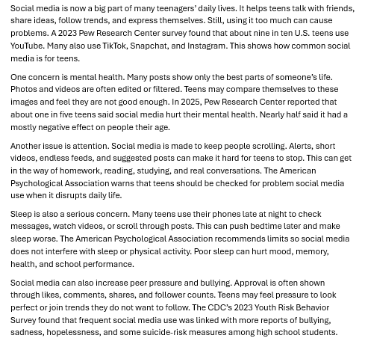
Teenagers and the Risks of Over-Reliance on Social Media

Slide 27
SPAM Analysis
Situation/Subject | Teens’ over-reliance on social media Heavy media use can impact mental health, attention, sleep and peer relationships
Purpose | Inform readers about possible risks of social media use. Has Pew Research, the American Psychological Assoc, and CDC gives credibility to info.
Audience | Students, parents, teachers who want to understand affects. Reading level is clear for middle/high school
Message | Social media is common/useful but can cause problems. Overuse may hurt mental health, reduce focus, affect sleep, increase bullying

Slide 28
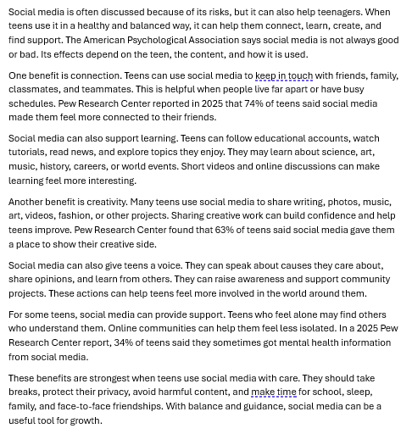
Teenagers and the Benefits of Social Media

Slide 29
SPAM Analysis
Situation/Subject
Purpose
Audience
Message

Slide 30
This CER Strategy for Reading
Claim, Evidence, Reasoning

Slide 31
The CER Strategy for Reading
Claim: What is the author’s primary arguable stance?
Evidence: What specific data, expert quotes or historical facts do they provide?
Reasoning: How does the author explicitly connect that evidence back to their claim?
Notes:
The Analytical Leap: If an author provides evidence but fails to explain how it connects to the claim, students learn to identify this as a structural weakness in the text.

Slide 32
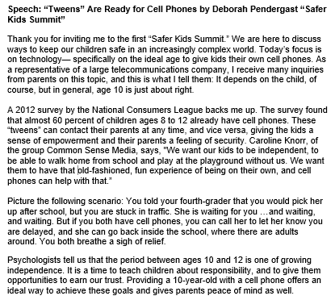

Slide 33
CER Summary
Claim | The speech claims that age 10 is generally an appropriate age for children to receive cell phones.
Evidence | The author supports the claim with a 2012 survey, a quote from Common Sense Media, and a rea-life example about using phones for safety during late pickup.
Reasoning | Reasoning is logical because the evidence connects cell phones to safety, communication, independence and parental peace of mind. Argument is limited because the survey is outdated, the speaker may be biased, and there are no counterarguments.
Notes:
Claim:
The speech claims that age 10 is generally an appropriate age for children to receive cell phones.
Evidence:
The author supports the claim with a 2012 survey showing many children ages 8–12 already have phones, a quote from Common Sense Media, and a real-life example about using a phone for safety during a delayed pickup.
Reasoning:
The reasoning is logical because the evidence connects cell phones to safety, communication, independence, and parental peace of mind. However, the argument is somewhat limited because the survey is outdated, the speaker may be biased as a telecommunications representative, and the speech does not address counterarguments like screen time, online safety, cost, or maturity.
Overall Evaluation:
The argument is somewhat convincing because it gives relevant reasons for why a 10-year-old might benefit from having a cell phone, but it would be stronger with more current evidence and discussion of possible risks.

Slide 34
Key Shifts for the Classroom
Build Knowledge
Text Complexity
Evidence
Notes:
The College and Career Readiness Standards for Adult Education identified three significant shifts that should be taken into account in working with reading in adult education.
Text Complexity
Students should have regular practice with complex text and its academic language. Complexity consists of three different features.
[Read following text with Animation 1.]
Quantitative measures like you would see in readability formulas
Qualitative measures such as text structure, language features, and knowledge demands
Task and purpose or what the teacher expects the reader to do with the text
[Read following text with Animation 2.]
The second shift focuses on the need for students to be able to use evidence from text (literary or nonfiction) whether they are reading, writing, and speaking. In other words, there is a shift away from writing an opinion about something the student has read to writing about the evidence the author provided.
[Read following text with Animation 3.]
Last, but certainly not least, is that in the adult education classroom students need to be reading content-rich nonfiction. Students should be able to learn something from the text they read; they should not just read to answer a couple of basic level questions. Rather, they need to leverage reading skills to gain knowledge in other areas. Students build knowledge through “close reading” of materials facilitated by text-dependent questions that require evidence drawn from what they have read.

Slide 35
It All Boils Down to . . .
Texts worth reading!
Questions worth answering!
Work worth doing!
35
Notes:
It All Boils Down to…
To keep things simple, think of it this way. The material that you have students read should be text worth reading – something from which they can learn. The questions that you ask should be worth answering – text-dependent questions. Questions that students have to answer using the information from the text. And, last but not least, students need to be doing work that has value. This is not about reading a short passage in a textbook and then answering

Slide 36

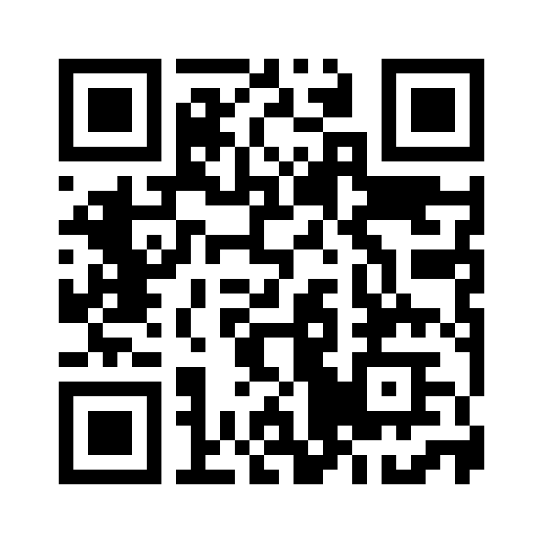
Session Survey
Your feedback is important. Please scan the QR code below to rate this session.

