Slide 1
Getting Back to Reading Fundamentals
Mellissa Hultstrand, State Relationship Manager

Slide 2
1
4
Review the Four Components of Reading
Strategies for the Classroom
Recognizing text structure
Questing the Author
Informational Text
Finding the Central Idea and Details
2
Focus on Vocabulary
3
Questions and Concerns
Focus on Comprehension
Notes:
This session highlights the importance of helping adult learners enhance their reading skills and the vital role reading plays beyond the GED RLA test including work, learning, and everyday life. Participants examine the challenges adult learners face while building on their strengths and experiences. The session introduces practical, effective reading strategies, including using relevant texts, teaching vocabulary, and reading texts not merely to acquire information but to interpret that information and to judge its message on multiple levels. Educators leave with actionable tools to boost engagement, confidence, and reading success in the classroom.
This workshop supports instructors working with adult learners by strengthening effective, research‑based reading instruction. Participants explore the four essential components of reading—alphabetics, fluency, vocabulary, and comprehension—and how these elements work together to support understanding and retention of text. Special attention is given to identifying common reading challenges and to using practical strategies that help students read more efficiently and with greater confidence.
The session includes concrete approaches for building academic vocabulary and that improve comprehension, such as activating prior knowledge, monitoring understanding during reading, and summarizing key ideas after reading.

Slide 3
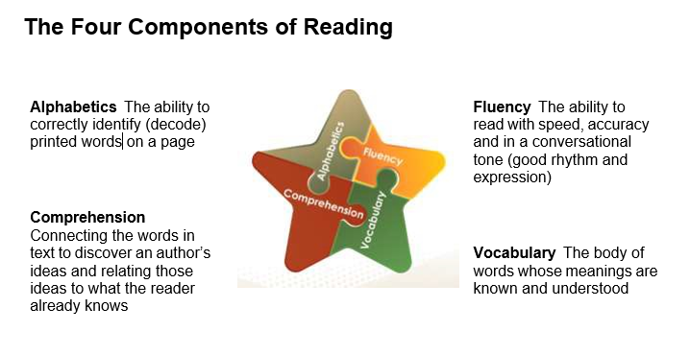

Notes:
There are four components of reading. Generally, in adult education, we focus on comprehension. However, there may be other issues that create the problems that a student may have with reading comprehension.
Let’s take a look at each of them.

Slide 4
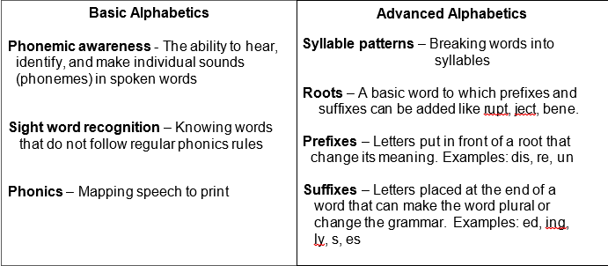
Alphabetics
Notes:
Review the information in the chart.
Keep in mind that without an understanding of alphabetics then the student is not going to gain reading fluency. Fluency impacts comprehension.
All of these parts work together.

Slide 5
You Can’t Have Fluency without Rate
Fluency: The ability to read with speed, accuracy and in a conversational tone (good rhythm and expression) Fluency is made up of:
Accuracy – Read words correctly in text
Rate – Read fast enough to understand text
Prosody – Read in meaningful phrases; pausing to support meaning
Reading rate – how quickly you read silently with understanding
Notes:
Review the information on the slide.
Students in our programs should be reading at 150-200 words per minute. That allows them to chunk words together – essential for comprehension. Without an appropriate reading rate, students will struggle with fluency and comprehension.
Focus in on the last bullet. Prosody – that is the ability to read in meaningful phrases, pausing to support meaning. Think about how you would say the Pledge of Allegiance
I pledge allegiance (pause) to the
"I pledge allegiance (pause) to the Flag (pause) of the United States of America, (pause) and to the Republic (pause)
for which it stands, (pause) one Nation under God, (pause) indivisible, (pause) with Liberty and Justice for all."

Slide 6
Reading Rate
Accurate word pronunciation but slow reading
results in:
Reading less text than peers and having less time to remember, review, or comprehend the text
Expending more cognitive energy trying to identify individual words
Increasing inability to retain text in memory
Failing to integrate various parts of the text
Notes:
Key Points
Sometimes we have students who can accurately pronounce words – but they are laboriously slow readers. In addition to reading less text – which can pose a major problem on something like the GED Tests where timing matters – they also expend so much energy trying to identify individual words that they lose the flow of the text.
They also have problems remembering what they read and they cannot pull various pieces of the text together to make sense of a passage.

Slide 7
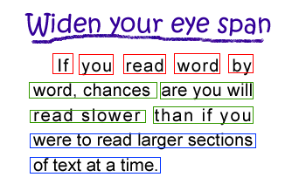
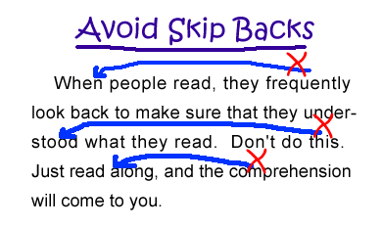
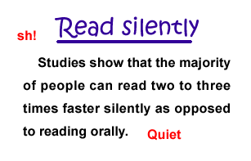
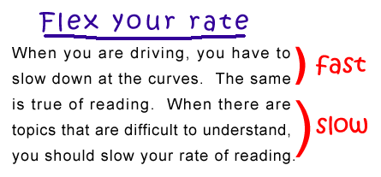
Building Reading Rate
Notes:
Key Points
Review the information from the text boxes. A more detailed explanation is provided below.
Carver (1990) used the analogy of adjusting reading speed to the shifting of gears in a car. First and second gears are the slowest, most powerful gears. First gear is used to memorize materials. Second gear is used to learn material. Third gear is the typical reading rate. The fourth gear, skimming, and the fifth gear, scanning, are the fastest but least powerful gears. These gears are useful when you are trying to locate a specific piece of information or trying to get the general sense of a passage without reading every word.
As an adult reader, consider the ways that you monitor your reading pace and shift gears depending on your goals. If you are trying to memorize material for a test, your pace is slow and reflective, characterized by stopping and reviewing as you progress. If you are reading a novel for pleasure, your pace is steady and fluent. If you are searching for information in a catalog, your pace is rapid. As a skilled reader, you know how to adjust the gears of your reading based on your purpose.

Slide 8
The Importance of Building Vocabulary
Notes:
As one of several components of reading vocabulary instruction may be best viewed as necessary, but not sufficient. Teaching the meanings of individual words will not ensure that learners can decode fluently or read passages of text with understanding. Teaching the meanings of individual words will not ensure that learners can decode fluently or read passages of text with understanding. Vocabulary knowledge and skills are crucial for getting meaning from text. Without knowledge of the meanings of the key concepts in a text, a reader will struggle to understand the writer’s intended message.

Slide 9
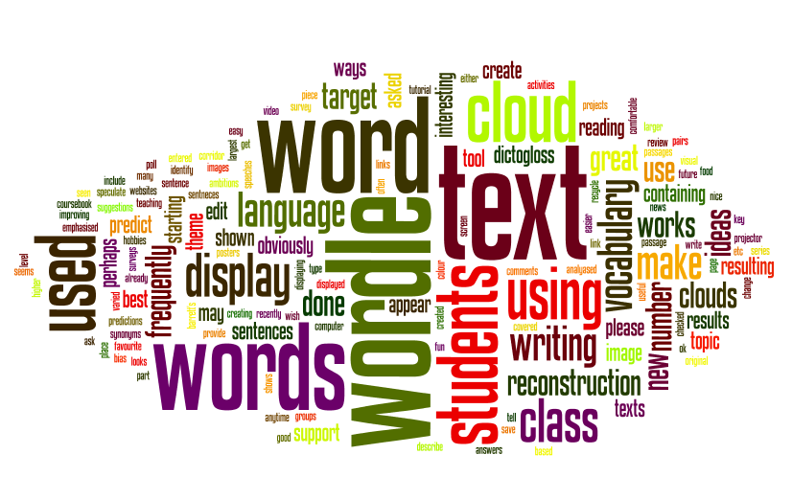
Four Categories of Vocabulary
Listening: the words we understand when we hear them.
Speaking: the words we use when talking.
Reading: the words we understand when we read
Writing: the words we use when writing
Notes:
Key Points
Edgar Dale identified four stages of knowledge of a word’s meaning listed on the slide.
Review the information on the slide. Have participants think about the disparity that they see between words students know because they have heard them and the words they recognize when they read.

Slide 10
Did you know…
If students have difficulty with 5-10% of the words in a text, the text is considered “challenging.”
If students have difficulty with more than 10% of the words in a text, the text is considered “frustrating.”
Notes:
Review the information on the slide.

Slide 11
Tiered Vocabulary
Tier 3
Domain-specific academic vocabulary
Tier 2
High-utility academic vocabulary found in many content texts, cross-curricular terms
Tier 1
Everyday words, familiar to most students primarily learned through conversation
catalyst, hypothesis,
inertia, variable
authority, diminish,
explicit, interpret
yesterday, together,
Important, thought
Notes:
When looking at vocabulary, there are three tiers of words that students need as they grow as learners.
Tier 1 – Everyday words, familiar to most students primarily learned through conversation. These are the words that students learned early in their homes and in school. You may be familiar with words from the Fry or Dolch list.
Tier 2 – High-utility academic vocabulary found in many content texts, cross-curricular terms. If you are interested in identifying even more of these words, you may want to download the Academic Word List handout included in the resources for this course. The Academic Word List was developed at the University of New Zealand and represents 500 words that are most commonly found in postsecondary text.
Tier 3 – Domain-specific academic vocabulary. Now, look at this list of words – notice how they are domain-specific, i.e., tied directly to mathematics. Would your students recognize and understand these words? Most adult learners need significant work in building their mathematical vocabulary.

Slide 12
Planning Vocabulary Lessons
Keep the following in mind…
Do students have multiple opportunities to practice and apply new words?
Have I planned the target words I’ll emphasize today or this week?
Do I challenge students to actively use new vocabulary in authentic ways, everyday conversation, journals, or group work?
Do I check for understanding to ensure students aren’t just memorizing, but applying word knowledge?
Notes:
Do students have multiple opportunities to practice and apply new words in reading, writing, and discussion?
Am I modeling rich vocabulary in my own speech, intentionally choosing precise or advanced words when addressing students?
Have I planned which target words I’ll emphasize this week, and am I using them often enough for students to notice and adopt them?
Am I challenging students to actively use new vocabulary in authentic ways (conversations, journals, group work)?
Do I incorporate fun, interactive word-learning activities (such as word games, semantic maps, or gradation tasks) that make vocabulary engaging?
Am I creating enough opportunities for all students—including multilingual learners and readers requiring more support—to meaningfully access and practice new vocabulary?
Do I check for understanding frequently to ensure students aren’t just memorizing, but actually applying word knowledge?

Slide 13
Targeted Vocabulary
A hurricane is a large storm with heavy winds and rain that begins in the ocean and builds up strength as it moves across the water. While some of the damage caused by hurricanes is from high winds, most of it is usually from tidal surge, flooding entire cities, and killing large numbers of people. A tornado is a storm that develops on land, with no warning, and moves in a circular motion with heavy winds with a funnel shape, picking up and carrying dirt, dust, and even objects. The damage caused by tornadoes is from the high velocity winds, which are extremely destructive and deadly. They can demolish entire neighborhoods in a matter of a few seconds to a few minutes. Tornadoes can form when hurricanes make landfall, as their winds at ground level slow down, while the winds near the top keep their momentum, but a hurricane cannot be created by a tornado.
Notes:
Identify target vocabulary for the lesson.
Hurricane - Tidal surge – Tornado – Funnel – Velocity – Demolish – Momentum
When working with students you need to list the words on the White Board. Then, ask students what they know about each word. See if they can provide a definition or explain in any way what the word represents.
Note that this is a lower-level text. The level of complexity of the vocabulary will increase as you increase the level of the text. However, the process is the same. Keep in mind that students may know some vocabulary when they hear it but not recognize it when encountering it in passages.
Have students (in this case participants) determine which words are defined for them. On the GED test, words that students may not be familiar with are defined for them. This is especially true with science text. Remember, that students often just stop reading when they reach a word that they do not know. They need to keep reading because the actual definition of the word may be in the next few lines. Look at the text on the slide, notice how many of the target words (in blue) have the definition or other context clues included.
As students read more, their vocabulary will grow.

Slide 14
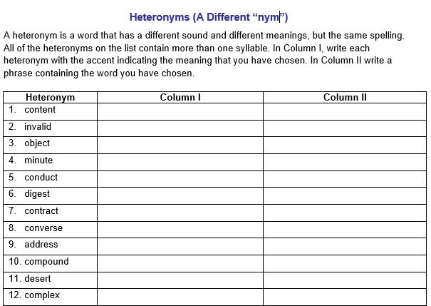
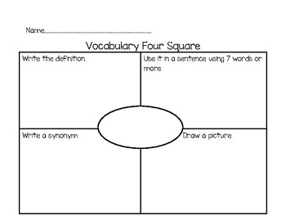
Activities to Improve Vocabulary
Notes:
Key Points
There are many different types of activities that can be used to build vocabulary. One activity included above focuses on heteronyms. Heteronyms are words that have different pronunciations and meanings, even though they are spelled the same. For example: content (as in the things of a box) and content (feeling satisfied).
Vocabulary Four Square works well for students who need a little more to connect with a word. Students include their own definition, a sentence, a synonym, and a picture that represents the word.

Slide 15
Helping Students Build Comprehension Skills

Slide 16
Reading comprehension is a process and product.
As a process, reading comprehension is made up of the background knowledge and strategies a reader uses in attempting to understand a text's meaning. These strategies include reader's knowing how a writer’s ideas fit with what they already know (prior knowledge) and recognizing when they no longer understand what they read (metacognition).
As a product, reading comprehension is strongly influenced by a reader’s ability to identify the words on a page (alphabetics), read with speed, accuracy, and in a conversational tone (fluency), and to recognize word meanings (vocabulary).
Notes:
Review the information on the slide.

Slide 17
Increasing Comprehension
Before Reading
Activate prior knowledge
Preview headings
During Reading
Visual imagery
Comprehension monitoring
After Reading
Summarize in own words
Ask clarifying questions
Notes:
Review the information.

Slide 18
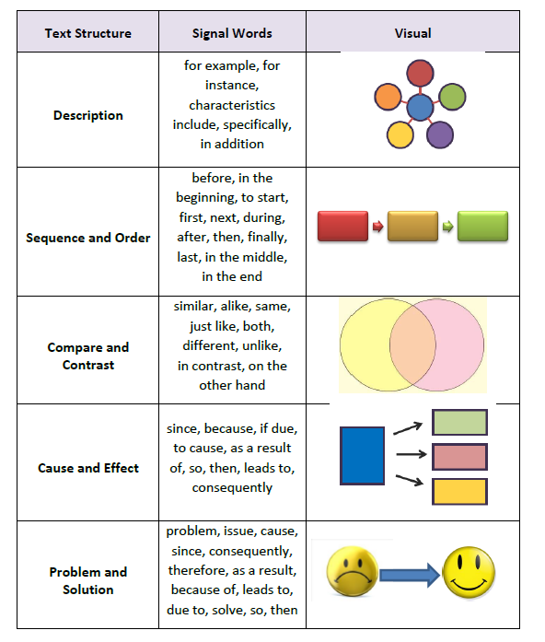
Recognize Text Structure
Teach the Process

Slide 19
What’s My Structure?
Screen Protector
Before applying the screen protector, clean the surface of your phone’s screen with a soft cloth. Once the surface of your screen is clean, remove the paper backing on the screen protector. Evenly apply the sticky side of the screen protector to your phone’s screen. Smooth out any air bubble trapped on surface of the screen protector.
The surface of the Earth is divided into pieces called "tectonic plates." These plates move or shift. When the plates rub against each other, they do not move smoothly. When the plates do not move smoothly, earthquakes result. Some parts of the world get more earthquakes than other parts. The parts of the earth that get most earthquakes are near the edges of these plates.
Notes:
Slide includes animations.
Have participants review the first text and decide the type of text structure.
Have participants review the second text and make the same type of decisions.

Slide 20
What’s My Structure?
Have you ever wondered what the inside of a volcano looks like? Deep underground is a magma chamber. The magma chamber is under the bedrock of the earth's crust. The conduit or pipe runs from the magma chamber to the top of the volcano. The conduit connects the magma chamber to the surface. Most volcanoes also have a crater at the top. Volcanoes are quite a sight, and you can enjoy this site all over the universe. Volcanoes are found on planets other than Earth, like the Olympus Mons on Mars.
Cooking the perfect pizza at home can be quite a challenge. You may find that it's difficult to get your oven to the right temperature. If the oven is too hot the crust will burn, become hard, and taste bad. If your oven isn't hot enough, the crust may get soggy. Even at the perfect temperature, extra moisture from your ingredients may prevent the bottom of the crust from fully cooking, but don't let oven temperature stop you from building the pizza of your dreams. Get yourself a pizza stone. A pizza stone will get very hot when preheated and will allow your crust to fully cook without burning it. Then you can pile the ingredients on your pizza and have a crispy crust that isn't burned. That's the way to go.
Notes:
Slide includes animations.
Have participants review the first text and decide the type of text structure.
Have participants review the second text and make the same type of decisions.

Slide 21
Questioning the Author
Identify the author’s purpose
Recognize what the author expects the reader to know (background knowledge)
Understand what the author is trying to say to the reader
What is the author trying to tell you?
Why is the author telling you that?
Does the author say it clearly?
How could the author have said things more clearly?
Notes:
Questioning the Author (QtA) is a series of questions that students make about the text they are reading. The strategy of Questioning the Author focuses on the importance of students’ active efforts to build meaning from what they read, and the need for students to grapple with ideas in a text.
QtA helps students understand the big and important ideas in nonfiction texts by inviting them to pause after a tough sentence or passage, or at the end of a section or chapter, and use queries (questions) to think through the information.
Initiating Questions/Queries (to get the discussion started)
What is the author trying to say?
Does this make sense to you?
What do you think the author wants us to know? What is the author talking about?
What is the important message in this section?
Follow-Up Questions/Queries
So, what did the author mean right here?
That’s what the author said, but what did the author mean?
Why do you think the author chose to use this phrase or wording in this specific spot?
Did the author explain this clearly?
Did the author tell us why?
What does the author want me to understand from these details? This information?
Why do you think the author tells us this now?

Slide 22
Question the Author
Each employee of the Sanders Department Store must perform his/her duties in a professional manner. All employees must treat customers in a professional and courteous manner. All employees must always speak respectfully and professionally. Employees must never argue with a customer. While it is important that employees be friendly, employees must not cross the line by flirting or making inappropriate advances to a customer. Employees who fail to follow store policy will face possible consequences including termination of employment.
What is the author trying to tell you?
Why is he telling you that?
Is it clear?
Who was the author of this text?
Notes:
Use the passage to practice the strategy.

Slide 23
Informational Text
Safety Alert
In recent months, more customers are exhibiting extreme behavior toward ticket agents. The airport authority has taken steps to ensure the safety of ticket agents confronted by angry customers, including posting additional security officers. Please cooperate with our efforts by following these instructions:
Don’t panic when confronted by an angry customer. Maintain a calm voice and non-threatening body language.
If the agitated customer persists, tell him/her: “Let me contact my supervisor to help you.” Be sure to use a sincere and kind tone. Do not talk down to the customer because the customer is likely to become more agitated.
If working at an isolated gate, always keep another employee with you. If no one from your airline is available, contact security for back-up coverage.
If a flyer’s angry behavior continues to escalate, push the silent alarm. If you suspect a weapon, push the alarm immediately.

Slide 24
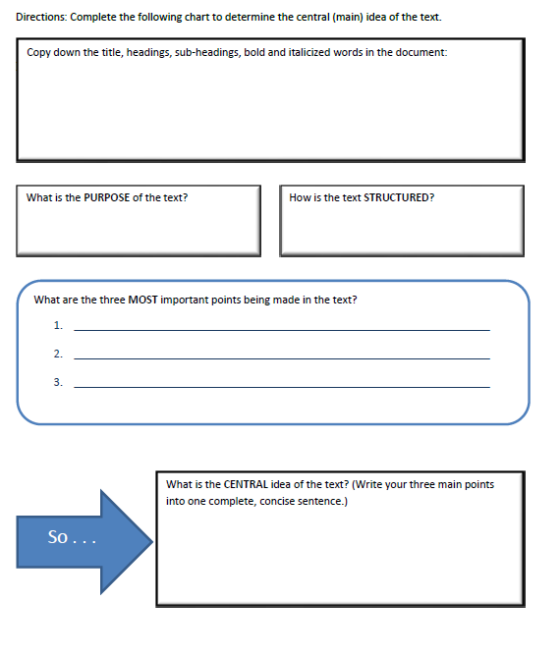
Helping Students Find Central Ideas
Teach the Process
Notes:
When students are asked to find the central or main idea of a text, they often recite the first or last sentence of a paragraph. The purpose of this activity is to provide students with a structure that they can use to identify the key details of a reading passage and how to determine the central idea.
The goal here is to give students a process that they can use when approaching virtually any text. Let’s look at the process and see what is involved.
First, we start with what students can see as they scan the text. What many students fail to do is look at all the clues the text gives them – the title, heading, sub-heading and any word that might be bold or italicized. This forces the student to begin noticing details of the text. Next move to the purpose of the text. We learned how to do this when we went through the Questioning the Author activity. Next, include the text structure. Is it cause-effect, sequence, problem-solution, etc.
Now, the students identifies three most important points the author made. From these three points, the student can pull together the central idea. On the next slide, we’ll look at a science-based text and put the process to work.

Slide 25
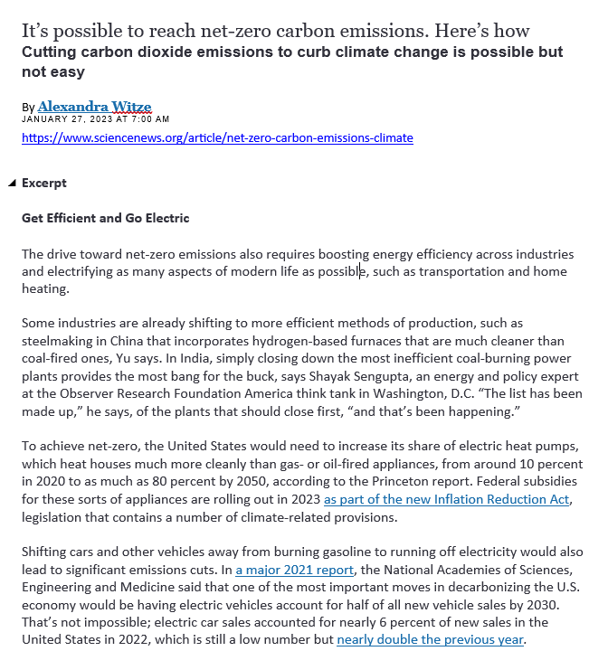
Notes:
Model the process for starting with a text.
Ask the following questions. Have the participants answer. Explain that this is what they need to do with their students. It is all about learning a process and making that process a habit.
What is the lead-in to the text?
What do you know about this topic?
When was the article written?
What is the heading for this excerpt?
What do you expect to learn in this excerpt?

Slide 26
Notes:
This slide includes animations.
At this point, students would need to identify three important points in the text.
Click forward and a circle will form. Read the sentence that is in the circle. Do the same with the next two circles.
Note that the sentences would be included on the form. Together these three sentences could be pulled together and create the central idea.

Slide 27
Recognizing Question and Answer Relationship
3H is a mnemonic learning strategy that students can use to remember how to answer different types of comprehension questions. It focuses on three types of question-answer relationships:
Here
Hidden
In my Head
This strategy helps students who have difficulty answering comprehension questions due to insufficient knowledge about question-answer relationships.
Notes:
3H is a learning strategy. After students have been taught how to use them, learning strategies are to be used by students independently.
Teachers should use explicit instruction (explanation, modeling, guided practice, independent practice) to teach this strategy.

Slide 28
3 Hs Reading Comprehension Strategy
https://nysrti.org/intervention-tools/reading-tools/tool:3h/
Here
Hidden
In my Head
Answers found in the text “directly.”
Answers are typically found in one place.
Answers are found “between the lines.”
Answers are found by joining together information found in different places in text.
Answers are found “beyond the lines.”
Answers come from
  background knowledge
  May involve opinions
  What a reader thinks.
Notes:
Guided practice: Guide students in performing the strategy in small groups or in pairs. If students need additional support, they can orally recite the description of the three H’s or use notecards with a description written on them. Monitor student progress. During this time, scaffold the learning and support students who need assistance in using the strategy. They can also model the think aloud strategy (when in pairs) to strengthen comprehension and learning of the steps involved.
Independent practice: After guided practice, students should only use the strategy independently, once they have shown they have mastered the strategy. Students can also be given the opportunity to reflect on the strategy.
Adapted from: Brown-Chidsey, R., Bronaugh, L., & McGraw, K. (2009). RTI in the classroom: Guidelines and recipes for success. New York: Guilford Press

Slide 29
Sample Text
Our School Rules
To maintain a safe, respectful, and welcoming school community, all students are expected to follow several important guidelines. Students should make a sincere effort to greet others courteously, as a simple smile can contribute to a positive school environment. When a classmate requires assistance, students are encouraged to offer help in a considerate and appropriate manner. This may include picking up dropped books, holding the door, or explaining part of a lesson that may be difficult to understand. Students should also use polite language, including “please” and “thank you,” to demonstrate respect for others. Finally, all shared spaces must be used responsibly and fairly. Hallways, water fountains, and lines are for everyone, so students should avoid pushing or attempting to be first at all times. Instead, they should show patience and consideration by allowing others to go first when appropriate.
Notes:
This text is at an 8th grade level.
Have participants read the text. Have them think about 3 H questions as they read.
Hidden
In my Head
Here

Slide 30
Sample Text
Three Questions = 3Hs
What is the main lesson you learn from this set of school rules?
What are three things you should share at school?
Why shouldn’t you push to be first in line?
Our School Rules
To maintain a safe, respectful, and welcoming school community, all students are expected to follow several important guidelines. Students should make a sincere effort to greet others courteously, as a simple smile can contribute to a positive school environment. When a classmate requires assistance, students are encouraged to offer help in a considerate and appropriate manner. This may include picking up dropped books, holding the door, or explaining part of a lesson that may be difficult to understand. Students should also use polite language, including “please” and “thank you,” to demonstrate respect for others. Finally, all shared spaces must be used responsibly and fairly. Hallways, water fountains, and lines are for everyone, so students should avoid pushing or attempting to be first at all times. Instead, they should show patience and consideration by allowing others to go first when appropriate.
Notes:
Have participants read and determine which “H” is represented by each question.
Hidden
Here
In my Head

Slide 31
Recommendations
To build better readers…
Model strategies
Make your thinking process visible
Use visuals
Start with single paragraphs
Move to multi-paragraph texts
Find materials that entice students to read
Incorporate reading into every class
Set aside some silent reading time (5-10 minutes)
Remember – The more they read; the better readers they become
Notes:
Review the recommendations

Slide 32
Reading Resources
Notes:
The following are some excellent online resources.

Slide 33
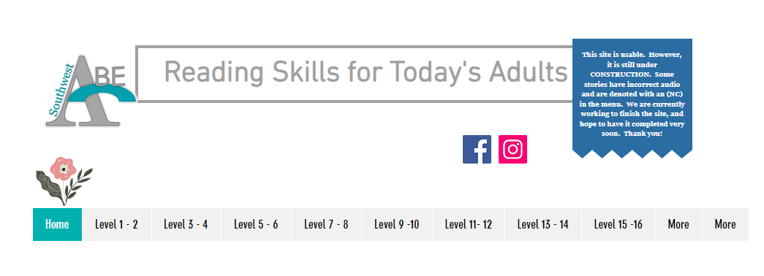
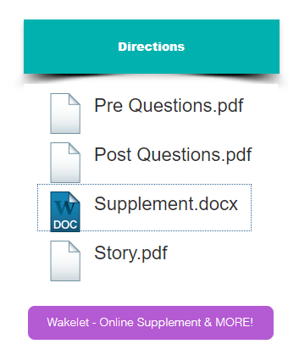
Reading Resource
https://www.readingskills4today.com/

Slide 34
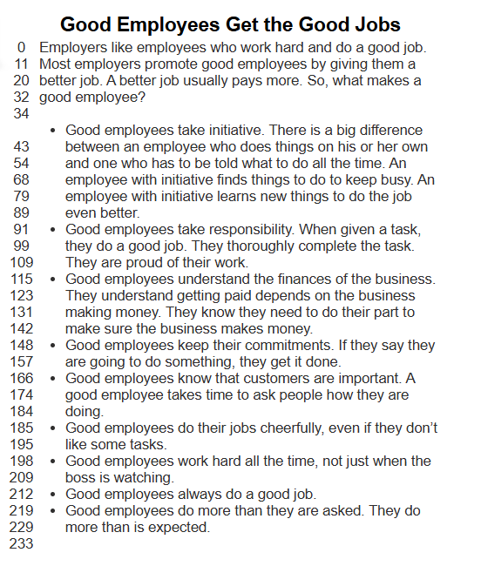
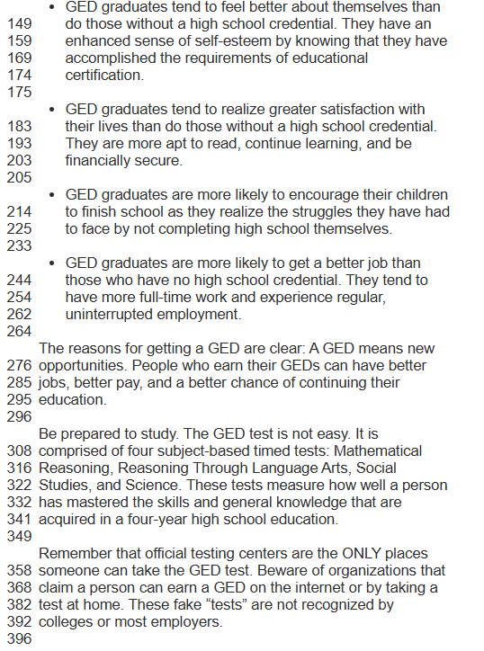
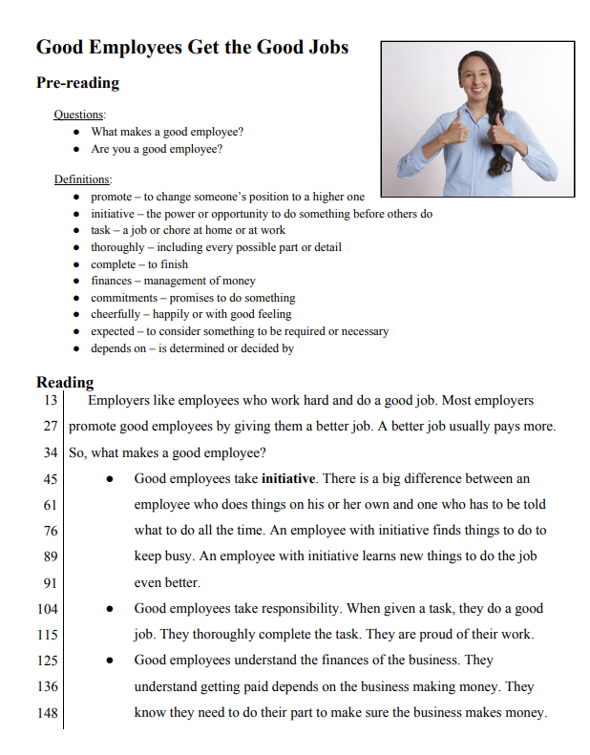
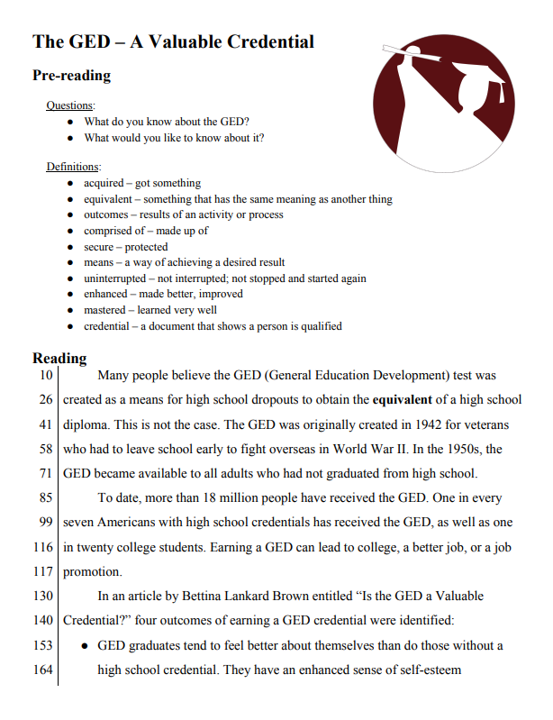
Samples
Notes:
Good Employee – mid-4th
The GED – A Valuable Credential – 8th grade
Lower-level and mid-level reading samples from Reading Skills for Today’s Adults.
Review the different types of material included on this website.

Slide 35
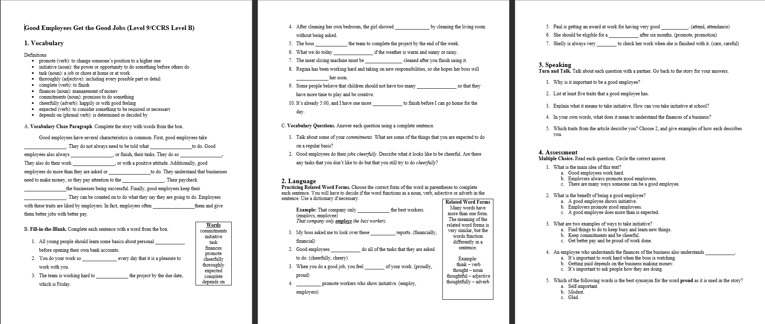
Reading Skills for Today’s Adults

Slide 36
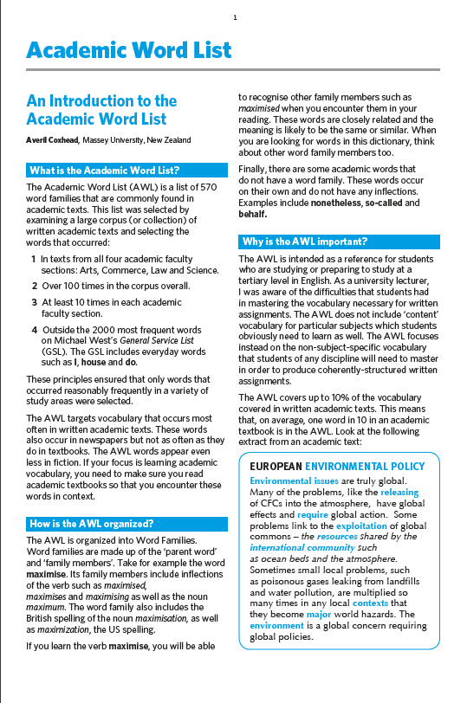
High Utility Academic Words
Sample Word Family - interpret
interpretation
interpretations
interpretative
interpreted
interpreting
interpretive
interprets
misinterpret
misinterpretation
misinterpretations
misinterpreted
misinterpreting
misinterprets
reinterpret
reinterpreted
reinterprets
reinterpreting
reinterpretation
reinterpretations
https://www.academia.edu/6556194/An_Introduction_to_the_Academic_Word_List_What_is_the_Academic_Word_List?auto=download

Slide 37
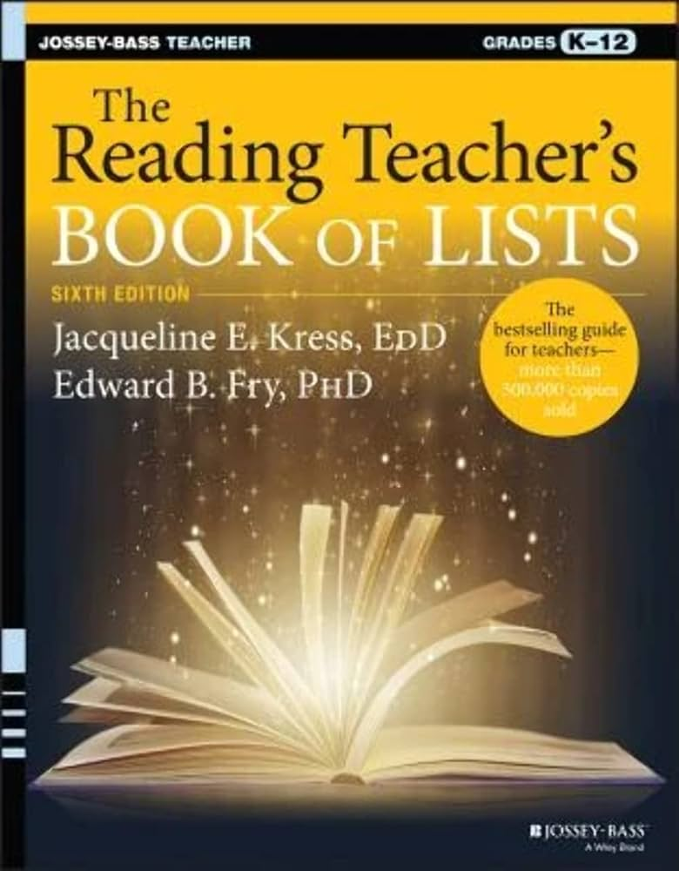
Teacher Favorite

Slide 38
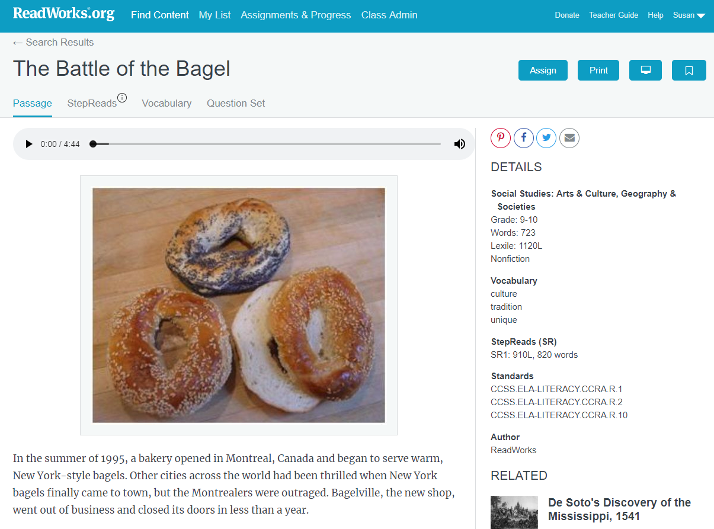
ReadWorks.org

Slide 39

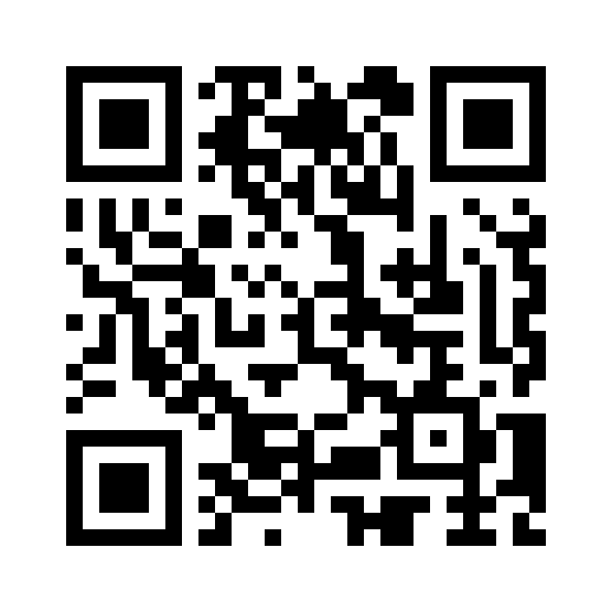
Session Survey
Your feedback is important. Please scan the QR code below to rate this session.

