Slide 1
Power Up the Talent Pipeline with GEDWorks™
Rachel Ludwig, Vice President, Global Operations & Strategic Partnerships, GED® Testing Service

Slide 2
1
4
The Workforce Case for Adult Learners
GEDWorks™: Capacity Builder & Workforce Accelerator
2
5
Zooming in on GED® Learner Trends & Persistence
GEDWorks™ Partner Examples Across States
3
6
Move Further Faster with GED® Tools & Resources
Q&A

Slide 3


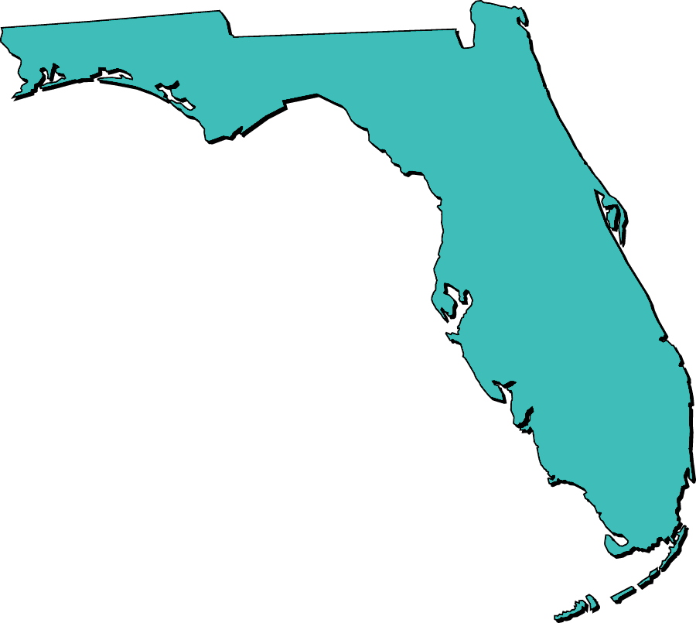








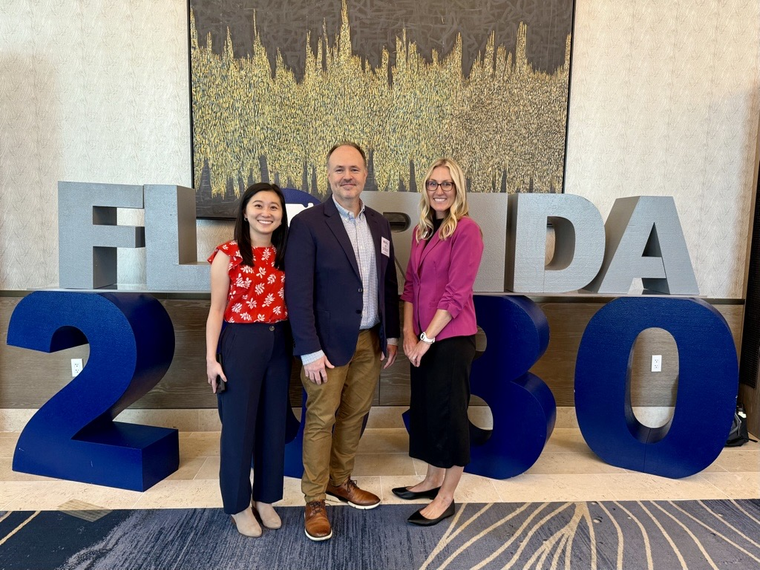
Discuss: How Did You Find Your Way to Adult Education? What’s Your Personal Mission in this Work?
Notes:
Let’s find out who is in the room. How many people have been in Adult Education for:
-1 year or less
-1 to 5 years
-6 to 10 years
-10+ years

Slide 4
Considerations for Workforce, Talent & Economic Development Leaders
Skills Expectations
Aging Workforce
Shrinking Workforce
By 2031, 72%
of jobs will require some postsecondary education or training
24%
of the US workforce is age 55+
(experience exiting)
1.6 vs 2.1
Birth rates fall below replacement
(long-term challenge)
Cost per quit ~33.3%
of base salary
Why Wait Years for Talent?
Turnover is Expensive
Untapped Talent
Invest in Adult Learners
~27.5M
Adults without a HS Diploma in the US

Slide 5
“When We Invest in Adult Learner Upskilling to Improve Economic & Career Mobility, Everybody Wins”

Slide 6
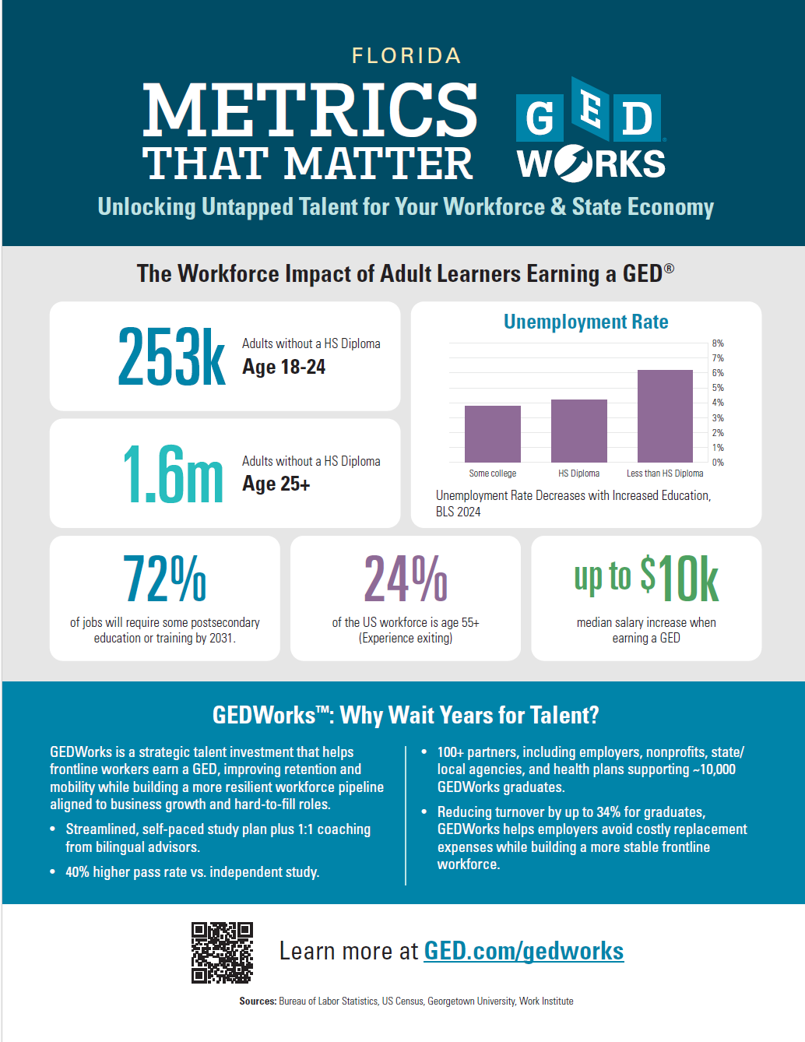
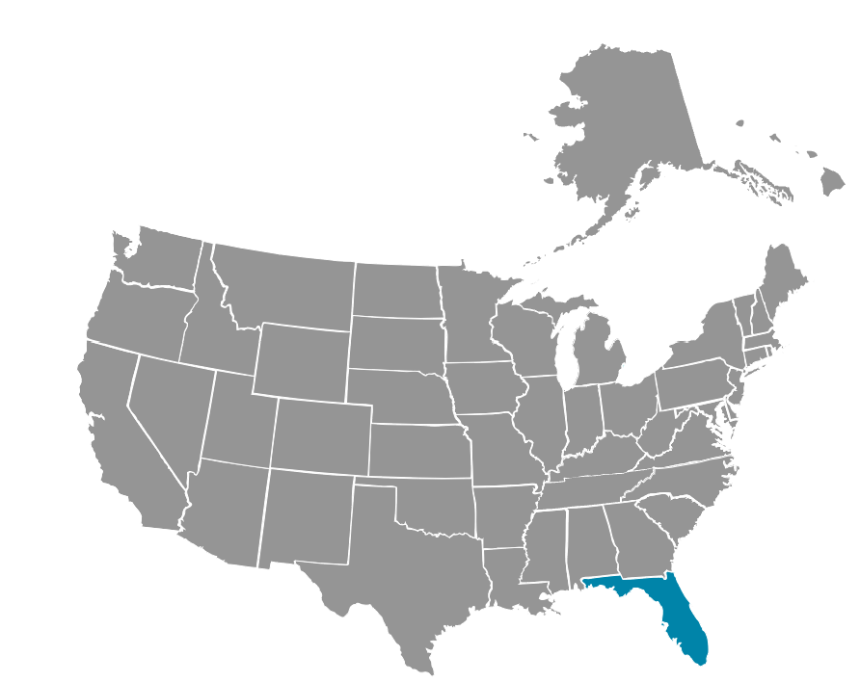
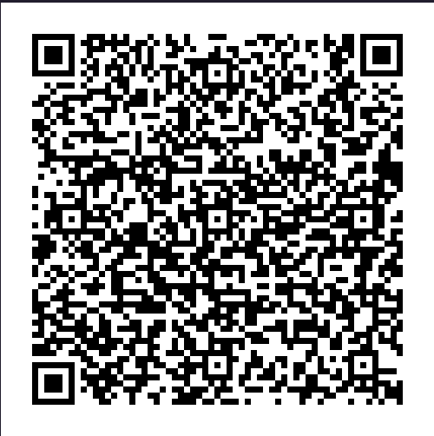
The Workforce Case for Adult Ed:
Equipping Adult Educators Across the US
Interested in diving into data for your state?
Check out our Workforce One-Pagers!

Slide 7
Level Set: GED® Learner Trends & Persistence

Slide 8
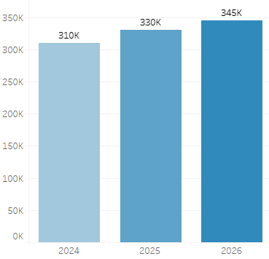
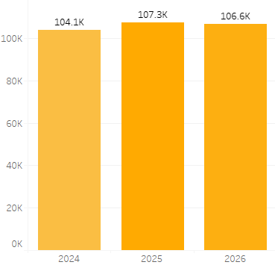
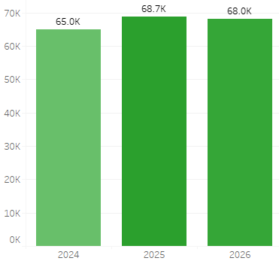
YTD Comparison on New Accounts, First Time Test Takers & Learners to Credential
New Accounts Created
First Time Test Takers
Learners to Credential
Notes:
-Tracking GED.com accounts, First Time Test Takers & Learners to Credential
-Only 35% of learners who create an account take any further action in the same year
-How can we work together to help learners persist?

Slide 9
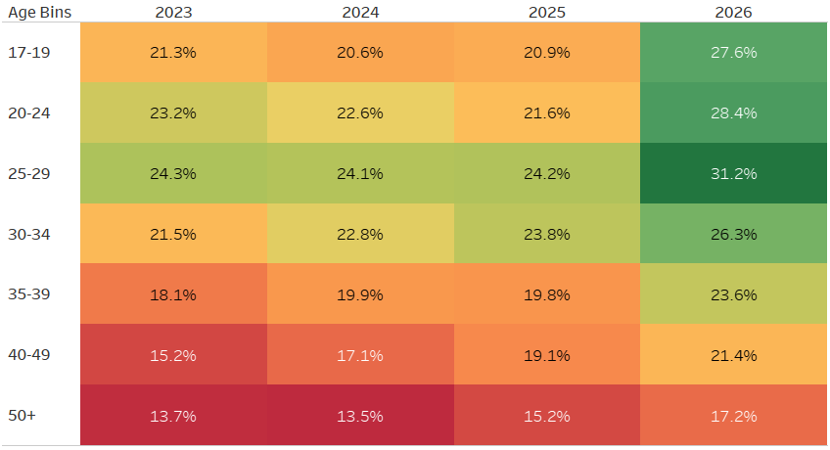
Increased Persistence from All Age Cohorts
Credential Rates of Test Takers (within 3 months of account creation)
*Percentages represent 3-month credential rate of that testing cohort

Slide 10
Taking a Ready has the most influence on taking 1st Test
Has taken a Ready?
no
yes
13% likelihood to take 1st GED Test
60% likelihood to take 1st GED Test
Questions:
What features drive learners to take a GED Ready®?
Why are some Ready takers not taking a GED® Test?
Notes:
Share story about Bilingual GED cohort – Using GED Ready as the baseline for assessing skills

Slide 11
Discuss:
How were your Adult Basic Education & Adult Secondary/GED® program enrollment numbers this year compared to years past?
What are some challenges you face with increasing GED® learner persistence through completion?
What are some challenges you face with offering more GED® prep classes?
  Shortage of students?
  Difficult to find teachers?
  Scheduling/Location?
  Something else?

Slide 12
How Can You Help Learners Move Further Faster With GED® Tools & Resources?

Slide 13
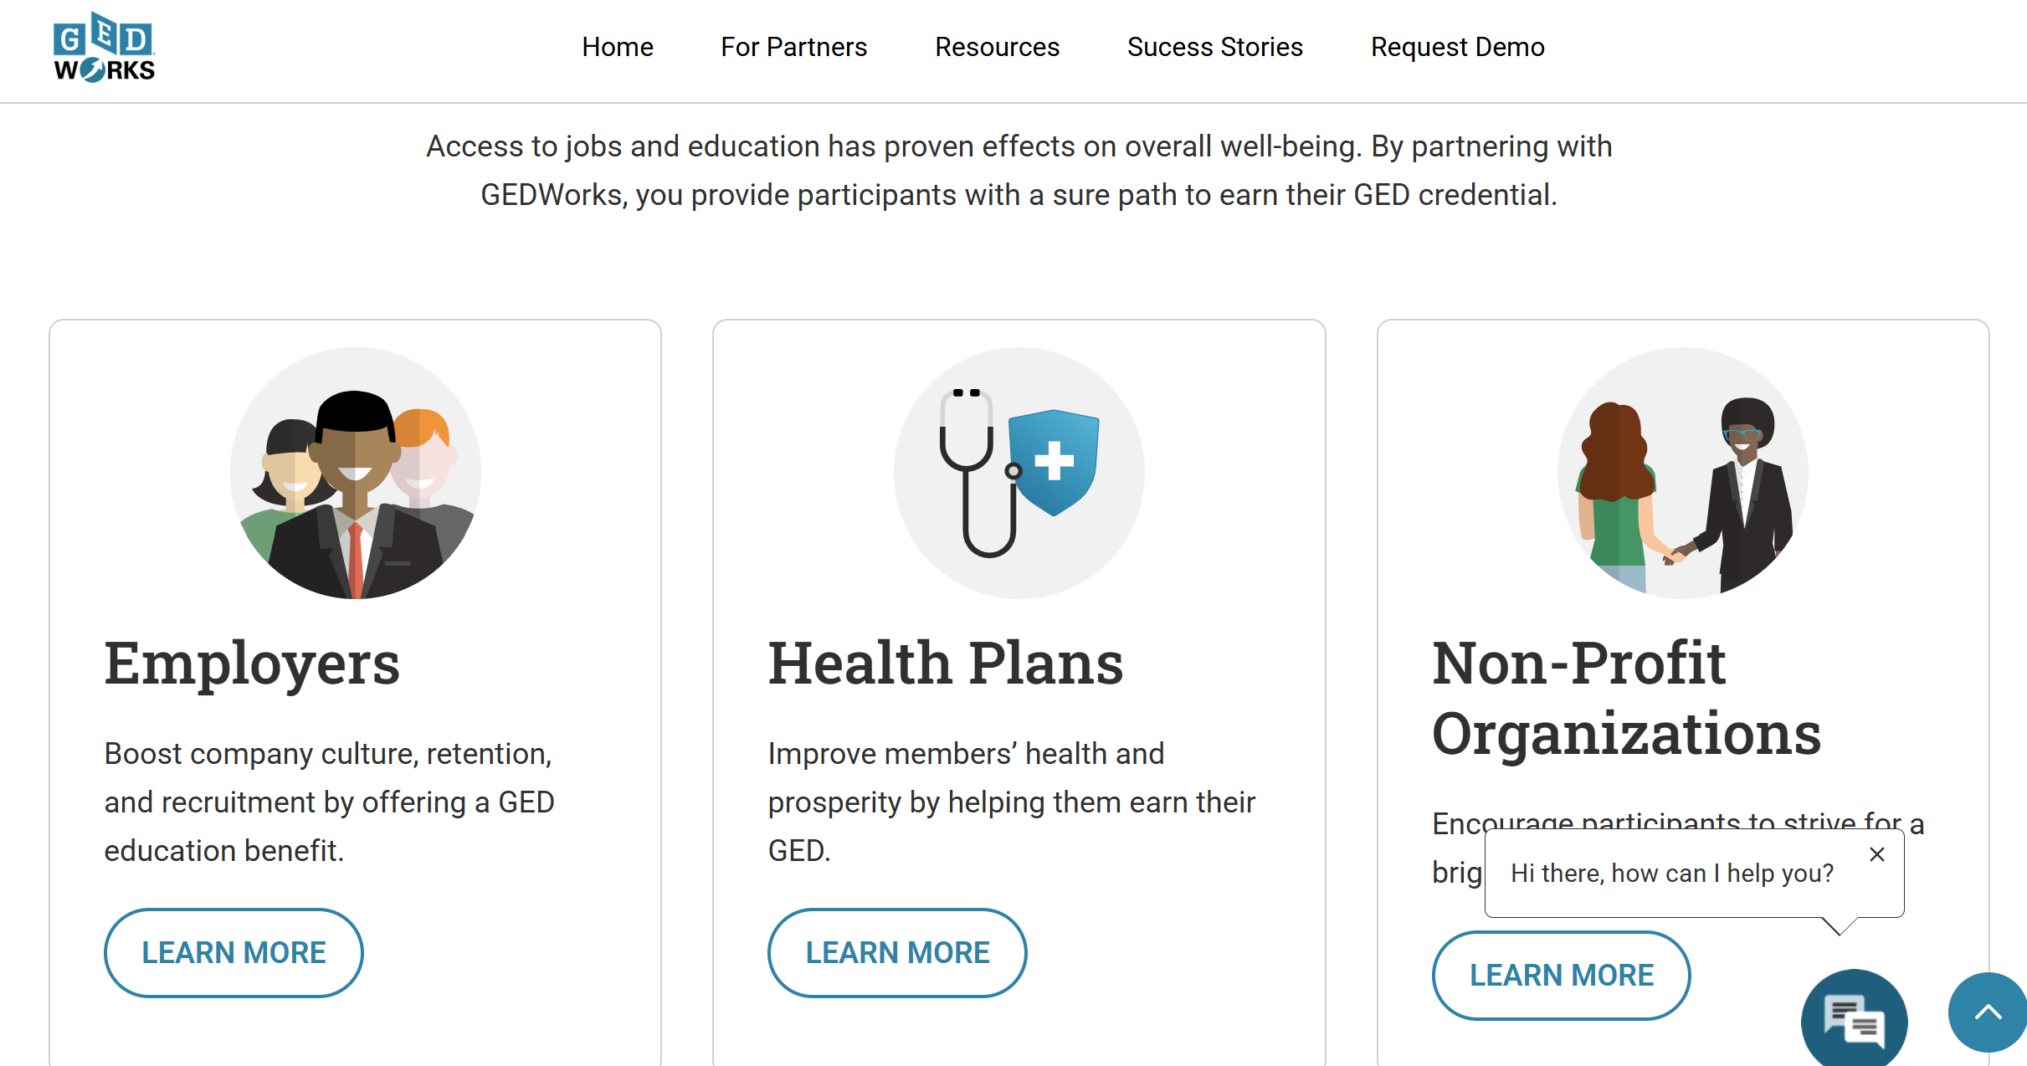





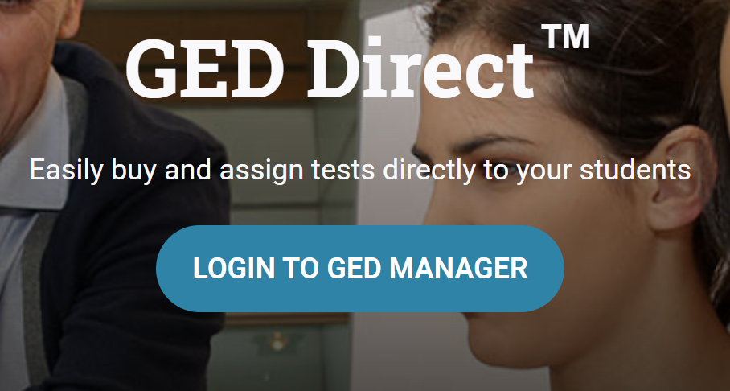
GED® Test Prep Products, Programs & Resources

Slide 14

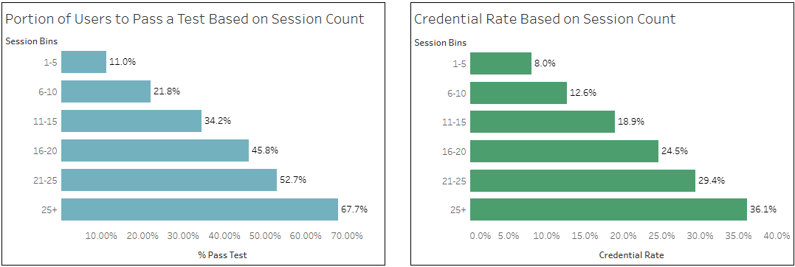
GED & MeTM Mobile App

Slide 15
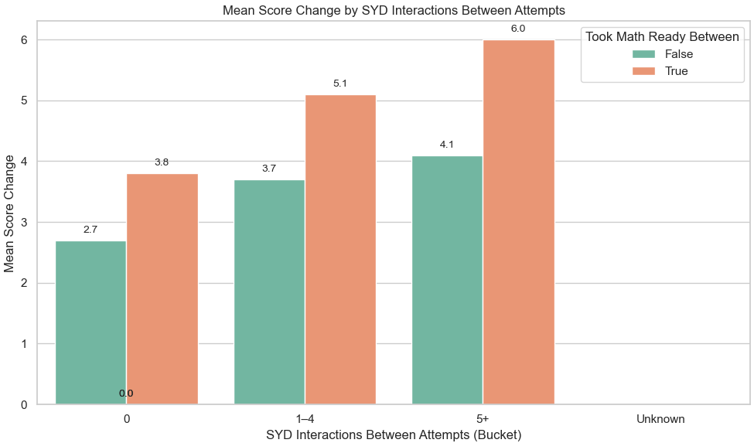
Math Magic: Higher Scores When Learners Engage with Syd AI Tutor

Slide 16
How Can We Work Collectively to Support the 27.5 Million Adults without a GED® Credential?

Slide 17


































GEDWorksTM: Capacity Builder & Workforce Accelerator
Thank You to our 115+ GEDWorks Partners!
Notes:
-60 Employers -11 Health Plans -44 Health Plans & Other

Slide 18



What’s Included for the Student?
Fees supported by GEDWorksTM partner
One-on-one guidance from a bilingual advisor
Top rated study materials
Unlimited GED Ready® practice tests and the GED® tests
Expert tutors
Private online community support group
Ability to earn college ready credits

Slide 19




How It Works
Enrollment through branded portal
GED® Advisor support
Schedule tests
Earn the GED® credential, which can lead to career/economic mobility, postsecondary access, improved health & increased retention

Slide 20
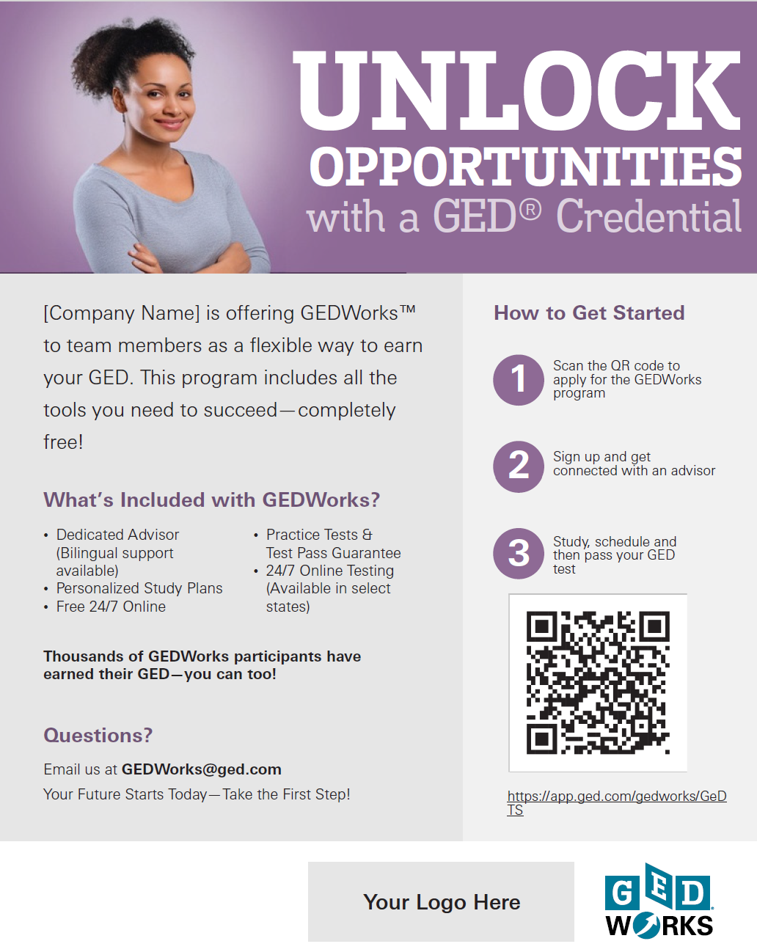
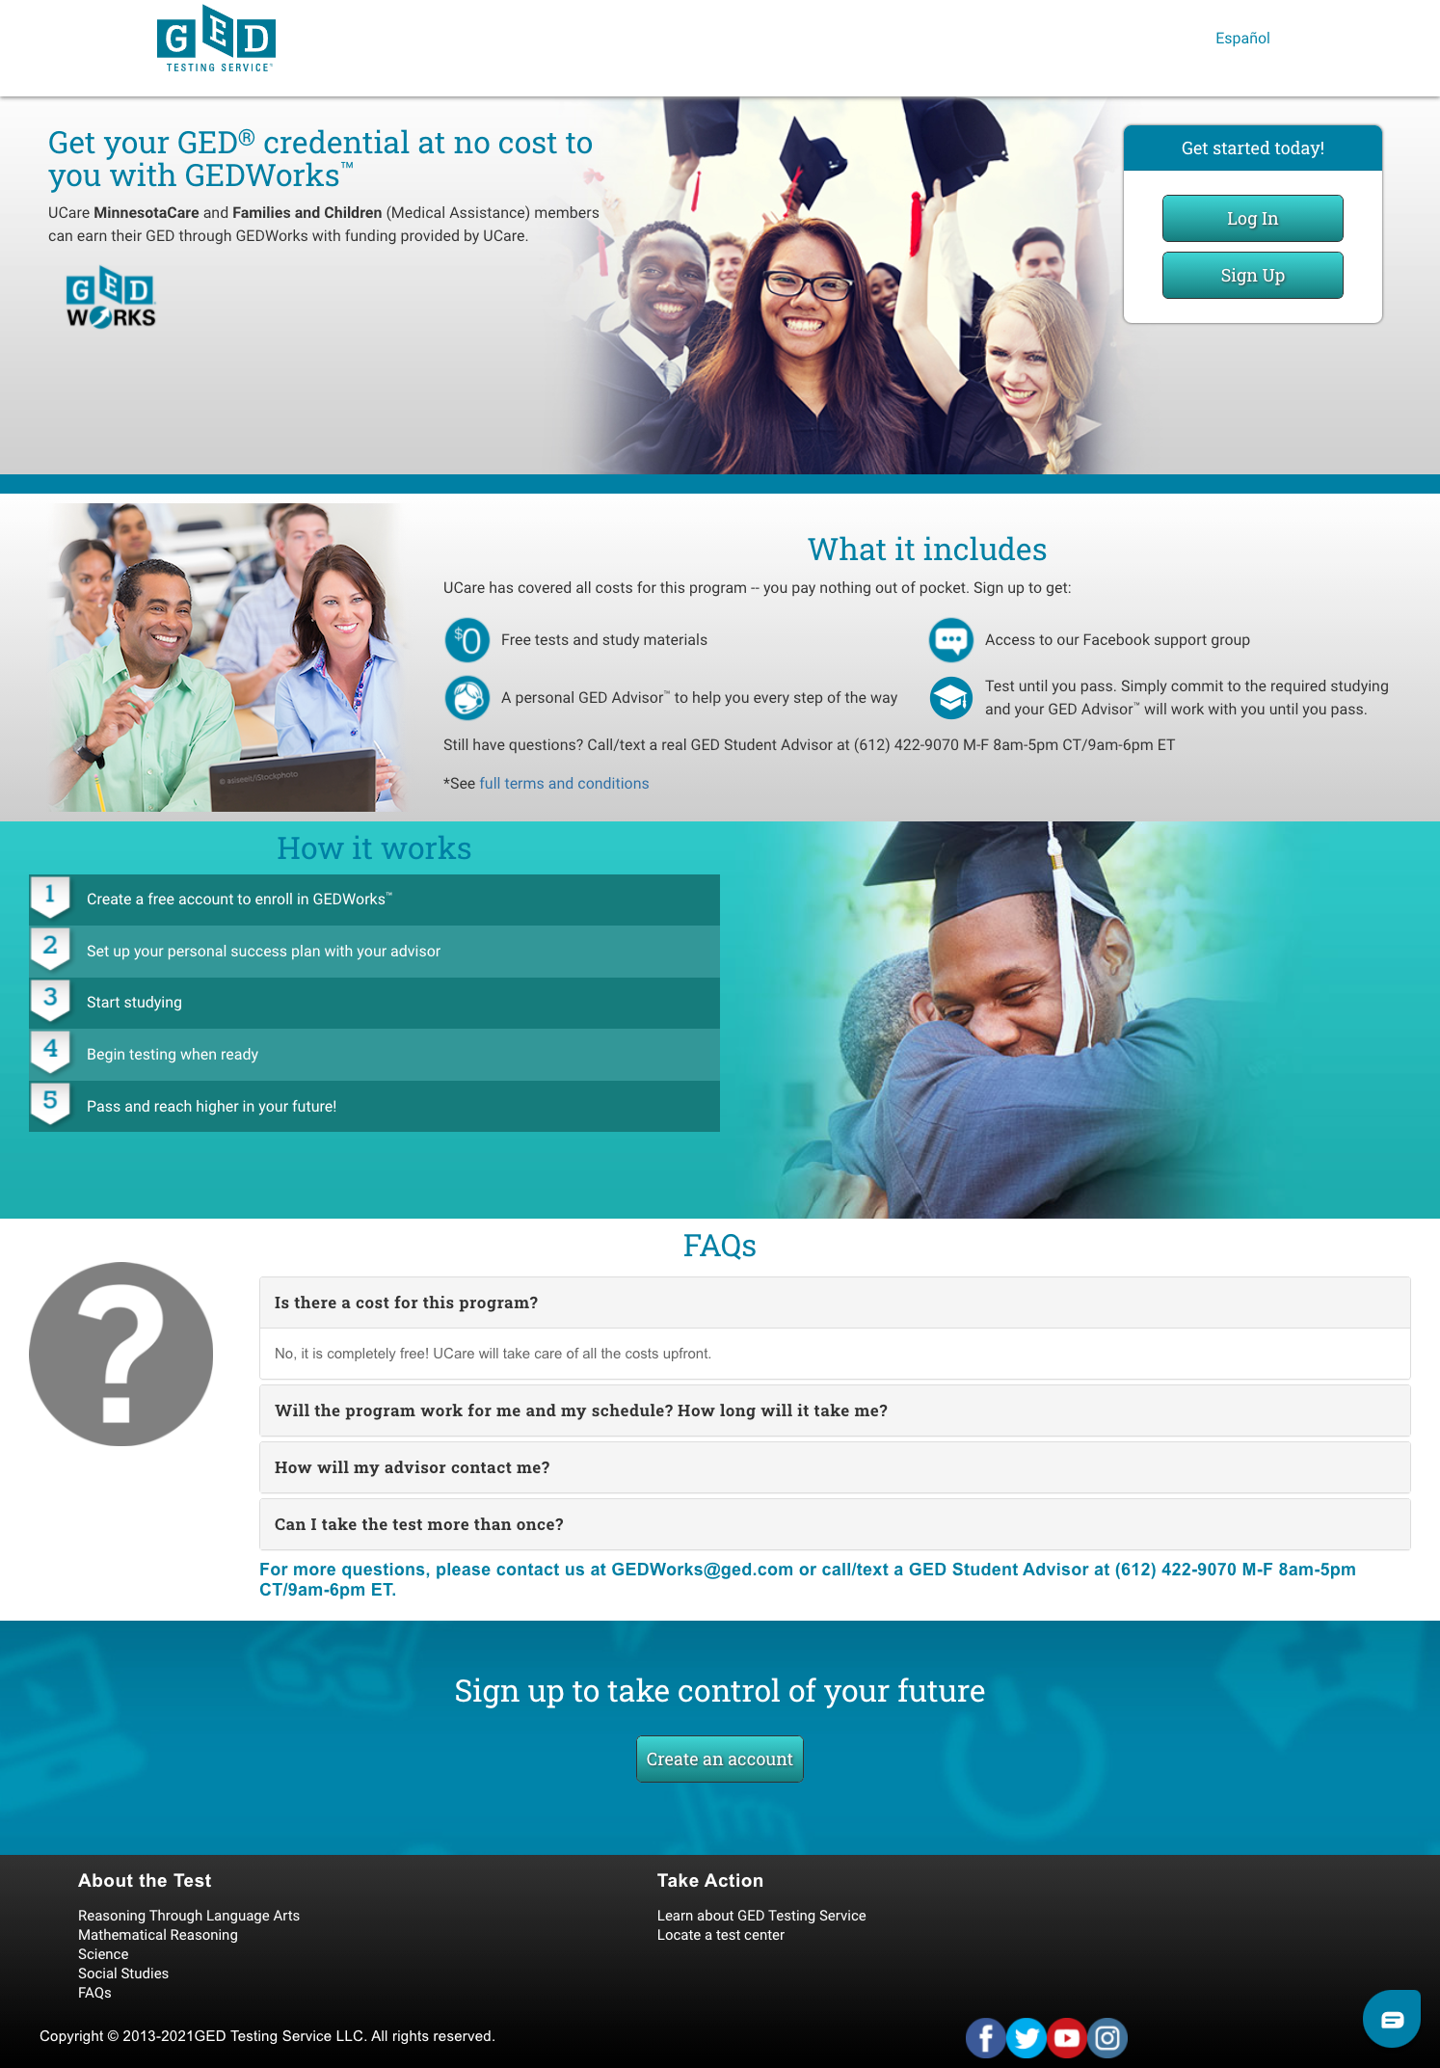
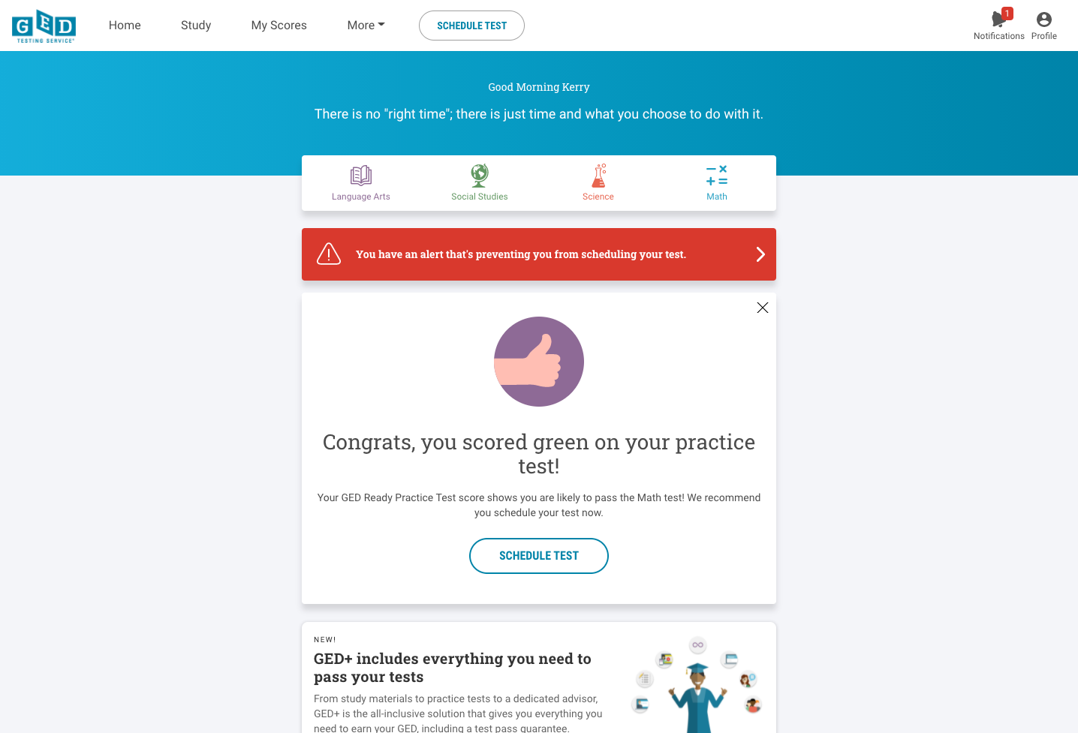
Customized Portal, Marketing Materials & Student Dashboard
(Ideal for Tracking Learner Outcomes)

Slide 21
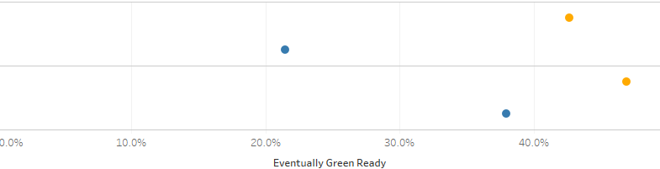
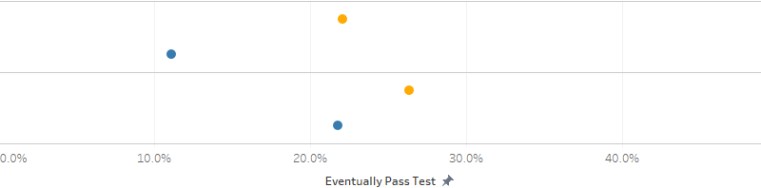
Mobile Engagement Accelerates Progress for GEDWorksTM
Progress to “Green Ready” (GEDWorksTM Learners)
Percentage of learners who eventually reach Green Ready, by first Ready band
Mobile Engaged
43%
RED
(<135)
Non-Mobile
22%
YELLOW
(135-144)
Mobile Engaged
47%
Non-Mobile
38%
Progress to “Passed Test” (GEDWorksTM Learners)
Percentage of learners who eventually pass the GED Test®, by first Ready band
RED
(<135)
Mobile Engaged
22%
Non-Mobile
11%
YELLOW
(135-144)
Mobile Engaged
26%
Non-Mobile
22%
Notes:
As of March 2026

Slide 22
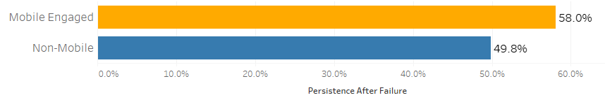
Learners Engaging with Mobile After a Failed Test Attempt Show Higher Persistence and a Quicker “Time to Retake”
Persistence After Failure (GEDWorksTM)
Percentage of learners who eventually retake after a failed Test attempt
Time to Retake
Median days it takes a learner to retake after a failed Test attempt
Mobile Engaged | 38 days
Non-Mobile | 45 days

Slide 23

GEDWorksTM Partner Examples

Slide 24
GEDWorksTM: Increasing Education Attainment and Economic Mobility Across the US
A partnership with GEDWorksTM serves multiple purposes:
A recruitment/retention tool for employers who are looking to build long-term talent pipelines
A capacity builder to come alongside Adult Ed/workforce development programs to increase educational attainment
A partner to community non-profits already serving opportunity populations (with philanthropic support)
Notes:
Employers
Districts/Colleges
Health Plans
Non-profits
State Agencies

Slide 25
GEDWorksTM:
Capacity Booster & Workforce Accelerator
Partner Spotlight:
~2,000 active learners across multiple states
56%
200%
KFC active GEDWorks participants’ turnover rate
Industry standard turnover rate
~27.5 Million
Adults w/out a GED
“GEDWorks is a ready-to-use solution to a problem we were already tackling. Best of all, it’s scalable and cost-effective.”
— Debbie Rollins,
Former Program Analyst, KFC Foundation.”
Notes:
~27.5 million adults without a GED.

Slide 26
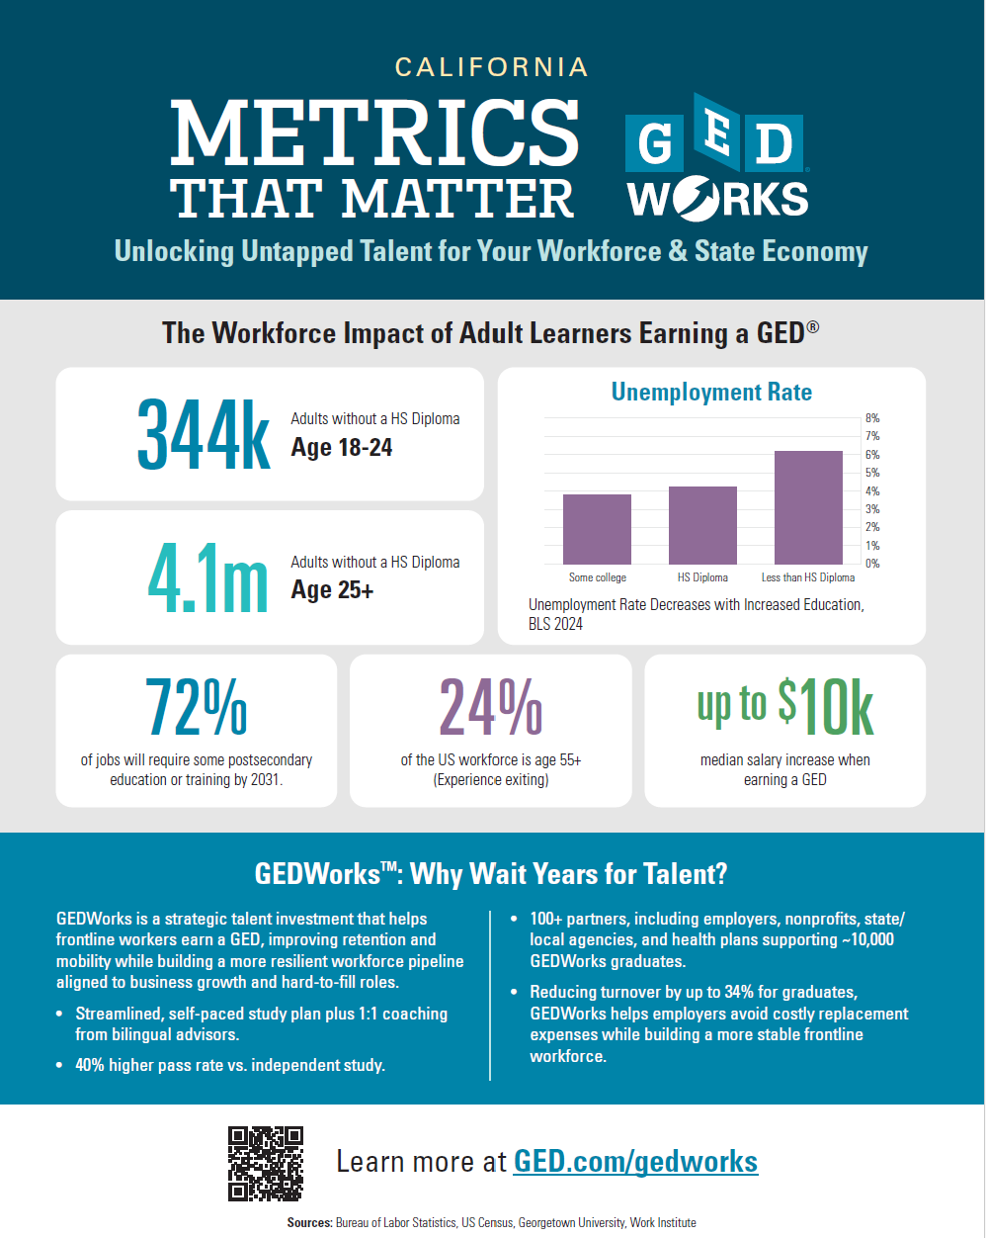
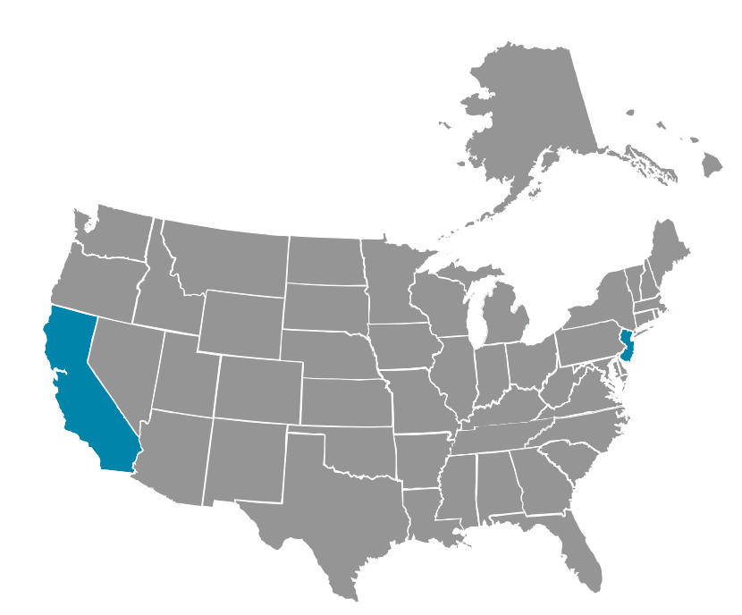
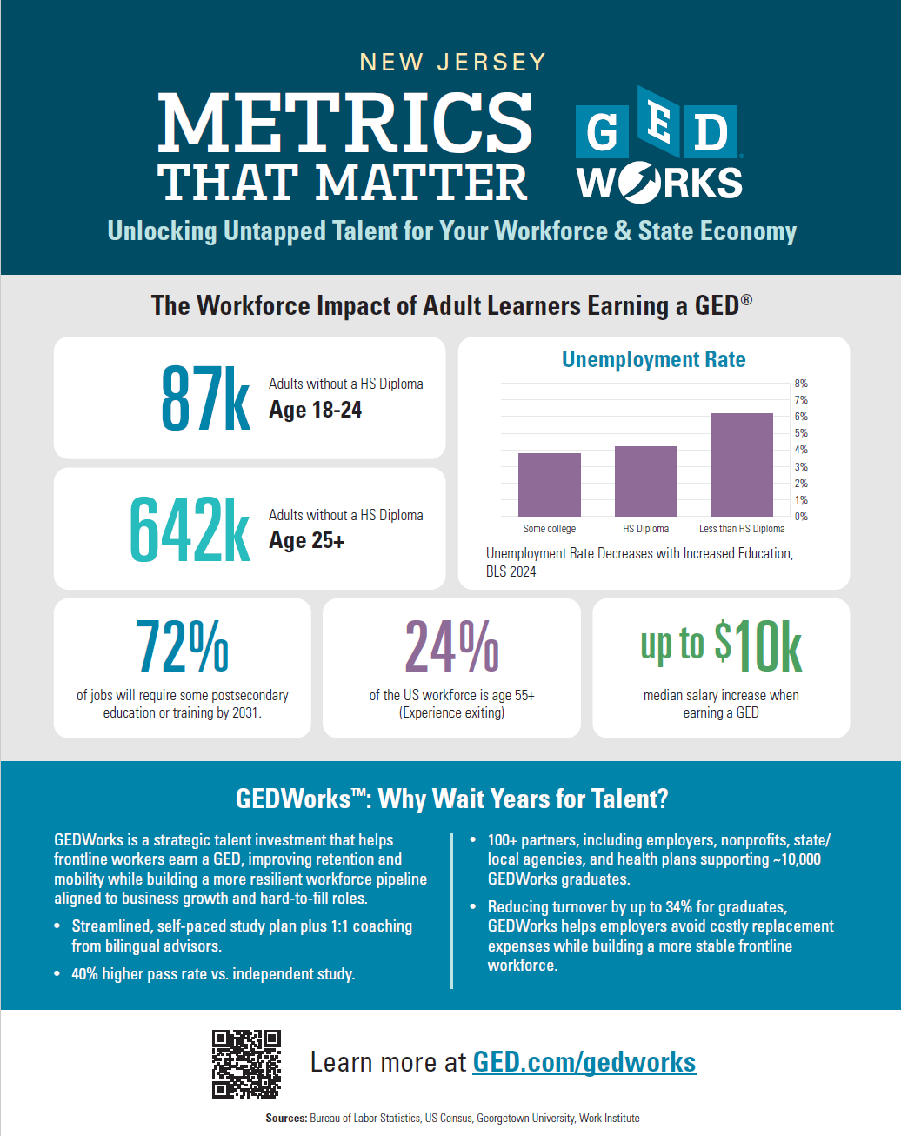
GEDWorksTM:
Capacity Booster & Workforce Accelerator
Increasing School District Talent Pipelines, Postsecondary Enrollment Pipelines & Adult Education Capacity
Notes:
~72 learners Adelanto Elementary (in process of increasing seats)
Rowan College starting partnership

Slide 27
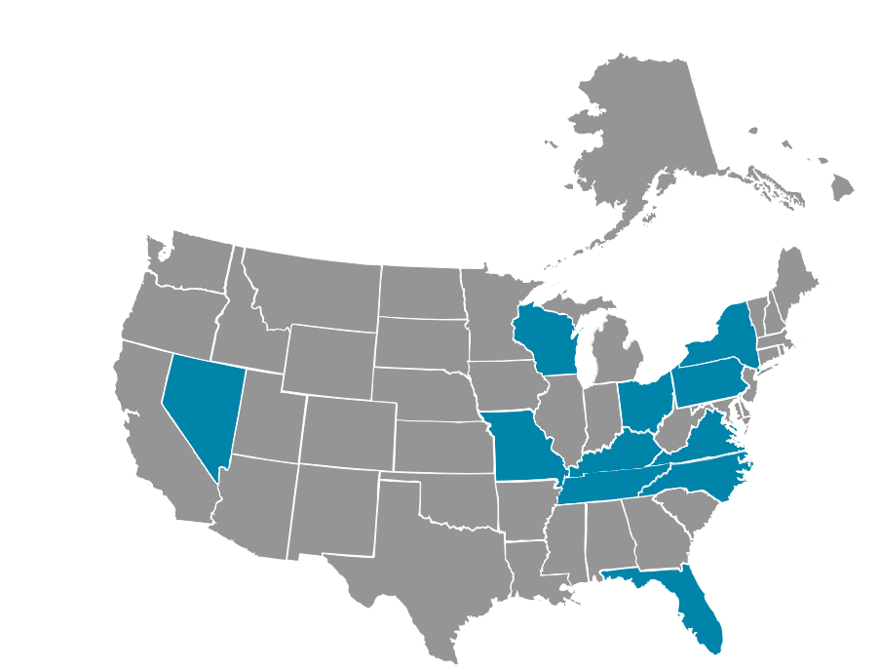
GEDWorksTM:
Capacity Booster & Workforce Accelerator
Partner Spotlight:
Offers GEDWorksTM to Medicaid recipients in 11 markets
A capacity builder to come alongside Adult Ed/workforce development programs to increase educational attainment & workforce mobility
Increased efficiencies for organizations operating across states

Slide 28
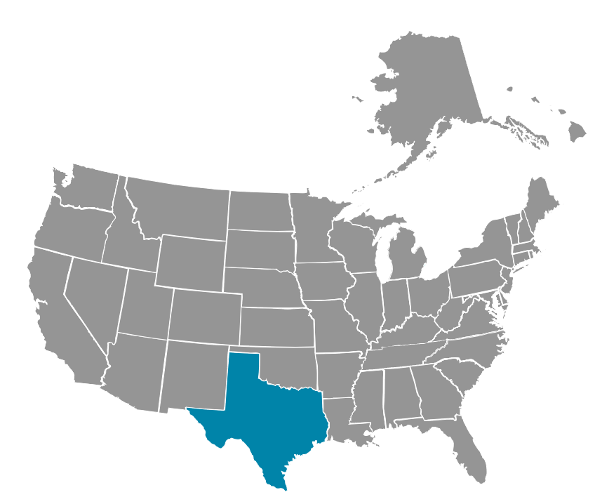
GEDWorksTM:
Capacity Booster & Workforce Accelerator
Partner Spotlights:
TDOT offers GEDWorksTM to employees across the state
  ~150 active participants
Goodwill Houston offers GEDWorksTM to employees at multiple facilities
  ~30 active participants
A capacity builder to increase educational attainment & workforce mobility

Slide 29
How Could We Partner To Meet Our Shared Goal Of Reaching
27.5 Million?
Let’s Connect!
Rachel Ludwig, Vice President, Global Operations & Strategic Partnerships, GED® Testing Service
Rachel.Ludwig@ged.com

Slide 30
Q&A
Thank You For The Work You Do!

Slide 31

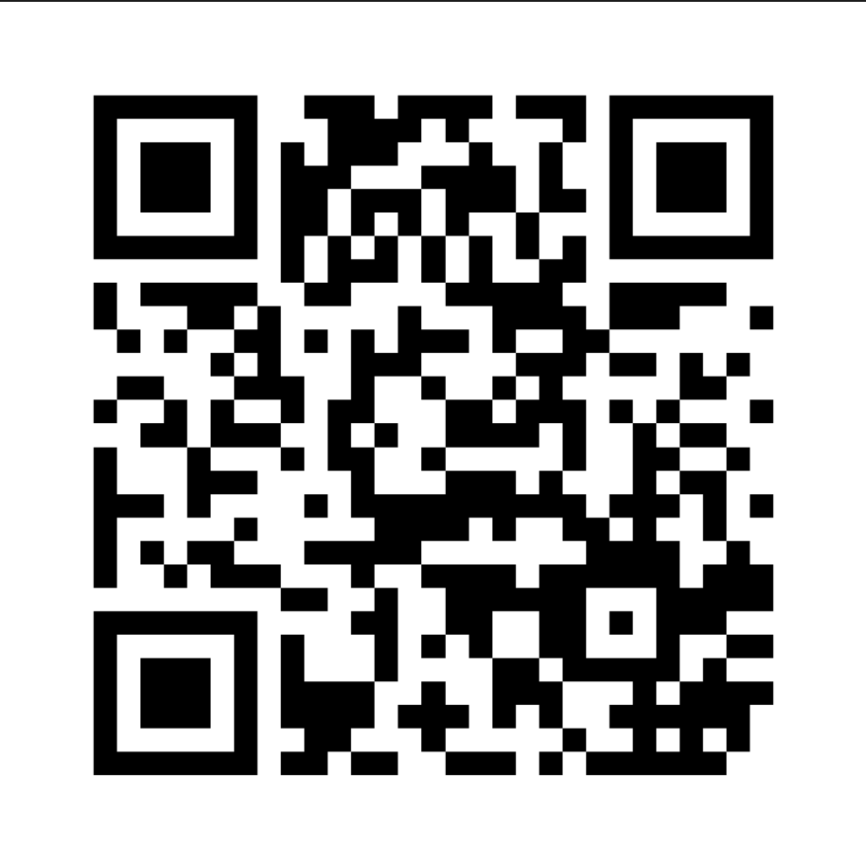
Session Survey
Your feedback is important. Please scan the QR code below to rate this session.

