Slide 1

Partnerships in Action: A Collaborative Approach to GED® Success
July 30, 2026

Slide 2
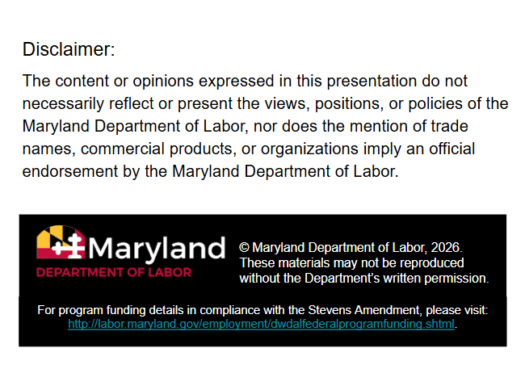

Slide 3
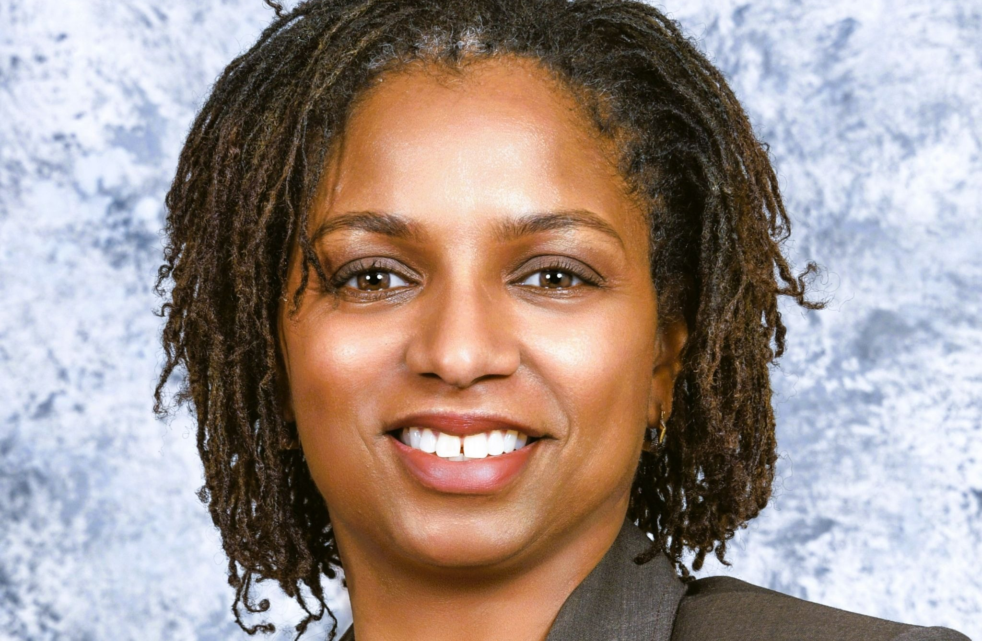
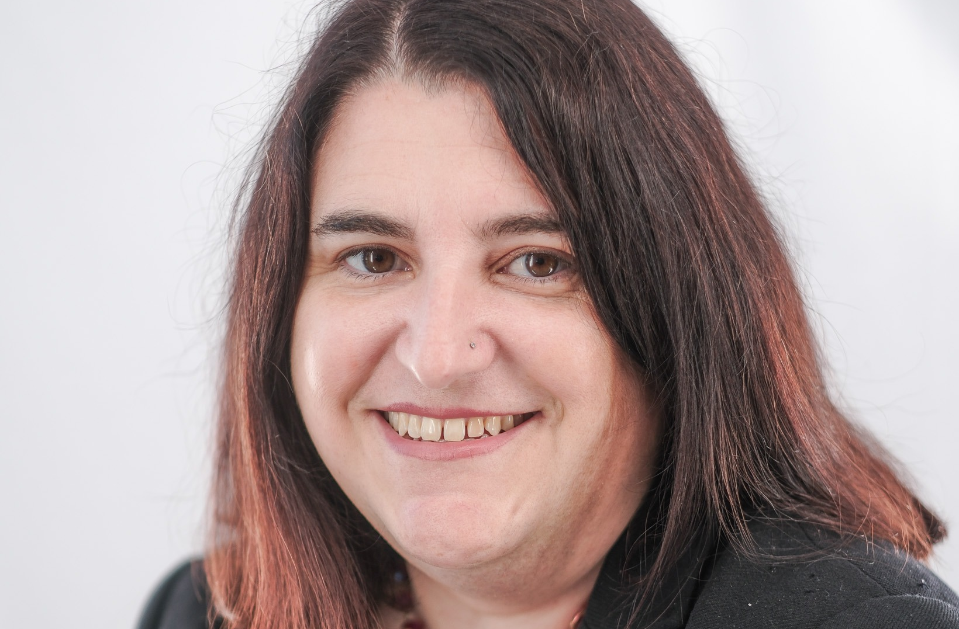
Introductions
Laura Ostrowski
GED Administrator™ & Adult High School Program
Supervisor
Maryland Department of Labor
Perketer Tucker
Director of Adult Education
Maryland Department of Labor

Slide 4
1
4
Partnership Highlights
Implementation
2
5
Benefits to Agencies
Q & A
3
Benefits to Adult Learners

Slide 5
Partnership Highlights
MD Labor & State agencies (Maryland State Department of Education, Governor’s Office of Children, Department of Public Safety and Correctional Services, Department of Juvenile Services)
Intra-MD Labor - Policy, Comms (Division & Agency), Correctional Education, Title I (Office of Workforce Development)
External (MD Labor) - Adult ed programs (Title II/non-Title II), GED Test Administrators
Communities of practice - (GED Test Administrators, 4th & Goal)
Library system in MD

Slide 6



Benefits to Agencies
Programming informed by policies and guidelines
Wider breadth of communication on initiatives
Different approaches to interpreting and analyzing solutions
Collaborative problem-solving

Slide 7
Benefits to Adult Learners
Heightens efficiency and execution
Informs programming
Connects and leverages responsibilities for processes
Strengthens referrals network to workforce services
Builds trust

Slide 8
Implementation
Investigate
Ask: Who is the subject matter expert?
Bring ideas to leadership!
Craft elevator pitches.
Come with ideas and solutions, be ready to defend, and be open.
Build
Develop resources for partnerships.
Form committees and workgroups to track focus and sector planning.
Schedule recurring calls and touch points agreeable to all.
Shape
Consult your WIOA State Plan, Titles I-V.
Examine existing frameworks for Perkins V.
Partner with Workforce Boards and K-12 re: CTE.

Slide 9
Thank you!
Perketer Tucker, Director of Adult Education, Maryland Department of Labor
perketer.tucker@maryland.gov
Laura Ostrowski, GED Administrator & Adult High School Program Supervisor, Maryland Department of Labor
laura.ostrowski@maryland.gov

Slide 10

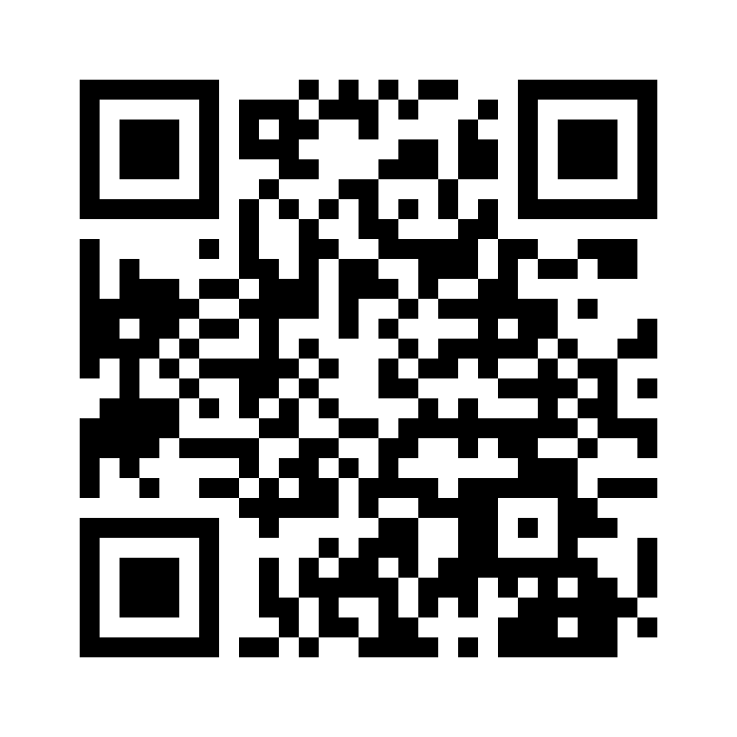
Session Survey
Your feedback is important. Please scan the QR code below to rate this session.

