Slide 1
Making Connections – Linking Historical Events to Contemporary Civics Issues
Susan Pittman, Educational Consultant to the GED Testing Service®

Slide 2
1
4
Civics Knowledge and the Impact on Feelings about Government
Roaring 20s to World War II
2
5
Revolution to Constitution
World War to Cold War
3
6
Civil War Era
Engaging Students in History and Civics

Slide 3
The Value of Making Connections
Connecting the past to governance provides benefits for students, including
Understanding the “why” behind the system
Developing critical thinking and media literacy
Building Civic Efficacy – how regular people can affect real political and social change
Helping build empathy and broad perspectives
Notes:
Helping students connect historical events to government structures and policies is the foundation of civic education. It transforms history from a list of memorized dates into a living framework, enabling students to understand current laws, recognize systemic change, and actively participate in a democratic society.
Connecting the past to governance provides several critical benefits for students:
Understanding the "Why" Behind the System: Learning how past events (like the Great Depression or the Civil Rights Movement) shaped current legislation or created new federal agencies helps students understand why their government operates the way it does today. [1, 2, 3]
Developing Critical Thinking and Media Literacy: By analyzing how governments have handled crises historically, students learn to evaluate the long-term consequences of political decisions and differentiate between fact and rhetoric in modern news. [1, 2, 3, 4]
Building Civic Efficacy: Recognizing that historical policy shifts were often driven by everyday citizens empowers students. It shows them that regular people can effect real political and social change, encouraging active, lifelong civic engagement. [1, 2]
Fostering Empathy and Broad Perspectives: Studying past struggles and governance from multiple viewpoints builds mutual respect and an appreciation for the complexity of societal problems.

Slide 4
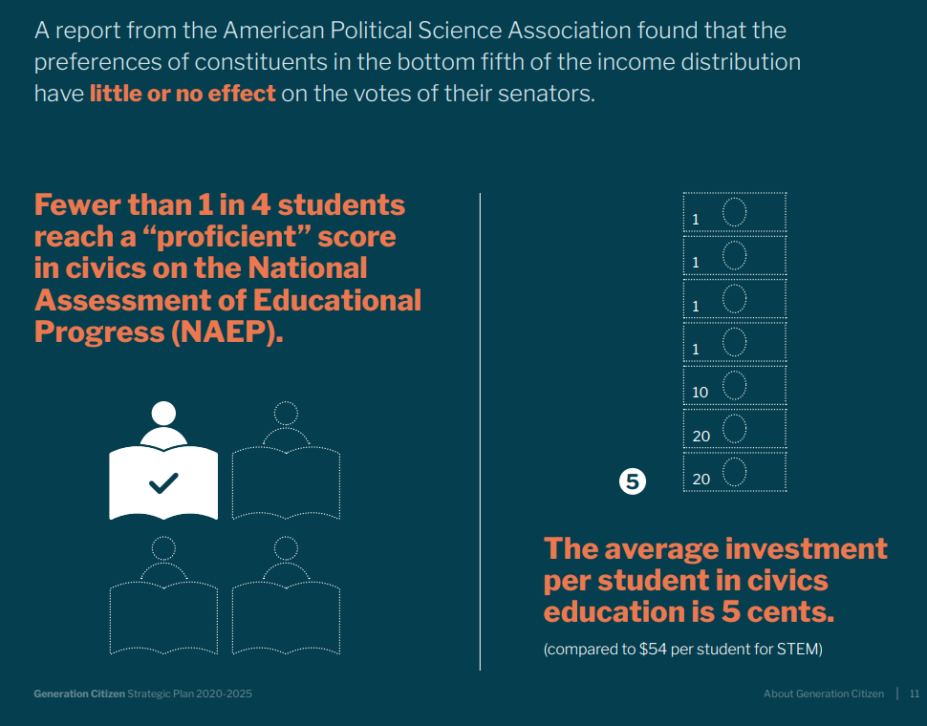
https://cms.generationcitizen.org/wp-content/uploads/2023/03/GC_Strategic_Plan_2020-2025_FINAL_72dpi.pdf

Slide 5
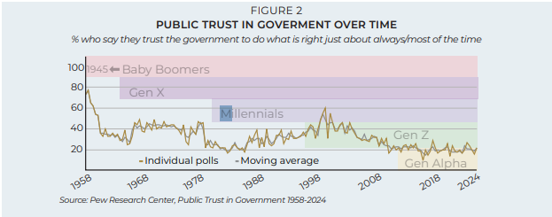
Trust in Government
A lack of civics knowledge goes hand-in-hand with a lack of trust in government institutions— research has shown that these states reinforce each other.
©SANDRA DAY O’CONNOR INSTITUTE FOR AMERICAN DEMOCRACY | OCONNORINSTITUTE.ORG

Slide 6
History and civics are deeply intertwined; historical events provide the vital context that explains how our civic rights, duties, and institutions were built and challenged.

Slide 7
Revolution to Constitution

Slide 8
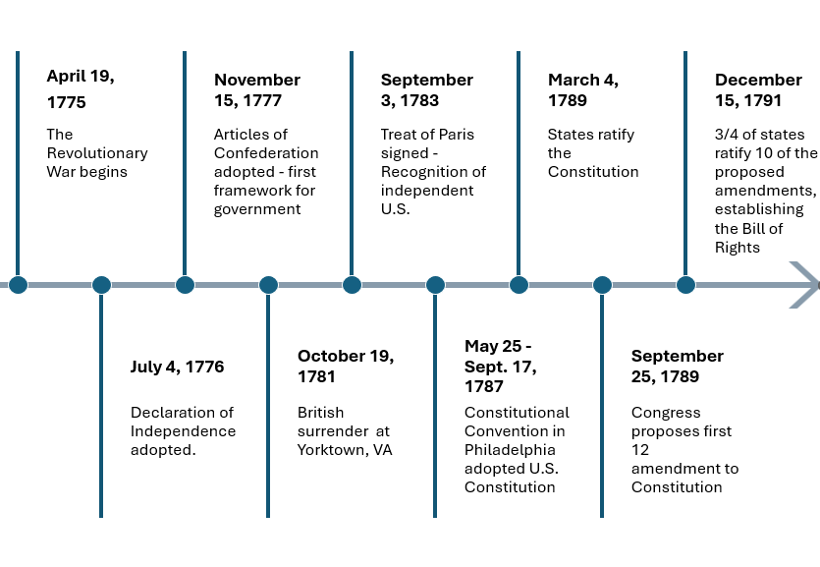
Timeline – Revolution to Bill of Rights

Slide 9
Three Essential Points
When in the course of human events, it becomes necessary for one people to dissolve the political bands which have connected them with another, and to assume among the powers of the earth, the separate and equal station to which the Laws of Nature and of Nature’s God entitle them, a decent respect to the opinions of mankind requires that they should declare the causes which impel them to the separation.
Under certain conditions it is necessary that people break the political bonds from another
Because of Natural Law, people can assume political independence
If they are going to make this split, they explain to others why that decision was made
Notes:
When in the course of human events, it becomes necessary for one people to dissolve the political bands which have connected them with another, and to assume among the powers of the earth, the separate and equal station to which the Laws of Nature and of Nature’s God entitle them, a decent respect to the opinions of mankind requires that they should declare the causes which impel them to the separation.
The Introduction makes three points.
Under certain conditions it is necessary that people break the political bonds from another
Because of Natural Law, people can assume political independence
If they are going to make this split, they explain to others why that decision was made

Slide 10
Primary Sources on the GED Social Studies Test
Man in Nature
John Locke asserted that man in nature is absolutely free, in total control of self and personal property, equal to the great person, and ruled by no one. Locke stressed that in a state of nature, there are no laws and no legal obligation for fair conduct and good behavior.
Which statement is an implication of Locke's claim regarding man in nature? He had no need for partners or allies. He has no need for rules or government. He lives in fear and is in constant danger from others. He lives with abundance and his needs are always met.
Notes:
In this question, John Locke stated that "man in nature is absolutely" and man is "ruled by no one". He also states in nature there are "no laws and no legal obligation." Therefore, the correct answer is number 2. He has no need for rules or government.
Social Studies test questions often ask that a student read an excerpt and determine what the author meant. In this case, the item asks what was implied. An implication is a conclusion that is drawn indirectly from something said or done. It is not stated outright.
In this sample question, the author is John Locke. John Locke was an English philosopher whose ideas laid the groundwork for modern democracy and capitalism. As you listened to the video and read through excerpts in the Declaration of Independence, you can see that the Committee of Five who worked on drafting the document relied heavily on the philosophy of John Locke. Each of the following phrases are drawn from the original work of John Locke.
Consent of the governed
Natural rights, Laws of Nature
Right to revolution

Slide 11
Steps to the Constitution and Bill of Rights
Document | Main Purpose | Key Ideas or Features | Limitations or Concerns | Role in the Evolution
Declaration of Independence | Announced separation from Britain and explained the reasons for independence. | Natural rights, consent of the governed, right to alter or abolish unjust government, and grievances against British rule. | Declared principles but did not create a governing system. | Established the ideals of liberty and self-government that later documents tried to put into practice.
Articles of Confederation | Created the first national government after independence. | Loose union of sovereign states, limited central authority, and cooperation among states. | National government was too weak to tax, regulate commerce, enforce laws, or respond effectively to crises. | Tested a weak union and revealed the need for a stronger national framework.
U.S. Constitution | Built a stronger and more effective federal government. | Separation of powers, checks and balances, federalism, representative government, and authority based on “We the People.” | Raised concerns that the federal government might become too powerful without explicit protections for individual rights. | Created a stronger republic while placing structural limits on government power.
Bill of Rights | Added explicit protections for individual liberties. | Freedom of speech, religion, press, assembly, and petition; due process; jury rights; and protection against unreasonable searches and seizures. | Addressed fears about federal power but required later interpretation and expansion over time. | Safeguarded individual freedom and completed the founding balance between power and liberty.
Notes:
Shaping the Constitution and Laws
The Catalyst: The end of the Revolutionary War revealed the severe limitations of the Articles of Confederation.
Civic Evolution: In 1787, leaders drafted the U.S. Constitution to establish a new system of checks and balances, separation of powers, and the foundation for representative government. The subsequent creation of the Bill of Rights codified protections for individual liberties.

Slide 12
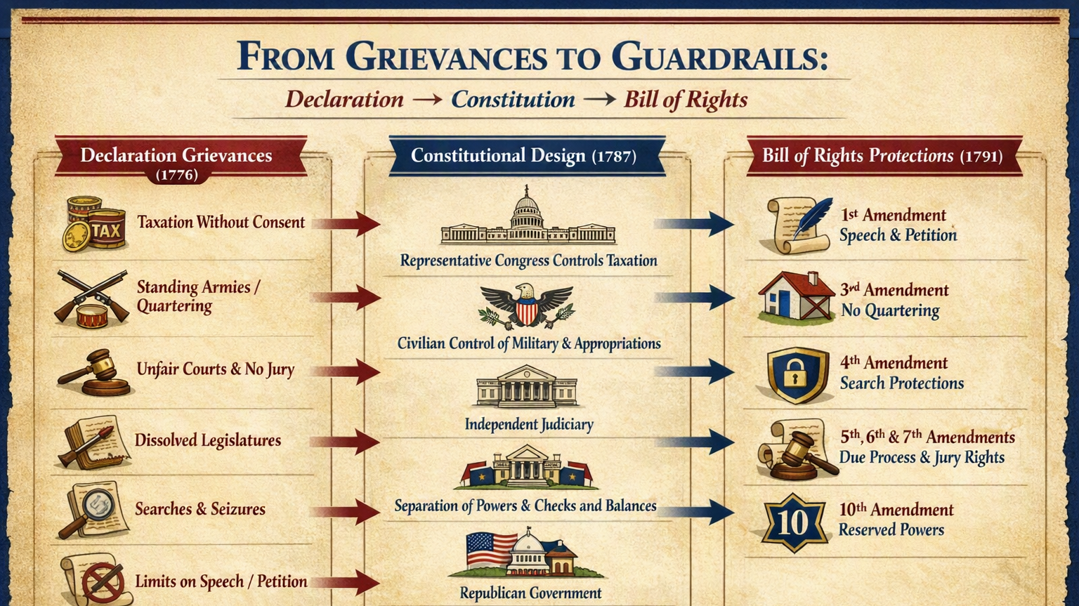

Slide 13
Online Resource for Your Students
Free to Choose Network: Our Constitution - A Timeline of Events
https://www.freetochoosenetwork.org/programs/perfect_union/explore/history.php

Slide 14
Civil War Era
Impact on Policy and Law

Slide 15
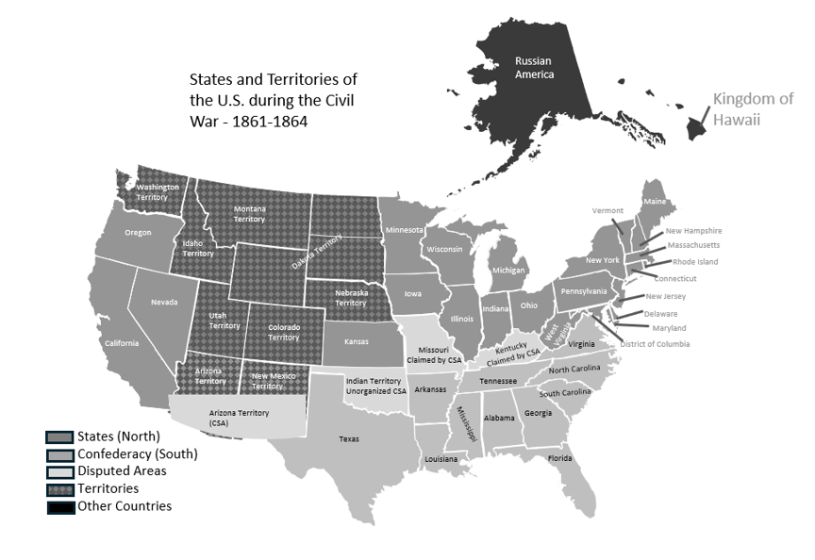
Notes:
Expanding the Definition of "Citizen"
The Catalyst: Major historical conflicts like the American Civil War and the fight for women's suffrage exposed deep flaws in who was allowed to participate in the democratic process.
Civic Evolution: Amendments and legislation were forged through intense civic activism. This is seen in the 14th Amendment (granting equal protection under the law), the 15th Amendment (voting rights for Black men), and the 19th Amendment (women’s suffrage). [1]

Slide 16
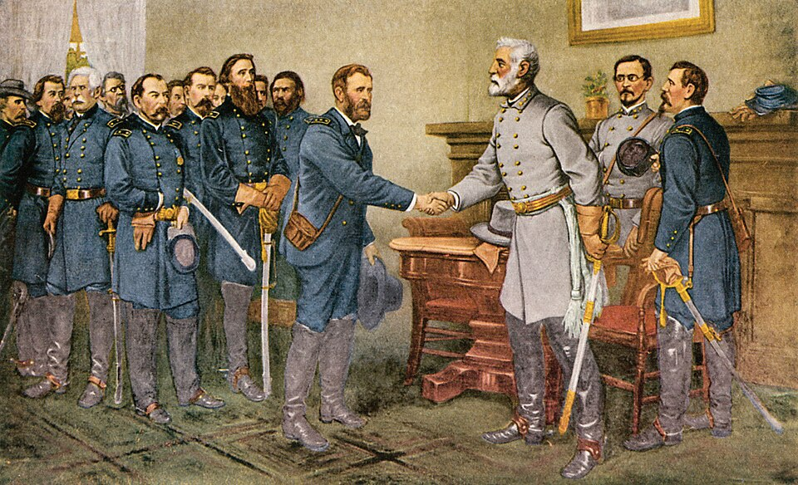
Civil War Ends and Reconstruction Begins
Lee's surrender 1865. 'Peace in Union.' The surrender of General Lee to General Grant at Appomattox Court House, Virginia, 9 April 1865. Reproduction of a painting by Thomas Nast, which was completed thirty years after the surrender.
-Public Domain
This work is in the public domain in the United States because it was published (or registered with the U.S. Copyright Office) before January 1, 1931.
http://38ccda.medialib.glogster.com/media/2ac4b05089e7aa91745de5be102243e550864dff4043259b7a4b0b987742461a/surrender.jpg

Slide 17
14th Amendment – More than just citizenship
The 14th Amendment to the U.S. Constitution, adopted in 1868 after the Civil War, guarantees citizenship to all people born or naturalized in the United States and ensures that states cannot deny any person “life, liberty, or property” without due process of law or deny anyone equal protection under the law. It was designed mainly to protect the rights of formerly enslaved people, but it has since become one of the most important constitutional foundations for civil rights, applying to issues such as racial equality, voting rights, privacy, marriage, and fair treatment by state governments.

Slide 18
Established birthright citizenship
Required due process
Applied Bill of Rights protections to the states
Supported school desegregation
Influenced voting and representation
Expanded civil rights protections
Equal protection under the law
Shaped modern equality debates
Strengthened federal authority to protect rights
Notes:
The 14th Amendment, ratified after the Civil War, reshaped American life by defining national citizenship, limiting state power, and becoming a foundation for modern civil rights protections.
Established birthright citizenship: It made people born or naturalized in the United States citizens of both the nation and their state, overturning the idea that states could deny citizenship to African Americans.
Expanded civil rights protections: It required states to respect basic rights and became a constitutional basis for protecting individuals from unfair state laws.
Guaranteed equal protection under the law: Its Equal Protection Clause has been used to challenge racial segregation, discrimination, and unequal treatment by government.
Required due process: States cannot deprive a person of life, liberty, or property without fair legal procedures, strengthening protections in courts, schools, policing, and government decisions.
Applied many Bill of Rights protections to the states: Through later Supreme Court decisions, many freedoms—such as speech, religion, and criminal procedure rights—came to limit state and local governments as well as the federal government.
Supported school desegregation: The amendment was central to decisions such as Brown v. Board of Education, which declared racial segregation in public schools unconstitutional.
Influenced voting and representation: It addressed representation in Congress and became part of the broader Reconstruction effort to protect the political rights of formerly enslaved people.
Shaped modern equality debates: Courts have relied on the amendment in cases involving gender discrimination, marriage rights, privacy, immigration, education, and criminal justice.
Strengthened federal authority to protect rights: It gave Congress power to enforce its guarantees, allowing the federal government to act when states violated constitutional rights.

Slide 19
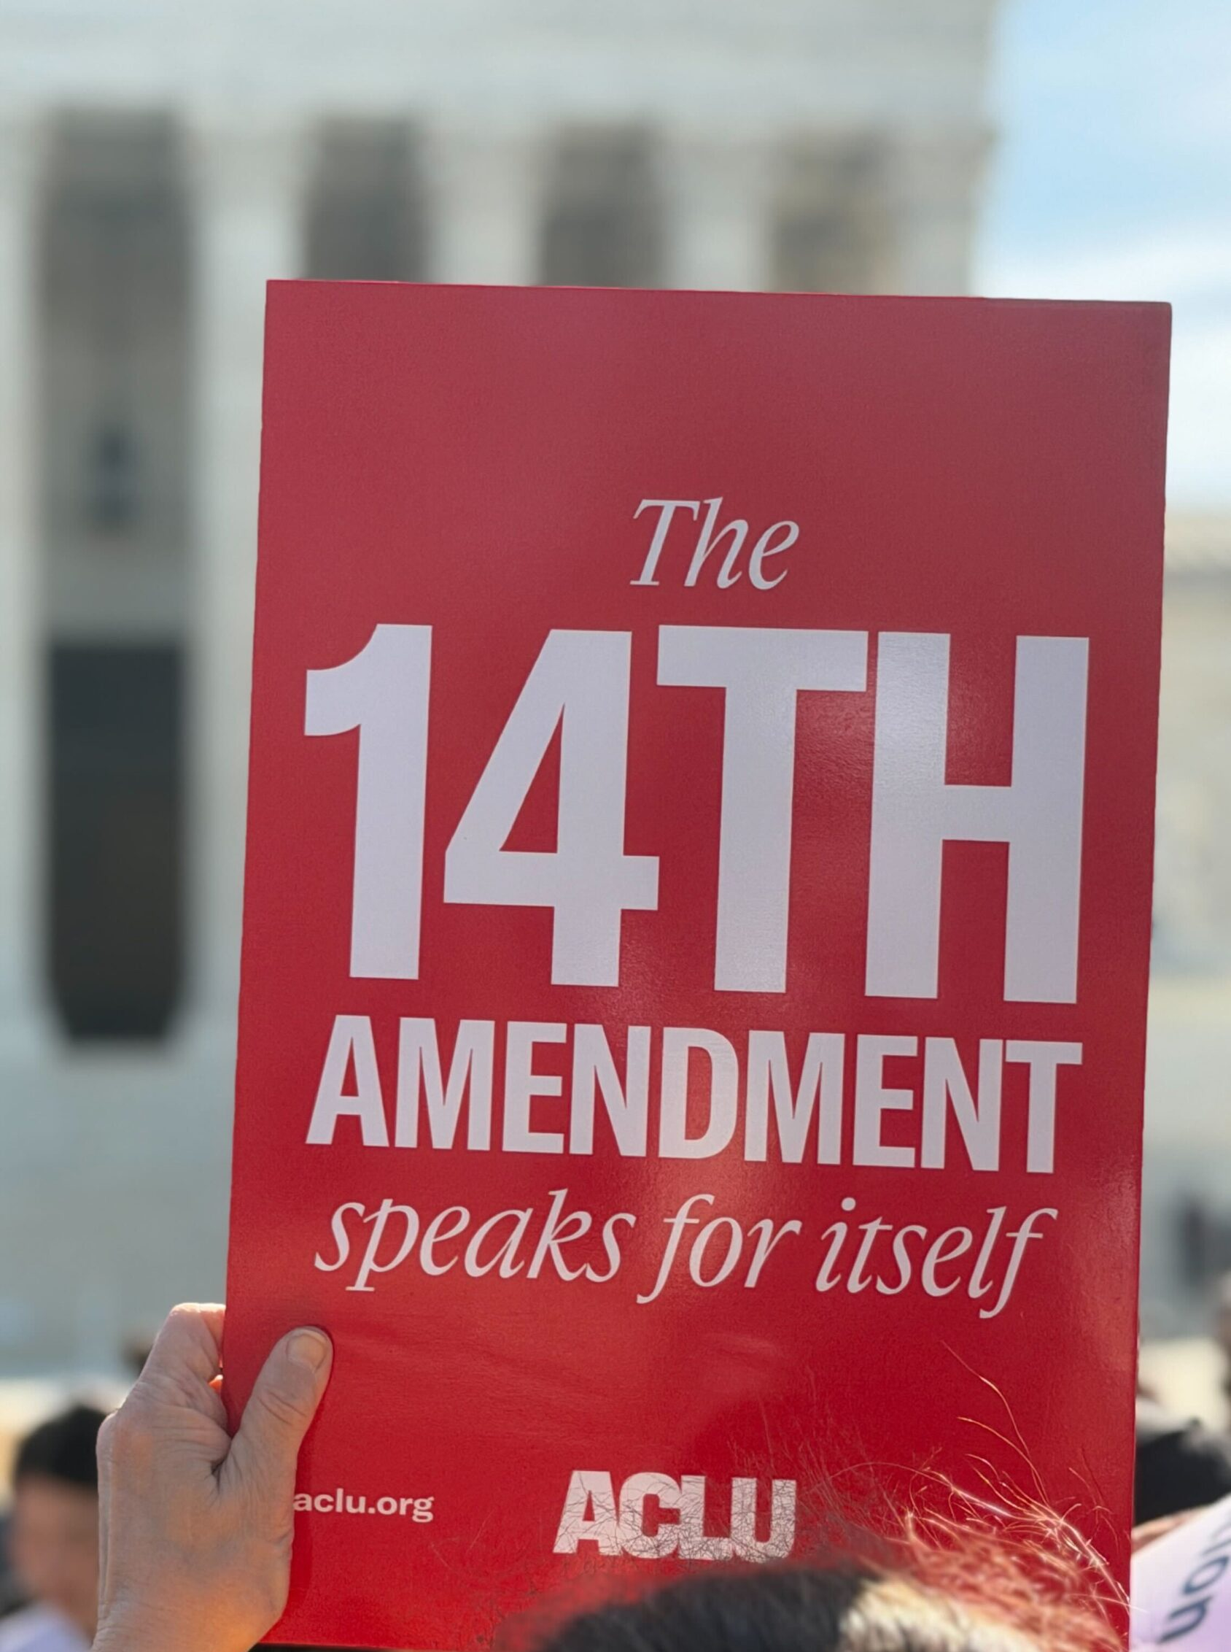
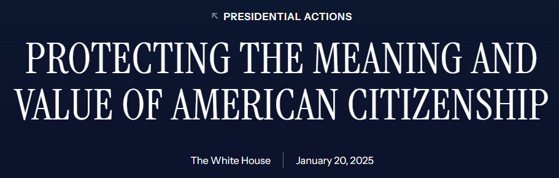
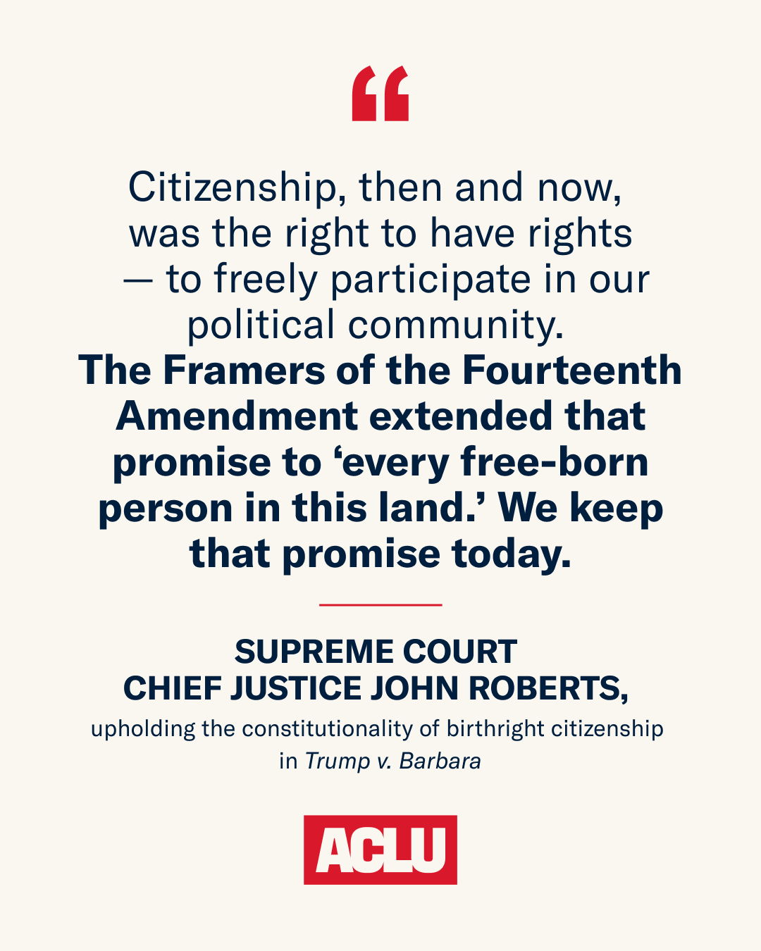
In the News
Excerpt of Executive Order 14160
Sec. 2. Policy. (a) It is the policy of the United States that no department or agency of the United States government shall issue documents recognizing United States citizenship, or accept documents issued by State, local, or other governments or authorities purporting to recognize United States citizenship, to persons: (1) when that person’s mother was unlawfully present in the United States and the person’s father was not a United States citizen or lawful permanent resident at the time of said person’s birth, or (2) when that person’s mother’s presence in the United States was lawful but temporary, and the person’s father was not a United States citizen or lawful permanent resident at the time of said person’s birth.
Notes:
The U.S. Supreme Court struck down President Trump's executive order on birthright citizenship, ruling in a 6-to-3 decision that the attempt to deny automatic citizenship to children born in the U.S. to undocumented or temporary visa-holding parents violates the 14th Amendment. [1, 2]
Key details of the executive order and the resulting legal battle:
The Order's Scope: President Trump signed Executive Order 14160 in January 2025, attempting to deny automatic U.S. citizenship to babies born on American soil unless at least one parent was a U.S. citizen or a lawful permanent resident (LPR). It specifically targeted the children of undocumented immigrants and individuals on temporary visas (such as students or tourists). [1, 2, 3]
The Legal Challenge: Civil rights organizations including the American Civil Liberties Union (ACLU) and the Asian Law Caucus immediately filed lawsuits, such as Trump v. Barbara, to block the policy. [1]
Supreme Court Ruling: On June 30, 2026, the Supreme Court ruled the executive order unconstitutional. Chief Justice John Roberts, writing for the majority, affirmed that the 14th Amendment's Citizenship Clause guarantees birthright citizenship to virtually everyone born within the United States. [1, 2]
Current Status: Following the Supreme Court's decision, Trump's directive is invalid, and birthright citizenship remains a constitutional right. President Trump has announced a push for the Court to rehear the case, though legal experts have noted that Supreme Court rehearings on already-argued cases are exceedingly rare. [1, 2, 3, 4]

Slide 20
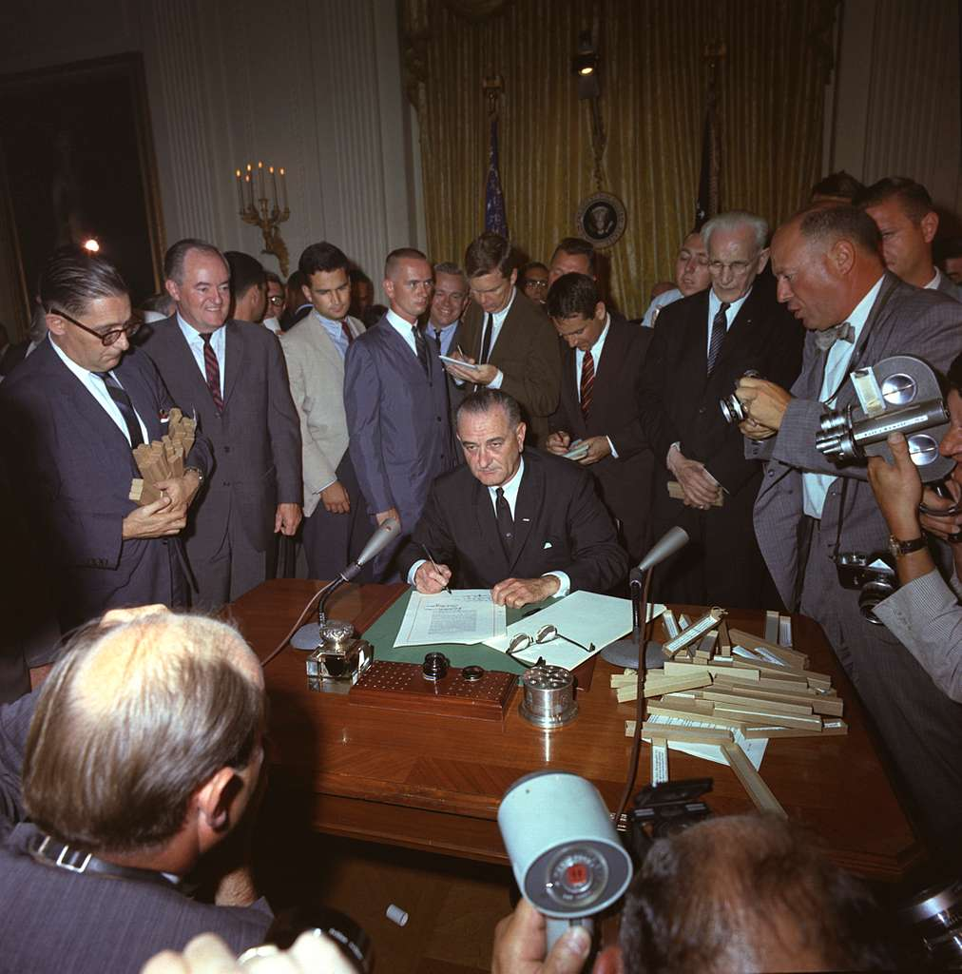
15th Amendment
The segregation and disenfranchisement laws known as "Jim Crow" represented a formal, codified system of racial apartheid that dominated the American South for three quarters of a century beginning in the 1890s. The laws affected almost every aspect of daily life, mandating segregation of schools, parks, libraries, drinking fountains, restrooms, buses, trains, and restaurants.
Section 1. The right of citizens of the United States to vote shall not be denied or abridged by the United States or by any State on account of race, color, or previous condition of servitude.
Section 2. The Congress shall have power to enforce this article by appropriate legislation.
Civil Rights Act, July 2, 1964
http://www.lbjlibrary.org/
Notes:
The 15th Amendment (1870)
Ratified on February 3, 1870, as part of the Reconstruction Amendments, the 15th Amendment prohibits the federal and state governments from denying a citizen the right to vote based on that citizen's "race, color, or previous condition of servitude". [1]
Purpose: The primary goal was to ensure African American men (particularly those recently freed from slavery) were enfranchised and given political representation. [1, 2]
Impact: While it was a monumental step forward, its implementation was severely restricted in the decades that followed through state-level discriminatory practices, such as poll taxes and literacy tests. It wasn't until subsequent legislation—like the Voting Rights Act of 1965—that the promises of the 15th Amendment were fully enforced. [1, 2]
The 15th Amendment was one of the "Reconstruction amendments," and was an important step in ensuring African Americans' right to vote. Unfortunately, change didn't happen overnight, and it would take further measures, such as the 24th Amendment, which nixed the use of poll taxes, to foster true equality.
te_range
Date
02/07/1964
create
Source
The LBJ Presidential Library
link
Link
http://www.lbjlibrary.org/

Slide 21
Roaring 20s – World War II
Foreign and Domestic Policy

Slide 22
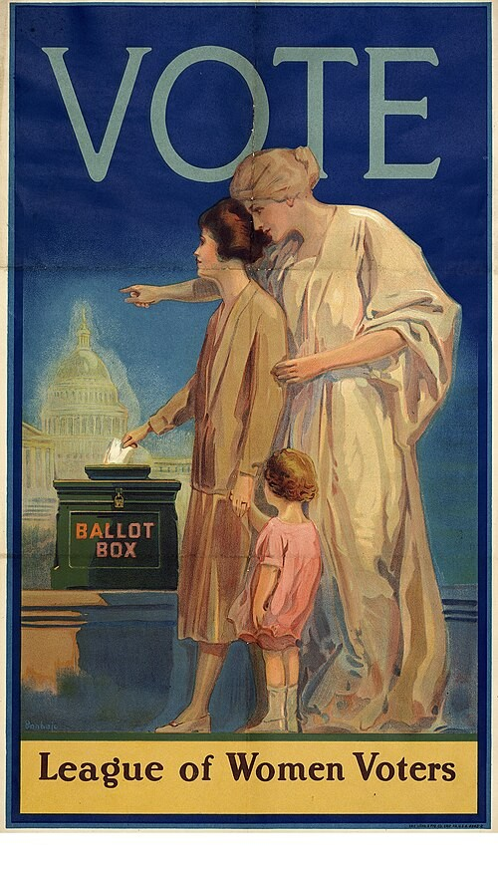
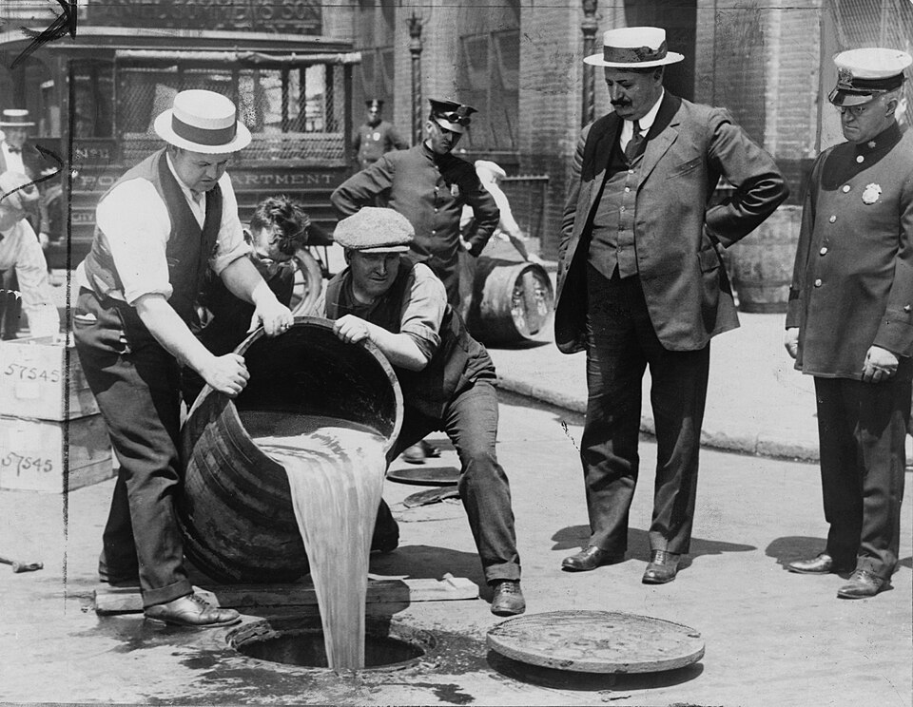

The Roaring 20’s
The Nineteenth Amendment provides:
The right of citizens of the United States to vote shall not be denied or abridged by the United States or by any State on account of sex.
Congress shall have power to enforce this article by appropriate legislation.
Prohibition agents destroying barrels of alcohol, 1921, in accordance with the 18th amendment, which made alcoholic beverages illegal in the United States throughout the entire decade.
https://en.wikipedia.org/wiki/1920s
Public Domain
VOTE poster by League of Women Voters (1920) Woman, with daughter, placing ballot in box, female spirit behind her pointing to U.S. Capitol.
http://edu.lva.virginia.gov/dbva/files/original/57260de85ec24fc10f971a60198a77bc.pdf
Public Domain
Notes:
The 1920s was a transformative decade defined by the aftermath of World War I, rapid technological advancements, and immense cultural shifts. It featured global milestones ranging from women’s suffrage and Prohibition to the dawn of commercial radio and the devastating stock market crash that sparked the Great Depression.
This media file is in the public domain in the United States. This applies to U.S. works where the copyright has expired,

Slide 23
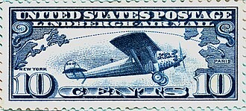
1920s - Innovations
1927 | Dawn of "Talkies" (U.S.): The Jazz Singer was released, becoming the first feature-length motion picture with synchronized singing and speech, revolutionizing the global entertainment industry.
1920 | First Commercial Radio Broadcast (U.S.): Station KDKA in Pittsburgh made the first historic commercial broadcast, covering the presidential election returns.
1927 | First Solo Transatlantic Flight: Charles Lindbergh successfully completed the first solo, non-stop flight across the Atlantic Ocean from New York to Paris in his plane, the Spirit of St. Louis.
U.S. "Lindbergh Air Mail" Postage Stamp (Scott C-10) issued June 11, 1927.
https://commons.wikimedia.org/wiki/File:Lindbergh_Airmail_Stamp_c10.jpg
Notes:
1920 | First Commercial Radio Broadcast (U.S.): Station KDKA in Pittsburgh made the first historic commercial broadcast, covering the presidential election returns. [1]
1921 | Tulsa Race Massacre (U.S.): A violent, armed mob destroyed the affluent Greenwood District in Tulsa, Oklahoma, often referred to as "Black Wall Street," in one of the worst incidents of racial violence in U.S. history. [1]
1922 | Rise of Italian Fascism: Benito Mussolini came to power in Italy following his "March on Rome", establishing a totalitarian fascist regime. [1, 2, 3, 4]
1923 | Great Kanto Earthquake (Japan): A devastating 7.9-magnitude earthquake struck the Tokyo-Yokohama area, resulting in massive firestorms, tsunamis, and over 100,000 deaths. [1]
1925 | The Scopes "Monkey" Trial (U.S.): Tennessee high school teacher John Scopes was put on trial for violating state law by teaching the theory of evolution, highlighting a deep cultural divide between fundamentalist and modern beliefs. [1, 2, 3, 4, 5]
1927 | First Solo Transatlantic Flight: Charles Lindbergh successfully completed the first solo, non-stop flight across the Atlantic Ocean from New York to Paris in his plane, the Spirit of St. Louis. [1]
1927 | Dawn of "Talkies" (U.S.): The Jazz Singer was released, becoming the first feature-length motion picture with synchronized singing and speech, revolutionizing the global entertainment industry. [1, 2, 3, 4, 5]

Slide 24
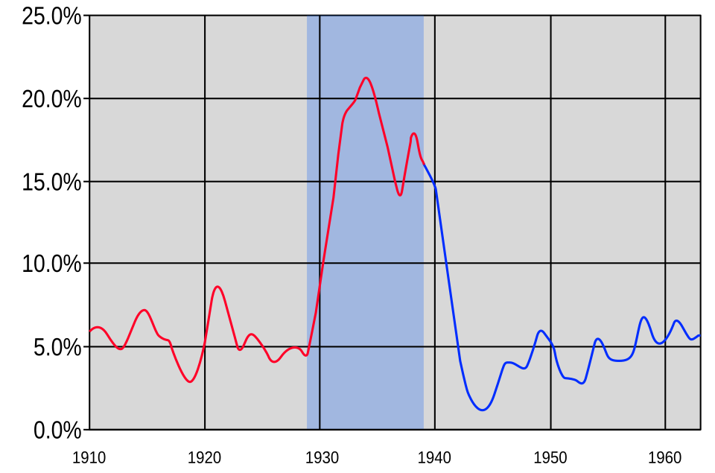
Great Depression
1929 | The Stock Market Crash (U.S.): On October 29—known as "Black Tuesday"—the Wall Street stock market crashed, wiping out millions of investors and triggering the onset of the Great Depression.
English: U.S. Unemployment rate from 1910-1960, with the years of the Great Depression (1929-1939) highlighted.
1910-1938 - % U.S. Unemployment (estimated)
1938-1963 - % U.S. Unemployment
This file is licensed under the Creative Commons Attribution-Share Alike 4.0 International license.

Slide 25
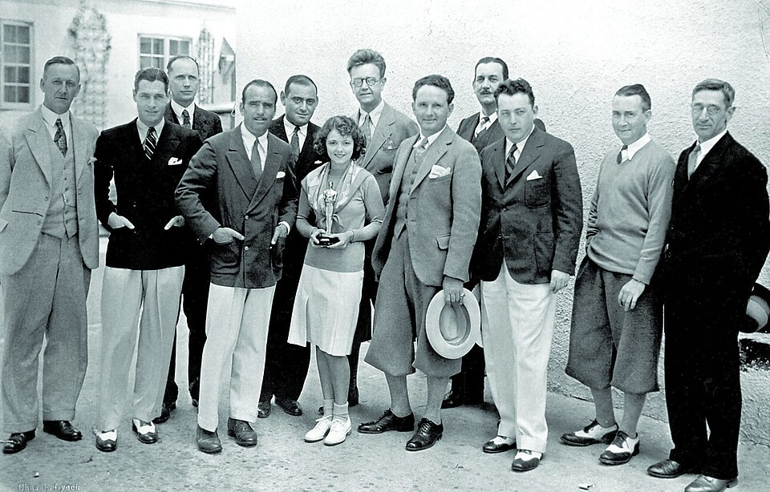
If not for the Great Depression…the “Big News” might have been…
Sliced bread was invented in 1928.
Bubble Gum was invented.
Penicillin was discovered.
Richard Byrd and Floyd Bennett flew over the North Pole.
The car radio was invented.
The Academy Awards made their debut.
The St. Valentine’s Day Massacre occurred.
https://commons.wikimedia.org/wiki/File:Janet_Gaynor_with_Group_1929.jpg
This work is in the public domain in the United States because it was published (or registered with the U.S. Copyright Office) before January 1, 1931.
Notes:
In the last year of the '20s, Richard Byrd and Floyd Bennett flew over the South Pole, the car radio was invented, the Academy Awards made their debut, and the murder of seven members of the Moran Irish gang in Chicago became infamous as the St. Valentine's Day Massacre.
But this was all dwarfed by the October crash of the stock market, which marked the beginning of the Great Depression.

Slide 26
Impact on Foreign or Domestic Policy
Foreign Policy
Domestic Policy
Globalism to Isolationism
Economic Protectionism
Absolute Neutrality Laws
Arsenal of Democracy
  “Cash and Carry”
  Lend-Lease Act
Command Economy
  War Industries Bond
  Food Administration
Suppression of Civil Liberties
  Espionage Act of 1917
  Sedition Act of 1918
The New Deal
  Government responsible for economic security
    Social Security
    FDIC
  Securities and Exchange Commission (SEC)
Notes:
Impact on Foreign Policy
1. The Pull Between Globalism and Isolationism (WWI)
The Shift: WWI forced the U.S. out of its traditional neutrality. President Woodrow Wilson attempted to establish a new world order based on collective security through his Fourteen Points and the creation of the League of Nations. [1, 2, 3, 4]
The Backlash: Fearing permanent entanglement in European conflicts, the U.S. Senate rejected the Treaty of Versailles. The nation retreated into intense political isolationism during the 1920s, refusing to join the League. [1, 2, 3, 4, 5]
2. Economic Protectionism and Global Collapse (The Great Depression)
The Policy: In an attempt to protect domestic industries after the 1929 crash, the U.S. passed the Smoot-Hawley Tariff Act (1930).
The Consequence: This raised tariffs on imported goods to record highs. Foreign nations retaliated with their own tariffs, choking off international trade and worsening the global depression. This economic instability directly fueled the rise of totalitarian regimes in Europe and Asia. [1, 2, 3, 4, 5]
3. Absolute Neutrality Laws
The Policy: As aggressive regimes expanded in the 1930s, a deeply isolationist Congress passed a series of Neutrality Acts (1935–1937).
The Restriction: These laws banned Americans from selling arms, providing loans, or traveling on ships belonging to nations at war, aiming to prevent the exact circumstances that dragged the U.S. into WWI.
4. Forging the Arsenal of Democracy
The Shift: By 1939, President Franklin D. Roosevelt realized that complete isolationism threatened U.S. security.
The Strategy: He systematically dismantled the Neutrality Acts through policies like "Cash and Carry" and the Lend-Lease Act (1941). This allowed the U.S. to supply Great Britain and its allies with military aid, effectively ending isolationism and cementing America's role as a global superpower right before entering World War II.
🏠 Impact on Domestic Policy
1. Birth of the Command Economy (WWI)
The Policy: To fight WWI, the federal government temporarily abandoned free-market principles. It created wartime agencies like the War Industries Board to dictate manufacturing output and the Food Administration to regulate agricultural supply. The Precedent: This demonstrated for the first time that the federal government could successfully manage and manipulate the national economy during a massive crisis. 2. Suppression of Civil Liberties (WWI)
The Policy: Fearing anti-war dissent and espionage, the government passed the Espionage Act of 1917 and the Sedition Act of 1918.
The Enforcement: These laws criminalized speech that criticized the government, flag, or military. The Supreme Court upheld these restrictions in Schenk v. United States (1919), establishing that free speech could be curtailed if it presented a "clear and present danger." [3. The New Deal and the Welfare State (The Great Depression)
The Policy: Facing 25% unemployment, President Roosevelt launched The New Deal. This massive suite of federal programs fundamentally altered the social contract between citizens and the government.
The Expansion: The government took on the direct responsibility of providing economic security through programs like Social Security, federal jobs programs (like the WPA and CCC), and financial safeguards like the Federal Deposit Insurance Corporation (FDIC). 4. Permanent Federal Regulation of Business
The Policy: The Great Depression ended the era of laissez-faire (hands-off) government capitalism.
The Institutions: The federal government created permanent regulatory bodies like the Securities and Exchange Commission (SEC) to monitor the stock market and the National Labor Relations Board (NLRB) to protect union rights, permanently embedding government oversight into the private sector.

Slide 27

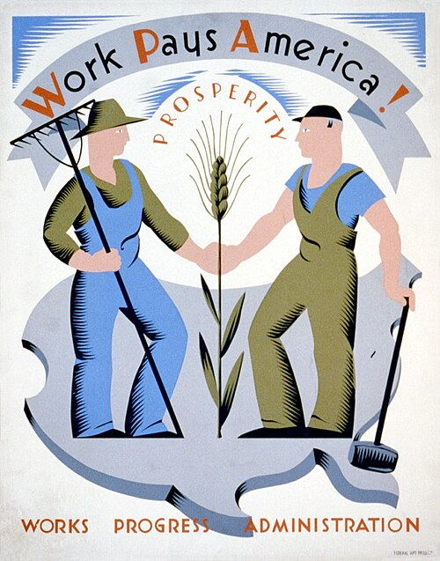
WPA and CCC
Poster for Works Progress Administration encouraging laborers to work for America, showing a farmer and a laborer.
The CCC built this low-water bridge across Rock Creek in the late 30s. Boyle Park, Pulaski County, Little Rock, Arkansas
This file is licensed under the Creative Commons Attribution-Share Alike 3.0 Unported license.
Notes:
The WPA (Works Progress Administration) and CCC (Civilian Conservation Corps) were major Depression-era relief agencies. The CCC was a paramilitary-style program for young, unmarried men focusing on conservation, while the WPA was a massive public works program that employed older adults in urban infrastructure and arts projects. Over the life of the programs, there were approximately 11.5 million people employed.
Works Progress Administration (WPA)
Established later in 1935 as part of the Second New Deal, the WPA (renamed in 1939 as the Work Projects Administration) employed millions of job-seekers.
Mission: Alleviated widespread unemployment by completing local infrastructure and arts projects.
Work: Workers constructed thousands of schools, hospitals, roads, and playgrounds. It also featured "Federal One," which employed artists, writers, and musicians to create public murals, historical guides, and theater performances.
Structure: Unlike the CCC, workers typically lived at home and were paid prevailing local wages.
Civilian Conservation Corps (CCC)
Established in 1933, the CCC was designed for unemployed, unmarried young men (initially ages 18-25).
Mission: Provided manual labor jobs related to the conservation and development of natural resources.
Work: Enrollees built roads, bridges, campgrounds, and planted millions of trees to prevent soil erosion.
Structure: Camps were managed by reserve officers of the U.S. Army. Enrollees were paid $30 a month, with $25 sent directly to their families.

Slide 28
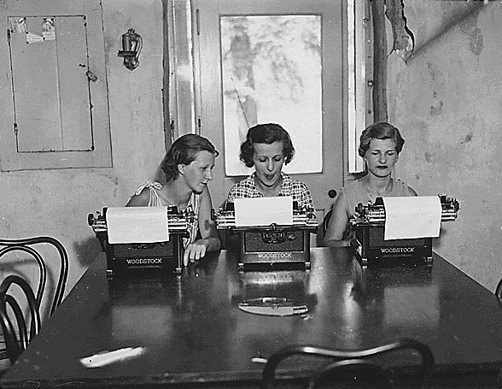
Federal Emergency Relief Administration (FERA)
Three women with typewriters. Federal Emergency Relief Administration: FERA camps for unemployed women in Arcola, Pennsylvania; "Second Camp", ca. 07/1934.
https://commons.wikimedia.org/wiki/File:FERA_camp_in_Pennsylvania.jpg
This work is in the public domain in the United States because it is a work prepared by an officer or employee of the United States Federal Government as part of that person’s official duties under the terms of Title 17, Chapter 1, Section 105 of the US Code.
FERA provided work for over 20 million people and developed facilities on public lands across the country.
Notes:
The Federal Emergency Relief Administration (FERA) was a New Deal program established by President Franklin D. Roosevelt in May 1933. Directed by Harry Hopkins, it distributed $3.1 billion in federal grants to state and local governments. Its primary goal was to provide immediate cash assistance, food, and work relief to millions of unemployed Americans during the Great Depression. [1, 2, 3, 4]
FERA operated under a dual approach: [1]
Direct Relief: It provided immediate cash, food, and clothing to the destitute, ill, and elderly.
Work Relief: It partnered with states to fund local work projects, providing gainful employment on public lands, construction, and arts programs for millions of Americans.
FERA's main goal was to alleviate household unemployment by creating new unskilled jobs in local and state government. Jobs were more expensive than direct cash payments (called "the dole"), but were psychologically more beneficial to the unemployed, who wanted any sort of job for self-esteem. From May 1933 until it closed in December 1935, FERA gave people and localities $3.1 billion (the equivalent of $70.8 billion in 2023).^{[1]} FERA provided work for over 20 million people and developed facilities on public lands across the country.
Faced with continued high unemployment and concerns for public welfare during the coming winter of 1933–34, FERA instituted the Civil Works Administration (CWA) as a $400 million short-term measure to get people to work. FERA was shut down in 1935 and its work taken over by two completely new federal agencies, the WPA and the Social Security Administration.

Slide 29
World War to Cold War

Slide 30
From World War to Superpower
Attack on Pearl Harbor leads to wartime economy and the War Production Board.
Executive Order 9066 instituted Japanese Internment camps in 1941. Over 100,000 Japanese Americans were stripped of their rights and forced into the camps.
The GI Bill was passed in 1944 and provided federal funding for veterans’ education, mortgages and healthcare.
After World War II, the U.S. established a massive, permanent defense apparatus and well-funded intelligence network.
Notes:
World War II transformed the US government into a global superpower and expanded its domestic reach. Key milestones include: [1, 2, 3]
Pearl Harbor and Total War Mobilization: Following the December 7, 1941, attack on Pearl Harbor, the government instituted a wartime economy, establishing agencies like the War Production Board to control manufacturing, wages, and food rationing. [1, 2, 3]
Executive Order 9066: Driven by wartime paranoia, President Roosevelt signed the 1942 order that stripped over 100,000 Japanese Americans of their rights and forced them into internment camps, a civil rights violation later acknowledged by the government. [1, 2, 3, 4]
The GI Bill: The 1944 Servicemen's Readjustment Act provided unprecedented federal funding for veterans' education, mortgages, and healthcare, cementing the government’s role in civilian economic welfare and the growth of the middle class. [1, 2, 3, 4, 5]
The Post-War Military-Industrial Complex: Escalating tensions with the Soviet Union and the dawn of the atomic age ended the traditional US peacetime military reductions. This established a massive, permanent defense apparatus and a heavily funded intelligence network
It is called the "GI Bill" because it was designed for ordinary U.S. service members. "GI" is a popular military nickname that stands for Government Issue or General Issue, a term originally stamped on standard-issue military equipment and gear

Slide 31
Catalyst to Dismantling Segregation
The Double V Campaign and Desegregation of Defense Industries – launched by African American leaders, the victory over fascism and victory over racism.
Executive Order 8802 was signed by FDR and banned racial discrimination in the defense industry.
Led to the Fair Employment Practices Committee (FEPC) – the first major federal action against workplace discrimination.
Wartime Service and Executive Order 9981 – African Americans served in segregated units. Their service led to President Truman signing the EO 9981 which officially desegregated the U.S. Armed Forces.
Notes:
Wartime participation during World War II acted as a powerful catalyst for the modern Civil Rights Movement, forcing the US government to begin dismantling systemic segregation to maintain global credibility and domestic productivity. [1]
Here is how key wartime events directly shaped subsequent civil rights breakthroughs:
The Double V Campaign and Desegregation of Defense Industries: African American leaders launched the "Double V" campaign—victory over fascism abroad and victory over racism at home. Facing a threatened march on Washington led by civil rights activist A. Philip Randolph, President Franklin D. Roosevelt issued Executive Order 8802 in 1941. This order banned racial discrimination in the defense industry and established the Fair Employment Practices Committee (FEPC), marking the first major federal action against workplace discrimination since Reconstruction. [1, 2, 3, 4, 5]
Wartime Service and Executive Order 9981: More than one million African Americans served in the military during WWII, despite being restricted to segregated units and often relegated to service duties. Their sacrifices, contrasted with the racist ideology the US fought against in Europe, created an undeniable moral contradiction. In 1948, building on this momentum and intense pressure from civil rights advocates, President Harry S. Truman signed Executive Order 9981, officially desegregating the United States Armed Forces. [1, 2, 3, 4, 5]
The GI Bill’s Unequal Implementation: The Servicemen's Readjustment Act of 1944 (GI Bill) offered transformative educational and housing benefits to veterans. However, because local and state administrations handled the distribution of these benefits, Black veterans were systematically denied access to mortgages and university admissions. This blatant inequity galvanized civil rights organizations like the NAACP to launch targeted legal campaigns against local and state segregation laws. [1, 2, 3, 4, 5]
The Birth of the "Cold War Credibility" Argument: As the US entered the Cold War, Soviet propaganda frequently exploited American racial violence and Jim Crow laws to win over unaligned nations in Africa and Asia. The US State Department quickly realized that domestic racism was a severe foreign policy liability. This shift forced the federal government to intervene more aggressively in civil rights matters, ultimately paving the way for landmark Supreme Court decisions like Brown v. Board of Education (1954) and the Civil Rights Act of 1964

Slide 32
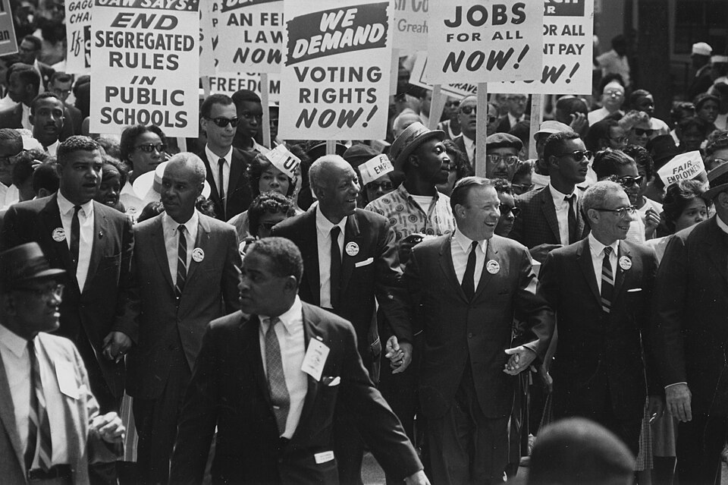
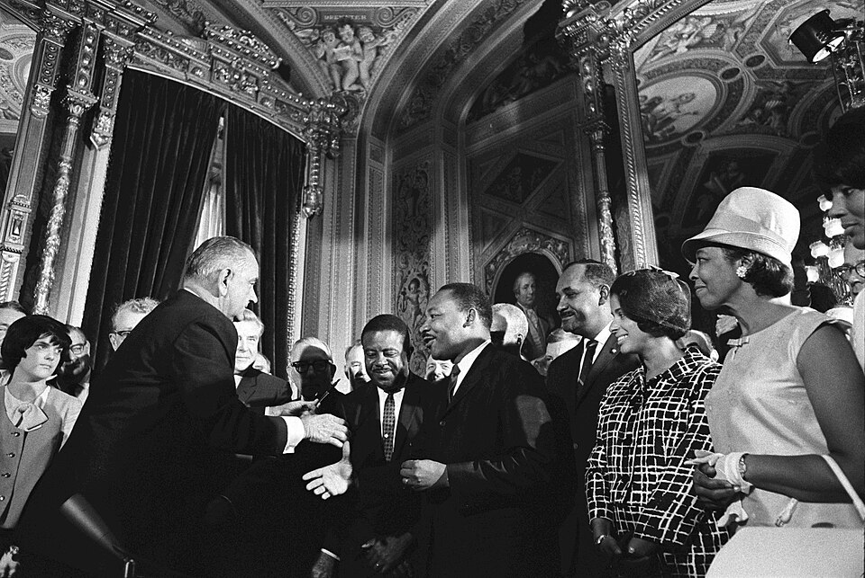
Civil Rights Act of 1964 and
Voting Rights Act of 1965
Civil Rights March on Washington, D.C.
President Lyndon B. Johnson meets with Martin Luther King, Jr., at the signing of the Voting Rights Act of 1965
The National Archives and Records Administration provides images depicting American and global history which are public domain or licensed under a free license.
This work is in the public domain in the United States because it is a work prepared by an officer or employee of the United States Federal Government as part of that person’s official duties under the terms of Title 17, Chapter 1, Section 105 of the US Code.
Notes:
The U.S. Civil Rights Movement dismantled legal segregation and restored universal voting rights. Driven by decades of grassroots organizing, litigation, and civil disobedience, landmark victories included the Civil Rights Act of 1964, which outlawed discrimination in public spaces and jobs, and the Voting Rights Act of 1965.

Slide 33
Engaging Students in History and Civics

Slide 34
Make History and Civics Engaging
Anchor the story to a person. Look at a specific event or era through that person’s eyes.
Focus on Emotions or Motivation. Help students understand “why” someone made a choice – the desire for freedom, the fear of the unknown or the struggle to protect one’s community, family, beliefs, etc.
Use Sensory Details. Help students bring the past to life by evoking the senses
Frame Events Around “The Great Unknown”. Provide information from the perspective of the moment it happened – when the outcome was uncertain.
Notes:
To make history feel like a compelling human story rather than a dry list of dates and facts, it helps to shift the perspective from the macro-level events to the micro-level experiences of the people who lived through them.
Here is how you can transform historical narratives into engaging stories:
1. Anchor the Narrative to an Individual
Instead of covering an entire war, revolution, or century all at once, view the era through the eyes of a single person. This could be a famous leader facing an impossible decision, or an ordinary citizen—a baker, a soldier, or a nurse—navigating the chaos of their time. Their personal stakes, fears, and daily routines make the broader historical context relatable.
2. Focus on Universal Emotions and Motivation
The technology and customs of the past change, but human emotions do not. Frame historical events around timeless conflicts: the desire for freedom, the pain of betrayal, the fear of the unknown, or the struggle to protect one's family. When audiences understand why someone made a choice based on their survival or ambitions, the history becomes alive.
3. Utilize Sensory Details
Bring the past to life by evoking the senses. Instead of just stating that a city was besieged, describe the smell of smoke, the sound of standard-issue boots on cobblestones, or the scarcity of clean water. Sensory details bridge the gap between ancient timelines and modern imaginations.
4. Frame Events Around "The Great Unknown"
Hindsight can make history feel inevitable, which drains it of suspense. To make it compelling, write from the perspective of the moment it happened—when the outcome was entirely uncertain. Highlight the doubts, the failed backup plans, and the sheer luck or miscalculation that altered the course of events.

Slide 35
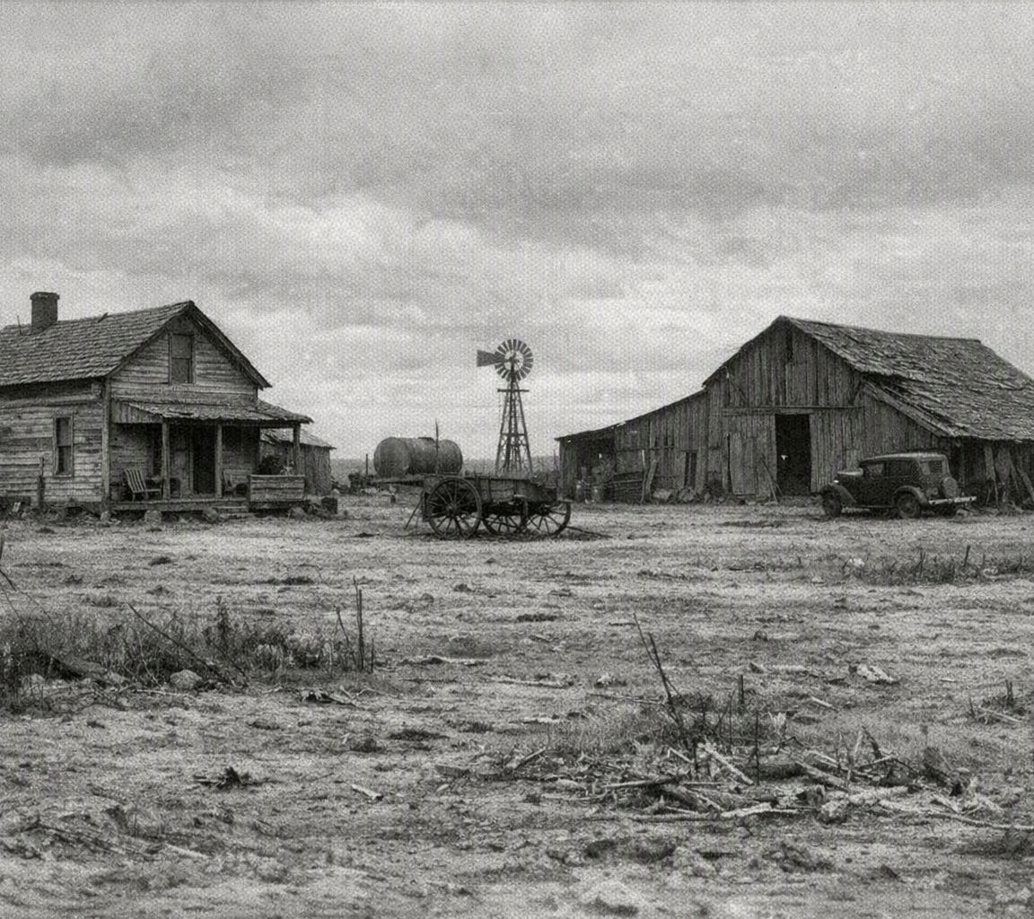
Losing the Farm
October 1932. Wheat that fetched near three dollars a bushel when I was a boy brought thirty cents today. I hauled a full wagon to town and still could not cover the note on the tractor. To keep the children warm we burned corn in the stove — coal costs more now than the crop I raised.
Then the rain quit. The drought took what low prices had left, and the wind took the rest — black blizzards rolling in at noon, dirt drifting against the door like snow. We ate with rags tied over our mouths and still tasted grit in the bread.
This spring the bank foreclosed. We were not alone — nearly a third of the farmers I know have lost their land the same way. I nailed shut the door on three generations, loaded the truck, and pointed it west toward California, carrying little but the hope that somewhere there is work for a man who once fed a county.
Notes:
Copilot - Write about the struggles of someone losing their farm during the great depression.
Ground the narrative in history
Add a period photograph of a farm

Slide 36
James Madison – A Tough Decision
In the spring of 1777, James Madison ran for a seat in the Virginia House of Delegates and lost — undone not by his ideas, but by an empty punch bowl.
Virginia elections then ran on a well-oiled custom known as “swilling the planters with bumbo”: candidates were expected to treat voters to whiskey, rum, and cider at the polls. Madison judged the practice a corrupt bargain, too much like buying votes, and refused to hand out a single drink.
His thirsty neighbors rewarded that principle by electing a more generous, less scrupulous opponent, Charles Porter. The defeat stung but did not sink him — later that same year the legislature named Madison to the Governor’s Council of State, setting him back on the path that would one day carry him to the presidency.
Notes:
AI prompt - Write a narrative about James Madison losing an election because he didn't serve alcohol to voters.

Slide 37
Valley Forge
The Taste of Scarcity (Gustatory)
Food was a luxury, and flavor was entirely nonexistent. Days were measured by the consumption of "firecake"—a miserable paste of flour and water baked over an open fire until the outside was blackened with ash and the inside remained gooey and tasteless. It felt like swallowing wet clay, offering little comfort to bellies that constantly roared and hollowed out with hunger. On the rare days when salt pork was rationed, it tasted intensely briny and tough, leaving a lingering, parching thirst that could only be quenched by melting handfuls of dirty, metallic-tasting snow in the mouth.
The Bite of the Cold (Tactile)
To step outside the log huts was to be assaulted by a bitter, biting wind that sliced through threadbare linen shirts like a dull blade. The ground beneath was an unyielding sheet of frozen mud and jagged ice, which tore mercilessly at bare feet. For those whose shoes had long since rotted away, the march left a gruesome trail of dark red splotches in the pristine snow. Fingers, stiff and graying from frostbite, felt like brittle twigs—clumsy and nearly numb as they wrapped around the icy, iron barrels of muskets. Even inside the crowded huts, the only warmth came from the suffocating huddle of shivering bodies pressing together for survival.
Notes:
Google AI Mode - Compose a narrative focusing on the sensory details that someone would feel at the battle of valley forge

Slide 38
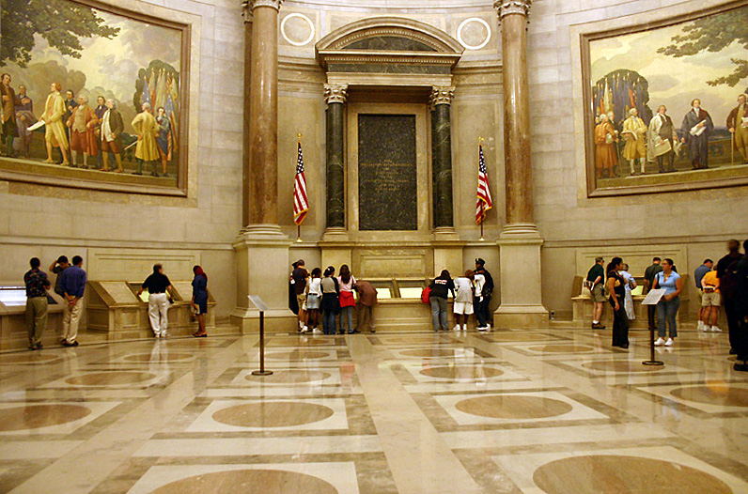
Rotunda for the charters of Freedom at National Archives (NARA) building in Washington, D.C. Here displayed are the Declaration of Independence, the Bill of Rights, and the U.S. Constitution.
This work has been released into the public domain by its author, Kkmd at English Wikipedia. This applies worldwide.

Slide 39

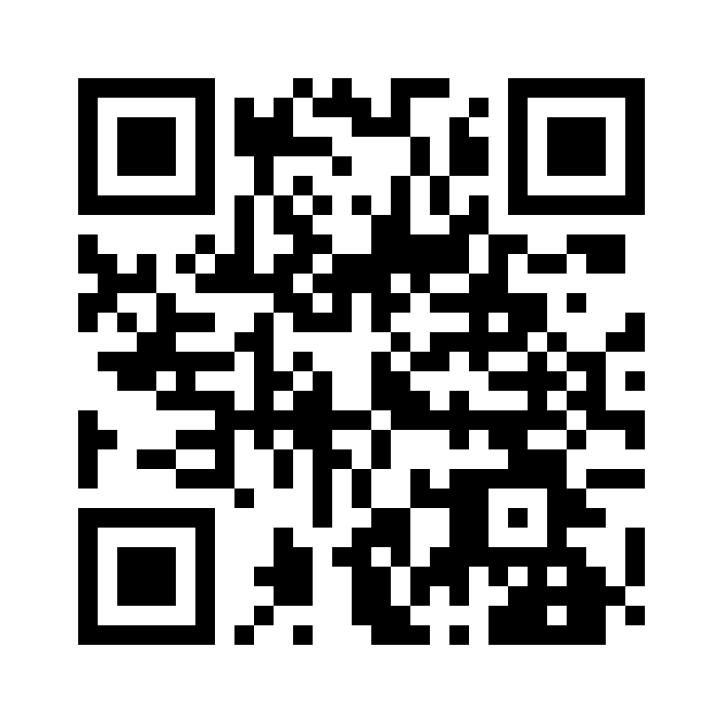
Session Survey
Your feedback is important. Please scan the QR code below to rate this session.

