Slide 1
Level Up with Strategies and Resources for the GED Social Studies Test
Liz Lanphear, MS

Slide 2
1
4
Overview of the Social Studies Test
Resources for Source texts
2
5
Reading Strategies
Gaps & Strategies
3
6
High Impact Indicators
Additional Resources

Slide 3
Overview of the Social Studies Test

Slide 4

Overview of Social Studies Test
70 Minutes
Content
  50% - Civics and Government
  20% - United States History
  15% - Economics
  15% - Geography and the World
Themes
  Development of Modern Liberties and Democracy
  Dynamic Responses in Societal Systems
Social Studies Practices – analyzing, thinking, reasoning
Technology-enhanced question items
Notes:
Key Points
This slide provides a short overview of the content and context of the Social Studies Test. Review the information on the slide. For additional information, access the Assessment Guide for Educators Social Studies section.

Slide 5
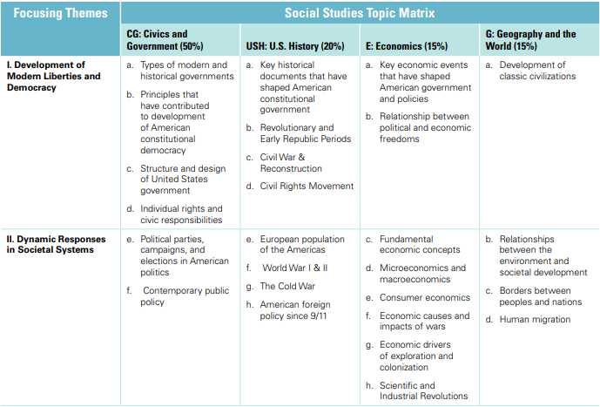
70%

Slide 6
Variety of Item Types
Multiple-choice
Fill-in-the-blank
Drag-and-drop
Hot-spot
Drop-down
Extended-response (Language Arts)
Notes:
The new GED test includes a wider variety of item types than were on the 2002 Series test. Multiple choice items continue to appear on the test as one of the key item types. Multiple choice items are a reliable method of measuring skills and knowledge at a range of cognitive levels in a standardized manner. But remember that the additional item types allow us to measure a wider range of skills and cognitive levels.
Constructed response items come in two versions – one, we call short answer, and that type can usually be answered in a few sentences (e.g. Science), and the extended response, which requires a longer response – multiple paragraphs (e.g. Reasoning Through Language Arts)

Slide 7
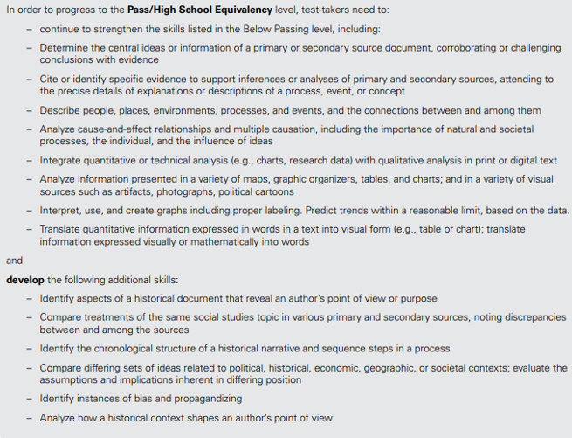
Assessment
Guide
assessment_guide_for_educators_social_studies.pdf

Slide 8
Reading Strategies

Slide 9
Close Reading Strategies
Prepare for reading
Think about what you are going to be reading and asking yourself questions.
Seek to understand the author’s purpose – why was this important?
Ask questions as you read to help maintain focus.
Re-read the text. Think about the WHOLE text.
Do not rush. Instead, take a breath and focus.
Stamina – stick with what they are reading, build up from one paragraph, to multiple
Use the highlighter tool to mark key parts in the text (and make the passage less daunting).
Note taking

Slide 10
Value of Reading in Context
Close Reading Strategies
Read and re-read to determine the details of what the text says explicitly and to make logical inferences from it
Notice significant language
Draw conclusions and make generalizations from synthesizing the information in the text and/or illustrations
Cite specific textual evidence that supports conclusions drawn from the text
Teach Before, During, and After Reading Strategies

Slide 11
Before Reading Strategies
Look at the title
Review headings and subheadings
Identify structure
Activate prior knowledge
Determine purpose

Slide 12
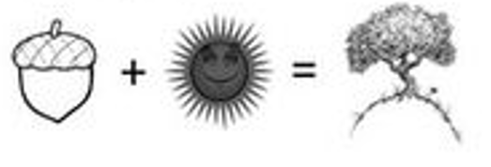
During Reading Strategies
Ask Questions
Make connections based on what they already know
Use context to identify unfamiliar words
Reread and make notes
Use signal words

Slide 13
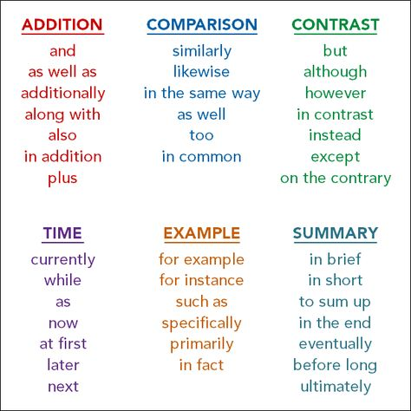
Signal Words

Slide 14
After Reading Strategies
Summarize
Ask clarifying questions
Evaluate what has been read
Discuss with the group

Slide 15
Common Mistakes Students Make When Reading
Not reading the entire text
Not seeing the building blocks of the author’s argument
Ignoring the details of the text
Not understanding the overall message of the text

Slide 16
Common Mistakes Students Make When Answering Questions Based on Reading
Choosing an answer that sounds true (plausible) but contradicts the views or overall message of THIS text
Choosing an incorrect option that is an opinion, but it is not THIS author’s opinion (or is not supported based on the author’s claim and line of reasoning)
Word matching: Picking an option because it uses a key word in the passage, without thinking through if it is a good answer

Slide 17
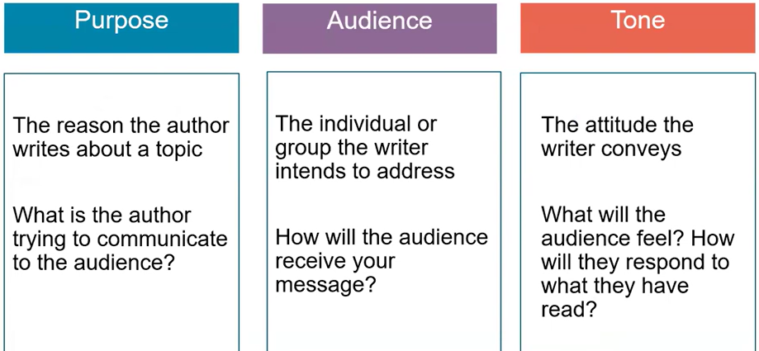
Elements that Shape the Text

Slide 18
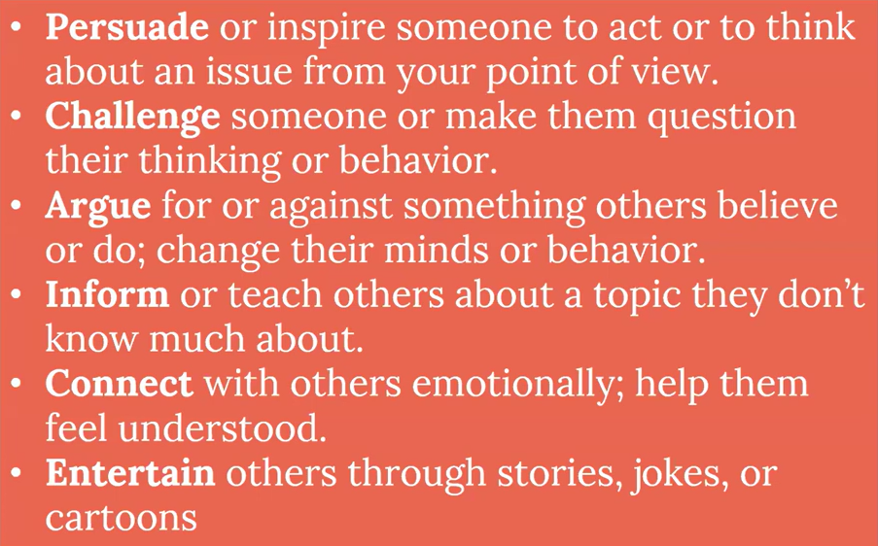
What’s the Author’s Purpose?

Slide 19
What’s the Author’s Purpose?
(Persuade, Challenge, Argue, Inform, Connect, Entertain)
An article emphasizes the importance of using more sustainable materials and less plastic in order to protect the environment.
What is the author’s purpose?
A speech by a candidate running for the U.S. Senate focuses on the need for volunteers and more donations to help him win the upcoming election.
What is the author’s purpose?
You just read a book about a young boy with superpowers.
What is the author’s purpose?
Notes:
Give students a photograph. Have them write how they would Persuade, Inform, Entertain

Slide 20

Strategy to teach Purpose
One topic – Three Purposes
Give students a photograph. Have them write how they would:
Persuade
Inform
Entertain
Notes:
Give students a photograph. Have them write how they would Persuade, Inform, Entertain

Slide 21
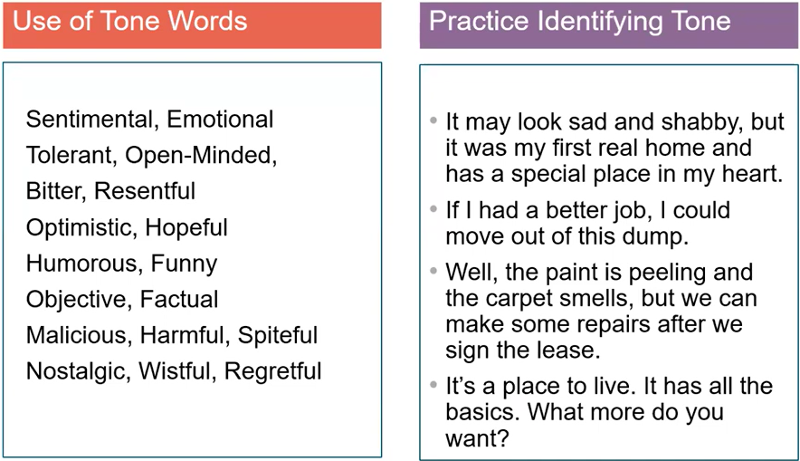
Reading Strategies

Slide 22
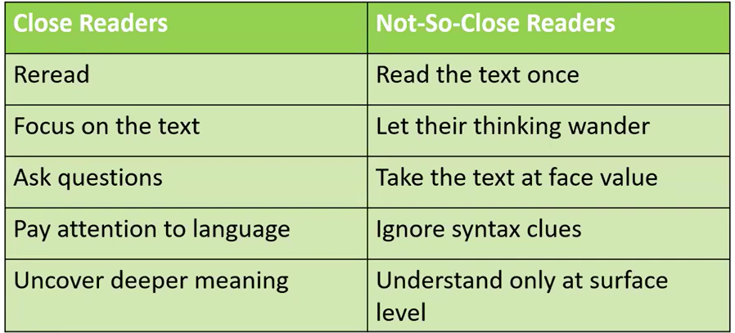
Reading Strategies

Slide 23
Don’t teach Social Studies in isolation
Use Social Studies content to teach Close reading and RLA skills (inference, identifying explicit claims…)
Set aside time every day to read – 15 min. Talk about what they read…
Math and Science Indicators can also translate to Social Studies!
Review the High Impact Indicators and weave in Social Studies skills with their partner subject

Slide 24
High Impact Indicators

Slide 25
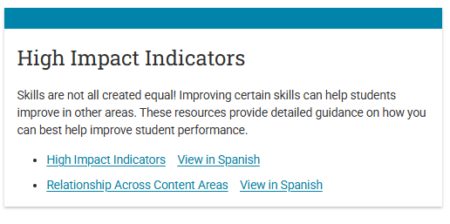
High Impact Indicators https://www.ged.com/wp-content/uploads/High_Impact_Indicators.pdf https://www.ged.com/wp-content/uploads/relationships_between_HII_and_other_indicators.pdf

Slide 26
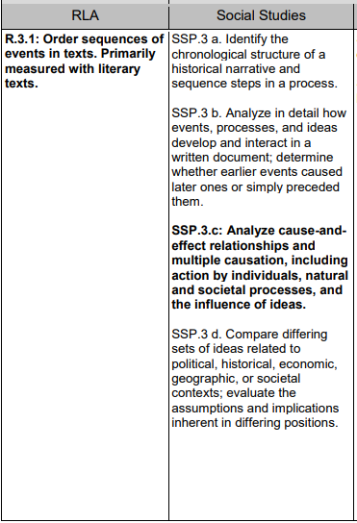
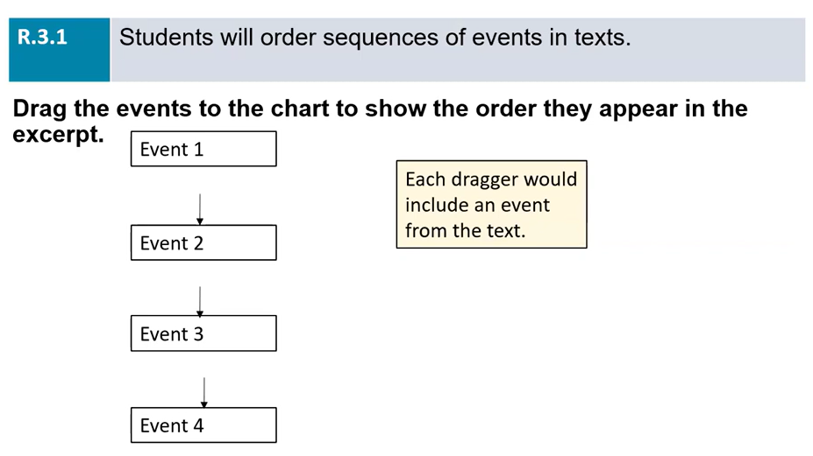
High Impact Indicator R.3.1, SSP.3.a,b,c,d

Slide 27
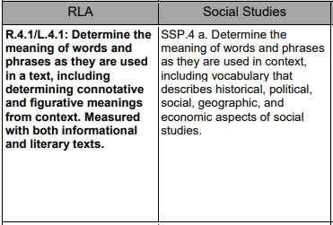
High Impact Indicator
R.4.1, L.4.1, SSP.4.a

Slide 28
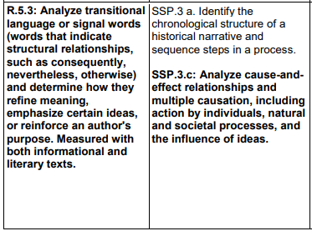
High Impact Indicator
R.5.3, SSP.3.a, c

Slide 29
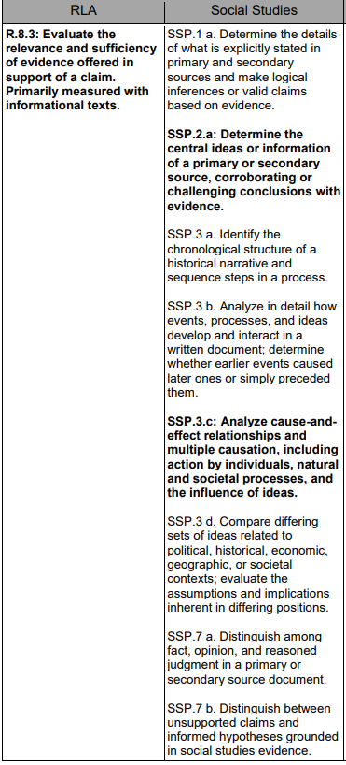
High Impact Indicator
R.8.3, SSP.1.a, 2.a, 3.a,b,c,d, 7.a,b

Slide 30
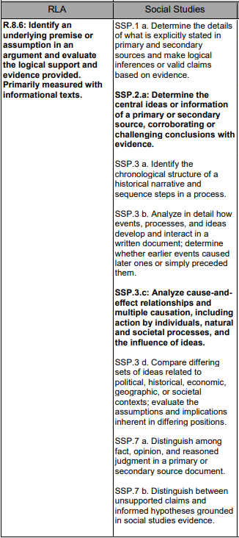
High Impact Indicator
R.8.6, SSP.1.a, 2.a, 3.a,b,c,d, 7.a,b

Slide 31
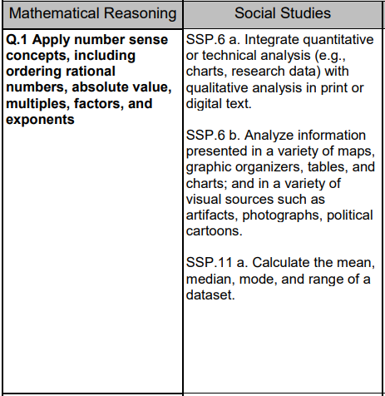
High Impact Indicators – Math & Social Studies
Q.1, SSP.6.a, b 11.a

Slide 32
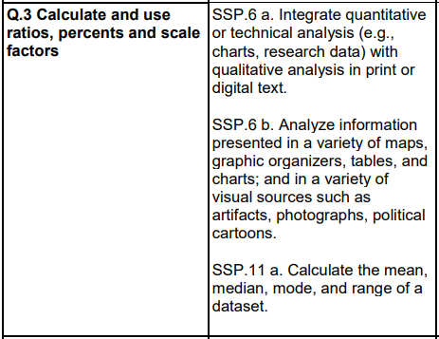
High Impact Indicators – Math & Social Studies
Q.3, SSP.6.a, b 11.a

Slide 33
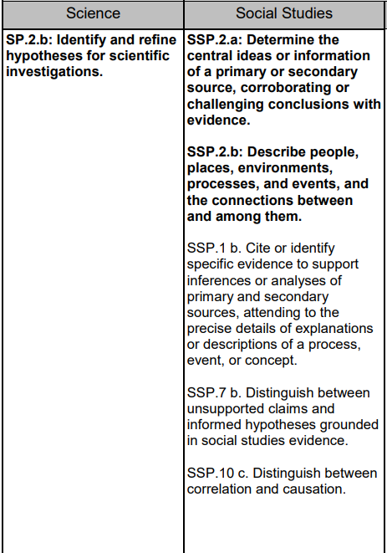
High Impact Indicators - Science
SP.2.b, SSP.2.a, b, 1.b, 7.b, 10.c

Slide 34
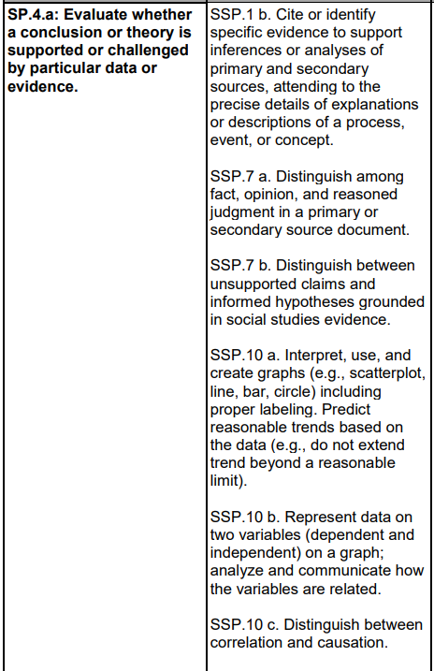
High Impact Indicators - Science
SP.4.a, SSP.1.b, 7.a, 10.a, b, c

Slide 35
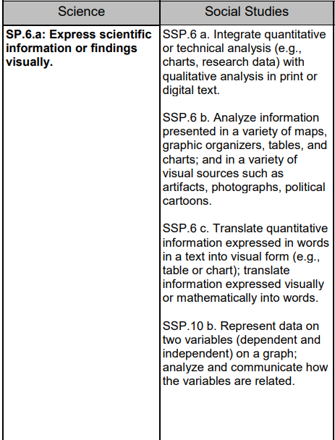
High Impact Indicators - Science
SP.6.a, SSP.6.a, b, c, 10.b,

Slide 36
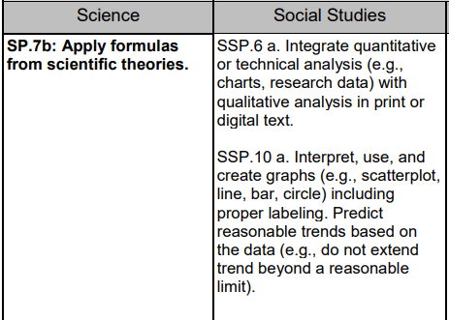
High Impact Indicators - Science
SP.7.b, SSP.6.a, 10.a,

Slide 37
Resources for Source Texts

Slide 38
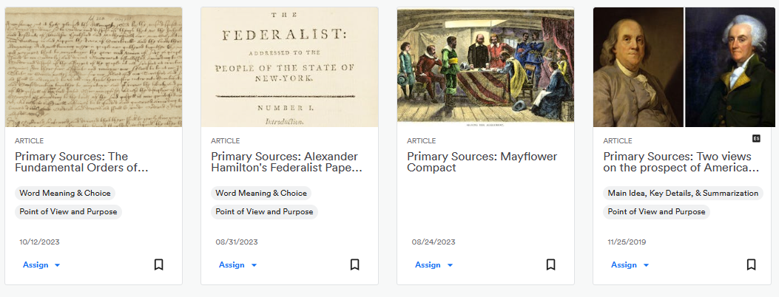
Need Resources for Source Texts?
Newsela, https://Newsela.com/

Slide 39
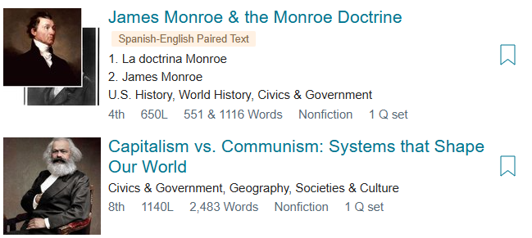
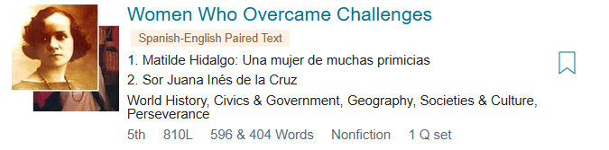
ReadWorks https://www.readworks.org/

Slide 40
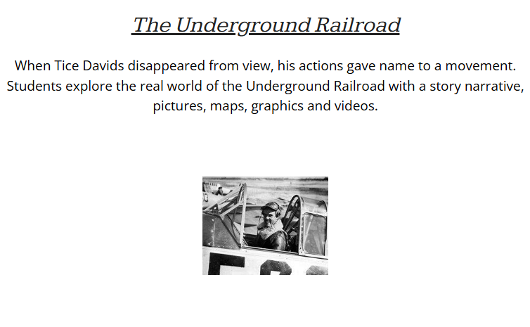
Awesome Stories https://www.awesomestories.com/

Slide 41
Gaps & Strategies

Slide 42
What gaps are there for test-takers in Social Studies ?
Students may need to improve their critical thinking and/or reading skills.
Gap 1 – Identify evidence to support inferences (SSP.1.b)
Gap 2 – Sequences of events (SSP.3.a)
Gap 3 – Compare differing ideas (SSP.3.d)
Gap 4 – Discrepancies between sources (SSP.8.a)
Gap 5 – Content knowledge
Notes:
Key Points
Gaps identified by the Assessment team

Slide 43
Gap 1: Identify Evidence to Support Inferences (SSP.1.b)
Cite or identify specific evidence to support inferences or analyses of primary and secondary sources, attending to the precise details of explanations or descriptions of a process, event or concept.
The gap:
Reading comprehension
Skill deficit in identifying evidence that supports inferences
Skill deficit in attending to precise details

Slide 44
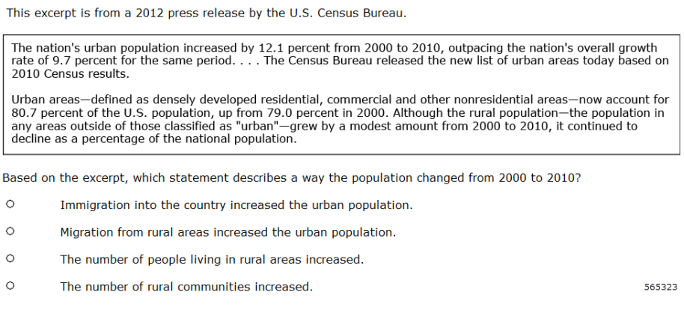
Gap 1 Example
Notes:
Precise details of the source. A – text doesn’t mention immigration, B – nothing about new urban population, C- Correct, the last sentence says “grew by a modest amount” D – misunderstanding – doesn’t say anything about # of rural communities.

Slide 45
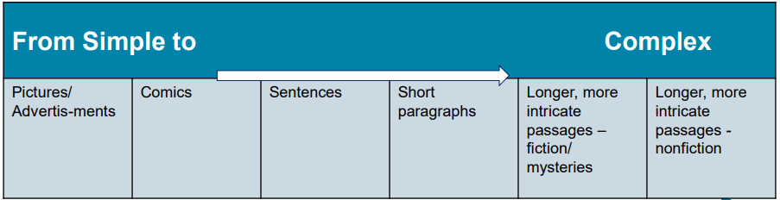
Gap 1 Strategies
Introduce the concept of inferencing by providing simple, real-life scenarios.
A woman is standing on a podium smiling, holding a medal.
What is going on?
How do you know? Identify specific words and phrases that give you hints about what is happening.

Slide 46

How Do Effective Readers Make Inferences?
They use:
Word/text clues
Picture clues
Define unknown words
Look for emotion (feelings)
Use what they already know
Look for explanations for events
ASK themselves questions!

Slide 47
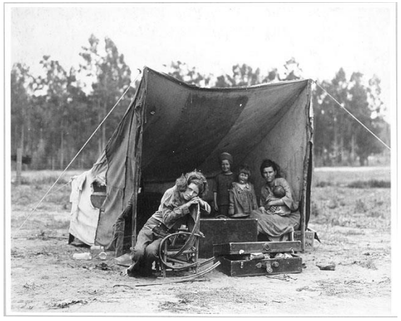
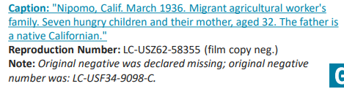
Use Photographs
What do you observe in this picture?
What does it remind you of?
What is the photographer’s purpose?
What inferences can you make based on what you see in this picture?

Slide 48
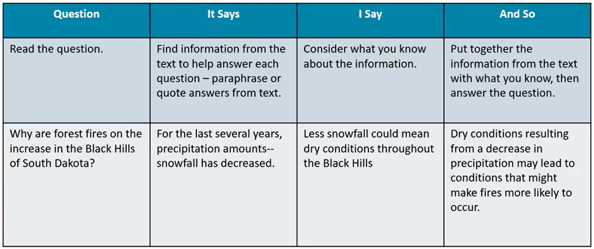
Strategy: It Says… I Say… And So…
Activating Background Knowledge
Notes:
Do you have to know specifically about South Dakota? No, you know that less snow = less moisture = dry conditions = higher likelihood of fire

Slide 49
Gap 2: Sequence of Events (SSP.3.a)
Identify the chronological structure of a historical narrative and the sequence steps in a process.
The gap:
Reading comprehension
Skill deficit in identifying the chronological order of events presented in a passage
Skill deficit in social studies content knowledge

Slide 50
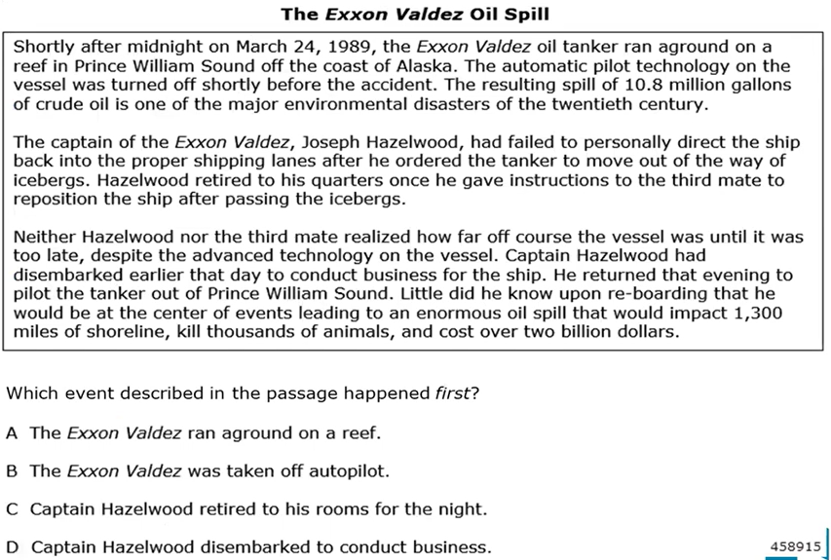
Gap 2 Example
Notes:
D. Not necessarily in chronological order in the paragraph. 1st in the passage isn’t first chronologically. 3rd paragraph is answer. Read entire text, highlight

Slide 51
Gap 2 Strategy
When reading primary and secondary sources, students need to be able to:
Order significant events on timelines
Understand the connections between and among people, places, and events
Identify cause and effect—both simple and complex
All of these require students to develop and use sequencing skills.

Slide 52
Gap 3: Compare differing Ideas (SSP.3.d)
Compare differing sets of ideas related to political, historical, economic, geographic, or societal contexts; evaluate the assumptions and implications inherent in differing positions.
The gap:
Reading comprehension
Skill deficit in making comparisons, logical assumptions, and rational inferences.

Slide 53
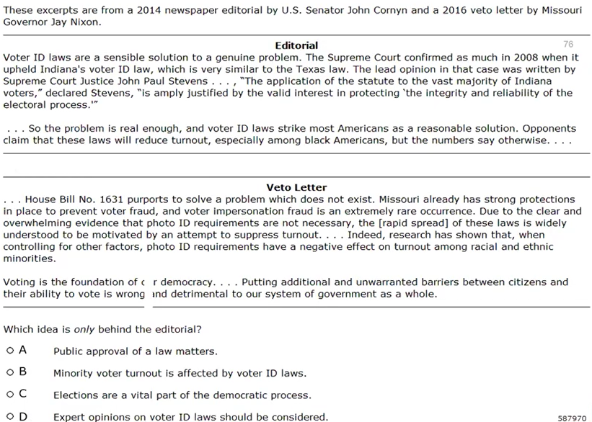
Gap 3 Example
Notes:
Read the question 1st, need to read both to determine which is only in Editorial, A

Slide 54
Gap 3 Strategies
Moving from Faulty to Logical Assumptions
Critical Questions
What am I taking for granted?
Am I assuming something I shouldn’t?
How can I determine whether this assumption is accurate?
What is the author assuming?
How can I determine if this author’s assumptions are accurate?
Example: Christie is researching representations of gender in popular music. She decides to search Google and, within a few minutes, locates more sources than she could possibly incorporate into her final paper.
Christie’s Inference/Conclusion: I can just use Google for my research.

Slide 55
Gap 4: Discrepancies between sources (SSP.8.a)
Compare treatments of the same social studies topic in various primary and secondary sources, noting discrepancies between and among the sources.
The gap:
Reading comprehension
Skill deficit in contrasting and comparing sources

Slide 56
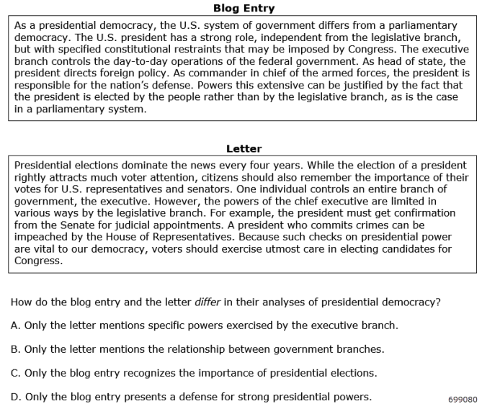
Gap 4 Example
Notes:
What is the question? Read the question first. A – both mention specific powers B- both mention relationship between branches C- Both, D-is correct, the letter doesn’t defend strong Pres. powers

Slide 57
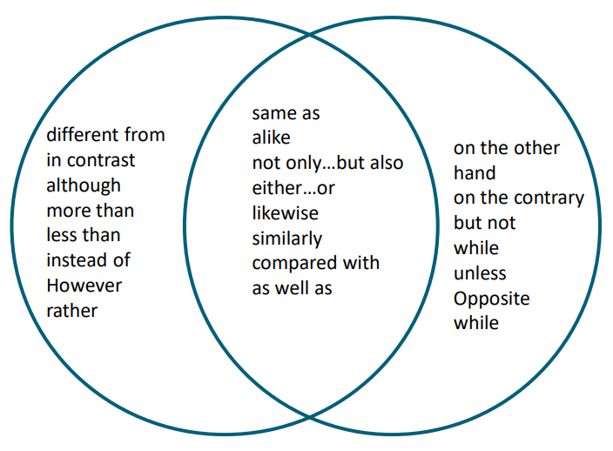
Gap 4 Strategies – Identify Signal Words to Compare and Contrast

Slide 58
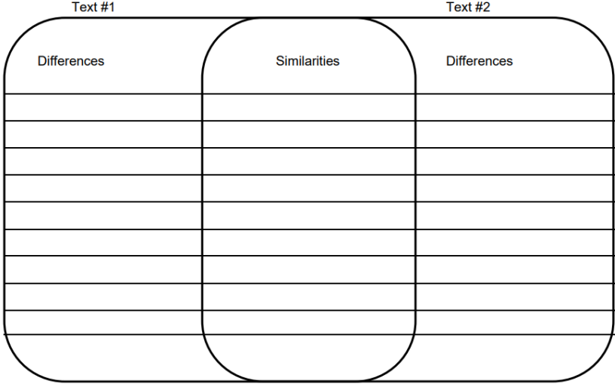
Compare and Contrast Graphic Organizer

Slide 59
Gap 5: Content Knowledge
Test questions assume students have a basic understanding of the social studies subject matter and terminology used in the content topics and indicators.
The gap:
  Civics/Government
  Economics

Slide 60
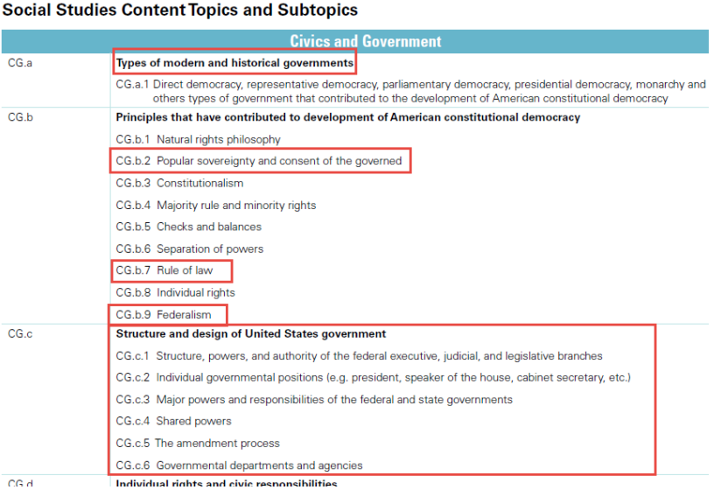
Gap 5 – Civics & Government
assessment_guide_for_educators_social_studies.pdf

Slide 61
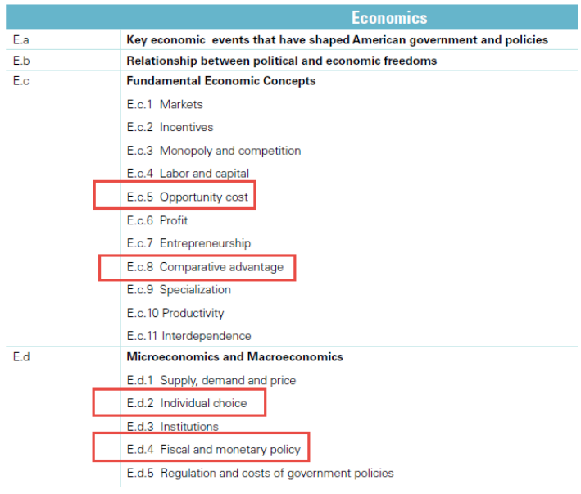
Gap 5 - Economics

Slide 62

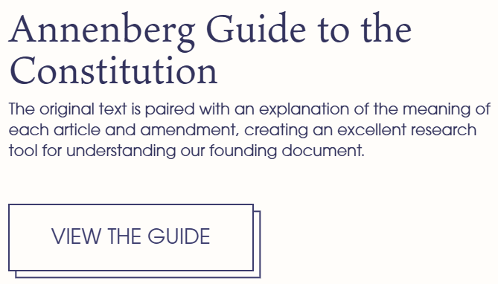
Gap 5 Strategies – Access Online Resources
http://www.annenbergclassroom.org
Copyright and Use of AnnenbergClassroom.org Books:
All AnnenbergClassroom.org books are free for viewing at AnnenbergClassroom.org and may be downloaded only by teachers and students without charge.

Slide 63
Gap 5 Strategies – Access Online Resources
http://docsteach.org
DocsTeach is a product of the National Archives education division.
Except where otherwise noted, DocsTeach is licensed under a Creative Commons Attribution-NonCommercial-ShareAlike 4.0 International License. Primary source documents included on this site generally come from the holdings of the National Archives and are in the public domain, except as noted. Teaching activities on this site have received the CC0 Public Domain Dedication; authors have waived all copyright and related rights to the extent possible under the law. See our legal and privacy page for full terms and conditions.

Slide 64

Gap 5 Strategies – Access Online Resources https://www.inquirygroup.org/?q=node/21
Civic Online Reasoning
Stanford University
Register but no charge

Slide 65
Additional Resources

Slide 66
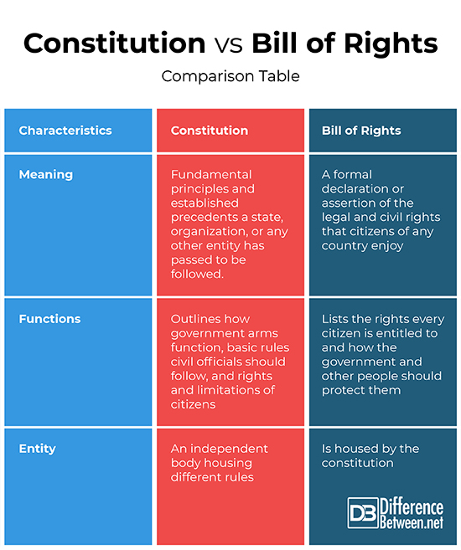
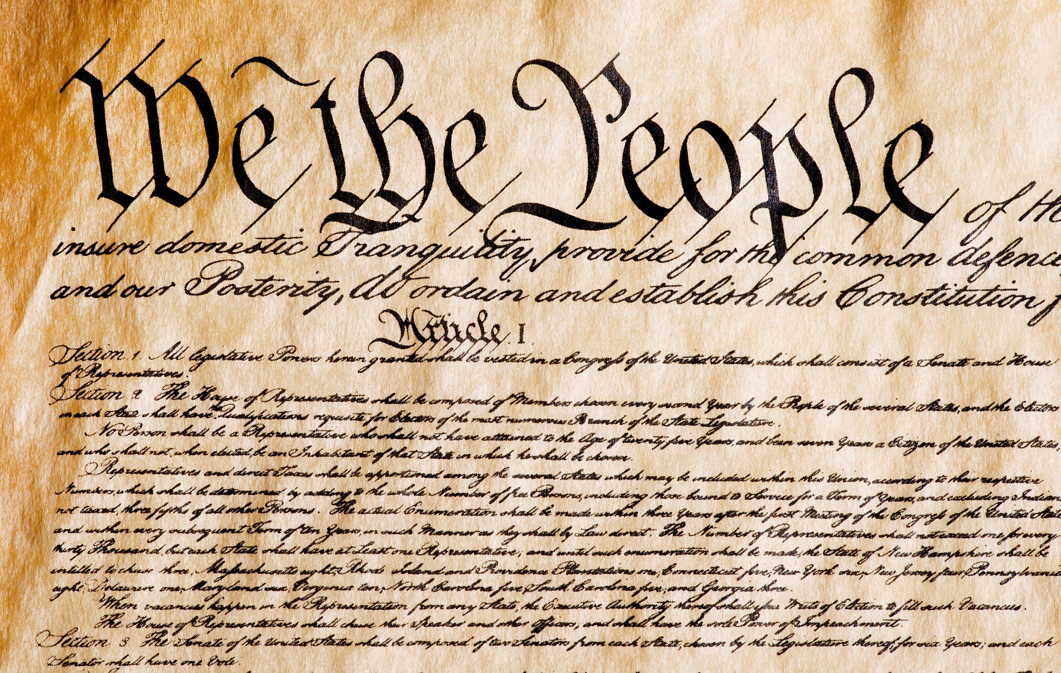
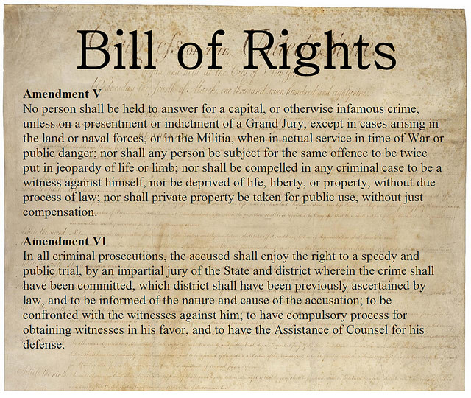
https://www.differencebetween.net/

Slide 67
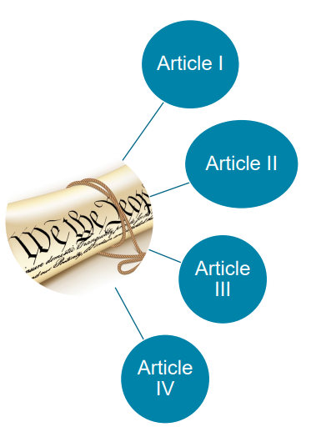
Explore the Basics – The Constitution
Article I
Congress
President
Article II
Article III
Courts
Article IV
States

Slide 68
The Constitution
Coin Money
Establish the Budget
Regulate Commerce
Declare war and support an army and navy
Make other laws to carry out powers
Congress
President
Courts
States

Slide 69
The Constitution
Coin Money
Establish the Budget
Regulate Commerce
Declare war and support an army and navy
Make other laws to carry out powers
Congress
Act as Commander-in-Chief
Maintain cabinet of advisers
Negotiate treaties
Appoint Supreme Court Justices
Execute laws
President
Courts
States

Slide 70
The Constitution
Coin Money
Establish the Budget
Regulate Commerce
Declare war and support an army and navy
Make other laws to carry out powers
Congress
Act as Commander-in-Chief
Maintain cabinet of advisers
Negotiate treaties
Appoint Supreme Court Justices
Execute laws
President
Interpret the meaning of laws Decide whether a law is relevant to a particular set of facts Rule on how a law should be applied Determine whether a law is constitutional
Courts
States

Slide 71
The Constitution
Coin Money
Establish the Budget
Regulate Commerce
Declare war and support an army and navy
Make other laws to carry out powers
Act as Commander-in-Chief
Maintain cabinet of advisers
Negotiate treaties
Appoint Supreme Court Justices
Execute laws
Interpret the meaning of laws Decide whether a law is relevant to a particular set of facts Rule on how a law should be applied Determine whether a law is constitutional
Create and enforce their own laws Respect laws of other states Extradite criminals Have a representative government Follow “supreme law of the land”

Slide 72
The Constitution
Article V
Process to Amend the Constitution
Article VI
Establishes the Constitution as the supreme law of the land, and includes provisions for debts and oaths of office
Article VII
Details the process for ratification of the Constitution

Slide 73
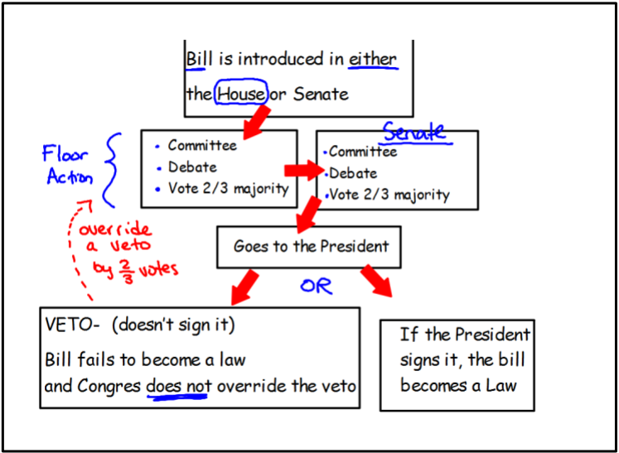
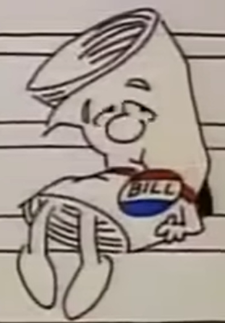
From Bill to Law
Schoolhouse Rock – I’m Just a Bill
https://youtu.be/OgVKvqTItto?si=p-a122-zDKrPoF1R

Slide 74
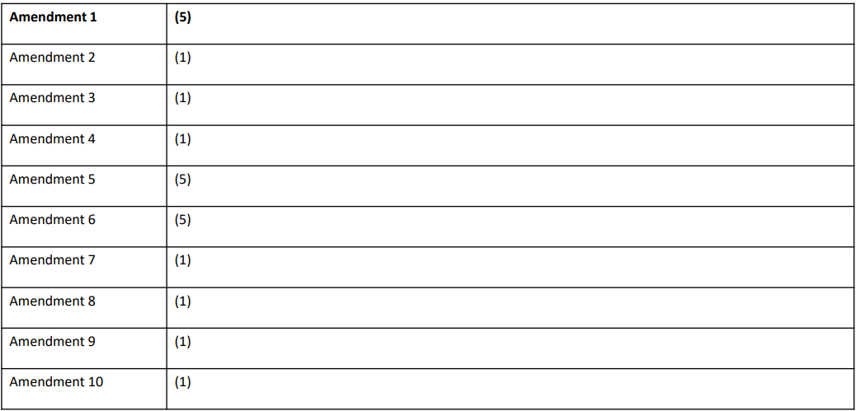
What are my rights?

Slide 75
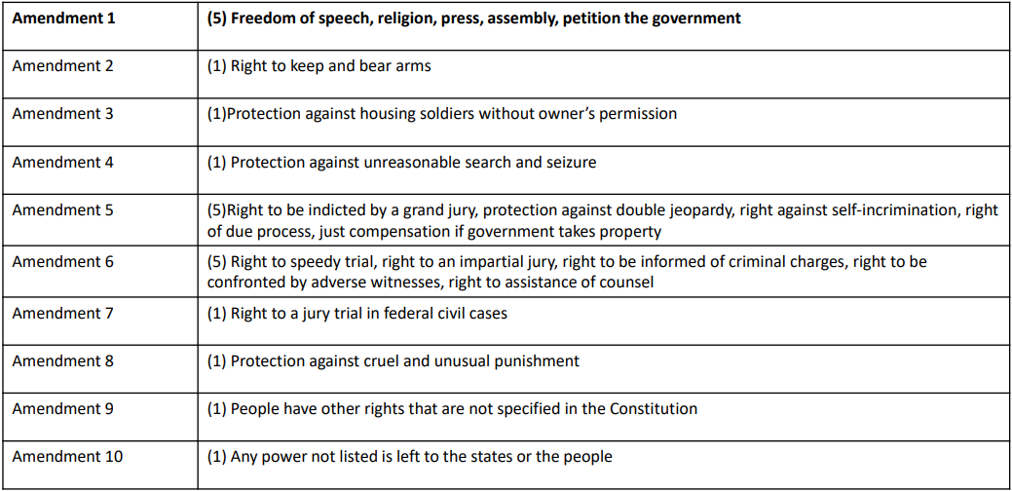
What are my rights?

Slide 76
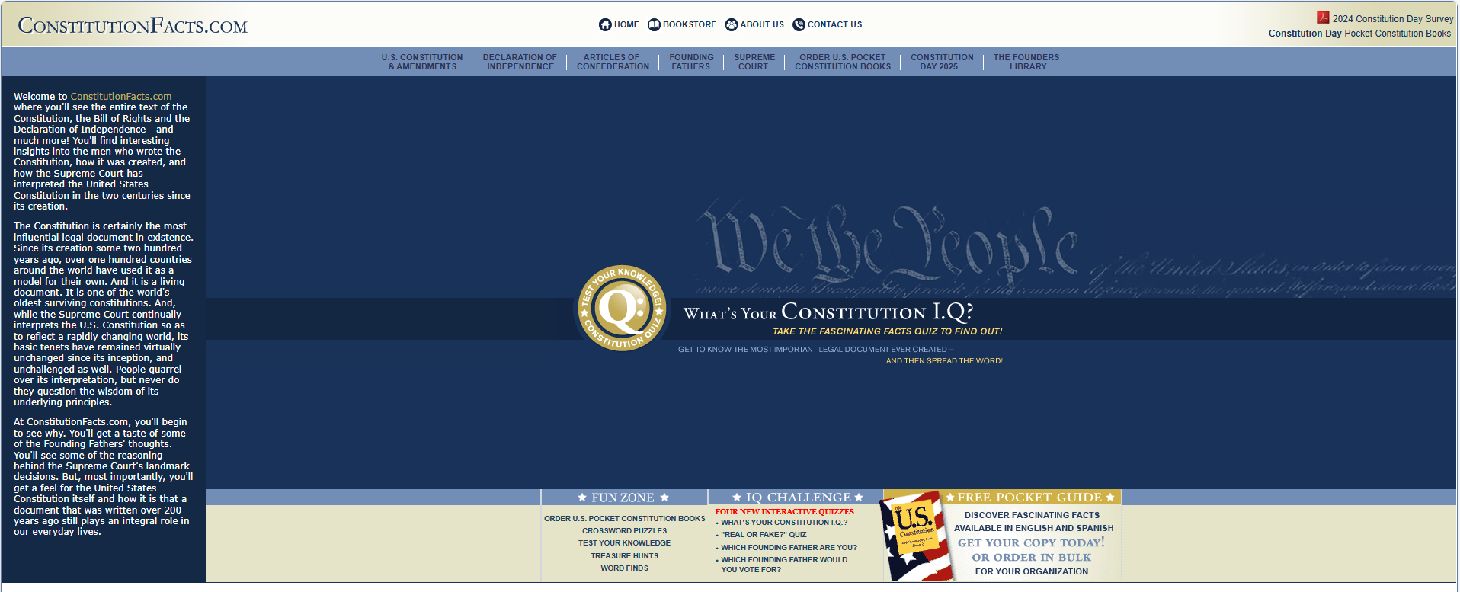
https://www.constitutionfacts.com/

Slide 77
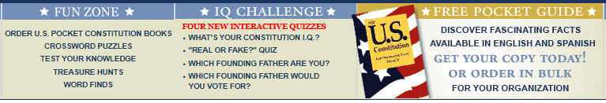
https://www.constitutionfacts.com/

Slide 78
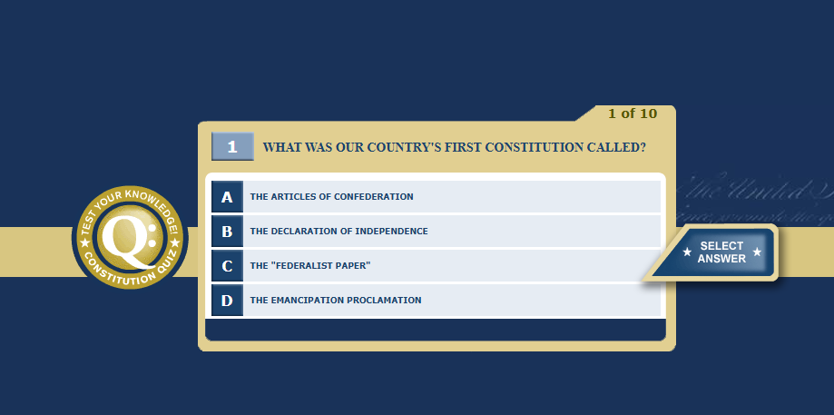

Slide 79

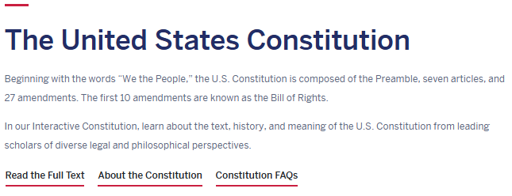

https://constitutioncenter.org/the-constitution

Slide 80
General Strategies
Share the GED® indicators and content topics with your students. The content topics can be used as a teaching/study guide.
Review key foundational concepts/content.
Remind students to carefully read the questions and excerpts.
Encourage students to study key definitions and terms.
Encourage students to read more. Strong reading skills will benefit students in all 4 subject area tests.
Encourage students to analyze the content they read on a daily basis. Strong critical thinking skills will benefit students in all 4 subject area tests.

Slide 81



ARMED for Reading and Answering Questions Carefully
Analyze Questions
Read the text
Make notes and highlight clues
Eliminate choices
Double check every answer

Slide 82
Resources
https://Newsela.com/
https://www.readworks.org/
https://www.awesomestories.com/
http://www.annenbergclassroom.org
https://docsteach.org/
https://www.inquirygroup.org/?q=node/21 (Civics online reasoning)
https://www.differencebetween.net/
https://youtu.be/OgVKvqTItto?si=p-a122-zDKrPoF1R (School house rock – I’m Just a Bill)
https://www.constitutionfacts.com/
https://constitutioncenter.org/the-constitution
GEDTS Resources
https://www.ged.com/wp-content/uploads/High_Impact_Indicators.pdf
https://www.ged.com/wp-content/uploads/relationships_between_HII_and_other_indicators.pdf
assessment_guide_for_educators_social_studies.pdf
WhytheBillofRightsMatterstoYouLesson1.pdf

Slide 83
Your State Relationship Team
Mellissa Hultstrand
IL,MI,MN,TN,VT,WI,
PR,VI
Mellissa.Hultstrand@ged.com
Scott Salesses
MA,NY,FBOP
Scott.Salesses@ged.com
Brian Smith, Director
Brian.Smith@ged.com
Adora Beard
DC,DE,MD,VA,PA,PR
Military
Adora.Beard@ged.com
Lisa Pool-Osorio AK,AZ,CA,ID,NV,OR,UT, WA, Guam
Lisa.Pool-Osorio@ged.com
Diane Vaccari
CT,FL,KY,NH,NJ,OH,RI,,WV
Bermuda
Diane.Vaccari@ged.com
Liz Lanphear CO,HI,IN,KS,MO,NE,NM,ND,SD
Elizabeth.Lanphear@ged.com
Shawn Watts
AL,AR,GA,LA,NC,SC
Shawn.Watts@ged.com
Jonna McDonough
CA,MS,MT,OK,TX,WY
Jonna.Mcdonough@ged.com

Slide 84


Session Survey
Your feedback is important. Please scan the QR code below to rate this session. https://www.surveymonkey.com/r/RQH27MG

