Slide 1
Felicia R. Thomas Phelps, M.Ed.
Grant Program Support Coordinator | Georgia Office of Adult Education, TCSG
GED Conference 2026 | July 29–31, 2026
Leading the Shift:
How Instructional Leaders Can Help GED Teachers Leverage AI for Student Success

Slide 2
01
75 Minutes of Practical Strategies
Immediately usable AI tips, peer exchange, and tools you can put to work on Monday
03
Take Everything With You
All handouts, digital resource, and your action plan go home with you today
02
Engagement
Interactive Activities and hand-on practice
04
Policy First, Always
Every AI strategy shared today must be filtered through your local institutional policy

Slide 3

Let’s Start Here
One word: where are you right now with AI?
https://www.menti.com/alz3krj9rmxm
No wrong answers. This room is a safe space to learn.

Slide 4
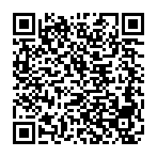
A Word Before We Dive In
1 Doc – Unlimited Resources
AI tools are powerful — and they come with responsibility.
Always govern AI use by your local institutional or district policies.
Never enter student names, ID numbers, IEP data, or any personally identifiable information into AI tools.
When in doubt, check with your program administrator before using a new tool with students or staff.

Slide 5
What Is AI, Really? In Plain Language, Please!
“AI is technology that learns from patterns in data to help humans complete tasks faster, more consistently, or at greater scale.”
You already use AI every day:
Spell check and Grammarly | Google Translate | Auto-captions on Zoom
Netflix and Spotify recommendations | GPS rerouting in real time
The key distinction: AI as a TOOL vs. AI as a REPLACEMENT
Instructional leaders set the frame. Your teachers follow your lead.

Slide 6
5 Practical AI Strategies — Starting Monday
1 Generate Leveled Practice Questions
Prompt: “Write 5 GED Math practice questions on linear equations at a 6th-grade reading level.” Adjust the level for your learners instantly.
2 Draft Differentiated Lesson Outlines
Prompt: “Create a 45-minute GED Science lesson on the water cycle for a mixed-level class including ELL students.” Edit and own it.
3 Build Vocabulary in Context
Prompt: “Give me 8 academic vocabulary words from this GED Social Studies passage with definitions and example sentences at a 7th-grade level.”
4 Create Extended Response Feedback Prompts
Prompt: “Review this student essay draft for GED RLA and give specific feedback on argument structure and use of evidence. Do not rewrite it.”
5 Generate Staff PD Discussion Questions
Prompt: “I am an instructional leader preparing a 20-minute staff meeting discussion on data-driven instruction. Give me 5 discussion questions that will generate honest conversation.”

Slide 7
TABLE ACTIVITY — 8 Minutes
Which Tip Fits Your Program?
1. Look at the 5 tips. Identify ONE your program could try within 30 days.
2. Discuss: What would you need to make it happen? Who owns it?
3. Choose one person to share your table’s answer with the room.
The best strategies are not the most complicated ones. They are the ones that actually get used.

Slide 8
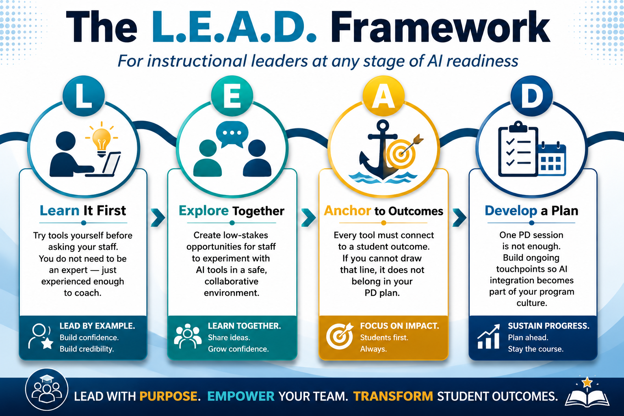

Slide 9
HANDS-ON ACTIVITY — 12 Minutes
Try It Yourself: AI Prompt Exploration
1. Open ChatGPT (chat.openai.com) or Claude (claude.ai) on your device.
2. Choose ONE prompt from your Prompt Exploration Card and type it exactly as written.
3. Read the response. Note what works, what is missing, and what you would change.
4. Discuss with your table: Would you use this? How? What would you coach a teacher about?
No device? No problem — follow along with a neighbor and debrief together.

Slide 10
Real Concerns — Real Responses
What about academic integrity?
Set clear guidelines with staff on what AI-assisted work looks like. This is a policy and coaching conversation, not a tech conversation.
What if students over-rely on AI?
Teach critical evaluation alongside tool use. Students must be able to identify when AI is wrong — and it will be wrong.
What about equity? Not all students have devices.
Start with teacher-facing AI use first. Leaders can build AI-generated materials without requiring student device access.
What if teachers resist?
Start with the win. Find the one teacher who is curious and let their experience be the story you tell at the next staff meeting.

Slide 11
Tools and Resources: 1 Doc | Unlimited Resources
Highlights by category:
AI Writing and Feedback:
Grammarly | QuillBot | ChatGPT (chat.openai.com)
Lesson Planning:
MagicSchool AI | Claude (claude.ai) | Diffit (diffit.me)
Vocabulary and Language:
Quizlet + AI | ELSA Speak | Google Translate AI
Assessment and Practice:
Khanmigo | Formative (goformative.com) | Curipod
All links and QR codes are on your resource one-pager. You do not have to memorize any of this today.

Slide 12

Before You Leave — Write It Down
The best professional development ends with a commitment, not just an idea. Use the Action Plan on your handout.
Please complete your session survey before you leave.
AI is a tool. You are the leader.
Leading the shift starts with a single step.
Felicia R. Thomas Phelps, M.Ed. | fphelps@tcsg.edu
470.606.4869 |
Reminder:
Always govern AI use by your local institutional policies.
Protect student data.

Slide 13

THANK YOU FOR YOUR PARTICIPATION & FOR TAKING TIME TO COMPLETE THE SURVEY.

