Slide 1
Instant Help, Real Results
App Support that Boosts GED Scores
Jared Brandau - 2026 GED Conference, Atlanta
Notes:
Good morning/afternoon and thank you for choosing this session. I'm Jared Brandau, product manager for the GED & Me mobile app. I'm not an educator — my job is to translate what your learners need into what the app does, built from two years of listening to hundreds of adult learners and educators.
Set expectations: this is not a product demo dressed up as a session. It's a story about how adult learning theory becomes concrete inside a mobile experience, and what you can do with it Monday morning. Keep the title slide to ~60 seconds.
VISUAL OPPORTUNITY: Full-width brand/title image or hero photo of a learner using the app on a phone.

Slide 2
Make the next step visible, doable, and worth taking.
Most GED prep doesn’t fail because learners don’t care, it fails when life gets complicated and the next step becomes unclear.
Notes:
We began with a problem statement
Learners kept saying “I don't know what to do next” — not “I can't” or “I don't want to.” Every design decision answers that.
VISUAL OPPORTUNITY: Full-width image with the single pull-quote overlaid.

Slide 3
Session Overview
1
App User Profile
2
Andragogy in Action, 5 Principles
3
Responsible AI in the Classroom
4
See It in Action (Live Demo)
5
Classroom Application
Notes:
Walk the arc in ~45 seconds. Highlight the demo explicitly — about a third of the way in you'll put the app on screen in real time; tell them to have notebook or phone ready. Note the repeating pattern for the middle section: what the principle says adults need, how the app responds, what learners do, and the educator/admin takeaway.
Timing cue: last 10 minutes reserved for discussion, takeaways, and a gift. Transition: “let's start where every good design should start — with the learner.” Full agenda also includes What's Coming and Close/Discussion/Survey & Gift.

Slide 4
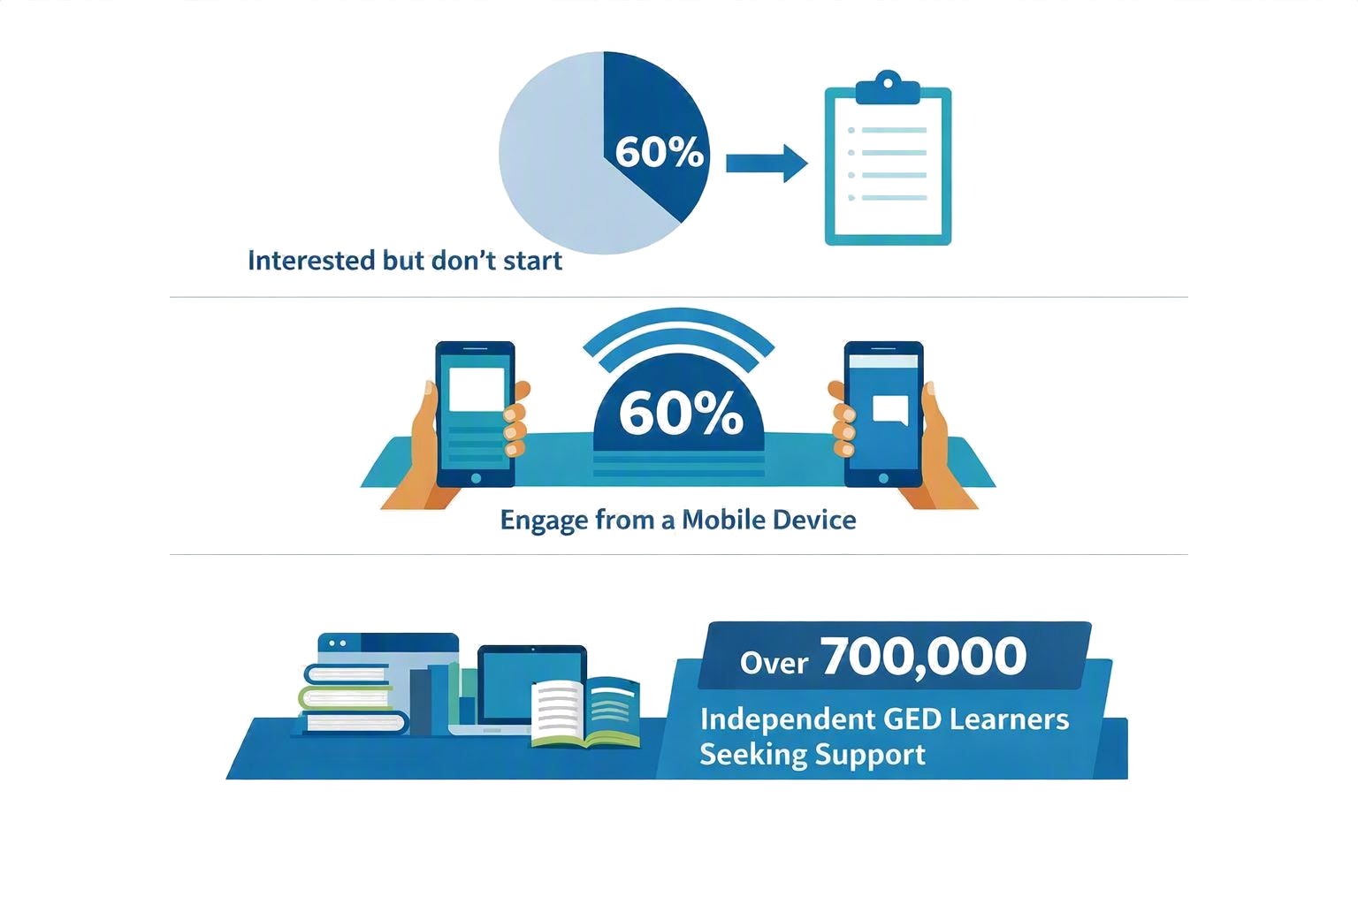
Why we built an app
Notes:
Our goal: Improve confidence for the Independent Learner to drive increased persistence to the final exam, leveraging AI when learners get stuck
Can we?
Keep learners engaged, resulting in higher persistence by making information easier to access on the go?
Reach more learners and get them engaged in their GED® journey?
Create an additional communication channel for nudging, informing and interacting with our learners?
Meet learner/educator expectations
Stats
60% of GED candidates express interest but don't start
60% of learners engage from a mobile device
over 700,000 independent GED learners looking for support.

Slide 5
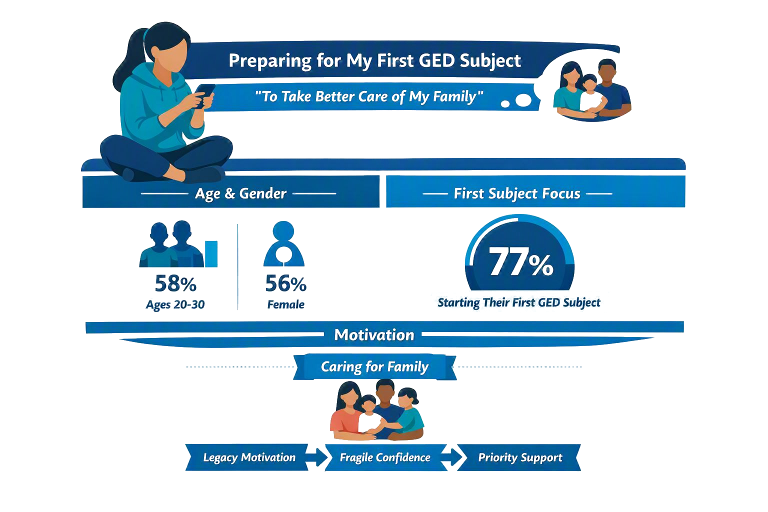
GED & Me^{tm} adopter profile
Notes:
Paint a compressed portrait: a ~22-year-old woman, likely Hispanic or White, engaging almost entirely from her phone, English-speaking but some wishing for more Spanish content, preparing for her first GED subject — and their reason is “to take better care of my family.”
Implications: that's a legacy motivation, not a career one, and it calibrates copy, notifications, and tutor tone.
77% first-subject means fragile confidence and highest drop-off; that's the population we prioritized. Source: GED Mobile / AI Summit demographic analysis and AI Learner Outcomes docs.
VISUAL OPPORTUNITY: Demographic infographic (age, gender, ethnicity, mobile %, first-subject %).

Slide 6



What they told us
MARGINS OF LIFE
Studying in the margins of life — around work, family, and transportation
SCHOOL BAGGAGE
Carrying past school frustration and test anxiety
TIME & CONFIDENCE
Time is scarce and confidence is fragile
Principles, best practices, and data can’t replace listening to the learner.
Notes:
No framework replaces listening to the learner; every design decision started with a learner interview, not a theory.
“Margins of life” = before a shift, on a lunch break, after kids are in bed, on a bus — not 90 minutes at a desk; design for a student who exists.
“Past frustration” = many left school feeling dumb, so every UI choice repairs or reopens that memory; we chose repair.
“Fragile confidence” = one confusing screen can send a learner away for weeks.
Principles and data cannot replace listening to the learner.

Slide 7
The Outcomes
MATH SCORES
+5–6 pts
Average math score increase among engaged learners
RETAKES
2x+
Pass-rate lift on retakes using the app between attempts
FIRST TEST
32%
More likely to take & complete their first test
Completion
18%
Higher credential attainment
Notes:
Open with the responsibility caveat BEFORE the numbers: these are engagement-linked outcomes, not guarantees. We don't promise any individual will hit them — learners who engage in these ways are associated with these outcomes at these rates. This earns credibility and lets educators share numbers responsibly.
+5–6 pts math: most struggling learners are within 5 points of passing, so this is often the exact gap.
2x retake pass rate: the persistence story administrators care about.
32% more likely to complete first test: the get-across-the-starting-line number.
18% higher completion rate: policymakers watch.
Definition of “engaged” if asked: generally 30+ practice questions, 5+ videos, or 5+ tutor interactions — sustained use, not casual downloads.
VISUAL OPPORTUNITY: Data visualization — four stat callouts or a simple bar chart of the four metrics.

Slide 8

Meet Our Content Strategist
CONTENT STRATEGIST
Dr. Christine Roberts
Shaping the content strategy and learning journey behind GED & Me^{tm} mobile app.

Slide 9
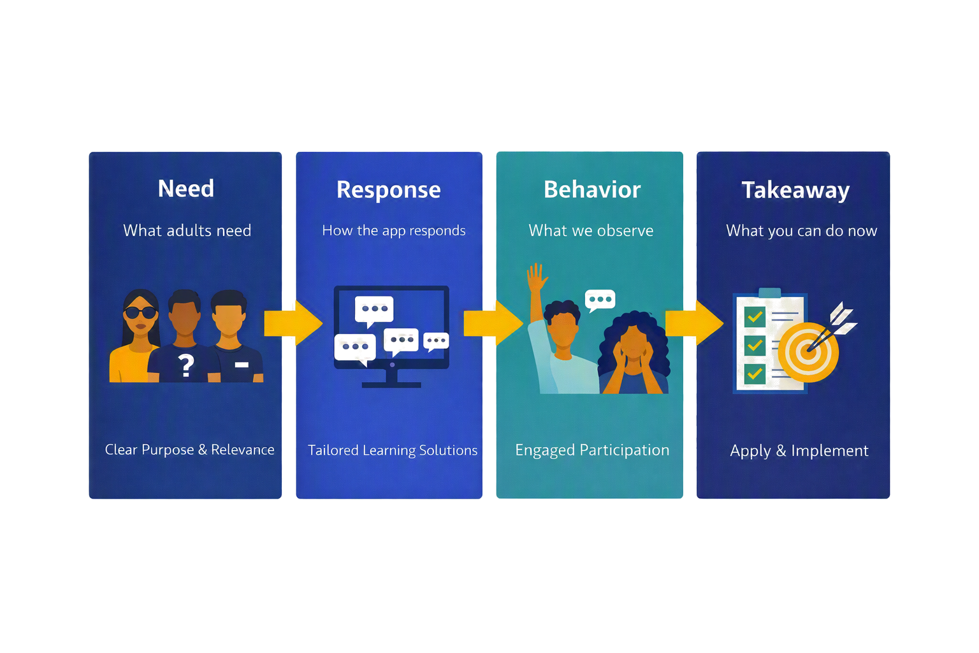
Development Discipline
By the fifth principle, you’ll use this lens to evaluate any digital tool a vendor puts in front of you, not just GED & Me.
Notes:
Framework focus
Andragogy is only useful when it changes what you build.
For each of the five principles you'll walk the same four-step chain: Need → Response → Behavior → Takeaway (N-R-B-T).
Example: Learners expressed need for assistance. They were going to ChatGPT and pasting in questions/text with a prompt of "break it down". They were very sensitive to not cheating themselves. We introduced a highly contextualized AI tutor with guardrails to pair with the practice questions (more on that later) to assist when a learner got a question wrong. -> The learners started interacting with the tutor PRIOR to attempting a question. -> The user was treating AI more for learning than correction/feedback New need = video content
VISUAL OPPORTUNITY: Process diagram — the four-step Need → Response → Behavior → Takeaway chain.

Slide 10
Principle 1: Adults Are Self-Directed
HOW THE APP RESPONDS
WHY IT MATTERS
Learners choose the subject, narrowing the to-do list to their own track
Agency without chaos - self-direction stays structured, not overwhelming
Short, frequent practice - sessions run just 5–10 minutes
Small time blocks fit adult schedules and still make real progress
AI tutor (Syd) converses in 250+ languages
Removes language as a barrier, meeting learners where they are
Notes:
Theory in 15 seconds: adults resent being told what to do but flounder with a blank canvas — give agency inside structure (“choice without chaos”).
Subject choice is psychological, not technical: “study math tonight” feels different from “study for the GED.” Specificity is agency.
Short practice: 5–10 minutes is enough — it violates the academic instinct for sustained study time, but adult learners have the 12 minutes before a kid wakes up.
Syd speaks 250+ languages including Haitian Creole — asking a question in Creole and being scaffolded back into English math can be the difference between staying and quitting.
If asked whether choice is risky: agency is bounded — after GED Ready the To-Do list nudges toward skill gaps (covered in Principle 2).

Slide 11
Ten Minutes Becomes a Study Habit
A learner has ten minutes before a shift. Traditionally that’s “not enough time to study.” In the app it’s one video, three practice questions, or a Syd conversation, small moments that compound into a habit.
Notes:
Pacing slide- Tell a story
Picture her outside the restaurant, ten minutes before clock-in; instead of scrolling, she gets one video, three practice questions, and a Syd moment. Multiply by four days a week — that's a study habit.
Pedagogical implication: traditional pedagogy protects sustained study blocks; mobile-first pedagogy fragments content to fit fragmented lives — for this population, the survival strategy. Teacher hook: to a student who says “I don't have time,” say “you have ten minutes; that's all we need.”
VISUAL OPPORTUNITY: Mobile app screenshot of the To-Do list / a short micro-session, or a customer-story image.

Slide 12
Principle 2: Adults Bring Prior Experience
HOW THE APP RESPONDS
WHY IT MATTERS
Personalized path - 3–8 modules per subject, 4–8 practice questions per section
Prior experience is both fuel and scar tissue
60% to advance, with targeted remediation, never an endless loop
A score report becomes a concrete action plan
After GED Ready, the to-do list auto-branches to skill gaps
The remediation plan is unique to the learner's skills
Notes:
Adult learners bring more life and work experience than any child, but also school baggage. Prior experience is fuel and scar tissue — honor the fuel, don't reopen the scar.
Personalized path of 3–8 modules per subject and 4–8 questions per section — a deliberately smaller footprint. 60% to advance (not 100 or 80) means learners advance while still growing; missing it routes to targeted remediation but never an endless loop.
After GED Ready the To-Do list re-shapes around actual skill gaps — the score report becomes an action plan. Aka Adaptive learning
Educator takeaway: the app replicates your remediation instinct at 10pm when you're not on shift. If asked how modules are chosen: adaptive routing on GED Ready scores and in-app performance, not a fixed curriculum.

Slide 13
You Are Not Starting From Zero
Prior experience often includes the belief “I’m just bad at math.” A personalized path reframes it: here are the specific skills to work on, here’s the next short task, here’s help when you get stuck.
Notes:
Learner 34, works two jobs, hasn't touched math since 10th grade, and believes “I'm just bad at math.” That belief is heavier than any content gap and stops her from opening the app on day two.
The reframe: don't tell her she's smart — she won't believe it. Make the next task small, specific, and forgiving enough to succeed, then again, until around task six or seven a new belief forms: “I can do this specific thing.” That's why the app celebrates small wins — a deliberate counterweight to math shame.
Callback: the 5.7-point gain and 2x retake pass rate come from reframing one small task at a time.
VISUAL OPPORTUNITY: Customer-story vignette or before/after “score report → action plan” visual.

Slide 14
Principle 3: Learning Must Be Relevant
HOW THE APP RESPONDS
WHY IT MATTERS
Vetted, official content, sourced and verified, not the open web
Content the learner can trust
Focused Syd, trained on a narrow set of content and questions, not the open internet
Answers stay accurate and on-topic for the GED
Smart gating - foundational concepts come before advanced ones
Learners build on a solid foundation before moving up
Clear navigation keeps the interface simple and distraction-free
Energy goes to learning, not navigating
Notes:
Expand “relevance” beyond content: for adult learners it also means “can I trust this is the right content and not a waste of my scarce time?” Trust is a component of relevance.
All content is Pearson-vetted, GED-aligned — no scraped-internet material.
Syd is not ChatGPT — It is trained on a very specific of learning content and practice questions that is vetted by GED; that narrowness makes it trustworthy and safe.
Gating sequences foundational before advanced concepts — respect for how skill builds. Navigation clarity matters because cognitive load spent finding the next tap is stolen from learning; orientation is care.
Anchor: when time is scarce and confidence is fragile, trust turns effort into persistence. Educator note: you can confidently point students to the app between sessions — you're betting on their consistency, not gambling on content quality.

Slide 15
Relevance → Trust → Retention
65.7%
32%
40%
Learner retention, up from 34.4% a year earlier
More likely to complete their first test
Re-engage 6+ months after creating their account
Retention nearly doubled year over year. A structural change, not a bump.
Notes:
Frame as evidence for Principle 3.
Retention nearly doubled year over year (Feb 2025: 34.4% → Feb 2026: 65.7%) — almost doubling retention in twelve months signals a structural change, the design commitments just walked through, not a marketing bump.
32% more likely to complete first test = the get-across-the-starting-line number again. The favorite stat: nearly 40% created their GED.com account 6+ months before downloading — they tried, stepped away, and came back; the app recovered lapsed learners, a persistence story disguised as engagement.
Strategic implication for administrators: every stopped-out learner is paused, not lost, and mobile-first re-engagement can bring a meaningful share back — an under-utilized completion-target tool. Verify Feb 2025 vs Feb 2026 numbers before presenting.
VISUAL OPPORTUNITY: Data visualization — timeline/line chart of retention 34.4% → 65.7% over the year.

Slide 16
Principle 4: Problem-Centered, Not Content-Centered
HOW THE APP RESPONDS
WHY IT MATTERS
Tell: short video with practical application
Learning starts with a real-world problem, not abstract theory
Show: immediately followed by a related practice question
Skills are applied right away, while the concept is fresh
Practice: full explanation whether right or wrong
Every attempt becomes a teaching moment
Ask First: most tap Syd before answering, not after failing
Support is proactive, keeping learners moving, not stuck
Scaffold: 90%+ use pre-scripted prompts, hints not answers
Guidance builds independence, not dependence
Notes:
One of the two most important slides
Theory: adults don't want a lecture then a test; that's how school failed them. What works is a tight Tell → Show → Practice loop — Knowles wrote it in the 1970s; what's new is applying it in a mobile experience.
Decisions:
Videos are short (often 60–90 sec) then an immediate related question.
Full explanation whether right or wrong, because understanding why beats the check mark.
The money moment: most learners tap Syd BEFORE answering, not after failing — help-seeking becomes a proactive learning move, not a failure identity. 90%+ of Syd interactions use pre-scripted prompts (“break this down,” “give me a hint”) — structured scaffolding, not open chat.
Reframe for educators: don't think of Syd as a chatbot — think Socratic scaffold. If asked whether students can make it give the answer: layered defense — pre-scripted prompts + walled-garden LLM + human QA (detail on slide 22).
VISUAL OPPORTUNITY: Process diagram — the Tell → Show → Practice loop, ideally circular.

Slide 17
Asking Before Guessing
A learner pauses before answering and taps Syd. The tutor doesn’t give the answer, it walks through the reasoning. The win isn’t correctness; it’s the new habit: help-seeking as a learning behavior, not a failure signal.
Notes:
Emotional payoff of Principle 4 — For most adult learners, guessing has been a lifelong coping strategy that avoided embarrassment but prevented learning. Tapping “help me think through this” before answering is a rewiring moment — small, easy to miss, but it separates a learner who will pass from one who keeps almost passing.
Closing frame: the win isn't a right answer, it's a new habit — and habits transfer to the real test where Syd isn't there. Reflection prompt for teachers: how many students still guess or freeze rather than ask? ~90 seconds, take a beat.
VISUAL OPPORTUNITY: Mobile app screenshot showing a practice question with the Syd “help me think” prompt.

Slide 18
Principle 5: Internal Motivation Matters More
HOW THE APP RESPONDS
WHY IT MATTERS
Diagnostics intentionally minimized to avoid discouragement
“43% proficient” triggers shame; a checkmark builds momentum
The to-do list is a checklist, not a series of pass/fail moments
Syd’s tone preserves dignity. Encouragement regardless of outcome
A readiness signal replaces chasing an undefined proficiency
Confidence is instructional infrastructure, not decoration
Notes:
Theory that may surprise: internal motivation sustains learning more than external.
Most products pile on badges, streaks, percentages, leaderboards — all work for a week, none sustain a scarce, fragile, family-motivated adult learner.
Decisions against the norm: minimized diagnostics — learners see readiness signals, not raw percentages, because “43% proficient” triggers shame. The To-Do list is a checklist (tick = dopamine) not a scoreboard (percentage = judgment). Disproportionate design time went into Syd's tone — dignity is an instructional variable. A binary readiness signal replaces an endless proficiency chase, grounding learners in “am I ready to test?”
Anchor: confidence is instructional infrastructure, not decoration. If admins ask how to report progress without exposing granular scores: that's what Mobile Learning Time in GED Manager solves — dignity-preserving signals for learners, underlying data for advisors (previewed on slide 29).

Slide 19
What they are saying
“
“
“
“When I don’t understand a math question, I ask my AI tutor. It gives me a better understanding… I like that I can talk to it until I understand the question fully.”
“Thank you for making a GED App that is the best thing ever! I feel like I can finally feel confident in passing my GED.”
“I feel great… willing to take the chance to pass.”
Notes:
Everything so far was in the product manager's voice; now hear learners in their own words (direct, anonymized quotes). Read three that fit — likely the math-learner quote and the “confident in passing” quote —
Land the pattern: nobody said “I love your algorithm” — they said “I feel great,” “I feel confident,” “willing to take the chance.”
Confidence is the currency; content is the vehicle.
Beta data: “not confident at all” was eliminated, and “very/extremely confident” rose from 22% to 50%. Ask educators to share one quote with their learners tomorrow.
VISUAL OPPORTUNITY: Customer-story quote cards / testimonial layout with learner attribution.

Slide 20
Live Demo: Andragogy in Your Hand
1
Self-Directed
The learner picks the subject and pace
2
Prior Experience
The to-do list adapts to what they know
3
Relevance
Official, vetted content they can trust
4
Problem-Centered
The Tell → Show → Practice loop in one tap
5
Internal Motivation
Dignity-preserving language, no red-pen moments
Notes:
1) To-Do list — note what's absent (no fifteen-metric dashboard, no red “behind” badges).
2) A short math video — play 15–20 sec then skip to the question.
3) The money moment — tap Syd BEFORE answering, use a pre-scripted prompt, read the scaffolding aloud.
4) Answer and show the explanation regardless of correctness.
5) Back to To-Do, tick one item — that's the whole loop, multiplied by 50,000 monthly active learners.
Debrief question (what makes it land): “Where would your students get stuck, and where would they lean in?”
Take 2–3 answers Likely questions: can Syd give the answer? (no — engineered to scaffold); students without smartphones? (extends, doesn't replace, desktop/classroom access); can I try it now? (yes — scan the QR).
VISUAL OPPORTUNITY: Live mobile app screenshots / screen mirror; embed a backup screen-recording of the demo path.

Slide 21
Engagement Behaviors, Last 90 Days
1M+
84K+
53K+
50K+
Practice questions answered
Videos watched
AI Tutor (Syd) interactions
Monthly active learners
Notes:
Coming off the demo the room is primed — deliver fast; the numbers do the work. Framing: everything just shown is happening at this scale every 90 days — these are learning behaviors, not download numbers.
Tie each back to the demo: 1M+ practice questions (“that question you just watched — a million of those”); 84K+ videos (active, replayed, watched just before answering); 53K+ Syd interactions (that “ask before answering” behavior); 50K+ monthly active learners (the persistence base, a 50,000-peer learning community). Andragogy at scale is a measurable pattern. Verify all four numbers before delivery.
VISUAL OPPORTUNITY: Infographic / data visualization of the four 90-day volume metrics.

Slide 22
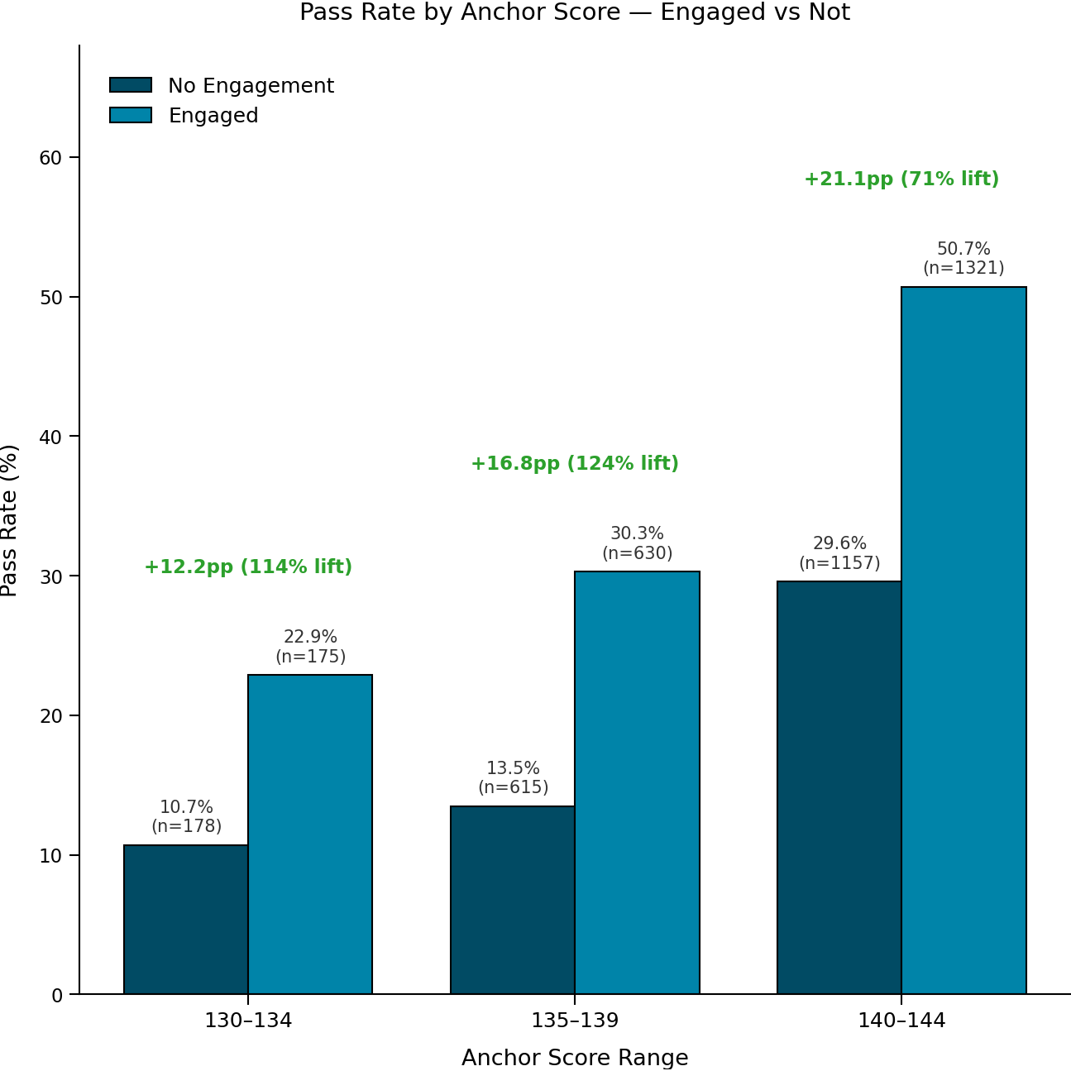
Retakers: Where the App Matters Most
70%
Of those who don’t pass are within 5 points
+5.7 pts
Average math gain with sustained engagement
2x
Math pass rate vs. non-engaged retakers
Notes:
Open with the “closer than you think” framing:
70% of learners who don't pass are within five points — not a failure of ability but of the last mile.
51.8% higher pass rate for retakers using the AI Tutor between attempts — the population programs lose most; 57.5% pass rate on the next attempt — well above typical retake rates; 2x math pass rate for app-engaged retakers — math is where the app moves the needle most; +5.7-point average math increase for learners completing 30+ practice questions and 5+ tutor interactions.
The more different types of interactions they have and the more they have the the higher the scores go without plateau (See Kris' stats
Strategic implication: retakers are the ROI cluster for mobile-first supports — concentrate GED & Me messaging there.
Teacher answer to “should I try again?”: yes, and here's the tool that doubles your odds.
VISUAL OPPORTUNITY: Data visualization emphasizing the “within 5 points” and 2x/51.8% retake stats.

Slide 23
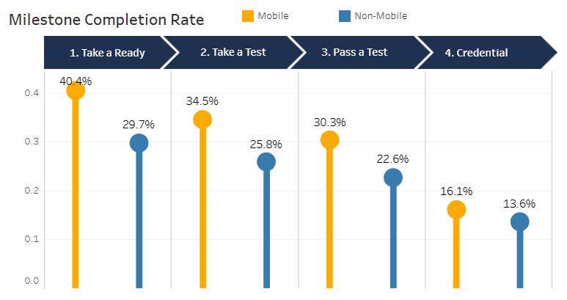
18%
Higher credential attainment rate for GED & Me users vs. Non-users

Slide 24
Responsible AI: How Syd Meets the Standard
BUILT TO A NATIONAL STANDARD
HOW SYD PUTS IT INTO PRACTICE
GEDTS’s AI policy is built on the NIST AI Risk Management Framework — the U.S. federal standard for trustworthy AI
Trained on one content context — no open internet
Runs inside a Pearson “walled-garden” LLM
Operationalized through Pearson’s Responsible AI Principles
Safety guardrails for vulnerable users
Scaffold, don't answer
We built to the rulebook the government publishes — not our own
Subject matter expert QA before every subject launch
Notes:
One of the highest-stakes slides — don't rush; it earns permission for the classroom recommendations.
Rehearsed opening: is it safe to put AI in front of my students? The right question, answered with more than a vendor's promise.
Credibility move — lead with NIST: we built to the NIST AI Risk Management Framework, the U.S. federal standard for trustworthy AI, independent of Pearson and GEDTS.
operationalized through Pearson's three Responsible AI Principles (Fair/Representative/Reliable; Transparency and Accountability; Trustworthy and Safe AI).
Walk the Syd table, hardest on the first two rows: narrow scope (one textbook + its questions, ~100 pages, ~500 Q&A per subject — nowhere to wander); scaffold-don't-answer; walled-garden LLM (no open internet); safety guardrails for vulnerable users; human-in-the-loop QA for every subject launch (Math, Science, Social Studies).
See appendix for framework
VISUAL OPPORTUNITY: Process/framework diagram of NIST + the Syd safeguards (requirement → how Syd is built).

Slide 25

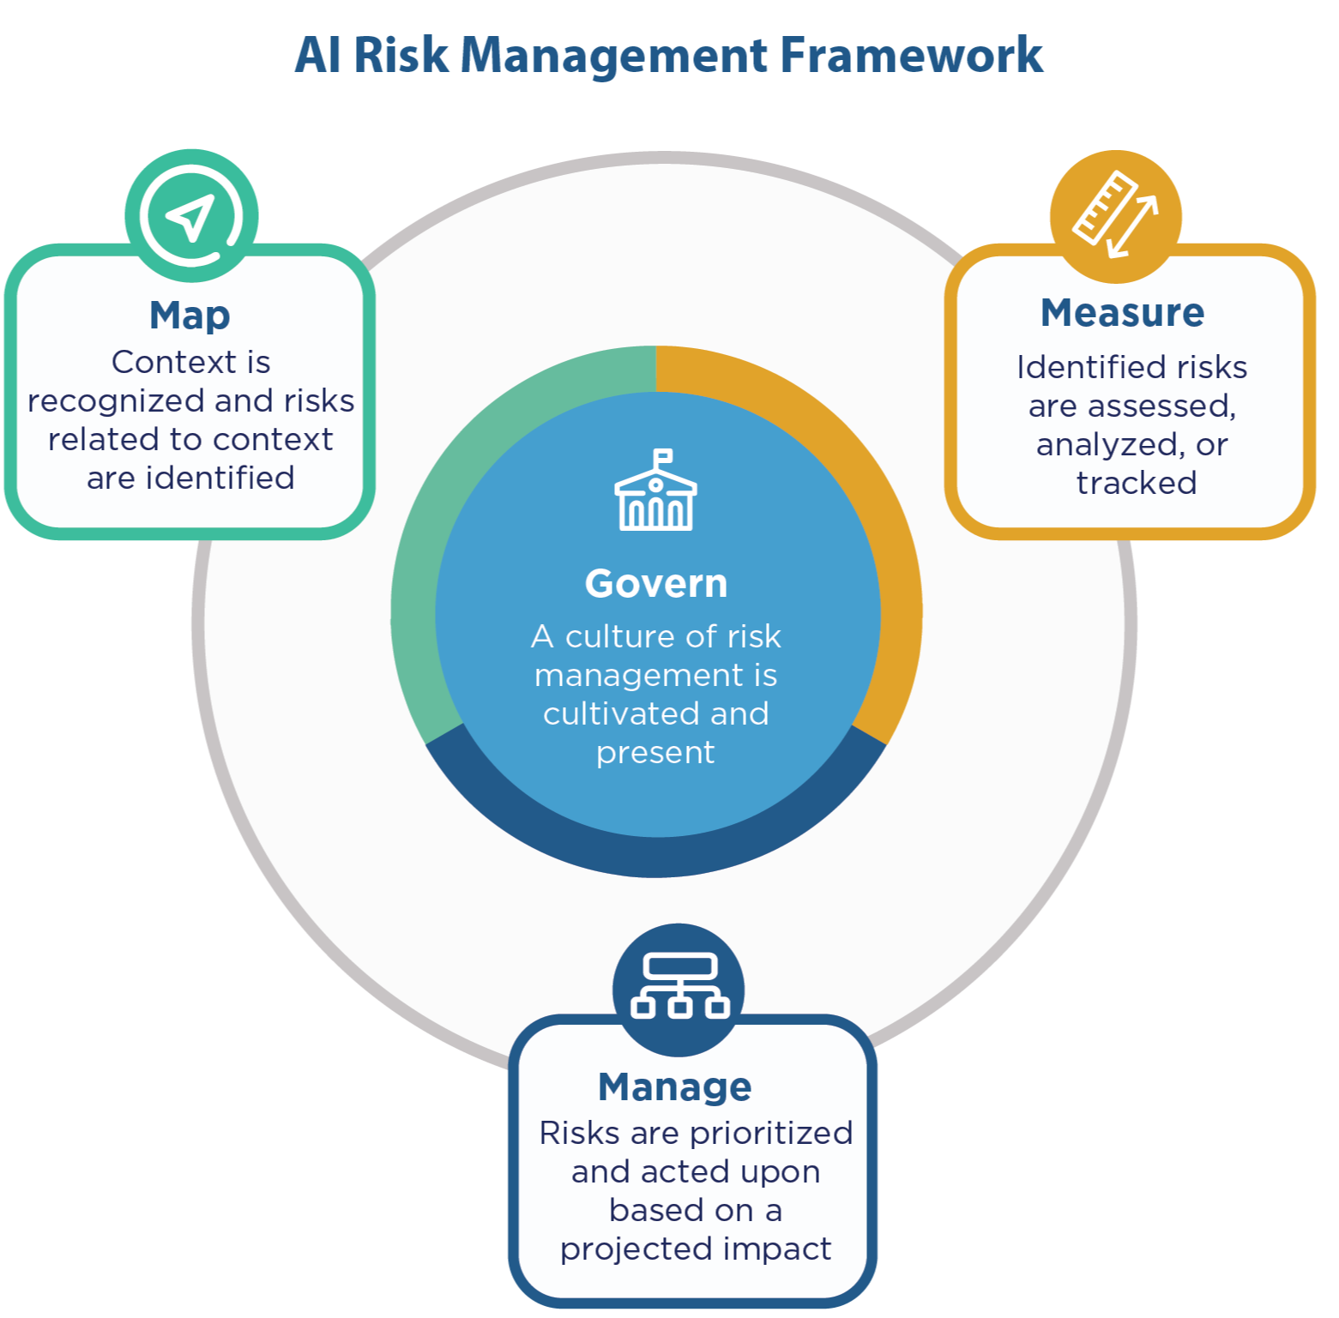
https://www.nist.gov/itl/ai-risk-management-framework
Notes:
Reference slide for Q&A — only surface if an administrator, state director, or compliance officer asks a deeper governance question; not one to walk the whole audience through.
Framing: here's how the four NIST functions map to what we built.
Govern — culture and accountability: Pearson Responsible AI Principles + GEDTS AI policy + human-in-the-loop QA governance per subject launch.
Map — scoping: Syd narrowed to one textbook per subject plus practice questions (bounded use case, bounded risk).
Measure — test and monitor: structured human QA windows for Math/Science/Social Studies, safety guardrails for health and well-being, ongoing behavior monitoring.
Manage — contain risk: walled-garden LLM (no open internet), scaffolded prompts, transparent terms-of-use disclosure.
Bottom line: Govern → Map → Measure → Manage is a continuous loop, not a one-time check — what makes it appropriate for vulnerable adult learners.
VISUAL OPPORTUNITY: Diagram of the four NIST functions as a continuous Govern → Map → Measure → Manage loop.

Slide 26
A Product Manager’s Perspective
Structured Independent Practice
Not a replacement for teaching.
The Teacher Remains Essential
Motivation, sense-making, relationship, remediation.
The App Extends Your Reach
Into moments you can’t be there.
Notes:
I'm a product manager, not an educator, and have never taught a GED class, so the next slides are recommendations — patterns from teachers already using GED & Me well.
Attribute the sources: Kellie Blair Hardt (adult educator using AI in her classroom, shared at COABE) and Jane Bledsoe (whose team has been in front of thousands of educators).
Address the elephant: no, the app is not replacing you — it's structured independent practice; the teacher remains essential for motivation, sense-making, relationship, and remediation, and the app extends your presence into the moments you can't be there. Teacher plus tool.

Slide 27
What Educators Are Already Saying
Already Using AI
At COABE 2026, about half of adult educators reported already using AI in their classrooms.
Thought Partner
K-12 educators' top 3 uses for AI are
1) Brainstorming new ideas for lessons, materials, & assignments
2) Create or update lessons, materials, & assignments
3) Simplify complex ideas for students
Modeling Drives Adoption
Teachers who model app use see faster student adoption than those who only recommend it.
Study of AI use in the classroom
Notes:
Report from the field, not marketing.
~51% of adult educators reported already using AI in their classrooms — not curious, actually using it; the question is how to do it well.
Thought Partner: educators are adopting AI as a thought partner to develop their content more than to do things more efficiently though that remains as notable value.
Strongest field pattern: teachers who model app use (pull it up on screen, walk a Syd interaction, reference a practice question) see faster student adoption than those who only recommend it verbally. When teachers use it, students use it.

Slide 28
Five Suggestions for Educators Using GED & Me
1
Reframe
Position the Syd AI tutor as a partner or aid vs. a crutch.
2
Model
Warm up the class with a Syd conversation or practice question and demonstrate it live.
3
Student Connection
Use shared app activity as a common reference and foster learners teaching each other.
4
Digital Literacy
Meet requirements while prepping for the test
5
Bridge the Gap
Official GED content between class sessions
Notes:
Attribute clearly: these five come from Jane Bledsoe's educator flyer and her COABE 2025 session — field-tested, not lab-tested.
Walk each briefly with examples.
Reframe: Position the Syd AI tutoras a partner or aid vs.a crutch. reframe on day one as a partner to turn to when stuck, not a shortcut. Learners WILL use AI...show them the right way...see my kids
Model: open with a Syd conversation or practice question so everyone shares headspace — a favorite routine for some teachers. walk a Syd interaction on the classroom screen so students see the thinking pattern.
Student connection: shared app activity becomes common classroom reference. have learners share the prompt or video that made a concept click — peer authority is powerful for adults.
Digital literacy: meet program requirements while prepping for the test — two birds.
Bridging the gap: trusted, official content between sessions instead of wondering whether YouTube is steering students wrong.
Take what fits your teaching style.
VISUAL OPPORTUNITY: Icon set, one per recommendation, for a clean five-up layout.

Slide 29
Three Simple Routines to Try
1
2
3
Launch the Habit
Reserve about ten minutes for download, orientation, and a first to-do item.
Make It Accountable
Ask learners to bring back one completed step, one confusing question, or one Syd prompt that helped
Mini-lessons
Use practice questions as formative checks: common wrong answers become the next day's mini-lesson.
Notes:
The “if you take nothing else” slide — a starter menu, not a prescription. Tell them to pick one routine, not all three.
Launch the habit: reserve ~10 minutes of a class session to download, orient, and complete a first To-Do item — an in-class win beats homework for follow-through.
Make it accountable: between sessions ask learners to bring back one completed step, one confusing question, or one Syd prompt that helped (three options means they can always bring something).
walk a Syd interaction on the classroom screen so students see the thinking pattern. Let students teach each other: have learners share the prompt or video that made a concept click — peer authority is powerful for adults.
Practice questions as formative checks: common wrong answers become the next day's mini-lesson.

Slide 30
Suggestions for Administrators​
Build Consistent Entry Points
Introduce the app during learner onboarding.
Encourage use after GED Ready and between test attempts.
Reinforce & Measure
Promote one message across programs: “small, consistent practice matters.”
Use engagement data in the persistence conversation.
Notes:
Administrators this is system strategy, not classroom tactics: consistent entry points and messaging while local educators implement for their learners.
Introduce at onboarding: the highest-leverage moment to place the app is intake/orientation, not as an afterthought — programs that do this see meaningfully higher adoption.
Encourage after GED Ready and between attempts: build a program habit that the next conversation after a test nudges toward the app (recall the retake data). Consistent message across programs: keep it simple — “small, consistent practice matters.” Use engagement data in persistence conversations:
Mobile Learning Time makes it concrete (“ten minutes a day for two weeks — that consistency is what got others across the line”).
Tagline: common pathway, local implementation — state leaders provide the framework, local educators bring the expertise, the app is one shared tool.

Slide 31
What’s New
FREE VIDEO FOR RLA, SCIENCE & SOCIAL STUDIES
Free video for all subjects in the mobile app is on our road-map for Q3/Q4
MOBILE LEARNING TIME IN GEDMANAGER
A new advisor and prep-center view showing time-on-task by subject, content type, and completion counts was added this month .
Notes:
Tease responsibly — give direction, not hard commitments; roadmap items shift. Free video for RLA, Science, and Social Studies: video is a strength on the math side today; Q3–Q4 roadmap brings that same free video to the other three subjects so they get the full Tell → Show → Practice loop. “meaningfully more video before end of year.”
Mobile Learning Time in GED Manager: a new view for advisors and prep-center educators showing time-on-task by subject and content type, completion counts, and Syd interaction sessions — the advisor view of the dignity-preserving model from Principle 5. Targeted for the July release, so it should be explorable around the conference.
Verify with Cameron Gross: exactly which roles can see Mobile Learning Time, and whether the July date holds. Ask teachers not to announce a launch date to students — frame video as “coming later this year” until firm.
VISUAL OPPORTUNITY: Roadmap timeline (Q3–Q4) plus a GED Manager screenshot mockup of Mobile Learning Time.

Slide 32
Five Takeaways
01
Start With the Learner
Not the feature
02
Pair Choice With Structure
Agency inside a scaffold
03
Relevance Builds Trust
And trust builds persistence
04
Scaffold Uncertainty
Turn help-seeking into a habit
05
Engagement Is the Bridge
Between design and outcomes
Notes:
this is the slide people photograph.
Frame: these five aren't GED & Me talking points, they're a framework for any digital learning tool.
One-sentence gloss each: start with the learner, not the feature — every good design starts with listening; choice paired with structure — agency without scaffolding overwhelms, scaffolding without agency infantilizes; relevance builds trust and persistence — vetted content earns scarce time; scaffolded support turns uncertainty into action — help-seeking becomes a habit, not a failure signal; engagement is the bridge — behavior at scale produces the outcomes.
Tagline: design for dignity, clarity, and momentum. Translate per audience — teachers pick one Monday move, administrators pick one consistent message, everyone applies the framework to the next vendor demo.
VISUAL OPPORTUNITY: Infographic summarizing the five takeaways as a memorable one-glance graphic.

Slide 33
Final Thought
THE DESIGN PRINCIPLE
Engagement through interaction beats volume for volume’s sake.
GED Learners Are Looking For
A simple, step-by-step plan • Micro-learning they can drop into when time is short
Trusted guidance when they don’t understand • Certainty that their effort is moving them toward the test
Notes:
Frame: adult learners aren't asking for more content, they're asking for four things — a simple step-by-step plan, micro-learning for scarce time, trusted guidance when stuck, and certainty their effort moves them toward the test. Read the bullets slowly with a beat between each.
Tagline: engagement through interaction beats volume for volume's sake — the guardrail against the instinct to keep adding content, and the reason the retake numbers exist. ~60 seconds, then transition to housekeeping (survey and gift).

Slide 34
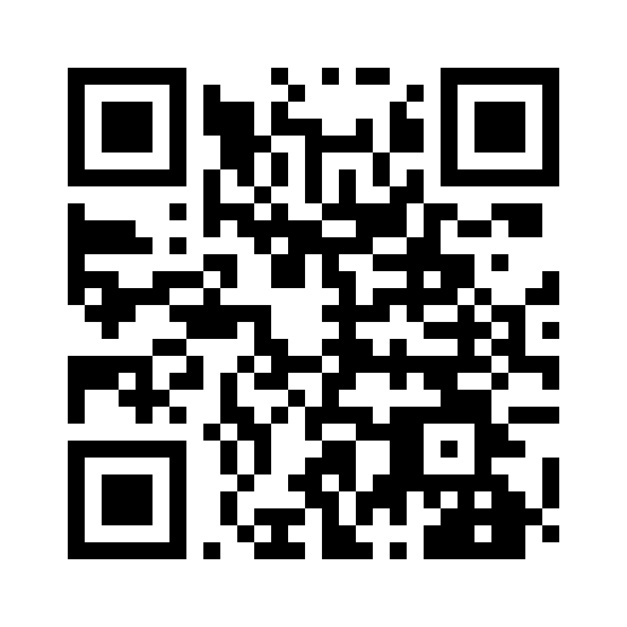
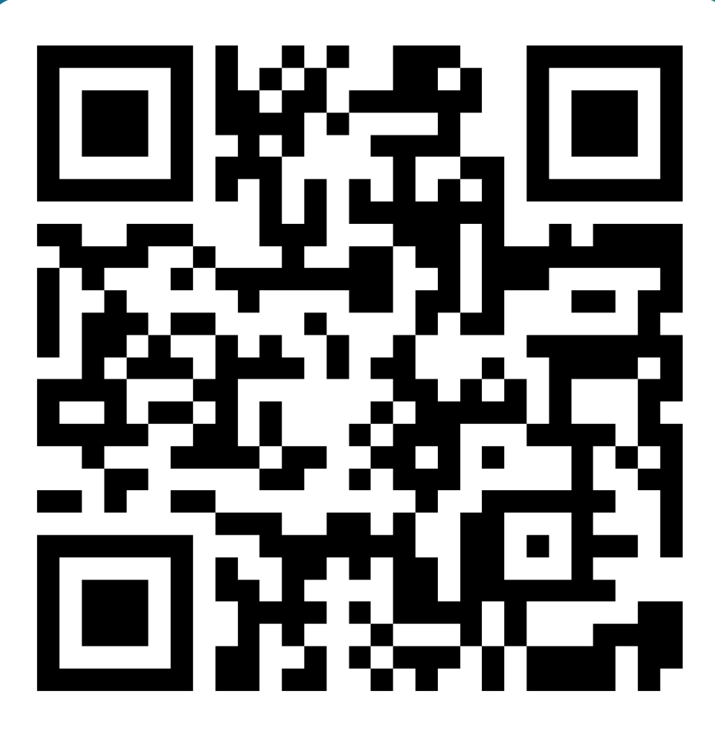
Session Survey
White Paper
Free Gift
Your feedback helps improve future GED Conference sessions.
Scan the QR code
Complete the brief session survey
Request a copy of our white paper on the andragogy behind the mobile app.
Scan the QR code
Get a free blanket or power bank!
Scan the QR code
Complete the brief survey
Show us the confirmation and get your gift
QR CODE
Notes:
Ask them to scan the QR code and complete the short session survey — feedback shapes next year's sessions and how you refine this material.
Bridge to the gift table.

Slide 35
Discussion Questions
For Your Learners
For Your Program
Q
Where do your learners most often lose momentum?
Q
What support would help educators introduce the app confidently?
Q
Which classroom routine would be easiest to try first?
Q
What outcome would matter most to your state or program?
Notes:
Discussion questions — use ONLY if time needs to be filled

